Slide 1

Density Functional Theory Formalism and Applications
Mauro Stener
Dipartimento di Scienze Chimiche e Farmaceutiche
Università degli Studi di Trieste
Via L. Giorgieri 1, 34127 TRIESTE
E-mail: stener@units.it
XIII-EM-TCCM-European Master in Theoretical Chemistry and Computational Modelling 13th International Intensive Course, Perugia (I), 3rd – 28th September 2018

Slide 2
Summary
THEORY - DFT Review of DFT basic theory and equations
THEORY - TDDFT with the aim to underline what is general from Linear Response formalism.
COMPUTATIONAL - Some numerical aspects of the implementation in the ADF code, most important computational choices, how to assign spectral features. New TDDFT algorithm.
APPLICATIONS:
4.a. Plasmons in metal clusters.
4.b. Core electron excitations (NEXAFS).

Slide 3
Objectives
Design of a DFT/TDDFT computational scheme to describe photoabsorption of alloyed nanoclusters
Validation with respect to experimental data
Identification of trends in alloys (composition, chemical ordering, cluster shape)
Rationalization of trends in terms of electronic structure

Slide 4
Computational scheme: geometry
Cluster geometry: DFT geometry optimization or experimental bulk interatomic distances (2.88 Å for Au)
Standard DFT-KS method: LDA (VWN), DZ basis
Scalar Relativistic (SR) effects: ZORA
Code: ADF parallel (MPI) IBM SP6

Slide 5
Computational scheme: geometry
Exp. Bulk: 2.88 Å
GGA → 2.97 Å
LDA → 2.89 Å
For Au, LDA is the best choice for geometry optimization
O. Häberlen, S.-C. Chung, M. Stener and N. Rösch, J. Chem. Phys. 106 (1997) 5189.

Slide 6
TDDFT electronic excitations
orbitals (ε) and eigenvalues (ϕ) obtained with:
DZ basis set
LB94 (correct asymptotic –1/r behavior) or LDA (VWN)
More stringent SCF convergence: |FP-PF|<10⁻⁸
Closed shell electronic structure (charged clusters)
Davidson iterative diagonalization, extraction of the lowest n eigenvalues (n = 300 in our calculations)
Common V_{XC} choices (LDA and GGA) do not obey to correct asymptotic –1/r behavior, this feature is important to obtain accurate excitation energies and intensities: LB94 is asymptotically correct.
LB94: R. van Leeuwen and E. J. Baerends, PRA 49 (1994) 2421

Slide 7

Gold and silver clusters
Gold nanoparticles whose size and shape distributions are well defined
Conventional chemical synthesis
Structural characterization
at electron microscopy (TEM)
Nikoobakht, B.; El-Sayed, M. A. Chem. Mater. 2003, 15, 1957-1962.
Gold nanoparticles TEM images with SPR at:
(a) 700, (b) 760, (c) 880, (e) 1130, e (f) 1250 nm.
Bar scale 50 nm.

Slide 8
Gold and silver clusters: optical properties
Samples of large large nanoparticle exhibit an absorption band in visible region
SPR
(Surface Plasmon Resonance)
Collective excitations of conduction band electrons
Important optical property
Theoretical models: classical
electrodynamics for large size
Small size: quantum confinement effects: TDDFT
Abs. spectrum of a sample of gold nanoparticles with aspect ratio di 2.6, 3.3, e 5.4 (λ = 480 nm).
Burda, C.; Chen, X.; Narayanan, R.; El-Sayed, M. A. Chem. Rev. 2005, 105, 1025-1102

Slide 9
How to identify SPR with TDDFT?
H. E. Johnson and C. M. Aikens, JPCA 113 (2009) 4445
TDDFT, SAOP XC potential, DZ basis set, ADF code

Slide 10
Plasmon resonance: contributed by many 1h1p configurations, with “constructive” interference of z-component of transition dipole moment
Typical “collective” behaviour!

Slide 11
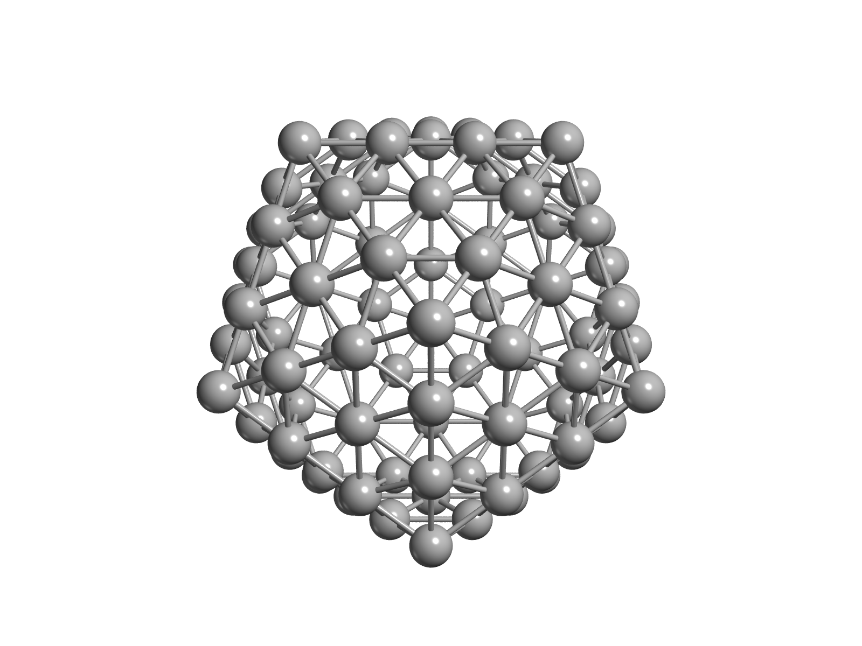
How to identify SPR with TDDFT?
The “Collective” nature of plasmon resonance is reflected in the “many configurations” which contribute to the excited states, properly described by TDDFT.
Comparison with Single Electron calculation: excited state described by only one Slater determinant, spectrum calculated from dipole moments between KS molecular orbitals.
Peak shifted at higher energy
In TDDFT one transition (plasmon) carries most of the intensity
The Plasmon is contributed by many configurations
KS
TDDFT

Slide 12

Emerging of SPR along a series of Au nanowires
Au₁₄ Σ_{u} >> Π_{u} lenghth: 3.744 nm
Au₂₀ Σ_{u} >> Π_{u} lenghth: 5.472 nm
Au₃₀ Σ_{u} >> Π_{u} lenghth: 8.352 nm
Gold nanowires (chains):
strong HOMO -> LUMO transition in both KS and TDDFT
It is not plasmonic (dominated by only 1 configuration)
Its energis goes to zero as length increases

Slide 13
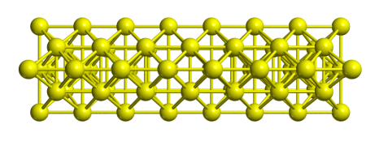
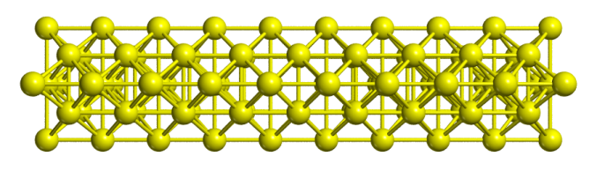
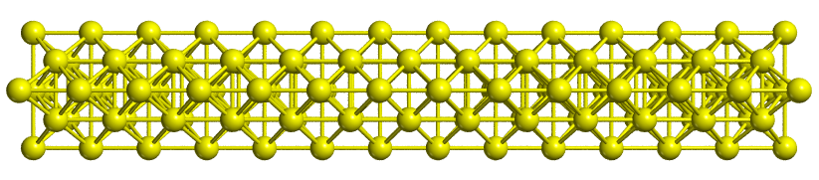
“Thick” Au nanowires
Peak shifted at higher energy
In TDDFT one transition (plasmon) carries most of the intensity
The Plasmon is contributed by many configurations
Typical plasmon size effect
TDDFT
Au₆₈ 2.016 nm
Au₈₆ 3.168 nm
Au₁₂₂ 3.744 nm

Slide 14
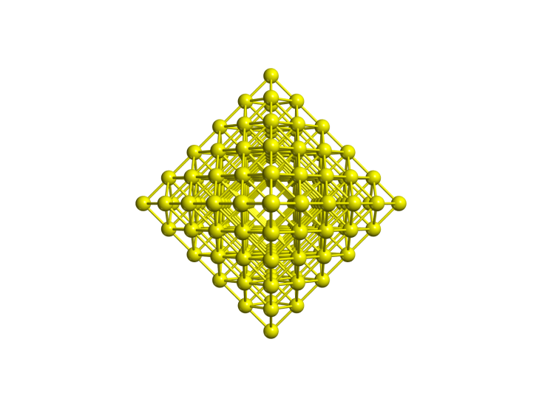
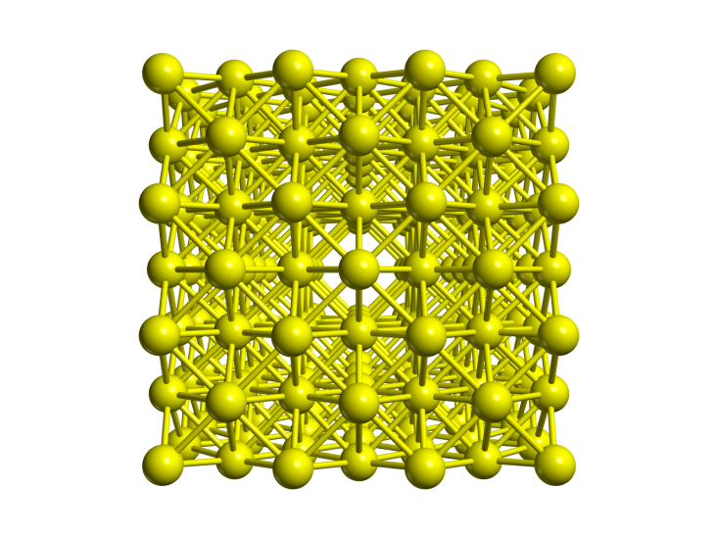
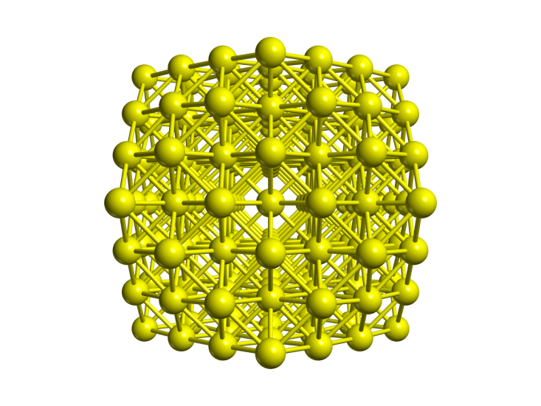
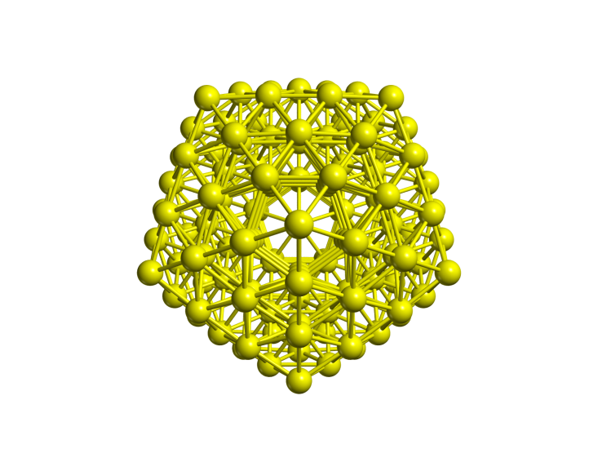
Structures of four gold clusters
N. Durante, A. Fortunelli, M. Broyer, and M. Stener, JPCC 115 (2011) 6277
[Au₁₄₆]²⁺ Octahedral
[Au₁₇₂]⁴⁺ Cubic
[Au₁₄₇]⁵⁺ Cube-octahedral
[Au₁₄₇]⁻ Icosahedral

Slide 15
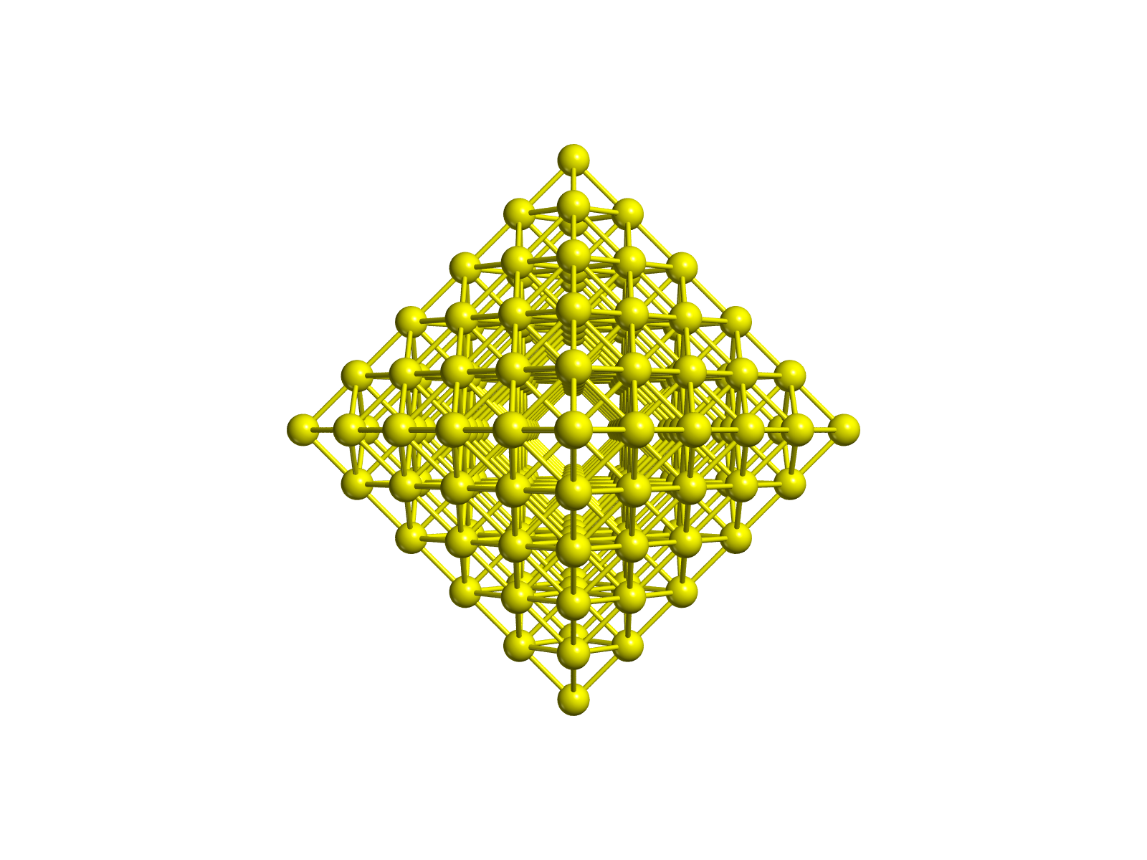
Structural relaxation:
[Au₁₄₆]²⁺ octahedral
Geometry: bulk (2.88 Å)

Slide 16
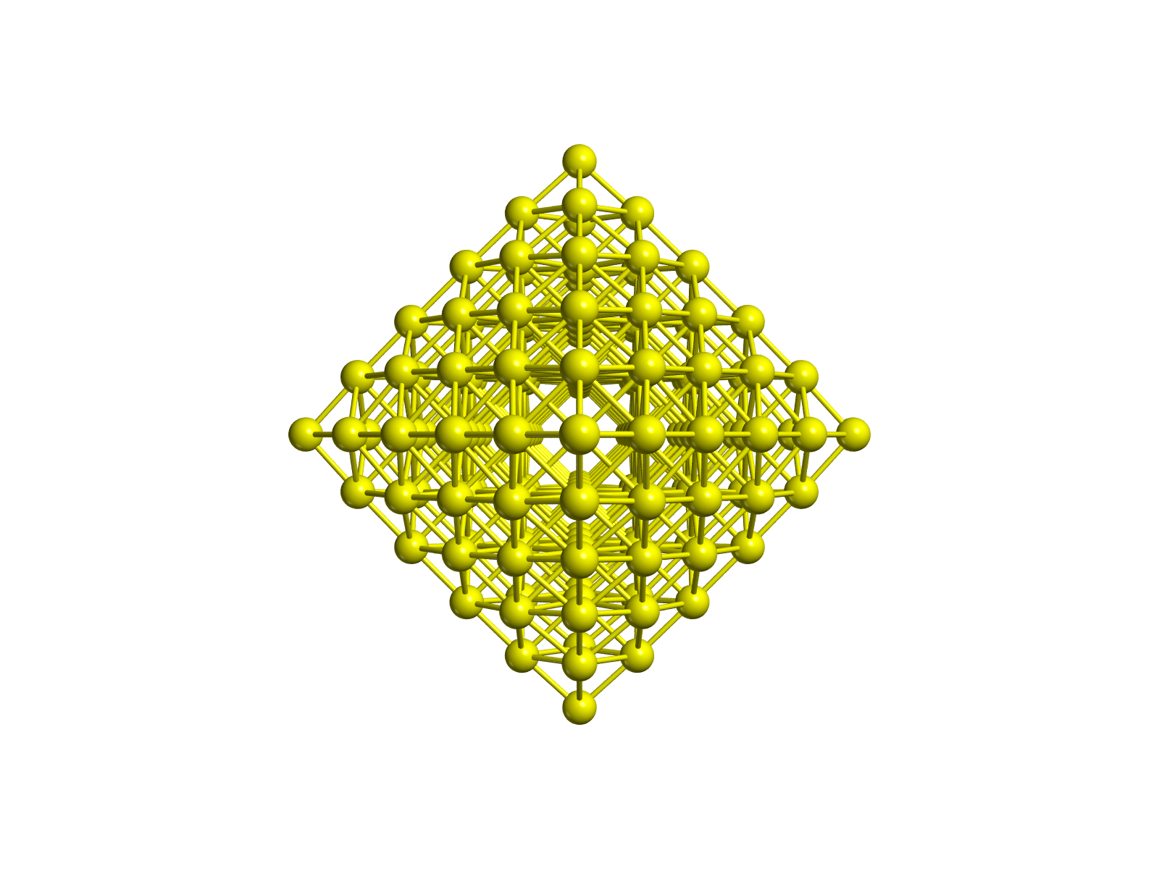
Structural relaxation:
[Au₁₄₆]²⁺ octahedral
Geometry: relaxed

Slide 17
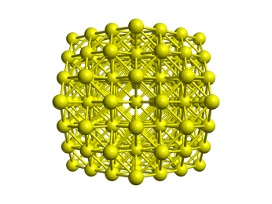
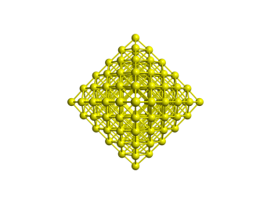
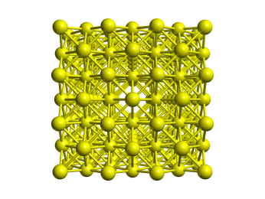
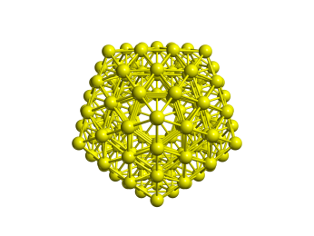
system | peak position (eV) | peak centre (eV) | peak height (f)
147-CO LB94 | 3.2 | 3.25 | 1.20
146-Oh LB94 | 3.4 | 3.25 | 1.80
172-CU LB94 | 2.95 | 3.00 | 1.20
147-Ih LB94 | 2.95 | 2.95 | 0.65
147-CO LDA | 2.3 | 2.55 | 0.47
146-Oh LDA | 2.6 | 2.50 | 0.55
172-CU LDA | 2.1 | 2.35 | 0.30
147-Ih LDA | 2.5 | 2.35 | 0.35
Estimate peak energy from exp.:
2.9 – 3.0 eV
Cottancin, E.; Celep, G.; Lermé, J.; Pellarin, M.; Huntzinger, J. R.; Vialle, J. L.; Broyer, M. Theor. Chem. Acc. 2006, 116, 514
LB94 better than LDA
Peak maximum more sensitive than peak center
Peak shape dependence

Slide 18
Charge effect
[Au₁₄₇]^{Z+} Cube-octahedral TDDFT (LDA)
relaxed geometry

Slide 19
Structural relaxation effect
[Au₁₄₆]^{Z+} Octahedral TDDFT (LB94)
relaxed and bulk (2.88 Å) geometry

Slide 20
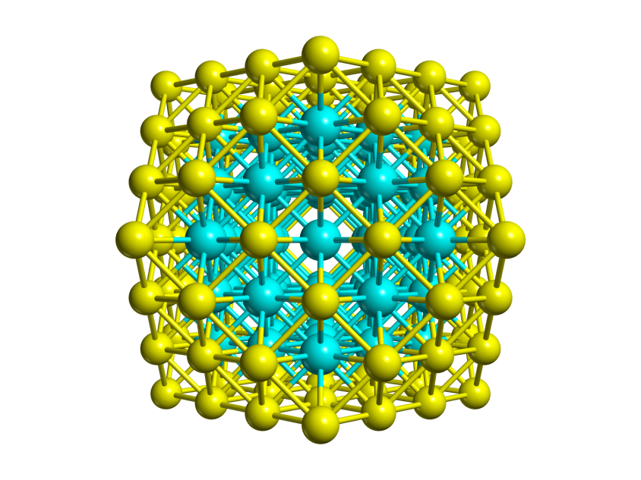
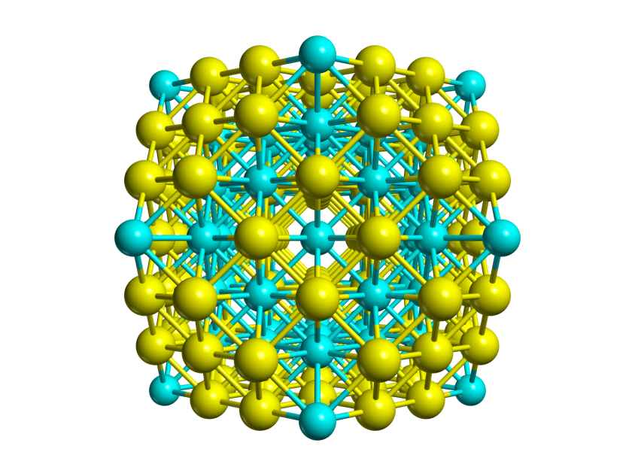
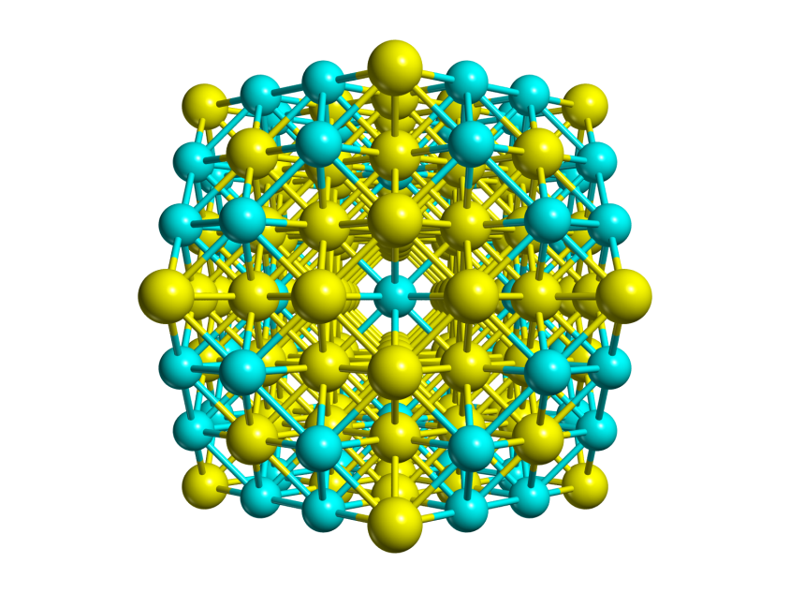
Alloys: nanoclusters
Built by chemical substitution of [Au₁₄₇]⁵⁺ Cubo-Octahedral, keeping O_{h} symmetry
Two chemical compositions: [Ag₅₅Au₉₂]⁵⁺ and [Au₅₅Ag₉₂]⁵⁺
Three chemical ordering: core-shell, multi-shell and maximum mixing.
G. Barcaro, M. Broyer, N. Durante, A. Fortunelli, and M. Stener, JPCC 115 (2011) 24085
[Ag₅₅Au₉₂]⁵⁺
core-shell
[Ag₅₅Au₉₂]⁵⁺
multi-shell
[Ag₅₅Au₉₂]⁵⁺
Max mixing
[Ag₆₈Au₇₉]⁵⁺
Max mixing

Slide 21
Alloys, chemical compositon effect:
[Au₁₄₇]⁵⁺ Cubo-Octahedral shape, core-shell chemical ordering
TDDFT (LB94) relaxed geometry
M. Gaudry, J. Lermé, E. Cottancin, M. Pellarin, J. -L. Vialle, M. Broyer, B. Prével, M. Treilleux, and P. Mélinon, PRB 64 (2001) 085407
As Ag concentration increases:
blue shift + intensity enhancement ⇒ consistent with experiment

Slide 22
Alloys, chemical ordering effect:
[Ag₅₅Au₉₂]⁵⁺ and [Au₅₅Ag₉₂]⁵⁺ [Ag₆₈Au₇₉]⁵⁺ [Au₆₈Ag₇₉]⁵⁺ Cubo-Octahedral shape
core-shell (CS), multi-shell (MS) , maximum mixing (MM) chemical ordering
TDDFT (LB94) relaxed geometry
Mixed bonds 55:92
CS 33.9 %
MS 54.6 %
MM 59.2 %
68:79 MM 64.0 %
MM
Double feature
core-shell and multi shell resemble each other
maximum mixing looks different
Ag₆₈Au₇₉ double feature is less evident

Slide 23
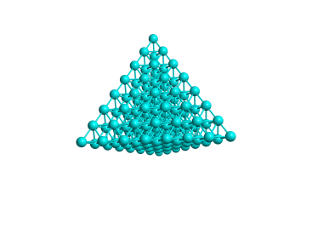
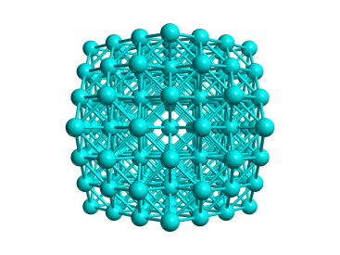
Shape effect:
[M₁₄₇]⁵⁺ and M₁₂₀ M=Au, Ag Cubo-Octahedral and T_{d} shapes
TDDFT (LB94) relaxed geometry
Shape effect is important for Au and dramatic for Ag, needs more investigation!

Slide 24
Rationalization in terms of electronic structure
Preliminar results on [Ag₅₅Au₉₂]⁵⁺ and [Au₅₅Ag₉₂]⁵⁺ core-shell
Analysis of transitions in terms of initial and final states
A: Au(6s) → Au (6p), Ag (5p)
B: Au(6s,5d) → Au (6s,6p)
C: Au(5d) → Au (6p)
D: Au(6s), Ag(5s) → Ag (5p)
E: Au(5d) → Au (6s,6p), Ag(5s,5p)
F: Au(5d) → Au (6s,6p), Ag(5s,5p)
Increasing Ag concentration, Ag contributions start to populate final states.

Slide 25
Validation of the method, Au₈₆
Au₈₆ nanowire, E longitudinal polarization along (Z).
Scalar Relativistic ZORA, DZ basis set, LB94 XC, energy cutoff at 7 eV, fitting: as in Au₂, intense plasmon at 2.35 eV
TCM analysis at 2.35 eV:
Strong intraband 6s → 6s 6p transitions, cutoff at 7 eV justified a posteriori
Induced density analysis:
Simple dipolar shape

Slide 26
Validation of the method, [Au₁₄₇]⁻
[Au₁₄₇]⁻ D_{5d} cluster, E polarization along C₅ axis (Z).
Scalar Relativistic ZORA, DZ basis set, LB94 XC, energy cutoff at 7 eV, fitting: as in Au₂, weak plasmon at 3.45 eV, accurate transition energy, but the intensity is overestimated
TCM analysis at 3.45 eV:
Strong interband 5d → 6s 6p transitions, Plasmon is quenched by screening!
cutoff at 7 eV justified a posteriori
Induced density analysis:
Simple dipolar shape

Slide 27
Plasmon analysis by scaling factor λ
ΔE = 0.6 eV
λK(r,r’) (kernel)
Scaling method: “Plasmons in molecules” S. Bernadotte F. Evers and C. R. Jacob JPCC 117 (2013) 1863.
ΔE = 0.4 eV

Slide 28
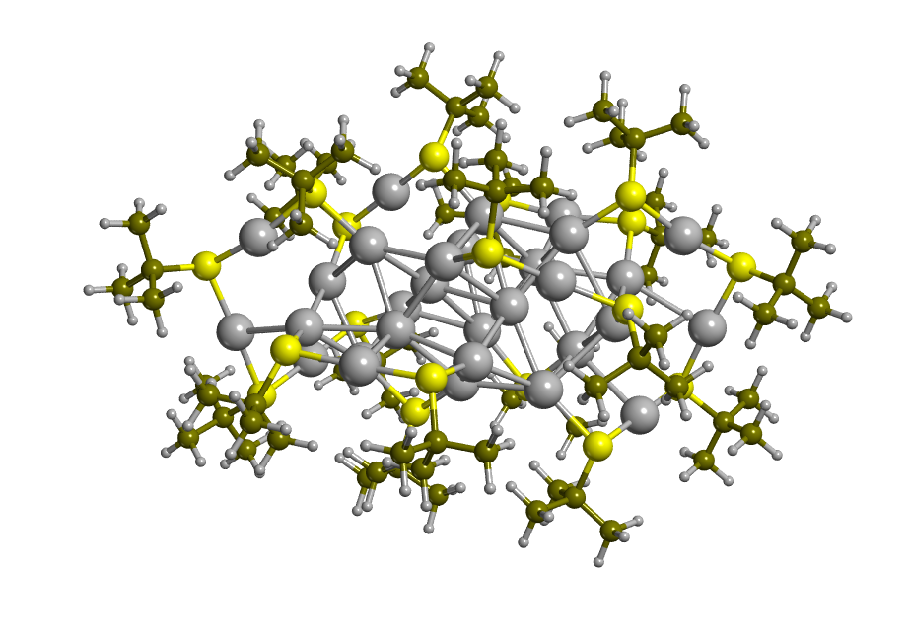
Applications: ‘green gold’Au₃₀(S-t-But)₁₈
D. Crasto and A. Dass, JPCC 117 (2013) 22094
D. Crasto, S. Malola, G. Brosofsky, A. Dass and H. Häkkinen, JACS, 136 (2014) 5000
TDDFT ADF with first X-ray structure from A. Dass (private communication)

Slide 29
Applications: ‘green gold’Au₃₀(S-t-But)₁₈

Slide 30
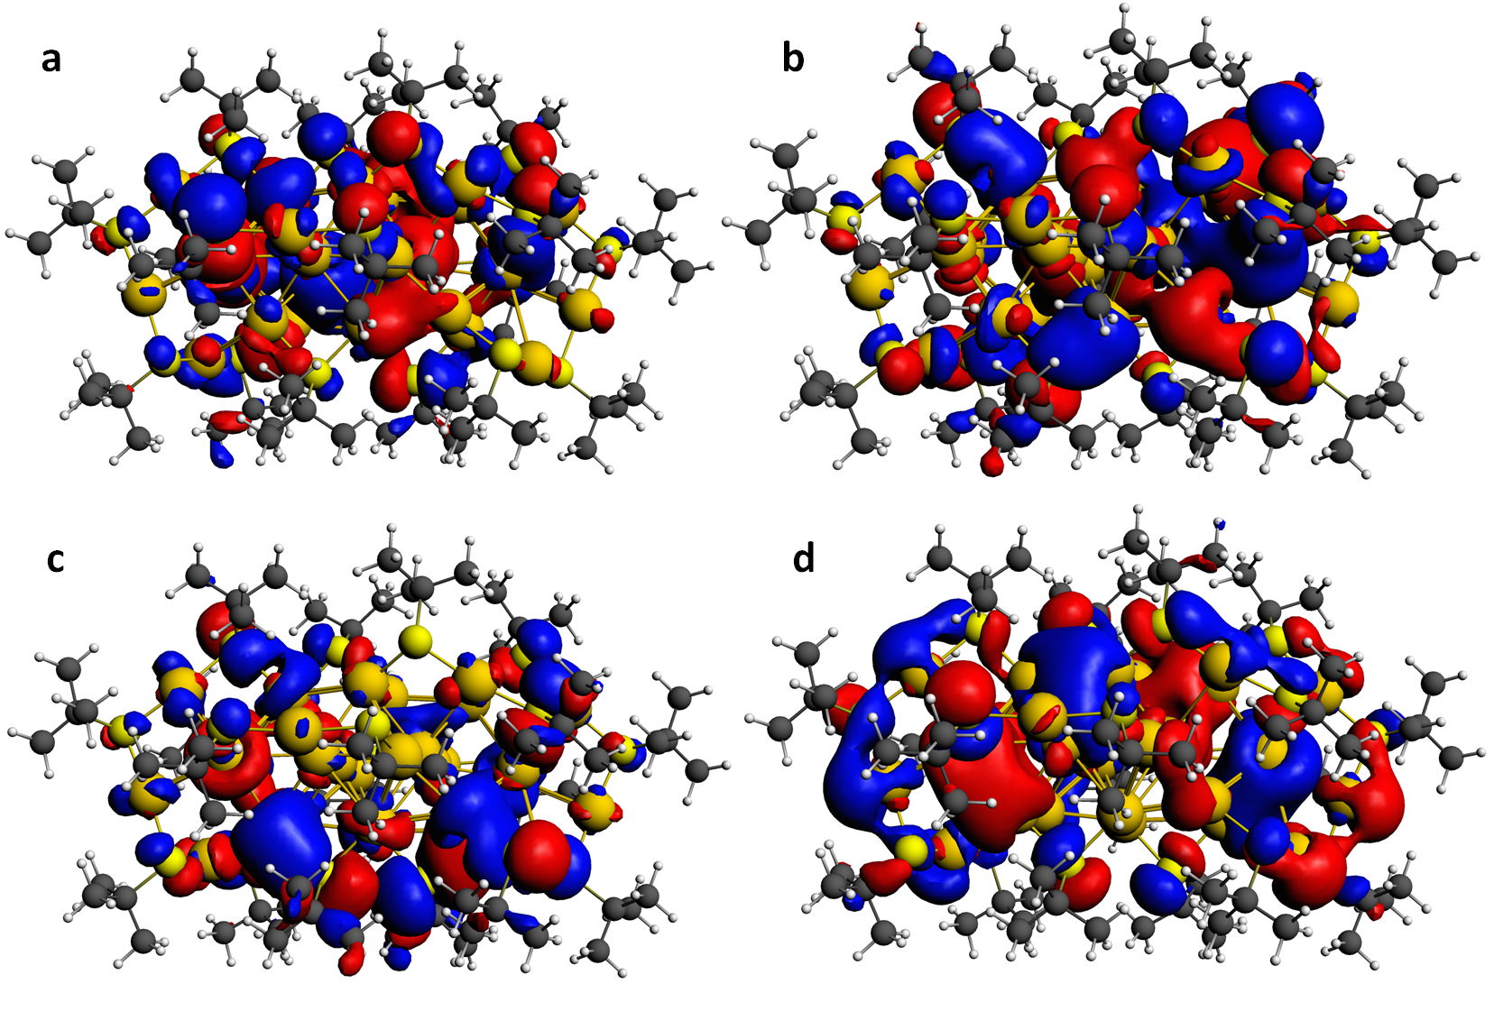
Applications: ‘green gold’Au₃₀(S-t-But)₁₈
HOMO-5
HOMO-4
HOMO-3
HOMO

Slide 31
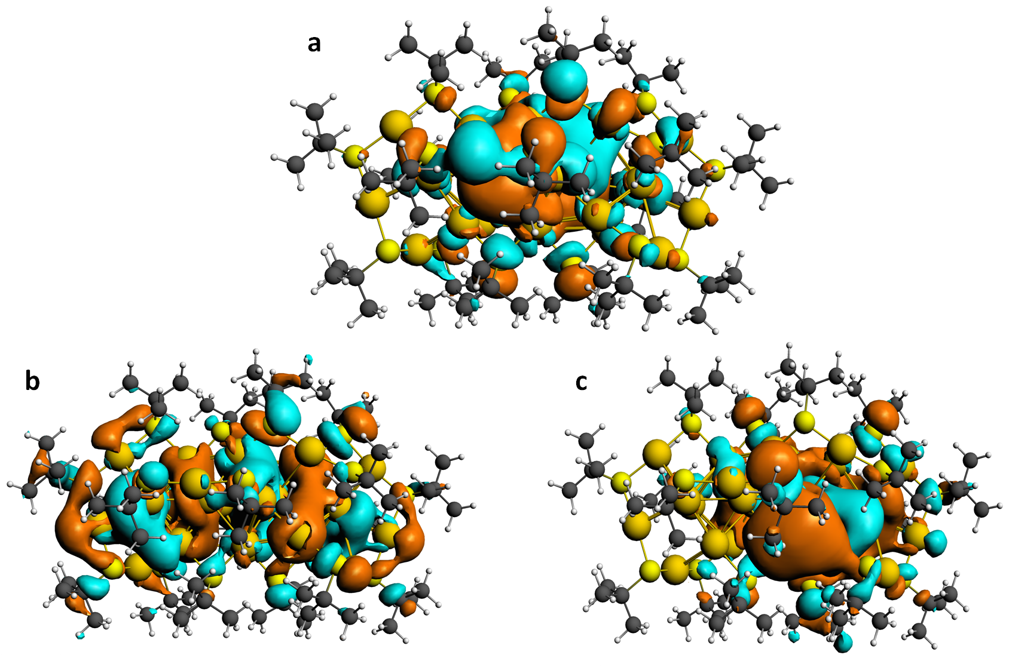
Applications: ‘green gold’Au₃₀(S-t-But)₁₈
LUMO
LUMO+2
LUMO+4

Slide 32
Applications: plasmon re-birth Au₃₀(SX)₁₈ X = t-Butyl, Phenyl and Phenyl-NO₂
Re-birth with TDDFT in Au23/Au25 clusters:
L. Sementa, G. Barcaro, A. Dass, M. Stener, and A. Fortunelli
Chem. Comm. 51 (2015) 7935 – 7938.
Going from t-But to PhenylNO2:
Red shift
Enhanced absorption
Rising of a new structure at 3.5 - 3.1 - 2.8 eV!
Further analysis is under consideration
New complex polarizability algorithm

Slide 33
Conclusions:
The density-matrix Casida approach is not practical to treat plasmons in big metal clusters, since many roots (lowest eigenvalues) are necessary.
A complex polarizability TDDFT algorithm is suggested too treat large systems
Implementation of the complex polarizability algorithm is completed in ADF code and published in JCP
Pros: efficiency, low memory, analysis of the transitions
Cons: some approximation (imaginary energy, energy grid), density depenedent kernel.
Applications to large and low symmetric systems, higher energy
Specific applications: re-birth, big clusters (>1000 metal atoms), chiral clusters.

