Slide 1

DFT and TDDFT: from basic theory to applications (3 ECTS)
Mauro Stener
Dipartimento di Scienze Chimiche e Farmaceutiche
Università degli Studi di Trieste
Via L. Giorgieri 1, 34127 TRIESTE
E-mail: stener@units.it
Within: Selected Topics in Theoretical Chemistry
European Master in Theoretical Chemistry and Computational Modelling (TCCM) Groningen (NL), 6th – 9th February 2017

Slide 2
Summary
THEORY - DFT Review of DFT basic theory and equations
THEORY - TDDFT with the aim to underline what is general from Linear Response formalism.
COMPUTATIONAL - Some numerical aspects of the implementation in the ADF code, most important computational choices, how to assign spectral features. New TDDFT algorithm.
APPLICATIONS:
4.a. Plasmons in metal clusters.
4.b. Core electron excitations (NEXAFS).

Slide 3
Core electron excitations (NEXAFS).
TDDFT extensions to treat core electron excitations
Illustrative example: calculations of XAS Ti2p excitation spectra in TiCl₄ and relativistic effects
Choice of XC functional
When TDDFT (L-edge) and when DFT (K-edge)?
Adsorbed molecules
Conclusions

Slide 4
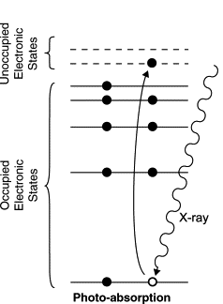
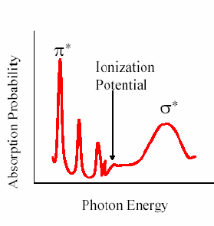
NEXAFS (Near Edge X-ray Absorption spectroscopy)
NEXAFS spectroscopy refers to the absorption fine structure around the absorption edge of a specific atomic species in the sample
C1s
The fine structure corresponds to transitions of core electrons towards unoccupied valence states
electric dipole selection rules require p final states for K edge, s and d for L_{2,3} edges
characterization of electronic structure
Notes:
4

Slide 5
DFT: the Kohn-Sham (KS) method
The electron density ρ can be extracted from a system of non-interacting electrons:
SCF iterative solution

Slide 6
Excited states are beyond the KS validity!
However, from a pragmatic point of view, the Transition State (TS) method has been proposed by Slater:
SCF with TS Configuration: (i)^{-½}(a)^{+½} difficult to converge for high virtual orbitals
SCF with “ionic” TS Configuration: (i)^{-½}(a)⁰ widely employed, no SCF problem, relaxation included

Slide 7
TDDFT: linear response
The problem is recast to the following eigenvalue equation:
ε and ϕ are the KS eigenvalues and eigenfunctions obtained at the GS configuration (unrelaxed)

Slide 8
Common V_{XC} choices do not obey to correct asymptotic –1/r behavior, in TDDFT this feature is important to obtain accurate excitation energies and intensities
Correct asymptotics can be implemented by:
SIC (orbitals no more orthogonal)
OEP (computationally demanding)
LB94 Our choice (model GGA)
(R. van Leeuwen and E. J. Baerends, PRA 49 (1994) 2421)

Slide 9
Such ADF implementation is, in practice, limited to valence electron excitation
Core electron excitations:
are at high energy in the spectrum, difficult to be extracted by iterative algorithms (Davidson)
coupled with the continuum (standard basis sets (STO) are not suitable)

Slide 10
Extension of the TDDFT method to treat core electron excitations (ADF program)
M. Stener, G. Fronzoni and M de Simone, CPL 373 (2003) 115.
The pairs ia e jb span the 1h-1p space
To limit the run of the indeces i and j to core orbitals
Core excitations become the lowest, are no more coupled with the valence, and Ω matrix is reduced:
(j,b)
← core orbitals
Ω →
(i,a)
Reduced Ω matrix

Slide 11
Case study: Ti2p excitations in TiCl₄
KS
TDDFT

Slide 12
TDDFT vs KS
Inclusion of configuration mixing effects
Mandatory for an accurate description of excitations of degenerate core orbitals (2p) of transition metals
Calculation: discrete lines, convoluted with gaussian functions (FWHM=0.6 eV)
large absolute errors (∼3 eV)

Slide 13
TiCl₄: T_{d} point group symmetry
10t₂: 3d_{xy} 3d_{xz} 3d_{yz}
Configuration mixing
3d
Crystal field splitting
3e: 3d_{x2-y2} 3d_{z2}
2t₂ : 2p
KS level:
2t₂ → 3e
2t₂ → 10t₂
TDDFT level:

Slide 14
At TDDFT level extradiagonal terms introduce mixing of 1h1p configurations
100% 2t₂→3e
100% 2t₂→10t₂
77% 2t₂→3e
22% 2t₂→10t₂
76% 2t₂→10t₂
21% 2t₂→3e

Slide 15
Ti2p excitations in TiCl₄: relativistic effects
2 KINDS OF RELATIVISTIC EFFECTS:
SCALAR RELATIVISTIC CORRECTIONS
(scalar ZORA TDDFT)
SPIN-ORBIT COUPLING
(two components ZORA TDDFT)

Slide 16
TiCl₄ – RELATIVISTIC APPROACH
SPIN-ORBIT COUPLING
SPLITTING of Ti 2p orbitals
SCALAR RELATIVISTIC CORRECTIONS
excitation energies increased (better agreement with experiment)
mandatory for heavy atoms
much important as the core hole is deeper
Energy
2p_{3/2}
L_{III}
2p
BUT the effect on energy differences is almost negligible
SO splitting
= 5.85 eV
exp: 6.10 eV
L_{II}
2p_{1/2}

Slide 17
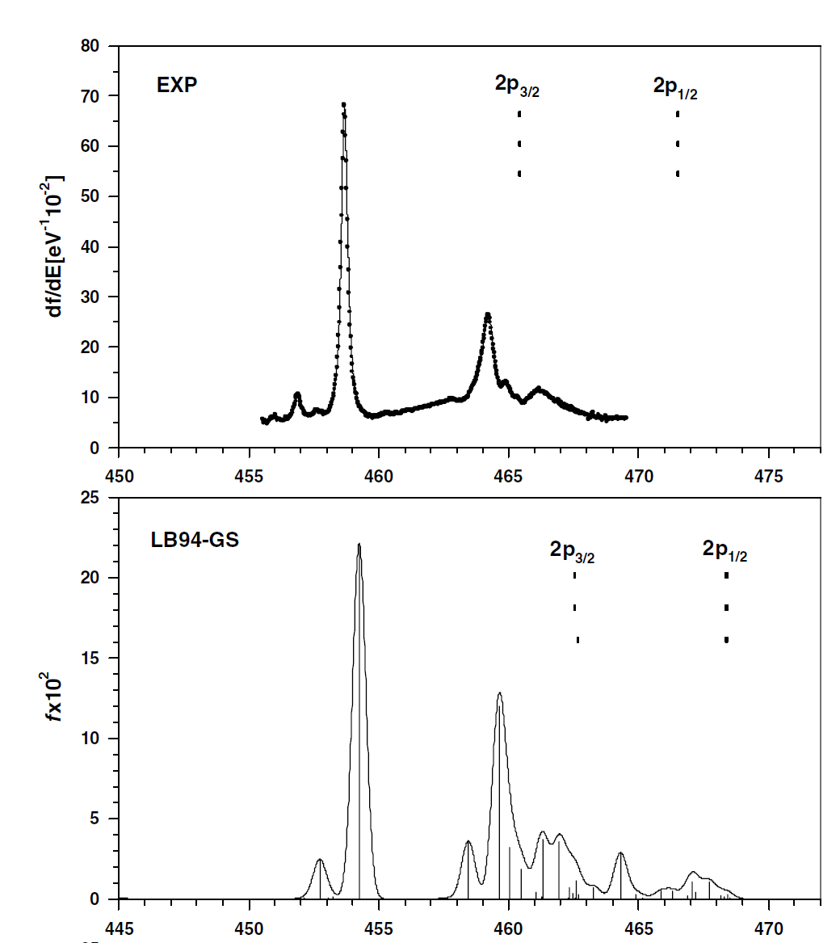
TiCl₄ – RELATIVISTIC APPROACH
high level complexity in the attribution of excited states;
complex distinction between valence and Rydberg transitions: careful choice of basis set functions!
6.10 eV
1.80 eV
5.60 eV
Physics behind the Ti2p spectrum:
SO-TDDFT LB94
3d crystal field splitting
configuration mixing
Spin-orbit coupling
5.85 eV
Val. L₃
Val. L₂
Ryd L₃
G. Fronzoni, M. Stener, P. Decleva, F. Wang, T. Ziegler, E. van Lenthe and E. J. Baerends
CPL 416, 56 - 63 (2005).
1.52 eV
Ryd L₂
5.72 eV

Slide 18
Fe(Cp)₂ – covalent nature: LB94 deterioration!
LB94 - scalar relativistic: poor description of L₃, features too close and wrong intensity distribution.
B3LYP - scalar relativistic: good description. Assignment:
A 2p_{z} → 3d_{xz} 3d_{yz} C2p_{z} π*
B 2p_{x} 2p_{y} → 3d_{xz} 3d_{yz} C2p_{z} π*
C 2p_{x} 2p_{y} → 3d_{x2-y2} C2p_{z} π*
B
A
C

Slide 19
Fe(Cp)₂ – B3LYP: scalar relativistic vs spin-orbit
Inclusion of SO coupling changes only slightly the spectrum, SR seems already adequate
The choice of XC functional is much more crucial than relativistic effects!

Slide 20
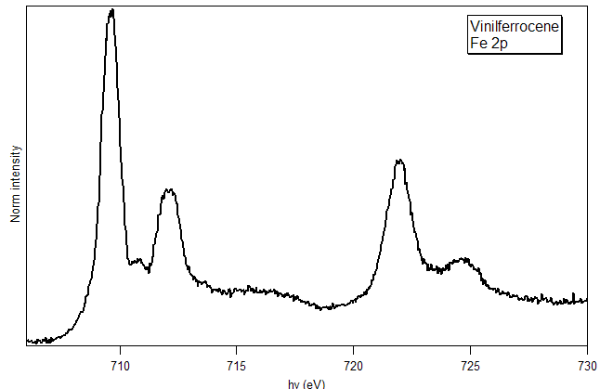
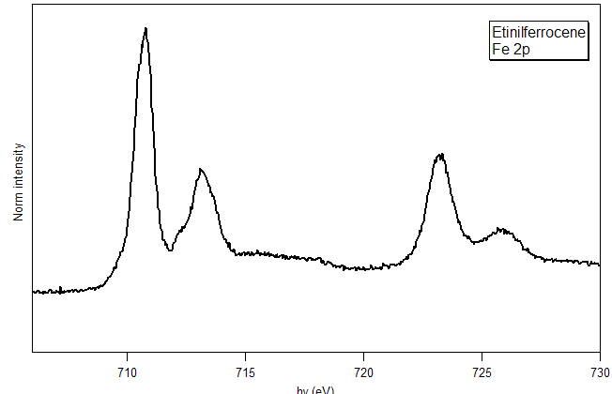
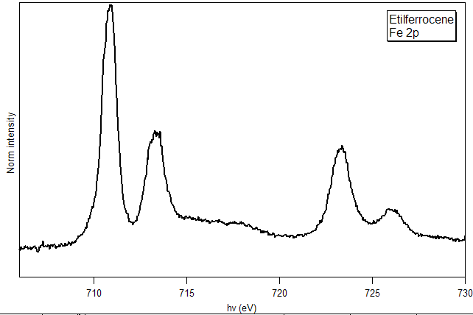
Fe(Cp)(Cp-R) – B3LYP SR: a stringent test
VFC
Substitution: very tiny spectral effects
Well described at SR-TDDFT level!
The new feature: Fe2p → Fe3d_{xz} + R C 2p_{z} π* coniugation
VFC
EFC
EFC
EtFC
EtFC

Slide 21
Limitation of TDDFT: good for Metal 2p, less accurate for C1s and N1s: metal phtalocyanine
CuPc N1s DFT TS
R. De Francesco, M. Stener, and G. Fronzoni, JPCA 116 (2012) 2885.
NiPc N1s DFT TS
H₂Pc N1s DFT TS

Slide 22
Limitation of TDDFT: good for Metal 2p, less accurate for C1s and N1s: metal phtalocyanine
We ascribe the deterioration to LB94 Vxc

Slide 23
NEXAFS spectra of molecules adsorbed on surfaces
great asset of NEXAFS : polarization dependence
if the molecule is oriented the peak intensity depends on the scalar product between E vector of the X-ray (linearly polarized for SR) and the transition moment vector
(ε versor along E)
K-shell transitions : the resonance intensity relative to a specific MO final state is
• largest if E vector points along the direction of that MO
• vanishes if E is perpendicular to the direction of the MO
Angle resolved NEXAFS : ideal technique for probing the orientation of molecules adsorbed on a surface
Notes:
23

Slide 24
Computational approach to NEXAFS spectra of adsorbed system
periodic slab methodology to simulate the surface
surface reconstruction
optimization of the adsorbate systems
(Quantum ESPRESSO calculations)
PERIODIC
CALCULATIONS
from the periodic structure suitable finite cluster is manually cut out
Molecular Orbital (MO) scheme
explicit treatment of core orbitals
CLUSTER MODEL FOR SOLID SYSTEM
drawbacks: cluster design, embedding
cluster design
Finite size cluster model for solid systems : very efficient and accurate to simulate NEXAFS due to the localized nature of core excitation processes.
NEXAFS SIMULATION
Total and polarized spectra
Core excitation energies and oscillator strengths
DFT–TS approximation (K-edge transitions)
TDDFT (L-edge or valence transitions)
DFT–TS approximation (K-edge transitions)
Notes:
24

Slide 25
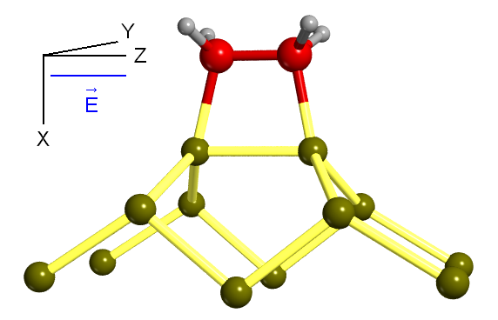
C₂H₄ on Si(100) case study: C K-edge
C₂H₄ on Si(100) case study
NEXAFS spectra of C₂H₄ on Si(100)
➢ model system for the adsorption of unsaturated organic molecules on semiconductor Si surface
➢ the adsorbtion of C₂H₄ is based on the interaction of the π C=C bond with the Si dimers of the surface
stable di-σ Si−C bonds
chemisorption
G. Fronzoni, G. Balducci, R. De Francesco, M. Romeo, M. Stener, J. Phys. Chem. C, 116 (35) 18910-18919 (2012).

Slide 26
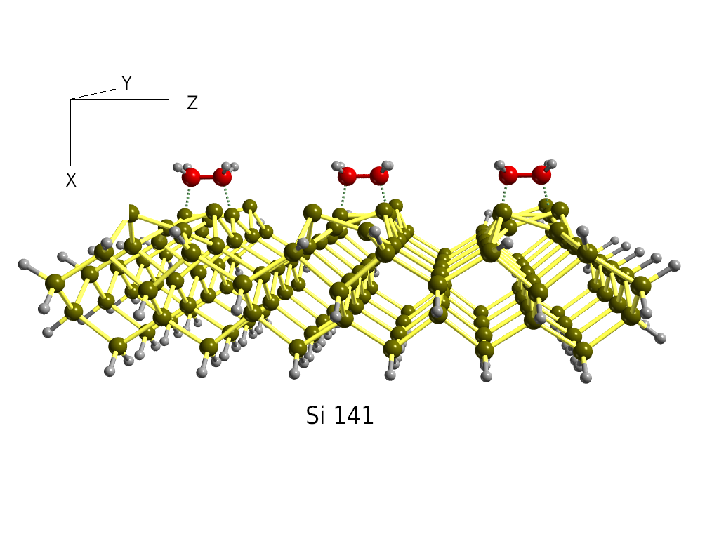
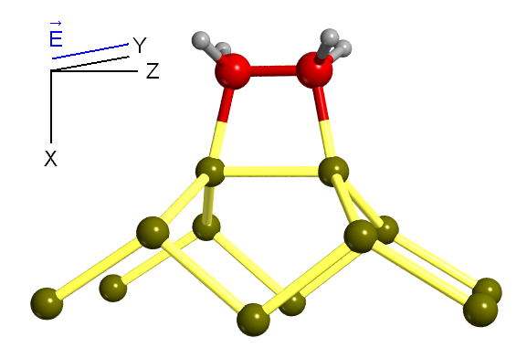
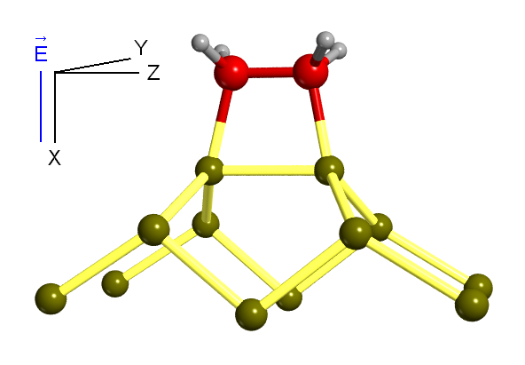
C₂H₄ on Si(100) on top
angle-resolved C K-edge
NEXAFS
σ*_{CC}
E
on top adsorption
σ*_{SiC}
σ*_{CC}
E
σ*_{CH}
E
calculated NEXAFS for on top adsorption reproduce the trend of experimental features with the polarization
σ*_{CH}
σ*_{SiC}
Notes:
26

Slide 27
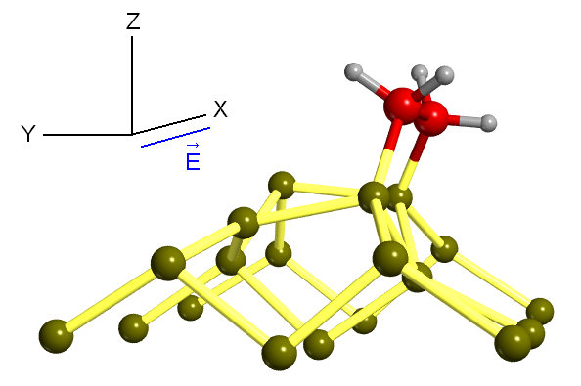
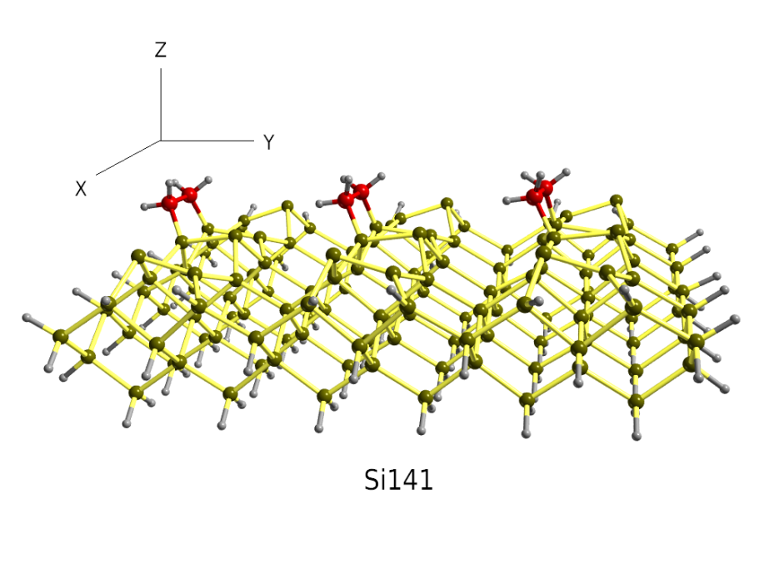
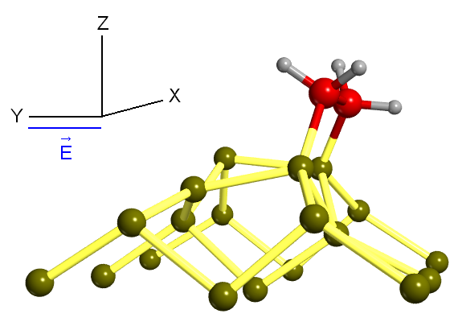
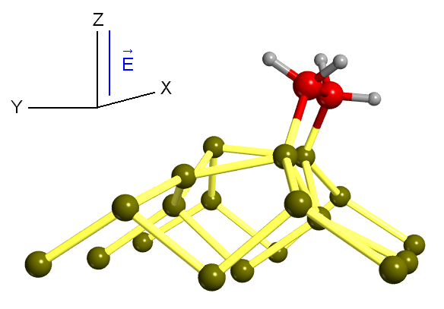
C₂H₄ on Si(100) bridge
angle-resolved C K-edge
NEXAFS
E
σ*_{CH}
bridge adsorption
σ*_{CC}
σ*_{SiC}
E
σ*_{SiC}
E
calculated NEXAFS for bridge adsorption do not reproduce all the trend of the experimental features with the polarization
Notes:
27

Slide 28
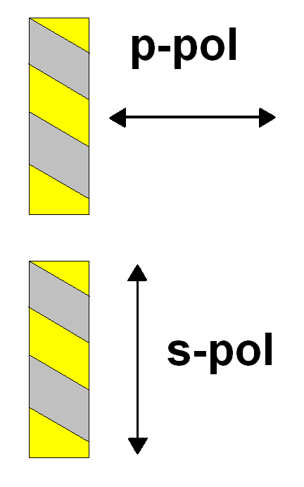
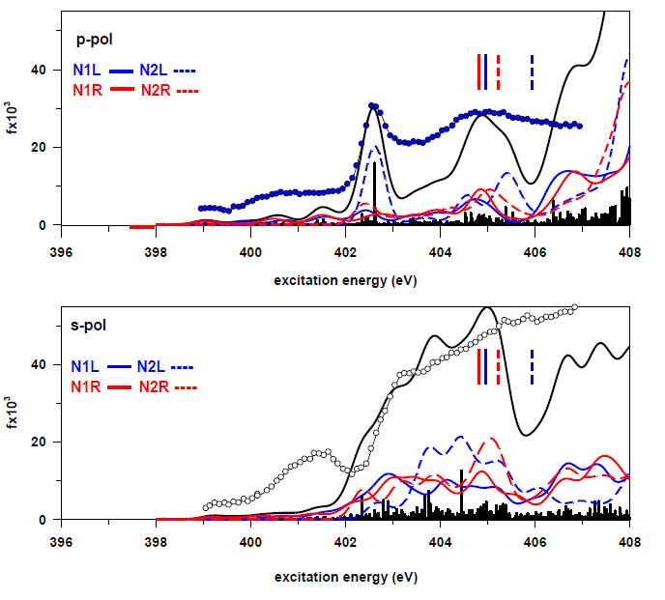
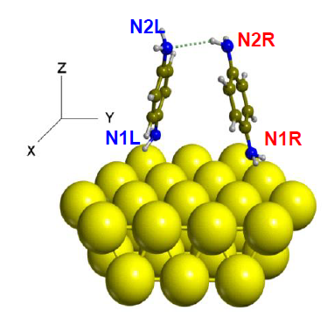
tilted-facing (8 PDB on Au₄₈ surface cluster)
PDB on Au(111)
orientation
Au-N interaction
H-bond interaction

Slide 29
CONCLUSIONS AND PERSPECTIVES
TDDFT applications to XAS
Metal L_{2,3} edges, large systems: good compromise (efficiency), relativistic effects (formalism).
XC functional: LB94 (ionic systems) B3LYP (covalent systems, but not efficient).
DFT applications to XAS
Metal K-edges, computationally very cheap, good description of relaxation.
Perspective:
Even larger systems: new TDDFT algorithms (avoid diagonalization)
Open-shell systems: TDDFT is not very well suited

Slide 30



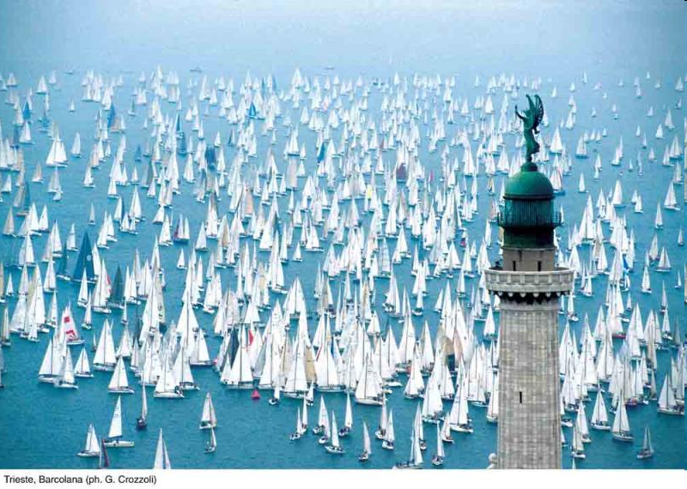
… what about the TCCM Master Thesis in Trieste?
Trieste: 150 Km from Venice, ~200000 people
University: ~17000 students

Slide 31
… what about the TCCM Master Thesis in Trieste?
Possible ‘hot’ topics in computational plasmonics:
a) dichroism in chiral clusters
b) analysis tools (beyond TCM)
c) coupling between clusters (“hot spots”)
d) optical properties of nano alloys
Other arguments:
a) core excitations (NEXAFS)
b) photoionization

Slide 32
ACKNOWLEDGEMENTS
Theoretical Chemistry Group at Trieste University
Piero Decleva, Giovanna Fronzoni, Sonia Coriani and Daniele Toffoli
CNR Pisa
Alessandro Fortunelli
Elettra Synchrotron
Stefano Stranges, Albano Cossaro, Monica De Simone
Funds: INSTM, MIUR, EU, UniTS
CINECA for generous grants of computer time on SP6 IBM supercomputer and technical support: ISCRA projects
Thanks to Ria Broer and Remco Havenith for the invitation!

