Slide 1
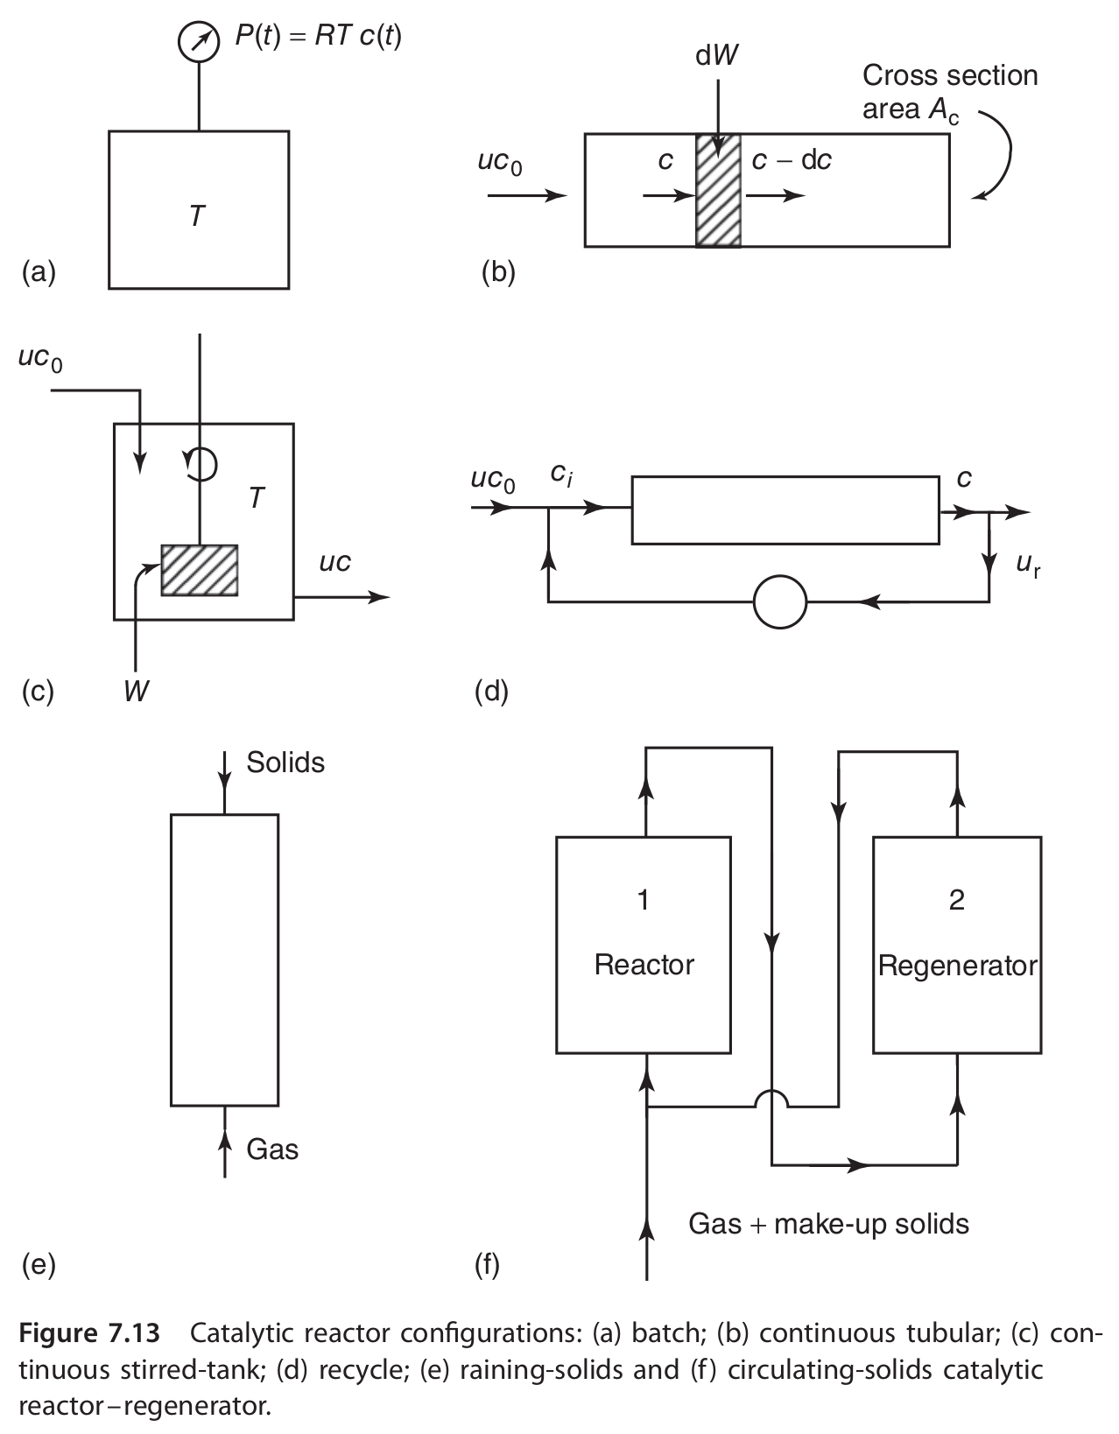
Fundamentals
Ideal Reactors :
  Perfectly mixed batch reactor (Batch)
  Continuous stirred tank reactor (CSTR) or Backmix reactor
  Plug flow reactor (PFR)
  Packed bed reactor (PBR)

Slide 2
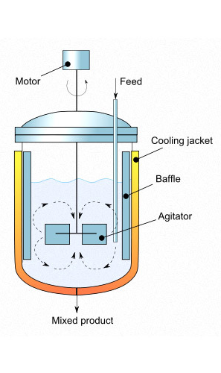
BATCH REACTOR
Perfectly mixed
No variation in the rate of reaction throughout the reactor volume
All reactants are supplied to the reactor at the outset. The reactor is sealed and the reaction is performed. No addition of reactants or removal of products during the reaction.
Vessel is kept perfectly mixed (uniform concentrations). Composition changes with time.
The temperature will also be uniform throughout the reactor - however, it may change with time.
Generally used for small scale processes, e.g. Fine chemical and pharmaceutical manufacturing.
Low capital cost. But high labour costs.
Multipurpose, therefore allowing variable product specification

Slide 3
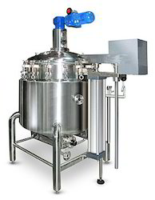
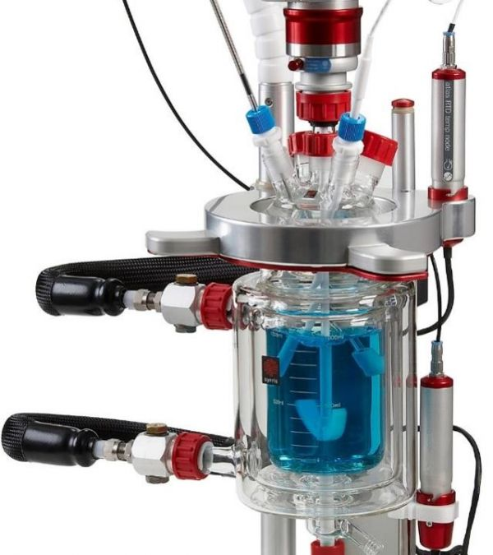
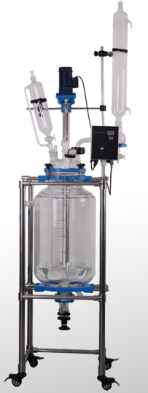
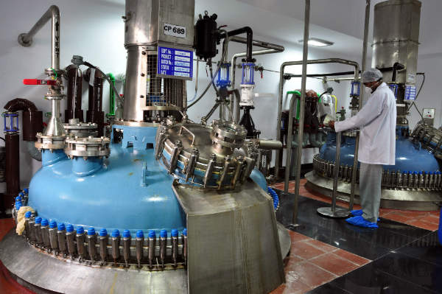
BATCH REACTOR
Laboratory scale
Industrial scale
Laboratory scale
vs

Slide 4
CONTINUOUS STIRRED TANK REACTOR (CSTR)
Normally run at steady state.
Quite well mixed
Generally modelled as having no spatial variations in concentration, temperature, or reaction rate throughout the vessel
Usually employed for liquid phase reactions.
Use for gas phase usually in laboratory for kinetic studies.
Perfect mixing: the properties of the reaction mixture are uniform in all parts of the vessel and identical to the properties of the reaction mixture in the exit stream (i.e. CA, outlet = CA, tank)
The inlet stream instantaneously mixes with the bulk of the reactor volume.
A CSTR reactor is assumed to reach steady state. Therefore reaction rate is the same at every point, and time independent.
F_{A0}
(C_{A0})
F_{A}
(C_{A})
C_{A}
C_{A}
C_{A}

Slide 5
PLUG FLOW REACTOR (PFR), TUBULAR REACTOR
Normally operated at steady state
No radial variation in concentration
Referred to as a plug-flow reactor
The reactants are continuously consumed as they flow down the length of the reactor.
There is a steady movement of materials along the length of the reactor. No attempt to induce mixing of fluid element.
At a given position, for any cross-section there is no pressure, temperature or composition change in the radial direction.
All fluid element have same residence time.
The plug flow assumptions tend to hold when there is good radial mixing (achieved at high flow rates) and when axial mixing may be neglected (when the length divided by the diameter of the reactor > 50 )

Slide 6
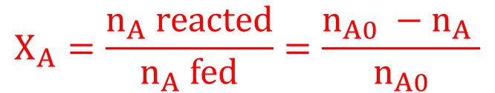
Design equations for the ideal reactors:
based on material balance
A → B + C
Rate law for r_{j}
r_{A} = the rate of formation of species A per unit volume [e.g., mol dm⁻³ s⁻¹]
-r_{A} = the rate of a disappearance of species A per unit volume
r_{j} is a function of concentration, temperature, pressure, and the type of catalyst (if any)
r_{j} is independent of the type of reaction system (batch, plug flow, etc.)
r_{j} is an algebraic equation, not a differential equation
Conversion
The conversion X_{A} is the number of moles of A that have reacted per mole of A fed to the system:
$$X_{A}=\frac{n_{A} reacted}{n_{A} fed}=\frac{n_{A0} −n_{A} }{n_{A0}}$$

Slide 7
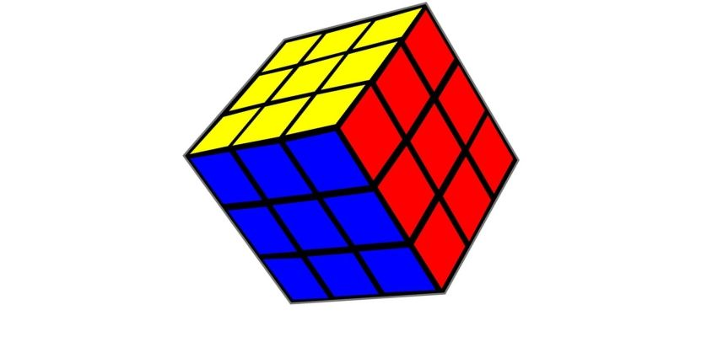
Material Balance for Any Simple Ideal Reactor - Isothermal
Rate of accumulation of reactants in element of volume
Rate of reactant flow
INTO
element of volume
Rate of reactant flow
OUT OF
element of volume
Rate of reactant LOSS due to
Chemical Reaction
Wothin element of volume
=
-
-
Element of reactor volume
Reactants enter
Reactants leave
Reactants accumulate
Reactants disappear due to chemical reaction
Reactants accumulate

Slide 8
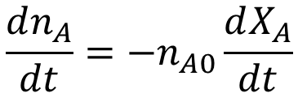

Mole Balance – Batch Reactor
No material enters or leaves the reactor.
If composition in uniform (i.e. perfect mixing) - material balance can be written over whole reactor.
No flow in or out of reactor.
Rate of accumulation of
reactant A in reactor
Rate of reactant A loss
by reaction in reactor
=
-
Rate of accumulation of A
$$\frac{dn_{A}}{dt}$$
$$\frac{dn_{A}}{dt}=−n_{A0}\frac{dX_{A}}{dt}$$
Where:
n_{A0} is the initial moles
X_{A} = fractional conversion of A = (n_{A0}-n_{A})/n_{A0}
n_{A} = moles of A at conversion X_{A}
n_{A} = n_{A0} (1-X_{A})
dn_{A} = -n_{A0} dX_{A}

Slide 9
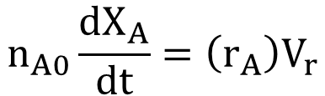
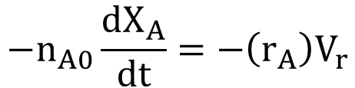
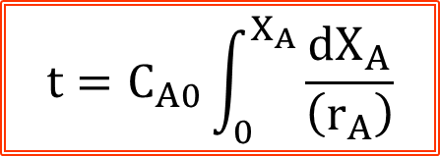
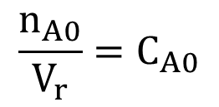
Mole Balance – Batch Reactor
Rate of disappearance of A
r_{A} V_{r}
where r_{A} = moles A reacting / (unit volume) (time)
V_{r} = Reactor volume, but really refers to the volume of fluid in reactor.
$$−n_{A0}\frac{dX_{A}}{dt}=−\left(r_{A}\right)V_{r}$$
$$n_{A0}\frac{dX_{A}}{dt}=\left(r_{A}\right)V_{r}$$
If system is constant volume, then
$$\frac{n_{A0}}{V_{r}}=C_{A0}$$
where C_{A0} is the initial concentration of A (mol/m³)
$$t=C_{A0}\int_{0}^{X_{A}}{\frac{{dX}_{A}}{\left(r_{A}\right)}}$$
Integrating the equation gives the design equation for the batch reactor

Slide 10

Mole Balance – CSTR
CSTR (at steady state) – NO ACCUMULATION
Accumulation = Input - Output - Disappearance by reaction 0 = F_{A0} - F_{A} - r_{A}V_{r}
F_{A} = F_{A0} (1-X_{A})
F_{A0} = F_{A} + r_{A}V_{r}
F_{A0} X_{A} = r_{A} V_{r}
$$\frac{V_{r}}{F_{A0}}=\frac{X_{A}}{r_{A}}$$

Slide 11
Mole Balance – Plug Flow Reactor
In a plug flow reactor the composition of the fluid varies from point to point along a flow path; consequently, the material balance for a reaction component must be made for a differential element of volume dV_{r} .
dV_{r}
C_{A0}
F_{A0}
X_{A0}= 0
C_{Af}
F_{Af}
X_{Af}
F_{A}
X_{A}
F_{A}+dF_{A}
X_{A}+dX_{A}
INPUT
Input of A, moles/time = F_{A}
Conversion of A = X_{A}
OUTPUT
Output of A, moles/time = F_{A} + dF_{A}
Conversion of A = X_{A} + dX_{A}
Disappearance of A by reaction, moles/time = r_{A} dV_{r}

Slide 12

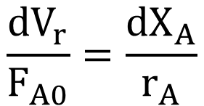
Mole Balance – Plug Flow Reactor
Accumulation = Input - Output - Disappearance by reaction
0 = F_{A} - F_{A}+dF_{A} - r_{A} dV_{r}
PFR (at steady state) – NO ACCUMULATION.
dF_{A} = -F_{A0} dX_{A}
$$\frac{{dV}_{r}}{F_{A0}}=\frac{{dX}_{A}}{r_{A}}$$
- dF_{A} = r_{A} dV_{r}
$$\frac{V_{r}}{F_{A0}}=\int_{0}^{X_{A}}{\frac{{dX}_{A}}{r_{A}}}$$

Slide 13
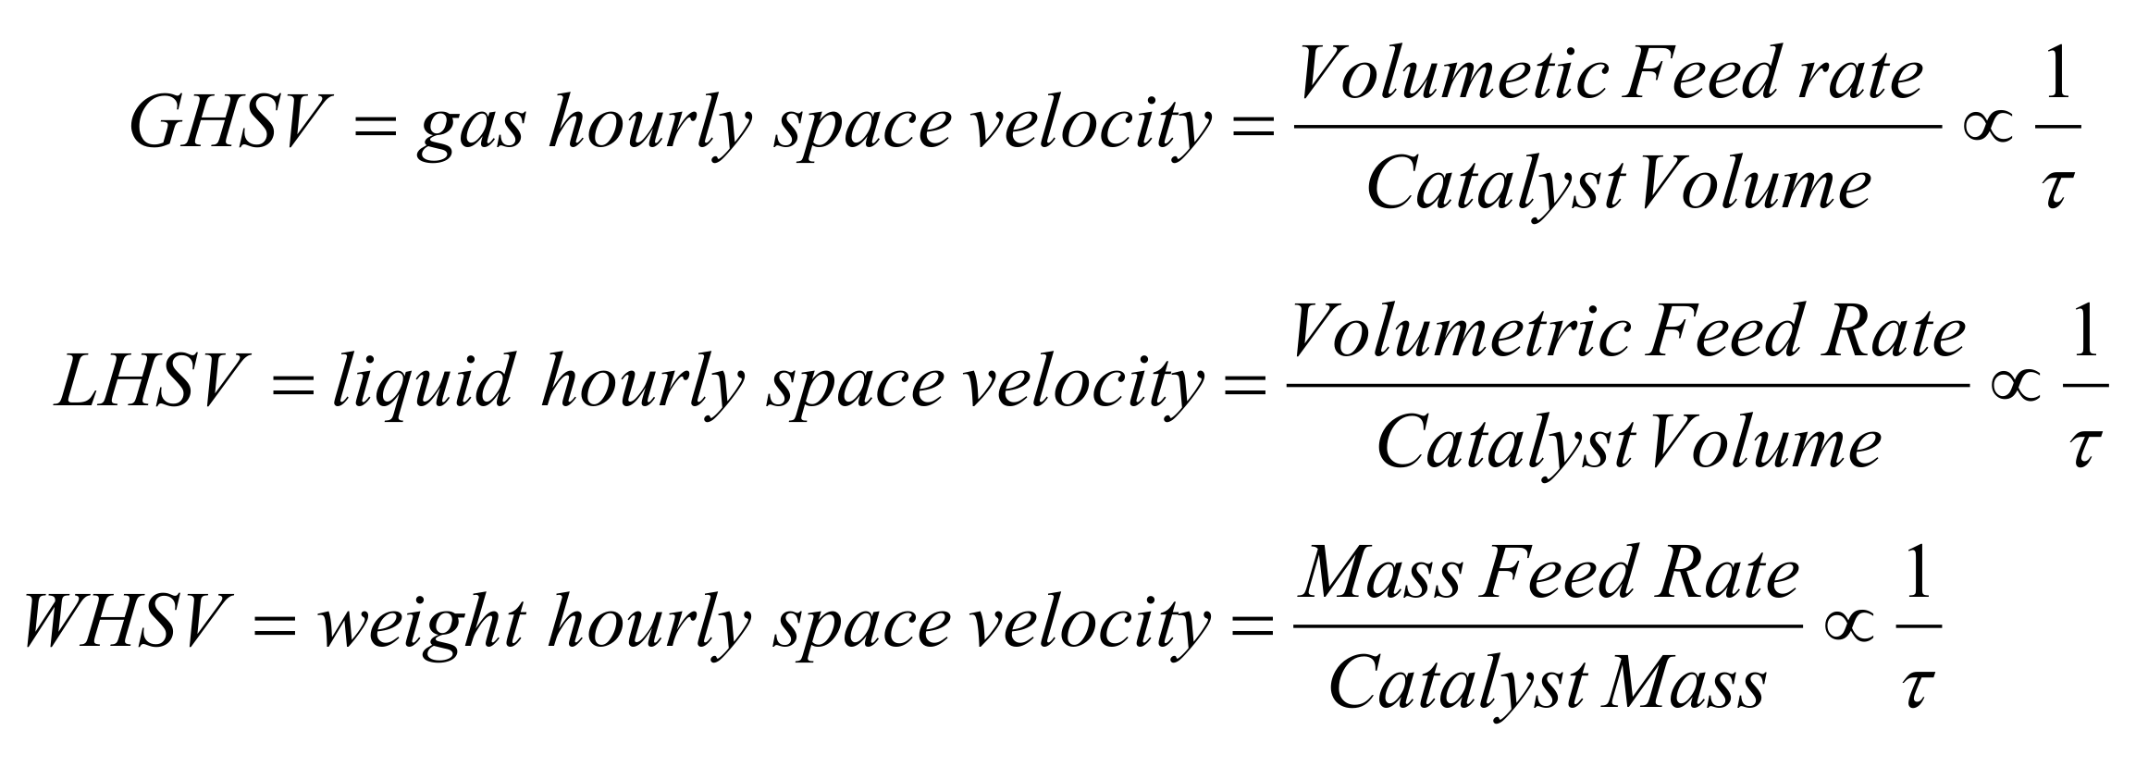
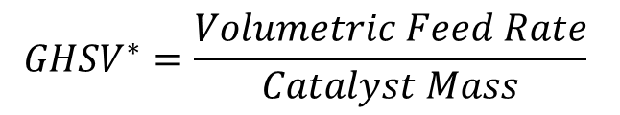
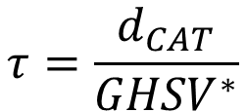
Mole Balance – Plug Flow Reactor
PFR – Space Velocity & Residence time
In our case:
$${GHSV}^{∗}=\frac{Volumetric Feed Rate}{Catalyst Mass}$$
Residence time
The residence time of a fluid parcel is the total time that the parcel has spent inside a control volume (e.g.: a chemical reactor).
$$τ=\frac{d_{CAT}}{{GHSV}^{∗}}$$

Slide 14
The heart of the design of an ideal reactor:
r_{A} = f(X_{A})
Depends on operative variables
(concentration, partial pressure etc.)

Slide 15
Light-off curves – Plug Flow Reactor
The light-off curve is the conversion-temperature plot
of a catalytic reaction
Light-off curves allow to deduce kinetic information such as:
apparent reaction orders
apparent activation energy
number of active sites
mass transfer limitations
External: reaction is limited by diffusion in the intra-particle volume
Internal: reaction is limited by diffusion within the pores
Light-off is defined as the temperature at which the mass transfer becomes rate controlling

Slide 16
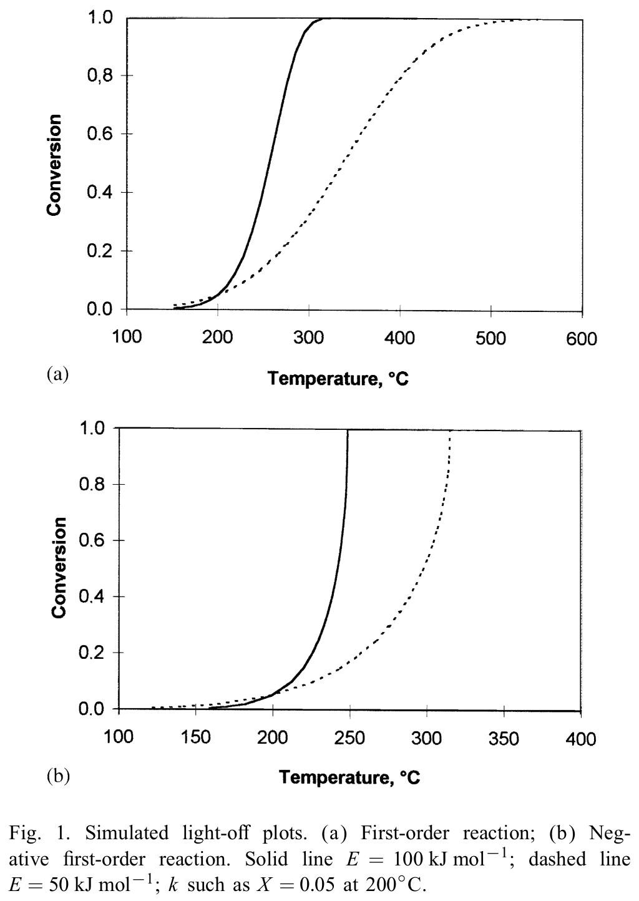
Light-off curves – Plug Flow Reactor
Light-off curves can be predicted, on the basis of a kinetic equation and considering mass transfer limitations.
For a detailed analysis, see F. Duprat “Light-o curve of catalytic reaction and kinetics” Chemical Engineering Science 57 (2002) 901–911
Extraction of kinetic parameters and verification of absence of mass transfer limitations by fitting the whole light-off curve are often not obvious.
Simulated light-off without mass transfer limitations.

Slide 17

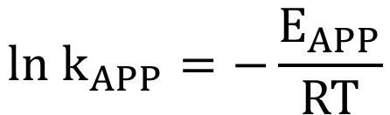



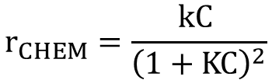
Light-off curves – Plug Flow Reactor
Positive first-order kinetics
In Plug Flow Reactor
$$r_{CHEM}=kC$$
$$k_{APP}=−\frac{ln⁡(1−X)}{τ}$$
Negative first-order kinetics
$$r_{CHEM}=\frac{k}{C}$$
$$k_{APP}=\frac{X(1−X/2)}{τ}$$
Langmuir-Hinshelwood kinetics
$${ln k}_{APP}=−\frac{E_{APP}}{RT}$$
$$r_{CHEM}=\frac{kC }{{\left(1+KC\right)}^{2}}$$

Slide 18
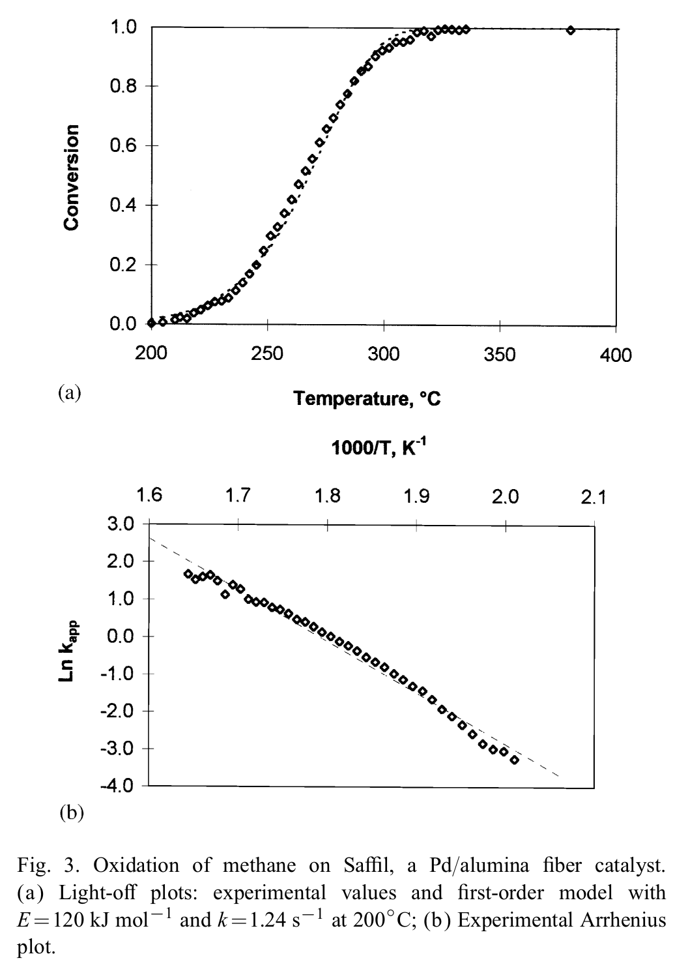
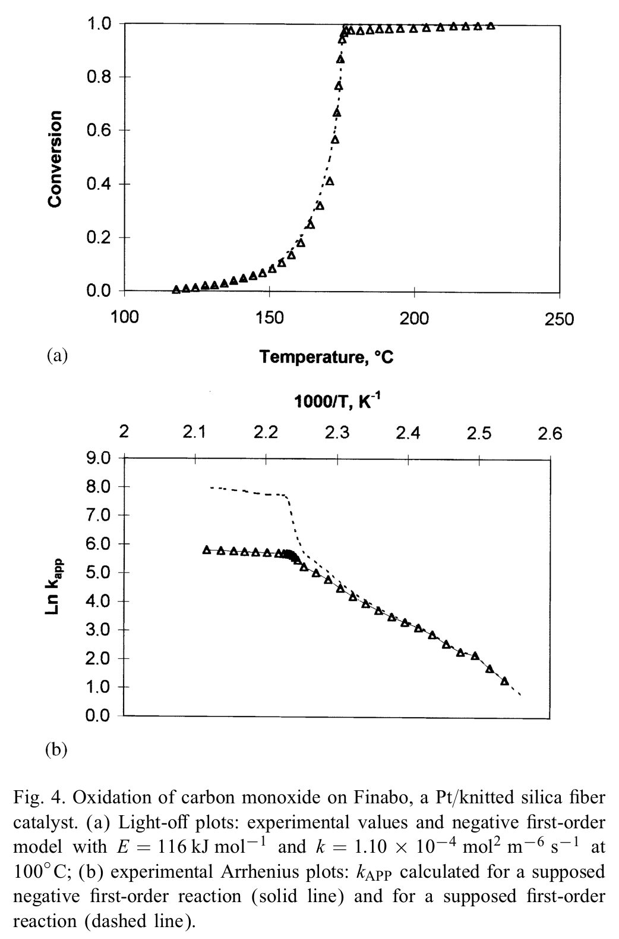
Light-off curves – Plug Flow Reactor
Negative first-order kinetics
Positive first-order kinetics

Slide 19
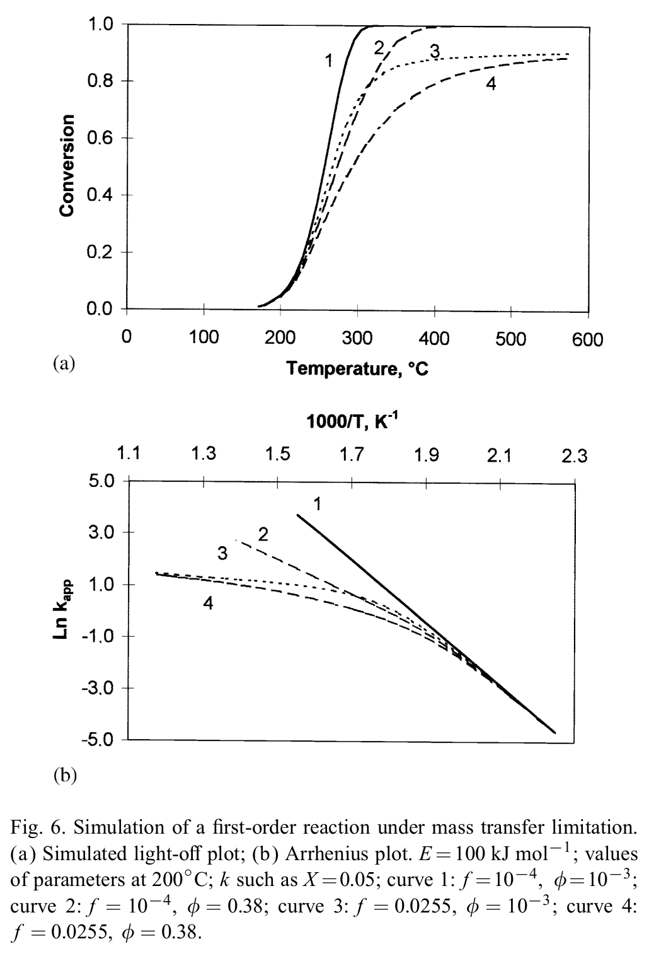
Light-off curves – Plug Flow Reactor
1
No mass transfer limitations
2
External mass transfer limitations
3
Internal mass transfer limitations
4
External + internal
mass transfer limitations
f
External mass transfer
φ
Internal mass transfer

Slide 20
Light-off curves – Plug Flow Reactor
In this region, the reaction is never affected by mass transfer limitations.
The reaction is under kinetic control.

Slide 21
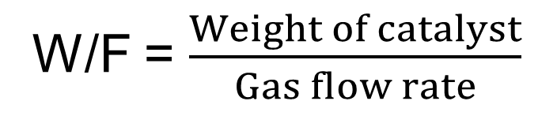
Light-off curves – Plug Flow Reactor
How can we easily highlight mass transfer limitations?
Select a temperature with X < 15%
Perform experiments with different gas flow rates
Calculate X at the selected temperature for the various gas flow rates
diffusional control
(under mass transfer limitations)
X
kinetic control
W/F = $\frac{Weight of catalyst}{Gas flow rate}$
W/F

Slide 22
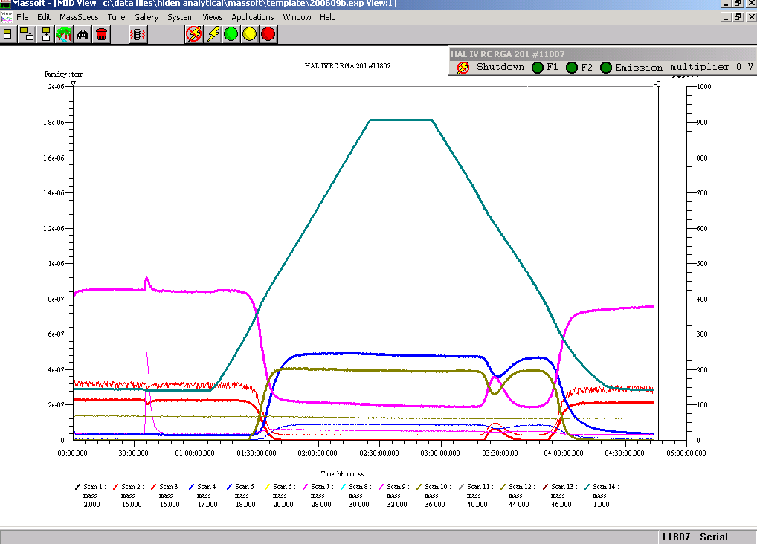
Light-off curves – Experiments
FEED

Slide 23
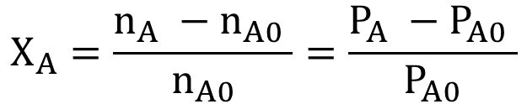
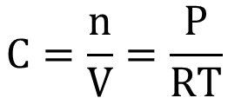
Light-off curves – Experiments
$$C=\frac{n}{V}=\frac{P}{RT}$$
$$X_{A}=\frac{n_{A} −n_{A0} }{n_{A0}}=\frac{P_{A} −P_{A0} }{P_{A0}}$$
Verifica delle condizioni sperimentali (X vs W/F)
Verifica dell’ordine di reazione rispetto CH₄
Determinazione di E_{APP}

Slide 25
Photoreactors
CONTINUOUS STIRRED TANK REACTOR (CSTR)
Rate of accumulation of reactants in element of volume
Rate of reactant flow
INTO
element of volume
Rate of reactant flow
OUT OF
element of volume
Rate of reactant LOSS due to
Chemical Reaction
Wothin element of volume
=
-
-
For degradation experiments:
O₂ enters
0
Molecules are degraded
For H₂ production experiments:
Evaporation of sacrificial agent
Sacrificial agent
is dehydrogenated
0

Slide 26
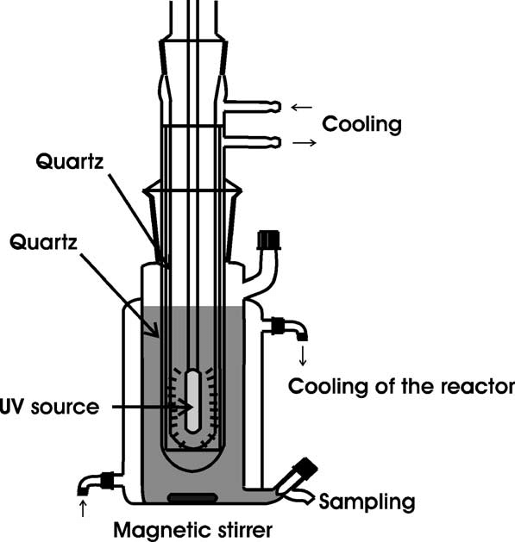
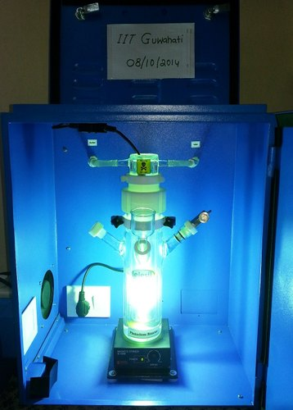
Photoreactors
Immersion photoreactors

Slide 27
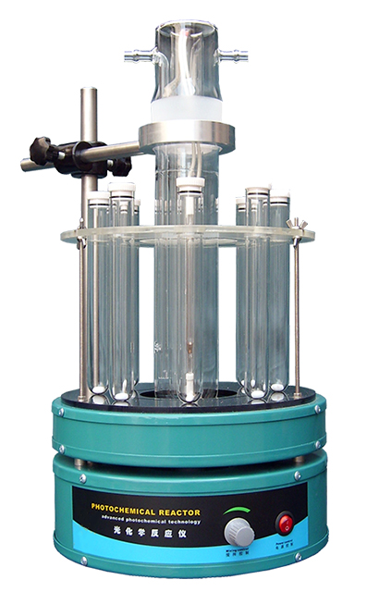
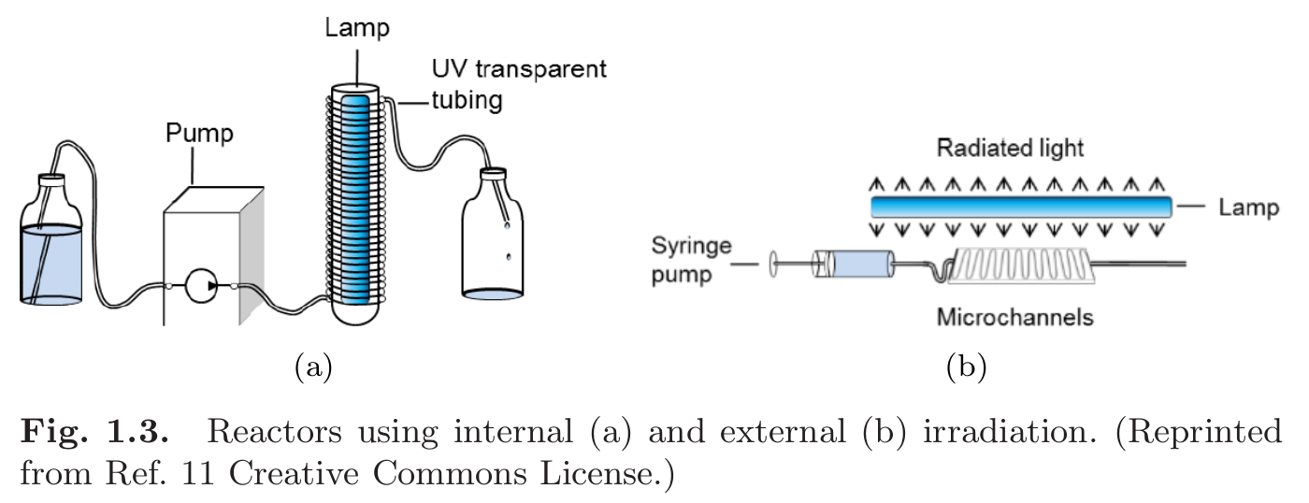
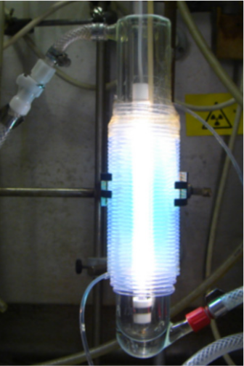
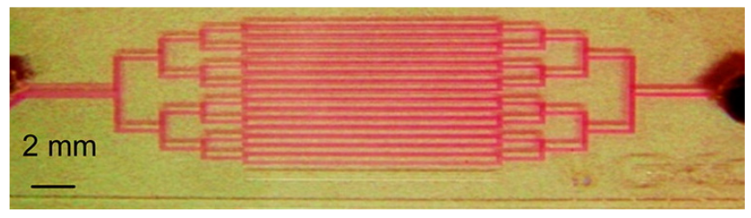
Photoreactors
Spinning wheel
photoreactor
Flow photoreactor

Slide 28
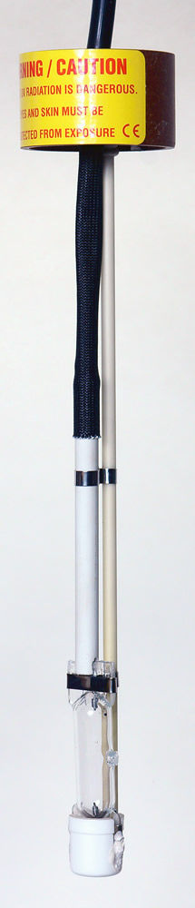
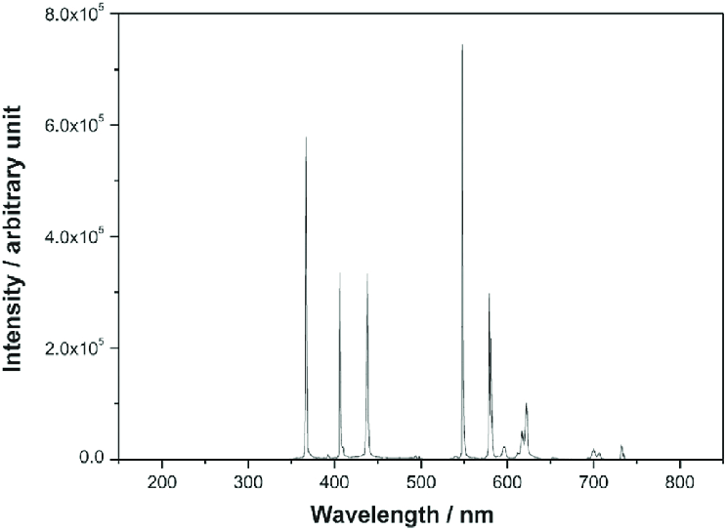
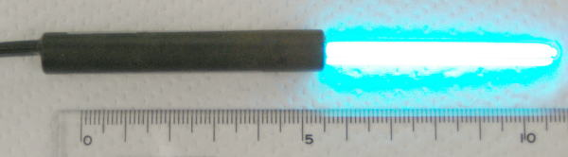
Exact emission spectrum depends on Ar pressure within the bulb
Photoreactors
Hg lamps
Pyrex glass cut-off
Medium pressure Hg lamp
Bulb with liquid Hg and filled with Ar
Low pressure Hg lamp: small, low power, monochromatic applications

Slide 29
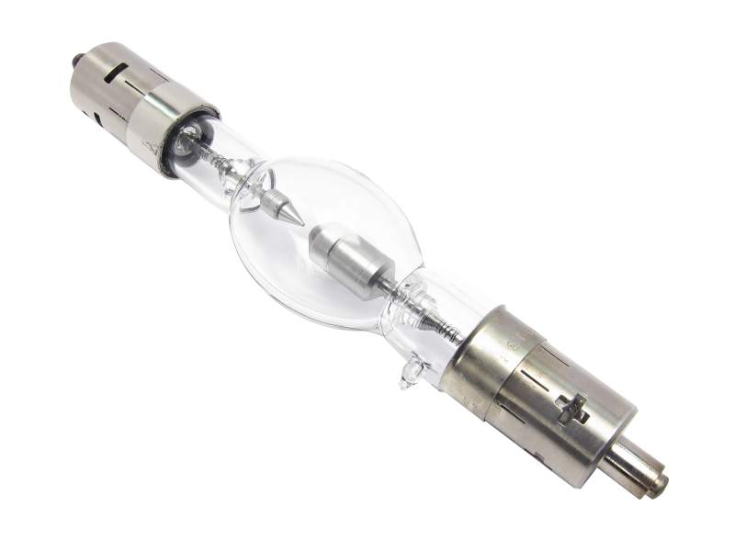
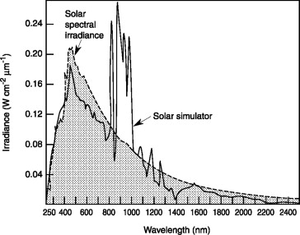
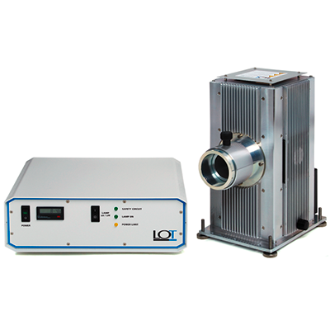
Photoreactors – Light sources
Xe lamps
Different power depending on size of bulb and current.
Need of a lamp holder with mirrors and lenses.

Slide 30
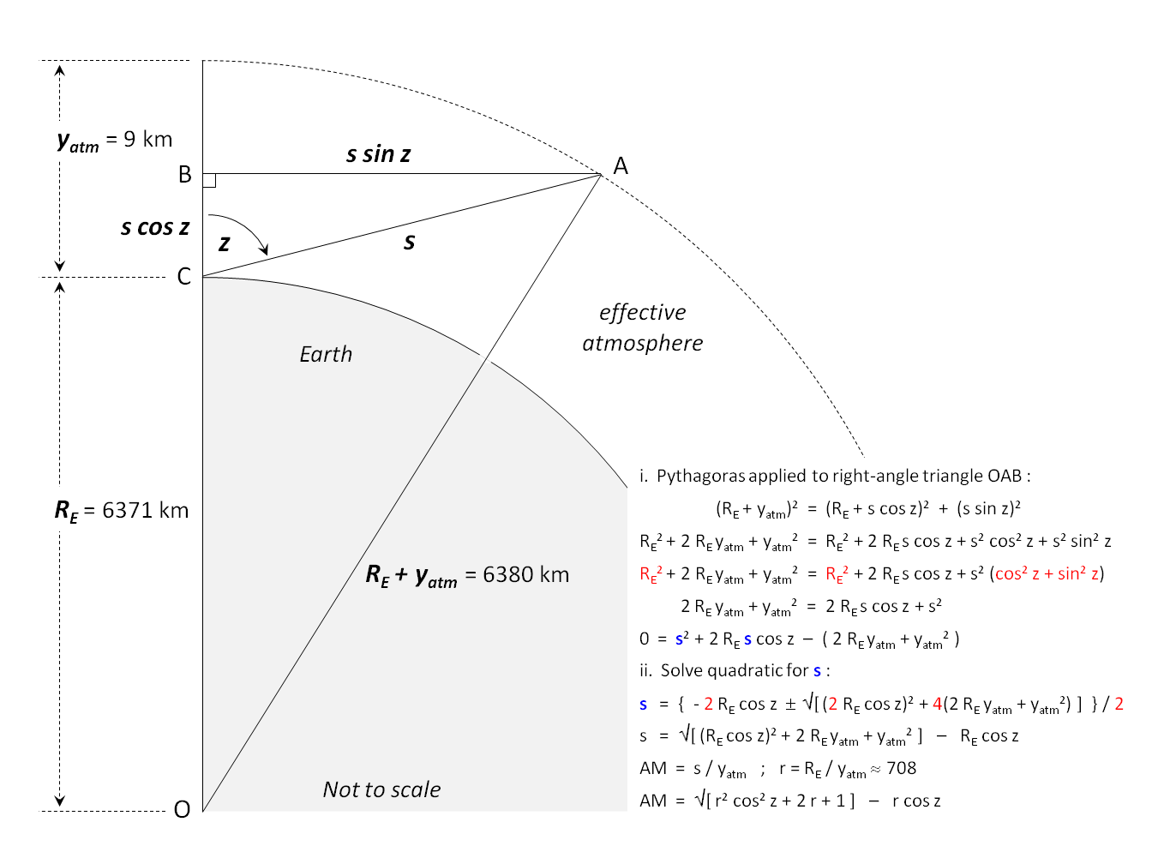
Photoreactors – Light sources
Air Mass coefficient
Important for solar Simulators
The air mass (AM) coefficient defines the direct optical path length through the Earth's atmosphere, expressed as a ratio relative to the path length vertically upwards, i.e. at the zenith.
Atmosphere thickness = 9km
z | AM
0° | 1.0
60° | 2.0
70° | 2.9
75° | 3.8
80° | 5.6
85° | 10.6
88° | 20.3
90° | 37.6
Notes:
Solar radiation closely matches a black body radiator at about 5,800 K.[1] As it passes through the atmosphere, sunlight is attenuated by scattering and absorption; the more atmosphere through which it passes, the greater the attenuation.
As the sunlight travels through the atmosphere, chemicals interact with the sunlight and absorb certain wavelengths changing the amount of short-wavelength light reaching the Earth's surface. A more active component of this process is water vapor, which results in a wide variety of absorption bands at many wavelengths, while molecular nitrogen, oxygen and carbon dioxide add to this process. By the time it reaches the Earth's surface, the spectrum is strongly confined between the far infrared and near ultraviolet.
Atmospheric scattering plays a role in removing higher frequencies from direct sunlight and scattering it about the sky.[2] This is why the sky appears blue and the sun yellow — more of the higher-frequency blue light arrives at the observer via indirect scattered paths; and less blue light follows the direct path, giving the sun a yellow tinge.[3] The greater the distance in the atmosphere through which the sunlight travels, the greater this effect, which is why the sun looks orange or red at dawn and sundown when the sunlight is travelling very obliquely through the atmosphere — progressively more of the blues and greens are removed from the direct rays, giving an orange or red appearance to the sun; and the sky appears pink — because the blues and greens are scattered over such long paths that they are highly attenuated before arriving at the observer, resulting in characteristic pink skies at dawn and sunset.

Slide 31

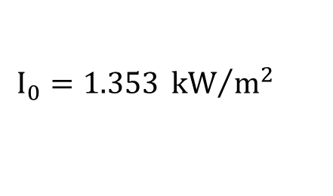
Photoreactors – Light sources
Air Mass coefficient
Important for solar Simulators
z | AM | Formula W/m² | ASTM G-173 W/m²
 | 0 | 1353 | 1347.9
0° | 1 | 1040
23° | 1.09 | 1020
30° | 1.15 | 1010
45° | 1.41 | 950
48.2° | 1.5 | 930 | 1000.4
60° | 2 | 840
70° | 2.9 | 710
75° | 3.8 | 620
80° | 5.6 | 470
85° | 10 | 270
90° | 38 | 20
Solar intensity
$$I=1.1∗I_{0}∗{0.7}^{{AM}^{0.673}}$$
Solar intensity external to the atmosphere
$$I_{0}=1.353 {kW}/{m^{2}}$$
The factor 1.1 is derived assuming that the diffuse component is 10% of the direct component.

Slide 32
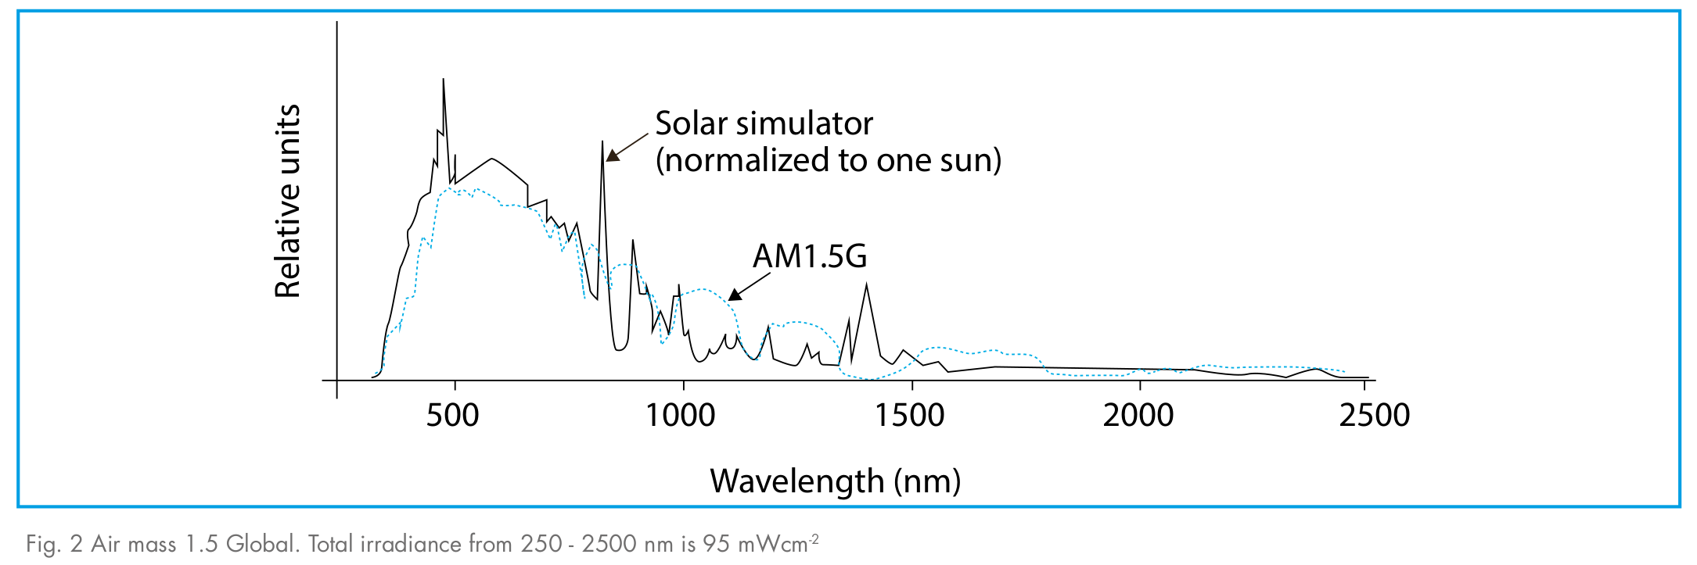
Photoreactors – Light sources
AM 1.5
Many of the world's major population centres, and hence solar installations and industry, across Europe, China, Japan, the United States of America and elsewhere (including northern India, southern Africa and Australia) lie in temperate latitudes. An AM number representing the spectrum at mid-latitudes is therefore much more common.
1 Sun
z | AM | Formula W/m² | ASTM G-173 W/m²
48.2° | 1.5 | 930 | 1000.4

Slide 33
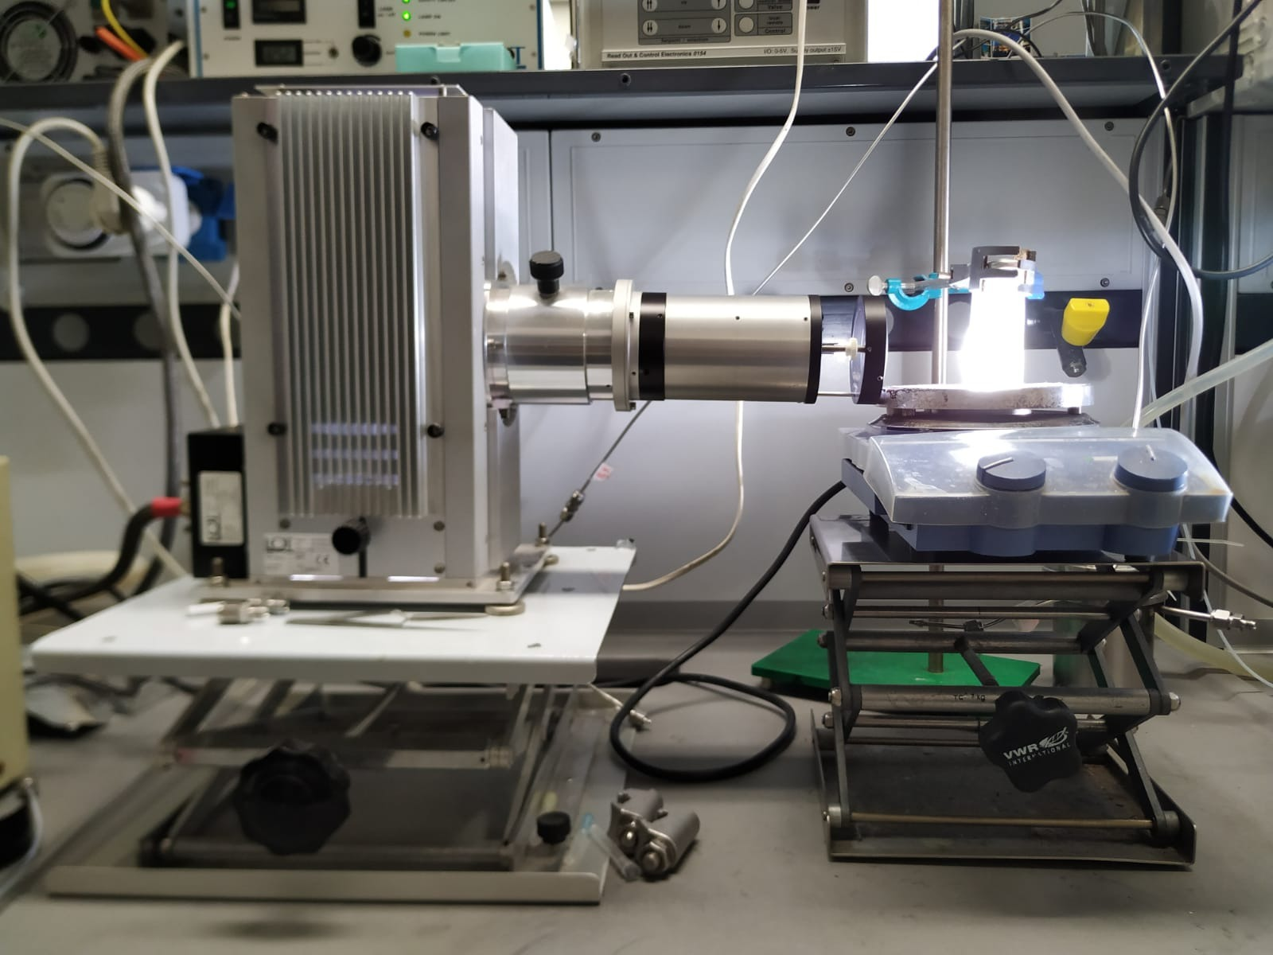
Photoreactors
AM1.5 filter
Xe lamp with holder

Slide 34
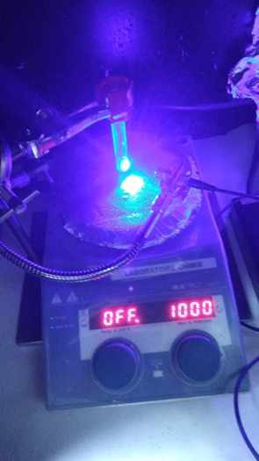
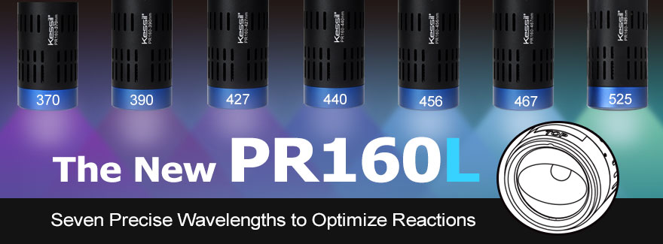
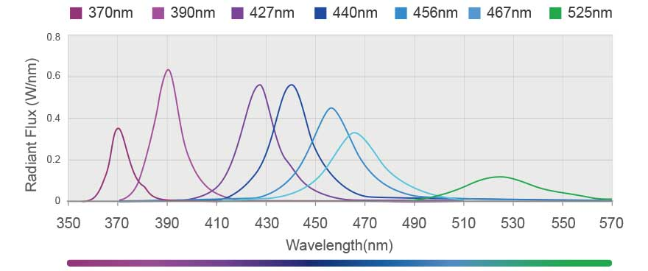
Photoreactors – Light sources
Other light sources
LED
LASER

Slide 35
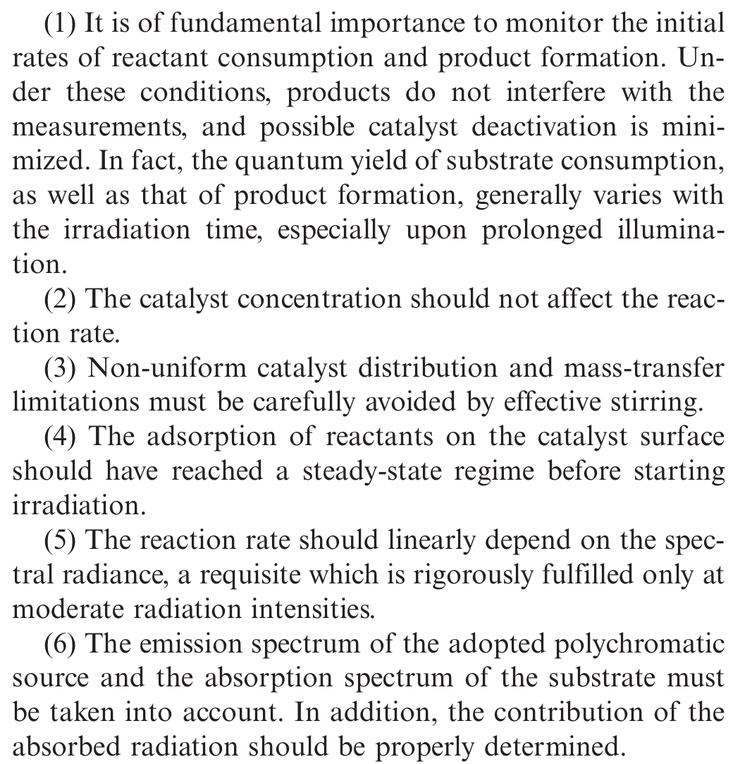
Photocatalytic experiments
Optimization of experimental parameters
Eur. J. Inorg. Chem. 2011, 4309–4323

Slide 36
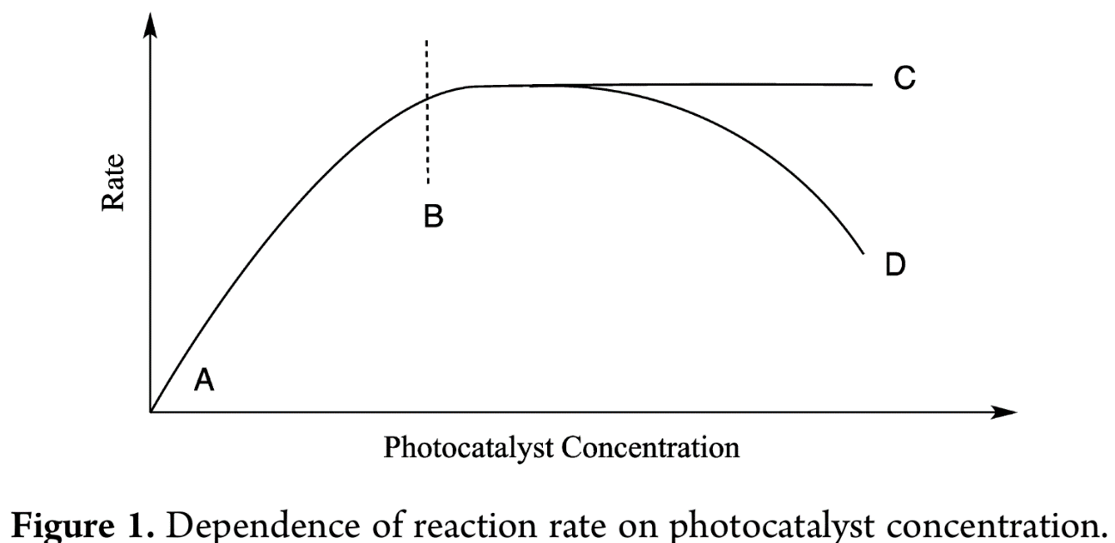
Photocatalytic experiments
Optimization of experimental parameters
OPTIMAL
Limited by light absorption
Limited by mass transfer and/or light scattering
J. Phys. Chem. Lett. 2015, 6, 1907−1910

Slide 37

Photocatalytic experiments
Estimation of efficiency
More adequate but needs monochromatic light
Eur. J. Inorg. Chem. 2011, 4309–4323

Slide 38
Photocatalytic experiments
In the case of solar fuels:
Estimation of efficiency
Light-to-Fuel Efficiency
F_{H2} is the flow of H₂ produced (expressed in mol s^{–1}),
ΔH⁰_{H2} is the enthalpy associated with H₂ combustion (285.8 × 10³ J mol^{–1}).
S is the total incident light irradiance (expressed in W cm^{–2})
A_{irr} is the irradiated area (expressed in cm²)
No need of
monochromatic light
Eur. J. Inorg. Chem. 2011, 4309–4323

Slide 39



Photocatalytic experiments
C₀
C₀⁺
Decolourization
$$\ln{\frac{C}{C_{0}}=−kt}$$
Determine k for Rhodamine B decolourization using TiO₂ P25 under UV-vis irradiation

Slide 40
Photocatalytic experiments
Determine H₂ production and LFE for dehydrogenation of EtOH using Pt/TiO₂

Slide 41
Modalità d’esame – Orale
Relazioni virtuali sugli esperimenti: consegna in pdf una settimana prima dell’esame, discussione di eventuali errori durante l’esame.
Opzione A:
Opzione B:
Appelli:
10 luglio ore 14.30 24 luglio ore 14.30 A chiamata
1 articolo assegnato dal docente (da presentare con un breve Power Point) in cui mettere in luce gli aspetti fondamentali esposti durante il corso.
1 domanda su tematiche del corso non inerenti all’articolo scelto.
1 argomento a scelta dello studente.
1 domanda su tematiche del corso non inerenti alla domanda precedente.

