Slide 1
Traumatologia CranioMaxilloFacciale
Roberto Rizzo
Chirurgia Maxillo-Facciale TRIESTE

Slide 2
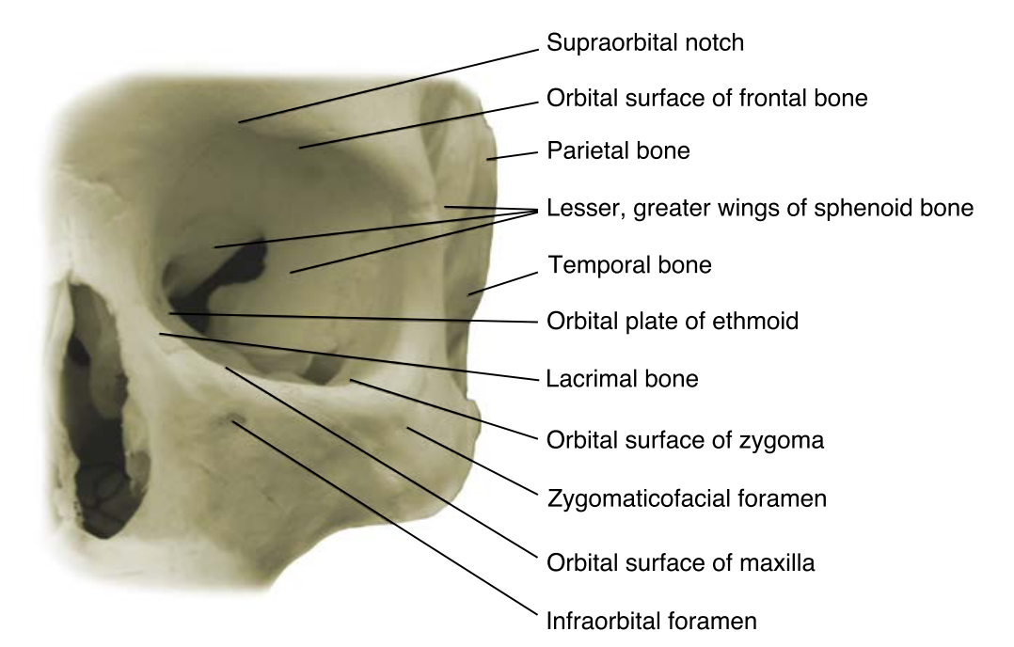
Frattura di COMZ

Slide 3
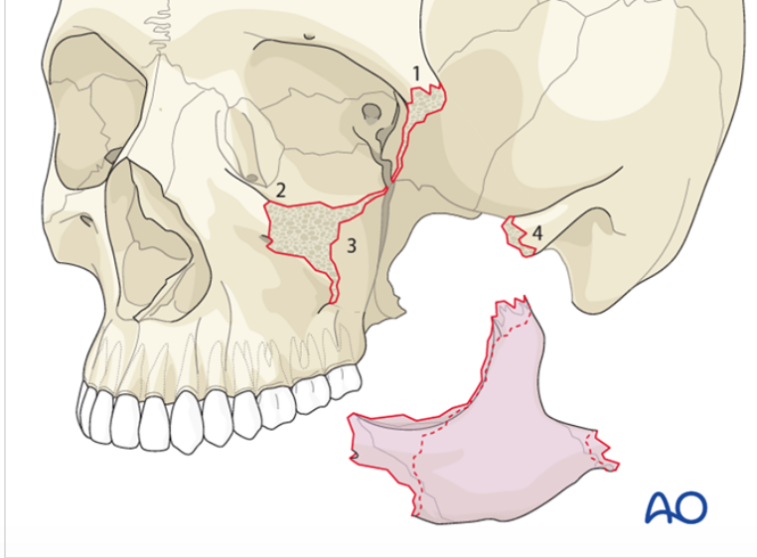
ZIGOMO

Slide 4
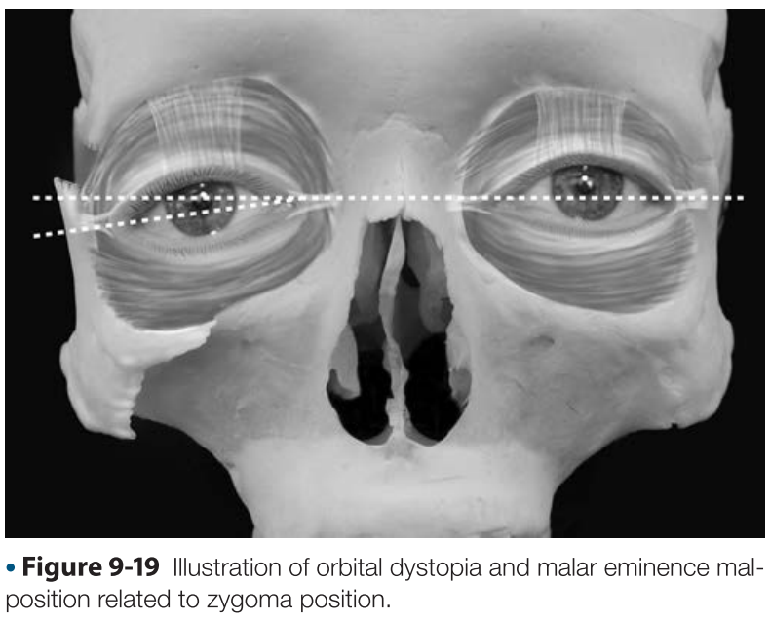
Fratture di COMZ
﻿Frattura ASIMMETRICA del terzo medio
Displaced fractures of the zygoma cause obvious deformities of the midface related to the projection of the malar eminence, lateral projection of the arch, and position of the globe, which can affect vision. For these reasons, the appropriate diagnosis and treatment of these fractures are important for the functional and cosmetic outcome of facial trauma patients.
﻿Because zygomatic bone forms part of the lateral wall and floor of the orbit, fractures of the body of the zygoma usually involve fractures of the floor or the lateral wall of the orbit, or both

Slide 5
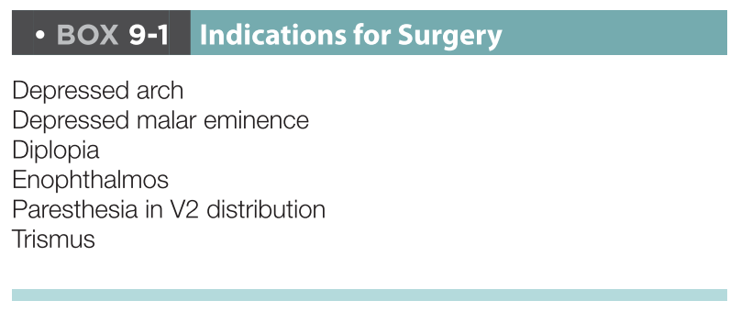
Frattura di COMZ

Slide 6
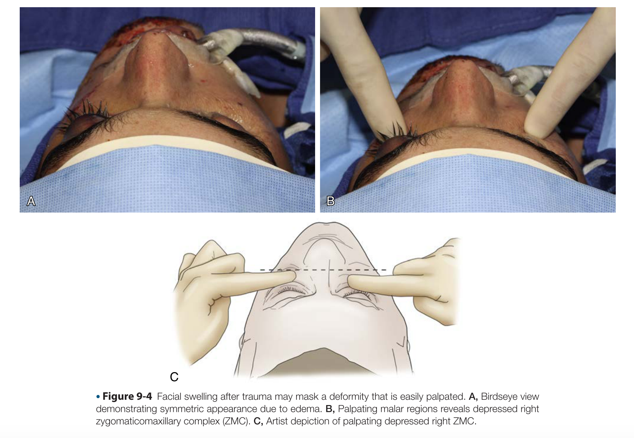
Frattura di COMZ

Slide 7
Frattura di COMZ
﻿Signs of zygomatic fracture are periorbital or maxillary
vestibular ecchymosis,
periorbital edema,
flattened arch or malar prominence, deformity or displacement,
trismus,
dis- placement of palpebral fissure,
enophthalmos, exophthalmos,
chemosis, and conjunctival hemorrhage,

Slide 8
Frattura di COMZ
﻿Symptoms that indicate zygomatic injury are:
pain,
sensory deficit,
crepitus from air emphysema,
diplopia.
Many surgeons consider an ophthalmologic examination
an essential part of the examination for zygomatic fracture.
Depending on the mechanism of injury, as many as 28%
of patients with zygomatic injuries may have moderate to
severe ocular injuries.

Slide 9
Frattura di COMZ
﻿IMAGES
Computed tomography (CT) is the gold standard for diagnosing bony injuries of the face.
﻿Three-dimensional (3D) reconstruction images can
provide greater visualization of displaced and fractures segments
Plain-RX ﻿a lateral skull view (air&sinuses), a Waters posteroanterior oblique view (﻿inferior or lateral rims or both and of the orbital floors, as well as the maxillary sinuses), or a reverse Waters anteroposterior oblique view, and a submental vertex view of the skull (zygomatic arches Zimmer’s).

Slide 10
Frattura di COMZ
The best evaluation of suspected zygomatic and orbital fractures is provided by:
1.5-mm slices in the axial plane (for information about the medial and lateral walls) and
The coronal plane (for specific information about the orbital floor),﻿
Sagittal images provide useful information about the posterior extent of a floor defect and the amount of posterior bone that remains.

Slide 11
Frattura di COMZ
﻿Treatment
During the consideration of treatment for zygomatic
injuries, the patient’s interests should be paramount. The
patient’s age and medical history should be factored into
the decision-making process. If, after being informed about
the risks and benefits of surgery or observation, the patient
elects surgery, the decision about how and when to treat can
be addressed.
WE DO NOT TREAT A DIAGNOSTIC IMAGE, WE TREAT A PERSON

Slide 12
Frattura di COMZ
When not to treat﻿
The main reason not to treat zygomatic fractures surgically are:
the clinical absence of functional and esthetic compromise,﻿
the degree of vision in the unaffected eye: » ﻿Although the
risk to vision associated with the repair of a zygomatic fracture is low (<1%), it may be unwise to risk affecting the sight in the remaining functional eye.»
When to operate
Waiting for residual edema to resolve, approximately 2 weeks, is usually acceptable. This delay allows time for adequately assessing and planning the case;in addition, findings associated with the injury manifest themselves during this time.
Evidence of muscle entrapment on CT scan or on physical ﻿exam is an indication for immediate surgery.

Slide 13
Frattura di COMZ
Objective=stable reduction --> one, two, three or four points fixation
Surgical approaches﻿:
Upper eyelid/Upper blepharoplasty (skin+muscle flap)
Transconjunctival with or without lateral canthotomy
Subciliar
Vestibular
Hemicoronal
Existing laceration(s)

Slide 14
Frattura di COMZ
Isolated zygomatic arch fracture
Surgical approaches﻿:
Gillies
Keen
Italian’s way (throughout an upper eyelid approach)

Slide 15
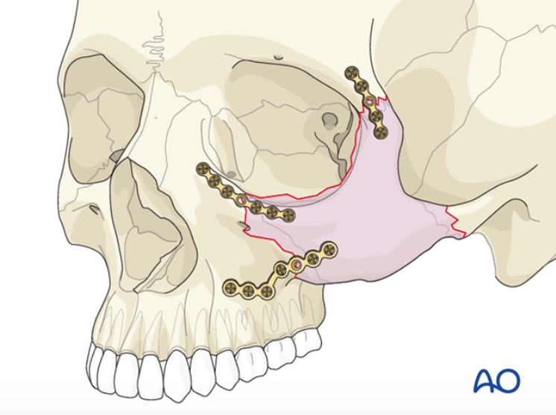
3 punti

Slide 16
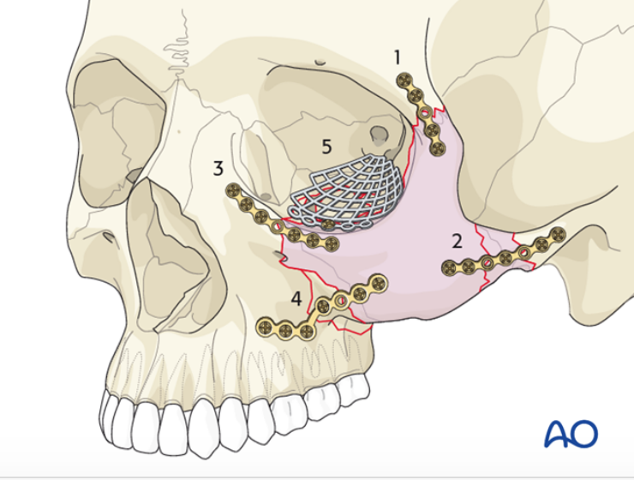
4 punti + ricostruzione pavimento

Slide 17
Frattura di COMZ
Orbital floor reconstruction goals
﻿to prevent herniation of orbital contents,
to provide a smooth orbital floor with or without an
implant,
to reconstruct the floor or wall to mirror the
contralateral side as closely as possible.

Slide 18
Frattura di COMZ
Complications of Zygoma injuries:
Persistent parethesia: ﻿due to compression, edema, ischemia, or laceration; ﻿recovery is faster when fractures are opened and fixated rather than reduced and not fixated. ﻿The return to normal sensation occurs on average within 15 weeks.
Entropion/Ectropion: ﻿mild and moderate ectropion usually resolve over time with gentle massage of the lid. However, severe ectropion may require surgical correction. ﻿chronic ectropion can result in exposure keratinization of the conjunctiva, which can con- tribute to ocular irritation and eventually lead to vision loss

Slide 19
Frattura di COMZ
Complications of Zygoma injuries:
Persistent diplopia: ﻿initially after a zygomatic fracture, it is most likely due to edema or hematoma of one or more extraocular muscles or their nerves, as well as to intraorbital edema or hematoma; resolution ﻿usually occurs spontaneously within 5 to 7 days; ﻿if it’s caused by muscle entrapment, this cause is usually evident. ﻿The cause of persistent diplopia is not known, but it has been postulated that post-traumatic fibrosis of the extra- ocular muscles results in residual diplopia after therapy.

Slide 20
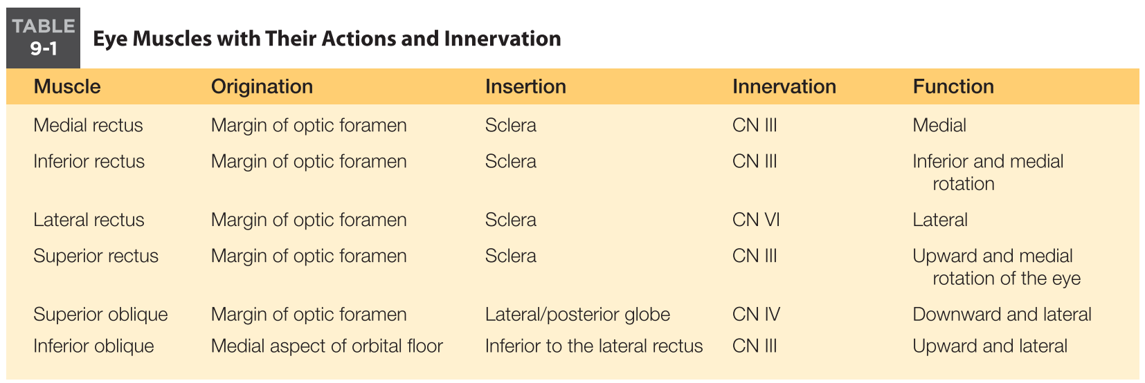
Frattura di COMZ

Slide 21
Fratture di COMZ
CT Eye muscles images:
Normal---------Flat section
Contused------Round section
Entrapped-----Vertical diameter>horizontal diameter

Slide 22
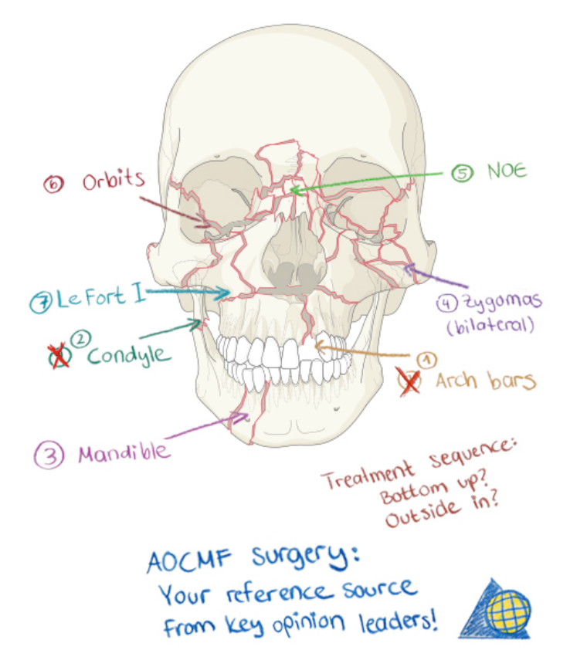
TRAUMATOLOGIA CMF-FRATTURE

Slide 23
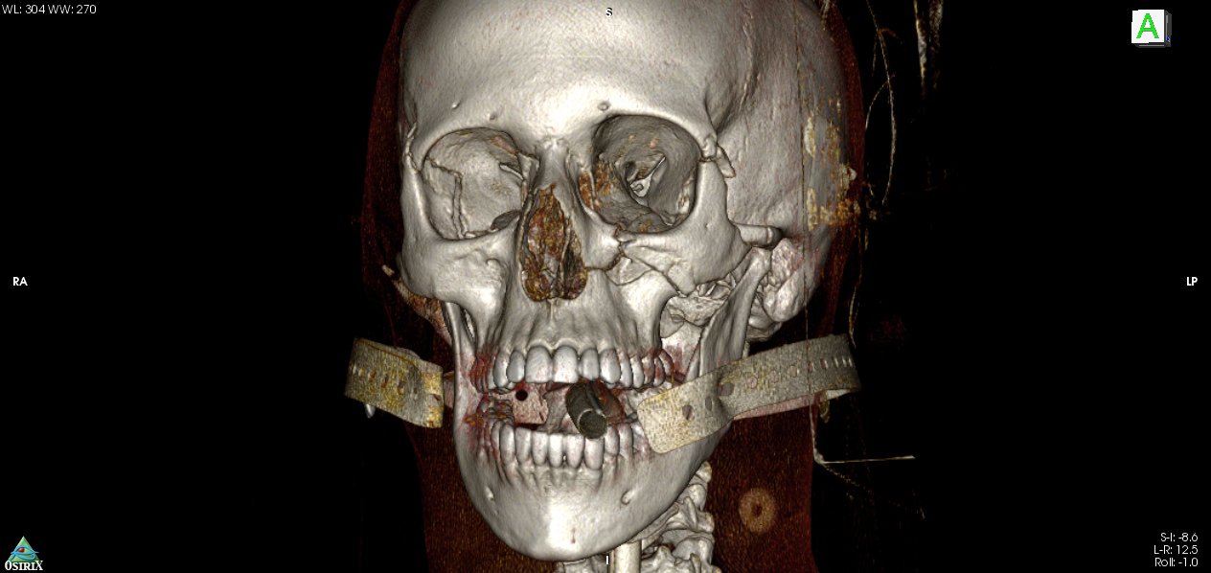
TRAUMATOLOGIA CMF FRATTURE

Slide 24
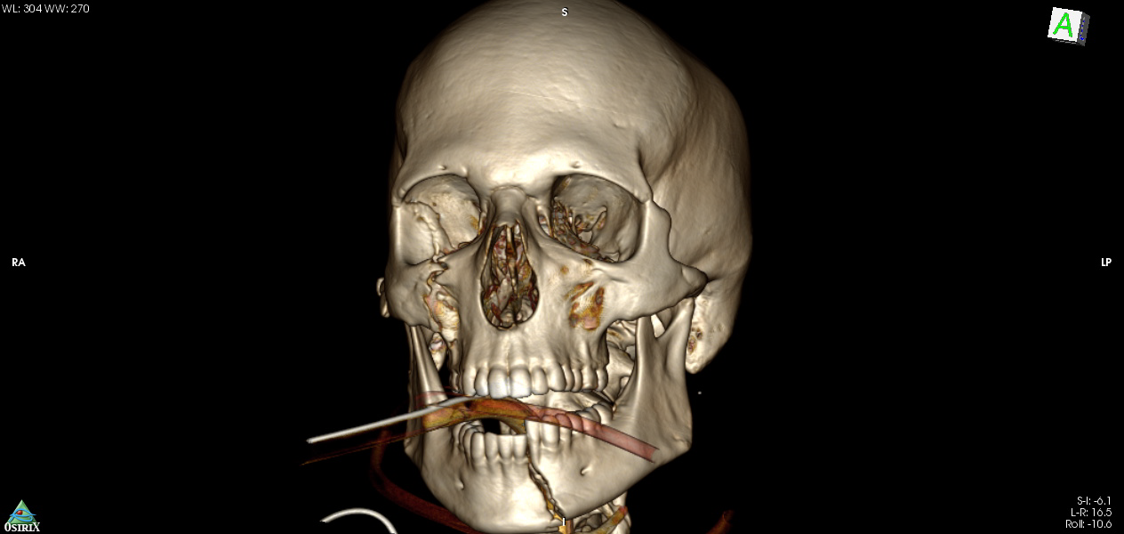
TRAUMATOLOGIA CMF FRATTURE

Slide 25
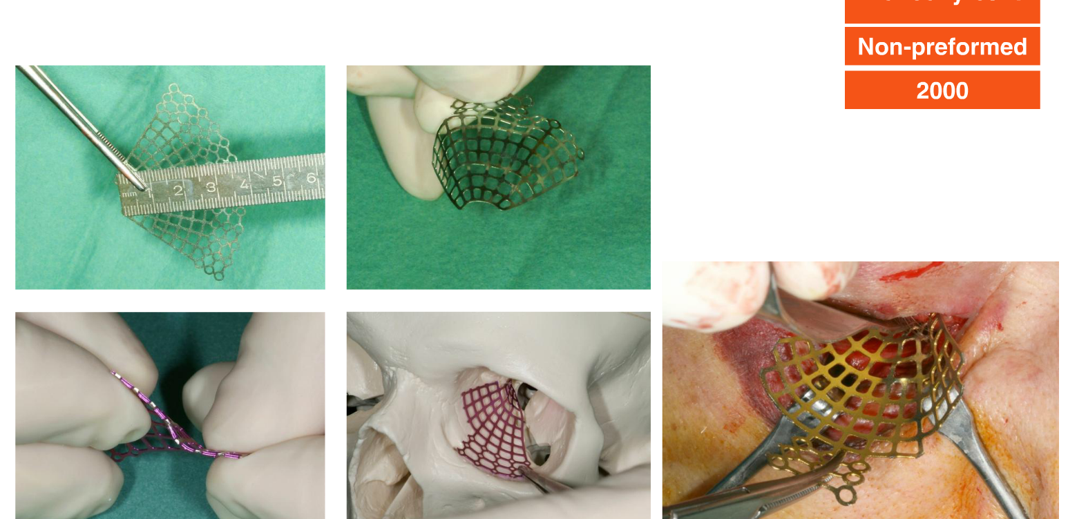

Slide 26
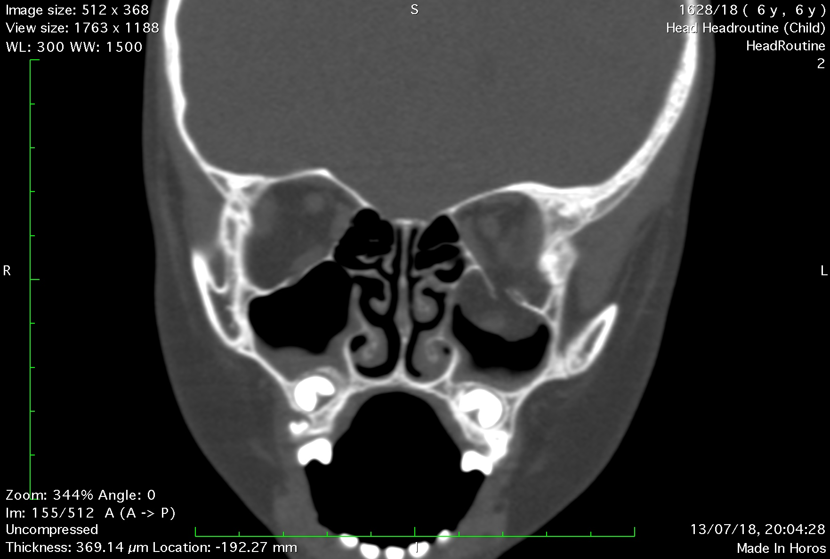
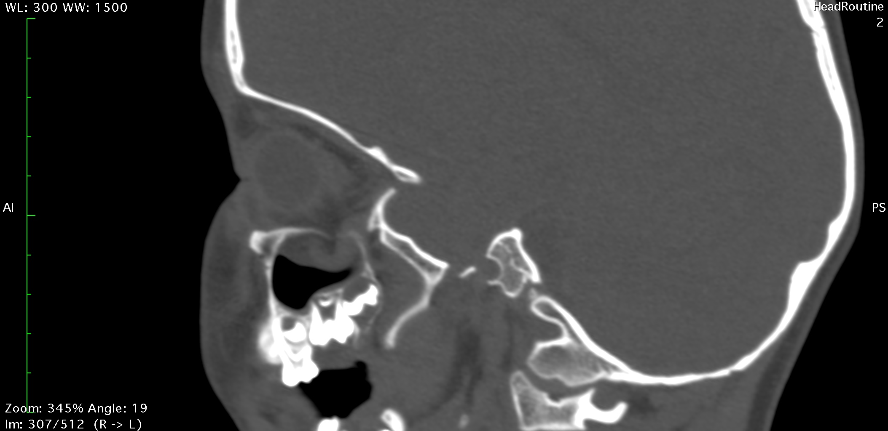
Frattura Blow-out pediatrica URGENZA

Slide 27
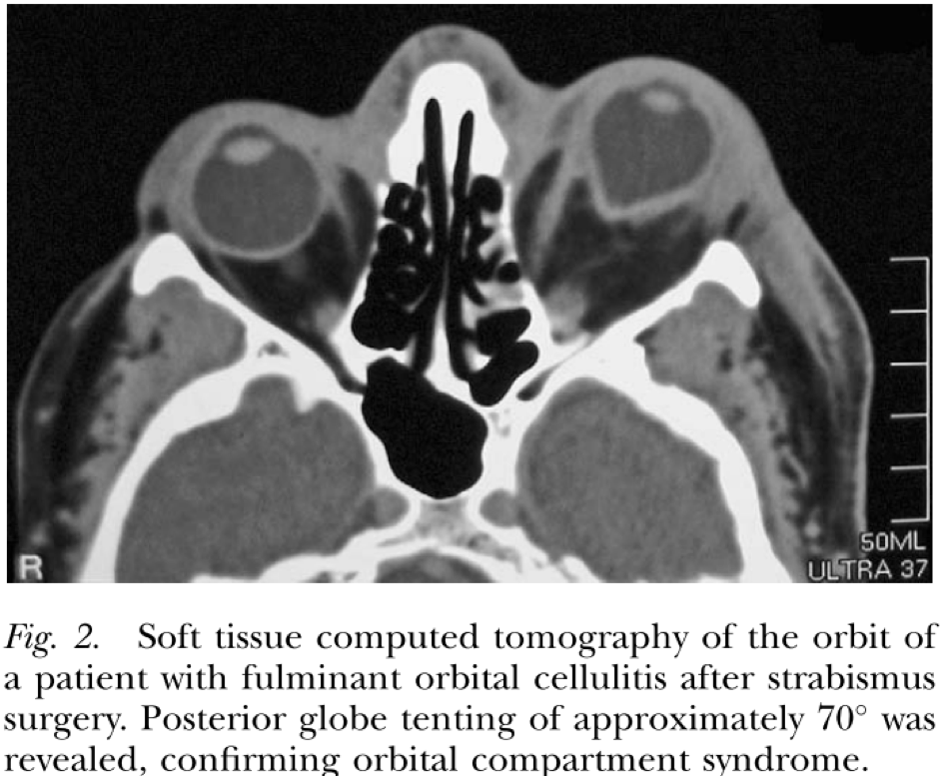
Sindrome Compartimentale

