Slide 1
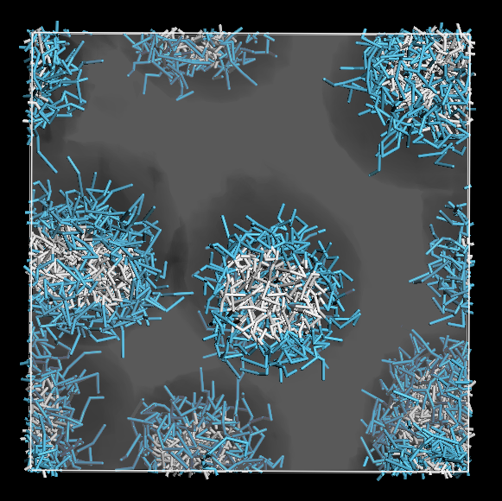
CORSO DI SIMULAZIONE MOLECOLARE
Dissipative Particle Dynamics and mesoscale techniques
A.A. 2020-2021

Slide 2
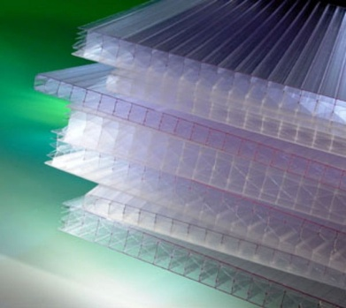
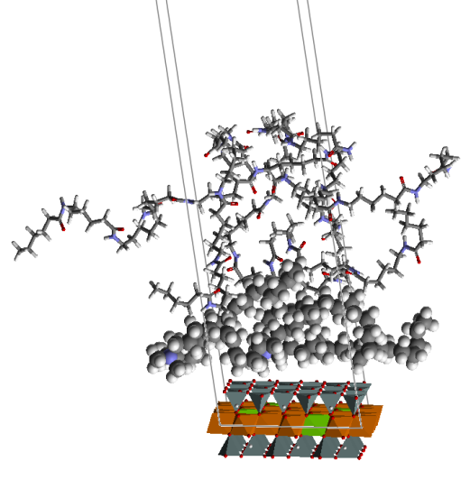
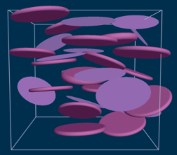
MULTISCALE SIMULATION
TEMPI
CARATTERISTICI
Morfologia
Miscibilità e compatibilità
Fenomeni di diffusione
Stabilità strutturale
Tensione superficiale
Fenomeni di aggregazione
e coagulazione
Engineering design
years
Engineering design
hours
Simulazione di processo
FEM
Process
simulation
FEM
minutes
Modellazione
di
mesoscala
(insiemi di atomi o molecole)
seconds
Mesoscale modeling
(groups of atoms or molecules)
microseconds
Molecular mechanics
(atoms)
Meccanica
molecolare
(atomi)
nanoseconds
Dissipative Particle Dynamics
picoseconds
Meccanica
Quantistica
(elettroni)
Quantum mechanics
(electrons)
1mm
1mm
Mesodyn
femtoseconds
1μm
1Å
1μm
1mm
1Å
1nm
1nm
1m
1m
LUNGHEZZE
CARATTERISTICHE

Slide 3
SOFT NANOTECHNOLOGY
Nanotechnology is the understanding and the control of matter at dimensions of roughly 1 to 100 nanometers, where unique phenomena enable novel applications.
At this level, the physical, chemical, and biological properties of materials differ in fundamental and valuable ways from the properties of individual atoms and molecules or bulk matter.

Slide 4
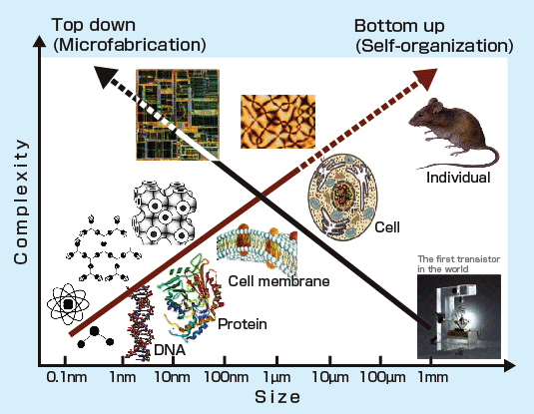
MANUFACTURING AT THE NANOSCALE

Slide 5
MANUFACTURING AT THE NANOSCALE
In the "top-down" approach, nano-objects are constructed from larger entities without atomic-level control.
The process involves material wastage and is limited by the resolution of the tools you can use, restricting the smallest sizes of the structures made by these techniques.
Examples of this kind of approach include the various types of lithographic techniques (such as photo-, ion beam-, electron- or X-ray- lithography) cutting, etching, ….

Slide 6
MANUFACTURING AT THE NANOSCALE
In the "bottom-up" approach, materials and devices are built from molecular components which assemble themselves chemically by principles of molecular recognition
molecules can be designed so that a specific conformation or arrangement is favored due to non-covalent intermolecular forces.
this technique is limited in how big the structures can be made.
Chemical synthesis, self-assembly, and molecular fabrication are all examples of bottom-up techniques. Self-assembly occurs when little manipulation occurs, but components spontaneously come together to form ordered nanoscale structures, for instance in the formation of nanotubes and some monolayers.
The limits of feature size and quality of these two approaches have started to converge in recent years, leading to new hybrid techniques of manufacture.

Slide 7
DPD - The particle or BEAD
What is a DPD particle?
molecule
part of a molecule
fluid element = many molecules
The colored area symbolizes the interaction range of all forces acting on a particle

Slide 8
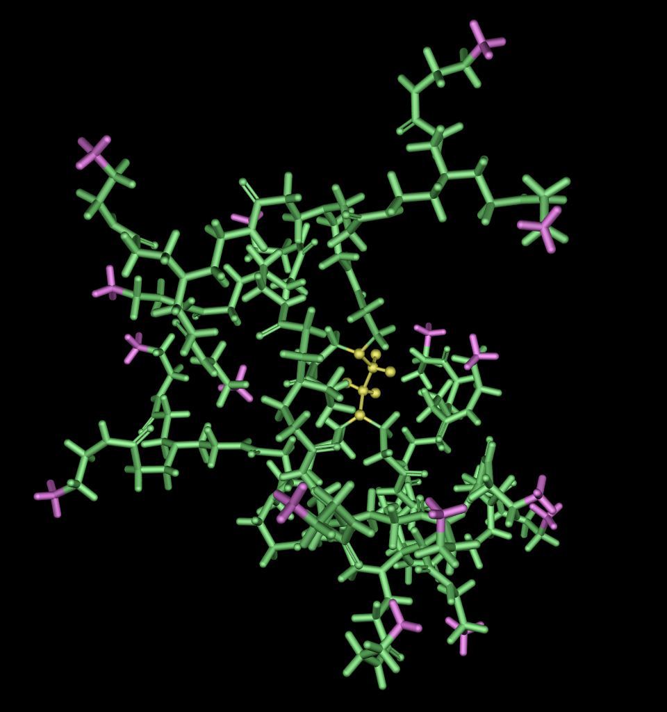
DPD - The particle or BEAD
bead of type A
bead of type B
bead of type C
Atomistic and mesoscopic model of the same complex macromolecule

Slide 9
DISSIPATIVE PARTICLE DYNAMICS (DPD)
Instantaneous force acting on particle i:
between no bonded particles
between bonded particles
conservative force
spring force
dissipative force
angle force
random force

Slide 10
DISSIPATIVE PARTICLE DYNAMICS (DPD)
In DPD the force between particles i and j is given by the sum:
conservative force
dissipative force
random force
Instantaneous force acting on particle i:
We assume pairwise additivity for all three types of force.

Slide 11
DPD – Equation of motion
where
Beads follow Newton’s equation of motion
f_{i} is the total force acting on particle i
All the masses are normalized to 1 for simplicity. All beads have the same volume.
Integration of the equation of motion as in MD
Conservative, Dissipative and Random force obey Newton’s third law F_{ij} = - F_{ji} :
- mass, momentum and energy are conserved
- hydrodynamic behavior correctly treated
DPD looks like MD

Slide 12
DPD - The conservative force
where
a_{ij} = bead –bead repulsion parameter or DPD interaction parameter
a_{ij} >0 purely repulsive
a_{ij} related to Flory-Huggins parameter
a_{ij} depends on the underlying chemistry of the system
r_{C} = cut-off radius
r_{C} sets the basic length scale of the system
SOFT REPULSION ACTING ALONG THE LINE OF CENTERS

Slide 13
DPD – Relation to Flory-Huggins theory
DPD – Relation to Flory-Huggins theory
DPD – Relation to Flory-Huggins theory
Map DPD simulation behaviour onto physical phase diagram of real fluids (compare the free energy of a DPD fluid with the Flory-Huggins theory)
ρ = 3
Map DPD simulation compressibility behaviour onto physical compressibility of water
ρ = 3

Slide 14
DPD - The dissipative (frictional) force
where
component of the relative speed
of i with respect to j in the direction
of r_{ij}
= friction coefficient (>0)
= weight function
positive definite and vanishing for r_{ij}>r_{C}
= relative speed
>0 if two particles move towards each other
F_{ij}^{D} is repulsive – force towards j
<0 if two particles move away from each other
F_{ij}^{D} is attractive – force away from j
THE DISSIPATIVE FORCE IS INTENDED TO MODEL THE FRICTION BETWEEN DIFFERENT PARTICLES DUE TO THEIR RELATIVE VELOCITY
and are yet to be defined!

Slide 15
DPD - The random force
where
= noise amplitude (>0)
= weight function
positive definite and vanishing for r_{ij}>r_{C}
= Gaussian noise variable
Stochastic properties of the noise, :
(mean)
(variance)
can have either sign, the random force can be either repulsive or attractive.
THE RANDOM FORCE MIMICS THERMAL FLUCTUATIONS AND MAINTAIN ENERGY INPUT INTO THE SYSTEM IN OPPOSITION TO THE DISSIPATION
and are yet to be defined!

Slide 16
DPD – The spring force
where
U^{S} total bond potential
k_{s} = spring constant
r₀ = bond lenght
U^{A} total angle potential
k_{A} = angle constant
θ₀ = equilibrium angle
k_{A} sets the stiffness of the chain
Default
the distance from a bead to a bonded and a non-bonded neighbor is approximately the same
θ
no introduction of another length scale

Slide 17
DPD – Scaling of length, velocity and time
All beads have the same mass, m, interaction radius, r_{c}, velocity distribution, k_{B}T
It is convenient to use them as units of mass, length and energy
All the quantities in a DPD simulation are dimensionless

Slide 18
Running a DPD calculation
STEPS TO DO
Specifying the structure of the mesoscale system
Define all chemical species present (beads)
Define the mesoscale molecular topology
Define the bead interaction
Define the input system
Define the length and the outputs of the simulation
Define the amount of each mesoscale molecule present in the system
Define the size of the simulation cell
Choose a value for the grid spacing
Specify the cell density and the number of beads
RUN!

Slide 19
VANTAGGI E SVANTAGGI
DELLA SIMULAZIONE DI MESOSCALA
Method | Main idea | Pro | Cons
Mesoscale | Introduce simplification to atomistic methods to remove the faster degree of freedom and/or treats groups of atoms as individual entities interacting through effective potentials | Can be used to study features of complex systems on the order of 10⁸-10⁹ atoms Can study dynamical processes on timescale inaccessible to classical methods, up to seconds | Can often describe only qualitative tendencies; the quality of quantitative results may be difficult to ascertain In many cases, the approximations introduced limit the ability to physically interpret the results

Slide 20
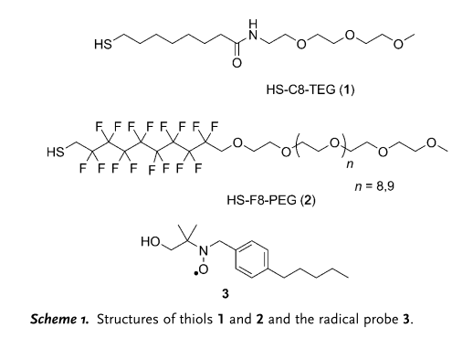
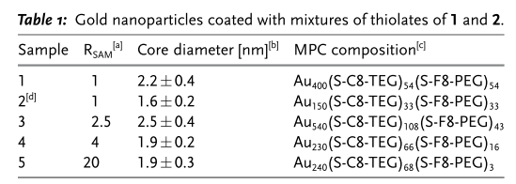
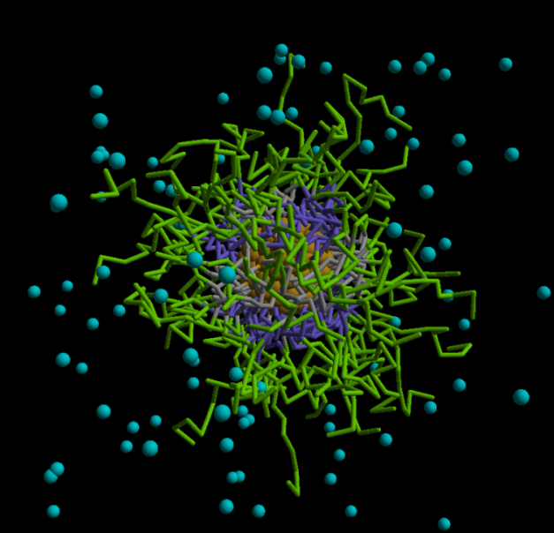
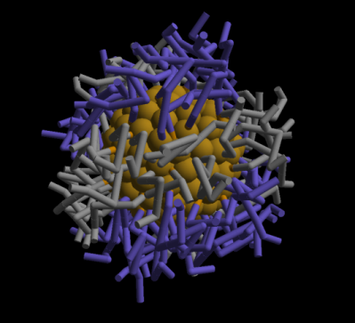
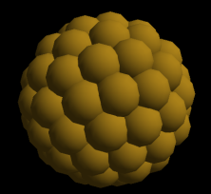
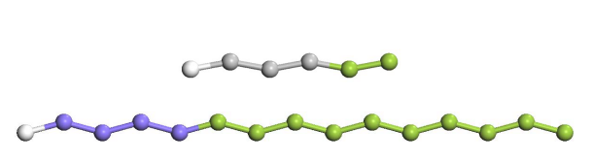
SELF-ASSEMBLY OF NANOSTRUCTURES
ON GOLD NANOPARTICLES
Color legend:
solvent=turquoise
TEG/PEG=green
C8=grey
F8=purple
gold=brown
1
Stripes
Stripe thickness ~ 0.65-0.7 nm

Slide 21
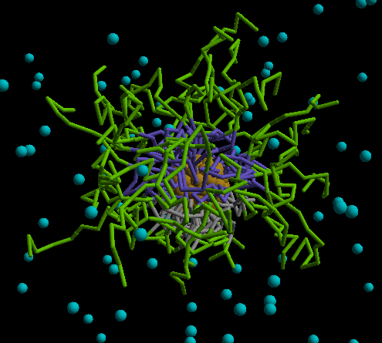
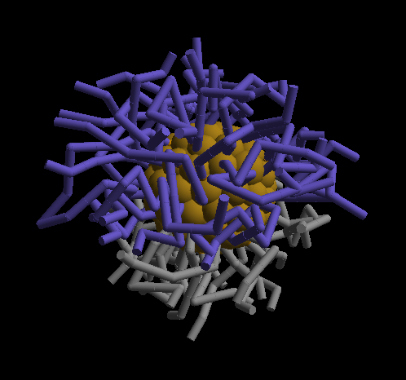
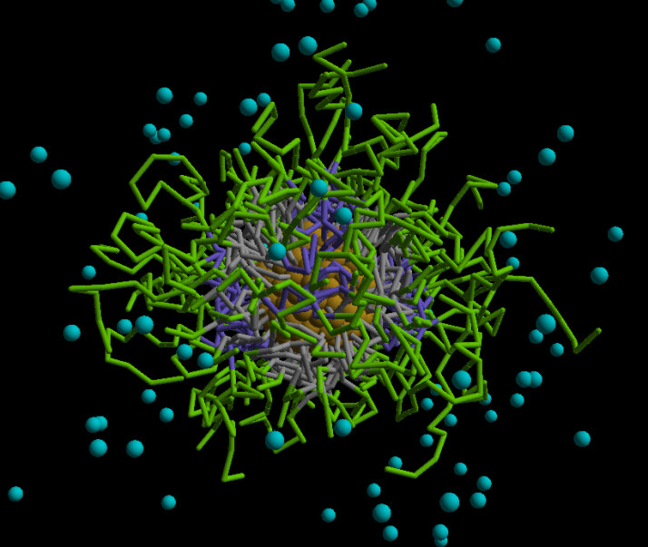
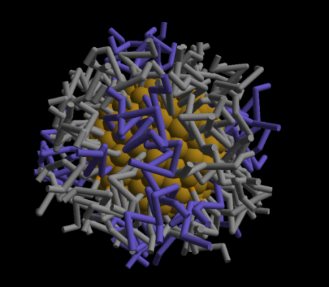
Effect of core size and grafted composition
Janus
nanoparticle
2
Color legend:
solvent=turquoise
TEG/PEG=green
C8=grey
F8=purple
gold=brown
3
Stripe-like pattern

Slide 22
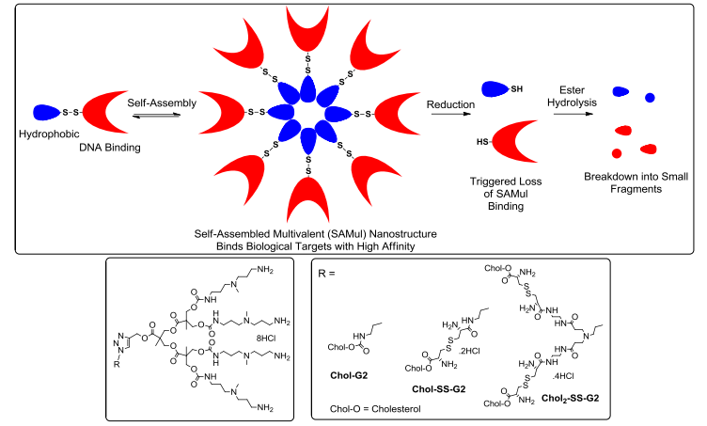
DEGRADABLE SELF-ASSEMBLY DENDRONS
FOR GENE DELIVERY

Slide 23
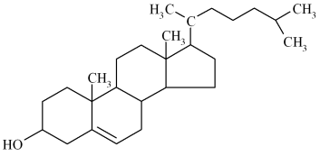
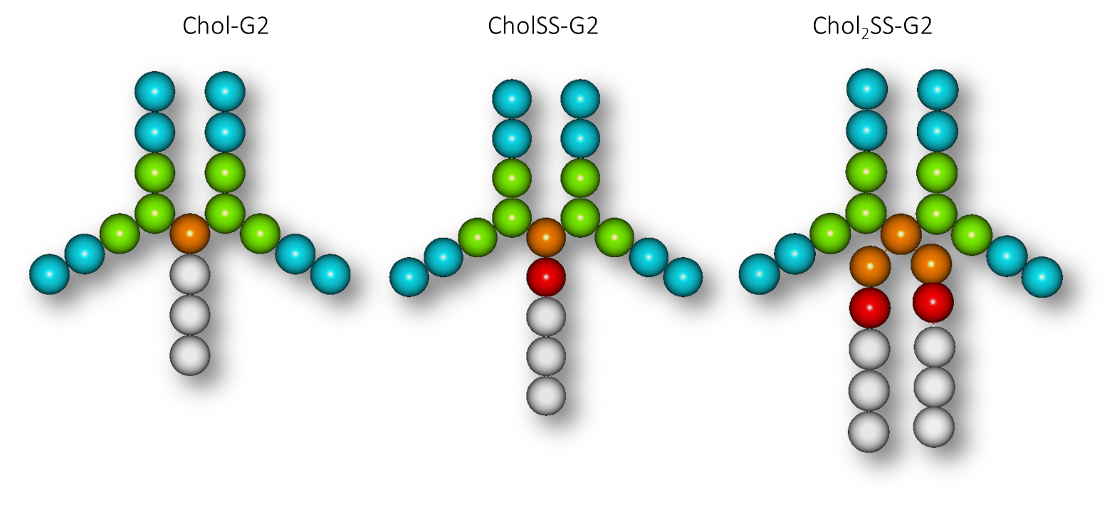
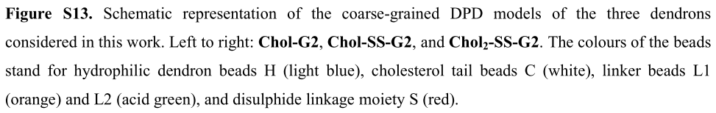
DEGRADABLE SELF-ASSEMBLY DENDRONS
FOR GENE DELIVERY
Cholesterol

Slide 24
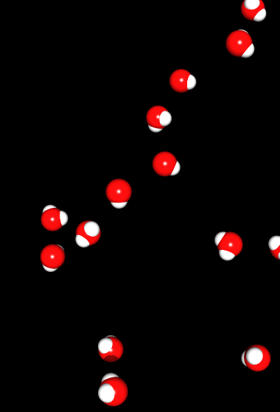
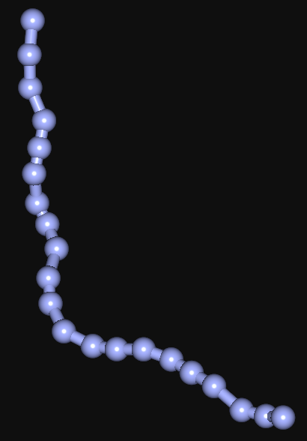
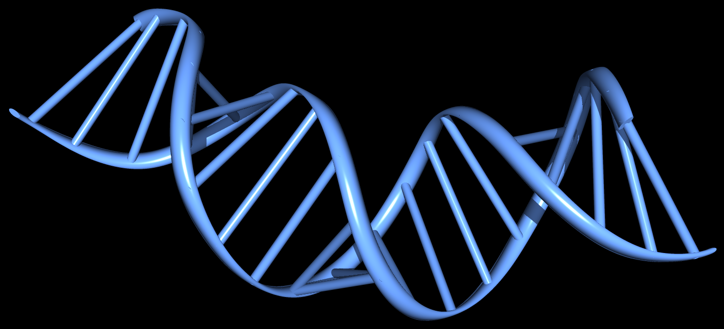
DEGRADABLE SELF-ASSEMBLY DENDRONS
FOR GENE DELIVERY
water
DNA

Slide 25
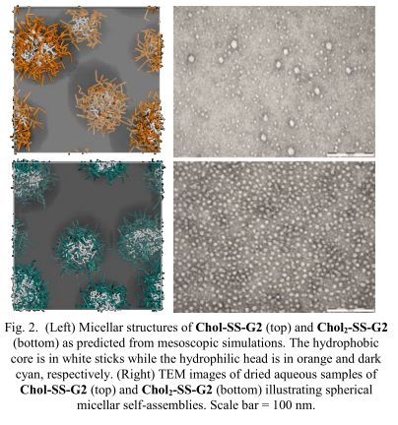
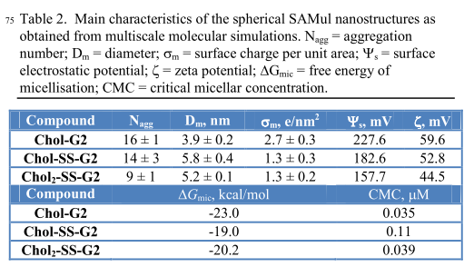
DEGRADABLE SELF-ASSEMBLY DENDRONS
FOR GENE DELIVERY
MESOSCALE SIMULATIONS

Slide 26
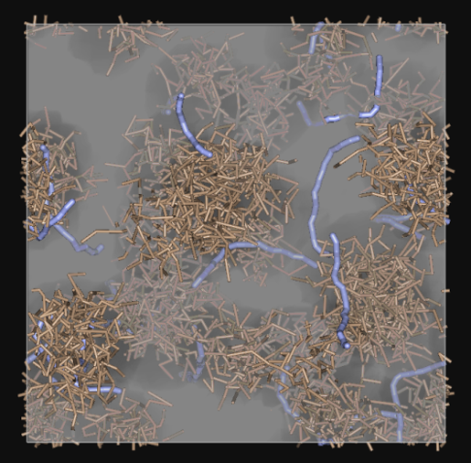
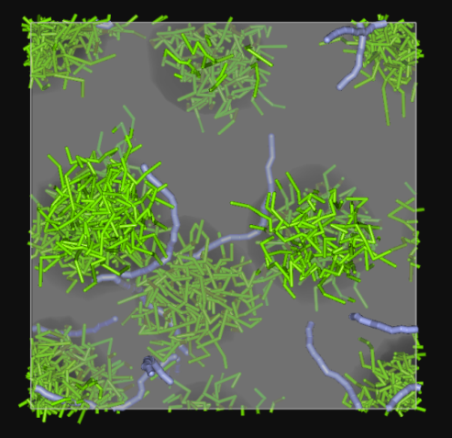
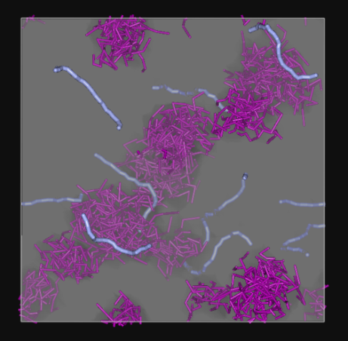
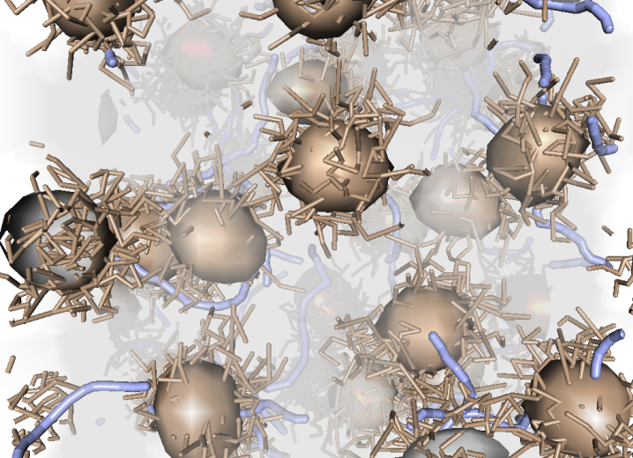
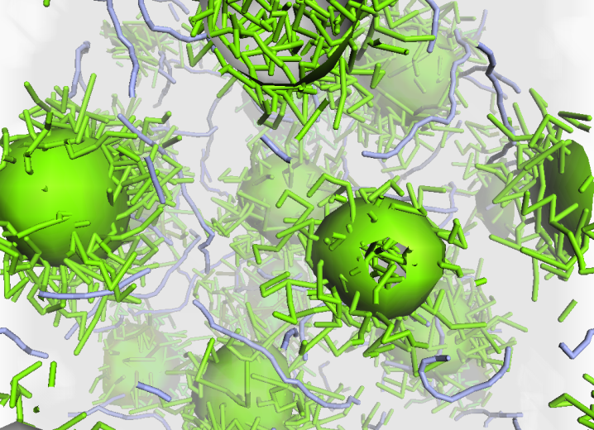
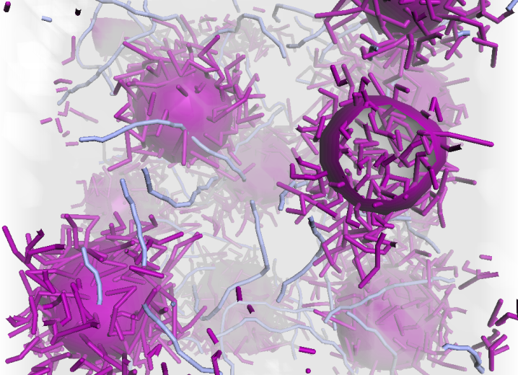
DEGRADABLE SELF-ASSEMBLY DENDRONS
FOR GENE DELIVERY
MESOSCALE SIMULATIONS
Chol_G2
CholSS_G2
Chol2SS_G2

Slide 27
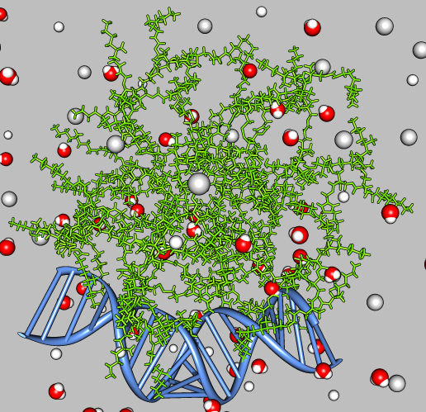
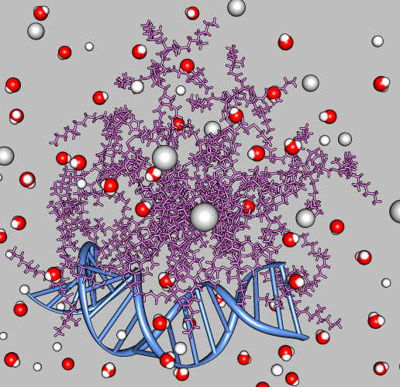
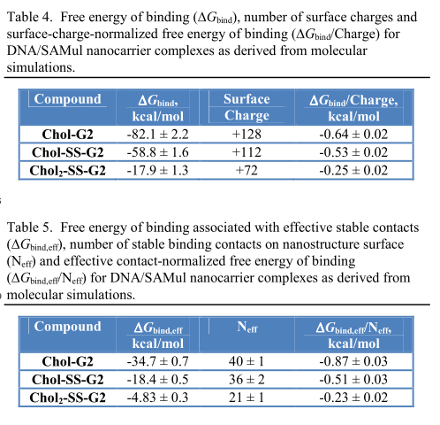
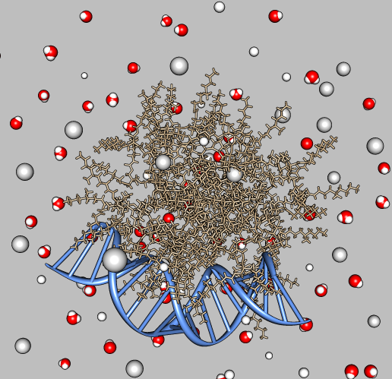
DEGRADABLE SELF-ASSEMBLY DENDRONS
FOR GENE DELIVERY
ATOMISTIC
SIMULATIONS
CholSS_G2
Chol2SS_G2
Chol_G2

Slide 28
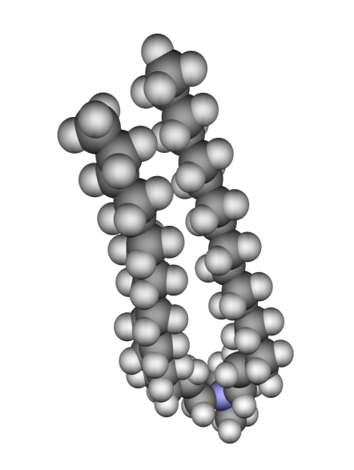
SOFT NANOTECHNOLOGY
Complex fluids, nanostructured fluids, soft matter, …..
- Contain nanoscale structures
- (Usually) formed by the self-assembly of molecules
- For example, surfactants and block copolymers
TYPICAL STRUCTURE OF A SURFACTANT
C₆
C₈
C₂
C₄
C₆
C₈
C₅
C₇
Water loving
Hydrophilic head
C₂
C₄
C₁
C₃
C₅
C₇
C₁
C₃
Water hating
Hydrophobic tails

Slide 29
MODERN SURFACTANTS
Typical anionic surfactants
Typical cataionic surfactants

Slide 30
MODERN SURFACTANTS
Typical lipids
Typical nonionic surfactants (very mild)
Notice the double tails. Most lipids can be found in
biomembranes. In general, they are
insoluble.

Slide 31
PACKING PARAMETER
packing parameter
V tail volume per molecule
A cross-sectional area per surfactant molecule
L length of hydrophobic tail
l (length)
A (cross-section)
V (volume)

Slide 32
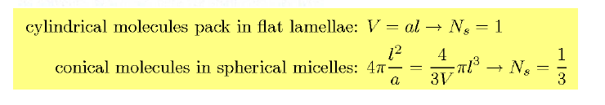
PACKING PARAMETER

Slide 33
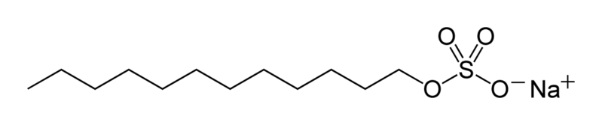
Esercitazione di mesoscala-Esempio
Predizione della morfologia di un surfattante
in soluzione
Sodio Lauril Solfato (SDS)
Tail
Head
H2O
W
H2O
H2O
H2O
H2O
T
T
T
T
H
H2O
H2O
H2O
H2O
Mesoscale model of SDS
H2O

