Slide 1
ITC Isothermal Titration Calorimetry
A.A. 2018-2019

Slide 3
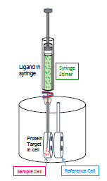

Slide 8
Data integration

Slide 9
Binding Mechanism

Slide 10
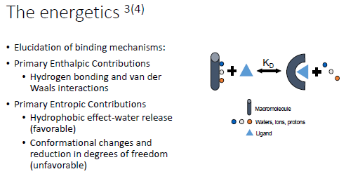
Binding Mechanism

Slide 11
Binding Mechanism

Slide 12
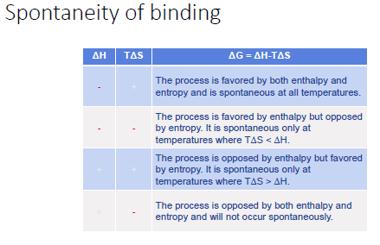
Binding Mechanism
-
+
-
-
+
+
+
-

Slide 14
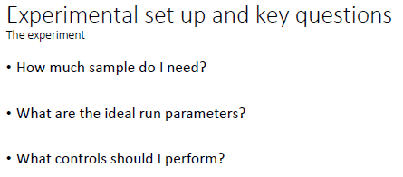

Slide 16
