Slide 1
Historically, the best that forecasters have been able to do consistently is recognize that we’re in a recession once we’re in one,” said Tara Sinclair, an economist at George Washington University. “The dream of an early warning system is still a dream that we’re working on.”
Always after the monetary roaring seasons, depressions unavoidable pop ups!

Slide 2
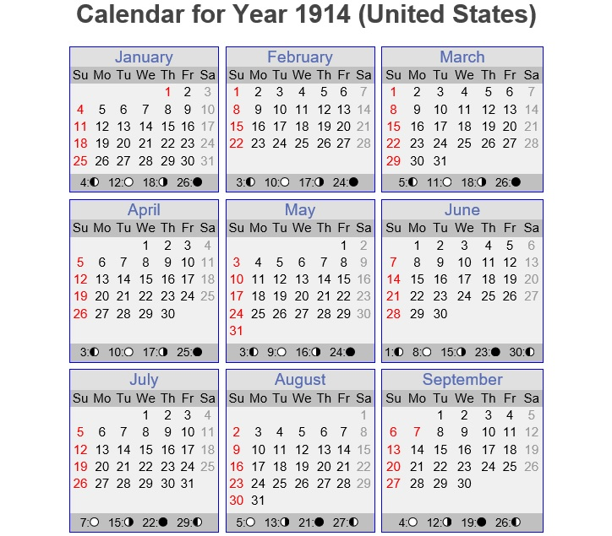

Slide 3

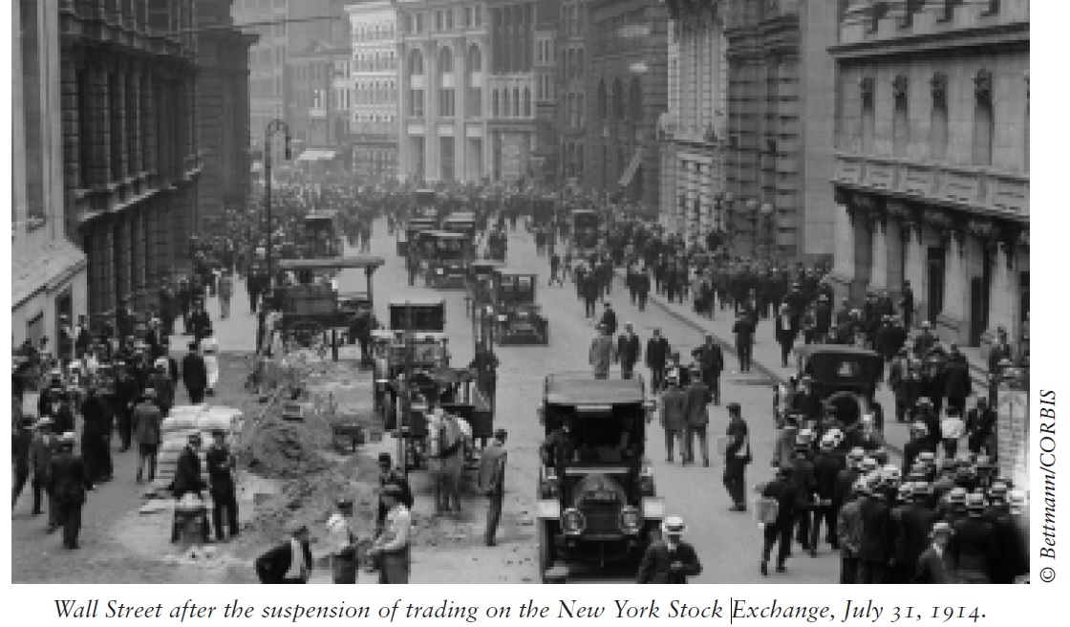

Slide 4
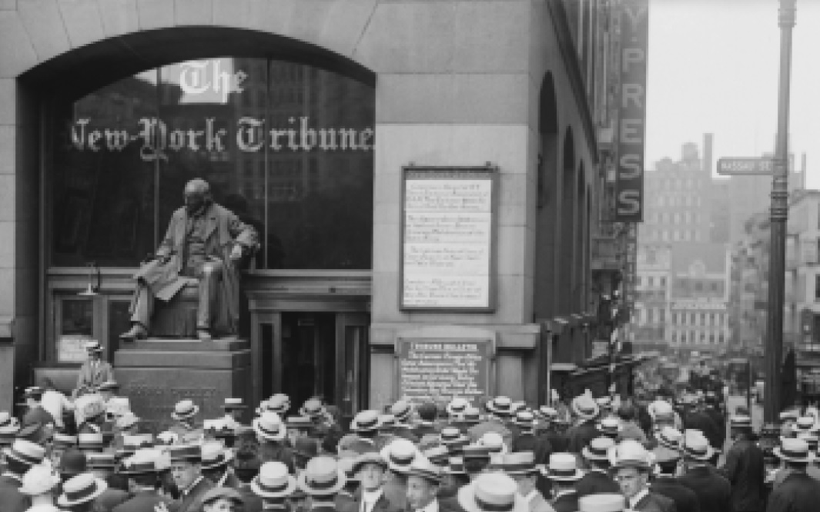

Slide 5
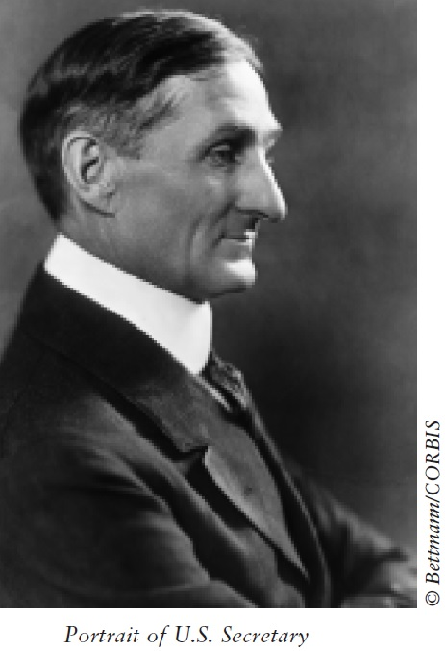

Slide 6
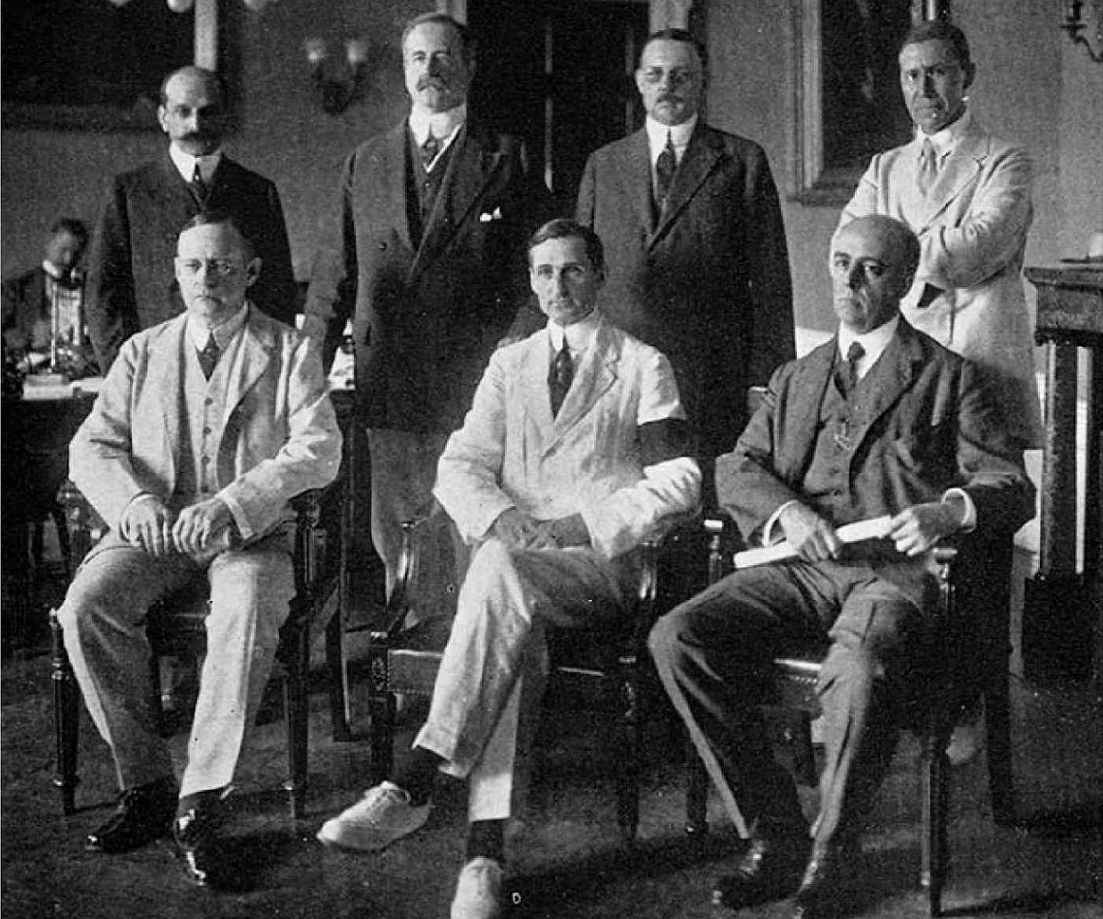

Slide 7
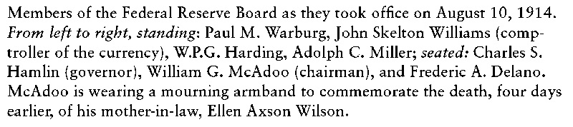
First Federal Council Board

Slide 8
The prologue and the misunderstandings

Slide 9
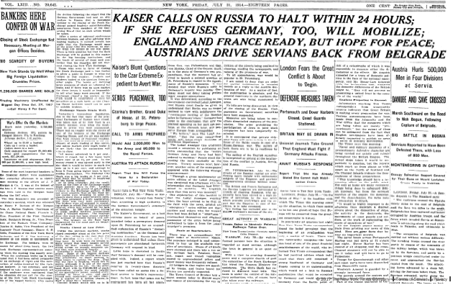

Slide 10
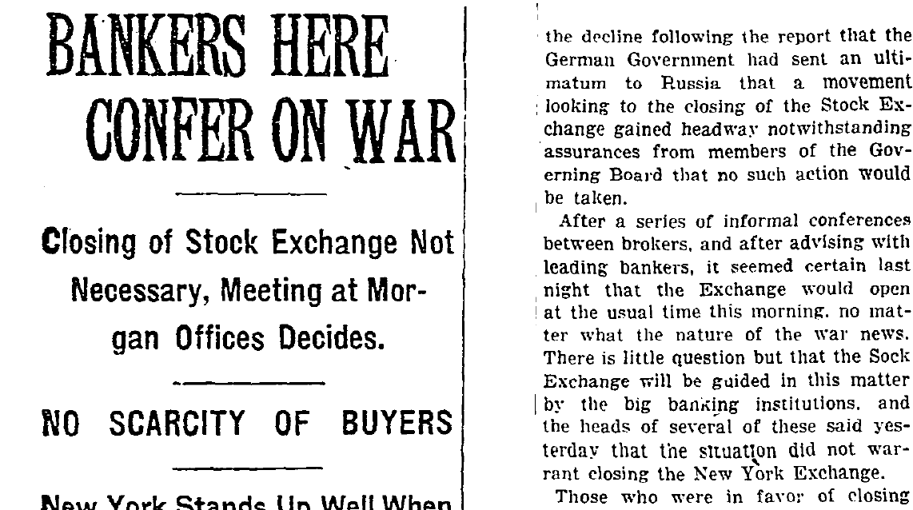

Slide 12
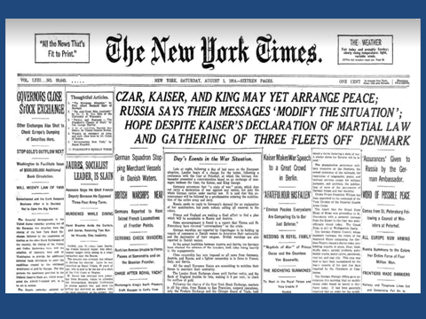

Slide 17
THE ALDRICH-VREELAND ACT
Congress passed the Emergency Currency Act modeled on these principles, and it was signed into law May 30, 1908. The act is commonly known as the Aldrich-Vreeland Act after its sponsors.
The Aldrich-Vreeland Act provided a mechanism that would permit banks to use securities other than U. S. government bonds to obtain short-term increases in their circulations. Two types of entities could apply for the additional currency: (1) groups of at least 10 banks formed into national currency associations and (2) individual banks.
National currency associations were authorized to accept securities from a member bank and then to apply to the Comptroller of the Currency for additional circulation for that member bank.
The total amount of emergency currency that could be issued under this act was set at $500,000,000. This amount was subsequently raised to over $1 billion by a hastily passed amendment dated August 4, 1914, immediately following the outbreak of World War I in Europe.

Slide 18
