Slide 1
Pharmacogenomics
Identification of genes variants that influence drug effects.
Is it possible to predict the effect of a drug in a certain patient?
Pharmacogenetics/genomics associate to a certain phenotype (specific therapeutic outcome) a certain genotype.
The promise of pharmacogenomics is that by knowing the genotype in a patient it will be possible to predict the therapeutic outcome.

Slide 2
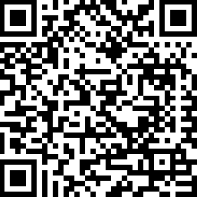
For some diseases the percentage of drug response is still unsatisfactory
US Food and Drug Administration

Slide 3
Interindividual variability in drug response
Treatment outcome
(same dose)
Response
No effect
Adverse effect

























Slide 4
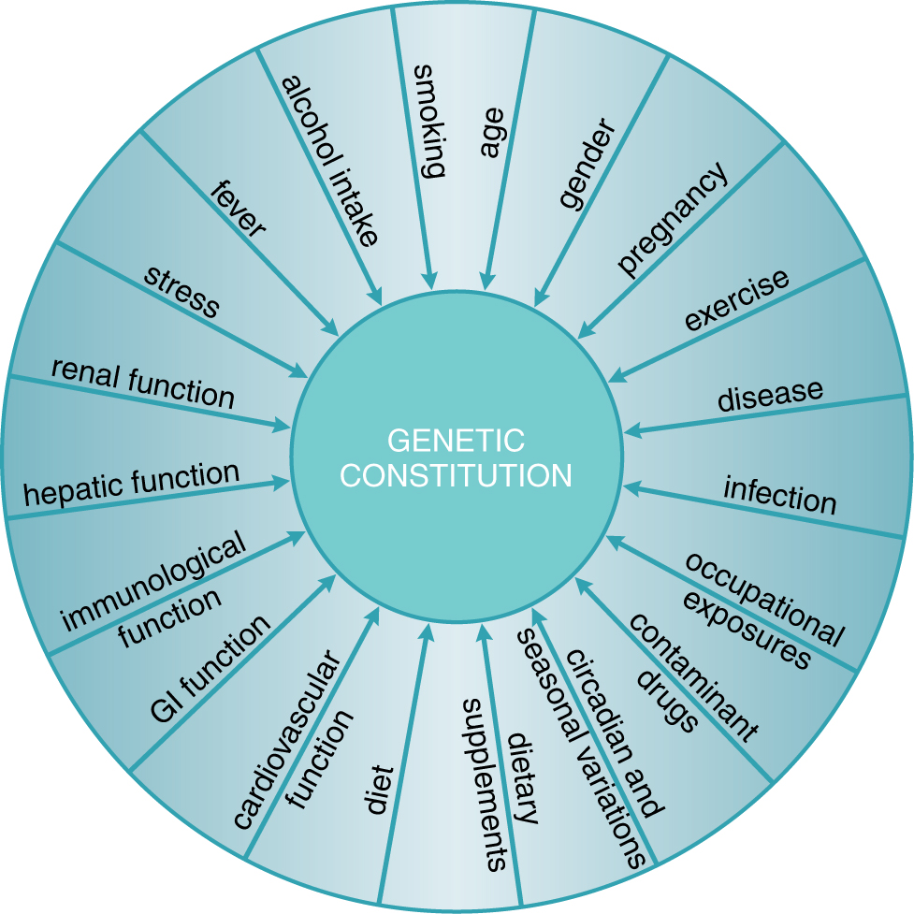
Exogenous and endogenous factors that contribute to interindividual variability in drug response
Physiological
Pathological
Genetic
Goodman and Gilman, 2011

Slide 5
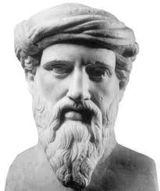
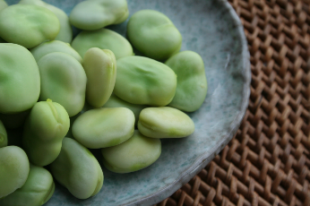
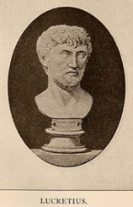
Genetic characteristics predispose to the response to substances
Pitagora
(Samo?, 570 b.C. – Metaponto, 495 b.C.)
He forbade his disciples to eat broad beans
(for the risk of favism?).
Lucrezio
(Campania, 98 /96 b.C. – Roma 55 /53 b.C.)
Quod ali cibus est aliis fuat acre venenum.
What is food for a man, it is poison for another.
«De rerum natura» Libro IV, linea 637
Pirmohamed, Br J Clin Pharmacol 2001
Ventura

Slide 6
Relling & Evans, Nature 2015

Slide 7
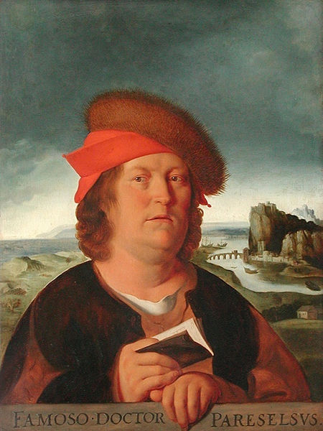
Modulation of the dose and drug effects
Paracelso (Philip Theophrastus Bombastus von Hohenheim)
(Einsiedeln 1493 – Salisburgo 1541)
“Omnia venenum sunt: nec sine veneno quicquam existit. Dosis sola facit, ut venenum non fit”
“All things are poison and nothing is without poison; only the dose makes a thing not a poison”
Yip et al., Clin Pharm Ther 2015

Slide 8
History of pharmacogenetics and pharmacogenomics
Pirmohamed, Br J Clin Pharmacol 2001

Slide 9
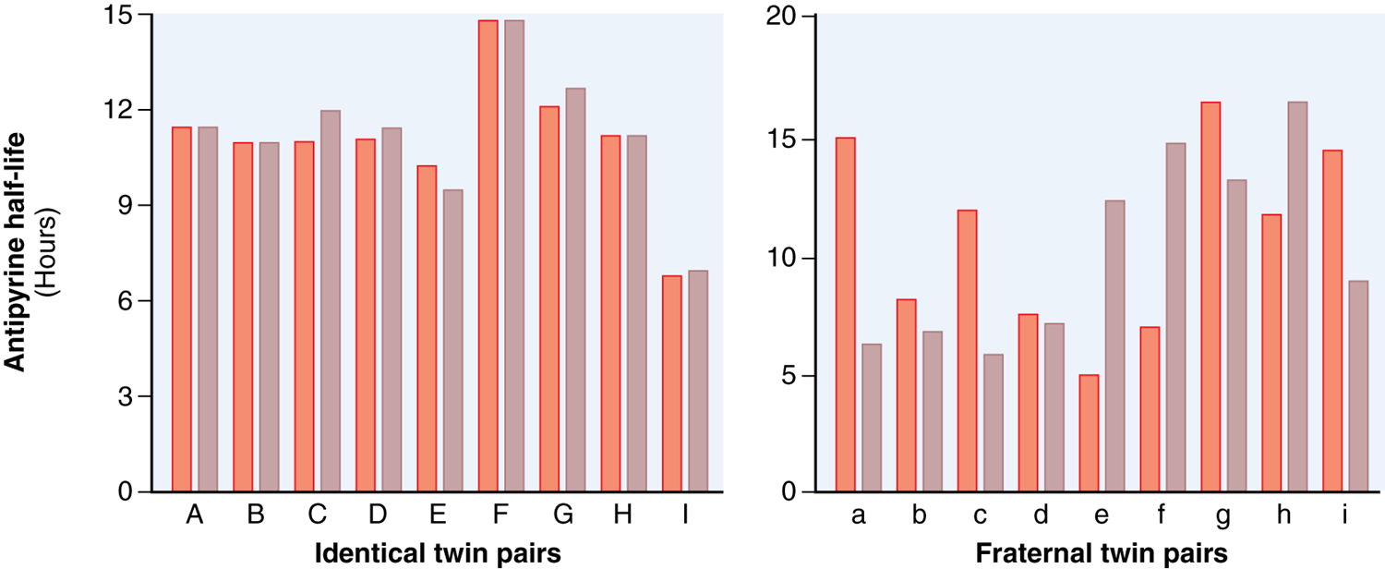
L’emivita dell’antipirina ha una concordanza maggiore nei gemelli identici che nei gemelli non identici.
Vessel & Page, Science 1968
Goodman and Gilman, 2011

Slide 10
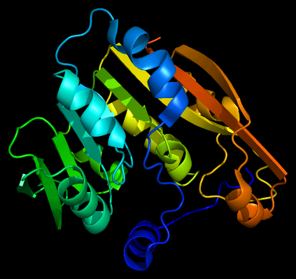
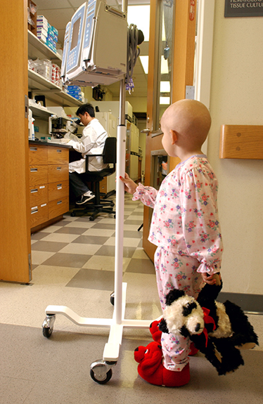
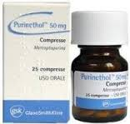
Exemple of pharmacogenetic trait
Enzyme thiopurine- S-methyltransferase
Thiopurine-S-methyltransferase enzymatic activity
Stocco et al., Human Mol Genet 2012

Slide 11
Cheok & Evans, 2006

Slide 12
Cheok & Evans, 2006

