Slide 1

Definitions of genetic terms
Gene: fundamental unit, physical and functional, of heritability, that transmits biological information from a generation to the next.
Phenotype: morphological and functional characteristic of an organism determined by its genotype and modulated by the environment.
Genetic polymorphism: presence in the population of more variants of the same phenotype determined by different alleles with a frequency higher than 1%.
Allele: alternative form of a specific gene.

Slide 2
Fenotipi farmacologici di tipo farmacocinetico hanno una componente genetica di fenotipi più complessi (clinici)
+
- Emivita
- Concentrazione allo steady state
Farmacocinetico
Variabilità spiegabile in termini genetici
Fenotipi di risposta ai farmaci
Farmacodinamico
- Sensibilità ai farmaci in vitro
- Risposta clinica ai farmaci
- Tossicità clinica dei farmaci
Clinico
-

Slide 3
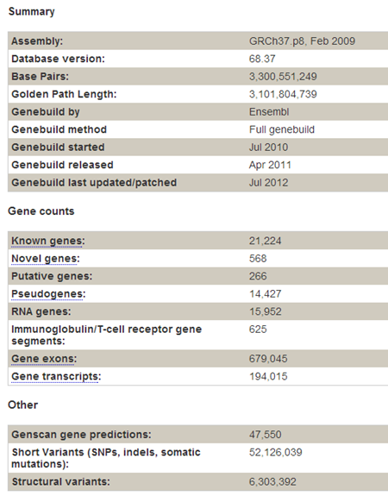
How big is the genome? How many genes does it contain?
http://jul2012.archive.ensembl.org/Homo_sapiens/Location/Genome?r=1:1-1000000

Slide 4
Objective of pharmacogenetic research
To associate to a certain PHENOTYPE (therapetuic response, adverse effects, resistance) a particular GENOTYPE
GENOTYPE
Single Nucleotide Variants (SNPs)
Deletions
Repeated sequences
Expression profiles (mRNA)
PHENOTYPE
Therapeutic response
Adverse effects
Lack of efficacy

Slide 5
Methods of pharmacogenetic research
The most critical step is to define and measure the drug-response phenotype.
Discovery model can be based on candidate gene studies or agnostic genome-wide analyses.
Pharmacogenetic discoveries require independent validation before they can be translated into clinical diagnostics.
The validation process can be facilitated by elucidating the mechanisms that determine how the variation alters drug responses.
Relling & Evans, Nature 2015

Slide 6
From the molecular point of view, drug efficacy is related to the concentration of active spiecies at the site of action.
Proteins that have a role in determining drugs:
- PHARMACOKINETICS (absorpion, distribution, metabolism, elimination, transport)
- PHARMACODYNAMICS (molecular targets)
can influence therapeutic response.

Slide 7
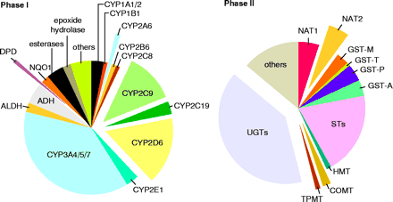
some of the main enzymes involved in the metabolic inactivation of drugs present polymorphisms of activity that are genetically determined
(Science 1999; 286: 487-491)

Slide 8

Pharmacogenetic effects on pharmacokinetics and pharmacodynamics
Evans & McLeod, NEJM 2003

Slide 9
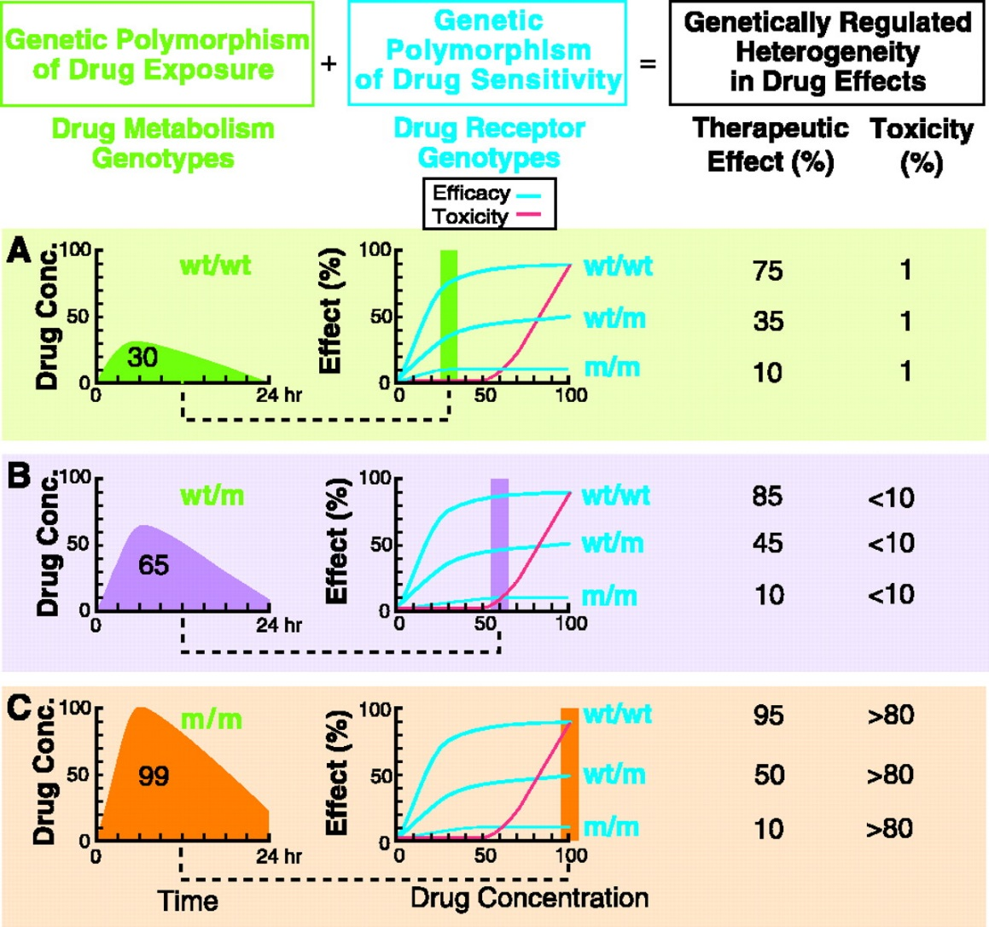
Genetic polymorphisms of enzymes involved in drugs’ metabolic inactivation or drug receptors influence treatment bioavailability and efficacy
Relling & Evans, Science 1999

Slide 10
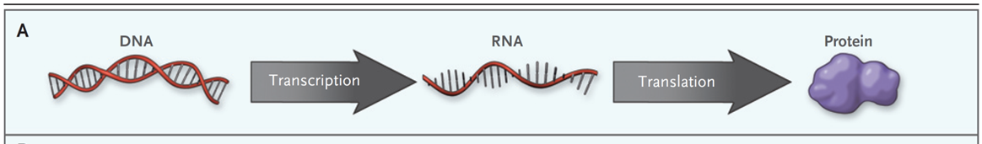
DNA polymorphisms can influences protein function
Feero et al., NEJM 2010

Slide 11

Epigenetic effects modulate the association of DNA variants with protein function
Feero et al., NEJM 2010

Slide 12
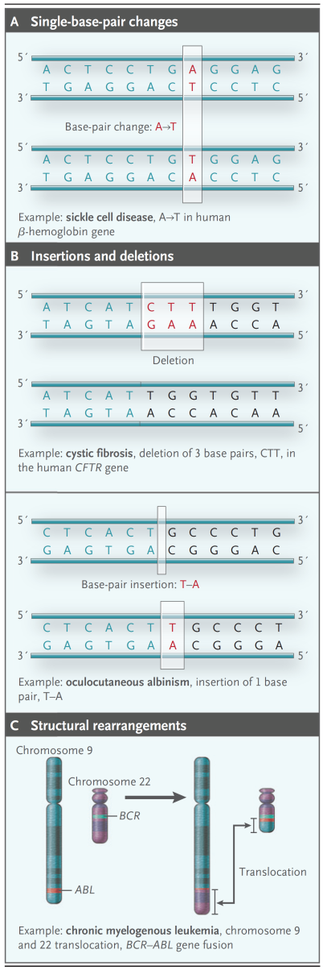
Elements of human genetic variation
Feero et al., NEJM 2010

Slide 13
Relevance of germline and somatic variants in oncology
Paugh et al., Clin Pharm Ther 2011

Slide 14
In infectious diseases, genetic variation can affect a pathogen's sensitivity to antimicrobial drugs
Huges and Andresson Nat Rev Genet 2015

