Slide 1
How to study TPMT gene variants?
Genotyping three SNPs allows to identify 95% of patients with reduced TPMT activity in Caucasians.
TPMT*2
TPMT*3

Slide 2
How to study TPMT gene variants?
Genotyping three SNPs allows to identify 95% of patients with reduced TPMT activity in Caucasians.
TPMT*2
TPMT*3

Slide 3
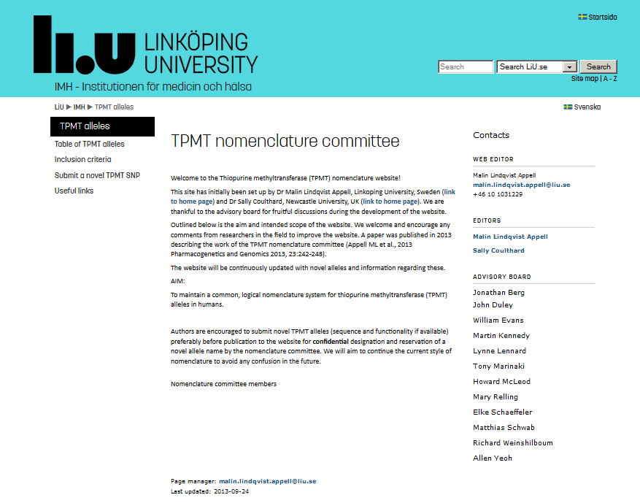
Official database of TPMT variant alleles
http://www.imh.liu.se/tpmtalleles?l=en

Slide 4
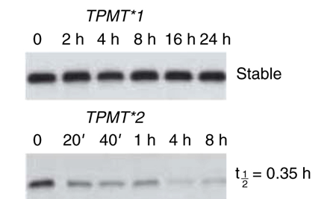
The protein encoded by the TPMT*3A variant allele is less stable than that encoded by the TPMT*1 (wild-type) allele
Dr. Evans’s lab (Tai et al., PNAS 1997)
picture from Jones TS et al, Clin Pharm Ther 2007

Slide 5
Cheok & Evans, 2006

Slide 6
Cheok & Evans, 2006

Slide 8
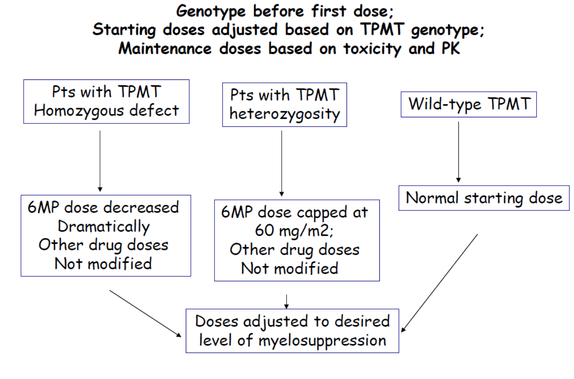

not
Relling et al., CPT 2013

Slide 9
NUDT15 variants are associated with mercaptopurine dose intensity in children with leukemia
Yang et al., J Clin Oncol 2015

Slide 10
NUDT15 variants and bone marrow suppression during treatment with thiopurines
NUDT15 is an enzyme with pyrophosphatase activity, capable of removing oxidatively damaged forms of guanine from nucleotide pools, preventing their incorporation in nucleic acids.
rs116855232 is a variant frequent in Asian patients rare in Caucasian patients.

Slide 12
HLA-DQA1/DRB1 variants and pancreatitis during treatment with thiopurines
rs2647087 in class II HLA region
P = 5x10⁻⁸
Heap et al., Nature Genetics 2014

