Slide 1
An Introduction to
Space Plasma Physics
M. Messerotti
Last Updated: 28 May 2020
Reference: C.J. Owen, in Space Science, L.K.Harra (eds.), Imperial College Press, 111, 2004

Slide 2
Plasma: a definition
An ionized, quasi-neutral gas
Composed of negatively and positively charged particles (electrons and ions)
Particles:
  are subject to electric, magnetic and other forces (e.g. gravitational)
  exhibit collective behavior (e.g. bulk motions, oscillations and instabilities)

Slide 3
Plasma Particle Interaction
Via short-range atomic forces during collisions.
  Most astrophysical plasmas can be treated as collisionless. In fact, the plasma density is so low that the particle mean free path exceeds the size of the plasma system.
Via long-range em forces due to currents and charges in the plasma.
  Are the prevailing forces, which determine the collective behavior.
Via long-range gravitational forces.
  Are relevant only in some applications

Slide 4
Sample Space Plasmas
Hydrogen plasma: equal number of e and p
  e/p mass ratio ∼ 1/1843
Earth Ionosphere: e, p, O ions, neutrals from upper atmosphere
  Ions and neutrals interact with charged particles via collisions and ionization

Slide 5



Plasma Characterization
An ionized gas with number density n₀ and kinetic temperature T is a plasma when:
The Debye length λ_{D} (shielding distance for a charge imbalance) is small in comparison with the plasma system scale length L.
The number density in the Debye sphere N_{D} is high.
The electron plasma frequency f_{pe} (natural oscillation frequency of the more mobile electrons associated with the em restoring force when reacting to charge imbalance) must be higher than the collision frequency with neutrals f_{CN} for the plasma to exhibit a collective behavior
e – electron charge
Me – electron mass
K – Boltzmann’s constant
ε₀ – free space permittivity

Slide 6
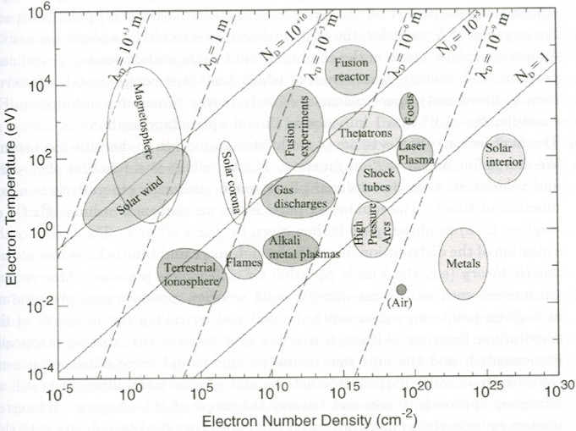
Plasma Regimes
PLASMAS
Temperature Range
10 orders of magnitude
Density Range
30 orders of magnitude
1 eV ∼ 11,604.5 K
S-T Plasmas
Temperature Range
6 orders of magnitude
Density Range
10 orders of magnitude
(Low-Density Region)

Slide 7
The Ideal MHD Limit or the Frozen-In Flux Approximation
The evolution of the MF in a plasma with conductivity σ is described by the MHD induction equation:
The scale length of the plasma is L → ∇∼1/L
The characteristic speed of the plasma is V
The ratio between the convection and the diffusion term (magnetic Reynolds number) can be written as
R_{M}∼μ₀σVL
Diffusion dominates when R_{M} << 1, convection when R_{M} >> 1
Convection of the MF with the plasma moving at velocity v
(Advection → transport in a fluid)
Diffusion of the magnetic field through the plasma
(Diffusion→ movement from high to low density)

Slide 8
Frozen-In Flux Approximation in Space Plasmas
Space plasma: high σ, very large L ⇒ R_{M}>>1
e.g. in the solar wind and magnetosphere RM∼10¹¹
The diffusion term is negligible ⇒ the magnetic field convects with the plasma flow
Where such approximation holds:
  The magnetic topology can be inferred from the plasma flow
  The plasma flow can be inferred from the magnetic topology

Slide 9
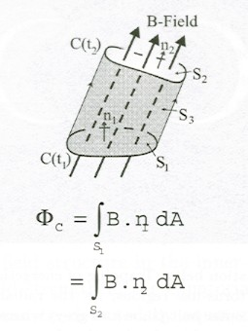
Convection of a Test Surface in the Plasma Under F-in Approx.
A surface S₁ in the plasma bounded by a closed contour C encloses a specific amount of magnetic flux at a given time t₁.
The surface can be subsequently deformed and/or
relocated by motions of the plasma.
Under the frozen-in flux approximation, the surface will enclose the same magnetic flux Φ_{C} at a later time t₂ as it did at time t₁.
If the surface is reduced in area, the field strength will have increased during convection.
A magnetic flux tube can be defined by moving the closed contour parallelly to the field it encloses → defines a surface S₃ (the tube) which has zero flux through it → the fluid elements that form the flux tube at one moment form the flux tube at all instants.

Slide 10
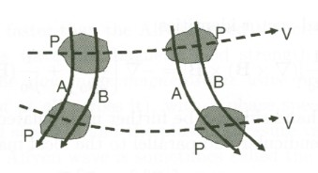
Convection of Two Test Volumes in the Plasma Under the F-in Approx.
A field line can be defined as the intersection of two flux tubes.
If two fluid elements P₁ and P₂ are linked by field lines A and B at one instant → they will always be so linked, whatever the individual motions V₁ and V₂ of the individual volumes P₁ and P₂.
1
1
1
2
2
2

Slide 11
Applications of the F-in Approximation
The f-in flux approximation allows a basic understanding of many applications without using explicit calculations of plasma motions and em field parameters.
A strict application → there can be no mixing of plasmas from different origins:
  The field and plasma of solar origin, which flow towards the Earth as solar wind (SW), are frozen out to the region occupied by the field and plasma of terrestrial origin (the Magnetosphere) → the SW is obliged to flow around it.
  The boundary between the two plasma regimes carries a current to support the change in field and plasma properties across the boundary. It is thin such that R_{M} is small within it.
Under some circumstances, the MF can “thaw” ⇒ diffusion of the field relative to the flow.

