Slide 1
Interindividual variability in MTX clearance substantially affects drug exposure (4 fold range): > 3800 courses in 640 pts
40 ml/min/m²
160 ml/min/m²
Trevino et al. J Clin Oncol 2009

Slide 2
St. Jude Total 12
NEJM, 1998

Slide 3
Intercourse targeting study (St.Jude Total XV)
Dose adjustment
Course I
Course II
Evans et al., NEJM, 1998

Slide 4
St. Jude Total 15 study

Slide 5
Intercourse targeting study (St.Jude Total XV) and effects on adverse events
Pauley et al., Cancer Chemother Pharmacol 2013

Slide 6
HD-MTX PHARMACOKINETIC ANALYSIS
Data and sample collection is still ongoing and will end on 2018, June 30th.
Data collection of methotrexate concentration levels at 24h, 42h, 48h after infusion (pharmacokinetic parameters).
SLCO1B1 rs4149056 SNP genotyping (pharmacogenetic parameters).
122 patients (median (IQ) age: 4.9 (3.3-9.6) years; gender: n_{tot}= 94; male: 67%)
Regina Margherita Hospital, Turin (n=33, 27,0%) “Centro Maria Letizia Verga”, San Gerardo Hospital, Monza (n=18, 14,8%) IRCCS Children's Research Hospital Burlo Garofolo, Trieste (n=71, 58,2%)
Protocol (n_{tot}= 82) AIEOP R2006: n= 27; 22.1% AIEOP-BFM ALL 2009: n= 95; 77.9%
Race: n_{tot}= 67; 97% Caucasians
Risk group: n_{tot}= 58; 31% SR, 58.6% MR, 10.4% HR
SLCO1B1 rs4149056 (AIEOP-BFM ALL 2009): n_{tot}= 79; 72.2%TT, 21.5%TC, 6.3%CC

Slide 7
HD-MTX PHARMACOKINETIC ANALYSIS
Hematological toxicities

Slide 8
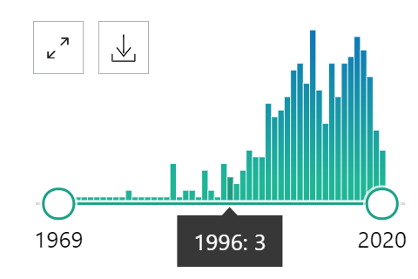
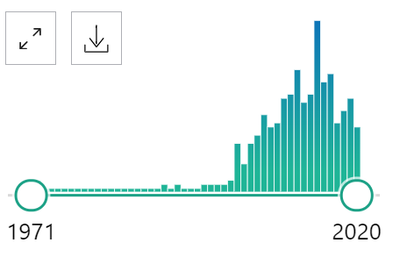

Farmacogenetica metotressato: molta ricerca ma un biomarcatore validato non è ancora chiaramente disponibile
Numero articoli su Pubmed
Linee guida cliniche (livello 1A su PharmGKB)
«Mercaptopurine pharmacogenetics»
«Methotrexate
pharmacogenetics»
31 annotazioni
(TPMT,
NUDT15)
345
350
134 annotazioni (nessuno livello 1A)

Slide 9
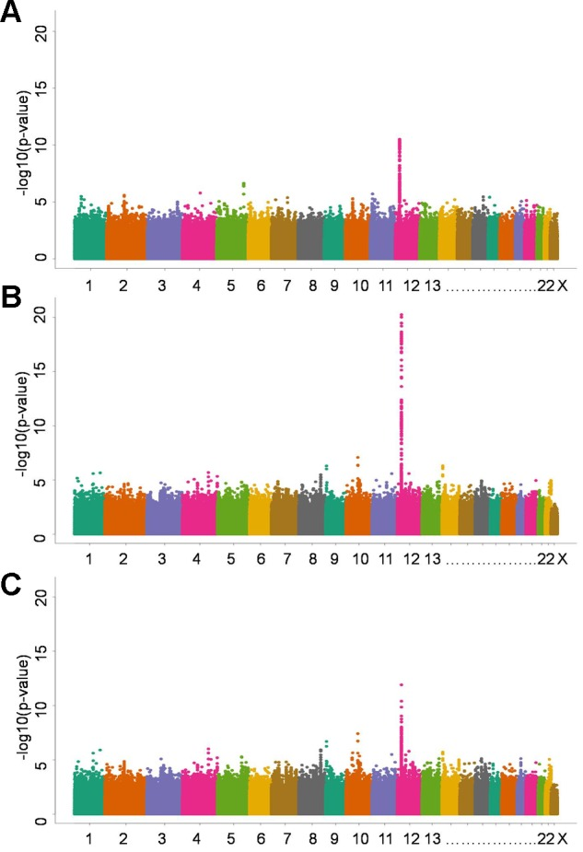
Variants in SLCO1B1 predict methotrexate clearance
Ramsey et al., Blood 2013

Slide 10
Candidate analysis on methotrexate pharmacogenetics
Aim of the study: to explore the role of these candidate genetic factors on methotrexate response in an Italian cohort of children with JIA

Slide 11
Rare variants contribute to methotrexate effects
Ramsey et al., Genome Res 2012

Slide 12
Concentration of methotrexate metabolites are associated with patients’ response in JIA
MTX-PG = Methotrexate PolyGlutamates
JADAS = Juvenile Arthrisits Disease Activity Score
Bulatovic Calasan Ann Rheum Dis 2014

Slide 13
Methotrexate in Juvenile Idiopathic Arthritis: mechanism of action
Cronstein et al., PNAS 1991

Slide 14
Immunosoppressori
Fine anni ‘50: Schwartz e Damesshek scoprono che la 6-mercaptopurina, un farmaco antileucemico, blocca la risposta anticorpale primaria
1962: un analogo della 6-mercaptopurina, l’azatioprina, si dimostra un valido agente immunosoppressore: inizia l’era dei trapianti
alla terapia con azatioprina viene aggiunto il prednisone
1979: viene introdotta la ciclosporina A
anni ‘90: sono messi in commercio tacrolimus e sirolimus, micofenolato mofetile, e gli anticorpi monoclonali murimonab CD3, basiliximab e daclizumab
Notes:
14

Slide 15
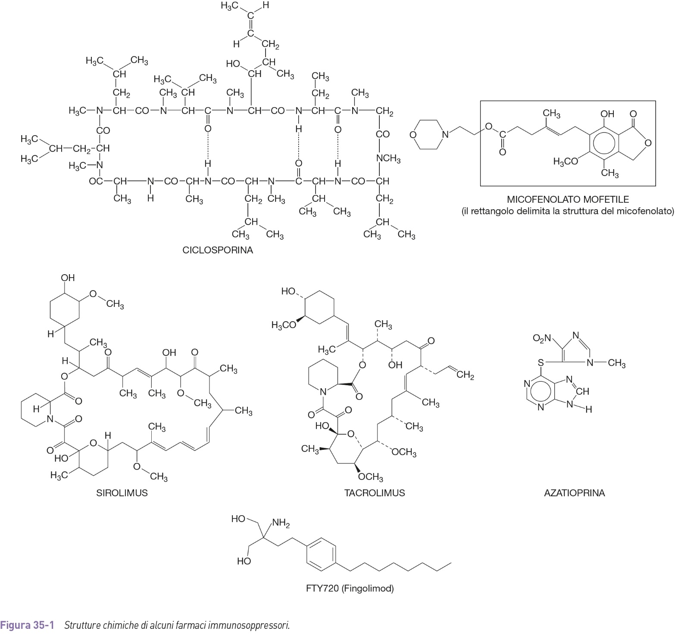

Slide 16
