Slide 1
Post-translational modifications and quality control in the RER
Newly synthesized polypeptides in the membrane and lumen of the ER undergo five principal modifications
Formation of disulfide bonds (ER)
Proper folding (ER)
Addition and processing of carbohydrates (ER, Golgi)
Specific proteolytic cleavages (ER, Golgi, secretory vescicles)
Assembly into multimeric proteins (ER)

Slide 2
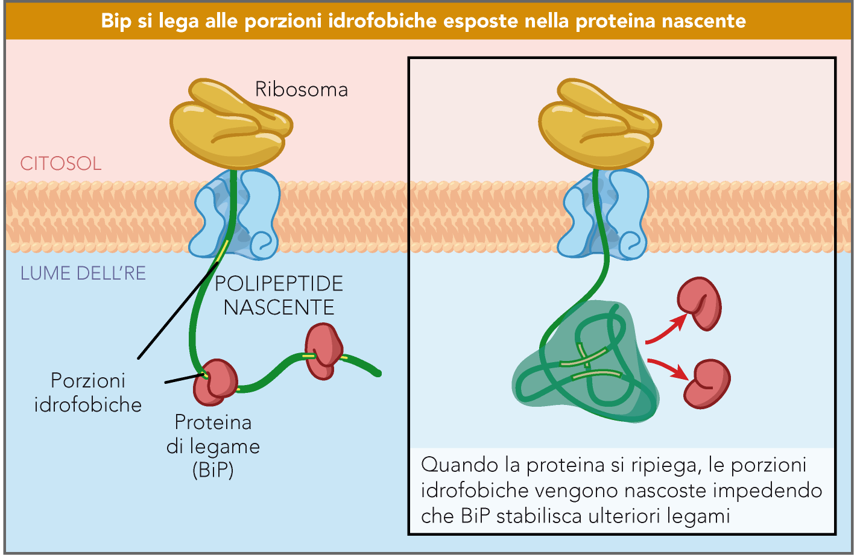

Slide 3
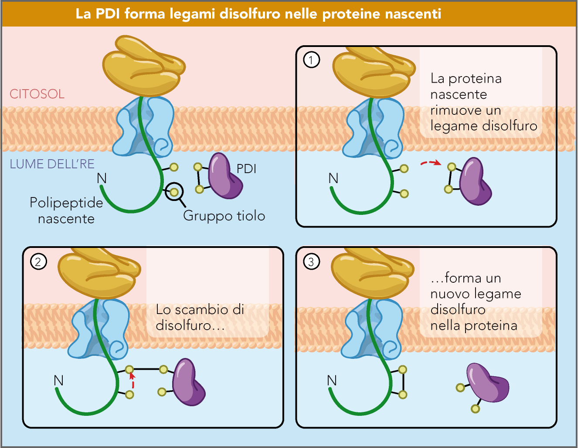

Slide 4
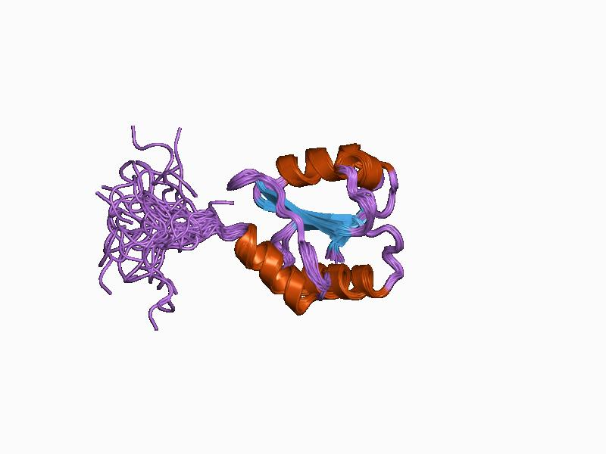
Structure of human protein disulfide isomerase (PDI)
PDI displays oxidoreductase and isomerase properties

Slide 5
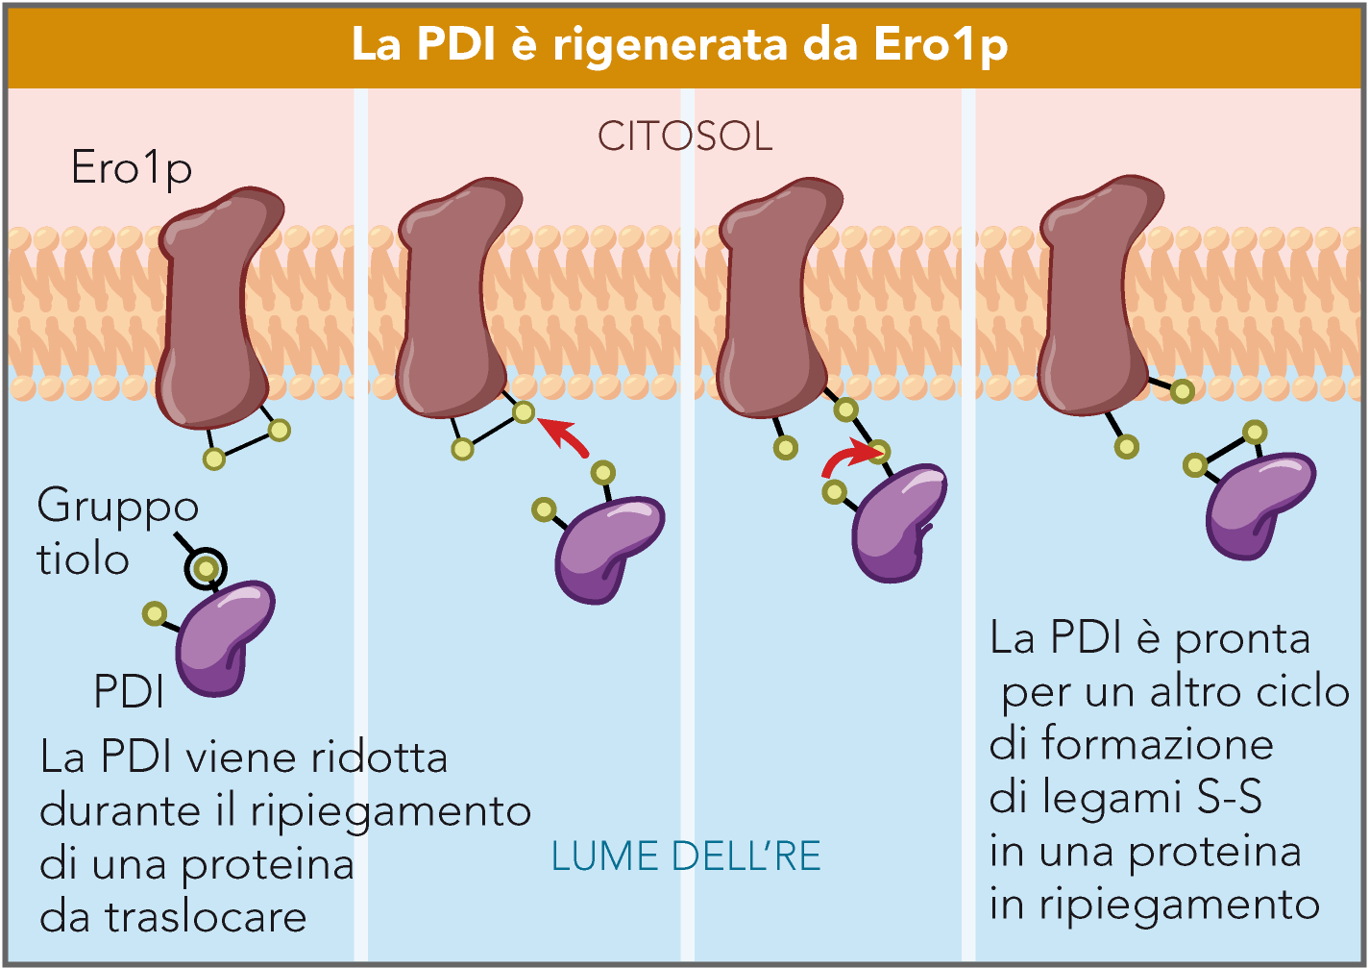

Slide 6
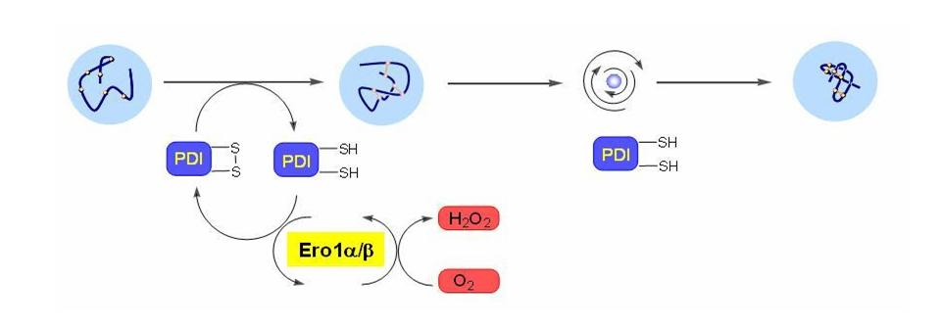
Regeneration of the oxidized form of protein disulfide isomerase (PDI)

Slide 7
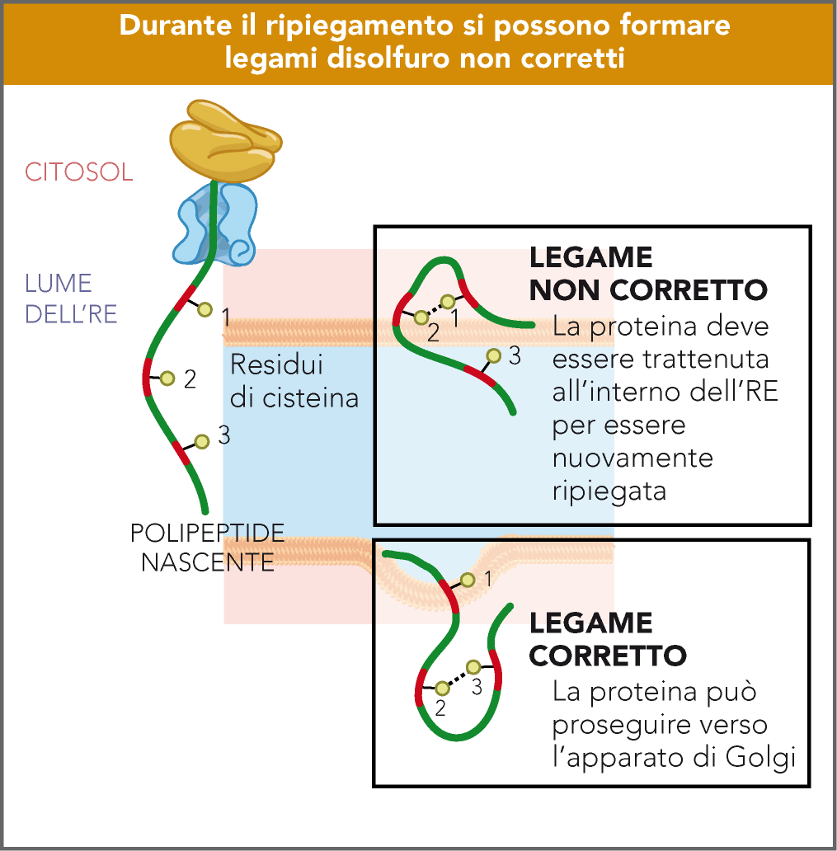

Slide 8
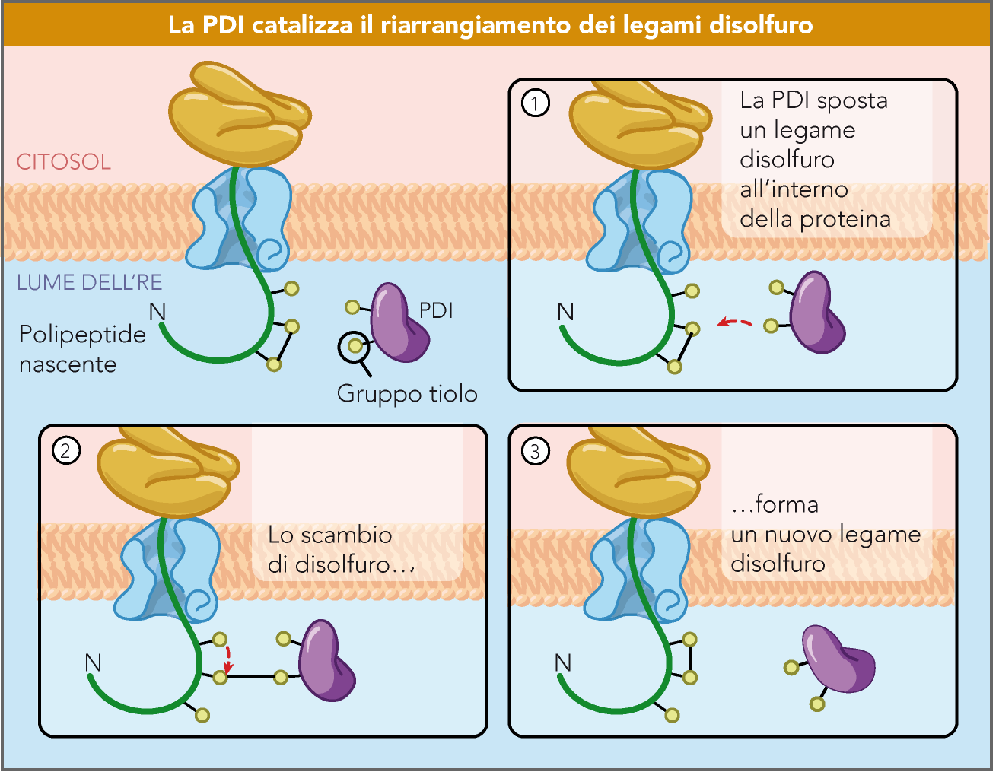

Slide 9
Summary of the role of PDI

Slide 10
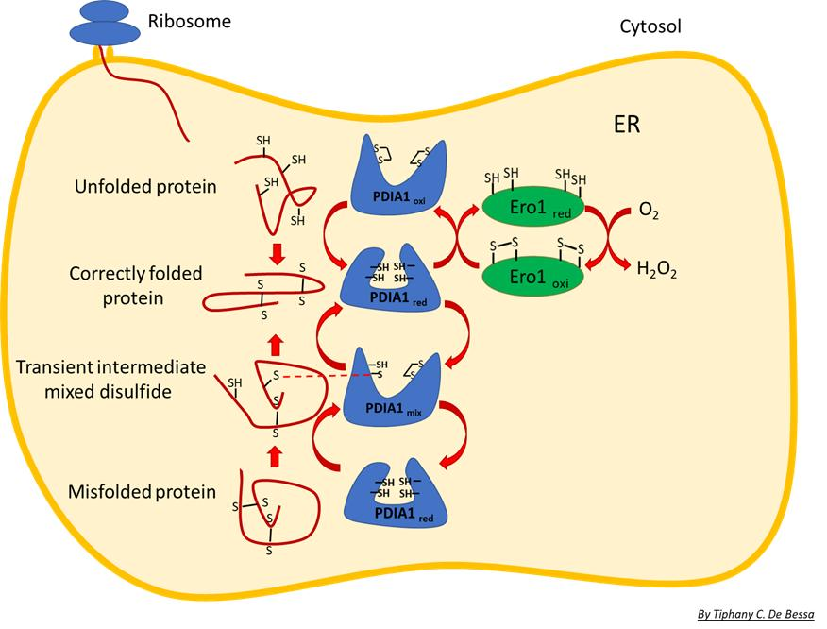
Summary of the
role of PDI

Slide 11
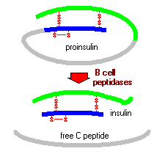
Ponti disolfuro
1-4; 2-6; 3-5

Slide 12
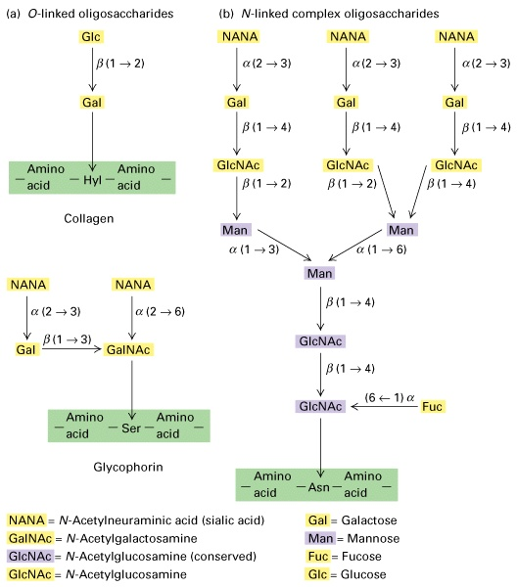
Different structures characterize O- and N-linked oligosaccharides

Slide 13
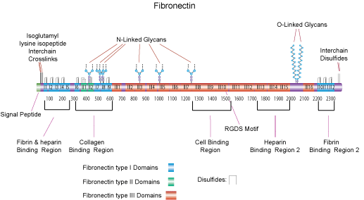
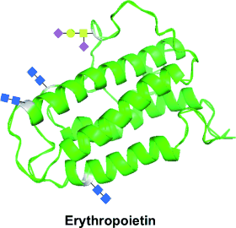
Fibronectin (monomer 220 KDa)
Erythropoietin (34-38 Kda)
Erythropoietin (34-38 KDa):
3 N-linked chains (Asn 24, 38, 83)
1 O-linked chain (Ser 126)
Important for biological activity and stability

Slide 14
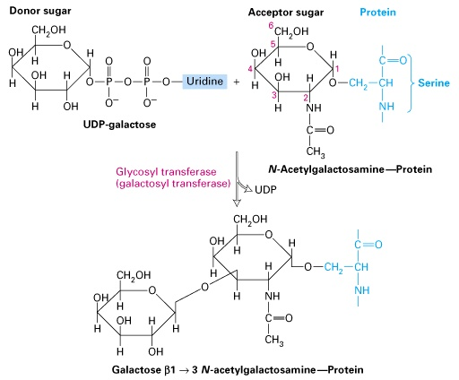
Specific sugars are linked by specific glycosyltransferases

Slide 15
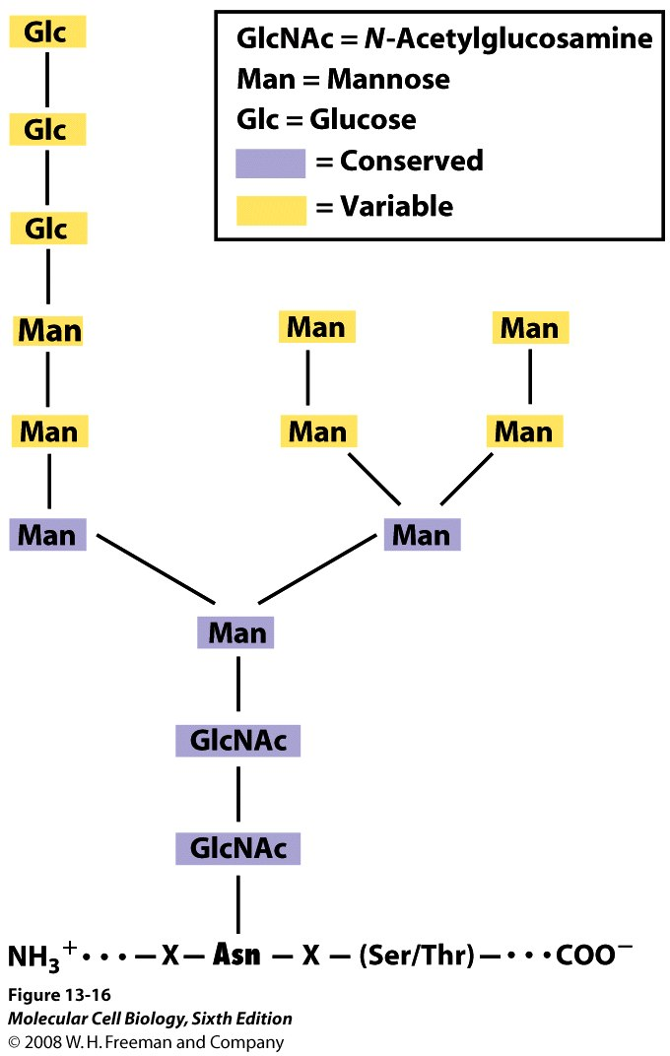
N-linked oligosaccharide
precursor added in the RER

Slide 16
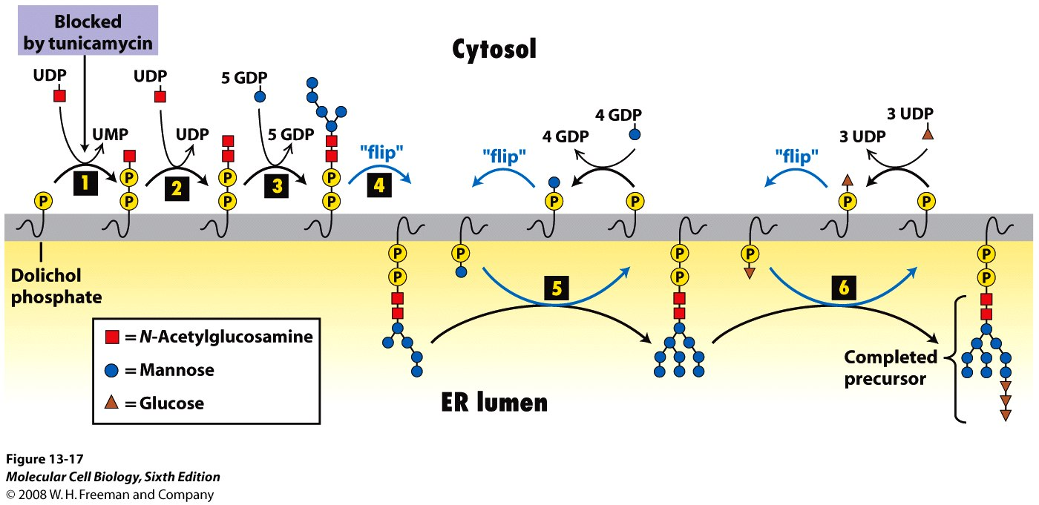
Biosynthesis of the oligosaccharide precursor of N-linked oligosaccharides

Slide 17
DOLICHOL
Un dolicolo è un terpenoide costituito da un numero variabile di unità
di isoprene, terminante con un'unità isoprenoide α-satura recante una
funzione alcolica

Slide 18
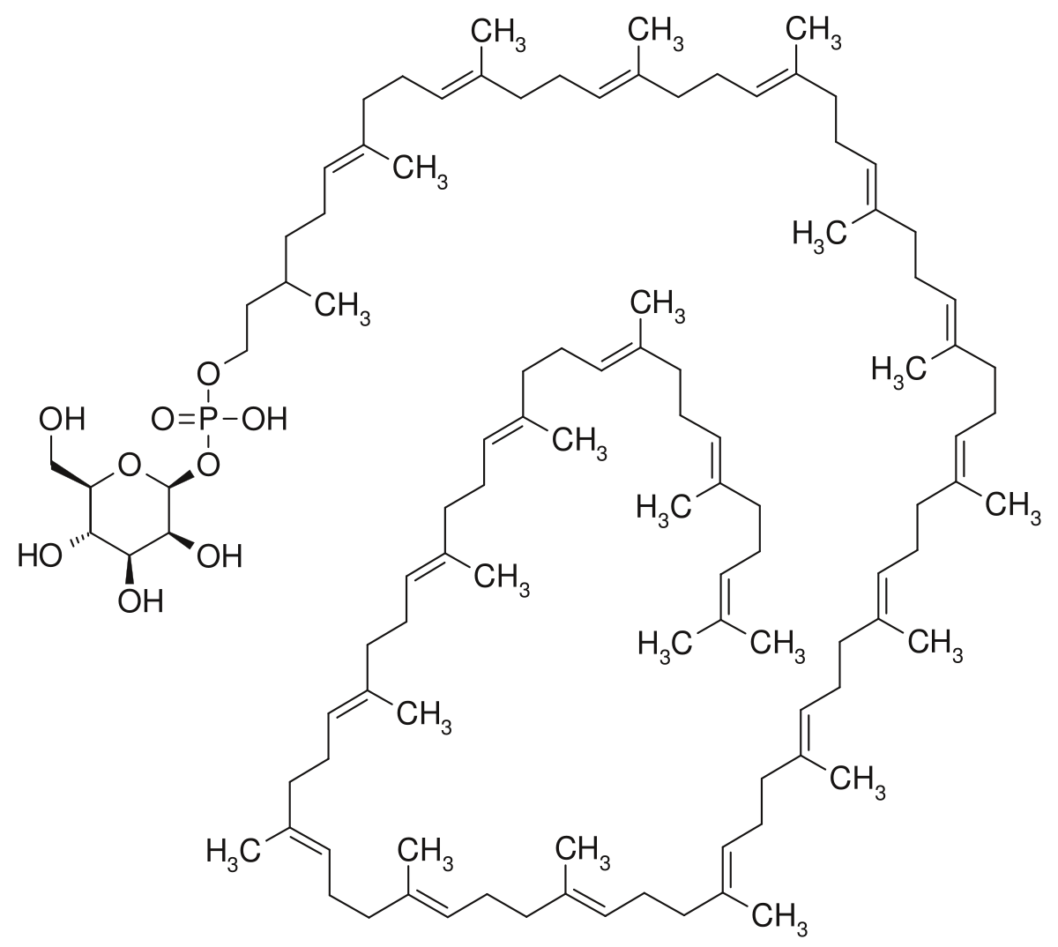
Dolicolo monofosfato mannosio

Slide 19
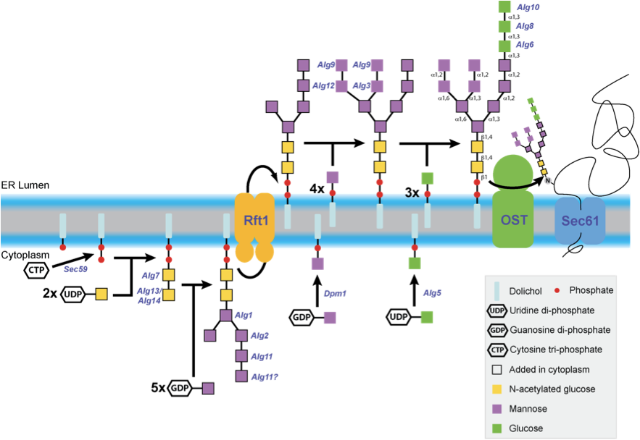
Translocation of lipid-linked
oligosaccharides across the
ER membrane
Rft1: discovered in yeast, it participates in the translocation of
oligosaccharide from the cytoplasmic side to the luminal side of the
endoplasmic reticulum membrane. There is a human homolog.

Slide 20
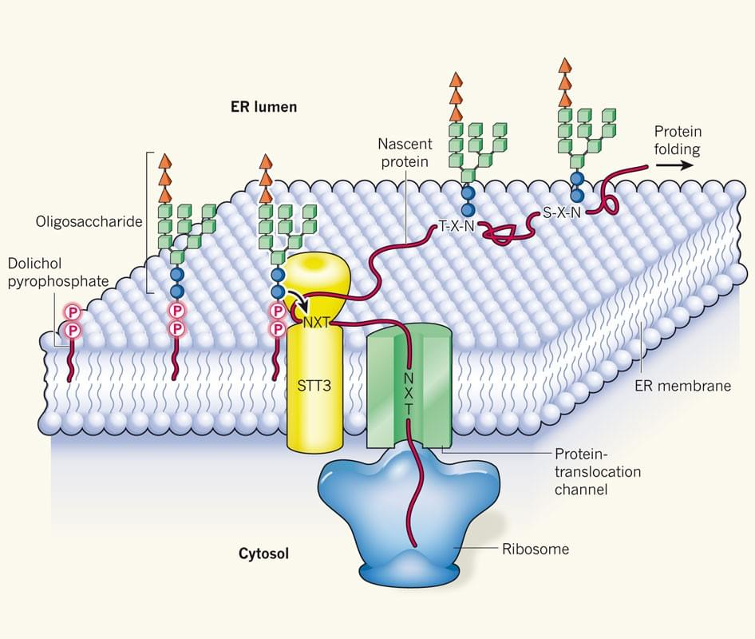
Oligosaccariltransferasi nel lievito (OST)
Yeast OST is composed of eight different membrane-spanning subunits. OST in mammals is known to have a similar composition.
OST is thought to require many subunits because it must:
Position itself near the translocon pore.
Recognize and bind oligosaccharyldolichol.
Scan the nascent protein in order to recognize and bind sequons (NXS/NXT).
Move these two large substrates into their proper locations and conformations.
Activate the Asn amide nitrogen atom for the actual transfer of oligosaccharide.
Release its substrates.
STT3: catalytically active subunit of the OST (8 subunits)
Notes:
Yeast OST is composed of eight different membrane-spanning proteins in three subcomplexes (one of them is OST4).^{[7][8]} These octomers do not form higher order oligomers, and three of the eight proteins are glycosylated themselves.^{[7]} OST in mammals is known to have a similar composition.^{[9][10]}
OST is thought to require many subunits because it must:^{[11]}
Position itself near the translocon pore.
Recognize and bind oligosaccharyldolichol.
Scan the nascent protein in order to recognize and bind sequons.
Move these two large substrates into their proper locations and conformations.
Activate the Asn amide nitrogen atom for the actual transfer of oligosaccharide.
Release its substrates.
The catalytically active subunit of the OST is called STT3. Two paralogs exist in eukaryotes, termed STT3A and STT3B. STT3A is primarily responsible for cotranslational glycosylation of the nascent polypeptide as it enters the lumen of the endoplasmic reticulum whereas STT3B can also mediate posttranslational glycosylation.^{[12]} The structure of PglB, the prokaryotic homolog of STT3 has been solved.^{[13]} The high sequence similarity between the prokaryotic and the eukaryotic STT3 suggests that their structures are similar.

Slide 21
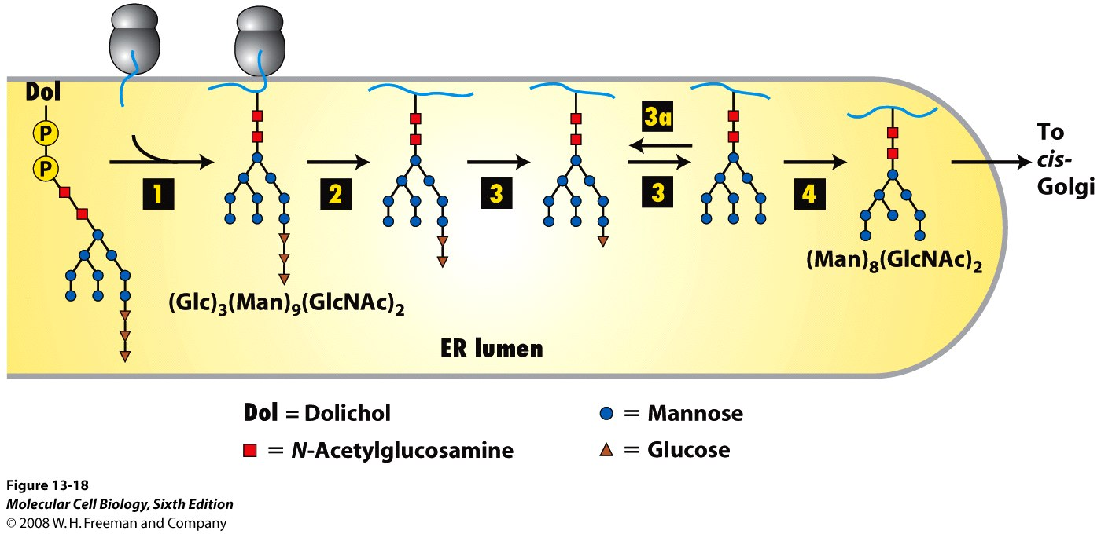
Addition and initial processing of N-linked oligosaccharides
Notes:
Addition and initial processing of N-linked oligosaccharides. In the rough ER of vertebrate cells, the Glc3Man9(GlcNAc)2 precursor is transferred from the dolichol carrier to a susceptible asparagine residue on a nascent protein as soon
as the asparagine crosses to the luminal side of the ER (step 1 ). In three separate reactions, first one glucose residue (step 2 ), then two glucose residues (step 3 ), and finally one mannose residue (step 4 )
are removed. Re-addition of one glucose residue (step 3a) plays a role in the correct folding of many proteins in the ER, as discussed later. The process of N-linked glycosylation of a soluble secretory protein is shown here, but the luminal portions of an integral membrane protein can be modified on asparagine residues by the same mechanism.

Slide 22
Modifications of N-linked oligosaccharides are used to
monitor folding and for quality control
(Mannose trimming)
Calnexin (CNX) and calreticulin (CRT) are lectins respectively localized in the RE membrane and in the RE lumen
OS-9: Lectin which functions in endoplasmic reticulum (ER) quality control and ER-associated degradation (ERAD).
May bind terminally misfolded non-glycosylated proteins as well as improperly folded glycoproteins, retain them in
the ER, and possibly transfer them to the ubiquitination machinery and promote their degradation.
Notes:
Modifications of N-linked oligosaccharides are used to monitor folding and for quality control. After three glucose residues are removed from N-linked oligosaccharides in the ER, a single glucose can be re-added by a glucosyltransferase (UGGT) to form Glc1Man9(GlcNAc)2 (see Figure 13-18, step 3a ). This modified N-linked oligosaccharide binds the lectins calnexin (CNX) and calreticulin (CRT) for retention in the ER and engagement of folding chaperones. Proteins that cannot fold properly, and are therefore retained in the ER for longer times, undergo mannose trimming by ER α-mannosidases to form Man5–6(GlcNAc)2, which is recognized by OS-9. Recognition by OS-9 leads to dislocation of the misfolded protein out of the ER, ubiquitinylation, and degradation by proteasomes.

Slide 23
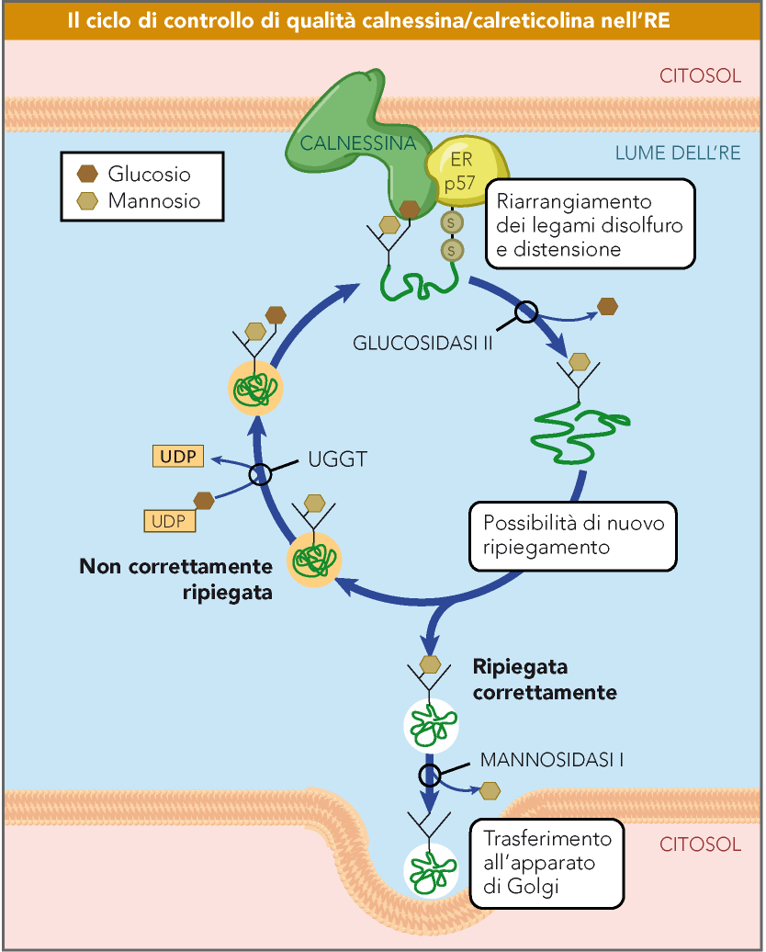
ERp57 (or PDIA3) is a
disulfide isomerase
UGGT: UDP-glucose:glycoprotein glucosyl transferase
Notes:
UDP-glucosio glicoproteina glucosil transferasi

Slide 24
Peptidil-prolil isomerasi
La gran parte degli amminoacidi hanno una fortissima preferenza per la conformazione trans a livello del legame peptidico a causa di ingombro sterico. Tuttavia, l’inusuale struttura della prolina stabilizza anche la forma cis cosicché entrambi gli isomeri sono presenti in condizioni fisiologiche. L’energia di attivazione richiesta per promuovere l’isomerizzazione cis/trans è relativamente elevata e pari a circa -20 kcal/mole.

Slide 25
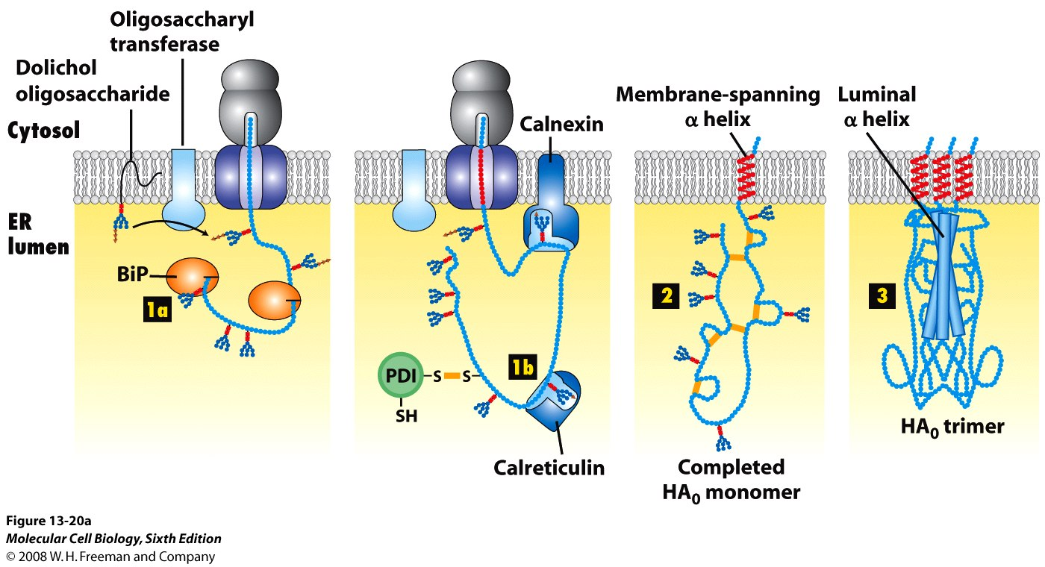
Hemagglutinin from influenza virus: folding and assembly
(7 N-linked oligosaccharides and 6 disulfide bonds per monomer)

Slide 26
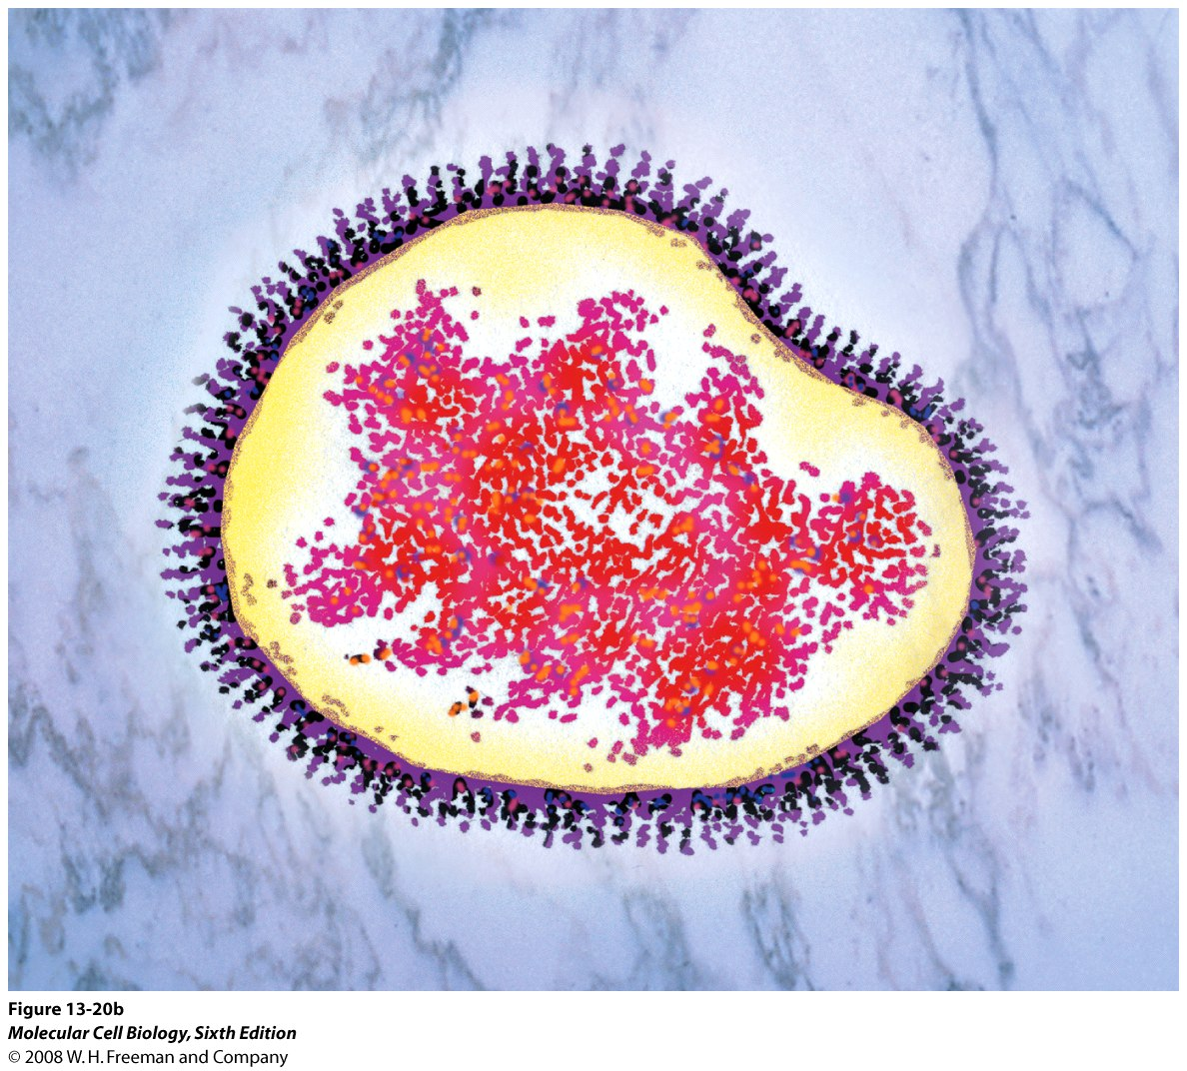
EM of a complete
influenza virus

Slide 27
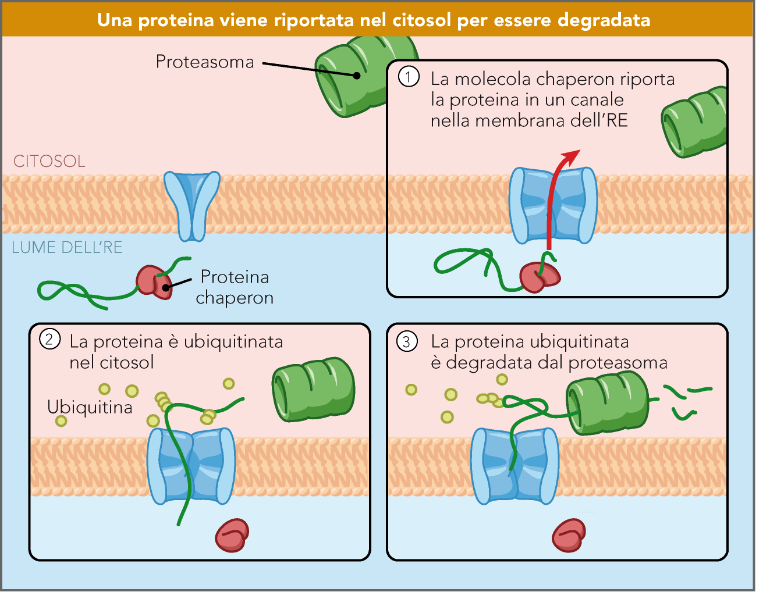
Traslocazione retrograda
delle proteine non ripiegate
Correttamente
(ERAD – ER-Associated
Degradation)

Slide 28
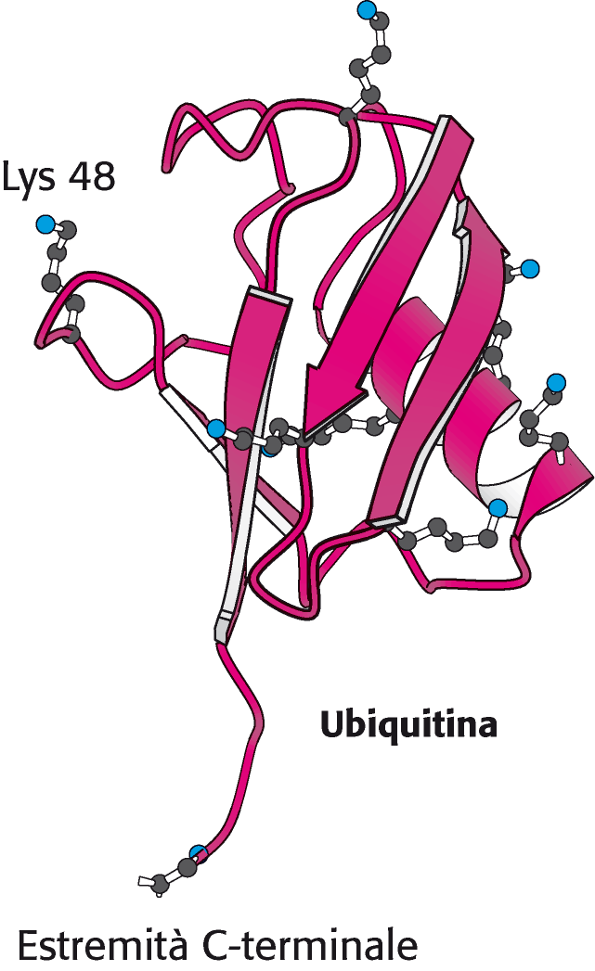
76 residui altamente conservati

Slide 29
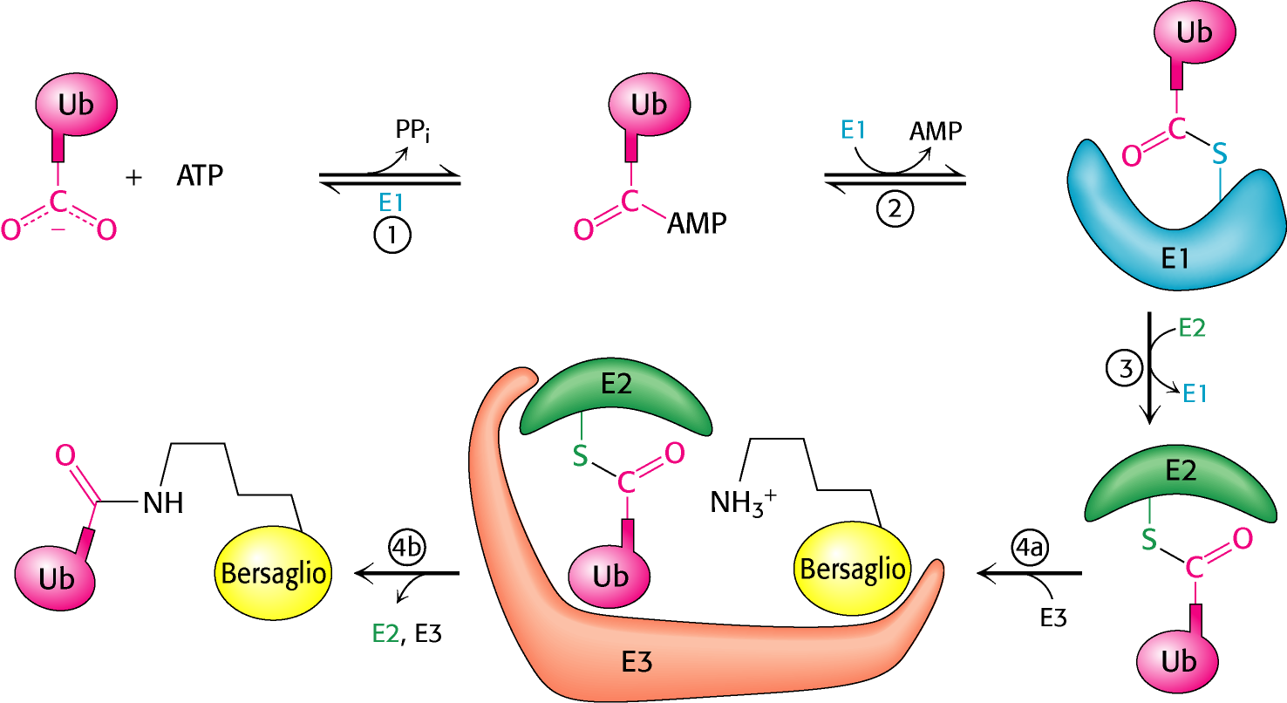
Il sistema di ubiquitinazione
Enzima E1: enzima attivatore (uno o pochi tipi distinti di E1)
Enzima E2: enzima coniugante (molti tipi di E2 appartenenti ad una sola famiglia)
Enzima E3: ubiquitina-proteina ligasi e poliubiquitinazione (4 famiglie, 500-1000
geni nel nostro genoma)

Slide 30
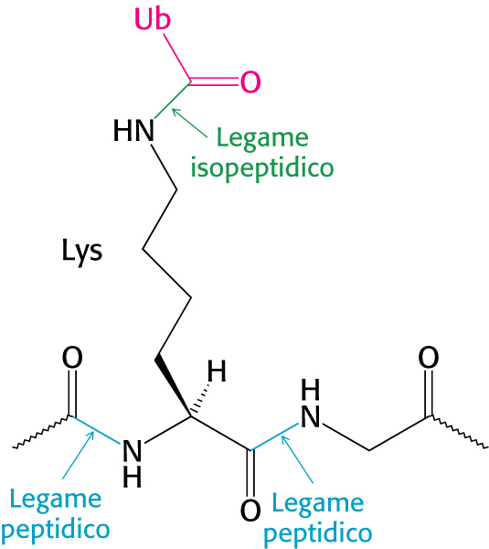
Legame dell’ubiquitina (Gly C-terminale) a una
Lys della proteina bersaglio

Slide 31
DEGRONI (segnali di degradazione) Relazione tra l’emi-vita di proteine citoplasmatiche e l’aa presente al loro N-terminale (in S. cerevisiae)
Residui fortemente stabilizzanti (t_{1/2} >20 h)
Ala Cys Gly Met Pro Ser Thr Val
Residui intrinsecamente destabilizzanti (t_{1/2} da 2 a 30 min)
Arg His Ile Leu Lys Phe Trp Tyr
Residui destabilizzanti dopo modifiche chimiche (t_{1/2} da 3 a 30 min)
Asn Asp Gln Glu
Sequenze di degradazione
Sequenza PEST (Pro-Glu-Ser-Thr) associate a proteine che hanno una emi-vita breve (ornitina decarbossilasi)
Cyclin destruction boxes, sono sequenze amminoacidiche che marcano le proteine del ciclo cellulare per la loro rapida degradazione

Slide 32
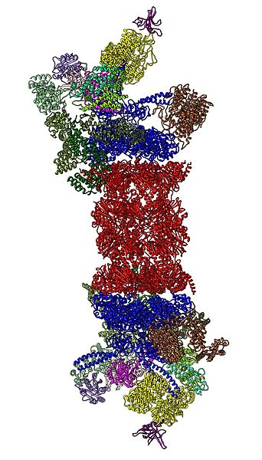
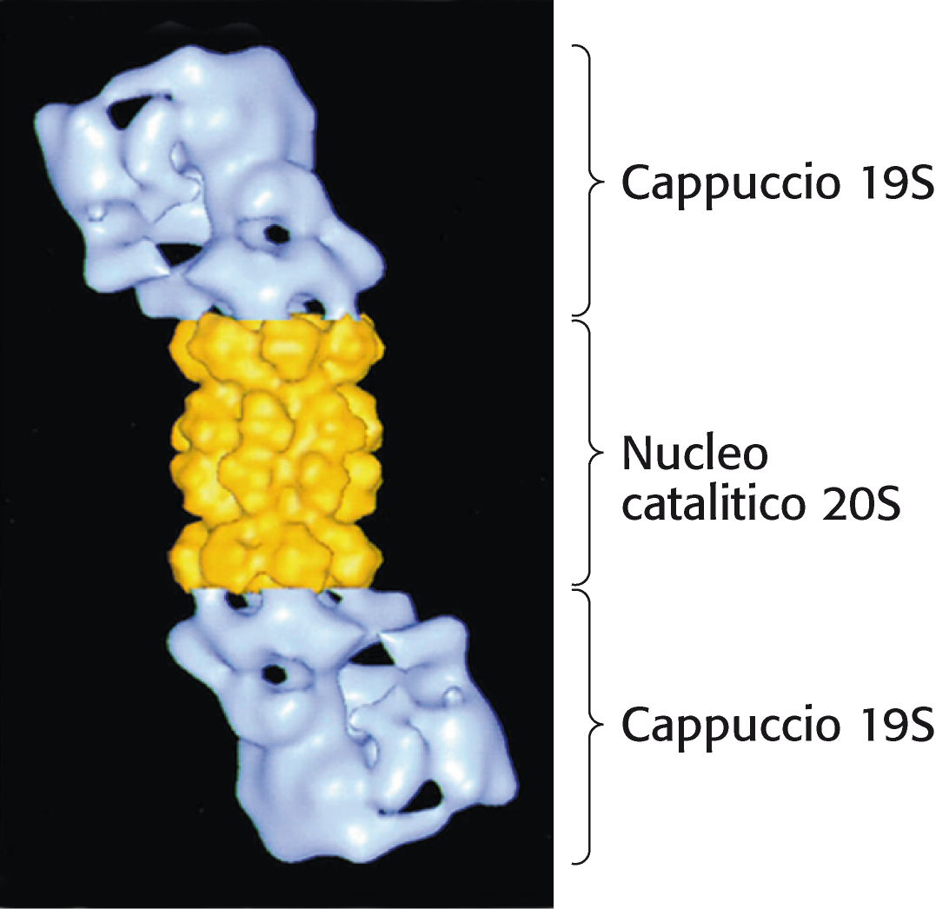
Proteasoma 26S

Slide 33
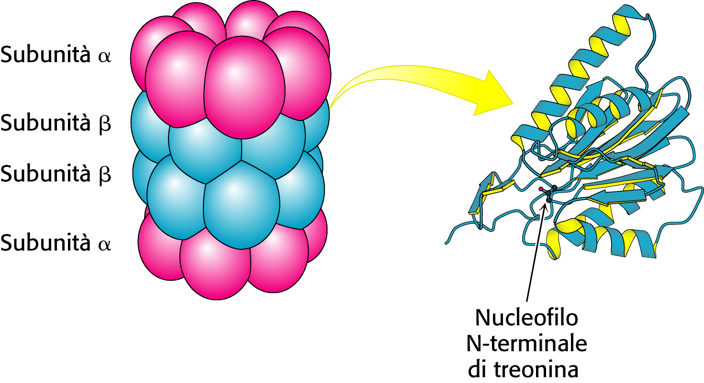
Proteasoma (parte 20S) e struttura subunità β
con attività proteolitica

Slide 34
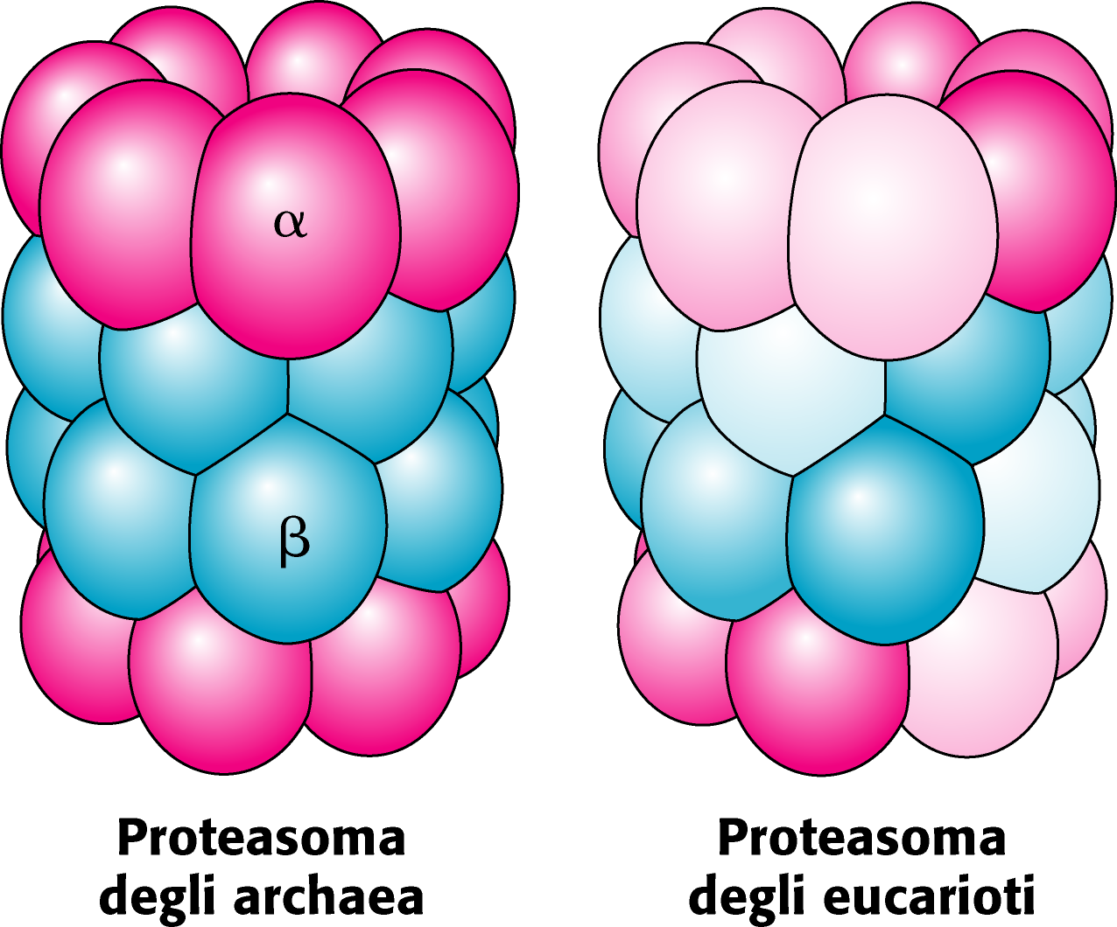
Proteasoma (core 20S)
Negli eucarioti 7 tipi di subunità α e 7 di β (β1, β2 e β5
hanno attività proteolitica

Slide 35
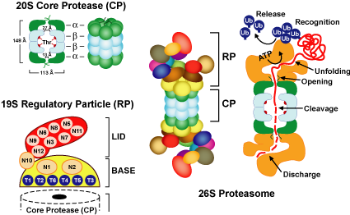
Struttura del proteasoma
Coperchio di 10 subunità e anello di
base di 9 (6 sono ATPasi AAA)

Slide 36
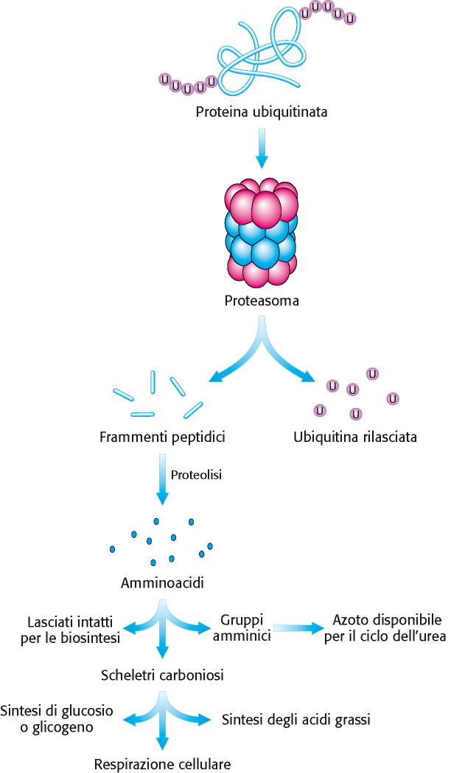
Digestione della proteina
ubiquitinata

Slide 37
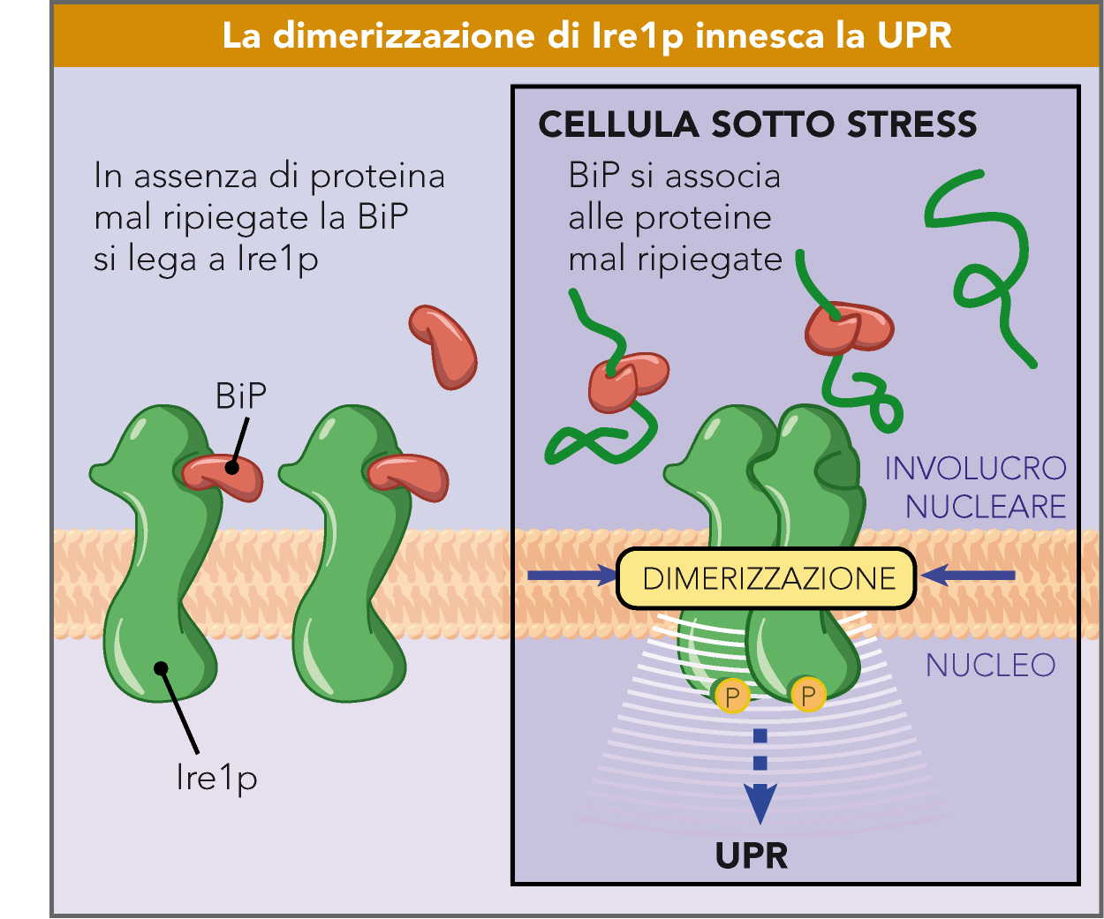
Unfolded Protein
Response (UPR) in
yeast
Reticolo
Dimerization induces
autophosphorylation
Nucleo

Slide 38
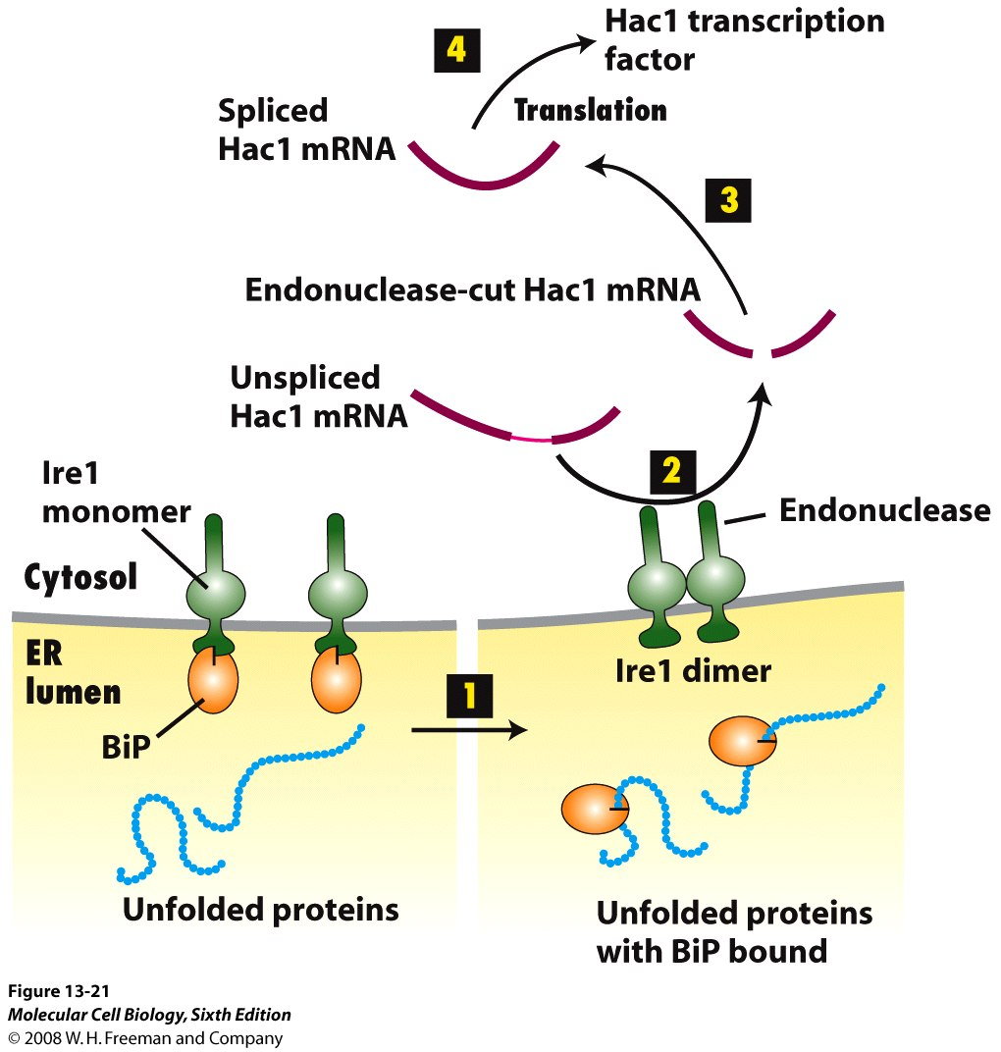
The unfolded protein
response (UPR) in yeast
P
P

Slide 39
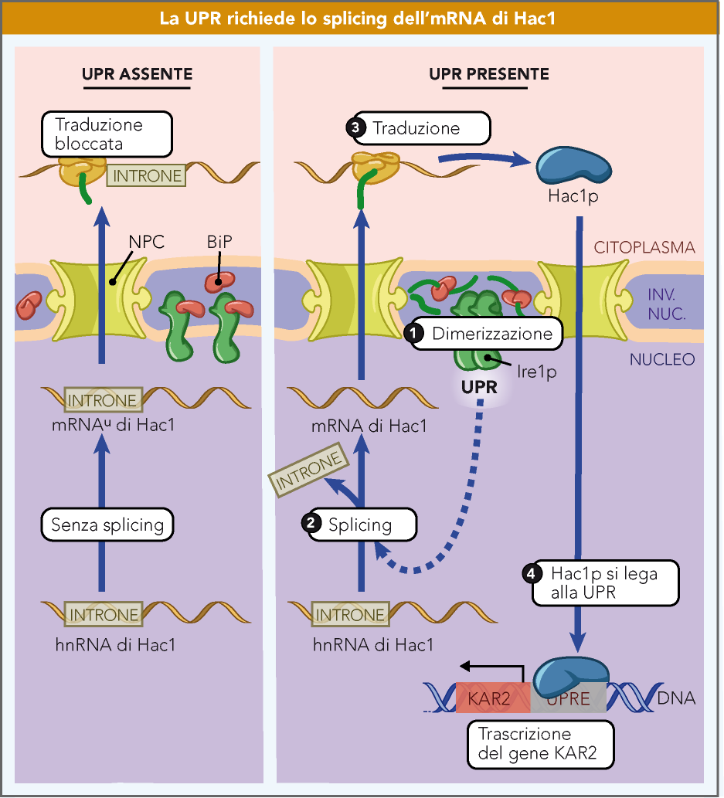
UPR in yeast
KAR2 omologo di BiP
in lievito

Slide 40
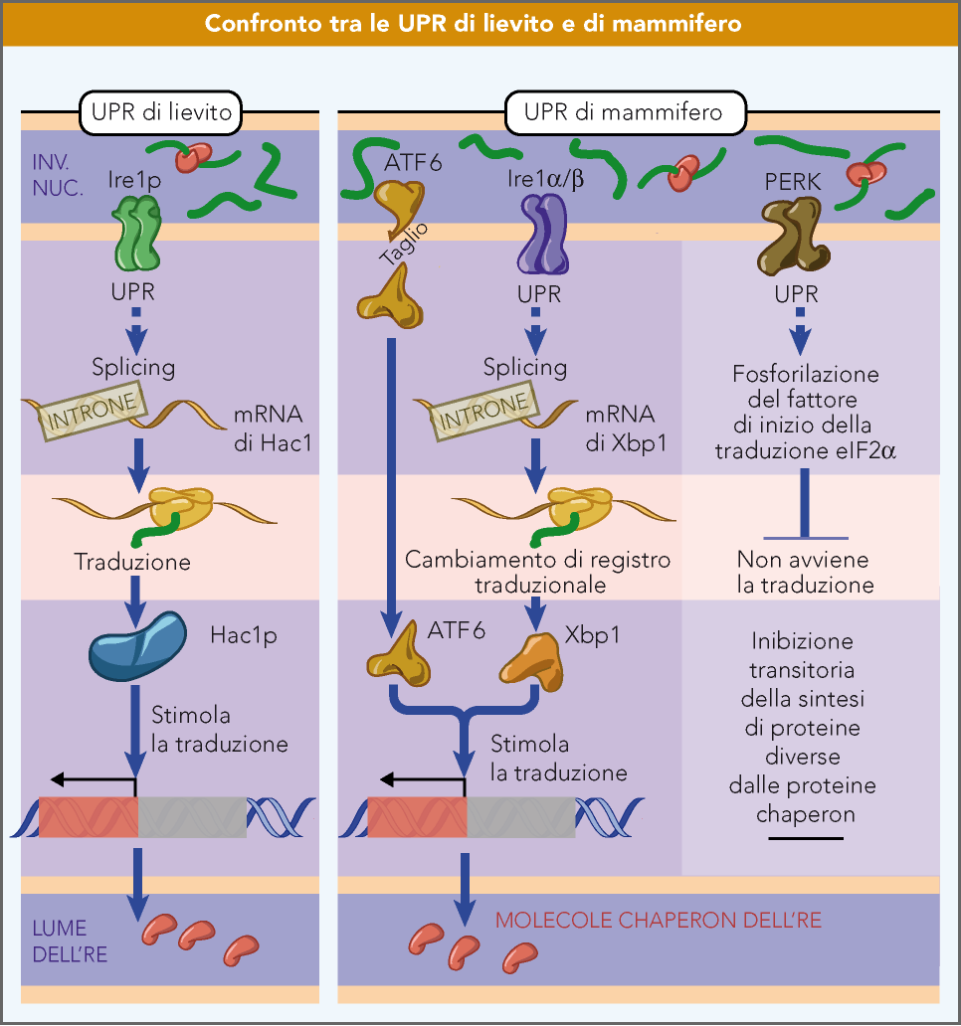
UPR nei
mammiferi
ATF6: Activating
Transcription Factor 6
Il fattore di trascrizione sXbp1
dei mammiferi non è correlato
ad Hac1p (deriva dal mRNA
Xbp1 una volta spliced per
excisione di 26 basi) e stimola
l’espressione di geni coinvolti
nella degradazione proteica
e nella UPR).
La proteina derivate dalla
forma unspliced (uXbp1) si lega
agli stessi promotori di quella
spliced esercitando però una
azione inibitoria sulla trascrizione
Notes:
XBP1 è un componente fondamentale del pathway di IRE1 (inositol-requiring enzyme 1), uno dei tre meccanismi principali (con i pathway di PERK e di ATF6) con cui la cellula risponde allo stress proteotossico del reticolo endoplasmatico (RE). Esso è innescato dal superamento del livello di soglia fisiologicamente tollerato di concentrazione di proteine un- o mis-folded all'interno del RE – a cui è capace di far fronte lo chaperone molecolare BiP.
Quando tale livello viene superato, il sensore IRE1 – proteina integrale della membrana del RE – dimerizza e si autofosforila, attivando il proprio dominio endoribonucleasico presente sul lato citosolico. All'interno del citoplasma è ubiquitariamente presente l'mRNA unspliced di XBP1 (uXBP1) — che è tradotto nella proteina uXBP1 —; su di esso agisce specificamente l'endonucleasi IRE1, andando ad effettuare un unconventional splicing che, con l'excisione di 26 nucleotidi (una cifra che non è multiplo di 3), produce un mRNA spliced (sXBP1) che, tradotto, dà luogo a una proteina differente, a motivo del frameshift a livello del codice genetico in fase di traduzione.

