Slide 1
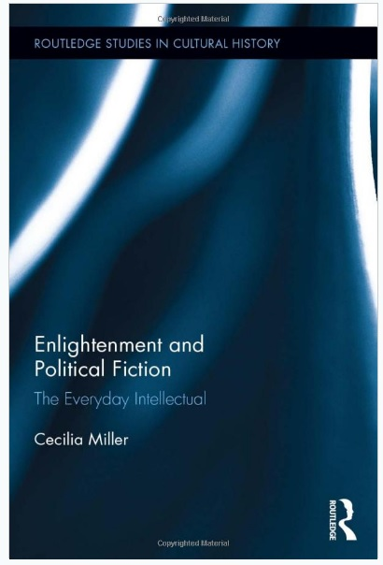

Slide 2
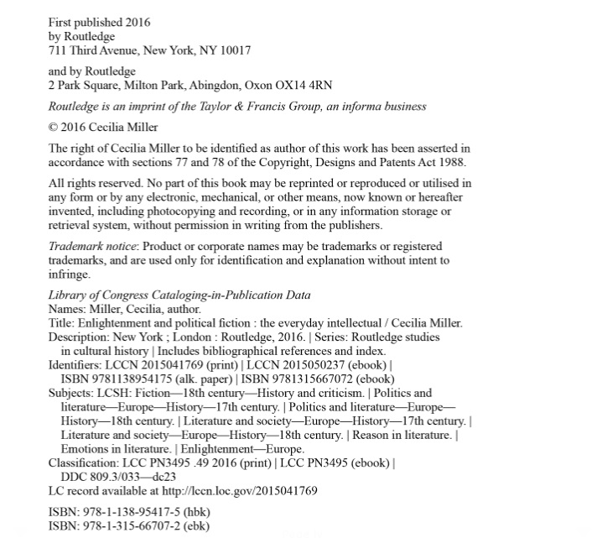

Slide 3
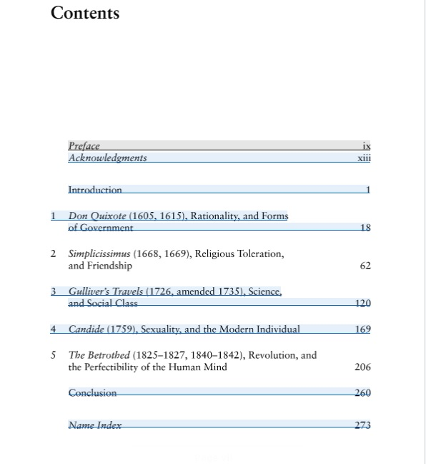

Slide 4
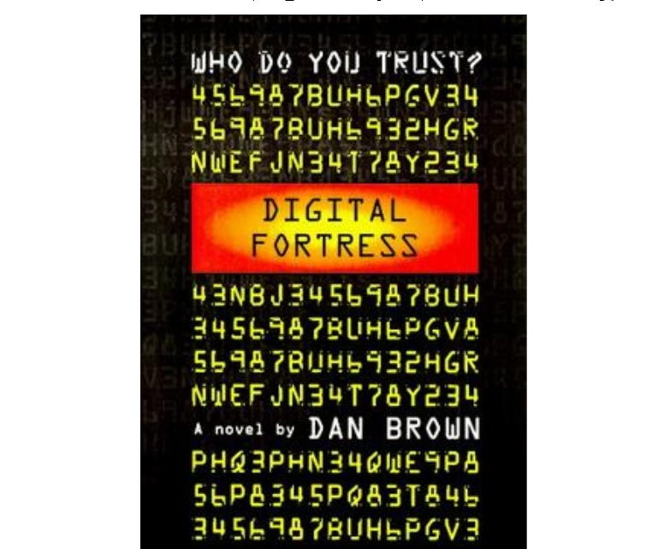

Slide 5
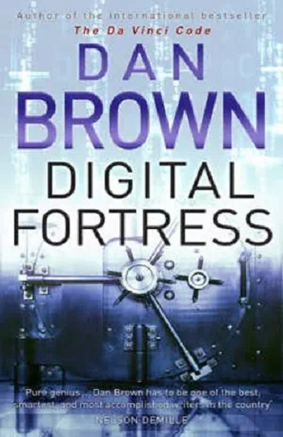
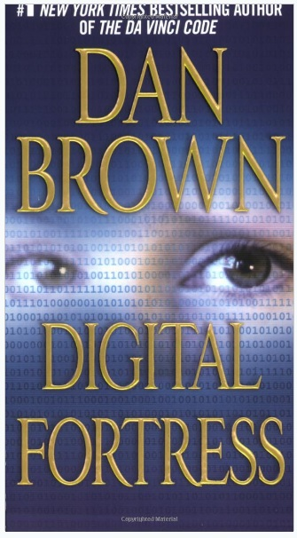

Slide 6
The book was criticized by GCN for portraying facts about the NSA incorrectly and for misunderstanding the technology in the book, especially for the time when it was published.^{[1]}
In 2005, the town hall of the Spanish city of Seville invited Dan Brown to visit the city, in order to dispel the inaccuracies about Seville that Brown represented within the book.^{[2]}
Although uranium-235 was used in the bomb on Hiroshima, the nuclear bomb dropped on Nagasaki used plutonium-239 (created from U-238). Uranium-238 is non-fissile.
Julius Caesar's cypher was not as simple as the one described in the novel, based on square numbers. In The Code Book by Simon Singh it is described as a transposition cypher which was undecipherable until centuries later.
The story behind the meaning of "sincere" is based on false etymology.^{[3]}
It is also untrue that in Spain (or in any other Catholic country) that the Holy Communion takes place at the beginning of Mass; Communion takes place very near the end.
Copyright 2020 © Global Compliance Network, Inc.

