Slide 1



The De1-SoC development board
A.Carini – Progettazione di sistemi elettronici

Slide 2

Top view
A. Carini - Progettazione di sistemi elettronici

Slide 3
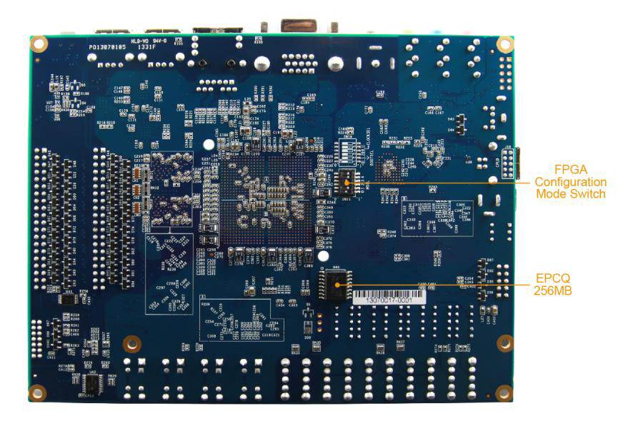
Bottom view
A. Carini - Progettazione di sistemi elettronici

Slide 4
HW FPGA
• Altera Cyclone® V SE 5CSEMA5F31C6N device
• Altera serial configuration device – EPCS128
• USB-Blaster II onboard for programming; JTAG Mode
• 64MB SDRAM (16-bit data bus)
• 4 push-buttons
• 10 slide switches
• 10 red user LEDs
• Six 7-segment displays
• Four 50MHz clock sources from the clock generator
• 24-bit CD-quality audio CODEC with line-in, line-out, and microphone-in jacks
• VGA DAC (8-bit high-speed triple DACs) with VGA-out connector
• TV decoder (NTSC/PAL/SECAM) and TV-in connector
• PS/2 mouse/keyboard connector
• IR receiver and IR emitter
• Two 40-pin expansion header with diode protection
• A/D converter, 4-pin SPI interface with FPGA
A. Carini - Progettazione di sistemi elettronici

Slide 5
HW HPS (Hard Processor System)
• 800MHz Dual-core ARM Cortex-A9 MPCore processor
• 1GB DDR3 SDRAM (32-bit data bus)
• 1 Gigabit Ethernet PHY with RJ45 connector
• 2-port USB Host, normal Type-A USB connector
• Micro SD card socket
• Accelerometer (I2C interface + interrupt)
• UART to USB, USB Mini-B connector
• Warm reset button and cold reset button
• One user button and one user LED
• LTC 2x7 expansion header
A. Carini - Progettazione di sistemi elettronici

Slide 6
Block diagram
A. Carini - Progettazione di sistemi elettronici

Slide 7
FPGA Device
• Cyclone V SoC 5CSEMA5F31 Device
• Dual-core ARM Cortex-A9 (HPS)
• 85K programmable logic elements
• 4,450 Kbits embedded memory
• 6 fractional PLLs
• 2 hard memory controllers
A. Carini - Progettazione di sistemi elettronici

Slide 8
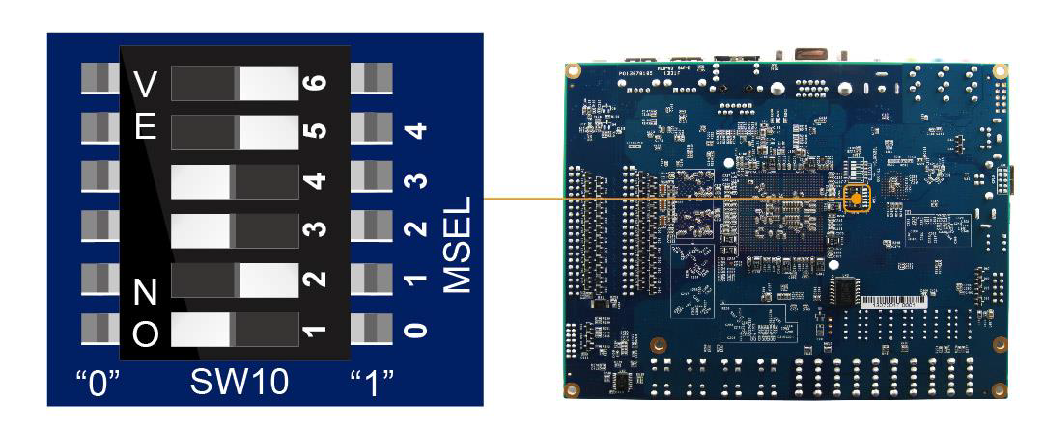
Settings of FPGA Configuration Mode
• These are the default settings (Active Serial mode) to be used in Labs:
A. Carini - Progettazione di sistemi elettronici

Slide 9
HW Resources and board manual
All HW resources (leds, buttons, switches, memories, etc.) are mapped into specific pins of the FPGA.
The pin assignment can be found on the board User Manual.
Keep at hand a copy of the board manual: DE1-SoC_User_manual.pdf
A. Carini - Progettazione di sistemi elettronici

