Slide 1
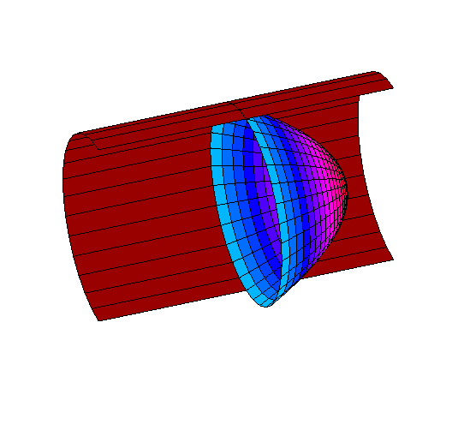
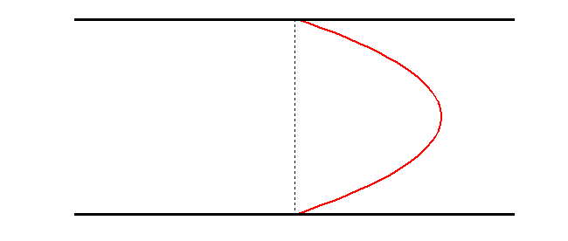
MOTO UNIFORME
In steady uniform flow in a circular vessel,
equations give the parabolic Poiseuille profile
$$v_{x}\left(r\right)=\frac{κ}{4ν}\left(R^{2}−r^{2}\right)$$
The corresponding wall shear stress is
WSS: friction
$$τ_{w}=τ\left(R\right)=μ{\left.\frac{dv_{x}}{dr}\right|}_{R}=−{\left.\frac{ρκr}{2}\right|}_{R}=−ρκ\frac{R}{2}=\frac{R}{2}\frac{∂p}{∂x}$$
$$τ_{w}2πR=\frac{∂p}{∂x}πR^{2}$$

Slide 2
The flowing discharge can be computed by integration
$$Q=\int_{A}{v_{x}dA}=\int_{0}^{R}{\int_{0}^{2π}{v_{x}rdθ}dr}=2π\int_{0}^{R}{v_{x}rdr}=2π\frac{κ}{4ν}\int_{0}^{R}{\left(R^{2}−r^{2}\right)rdr}=\frac{πκ}{2ν}{\left[\frac{R^{2}r^{2}}{2}−\frac{r^{4}}{4}\right]}_{R}=\frac{π}{8}\frac{κR^{4}}{ν}$$
And the average velocity across the section is
$$U=\frac{Q}{A}=\frac{π}{8}\frac{κR^{4}}{ν} \frac{1}{πR^{2}}=\frac{κR^{2}}{8ν}$$
$$v_{x}\left(r\right)=\frac{κ}{4ν}\left(R^{2}−r^{2}\right)$$
$$v_{x}\left(r\right)=\frac{2U}{R^{2}}\left(R^{2}−r^{2}\right)$$

Slide 3
$$β=\frac{2π\int_{0}^{R}{v_{x}^{2}rdr}}{πR^{2}U^{2}}=\frac{2}{R^{2}U^{2}}\int_{0}^{R}{v_{x}^{2}rdr}=\frac{2}{R^{2}U^{2}}\frac{4U^{2}}{R^{4}}\int_{0}^{R}{{\left(R^{2}−r^{2}\right)}^{2}rdr}=\frac{8}{R^{6}}\int_{0}^{R}{{\left(R^{2}−r^{2}\right)}^{2}rdr}=8\int_{0}^{1}{{\left(1−s^{2}\right)}^{2}sds}=8\int_{0}^{1}{\left(1+s^{4}−2s^{2}\right)sds}=8\int_{0}^{1}{\left(s+s^{5}−2s^{3}\right)ds}=8{\left[\frac{s^{2}}{2}+\frac{s^{6}}{6}−\frac{s^{4}}{2}\right]}_{s=1}=\frac{8}{6}\left(3+1−3\right)=\frac{4}{3}>1 !$$
Given a flow rate Q, the pressure loss per unit length increases with the fourth power of the vessel diameter
it is therefore natural to recognize that the decrease of the vessel size is accompanied in the vascular network by division of the vessel into multiple smaller vessels each bringing a much smaller discharges.
$U=\frac{κR^{2}}{8ν}$ → $Q=\frac{κ{πR}^{4}}{8ν}$ → $κ=\frac{8νQ}{πR^{4}}$
$U=\frac{κR^{2}}{8ν}$ and $κ=\frac{8νU}{R^{2}}$

Slide 4
GENERAL EXPRESSION OF PRESSURE LOSSES
$$\frac{dp}{dx}=\frac{8ρνU}{R^{2}}=\frac{32ρνU}{D^{2}}$$
Poiseuille
$$\frac{dp}{dx}=f(U,D,ρ,ν)$$
$$\begin{matrix}[L]=D & [T]=\frac{D}{U} & [M]=ρD^{3}\end{matrix}$$
Dimensional Analysis
$$\begin{matrix}\left[\frac{dp}{dx}\right]=\left[\frac{ML}{T^{2}}\frac{1}{L^{2}}\frac{1}{L}\right]=\left[\frac{M}{{L^{2}T}^{2}}\right]=\frac{ρD^{3}U^{2}}{D^{2}D^{2}}=\frac{ρU^{2}}{D}, & [D]=\left[L\right]=D, & [U]=\left[\frac{L}{T}\right]=U, & [ρ]=\left[\frac{M}{L^{3}}\right]=ρ, & \left[ν\right]=\left[\frac{L^{2}}{T}\right]=UD∙\end{matrix}$$
$$\frac{dp}{dx}=\frac{ρU^{2}}{D}f\left(1,1,1,\frac{ν}{UD}\right)$$
$$\frac{dp}{dx}=f\left(Re\right)\frac{ρU^{2}}{2D}$$
General Expression (Darcy Law)
$$Re=\frac{UD}{ν}$$
Reynolds number
friction coefficient
$$f\left(Re\right)=\frac{64ρνU}{D^{2}} \frac{D}{ρU^{2}}=\frac{64ν}{UD}=\frac{64}{Re}$$
Poiseuille

Slide 5
MOTO UNIFORME NON STAZIONARIO: OSCILLANTE (SINUSOIDALE)
Dopo aver considerato il caso di gradiente di pressione dato,
Passiamo al moto non stazionario con un gradiente di pressione «sinusoidale»
$$\frac{1}{ρ}\frac{∂p}{∂x}=κ\sin{ωt}$$
Stesse HP del moto di Poiseuille, rimuovendo solo l’ipotesi di moto stazionario
$$κ=ν\frac{1}{r}\frac{∂}{∂r}\left(r\frac{∂v_{x}}{∂r}\right)$$
$$\frac{∂v_{x}}{∂t}+κ\sin{ωt}=ν\frac{1}{r}\frac{∂}{∂r}\left(r\frac{∂v_{x}}{∂r}\right)$$
EQUAZIONE DA RISOLVERE
Stesse condizioni di aderenza, $v_{x}\left(t,R\right)=0$, e di regolarità a r=0
$$v_{x}\left(t,r\right)=\frac{κ}{ω}\left[1−\frac{J_{0}\left(r\sqrt{\frac{−iω}{ν}}\right)}{J_{0}\left(R\sqrt{\frac{−iω}{ν}}\right)}\right]e^{iωt}$$
SOLUZIONE
Soluzione sinusoidale
con diversa fase lungo “r”

Slide 6
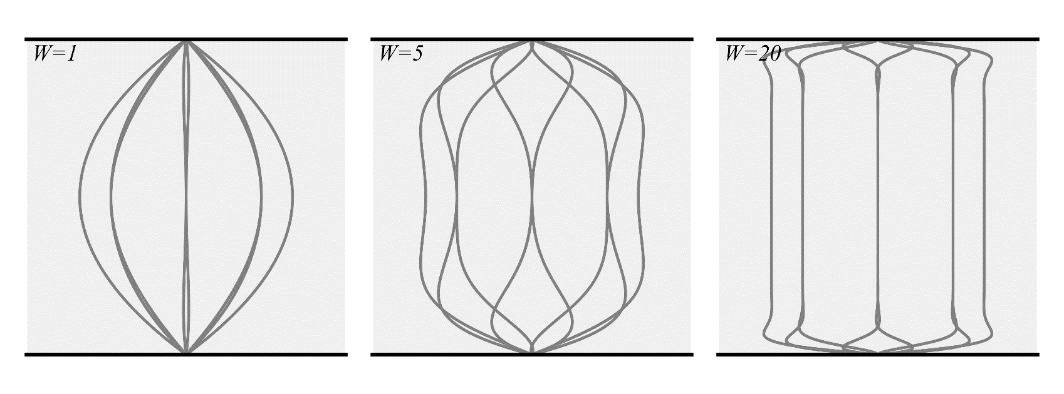
$U=\frac{κ}{ω}$ = maximum velocity
$$v_{x}\left(t,r\right)=U\left[1−\frac{J_{0}\left(\frac{r}{R}W\sqrt{\frac{−iπ}{2}}\right)}{J_{0}\left(W\sqrt{\frac{−iπ}{2}}\right)}\right]e^{i2π\frac{t}{T}}$$
SOLUZIONE
Same solution
in dimensionless form
Boundary-layer thickness
$W=R\sqrt{\frac{ω}{ν}\frac{2}{π}}=\frac{D}{\sqrt{νT}}$,
unsteadiness Vs. dissipation
high W → thin boundary layer
low W → thick, smooth, boundary layer
Womersley number:
$$Re=\frac{UD}{ν}$$
convection Vs. dissipation
high Re → vortices, turbulence, thin boundary layer
low Re → smooth viscous flow
Reynolds number:
$$St=\frac{D}{UT}=\frac{W^{2}}{Re}$$
unsteadiness Vs. convection
high St → high vibration
low St → long jets
Strouhal number:

Slide 7
MOTO UNIFORME NON STAZIONARIO: PULSANTE
Moto non stazionario con un gradiente di pressione periodico «pulsante»
$$\frac{1}{ρ}\frac{∂p}{∂x}=−κ_{0}+\sum_{n}{κ_{n}e^{iω_{n}t}}$$
Equazione (stesse HP del moto di Poiseuille, non moto stazionario)
$$\frac{∂v_{x}}{∂t}−κ_{0}+\sum_{n}{κ_{n}e^{iω_{n}t}}=ν\frac{1}{r}\frac{∂}{∂r}\left(r\frac{∂v_{x}}{∂r}\right)$$
EQUAZIONE LINEARE
Soluzione è somma delle soluzioni corrispondenti alle singole componenti della forzante
$$v_{x}\left(t,r\right)=\frac{κ_{0}}{4ν}\left(R^{2}−r^{2}\right)+\sum_{n}{\frac{κ_{n}}{ω_{n}}\left[1−\frac{J_{0}\left(r\sqrt{\frac{−iω_{n}}{ν}}\right)}{J_{0}\left(R\sqrt{\frac{−iω_{n}}{ν}}\right)}\right]e^{iω_{n}t}}$$
Moto «medio»
Poiseuille
Componenti oscillanti

Slide 8
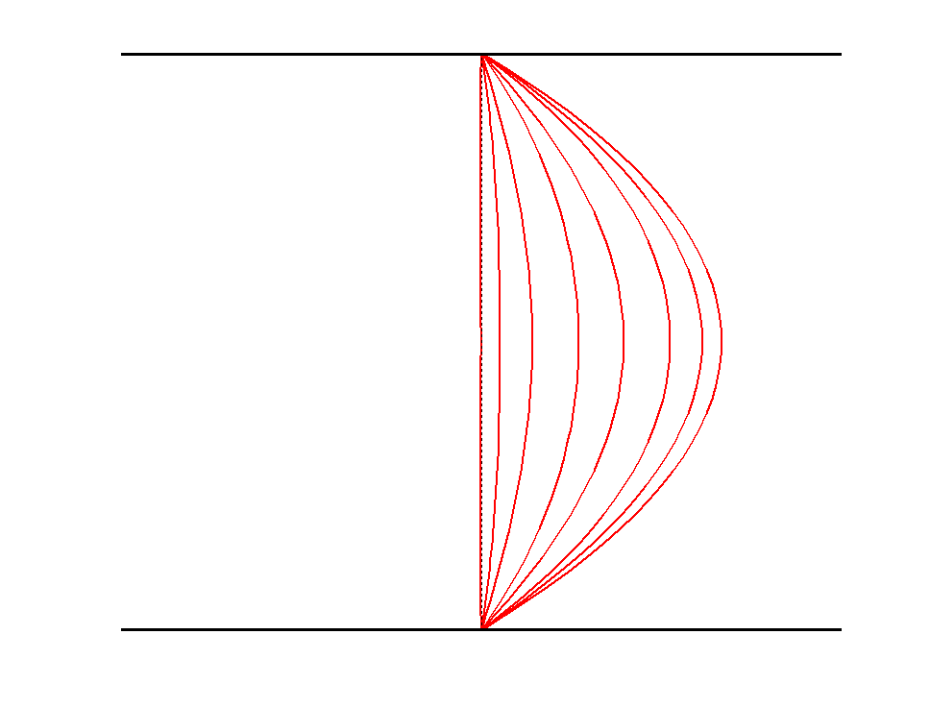
MOTO UNIFORME PULSANTE
In PULSATILE flow,
if pulsatility is SLOW → Womersley number is SMALL
Shear generate at the wall has time to diffuse and to fill the vessel
→ the solution is still approximately a sequence of parabolic profiles
$$W=\frac{D}{\sqrt{νT}}=\frac{D}{δ}$$

Slide 9
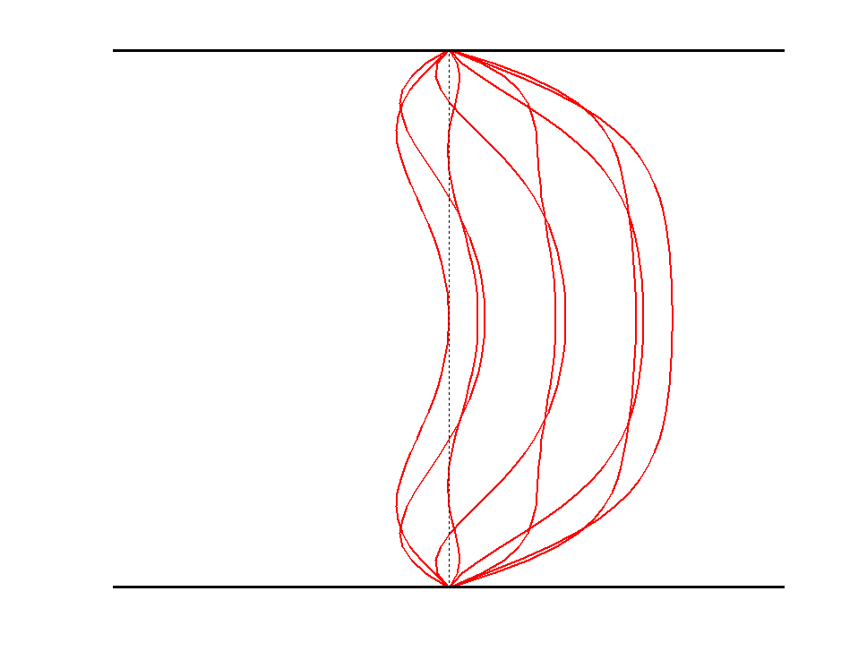
MOTO UNIFORME PULSANTE
In PULSATILE flow,
if pulsatility is RAPID → Womersley number is HIGH
Shear generate at the wall is modified by the oscillation before it has time to diffuse away
→ the solution is far from being parabolic
$$W=\frac{D}{\sqrt{νT}}=\frac{D}{δ}$$
δ
WSS (viscous phenomena)
remain confined in a thin
boundary layer near the wall
δ

Slide 10
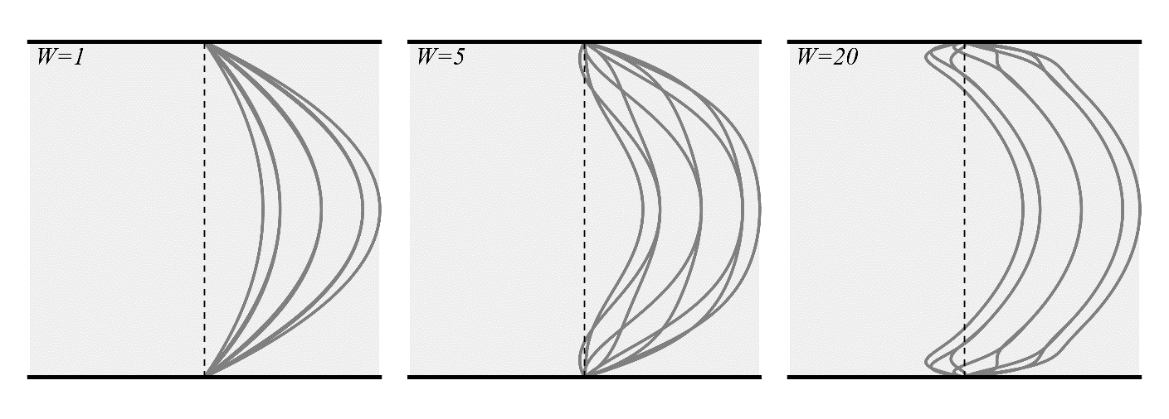
MOTO UNIFORME PULSANTE
LARGE ARTERIES
SMALL ARTERIES
& VEINS
 | $U$ [cm/s] | $D$ [cm] | $$Re$$ | $$W$$ | $$St$$
Aorta | 100 | 3 | 10000 | 20 | 0.04
Middle arteries | 30 | 1 | 1000 | 5 | 0.05
Small arteries | 5 | 0.2 | 30 | 1 | 0.05
Arterioles | 0.1 | <0.1 | <0.5 | <0.5 | ~1

