Slide 1
Main events in acute inflammation
Recognition of the INFLAMMATORY STIMULUS
RELEASE OF MEDIATORS
vascular changes
cell recruitment into tissues
formation of the inflammatory exudate

Slide 2
Phase 2: release of inflammatory mediators
Mediators are essentials for the development of inflammation
Represent the “chemical language” of inflammation, as they timely regulate all the flogistic events
May be produced locally (by cells at the site of inflammation), or may be derived from circulating inactive precursors (typically synthesized by the liver) that are activated in inflamed area
Most mediators act by binding to specific receptors on different target cells; others (e.g., lysosomal proteases, ROS) have direct enzymatic and/or toxic activities
Their actions are tightly regulated and usually shortlived
Knowing how they are generated and act, has helped to design many anti-inflammatory drugs

Slide 3
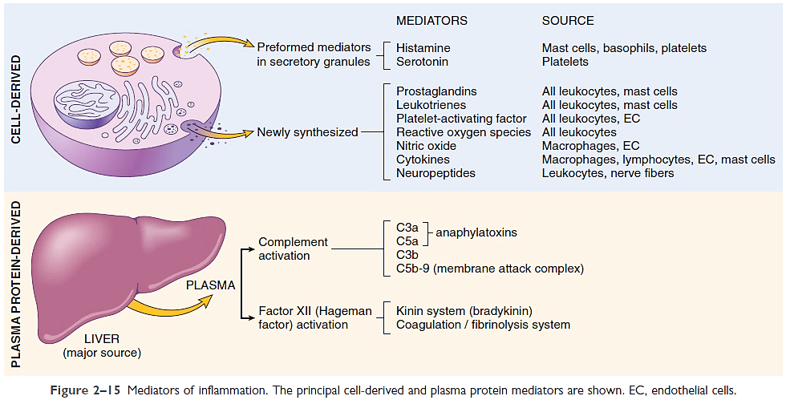
Principal mediators of inflammation

Slide 4
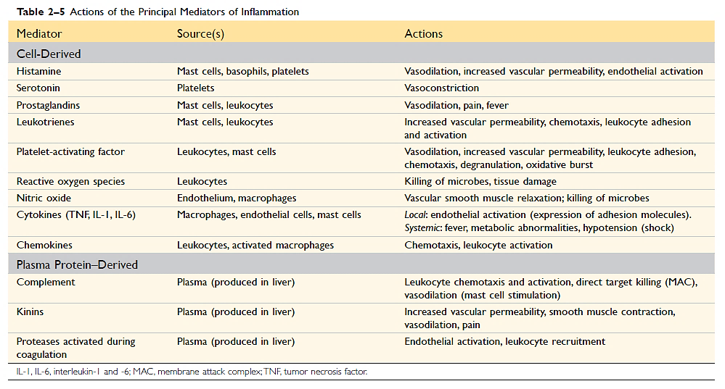
Sources and actions of the principal inflammatory mediators

Slide 5
Main events in acute inflammation
Recognition of the INFLAMMATORY STIMULUS
RELEASE OF MEDIATORS
vascular changes
cell recruitment into tissues
formation of the inflammatory exudate

Slide 6
Phase 3: vascular reactions
transient vasoconstriction (if occurs, lasts only few seconds)
arteriolar vasodilation: locally increased blood flow and hydrostatic pressure; engorgement of the down-stream capillary beds [erythema (rubor), warmth (calor)]
increased vascular permeability: microvasculature becomes more permeable; protein-rich fluid moves into the extravascular tissues [edema (tumor)]
the flowing blood becomes more concentrated, blood viscosity increases, slowing of the circulation [stasis]
Vascular walls become pro-adhesive and leukocytes (principally neutrophils) begin to accumulate along the vascular endothelial surface [margination]

Slide 7
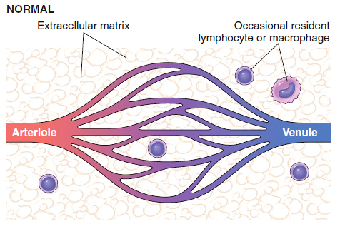
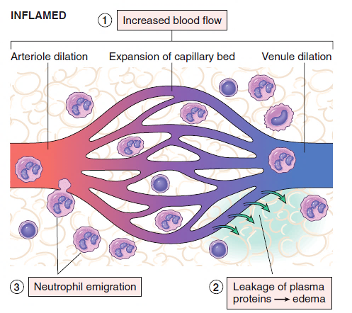
Phase 3: vascular reactions in acute inflammation
Major local manifestations of acute inflammation
(1) vascular dilation and increased blood flow (erythema and warmth); hydrostatic pressure increases
(2) extravasation of plasma fluid and proteins (edema); blood slows down
(3) neutrophil emigration and accumulation in the interstitium
↑ ρgh

Slide 8
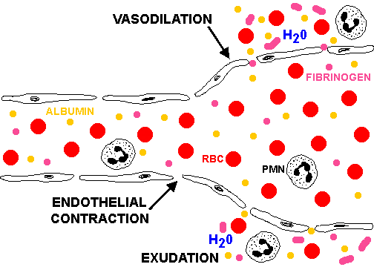
Formation of exudate in acute inflammation: plasma proteins and neutrophils
Alcuni mediatori infiammatori interagiscono con recettori specifici presenti sulle cellule endoteliali
Innesco del signaling che promuove la fosforilazione di proteine citoscheletriche e contrattili
Contrazione delle cellule endoteliali con separazione delle giunzioni intercellulari (da 5-10 nm a 100-300 nm)
Soluble defensive factors move from the blood to the extra-vascular space: - antibodies - complement fragments - drugs

Slide 9
Main events in acute inflammation
Recognition of the INFLAMMATORY STIMULUS
RELEASE OF MEDIATORS
vascular changes
cell recruitment into tissues
formation of the inflammatory exudate

Slide 10
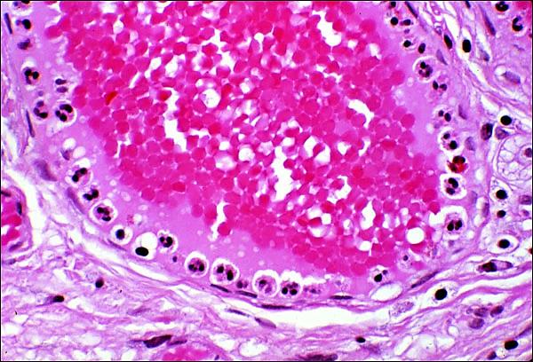
Phase 4: leukocyte recruitment into tissue
Leukocytes normally flow rapidly in the blood in the center of the vessel
During the inflammatory response, as blood flow slows, leukocytes collect along the endothelium [margination]
They have to be stopped and brought to the offending agent or the site of tissue damage [diapedesis], which are typically outside the vessels
Post-capillary venule section in an inflamed lung: hyperemia stasis leukocyte margination

Slide 11
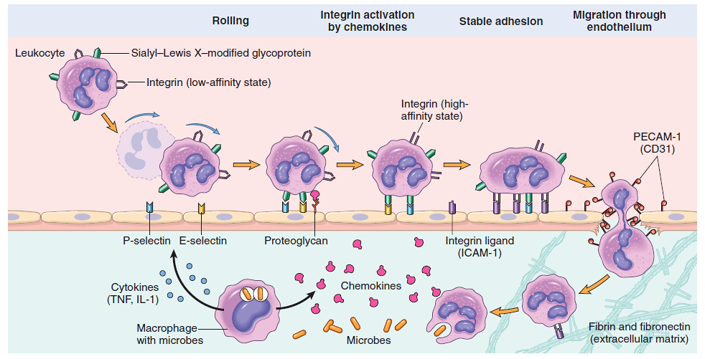
Neutrophil recruitment into infected tissue: the prototype model of leukocyte migration
3 main chemoattractant-producing cells:
macrophages
endothelial cells (EC)
microbes
EC
Neutrophils first roll, then become activated and adhere to endothelium, then transmigrate across the endothelium, pierce the basement membrane, and migrate toward chemoattractants emanating from the source of injury

Slide 12
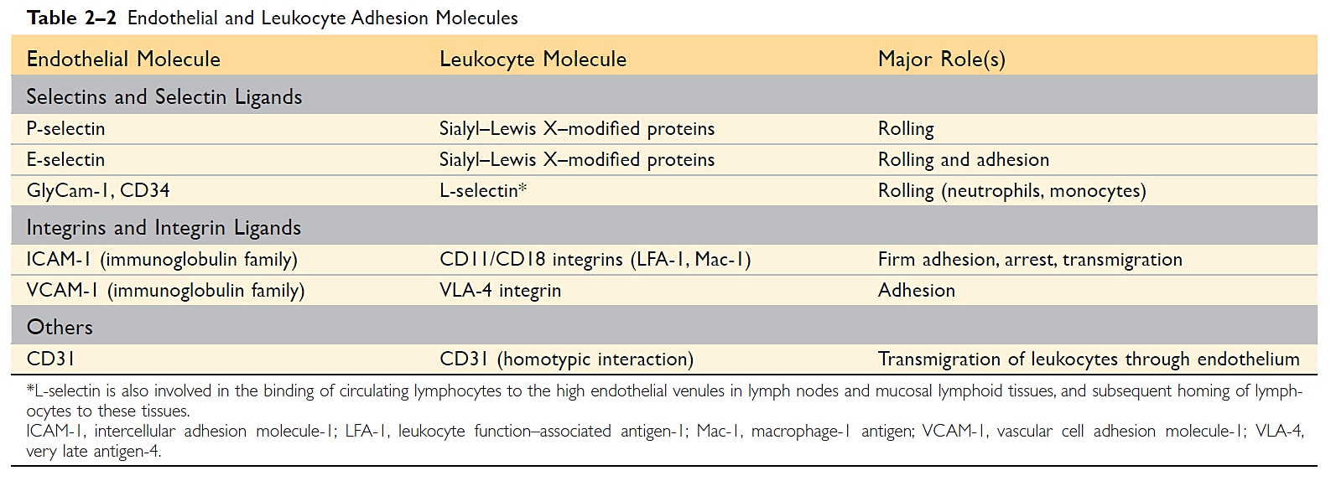
Specific molecular interactions with endothelial cells regulate leukocyte migration into the extra-vascular microenvironment
Integrins

Slide 13
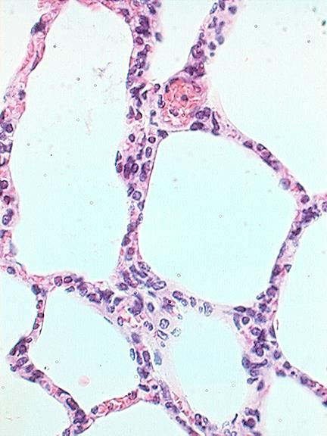
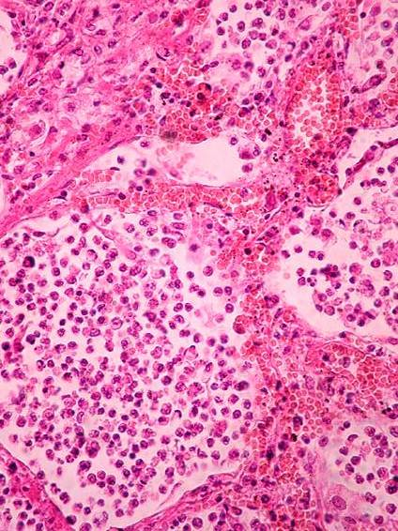
Normal lung
Inflammed lung in lobar pneumonia: neutrophils accumulate into alveoli
http://www.youtube.com/watch?v=w6OTFKACT2w

Slide 14
Moving toward the inflammatory stimulus: chemotaxis
After extravasating from the blood, leukocytes move toward sites of infection or injury along a chemical gradient
Both exogenous and endogenous substances can be chemotactic for leukocytes, including the following:
Bacterial products, mainly peptides with N-formylmethionine residues
Cytokines, especially those of the chemokine family (IL-8)
Components of the complement system, particularly C5a
Products of the lipoxygenase pathway of arachidonic acid
metabolism, particularly leukotriene B4 (LTB4)

Slide 15
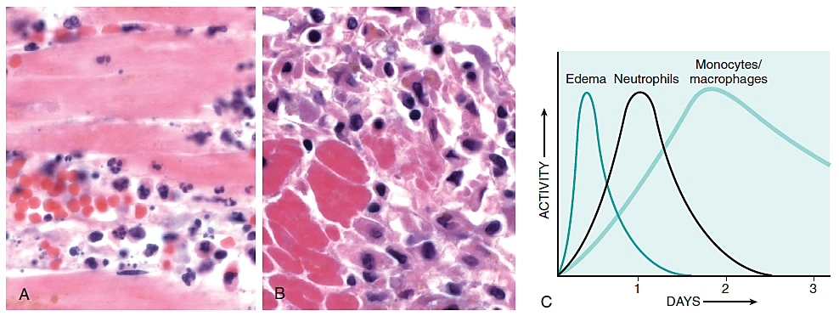
Leukocyte recruitment into tissue
The kind of emigrating leukocyte varies with the age of the inflammatory response and the type of stimulus
In most forms of acute inflammation, neutrophils predominate in the inflammatory infiltrate during the first 6 to 24 hours and are replaced by monocytes in 24 to 48 hours
Inflammatory reaction in the myocardium after ischemic necrosis. A, Early neutrophilic infiltrates and congested blood vessels. B, Later mononuclear cellular infiltrates. C, Kinetics of edema and cellular infiltration.

Slide 16
Leukocyte recruitment into tissue
The relevance of all the events leading to leukocyte recruitment into tissues is witnessed by the existence of pathologic syndromes characterized by defects in cell migration and consequent recurrent infection
This topic will be tackled later in more details in the chapter «IMMUNOPATHOLOGY», section «Immunodeficiencies»

Slide 17
Acute inflammation
Leukocyte activation: a prerequisite for leukocyte to complete their mission

Slide 18
Leukocyte activation
Stimuli for leukocyte activation include microbes, products of necrotic cells, and several other mediators
Leukocytes use various receptors to sense the presence of microbes, dead cells, and other foreign substances
Leukocyte activation results in the enhancement of the following functions:
Phagocytosis (typical of professional phagocytes, such as neutrophils, monocytes and macrophages)
Liberation of substances (e.g., granular lytic enzymes) that destroy extracellular microbes and dead tissues
Production of mediators, including arachidonic acid metabolites and cytokines that amplify the inflammatory reaction by recruiting and activating more leukocytes

Slide 19
Major steps and consequences of leukocytes activation
Recognition of stimulus
PROFESSIONAL PHAGOCYTES
Engulf particles
Kill microbes
Release lytic enzymes
Release mediators
Leukocyte activation
AMPLIFICATION OF THE INFLAMMATORY REACTION
OTHER LEUKOCYTES
Approach the inflammatory site
Release mediators

Slide 20
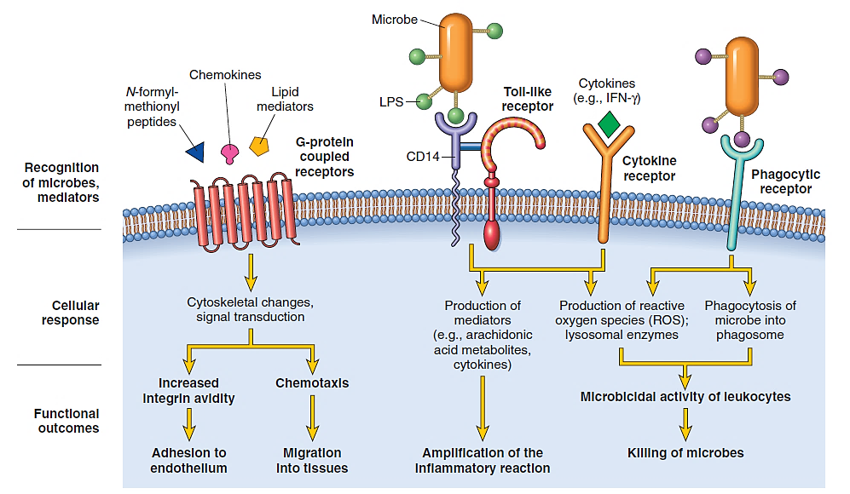
Different classes of cell surface receptors can mediate leukocyte activation
e. g. opsonin receptors
FcγR, CR1, CR3
C3b
IgG

Slide 21
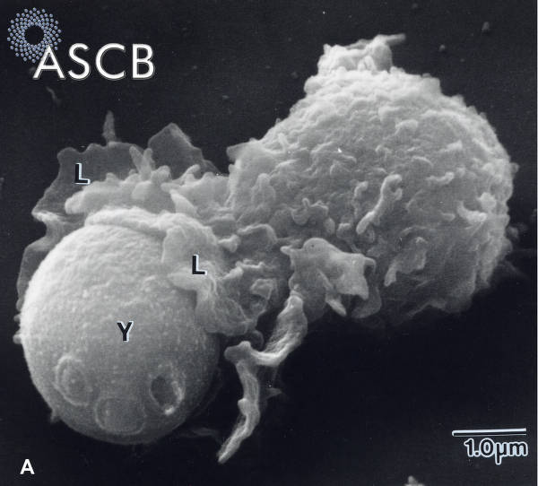
Phagocytosis: crucial to defeat infections
A phagocyte (L) engulfing a blastospore of Candida albicans (Y)

Slide 22
Main steps of phagocytosis and microbial killing
Three main steps:
(1) recognition and attachment of the microbe to the ingesting leukocyte [role of opsonins (IgG, C3b) that coat microbes and target them for phagocytosis; opsonization]
(2) engulfment: pseudopods are extended around the microbe, with subsequent formation of a phagocytic vacuole; lysosomes containing microbicidal proteins than fuse to the membrane of the phagocytic vacuole (birth of phagolysosome, an authentic “death chamber” sequestering the ingested microbe)
(3) killing and degradation of the ingested microbe

Slide 23
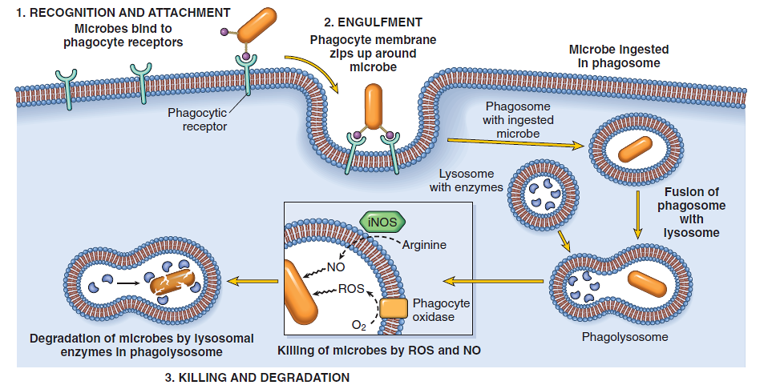
Main steps of phagocytosis and microbial killing
iNOS, inducible nitric oxide synthase; NO, nitric oxide; ROS, reactive oxygen species

Slide 24
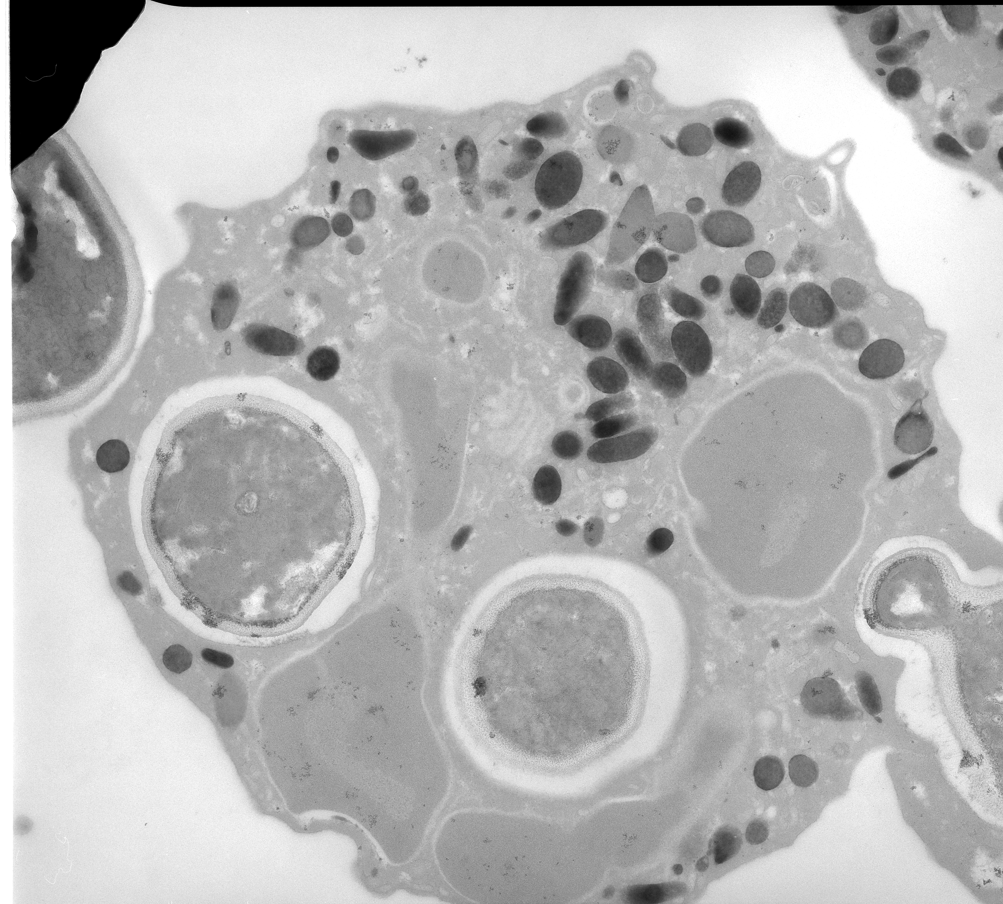
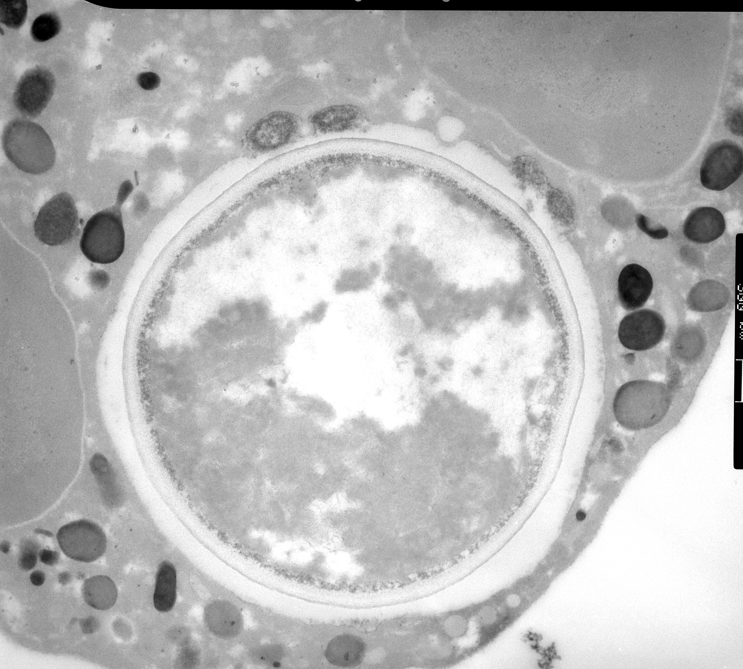
Phagocytosis by electron microscopy
blastospores of Candida albicans
Lysososmes fuse with the phagosome membrane
phagolysosome
phagosomes
Section of a neutrophil engulfing C. albicans observed by transmission electron microscopy

Slide 25
How can neutrophils kill microbes?
Two main mechanisms (often acting together)
Oxygen-dependent
Phagocytosis and engagement of various cellular receptors stimulate an oxidative burst, which is characterized by a rapid increase in oxygen consumption, glycogen catabolism, increased glucose oxidation, and production of ROS
Oxygen-independent
Microbicidal substances stored in neutrophil granules are discharged into the phagolysosome

Slide 26
How can neutrophils kill microbes? oxygen-dependent microbicidal mechanisms
ROS generation is due to rapid activation of a leukocyte NADPH oxidase (the phagocyte oxidase, phox) which oxidizes NADPH thereby converting oxygen to superoxide anion (O₂⁻•)
Superoxide is then converted by dismutation into hydrogen peroxide (O₂⁻• + 2H+ → H₂O₂)
The lysosomes of neutrophils (azurophilic granules) contain the enzyme myeloperoxidase (MPO) that in the presence of a halide, such as Cl⁻, converts H₂O₂ to HOCl (hypochlorous acid), a powerful antimicrobial agent that kills bacteria by protein and lipid chlorination and/or peroxidation

Slide 27
Main steps of phagocytosis and microbial killing
iNOS, inducible nitric oxide synthase; NO, nitric oxide; ROS, reactive oxygen species

Slide 28
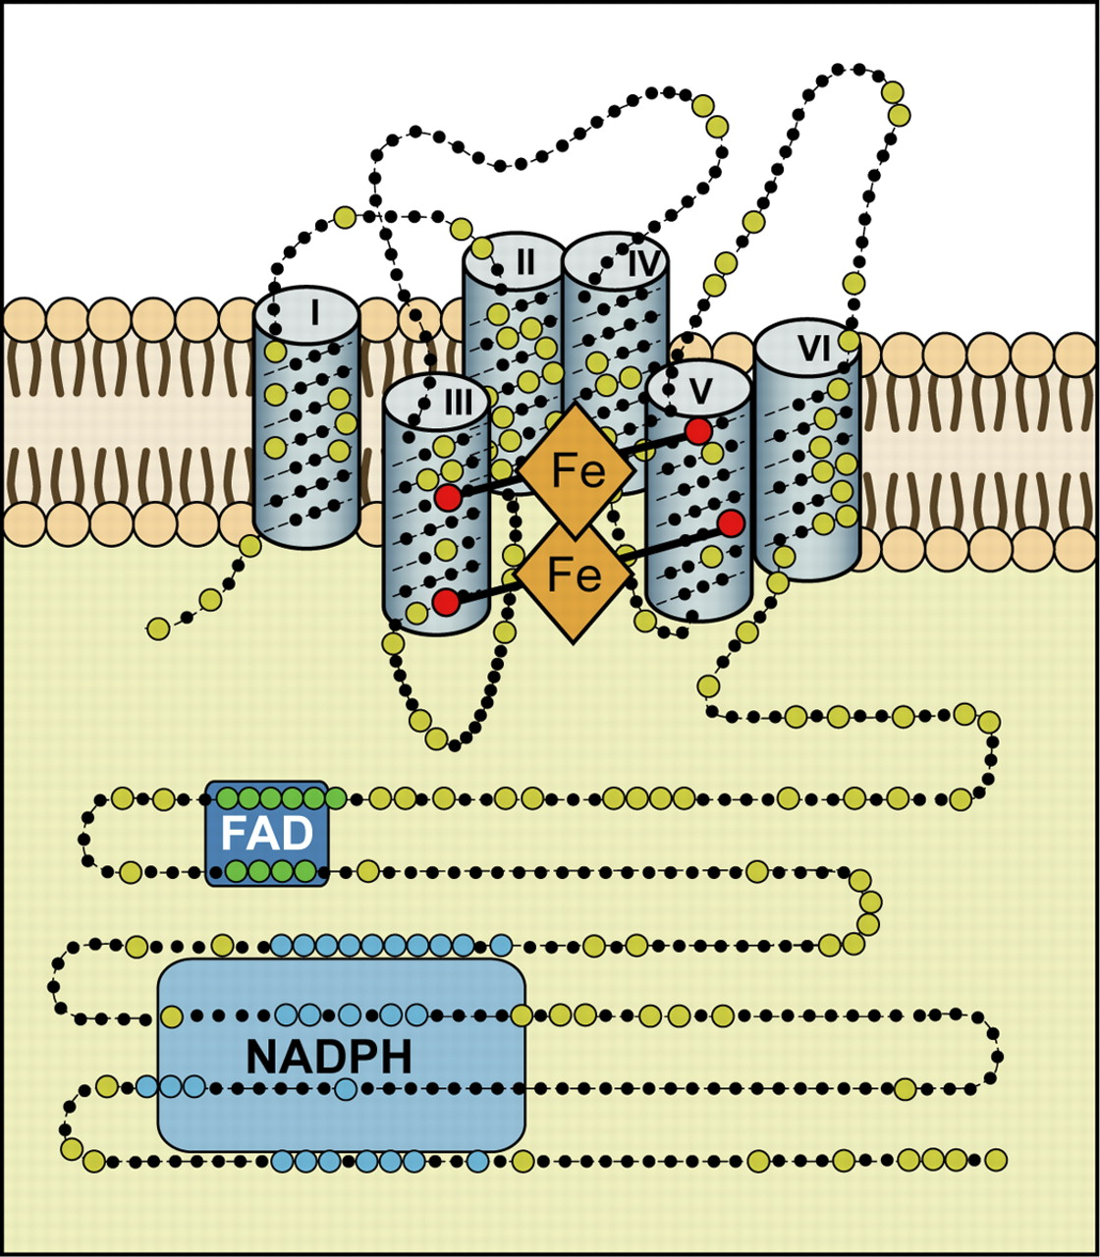
The cytoplasmic COOH terminus contains conserved flavin adenine dinucleotide (FAD) and NADPH binding domains. NOX enzymes are single electron transporters: they pass electrons from NADPH to FAD, to the first heme, to the second heme, and finally to oxygen
NADPH-ox in activated phagocyte
Phagolysosome membrane
MPO (from granules)
HOCI
H₂O₂
SOD
O₂
O₂–
NADPH oxidase in resting phagocyte
Activation
e–
gp91^{phox}
gp91^{phox}
p22^{phox}
p22^{phox}
HEME
HEME
plasma membrane
HEME
HEME
p47^{phox}
rac
GTP
cytoplasm
p40^{phox}
p67^{phox}
FAD
FAD
e–
p47^{phox}
p7^{phox}
p67^{phox}
rac
NADPH
NADP⁺ + H⁺
GDP
RhoGDI
(Rho-GDP diss. inh.)
p40^{phox}

Slide 29
How can neutrophils kill microbes? oxygen-independent microbicidal mechanisms
Constituents of neutrophil granules mostly involved in killing infectious pathogens:
Bactericidal permeability-increasing protein (BPI): causes phospholipase activation and membrane phospholipid degradation
Lysozyme: degrades bacterial coat oligosaccharides
Defensins: peptides that kill microbes by creating holes in their membranes (osmotic lysis)

Slide 30
Defensins: antimicrobial peptides
Small (29–35 amino acids), positively-charged proteins produced mainly by circulating white blood cells and epithelial cells
Antimicrobial properties: disrupt bacteria, fungi, parasites, and some enveloped viruses mainly by forming multimeric pores in the cell membranes of these pathogens
Two families, the α- and β-defensins
Neutrophils mainly contain α-defensins (HD, human defensins)
HD 1 to HD 4 are produced by neutrophils and are found in the airways; HD 5 and HD 6 are found in the small intestine and female urogenital tract
The β-defensins are produced by most mucosal epithelial tissues, but appear to be preferentially expressed in the urogenital tract, particularly in the testis and epididymis in the male, and their production is stimulated by TLR ligands and cytokines

Slide 31
Leukocyte activation
Alterations of leukocyte functions underlie many human diseases
Syndromes featured by defective or excessive activation are known
Given the irreplaceable role of leukocytes in defending from invading microorganisms, defects are inevitably associated with an increased susceptibility to infections
Excessive leukocyte activation is peculiar of hypersensibility reactions

Slide 32
Outcomes of acute inflammation
The consequences of acute inflammation depend on the nature and intensity of the injury, the site and tissue affected and, notably, the ability of the host to mount a response
Acute inflammation generally has one of the three following outcomes:
resolution (with regeneration and repair)
progression to chronic inflammation
scarring

Slide 33
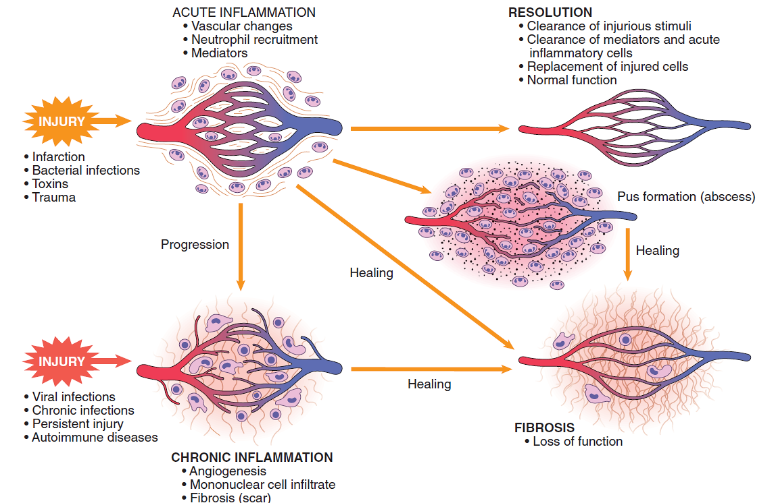
Outcomes of acute inflammation
scar
scar
scar
persistent tissue damage

Slide 34
Outcomes of acute inflammation: resolution
The usual outcome is restoration to structural and functional normalcy (restitutio ad integrum) when:
the injury is limited or short-lived
there has been no or minimal tissue damage
the injured tissue is capable of regenerating

Slide 35
Resolution: main events involved in the termination of acute inflammation
Neutralization (e.g. decay, enzymatic degradation) of the various chemical mediators (e.g. histaminase)
Normalization of vascular permeability
Cessation of leukocyte emigration, with subsequent death (by apoptosis) of extravasated neutrophils
Decreased synthesis of pro-inflammatory mediators (e.g, TNF)
Increased synthesis of anti-inflammatory mediators (e.g. TGFβ)

Slide 36
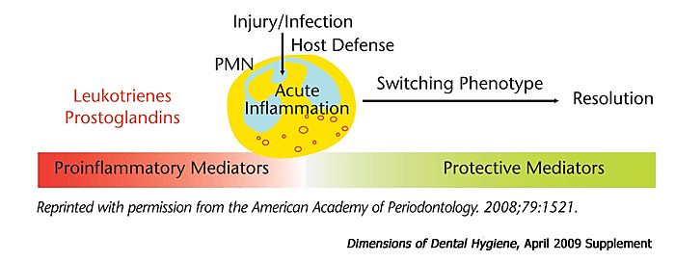
Resolution: novel endogenous anti-inflammatory pro-resolving lipid mediators
Specific pro-resolving lipid-based mediators belong to a family of novel endogenous chemical mediators that include lipoxins, resolvins and protectins
Potent modulators of the duration and magnitude of inflammation; synthesized by leukocytes, epithelial cells and platelets

Slide 37
Pro-resolving lipid mediators
Lipoxins (from arachidonic acid): powerful inhibitors of neutrophil infiltration; potentiate macrophage-mediated clearance of apoptotic neutrophils. Aspirin (acetylsalicylic acid), alone among the non-steroidal anti-inflammatory drugs (NSAIDs*), stimulates the early formation of pro-resolving lipoxins
Resolvins and protectins (from omega-3 polyunsaturated fatty acids); potent anti-inflammatory capabilities at very low concentrations (nM, pM). Like lipoxins, both halt PMN infiltration and transmigration
* Noti anche come farmaci anti-infiammatory non-steroidei (FANS)

Slide 38
Outcomes of acute inflammation: scarring
Scarring is a type of repair after substantial tissue destruction or when inflammation occurs in tissues that do not regenerate, in which the injured tissue is filled in by connective tissue (e. g., myocardial infarction, deep excisional wounds)
In organs in which extensive connective tissue deposition occurs in attempts to heal the damage (or as a consequence of chronic inflammation, discussed later) the outcome is fibrosis, a process that can significantly compromise function

Slide 39
Outcomes of acute inflammation
scar
scar
scar
persistent tissue damage

Slide 40
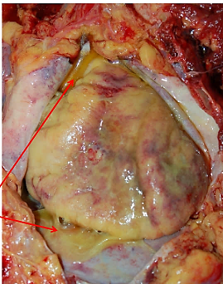
Outcomes of acute inflammation: suppuration (pus formation)
A peculiar outcome of acute inflammation is the collection of large amounts of purulent exudate (pus) consisting of neutrophils, necrotic cells, and edema fluid.
Certain organisms (e.g., staphylococci, gonococci, meningococci) are more likely to induce such localized suppuration (and are therefore referred to as pyogenic, i. e. pus-forming); they can attract and kill neutrophils
purulent exudate in pericardial cavity

Slide 41
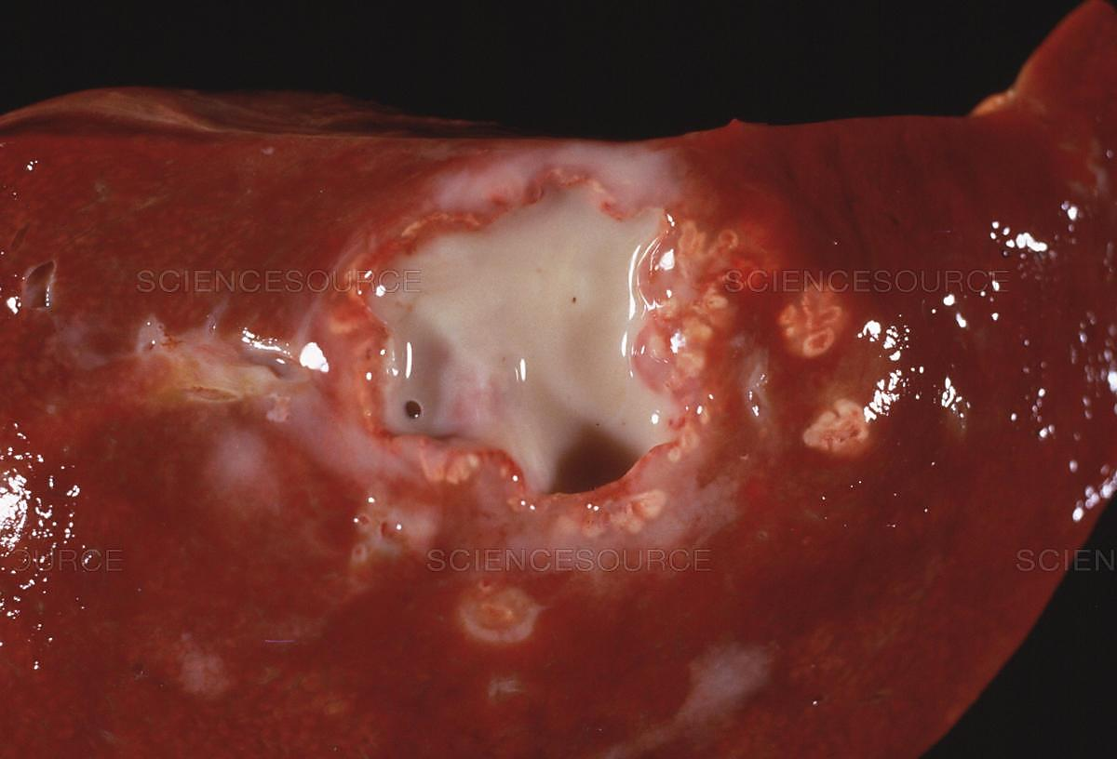
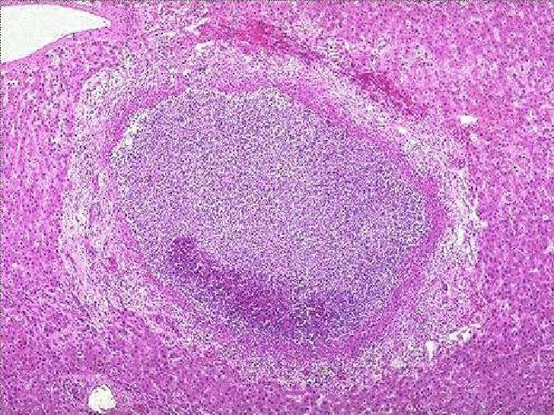
Outcomes of acute inflammation: suppuration with abscess formation
Abscesses are focal collections of pus that may be caused by seeding of pyogenic organisms into a tissue or by secondary infections of necrotic foci
Abscesses typically have a central, necrotic region rimmed by a layer of preserved neutrophils, with a surrounding zone of dilated vessels and fibroblast proliferation indicative of attempted repair
As time passes, the abscess may become completely walled off and eventually be replaced by connective tissue
Because of the underlying tissue destruction, the usual outcome with abscess formation is scarring
intact liver
necrosis
Liver abscess

Slide 42
Outcomes of acute inflammation
scar
scar
scar
persistent tissue damage

