Slide 1
A journey to cancer: inflammation as the driving force?
A tangled web of molecular signals mediate the crosstalk between inflammatory and tumor cells

Slide 2
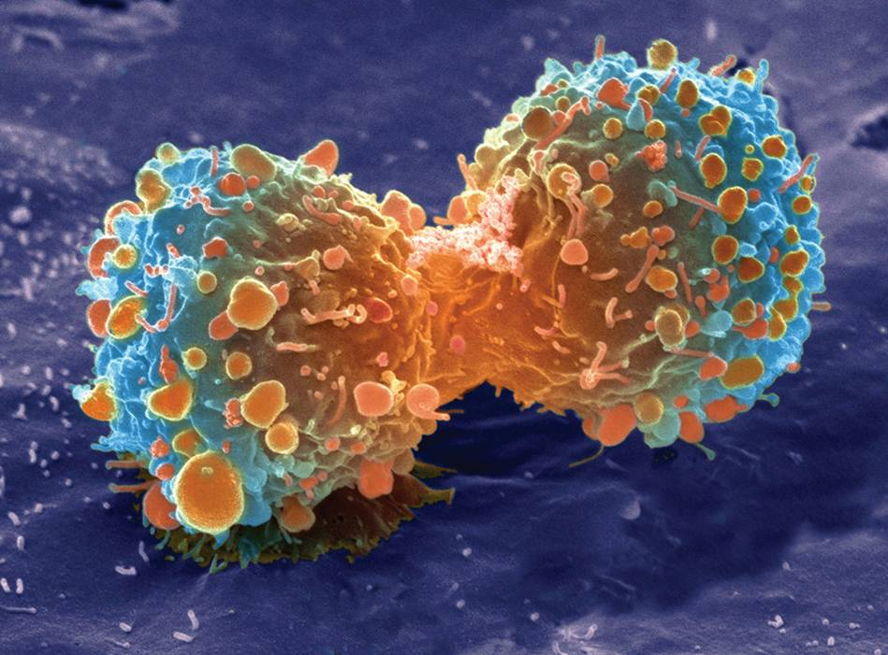
Neoplasie
La malattia neoplastica è caratterizzata da un’alterazione di quei meccanismi omeostatici che hanno un ruolo rilevante nella regolazione della proliferazione cellulare
segnali proliferativi
segnali di morte

Slide 3
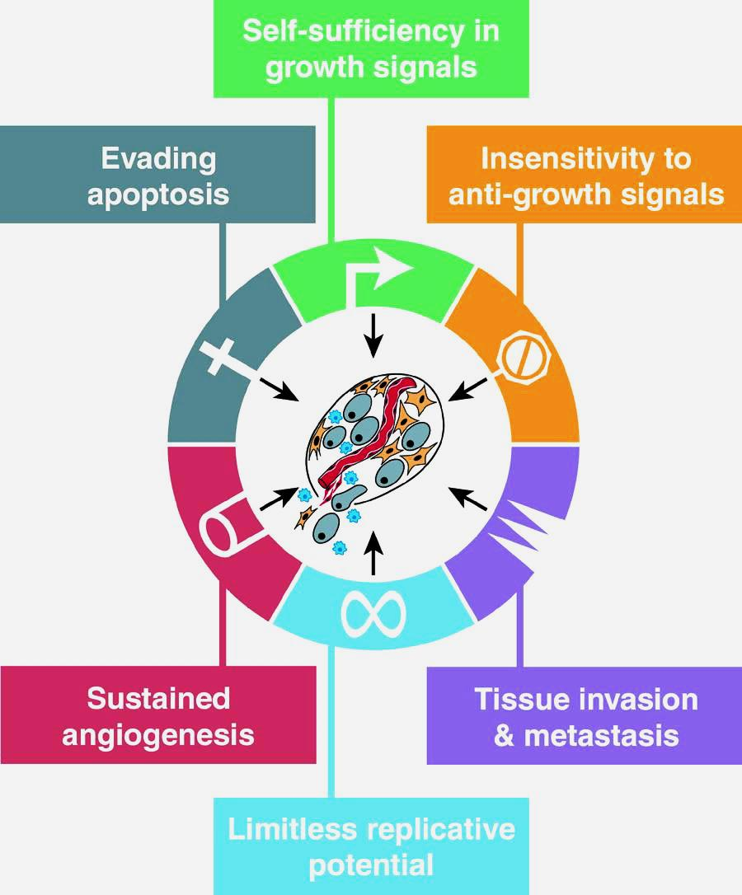
Growth dysregulation underlies cancer development
Hanahan D, et al. [Cell, 2000]
The hallmarks of cancer

Slide 4
Inflammation and cancer: more than one century ago….
1863: Rudolf Virchow (german pathologist, 1821-1902) first noted leucocytes in neoplastic tissues;
He made a connection between inflammation and cancer;
He suggested that “….the lymphoreticular infiltrate (nowadays “leukocytes”) reflects the origin of cancer at sites of chronic inflammation”.
Virchow’s detection of inflammatory infiltrates in solid malignancies has gained strong mechanistic support, leading to recognition of tumor-associated inflammation as a hallmark of cancer

Slide 5
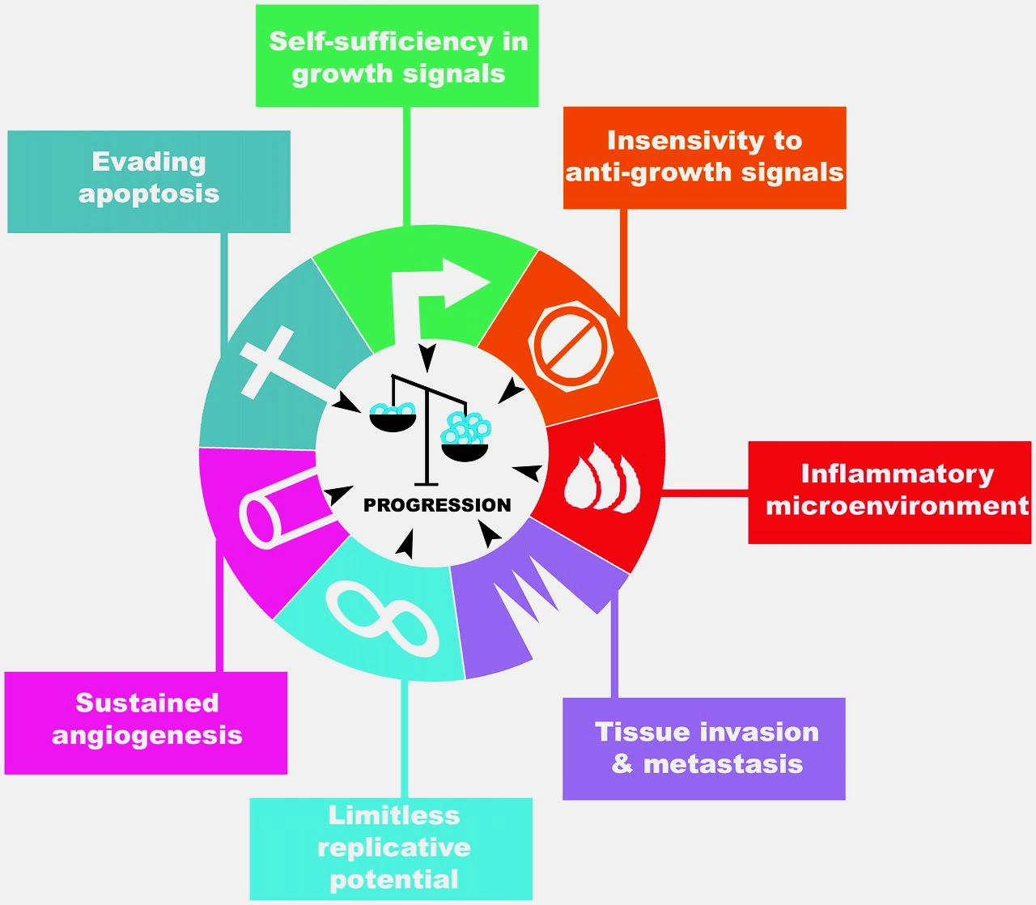
Inflammation: the seventh hallmark of cancer
Colotta F, et al. [Carcinogenesis, 2009]
Cancer-related inflammation, the seventh hallmark of cancer

Slide 6
Evidence linking cancer and inflammation: about cells and molecules
• Chronic inflammatory diseases increase the risk of developing many types of cancer (including bladder, cervical, gastric, intestinal, oesophageal, ovarian, prostate, lung and thyroid cancer)
• Experimental data show that adoptive transfer of inflammatory cells or overexpression of inflammatory cytokines promote the development of tumours
• Inflammatory cells, chemokines and cytokines are present in the microenvironment of all tumours in experimental animal models and humans from the earliest stages of their development

Slide 7
Evidence linking cancer and inflammation: about therapy
Non-steroidal anti-inflammatory drugs, acting mainly on arachidonic acid metabolim, reduce the worsening and the mortality caused by certain cancers (such as colon and breast cancer)
New generation drugs targeting inflammatory mediators (chemokines and cytokines, such as TNF-α and IL-1β) and key transcription factors involved in inflammation (such as NF-κB and STAT3) decrease the incidence and spread of cancer

Slide 8
Frequently used abbreviations
NF-κB: nuclear factor-κB
STAT3: signal transducer and activator of transcription 3
NSAIDs: non steroidal anti-inflammatory drugs
TNF: tumor necrosis factor
TAMs: tumor associated macrophages
IBD: inflammatory bowel disease
CD: Crohn’s disease
UC: ulcerative colitis
CAC: colitis associated cancer
MDSCs: myeloid-derived suppressor cells
LPS: lipopolysaccharide
APC: antigen presenting cell
FGF : fibroblast growth factor
VEGF: vascular endothelial growth factor

Slide 9
Inflammation and cancer
Early work (in the ‘90s) has mainly addressed the link between preexisting inflammation and subsequent tumor development (extrinsic pathway)
More recent efforts have been dedicated to understand tumor-elicited inflammation, the inflammatory reaction that follows tumor development and is detected in nearly all solid malignancies (intrinsic pathway)

Slide 10
Pathways connecting inflammation and cancer
Extrinsic pathway: pre-existing inflammatory or infectious conditions augment the risk of developing cancer at certain anatomical sites (for example, the colon, prostate and pancreas)
Intrinsic pathway: stimulated by genetic events that cause neoplasia, such as activation of tumor-promoting genes (by mutations, chromosomal rearrangements or amplifications) and/or inactivation of tumour-suppressor genes
Transformed neoplastic cells acquire the ability to produce inflammatory mediators, thereby generating an inflammatory microenvironment in tumours without a pre-existing inflammatory condition (for example, some breast tumours)

Slide 11
Pathways connecting inflammation and cancer
Intrinsic and extrinsic pathways converge, resulting in the activation in tumour cells of transcription factors, mainly nuclear factor-κB (NF-κB) and signal transducer and activator of transcription 3 (STAT3)
Transcription factors coordinate the production of inflammatory mediators, including cytokines and chemokines, and cyclooxygenase 2 (COX2)
Cytokines and chemokines recruit and activate various leukocytes, most notably cells of the myelomonocytic lineage
Cytokines activate the same key transcription factors in inflammatory cells, stromal cells and tumour cells, resulting in more inflammatory mediators being produced and a cancer-related inflammatory microenvironment being generated

Slide 12
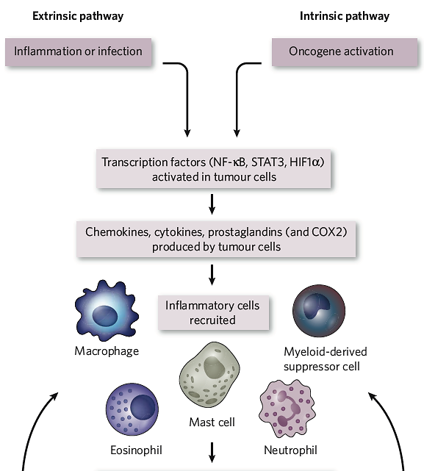
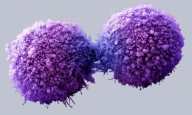
Intrinsic and extrinsic pathway (1)

Slide 13
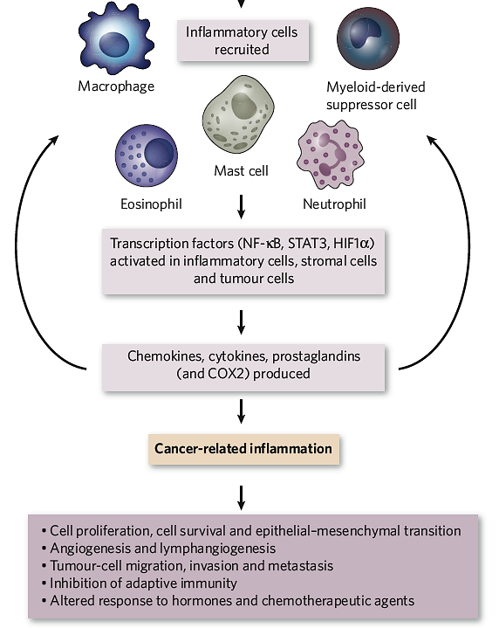
Intrinsic and extrinsic pathway (2)
amplification

Slide 14
Examples of associations between inflammation and cancer risk
Inflammatory stimulus/condition Malignancy
Schistosomiasis (parasitic) Bladder
Papillomavirus Cervical
Pelvic inflammatory disease Ovarian
H. pylori induced gastritis Gastric
Barrett’s metaplasia Oesophageal
Inflammatory bowel disease Colorectal
Hepatitis virus (B and C) Hepatocellular
Silica, asbestos, cigarette smoke Bronchial
Asbestos Mesothelioma
Human herpesvirus type 8 Kaposi’s sarcoma

Slide 15
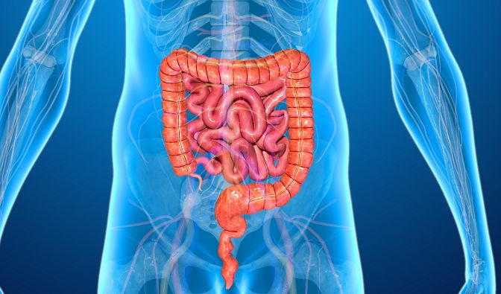
Inflammatory bowel diseases

Slide 16
Factors involved in the pathogenesis of inflammatory bowel diseases (IBDs)
infectious
genetic
immunological
IBD
environmental
nutritional

Slide 17
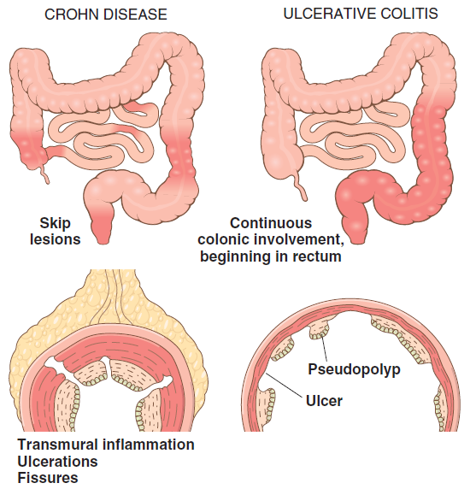
Inflammatory bowel diseases (IBDs)
Chronic conditions
Two major entities:
- Crohn disease (CD)
- Ulcerative colitis (UC)
They differ for the distribution of
affected sites and morphologic
expression of the disease
Ulcerative colitis: limited to the colon and rectum, extends only into the mucosa and submucosa
Crohn disease: may involve any area of the gastrointestinal tract, frequent transmural lesion

Slide 18
Factors involved in the pathogenesis of inflammatory bowel diseases (IBDs)
infectious
genetic
immunological
IBD
environmental
nutritional

Slide 19
Epidemiology of IBDs
Both CD and UC are more common in females and frequently present during adolescence or in young adults
In Western industrialized nations, IBDs are more common among whites; this is at least partly due to genetic factors
The geographic distribution of IBDs is highly variable, but it is most prevalent in North America, northern Europe and Australia
IBDs incidence worldwide is becoming more and more common

Slide 20
Incidence of IBDs: the hygiene hypothesis
The increasing incidence of IBDs is related to improved food storage conditions and decreased food contamination
According to this theory, the reduced frequency of enteric mild infections early in life, due to improved hygiene, has limited a favorable mucosal immune responses (protective inflammatory programme)
As a result, exposure of susceptible individuals to normally innocuous microbes later in life triggers inappropriate immune responses that may be self-sustaining

Slide 21
Pathogenesis of IBDs: causes and mechanisms of onset
The causes of IBDs still remain uncertain
According to the majority of investigators, IBDs result from a combination of
genetic susceptibility
alterations of intestinal microbiota
intestinal epithelial dysfunction
aberrant mucosal immune responses

Slide 22
Pathogenesis of IBDs: (1) genetic aspects
Risk of IBD increases in a given subject when there is an affected family member
The concordance rate for monozygotic twins is approximately 50% in CD and only 16% in UC, suggesting that genetic factors are more dominant in the former form of IBDs
Genetic aspects of CD will be treated later in more details

Slide 23
Pathogenesis of IBDs: (2) role of intestinal microbiota
There is significant inter-individual variation in the composition of this microbial population, which is modified by diet and disease
Many data suggest that intestinal microbiota contribute to IBDs pathogenesis, but its precise role remains to be defined. Disbiosis (disequilibrium between “good” and “bad” microbes) is under active investigation
In keeping with this, some antibiotics can be helpful in maintenance of remission in CD
Other studies suggest that mixtures containing probiotic [beneficial] bacteria also may combat disease in some patients with IBDs, but the mechanisms responsible are not well understood

Slide 24
Pathogenesis of IBDs: causes and mechanisms of onset
The causes of IBDs still remain uncertain
According to the majority of investigators, IBDs result from a combination of
genetic susceptibility
alterations of intestinal microbiota
intestinal epithelial dysfunction
aberrant mucosal immune responses

Slide 25
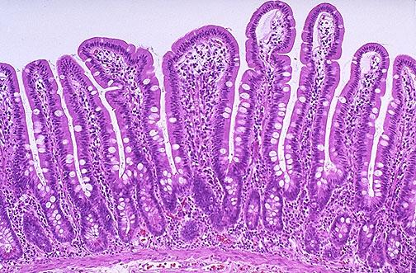
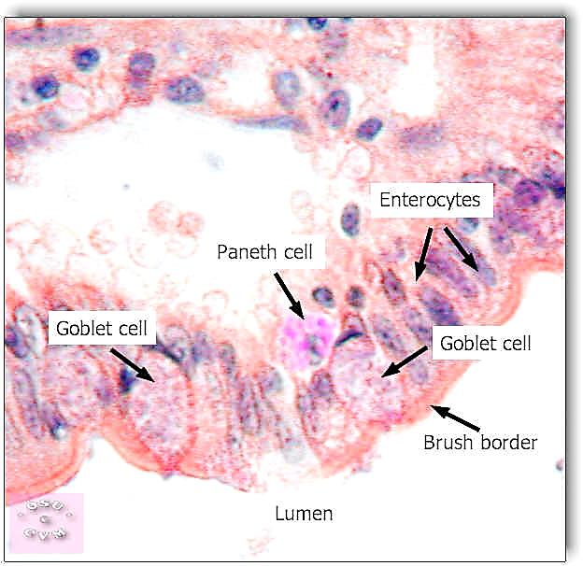
Small intestine epithelium

Slide 26
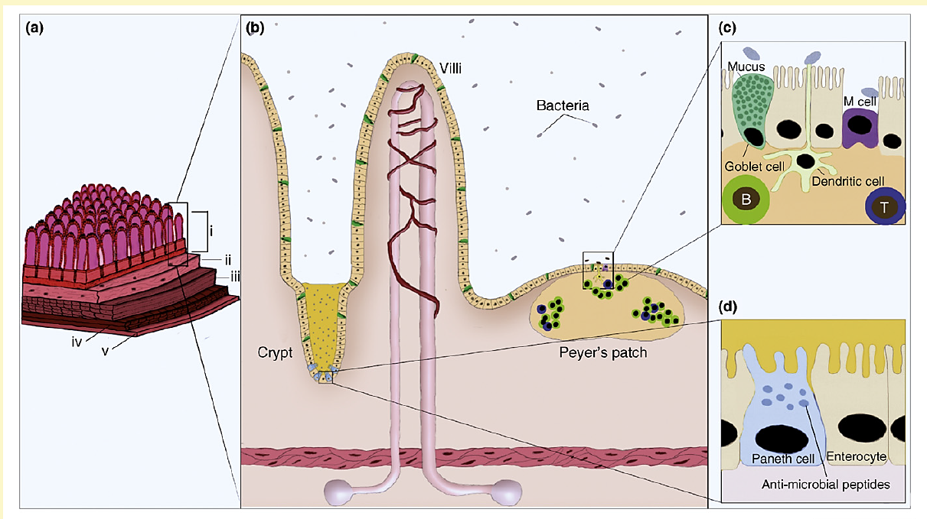
Structure and protective functions of intestinal epithelium
The epithelial layer (b) is composed of several different cell types. Specialized Goblet cells secrete mucins that form a protective layer on the luminal surface (c). Paneth cells (d) produce several classes of anti-microbial peptides, such as defensins, cathelicidins and lysozyme

Slide 27
Pathogenesis of IBDs: (3) epithelial defects
A variety of epithelial defects have been described in CD and UC
Defects in intestinal epithelial tight junctions (barrier function) are present in patients with CD
Barrier dysfunction is linked to specific disease-associated NOD2 polymorphisms (discussed later in detail)
The Paneth cell granules, which contain antimicrobial peptides that can affect the composition of the luminal microbiota, are defective in patients with CD

Slide 28
Pathogenesis of IBDs
genetic susceptibility
alterations of intestinal microbiota
intestinal epithelial dysfunction
aberrant mucosal immune responses
The mechanisms by which mucosal immunity contributes to the pathogenesis of UC and CD are still under investigation
The involvement of mucosal immunity is supported by the fact that immunosuppressive and immunomodulatory agents remain mainstays of IBDs therapy

Slide 29
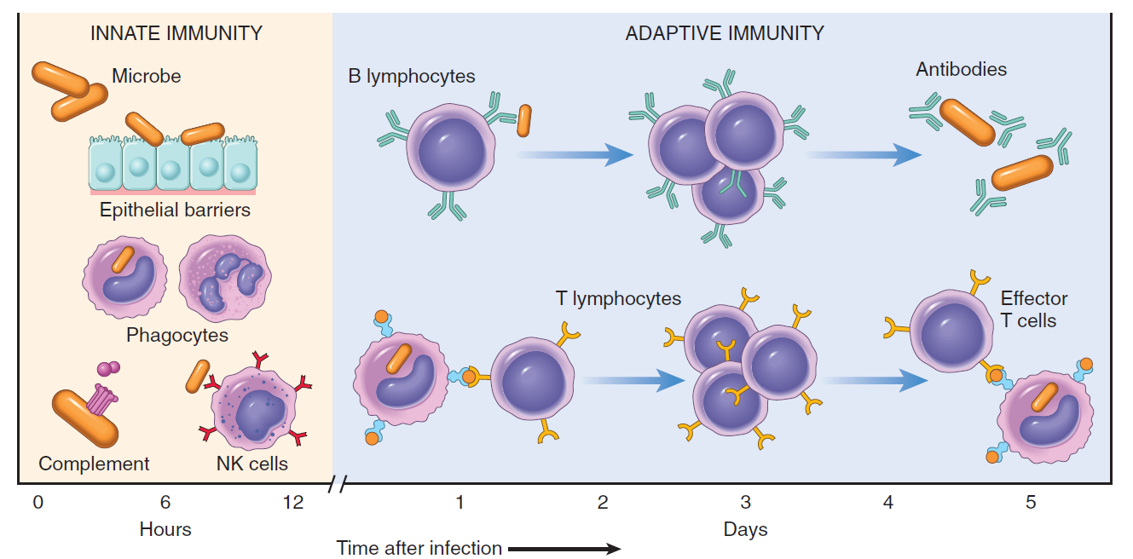
Le difese immunitarie
I
I principali meccanismi dell’immunità innata ed adattativa

Slide 30
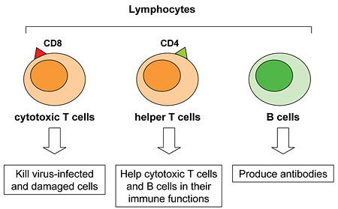
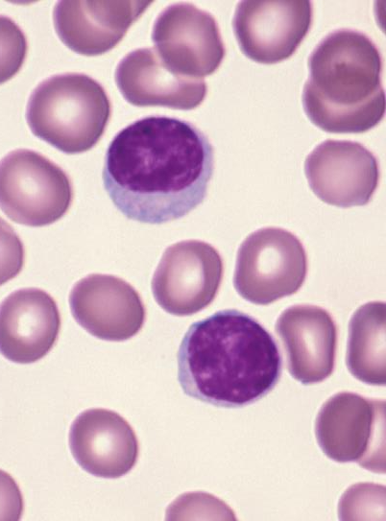
Lymphocytes: actors of acquired immunity
I

Slide 31
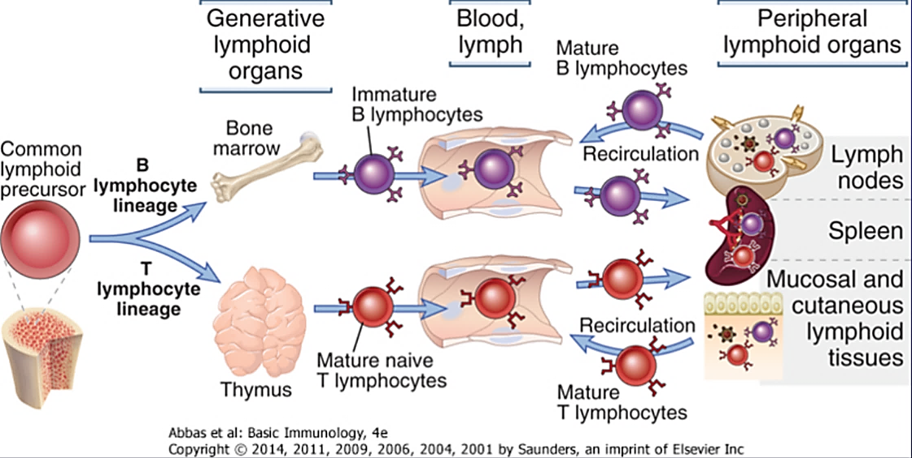
Lymphocytes’ traffic
I
Lymphocytes migrate to secondary lymphoid tissues where they interact with antigens and antigen-presenting cells and then recirculate

Slide 32
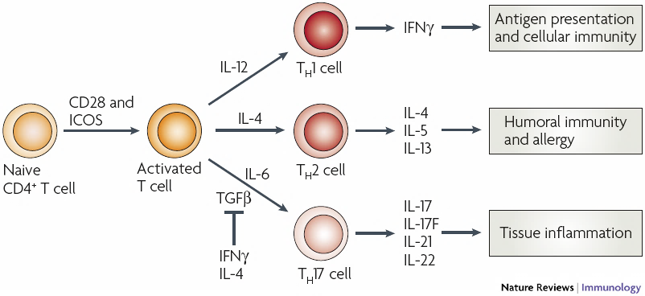
Origin of diverse CD4+ (T helper) cell subsets
I
Naive CD4⁺ T cells, after activation, differentiate into one of three lineages of effector T helper cells, T_{H}1, T_{H}2 or T_{H}17, which produce different cytokines and have distinct immunoregulatory functions

Slide 33
Pathogenesis of IBDs: T_{H}1 , T_{H}2 and T_{H}17 cells in mucosal immune responses
Polarization of helper T cells to both the T_{H}1 and T_{H}2 type is well recognized in both CD and UC
Emerging data show that T_{H}17 cells (subset of IL-6- activated CD4+ T cells) also contribute to IBD pathogenesis

Slide 34
T_{H}17 cells (discovered in 2003)
Th17 cells play a key role in host defense against extracellular microbes (bacteria, fungi) and a significant role in autoimmune diseases and the accompanying inflammatory response
Th17 cells are localized primarily in tissues that separate the host from the environment, principally the skin and mucosa
Activated Th17 cells produce cytokine triggering pro-inflammatory signaling that promotes neutrophil mobilization and the expression of antimicrobial peptides (defensins)
Th17 cells are implicated in a broad array of inflammatory and autoimmune diseases, such as rheumatoid arthritis, inflammatory bowel diseases, asthma, multiple sclerosis, psoriasis and many others

Slide 35
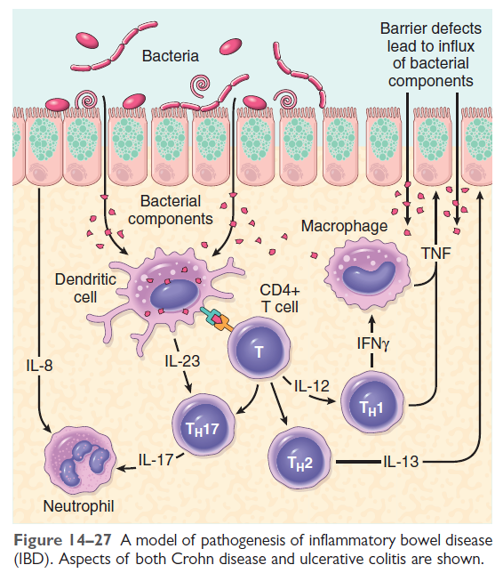
Pathogenesis of IBDs: immune cell cross-talk
Dendritic cells are antigen-presenting cells (APCs) which play a critical role in the regulation of the adaptive immune response. DCs are capable of capturing antigens, processing and presenting them on the cell surface

Slide 36
Crohn disease: clinical keynotes
CD may occur in any area of the gastrointestinal tract; the presence of multiple, separate, sharply delineated areas of disease [skip lesions], is peculiar of CD (may help for differential diagnosis)
The clinical manifestations of CD are extremely variable; in most patients, disease begins with intermittent attacks of mild diarrhea, fever, and abdominal pain
Typically, periods of active disease (worsening phase) are interrupted by asymptomatic intervals (remission phase) that last for weeks to many months
Fibrosing strictures, particularly of the terminal ileum, are common and require surgical resection and subsequent anastomosis
Disease often recurs at the site of anastomosis: as many as 40% of patients require additional resections within 10 years

Slide 37
Stages of CD development
The development of CD occurs in three stages:
entry of bacteria and/or other antigenic material into the bowel wall
a weak acute inflammatory response results in impaired clearance of this material
chronic granulomatous inflammation, with involvement of adaptive immune response, are subsequently provoked, culminating in evolution and worsening of CD

Slide 38
Alteration of intestinal permeability in CD: the “leaky” intestine
Altered function of the epithelial barrier, leading to a pronounced infiltration of luminal microflora and/or other antigenic material is critical for the manifestation of IBDs
Epithelial barrier dysfunction in CD is characterized by alterations in intercellular tight junctions
Elevated levels of the pro-inflammatory cytokine interferon-γ (IFNγ), are believed to prominently affect intestinal permeability
IFNγ effect is due to disruption of the apical actin cytoskeleton in conjunction with decreased expression, and/or increased internalization, of important tight junction proteins, such as occludin, zonula occludens-1 and claudins

Slide 39
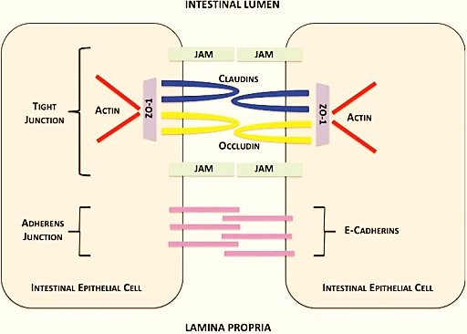
Tight junction structure

Slide 40
CD pathogenesis: defects in mucosal barriers
Mucosal cells secrete key components of the intestinal mucus, including phospholipids, secretory dimeric immunglobulin A (IgA), and mucins, which are highly glycosylated, filamentous proteins present at the interface between many epithelia and their extracellular environments
An intact mucus layer is essential for accurate protection, and an altered mucus composition has been identified in IBD
Polymorphisms in mucin genes, such as MUC2 and others, are associated with increased risk of CD. These variants could increase the susceptibility of the mucosal barrier to injury
Alterations in expression and post-translational modifications of mucins have also been reported

Slide 41
CD pathogenesis: defects in epithelial barrier
Several in vivo experimental data (mouse models) underscore the importance of overall mucosal barrier dysfunction in the induction of bowel inflammation
Transgenic mice manipulated to express a dominant negative N-cadherin, a junctional adhesion protein, develop spontaneous inflammatory bowel disease
Introduction of mutations in the mucin encoding gene MUC2 also results in spontaneous bowel inflammation

Slide 42
Factors involved in the pathogenesis of CD
Immunological
TH1, TH2
TH17 defects?
defective epithelial barrier tight junctions
altered mucus
CD
Infectious
disbiosis
Weak primary
inflammatory response
chronic inflammation

Slide 43
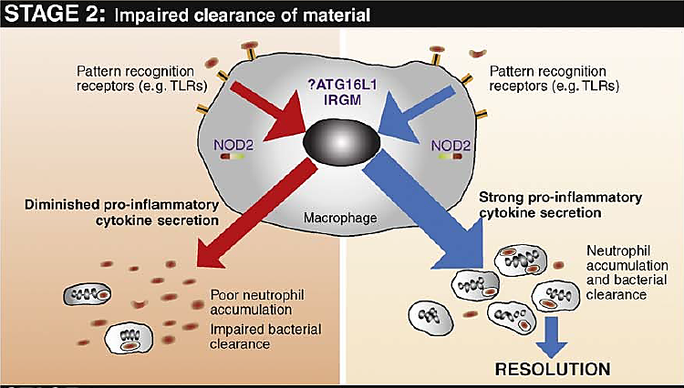
Stages of CD development
mutated ?
Healthy individuals: resident macrophages secrete pro-inflammatory cytokines in response to foreign material, resulting in neutrophil accumulation, clearance of the material, and resolution. CD patients: defective secretion of pro-inflammatory cytokines by macrophages results in decreased neutrophil influx and impaired clearance of foreign material

Slide 44
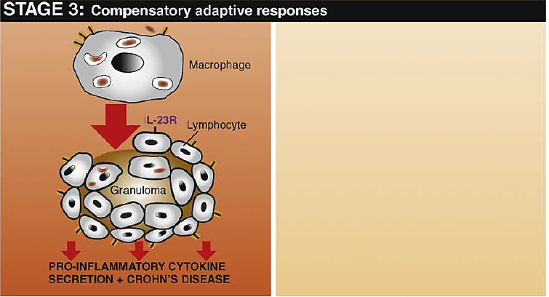
Stages of CD development
In CD patients, a chronic inflammatory response flares up owing to intense macrophage accumulation and activation, giving rise to the characteristic features of the CD lesion (granuloma)

Slide 45
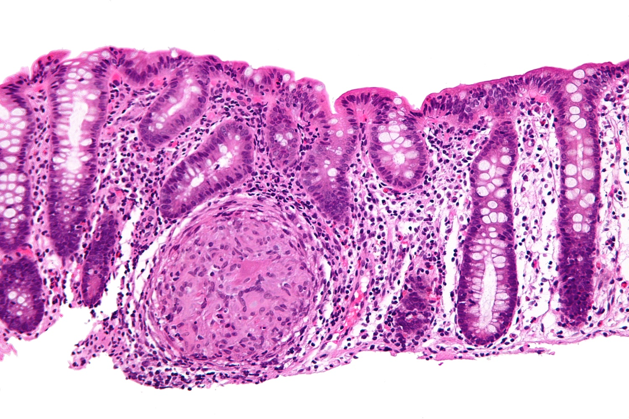
Microscopic features of active CD
Granulomas are a hallmark of CD; are found in approximately 35% of cases and may arise in areas of active disease or uninvolved regions in any layer of the intestinal wall
The absence of granulomas does not preclude a diagnosis of CD

Slide 46
Factors involved in the pathogenesis of CD
Immunological
TH1, TH2
TH17 defects?
defective epithelial barrier tight junctions
altered mucus
CD
Genetic
Infectious
disbiosis
Weak primary
inflammatory response
chronic inflammation

Slide 47
Genetics of CD: main genes involved
NOD2 (nucleotide oligomerization binding domain 2)
ATG16L1 (autophagy-related 16–like-1)
IRGM (immunity-related GTPase M)
Both defects and hyperactivity of NOD2 are supposed to be involved in CD pathogenetic mechanisms

Slide 48
Summary of molecular interactions involved in the recognition of pathogens and/or substances released by necrotic cells
Pathogen-associated molecular patterns (PAMPs)
Pattern recognition receptors (PRRs)
Damage-associated molecular patterns (DAMPs; allarmins)
Toll-like receptors (TLRs)
NOD-like receptors (NLRs)
Inflammasome

Slide 49
The inflammasome
The inflammasome is a multimolecular complex (hexamers or heptamers) which serves as a platform for the maturation of inflammatory cytokines, such as IL-1β and IL-18
Most inflammasome complexes comprise:
a nucleotide-binding and oligomerization domain-like (NOD-like) receptor (NLR)
An apoptosis-associated protein containing a caspase recruitment domain (ASC)
procaspase-1
NLRP3 is the best characterized NOD-LIKE RECEPTOR

Slide 50
Inflammasome and CD
The NLR family members, such as NLRP3, are emerging as important regulators of intestinal homeostasis
Recent studies suggest that altered NLRP3 signaling in the gut contributes to CD by:
increasing permeability across the epithelial barrier
inducing detrimental immune responses against invading commensals
Increased levels of proinflammatory cytokines (IL-1β, IL-18, TNF) are detected in active CD and correlate with the severity of inflammation, indicating that these cytokines may play a key role in the development of the disease

Slide 51
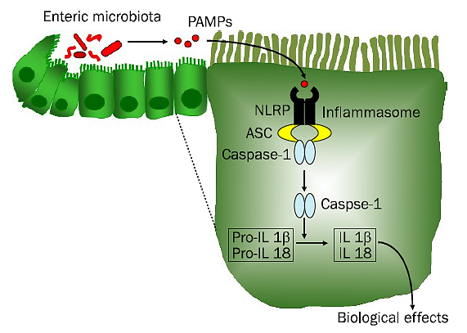
A simplified model of the inflammasome
DAMPs
Simplified diagram of inflammasome signaling pathways. NLRP3 in the cytosol of intestinal epithelial cells, as a part of a multiprotein complex, recognizes PAMPs (from enteric microbiota) and, possibly, DAMPs (from injured intestine). The activation of caspase-1 whitin this complex mediates the subsequent activation of proinflammatory cytokines, such as IL-1β and IL-18

Slide 52
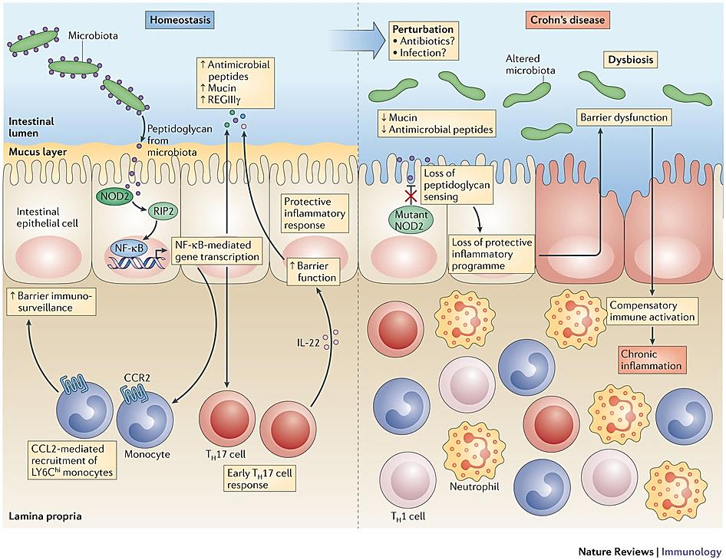
NOD2: regulator of inflammation in health and disease
Defective NOD2 promotes compensatory immune activation leading to chronic inflammation
Descriptive legend in the next slide

Slide 53
NOD2: regulator of inflammation in health and disease
NOD2 has a key role in intestinal homeostasis by detecting PAMPs that is released from the gut microbiota and by driving a physiological protective inflammatory program
This programme includes the production of antimicrobial peptides and mucin, which restrain the microbiota and maintain a physical distance between the microorganisms and the gut epithelial cells
In CD associated with NOD2 mutations, some perturbation (e.g., infections) alters the protective inflammatory programme and leads to a breakdown in the intestinal barrier and potentially to dysbiosis (alterations in the bowel flora and its activities)
Compensatory immune activation through other pathways then drives chronic inflammation
Molecular linkage analyses of affected families have identified NOD2 as a susceptibility gene in CD

Slide 54
Genetics of CD
Whatever the mechanism by which NOD2 polymorphisms contribute to the pathogenesis of CD, it should be recognized that the disease develops in less than 10% of persons carrying NOD2 mutations and NOD2 mutations are uncommon in African and Asian patients with CD
Two recently identified CD–related genes (and proteins) of particular interest are linked to autophagy:
ATG16L1 (autophagy-related 16–like-1), a part of the autophagosome pathway that is critical to host cell responses to intracellular bacteria;
IRGM (immunity-related GTPase M), also involved in autophagy and clearance of intracellular bacteria

Slide 55
Genetics of CD: NOD2, ATG16L1, IRGM
NOD2, ATG16L1, and IRGM are expressed in multiple cell types, and their precise roles in the pathogenesis of CD disease are increasingly clear
Like NOD2, ATG16L1 and IRGM are related to recognition and response to intracellular pathogens
Both genetic data and novel functional insights argue for crosstalk of NOD2- and ATG16L1-pathways in the context of clearance of pathogens, such as cyto-invasive bacteria
Noteworthy, alterations of none of these genes are associated with UC

Slide 56
Autophagy
Autophagy is a cellular stress response that plays key roles in physiological processes, such as:
adaptation to starvation
degradation of aberrant proteins or organelles
protein secretion
anti-microbial defense

Slide 57
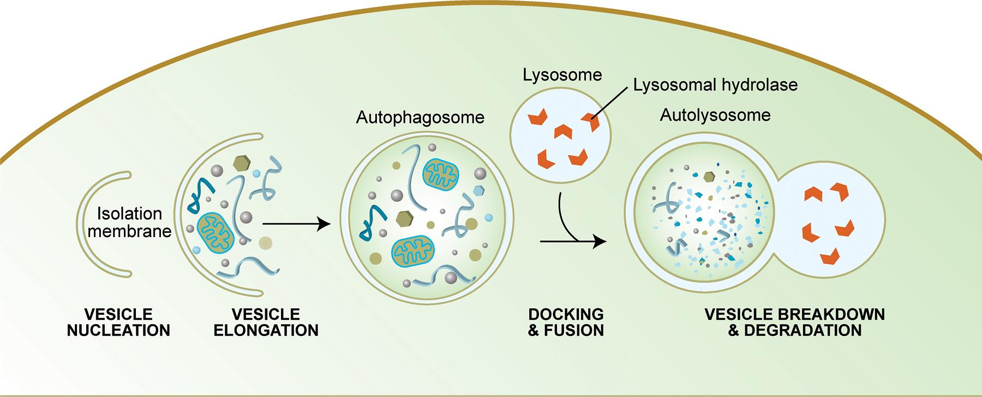
Schematic representation of autophagy
Autophagy begins with the formation of the phagophore or isolation membrane (vesicle nucleation step). Expansion of the phagophore leads to autophagosome (vesicle elongation). The autophagosome can engulf bulk cytoplasm, including entire organelles, or foreign cargos (e.g. microbes).
When the outer membrane of the autophagosome fuses with a lysosome (docking and fusion steps), it forms an autophagolysosome. Finally, the sequestered material is degraded inside the autophagolysosome (vesicle breakdown and degradation) and possibly recycled

Slide 58
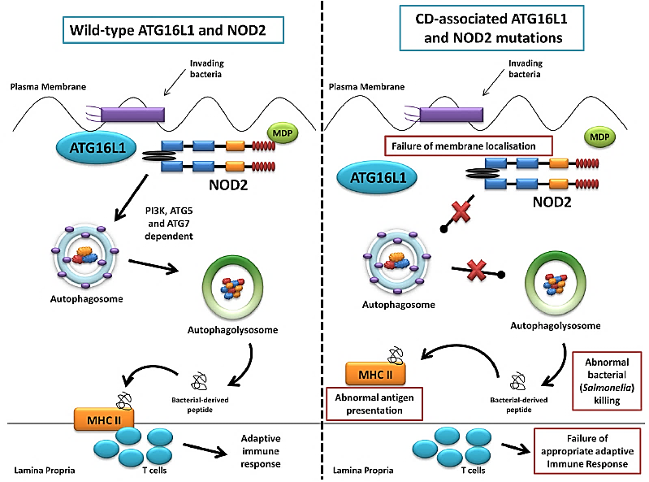
Autophagy pathway: defects observed in CD
bacterialmuramyl dipeptide
Cells studied:
Macrophages
Intestinal epithelium
mutated
Left: normal autophagy response: NOD2 recruits ATG16L1 to the plasma membrane, normal autophagosome formation. Right: abnormal membrane localisation of mutated ATG16L1 resulting in abnormal bacterial killing and defective antigen presentation

Slide 59
Autophagy in IBDs
Dysfunctional autophagy is recognized as a contributing factor in many chronic inflammatory diseases
Several lines of evidence demonstrate that autophagy is impaired in IBD patients, but how dysfunctional autophagy contributes to IBD onset is currently under investigation
Genetic studies have identified multiple IBD-associated risk loci that include genes required for autophagy

Slide 60
Mutations of NOD2 and ATG16L1: impairment of autophagy in CD
2010: first demonstration that NOD2 stimulation by its ligand muramyl dipeptide (MDP) induced autophagy in human monocyte-derived dendritic cells (APCs)
Activation of some NOD2-related signaling mediators and partecipation of the autophagy-related protein ATG16L1 are required for autophagy to take place
Dendritic Cells isolated from individuals with any of the known CD-associated NOD2 or ATG16L1 variants exhibited defective autophagy

Slide 61
Outcomes of autophagy defects
Dysfunctional autophagy is thought to play a role in CD pathogenesis by altering:
(1) intracellular bacterial killing
(2) anti-microbial peptide secretion by Paneth cells
(3) pro-inflammatory cytokine production by macrophages
(4) antigen presentation by dendritic cells
(5) mucus secretion by goblet cell

Slide 62
Inflammatory bowel disease and risk of cancer: the extrinsic pathway connection
Patients with IBD are at an increased risk of cancer secondary to long ­standing intestinal inflammation
IBDs predispose patients to the development of a form of colon cancer known as colitis associated cancer (CAC)
More than 20% of IBD patients develop CAC within 30 years of inflammatory disease onset and > 50% of these die from CAC
Crohn disease increases the risk of developing CAC by roughly 1.8 times, ulcerative colitis up to 8 times compared to the risk of developing colon cancer in the general population

Slide 63
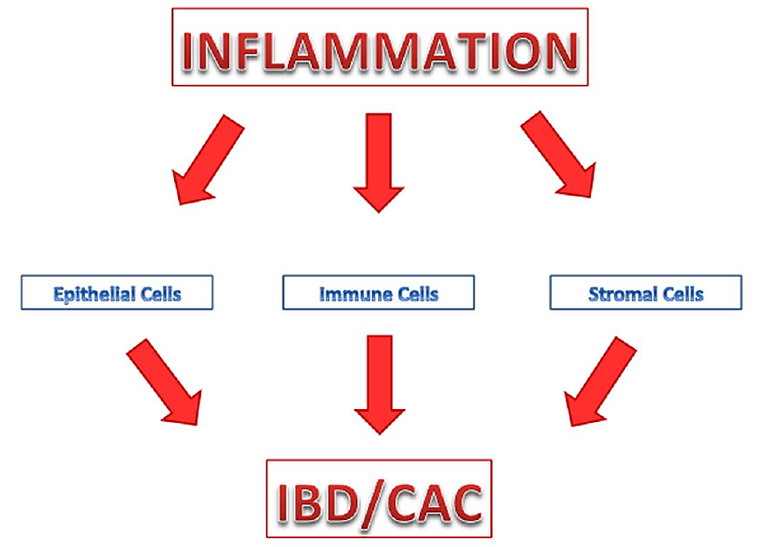
cytokines – chemokines - ROS
worsening of IBD / CAC
Inflammation drives IBD and CAC pathogenesis. The extensive inflammation in the colon has an overall negative impact on epithelial cells, resident and recruited immune cells, and stromal cells. The non-resolving chronic inflammatory reaction may lead to the worsening of IBD and potential development of CAC.

Slide 64
IBD microenvironment
Inflammatory microenvironment is a constantly evolving entity that has a diverse cellular makeup and contains a vast array of mediators with a multeplicity of functions
The complex, often unpredictable combination of such factors ultimately determines if a tumor develops and how it grows and responds to therapies
Targeted inhibition of selected inflammatory cell types would ultimately stunt more aggressive tumors by normalizing the dysregulated cellular functions altered by cytokines and related signaling

Slide 65
Inflammatory microenvironment favors CAC development
The immune cell infiltrates in the colon create an environment rich in reactive oxygen species (ROS) and reactive nitrogen species (RNS)
These highly reactive molecules can cause DNA damage in addition to exogenous mutagens (e.g.,dietary components), facilitating the initiation of cancer
Moreover, inflammatory cells can produce large amounts of protumorigenic cytokines (growth factors) that drive tumor progression

Slide 66
IBD and risk of cancer: the extrinsic pathway connection
cytokines – chemokines - ROS
worsening of IBD / CAC
Colitis Associated Cancer
In IBD, continuing, non resolving inflammation, tissue injury, and repair attempts (epithelial rigeneration and fibrosis) proceed simultaneously
Such a situation represents a high proliferative rate site, where the risk of tumorigenic DNA lesions increases

Slide 67
cytokines cells
Roadmap
To analyze the inflammatory/tumoral microenvironment
experimental models
patients
To design and test new molecules that can interfere with cytokine and/or cell activities
experimental models
clinical trials in patients
to establish their role in promoting and sustaining the inflammatory/tumoral microenvironment

Slide 68
Role of cytokines in IBD and CAC
The development, growth, activation, and function of immune cells are controlled largely by cytokines, whose effect on tumor associated immune cells is extremely influential (autocrine and paracrine pathways)
Multiple lines of evidence suggest that, within the tumor microenvironment, cytokines utilize similar mechanisms to:
promote and sustain IBD
predispose to CAC
regulate CAC development and progression
TNF, IL-6 and IL-1 are major players of the dialogue between immune and intestinal cancer cells

Slide 69
Major cytokines in IBD and CAC: TNF
TNF: well-known pro-inflammatory cytokine, plays an important role in physiologic cellular events, such as proliferation, differentiation and cell death, as well as in inflammation and carcinogenesis
Main sources: monocyte/macrophage lineages. Other sources: mast cells, T and B lymphocytes, natural killer cells, neutrophils, endothelial cells, smooth and cardiac muscle cells, fibroblasts and osteoclasts
TNF activates the pro-inflammatory transcription factor NF-kB, which also upregulates the expression of genes linked to tumor cell survival, proliferation, invasion, angiogenesis
Neutralization of TNF protects from IBD (mouse models and patients): anti-TNF monoclonal antibodies have been shown to be effective in treating CD and UC and lowering CAC development

Slide 70
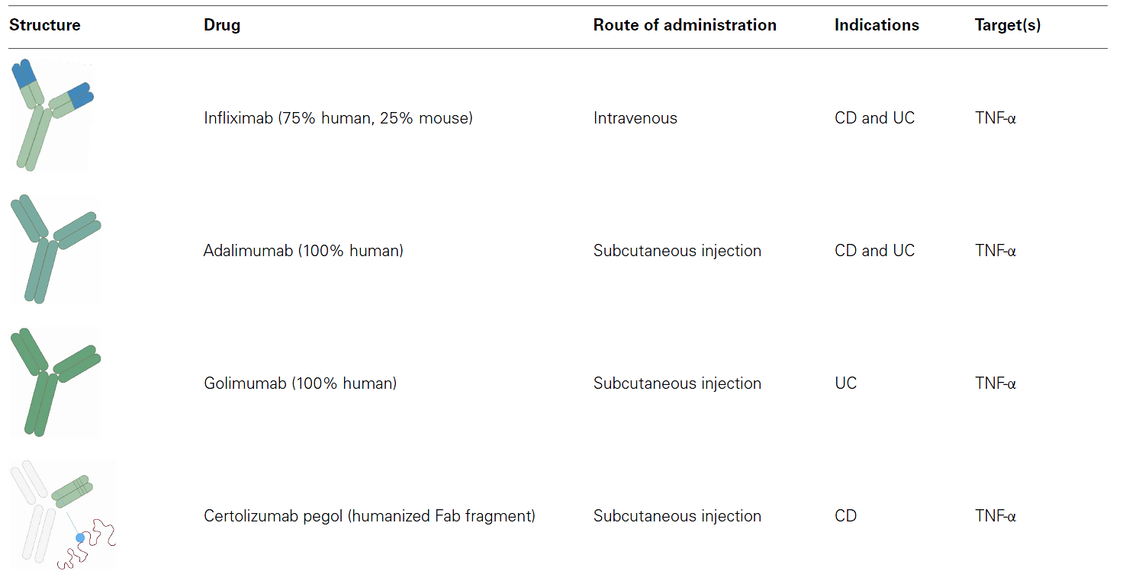
Targeting TNF for IBDs treatment
1998
2002
2009
2008
TNF inhibitors are not useful for one third of all patients (i.e. “primary failures”), and further one third lose effect over time (“secondary failures”)
Other strategies have in later years been developed.
https://www.ncbi.nlm.nih.gov/pmc/articles/PMC4323544/pdf/fmed-01-00003.pdf

Slide 71
Major cytokines in IBD and CAC: IL-6
IL-6: mostly produced by stimulated monocytes, macrophages, T and B lymphocytes
In IBD patients, macrophages and CD4+ T cells produce high amounts of IL-6; elevated IL-6 expression is linked to increased risk of colorectal adenomas
Of note, binding of IL-6 to target cells prevents apoptosis and activates STAT3, a major oncogenic transcription factor
In mouse model of CAC, IL6-/- mice have reduced number of tumors compared to the WT mice and showed increased apoptosis and decreased proliferation of intestinal epithelial cells
IL-6 arises as a potential target in colon cancer

Slide 72
Major cytokines in IBD and CAC: IL-1
IL-1: in inflamed mucosa of IBD, dendritic cells (DC) and macrophages secrete huge amounts of this pro-inflammatory cytokine (animal models and patients)
Intestinal epithelial cells normally produce IL-1Ra (IL-1 receptor antagonist) which inhibits IL-1 pro-inflammatory actions by binding to the IL-1 receptor of target cells and competitively counteracting the effects of IL-1
In IBD intestinal epithelial cells, a decrease of IL-1Ra expression (gene polymorphisms) is accompanied by an increase in inflammatory reaction
In mice, blocking IL-1 activity was shown to reduce tumorigenesis by impairing macrophage-dependent IL-6 secretion

Slide 73
cytokines – chemokines - ROS
worsening of IBD / CAC

Slide 74
Targets of cytokines in IBD and CAC: colon epithelial cells
The milieu of cytokines, including growth factors, and chemokines can push the inflamed colon towards a pro-regenerative state (epithelial stemness; high proliferative rate site) and create a local environment conducive to epithelial transformation and tumor development
Epithelial cells themselves are both producers of and responders to cytokines whose effects can modulate the proliferation and survival of the target cells in a paracrine and/or autocrine manner
In colon epithelial cells, IL-6 was demonstrated to simultaneously down-regulate the tumor suppressor p53 and up-regulate the oncogene c-myc

Slide 75
Targets of cytokines in IBD and CAC: fibroblasts and myofibroblasts
Fibroblasts and myofibroblasts are major stromal cells that play a crucial role in wound healing but also in tumor growth
They originate from various locations (tissue resident, bone marrow) and are recruited to the tumor by chemokines
Recent studies have demonstrated that fibroblasts contribute to the exacerbation of colon cancer by producing chemokines and cytokines (such as IL-6) which promote monocytic differentiation into pro-tumorigenic macrophages
Also, fibroblast-derived cytokines facilitate the recruitment and activation of other immune cells which support an inflammatory microenvironment in IBD and CAC

Slide 76
Endothelial cells: crucial players in IBD and CAC
EC are prominent cell type in both the inflammatory and tumor microenvironment being involved in angiogenesis
Although angiogenesis is an important step of wound healing, overamplification of revascularization can sustain IBD and promote CAC by supplying inflammatory and tumor cells with vital nutrients and oxygen
EC proliferation, permeability, migration, and survival are controlled by cytokine detected in the tumor microenvironment
One major cytokine-like factor, vascular endothelial growth factor (VEGF) induces angiogenesis by binding to its major receptor, VEGFR2
In CAC patients, anti-VEGF therapy (Bevacizumab, anti-VEGF monoclonal antibody) have improved survival, but its effects as a single agent are limited

Slide 77
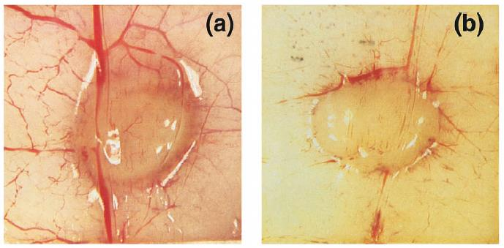
Angiogenesi indotta da VEGF in un modello sperimentale di tumore
Trattamento anti-angiogenico (anti VEGF) di un tumore sperimentale
(a): non trattato; (b): trattato

Slide 78
Endothelial cells: crucial players in IBD and CAC
In addition to VEGF, other cytokines and their downstream mediators can have a dramatic effect on CAC neo-vascularization
IL-8 (known as one of the most potent neutrophil chemotactic factor) stands out as a potent angiogenic factor in colon wound healing, colitis and cancer
IL-8 is over-expressed in patients with IBDs, and is generally localized to areas of active inflammation and tissue damage
IL-8 signals through its receptor on intestinal endothelial cells and promotes CAC development (in vitro and in vivo experiments)

Slide 79
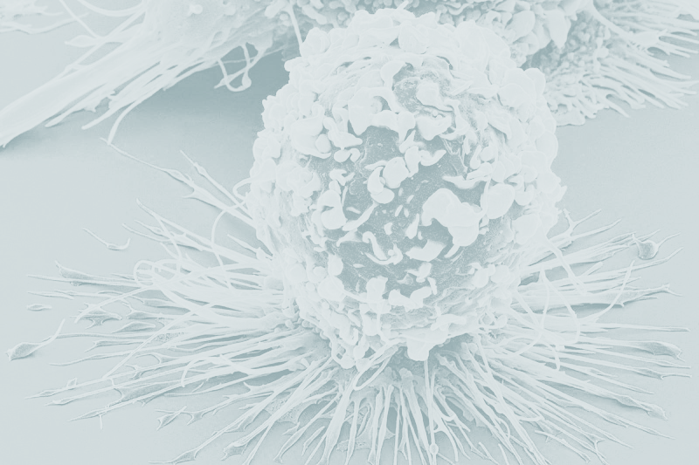
The macrophage: the main player in the inflammatory/tumor microenvironment
Macrophages are the dominant cells of chronic inflammation but are involved also in wound healing process as well as fibrotic response to tissue damage
Macrophages displaying pro-inflammatory activity may antagonize tumor growth
Macrophages displaying anti-inflammatory activity may promote tumor growth and dissemination

Slide 80
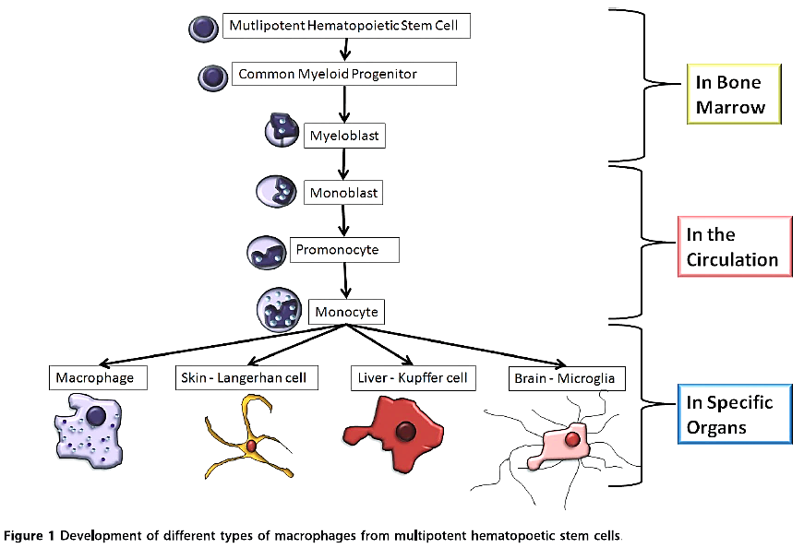
Origin and development of macrophages

Slide 81
Macrophage polarization
Owing to their phenotypic plasticity, macrophages can be classified into two types: M1 (Type I) and M2 (Type II)
M1 and M2 have different characteristics and functions within the body and immune system
M1 and M2 can be distinguished on the basis of:
modalities of activation
types of cytokines and chemokines they produce
types of membrane receptors
distinct marker

Slide 82
Macrophage polarization: M1 type
M1 macrophages are known as classically (INFγ-, LPS-) activated macrophages; play various roles in both arms of the immune system
In the innate immune system:
guard against infection by engulfing and digesting invading microbes
defend against tumour cells by releasing cytotoxic RNS and ROS
In the adaptive immune system
operate as T lymphocyte activators (APC)
secrete immunomodulatory and proinflammatory cytokines

Slide 83
Macrophage polarization: M2 type
M2 macrophages: known as alternatively (IL-4-, IL-13-, IL-10-) activated macrophages are better adapted to remove necrotic debris and secrete growth factors that promote angiogenesis (VEGF)
Show reduced immune activity, such as poor antigen-presenting capability, and suppress T cell and NK cell proliferation and functions
Are still highly phagocytic but mainly help repair sites of injury by engulfing cell debris; regulate tissue remodelling and repair and control normal cell turnover

Slide 84
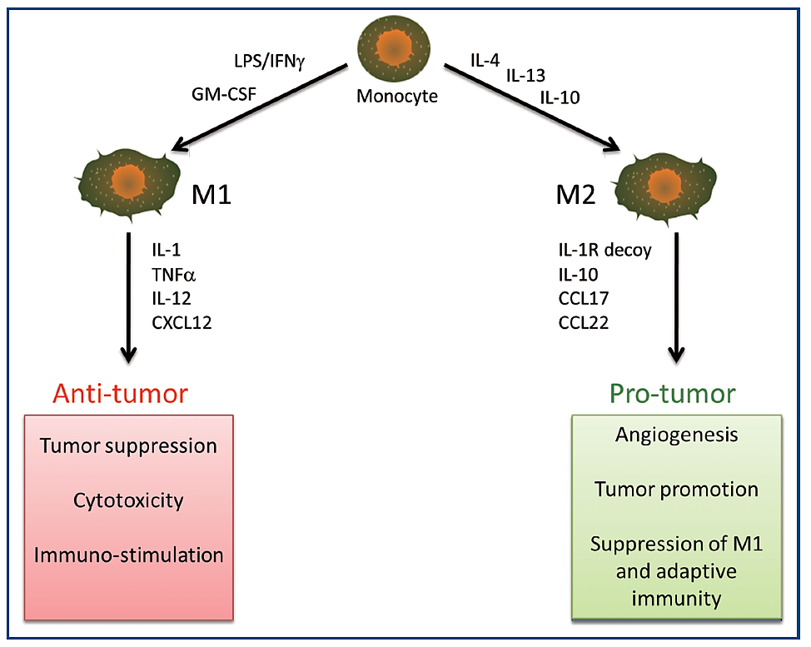
Differential activation of macrophages and their effect on tumor growth

Slide 85
Intrinsic and extrinsic pathway (1)
TAMs: tumor associated macroph.

Slide 86
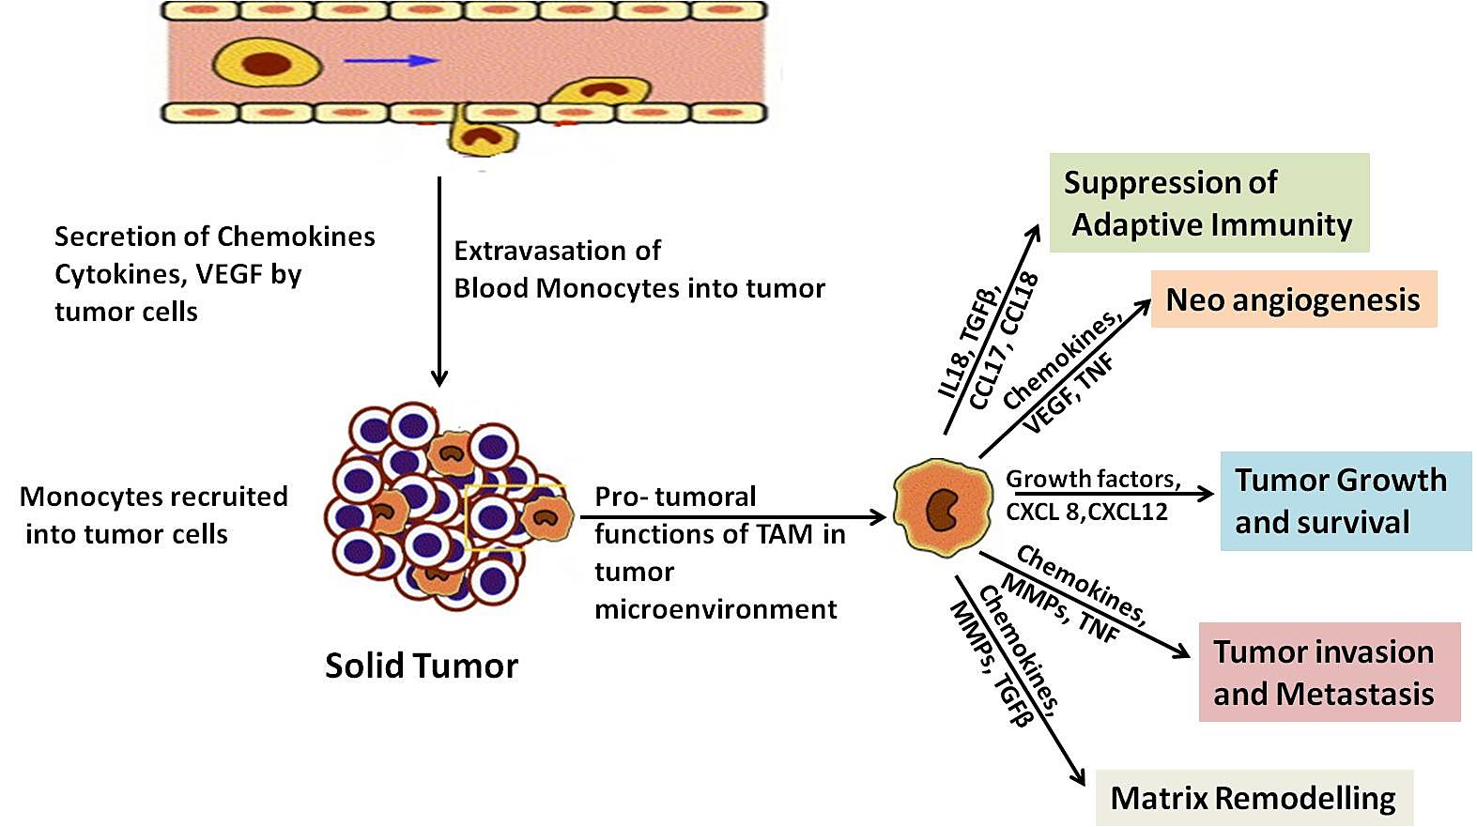
Tumor associated macrophages (TAMs)
enhanced cancer aggressiveness

Slide 87
Tumor associated macrophages (TAMs)
TAMs (derived from monocytic precursors circulating in the blood) are key regulators of the link between inflammation and cancer (mostly pro-tumoral functions)
a tumor-derived chemoattactant (later identified as CCL2) plays a pivotal role in their recruitment
(Gut, 2015)
Therapeutic blocking of the CCL2/CCR2 axis inhibits (1) the recruitment of inflammatory monocytes, (2) the infiltration and M2-polarisation of TAMs, resulting in reversal of the immunosuppression status of the tumour microenvironment and activation of an antitumorous CD8+ T cell response

Slide 88
TAMs: M2-like macrophages
Major pro-tumoral functions of TAMs:
Production of growth and survival factors for tumor cells (e.g. EGF, IL-6, CXCL8)
Production of angiogenic factors (EGF, FGF, VEGF, PDGF, TGFβ)
Expression and release of proteases (degradation of extra-cellular matrix)
Suppression of adaptive immune responses (production and release of immuno suppressive mediators, e.g. IL-10, PGE2)
Release of chemokines recruiting T cell subsets devoid of cytotoxic ability (Th2, T naive and Treg)

Slide 89
Immune suppressive cells infiltrate the tumor microenvironment
Various immunosuppressive cells are present in the inflammatory tumor microenvironment, including regulatory T cells (Tregs), regulatory dendritic cells (DCs) and myeloid-derived suppressor cells (MDSCs)
MDSCs, a heterogeneous population of immature myeloid cells recruited by inflammatory citokines, play a key role in creating and sustaining the inflammatory tumor microenvironment
Under chronic inflammatory conditions, like that underlying the evolution of tumor microenvironment, MDSCs acquire strong immunosuppressive functions thereby inhibiting efficiently T-cell mediated anti-tumor reactivity
Different strategies target MDSCs directly by reducing their expansion, recruitment and immunosuppressive activity

Slide 90
Immune suppressive activity of MDSCs
MDSCs are closely related to neutrophils and monocytes
Their features include:
high NO synthase expression and activity
high and persistent ROS production, including superoxide and hydrogen peroxide
myeloperoxidase activity
ROS and RNS production is essential for MDSC-mediated immune suppression: reaction of NO with superoxide generates peroxynitrite (PNT) which directly inhibits T cells by nitrating the antigen recognizing T-cell receptor
PNT also blocks T-cell migration by nitrating T-cell–specific chemokines

Slide 91
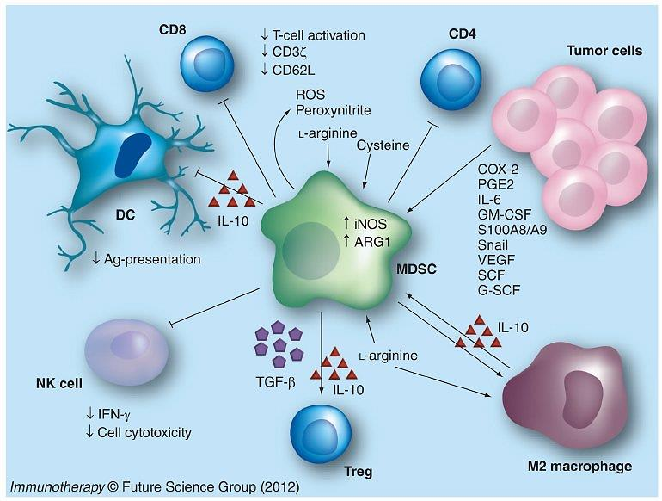
Summary of MDSCs major activities
inhibitory

Slide 92
Immune suppressive activity of regulatory T cells (Treg)
Tregs comprise diverse subsets of immunosuppressive cells that play critical roles in maintaining immune homeostasis
They are involved in controlling autoimmunity, infection, inflammation, fetal-maternal tolerance and tumor immunity
In cancer, Tregs suppress anti-tumor immune responses and contribute to the development of an immunosuppressive tumor microenvironment, thus promoting immune evasion and cancer progression
In cancer, they expand, migrate to tumor sites, downregulate autologous CD4+ (helper) and CD8+ (cytotoxic) effector T cell proliferation and suppress their anti-tumor activities

Slide 93
Immune suppressive activity of Treg
Recruitment: Tregs are recruited into tumors in response to chemokines secreted by both tumor and inflammatory cells (e.g.,TAMs)
Expansion: Tregs can expand and proliferate efficiently within the tumor/inflammation microenvironment in response to tumor-derived factors (TGF-β, IL-10)
Numerous studies have identified suppressive Treg subsets in the peripheral blood of cancer patients
Treg subsets isolated from primary tumors of colorectal cancer patients exerted a potent suppressive activity mediated by TGF-β and IL-10 production
The presence of Treg in patients with cancer have been linked to poor prognosis

Slide 94
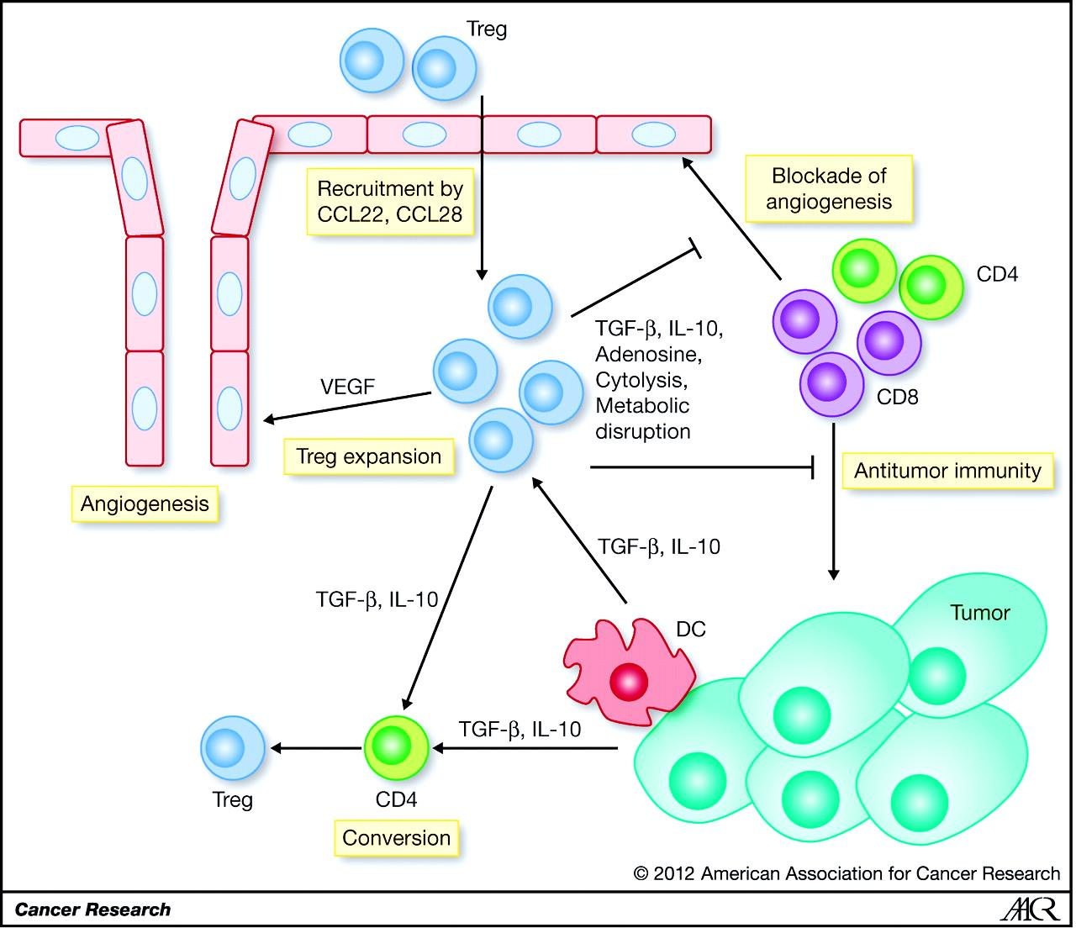
Summary of Tregs major activities

Slide 95
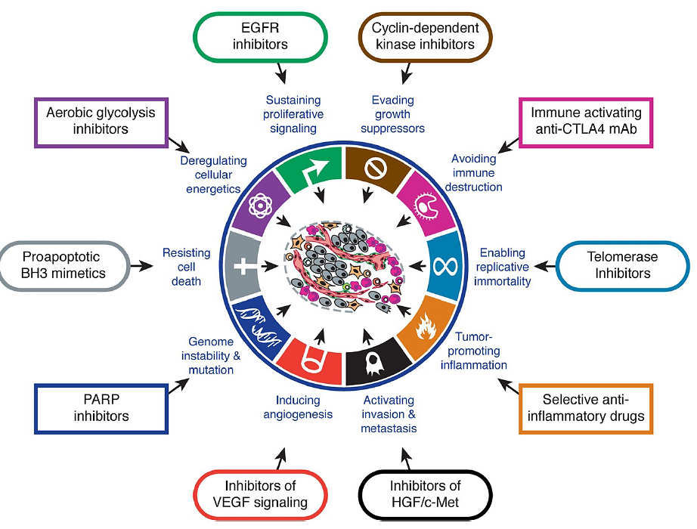
Therapeutic targeting of the hallmarks of cancer

