Slide 1


Techniques in Cellular and Molecular Neurobiology
International Master’s Degree in Neuroscience
Lesson 6
Gabriele Baj
gbaj@units.it

Slide 2
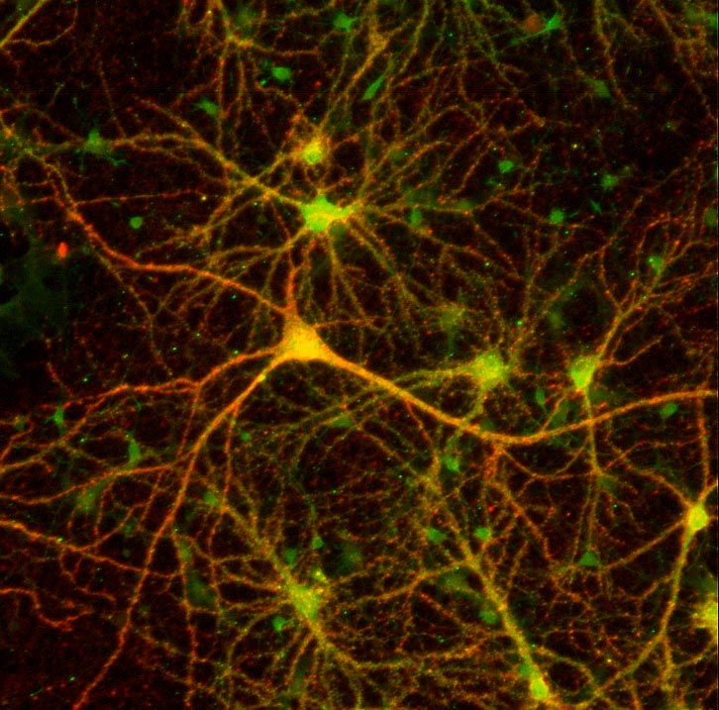
MICROSCOPY
and BIOLOGY
Gabriele Baj
gbaj@units.it

Slide 4
MICROSCOPY
There are two important values to consider in microscopy:
Magnification refers to how much larger the sample appears compared to its actual size.
Resolution (or resolving power ) refers to the minimum distance by which two points can be separated yet still be distinguished as two separate points.

Slide 5
Microscopy is not simply see “bigger”!!
Location
Morphology
Intensity/Amount
Movement
Interactions
Etc.

Slide 6
Numerical aperture
Numerical aperture and the angle of light entering the objective.
An objectivewith a higher NA collects more light rays, leading to a higher resolving power

Slide 7
Light wavelength and the visible spectrum.
(A) The wavelength of light, λ , is the distance between two repeating units of a propagating light wave. (B) Light rays of different wavelengths appear as different colors to the human eye. Shorter wavelengths ( λ 1 ) appear violet-blue, while longer wavelengths ( λ 2 ) appear more red. (C) Approximate peak excitation (black) and emission (blue) wavelengths of commonly used fluorophores

Slide 10
Four types of light microscopy used to analyze the same cell
Various methods of light microscopy are used to enhance contrast and visualize details in unstained tissue preparations.
(A) Brightfield microscopy, (B) phase-contrast microscopy, (C) differential interference
contrast (DIC/Nomarski) microscopy, and (D) darkfield microscopy.

Slide 11
Fluorescence process
Jablonski diagram illustrating the processes involved in creating an excited electronic singlet state by optical absorption and subsequent emission of fluorescence. ➀ Excitation; ➁ Vibrational relaxation; ➂ Emission.

Slide 12
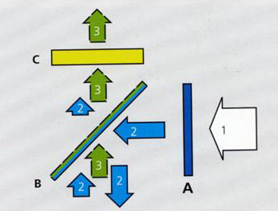
Filter-set and its choice, limitation
Arrow 1 represents the excitation light source of mixed wavelength.
Filter A is the excitation filter, which is usually a band pass or long pass filter, allows light at certain wavelength range or wavelength longer than cut-off value to go through.
Arrow 2 represents excitation light which passes through A and reaches the surface of Beam Splitter B, BSP is a special filter which reflects certain wavelength away but permit other wavelength to pass. A multiple-bands reflecting filter or neutral percentage splitter can be used for this role. Wavelength falling into the reflecting band or shorter than the cut-off value will be stopped and reflected to the specimen. The fluorescence light emitted from specimen is illustrated as Arrow 3. The emission is longer than excitation wavelength and cut-off value of the BSP, so the returned emission can go through the BSP towards emission filter C.

Slide 13
Fluorescence Microscopy
Schematic diagram of the configuration of reflected light fluorescence microscopy. Light emitted from a mercury burner is concentrated by the collector lens before passing through the aperture and field diaphragms. The exciter filter passes only the desired excitation wavelengths, which are reflected down through the objective to illuminate the specimen. Longer wavelength fluorescence emitted by the specimen passes back through the objective and dichroic mirror before finally being filtered by the emission filter.

Slide 14
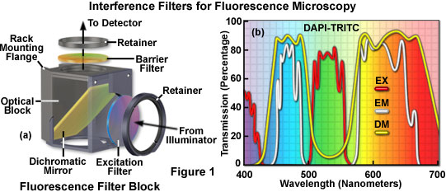
FILTER CUBE

Slide 15
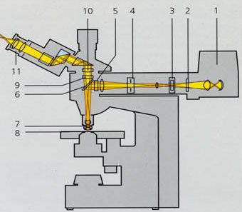
Basics of conventional fluorescence microscope
The light from source (1) pass through neutral density filter, aperture, field stop (2,3,4) for Köhler illumination adjustment, reaches excitation filter(5). After filtering away unwanted wavelength, excitation light goes further and reaches a special and important filter called beam splitter (6), BSP for short. The excitation light selected by BSP is reflected to the specimen via objective (7) and excites fluorophores within specimen (8).
The fluorescence emission from the specimen comes back through the same path to BSP again. This time, the light should not be reflected away but passes through it and reaches emission filter(9). Being further filtered by emission filter, the emission light is either focused on the front focal plane of binocular or projected to infinite by tube lens in case of infinite corrected objectives(10). The final image is further magnified by binocular(11).

Slide 16
Illumination is a critical determinant of optical
performance in light microscope
FLUO
microscopy
“different lights”
CONFOCAL
microscopy

Slide 17
Fluorescence Microscopy
Normalized absorption and fluorescence emission spectra of fluorescein-conjugated IgG.
Both spectra span a wide range of wavelengths. Fluorescein has an absorption/excitation
peak at 492 nm, but is also stimulated by ultraviolet wavelengths. Fluorescein emission has
a peak at 520 nm and looks yellow-green to the eye, but actually fluoresces at wavelengths
ranging from blue to red. The difference in nanometers between the excitation and emission
maxima is called the Stokes shift.

Slide 18
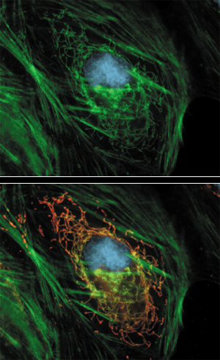
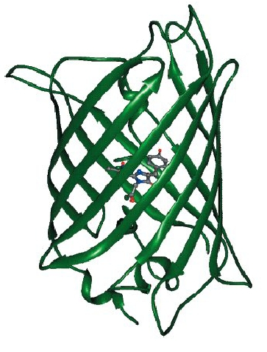
FLUORESCENT PROTEINS AND PROBES

Slide 19
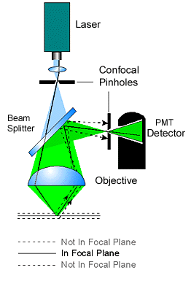
What is confocal?
In practical, a point-like light source is achieved by using a laser light passing through a illumination pinhole.
This point-like light source is directed to the specimen by a beam splitter (or AOBS in Leica's BSP-free system) to form a point-like illumination in the specimen.
The point-illumination move or scan on the specimen by the help of a scanner. The reflected emission light from specimen's focal plane passes through the detecting pinhole and form point-like image on detector PMT (photon multiply tube).
PMT converts detected photon into electron.
It is possible to amplify weak signal by manipulating the voltage (gain) on the tube. It is also possible to cut off background signal by set certain threshold (Offset) on the tube.

Slide 20
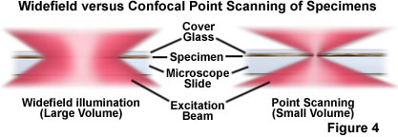
What is confocal?

Slide 21
Laser scanning confocal Microscope (LSCM)
Illustration of confocal optics. Fluorescence from the sample is collected by a objective lens and directed toward a pinhole aperture. The pinhole allows the emitted light from a narrow focal plane (red solid lines) to pass to the detector, while blocking most of the out-of-focus light (black dashed lines).

Slide 22
What is confocal?
A point light source for illumination
A point light focus within the specimen
A pinhole at the image detecting plane
These three points are optically conjugated together and aligned accurately to each other in the light path of image formation, this is confocal.
Confocal effects result in supression of out-of-focal-plane light, supression of stray light in the final image
Confocal images have following features:
void of interference from lateral stray light: higher contrast.
void of supperimpose of out-of-focal-plane signal: less blur, sharper image.
images derived from optically sectioned slices (depth discrimination)
Improved resolution (theoretically) due to better wave-optical performance.
PROBLEMS
confocal effect is obtained at a cost of reduced detecting volume (total signal amount), increase vulnerability to noise, reduced dynamic range.

Slide 23
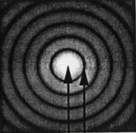
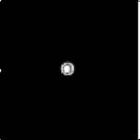
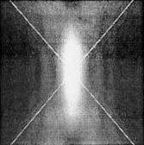
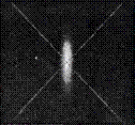
What is confocal?
Standard Microscope
Confocal Microscope
Lateral
Lateral
with pinhole
Axial
Axial
with pinhole

Slide 24


Lateral and Axial Resolution in confocal system
RESEL
50 -100 nm with interpolation
100 -150 nm with interpolation

Slide 25
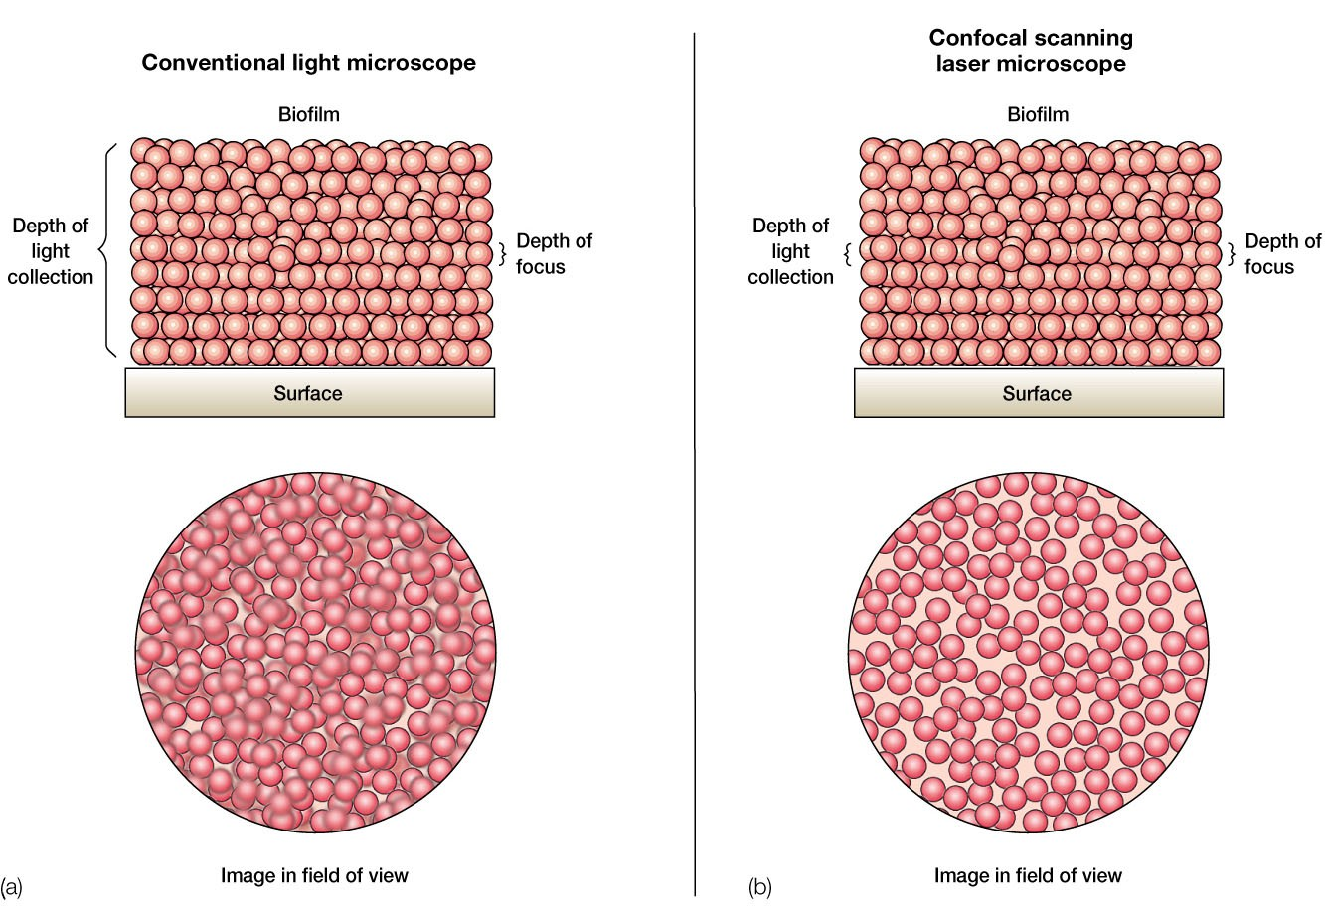
What is confocal?

Slide 26
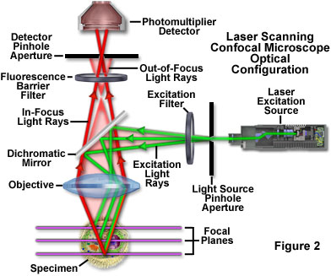
Laser scanning confocal Microscope (LSCM)
It utilizes laser and illumination pinhole to get point-like light source illumination on the specimen.
Detecting pinhole is used to get rid of out-of-focus signal. PMTs are used as detecting device.
The main advantage of this type is its combination of good image quality, versatile functionality and reliability.

Slide 27
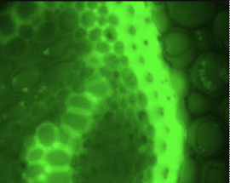
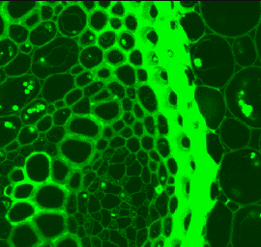
CONVENTIONAL vs CONFOCAL
DETAILS

Slide 28
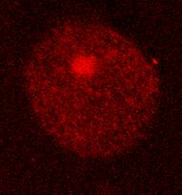
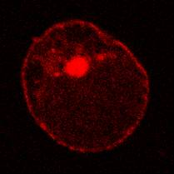
CONVENTIONAL vs CONFOCAL
MOLECULES LOCALIZATION

Slide 29
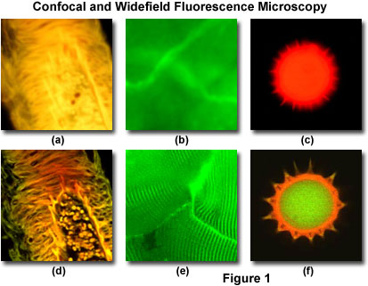
CONVENTIONAL vs CONFOCAL
In a conventional widefield optical epi-fluorescence microscope, secondary fluorescence emitted by the specimen often occurs through the excited volume and obscures resolution of features that lie in the objective focal plane.

Slide 30
CONVENTIONAL vs CONFOCAL

Slide 31
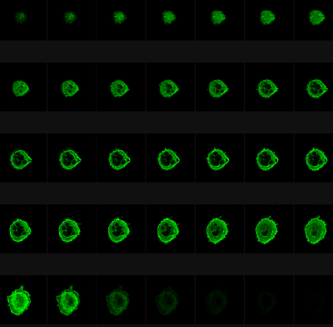
Confocal Microscopy is the only way to get a true Z-stack for 3-D reconstruction from light microscope.

Slide 32
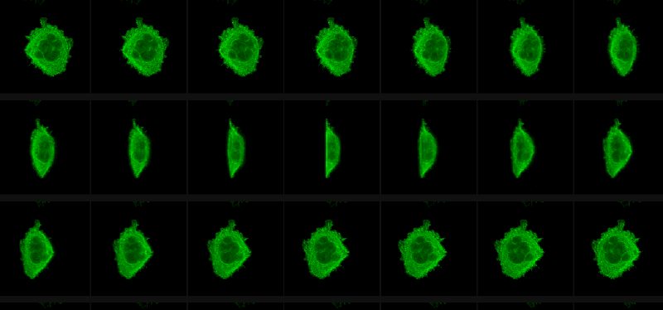
Confocal Microscopy is the only way to get a true Z-stack for 3-D reconstruction from light microscope.

Slide 33
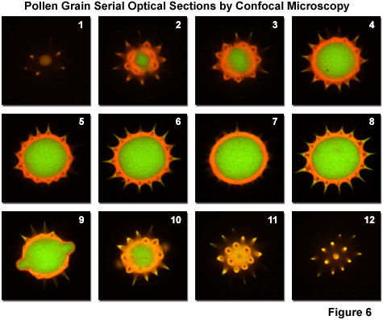
Confocal Microscopy is the only way to get a true Z-stack for 3-D reconstruction from light microscope.

Slide 34
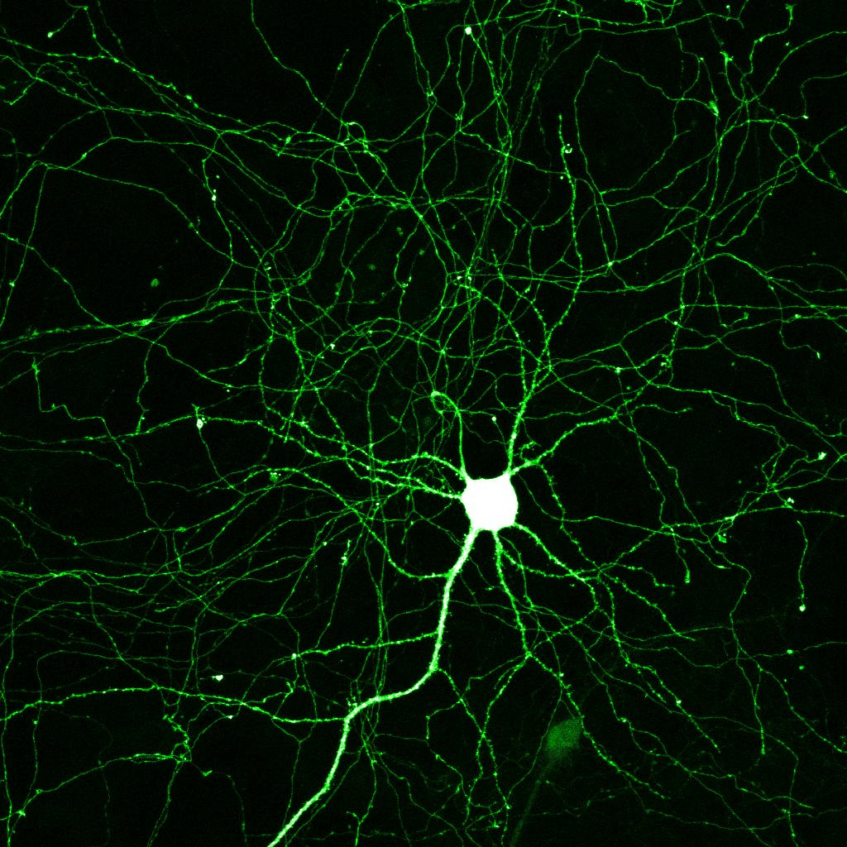

Slide 35
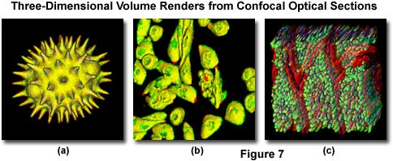
3D CONFOCAL rendering

Slide 37
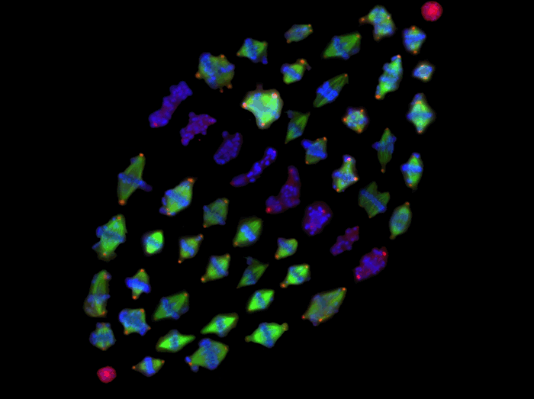
CONFOCAL and DNA

Slide 38
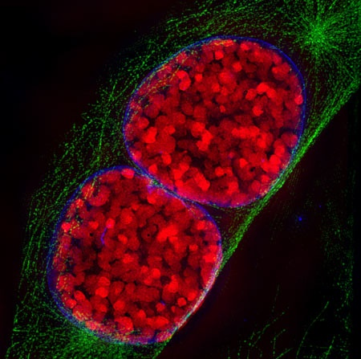
CONFOCAL and DNA

Slide 39
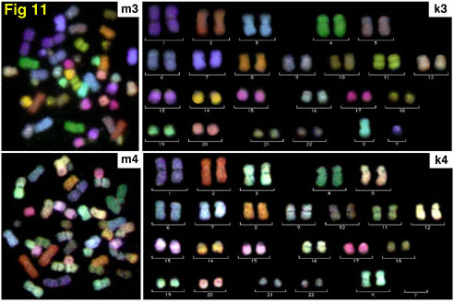
CONFOCAL and DNA

Slide 40
Comparison of Different Forms of Microscopy

Slide 41
Comparison of Different Forms of Microscopy

Slide 42
Comparison of Different Forms of Microscopy

Slide 43
LINKS and TUTORIALS
http://www.microscopyu.com
tutorials
http://www.microscopyu.com/tutorials/java/objectives/immersion/index.html
http://www.microscopyu.com/tutorials/java/virtual/confocal/index.html
http://www.olympusfluoview.com/theory/index.html
tutorials
http://www.olympusfluoview.com/java/confocalsimulator/index.html
http://unitsconfocal.googlepages.com/

