Slide 1
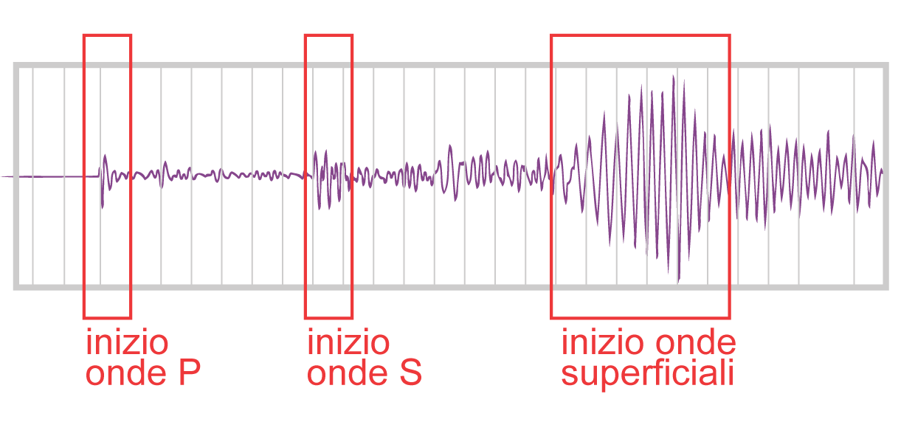
Surface waves
On seismic records of distant earthquakes (teleseisms), the waves of greatest amplitudes are generally surface waves that have followed the Earth’s surface and not penetrated the interior. The exceptions are seismograms of deep focus earthquakes, which are not effective generators of surface waves, so that the body waves are more prominent. The dominance of surface waves on teleseismic records is due to the geometrical effect of wave spreading
Just as seismic body waves can be classified as P- or S-waves, there are two categories of seismic surface waves, sometimes known collectively as L-waves and subdivided into Rayleigh waves (LR) and Love waves (LQ), which are distinguished from each other by the types of particle motion in their wavefronts.
In the description of body waves, the motion of particles in the wavefront was resolved into three orthogonal components – a longitudinal vibration parallel to the ray path (the P-wave motion), a transverse vibration in the vertical plane containing the ray path (the vertical shear or SV-wave) and a horizontal transverse vibration (the horizontal shear or SH-wave).
These components of motion, restricted to surface layers, also determine the particle motion and character of the two types of surface waves.
1
Notes:
1

Slide 2
Rayleigh waves
In 1885 Lord Rayleigh described the propagation of a surface wave along the free surface of a semi-infinit elastic half-space. The particles in the wavefront of the Rayleigh wave are polarized to vibrate in the vertical plane. The resulting particle motion can be regarded as a combination of the P- and SV-vibrations.
If the direction of propagation of the Rayleigh wave is to the right of the viewer, the particle motion describes a retrograde ellipse in the vertical plane with its major axis vertical and minor axis in the direction of wave propagation.
If Poisson’s relation holds for a solid (i.e., Poisson’s ratio ν=0.25) the theory of Rayleigh waves gives a speed (V_{LR}) equal to 0.9194 of the speed β of S-waves. This is approximately the case in the Earth
2
Notes:
2

Slide 3
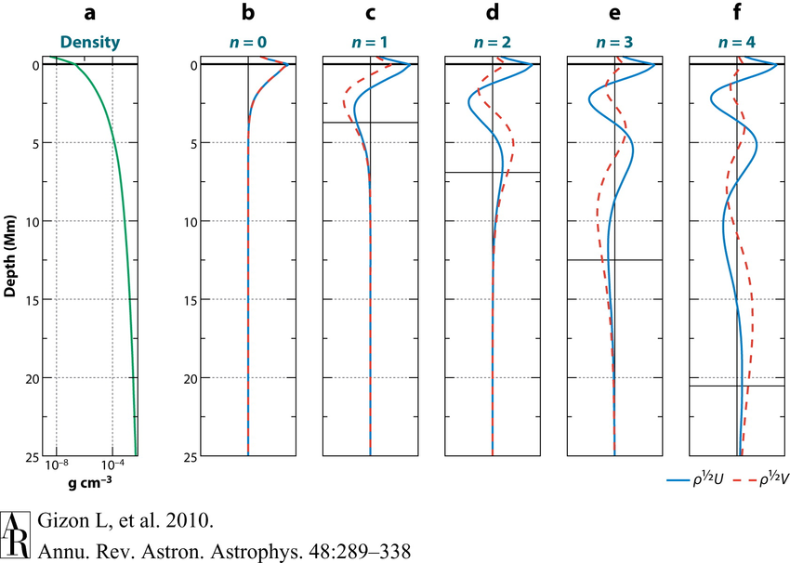

Slide 4
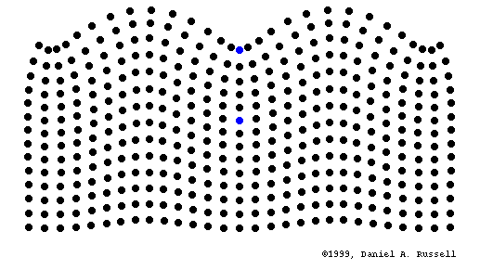
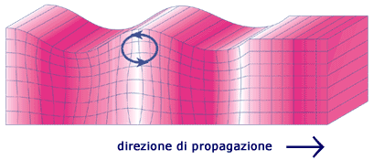
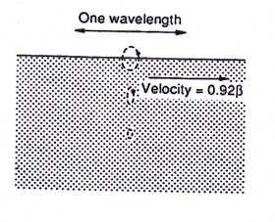
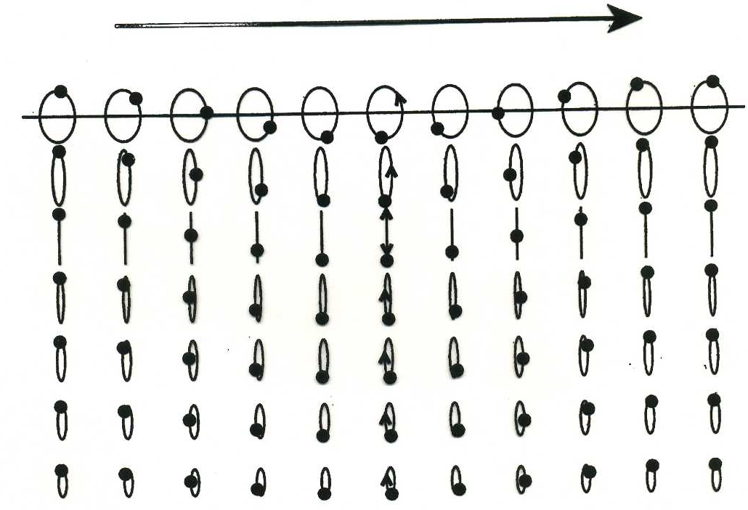
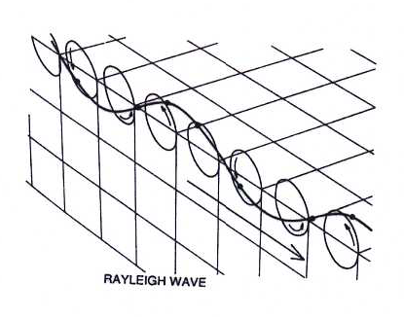
The particle displacement is not confined entirely to the surface of the medium. Particles below the free surface are also affected by the passage of the Rayleigh wave; in a uniform half-space the amplitude of the particle displacement decreases exponentially with increasing depth. The penetration depth of the surface wave is typically taken to be the depth at which the amplitude is attenuated to (e₋₁) of its value at the surface. For Rayleigh waves with wavelength λ the characteristic penetration depth is about 0.4 λ.
4
Notes:
4

Slide 5
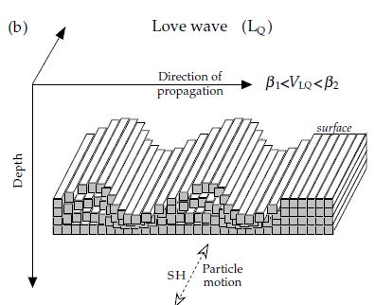
Love waves
The boundary conditions which govern the components of stress at the free surface of a semi-infinite elastic halfspace prohibit the propagation of SH-waves along the surface.
However, A. E. H. Love showed in 1911 that if a horizontal layer lies between the free surface and the semi-infinite half-space SH-waves within the layer that are reflected at supercritical angles from the top and bottom of the layer can interfere constructively to give a surface wave with horizontal particle motions
The velocity (β₁) of S-waves in the near-surface layer must be lower than in the underlying half-space (β₂). The velocity of the Love waves (VLQ) lies between the two extreme values: β₁ < V_{LQ}< β₂
Theory shows that the speed of Love waves with very short wavelengths is close to the slower velocity β₁ of the upper layer, while long wavelengths travel at a speed close to the faster velocity of β₂ the lower medium. This dependence of velocity on wavelength is termed dispersion. Love waves are always dispersive, because they can only propagate in a velocity-layered medium.
5
Notes:
5

Slide 6
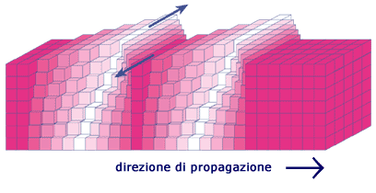
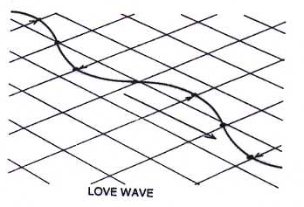
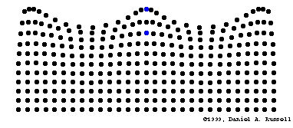
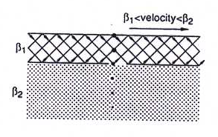
6
Notes:
6

Slide 7
7
Notes:
7

Slide 8
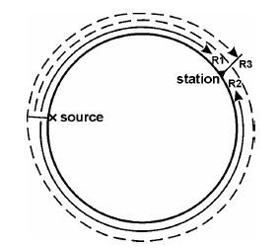
Love and Rayleigh waves travel along great circle paths around the globe. Surface waves from strong earthquakes may travel several times around the Earth. They are termed global surface waves. The first surface wave group arriving at a seismic station at the epicentral distance D° will have taken the shorter great circle while the later arrival has traveled the major arc path over 360° - D°.
These arrival groups are called R1, R2, R3, R4 etc. for Rayleigh waves and G1, G2, G3, G4 etc. for Love waves, respectively. R3 (or G3) have traveled over 360° + D° and R4 over 720°- D° etc. Figure gives an example for long-period records of P, SV, SH, R1, R2, G1 and G2 in the vertical (Z) and the two rotated horizontal components (radial R and transverse T). As expected, P appears only on Z and R while S has both SV and SH energy. The Love wave groups G1 and G2 are strongest in T and arrive ahead of R1 in R2, which are visible only on the R and Z components.
8
Notes:
8

Slide 9
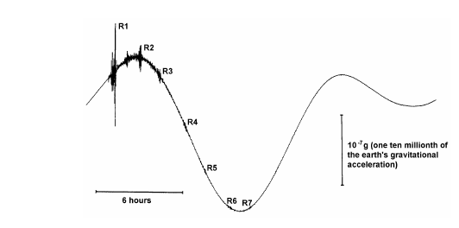
Example of a very broadband (VBB) record with high dynamic range by the STS1 seismograph operated by the Nagoya University, Japan. The seismic wave groups from a magnitude 8.2 earthquake in the Kermadec Islands (October 20, 1986) are superimposed to solid Earth’s tides
9
Notes:
9

Slide 10
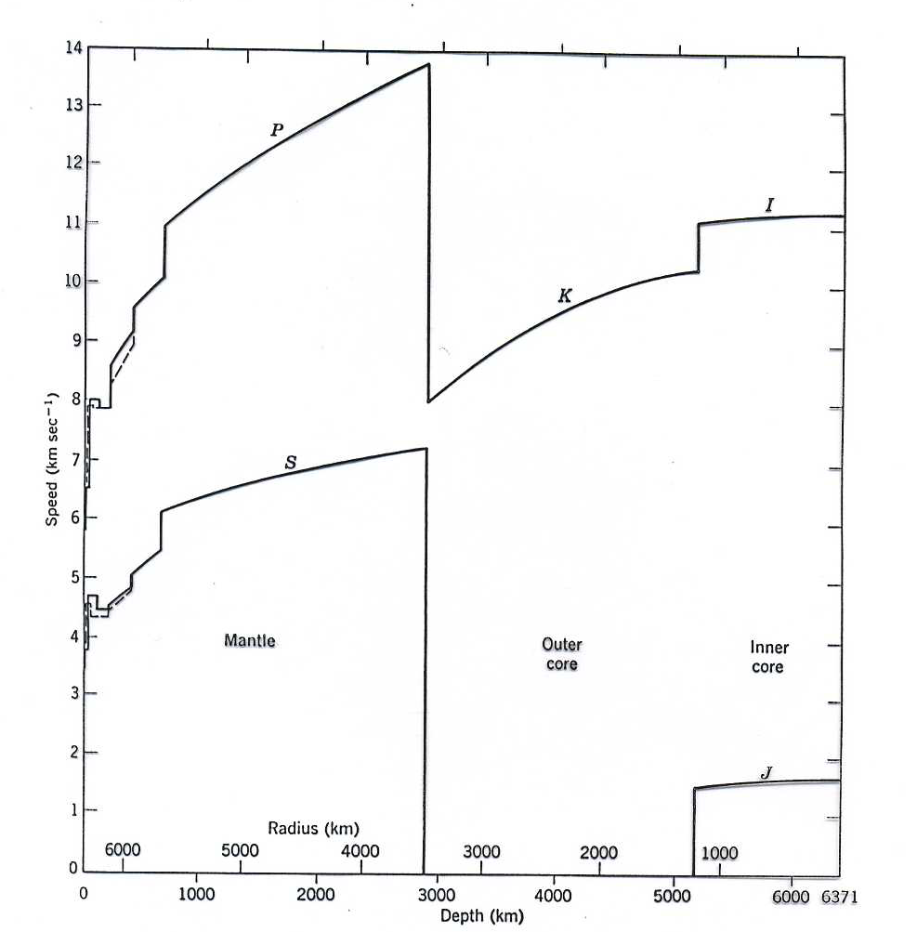
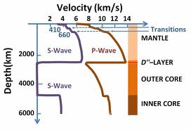
dispersion
The penetration depth below the surface increases with λ. This is comparable with the frequency-dependent skin effect of electromagnetic waves propagating in a conducting medium with a free surface.
Since the types of rocks, their rigidity and bulk modulus change (usually increase) with depth, the velocities of surface waves change accordingly since the longer waves “sense” deeper parts of the Earth. This results in a frequency dependence of their horizontal propagation velocity, called dispersion. Accordingly, while body-wave arrivals with no or negligibly small dispersion only (due to intrinsic attenuation) appear in seismic records as rather impulsive onsets or short transient wavelets, the dispersion of surface waves forms long oscillating wave trains. Their duration increases with distance
10
Notes:
10

Slide 11
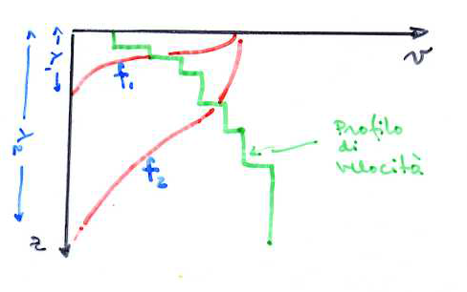
Usually, the more long-period surface waves arrive first (normal dispersion). But in some regions of the Earth low-velocity layers exist (e.g., the asthenosphere in the upper mantle; in the depth range between about 80 and 220 km). This general trend may then be reversed for parts of the surface wave spectrum.
Presentations of the propagation velocity of surface waves as a function of the period or the frequency f are called dispersion curves
11
Notes:
11

Slide 12
Dispersion
The dispersion of surface waves provides an important tool for determining the vertical velocity structure of the lower crust and upper mantle. Love waves are intrinsically dispersive even when the surface layer and underlying halfspace are uniform.
Rayleigh waves over a uniform halfspace are non-dispersive. However, horizontal layers with different velocities are usually present or there is a vertical velocity gradient. Rayleigh waves with long wavelengths penetrate more deeply into the Earth than those with short wavelengths. The speed of Rayleigh waves is proportional to the shear-wave velocity (V_{LR}≈0.92β), and in the crust and uppermost mantle b generally increases with depth.
Thus, the deeper penetrating long wavelengths travel with faster seismic velocities than the short wavelengths. As a result, the Rayleigh waves are dispersive.
The packet of energy that propagates as a surface wave contains a spectrum of wavelengths. The energy in the wave propagates as the envelope of the wave packet, at a speed that is called the group velocity (U). The individual waves that make up the wave packet travel with phase velocity (c), as defined in Eq. 20.
12
Notes:
12

Slide 13
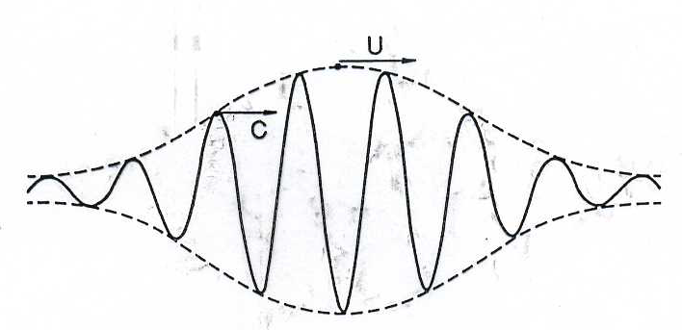
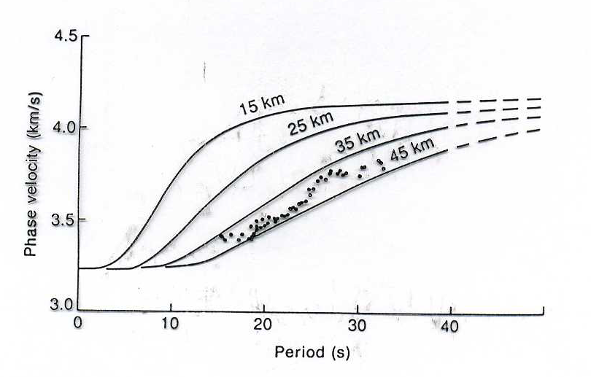

Slide 14
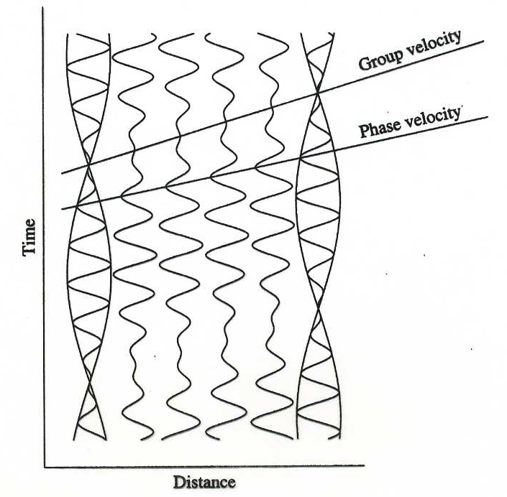
La somma di due onde di frequenze leggermente differenti risultano in un’onda modulata. La velocità di gruppo è la velocità del pacchetto d’onda; la velocità di fase è la velocità dei picchi singoli.

Slide 15
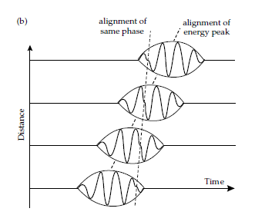
Theoretically, the group velocity U(f) and phase velocity c(f) are linked by:
The situation in which phase velocity decrease as frequency increase (i.e., the longer wavelengths propagate faster than the short wavelengths) is called normal dispersion. In this case, because ∂c/∂f is negative, the group velocity U is slower than the phase velocity c.
The shape of the wave packet changes systematically as the faster moving long wavelengths pass through the packet
As time elapses, an initially concentrated pulse becomes progressively stretched out into a long train of waves. Consequently, over a medium in which velocity increases with depth, the long wavelengths arrive as the first part of the surface-wave record at large distances from the seismic source.
15
Notes:
15

Slide 16
Consider the Figure which illustrates a record section of surface waves. Notice that, on each seismogram, the lower-frequency waves arrive before the higher frequency waves The first phase to arrive on each record is peak A. Notice also that the frequency of peak A is not a constant from one record to the next: the frequency decreases (period increases) as the distance increases
The dashed curve linking peak A on each record defines the phase velocity for peak A. The phase velocity for the frequency of peak A at each distance is the inverse slope of the dashed curve at that distance. The dashed lines linking the subsequent peaks B, C and D also determine the phase velocity as a function of frequency.
The slopes of all these dashed lines indicate that, in this example, the phase velocity decreases as the frequency of the surface waves increases (i.e., the phase velocity increases with the period).
16
Notes:
16

Slide 17
The group velocity of surface waves is the velocity at which surface-wave energy of a given frequency travels. It is a constant for a given frequency. Therefore on Figure a straight lines passing through the origin mark the surface-wave signal of any particular frequency on each successive record. Such lines for the three frequencies f1, f2 and f3, where f1 < f2 < f3, are shown in Figure b.
The group velocities for these frequencies are U1, U2 and U3, where U1 > U2 > U3. In this example, the group velocity decreases as the frequency of these surface waves increases (i.e., the group velocity increases with the period).
A plot of velocity against period, called a dispersion curve, is the usual way of presenting this velocity–frequency information. Notice that, in this example, the group velocity is less than the phase velocity. To repeat, energy travels with the group velocity, not the phase velocity.
17
Notes:
17

Slide 18
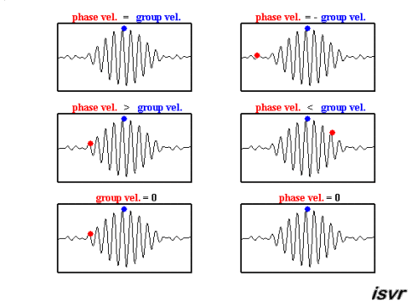
18
Notes:
18

Slide 19
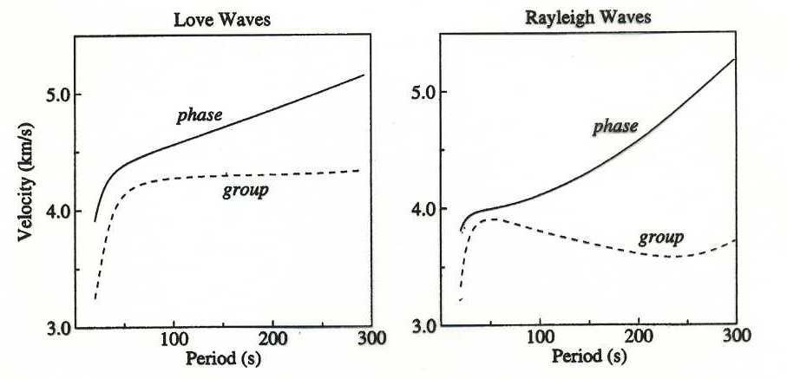
Theoretical Love- and Rayleigh-wave dispersion curves computed for the PREM model with anisotropy
19
Notes:
19

Slide 20
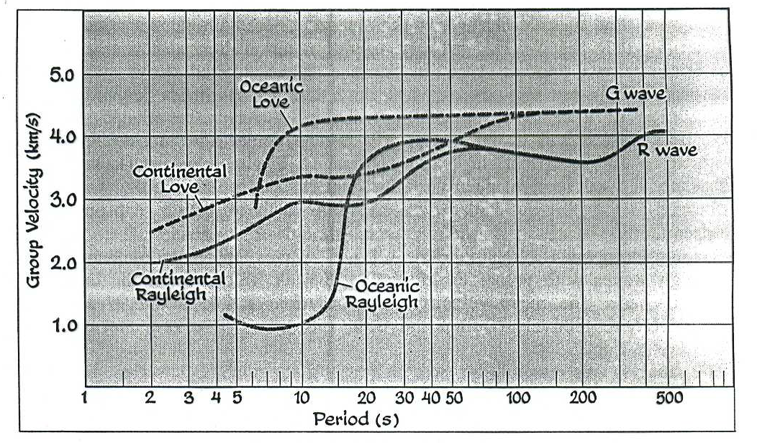
Curve di dispersione per la velocità di gruppo per le onde fondamentali di Rayleigh e di Love che hanno viaggiato lungo un percorso oceanico e continentale.

Slide 21
They differ for Love and Rayleigh waves depend on the velocity-depth structure of the Earth along the considered segment of the travel path
Thus, from the inversion of surface wave dispersion data, information on the shear-wave velocity structure of the crust, and, when using periods up to about 500 s (mantle surface waves), even of the upper mantle and transition zone can be derived.
21
Notes:
21

Slide 22
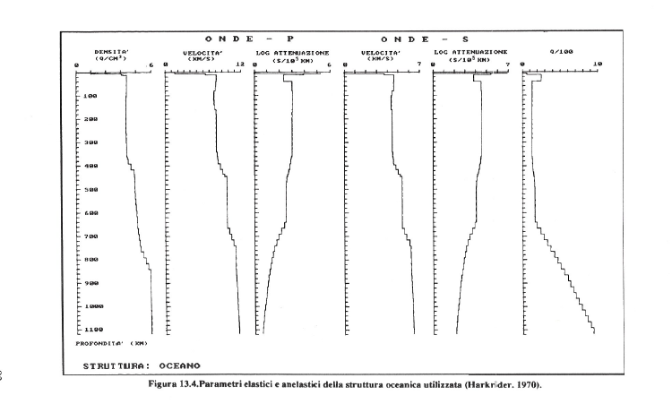

Slide 23
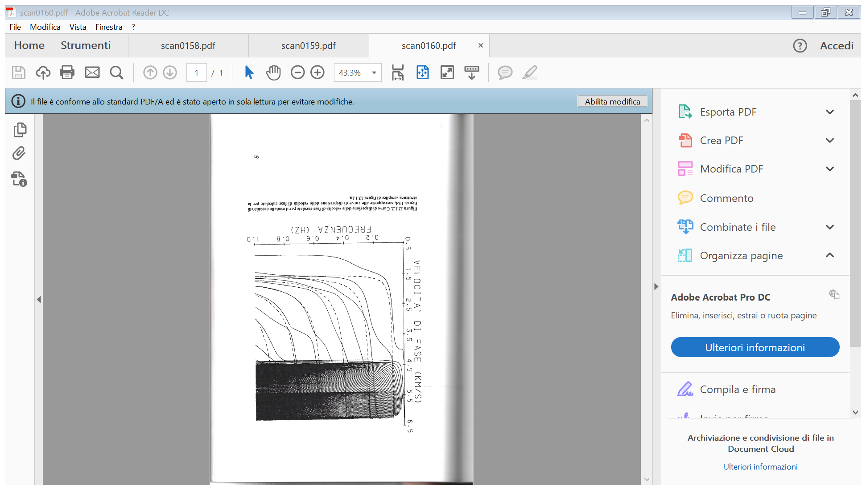
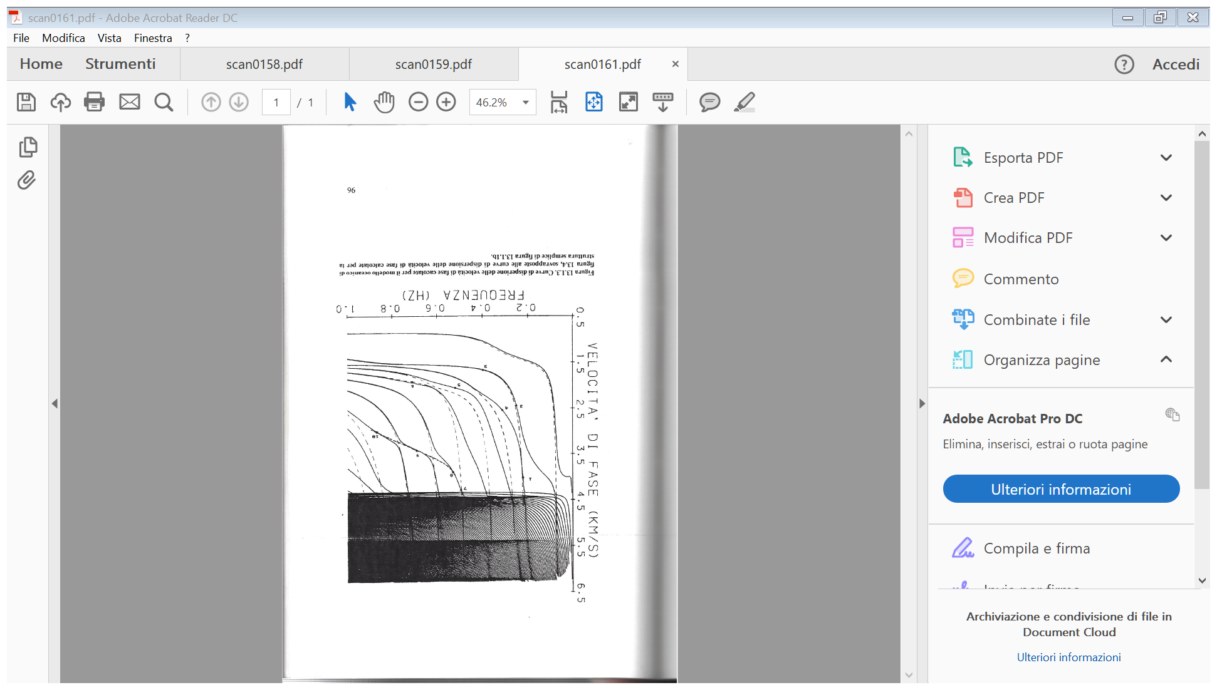

Slide 24
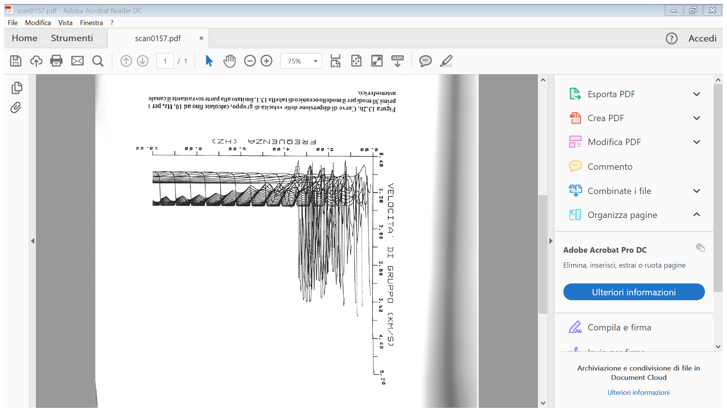
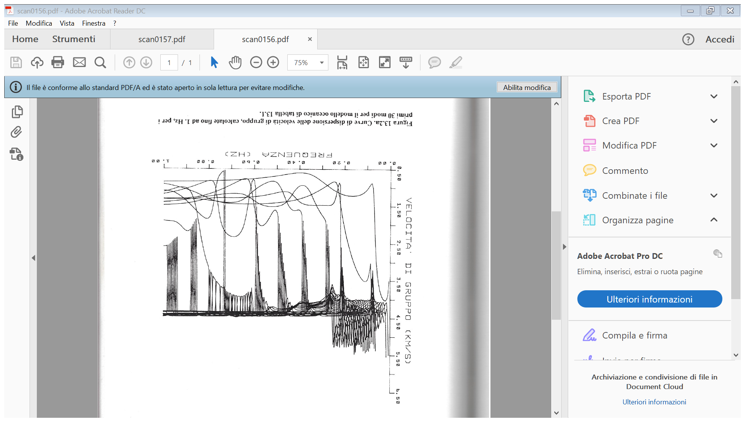

Slide 25
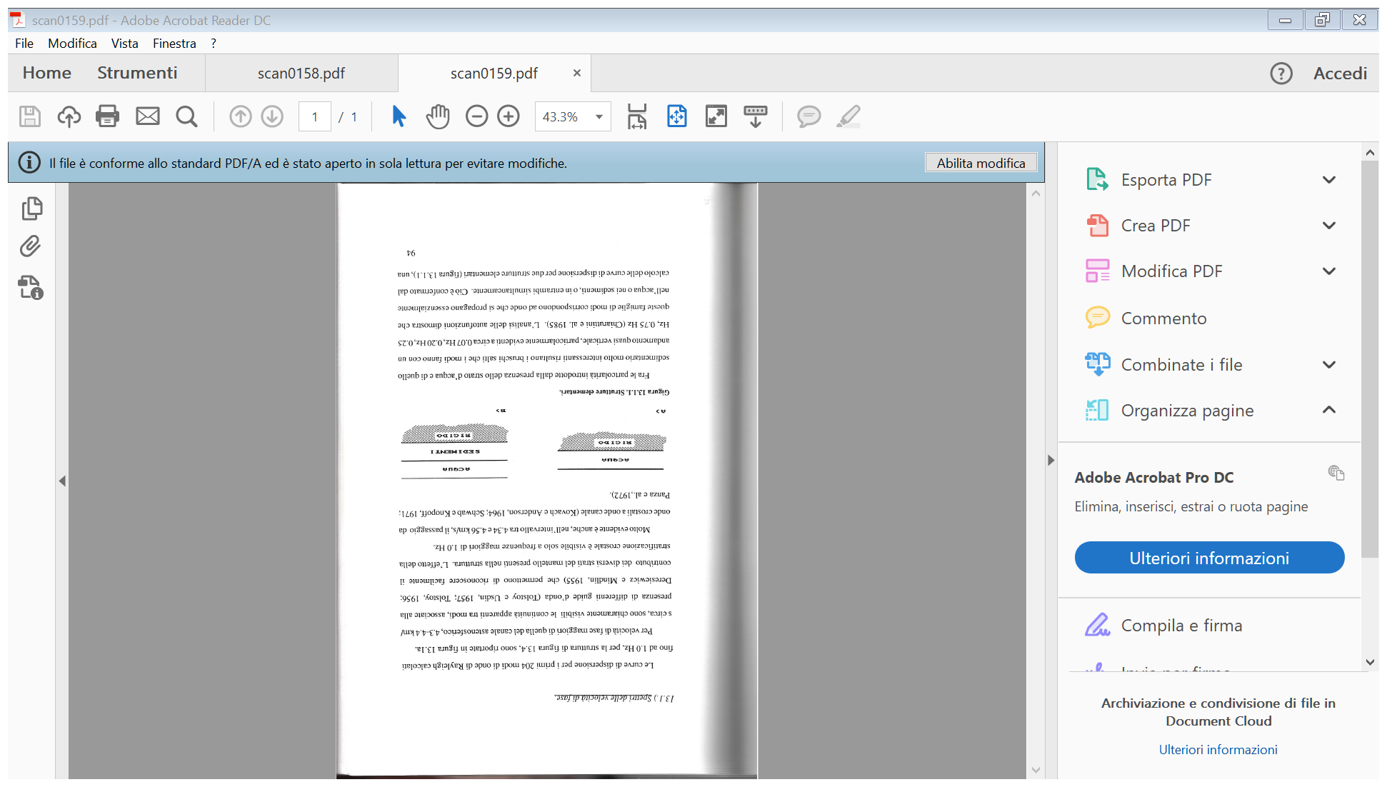

Slide 27
Normal modes
The analysis of surface waves in terms of a flat Earth model is adequate at short periods, but becomes progressively less satisfactory at longer periods. Curvature of the Earth influences the dispersion and must be taken into account. A more general approach is to consider the modes of free oscillation.
When a bell is struck with a hammer, it vibrates freely at a number of natural frequencies. The combination of natural oscillations that are excited gives each bell its particular sonority. In an analogous way, the sudden release of energy in a very large earthquake can set the entire Earth into vibration, with natural frequencies of oscillation that are determined by the elastic properties and structure of the Earth’s interior. The free oscillations involve three-dimensional deformation of the Earth’s spherical shape and can be quite complex
Before discussing the Earth’s free oscillations it is worth reviewing some concepts of vibrating systems that can be learned from the one-dimensional excitation of a vibrating string that is fixed at both ends.
Any complicated vibration of the string can be represented by the superposition of a number of simpler vibrations, called the normal modes of vibration. These arise when travelling waves reflected from the boundaries at the ends of the string interfere with each other to give a standing wave.
27
Notes:
27

Slide 28
28
Notes:
28

Slide 29
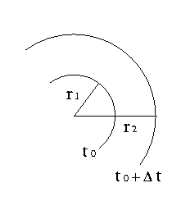
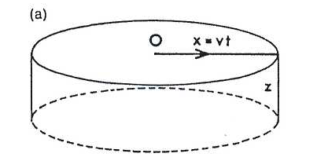
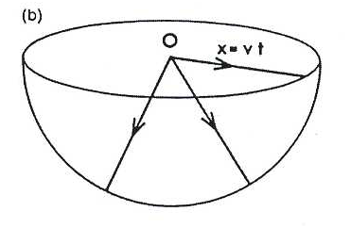
Le onde di superficie hanno velocità minore delle onde P ed S, per cui il loro arrivo in una stazione è successivo a quelle delle onde di corpo. La loro ampiezza è però molto maggiore delle onde di corpo.
La loro maggiore ampiezza è spiegata dal fatto che le onde di superficie hanno fronti d’onda cilindrici (a) quello delle onde di corpo sferico (b).
Cylindrical wave front
Spherical wave front
Flusso di energia per unità di superficie ed unità di tempo
Il flusso totale di energia che attraversa i fronti d’onda ad istanti successivi deve conservarsi:
Surface waves
Body waves

Slide 30
SMORZAMENTO DELLE ONDE
Nel tempo:
Notes:
30

Slide 31
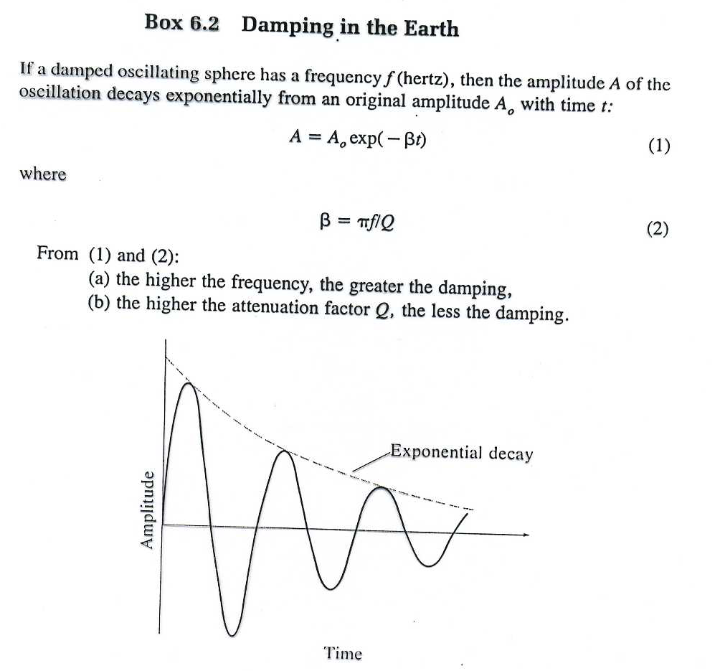
Notes:
31

Slide 32
Nello spazio
Definendo
Con A₁ ed A₂ le ampiezze dell’onda separate di un periodo (o lunghezza d’onda), si dimostra che:
Notes:
32

Slide 33
Dovuto all’attrito interno nel mezzo al passaggio dell’onda (calore generato da movimenti di taglio sui confini dei grani, moto lungo le dislocazioni nei minerali ecc.).
Q in genere cresce con la densità e la velocità.
In genere e per i mezzi in cui tutte le perdite di energia sono dovute a meccanismi di taglio:
Q è indipendente dalla frequenza per 0.001 < f < 1 Hz
Per f > 1 Hz con
Notes:
33

Slide 34
Q è il parametro (adimensionale) che descrive l’anelasticità di un mezzo.
mezzo perfettamente elastico
mezzo completamente dissipativo
nei sedimenti
nella crosta
nel mantello
Notes:
34

Slide 36
Eq. 29 shows that the damping of a seismic wave is dependent on the Q-factor of the region of the Earth that the wave has travelled through.
In general the Q-factor for P-waves is higher than the Q-factor for S-waves. This may indicate that anelastic damping is determined primarily by the shear component of strain.
In solids with low rigidity, the shear strain can reach high levels and the damping is greater than in materials with high rigidity.
In fluids the Q-factor is high and damping is low, because shear strains are zero and the seismic wave is purely compressional.
The values of Q are quite variable in the Earth: values of around 10² are found for the mantle, and around 10³ for P-waves in the liquid core.
Because Q is a measure of the deviation from perfect elasticity, it is also encountered in the theory of natural oscillations of the Earth, and has an effect on fluctuations of the Earth’s free rotation, as in the damping of the Chandler wobble.
36
Notes:
36

Slide 37
Each normal mode corresponds to a standing wave with frequency and wavelength determined by the condition that the length of the string must always equal an integral number of half-wavelengths.
As well as the fixed ends, there are other points on the string that have zero displacement; these are called the nodes of the vibration.
The first normal (or fundamental) mode of vibration has no nodes. The second normal mode (sometimes called the first overtone) has one node; its wavelength and period are half those of the fundamental The third normal mode (second overtone) has three times the frequency of the first mode, and so on.
Modes with one or more node are called higher-order modes.
37
Notes:
37

Slide 40
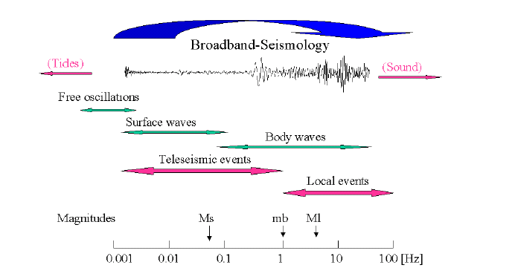

Slide 41
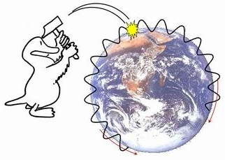
OSCILLAZIONI LIBERE DELLA TERRA
Ogni sistema meccanico ha un’oscillazione propria (corde, pendolo......) che può essre eccitata. Ciò vale anche per la Terra che può oscillare in un numero infinito di modi di oscillazione, come una gigantesca campana.
Sebbene tali oscillazioni fossero predette teoricamente, non furono osservate fino al 1960, quando vennero sufficientemente eccitate da un grande terremoto in Cile.
Notes:
41

Slide 42
OSCILLAZIONI LIBERE DELLA TERRA
Esistono due modi indipendenti di oscillazione:
oscillazioni torsionali (o toroidali) indicate con T in cui lo spostamento è sempre perpendicolare al raggio della Terra, limitato alla crosta ed al mantello e confinato in superfici sferiche concentriche.
oscillazioni sferoidali indicate con S in cui lo spostamento ha sia componenti radiali che torsionali. L’oscillazione sferoidale più semplice è puramente radiale
Notes:
42

Slide 43
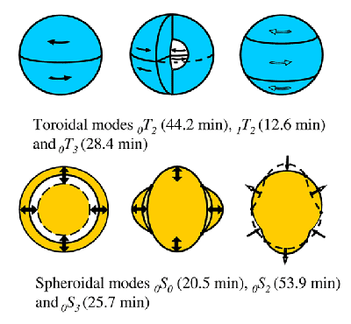
Notes:
43

Slide 44
OSCILLAZIONI LIBERE DELLA TERRA
Ambedue le oscillazioni hanno un numero infinito di modi.
Le oscillazioni libere vengono di solito misurate da gravimetri ed estensimetri, che hanno periodo di oscillazione dell’ordine dei minuti.
Le oscillazioni toroidali sono equivalenti alle onde di Love, quelle sferoidali alle onde di Rayleigh. Le misure dei periodi di oscillazione (massimo circa 2500 s per T, 3200 s per S) possono venire usate per estendere alle basse frequenzre le curve di dispersione.
Notes:
44

Slide 45
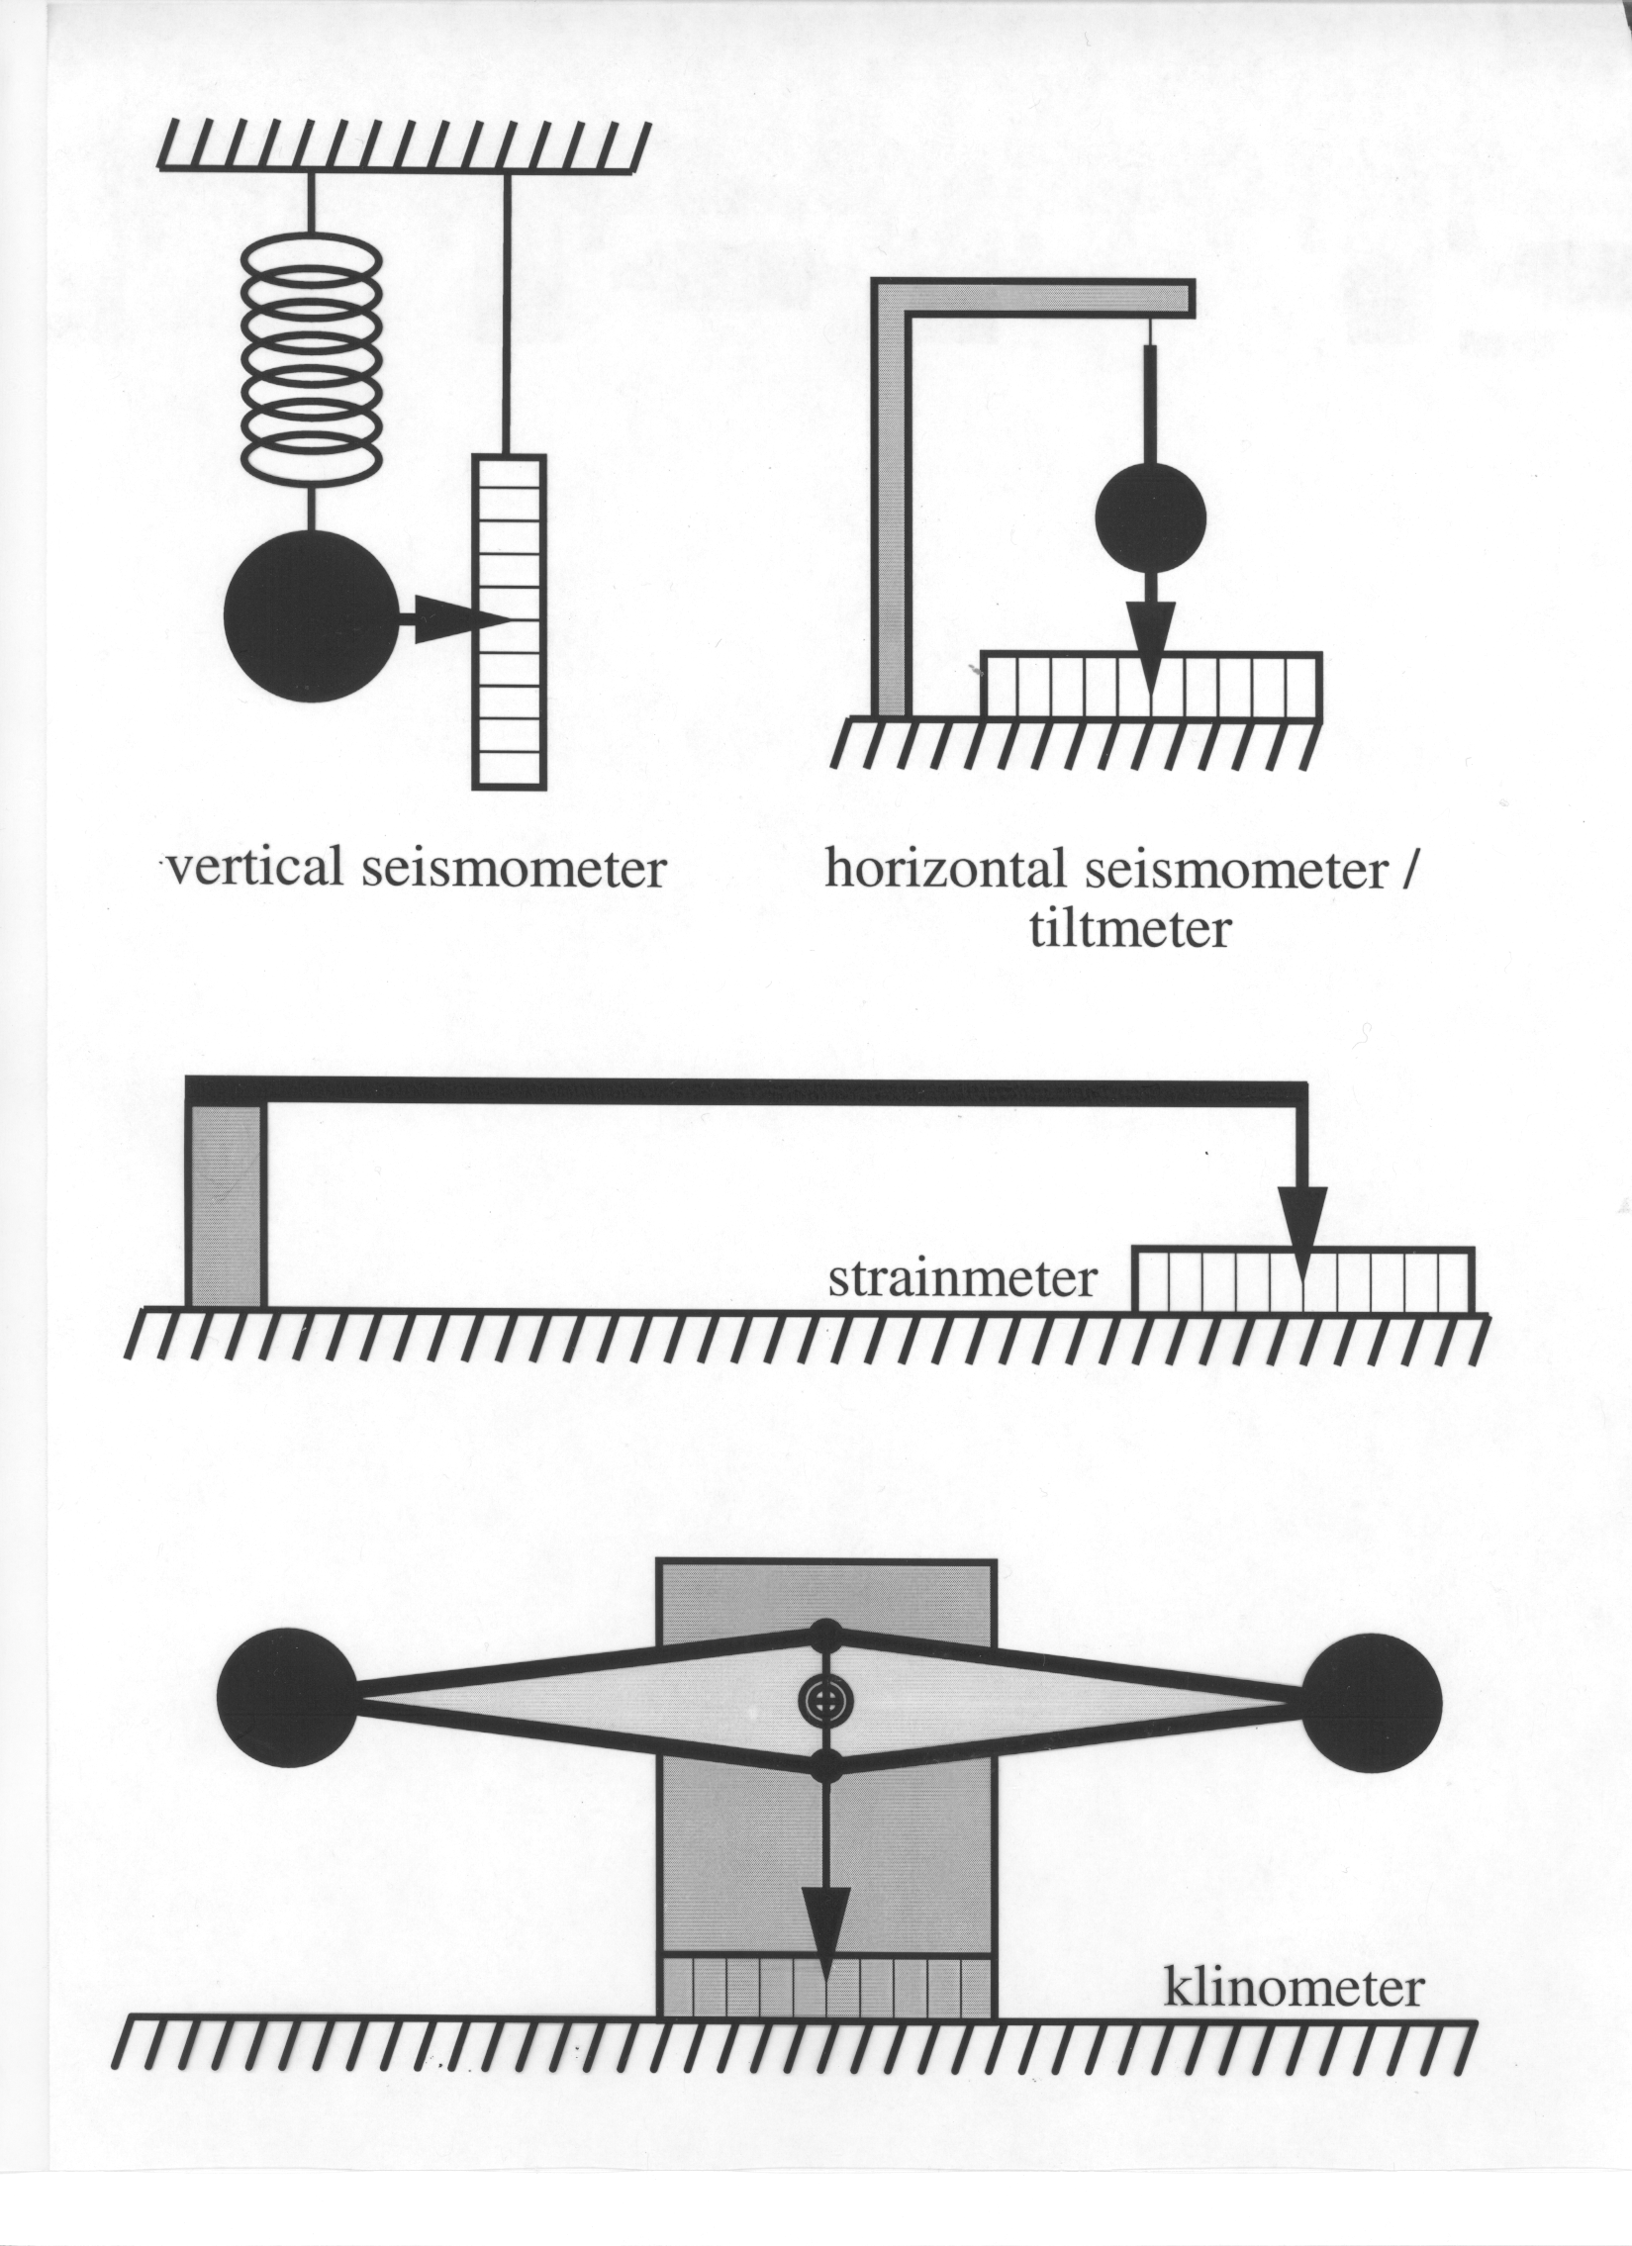

Slide 46
Estensimetri e clinometri

Slide 47
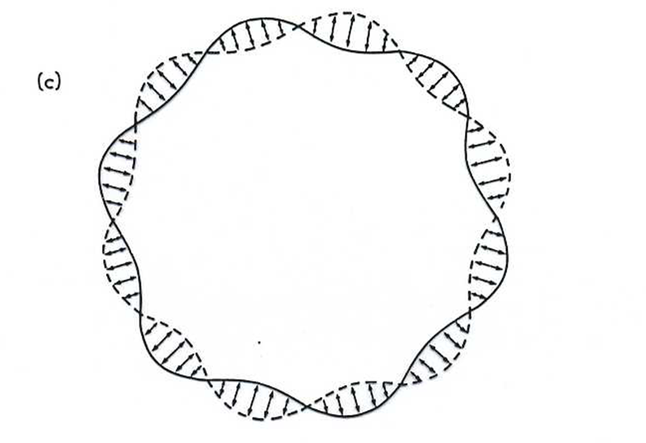
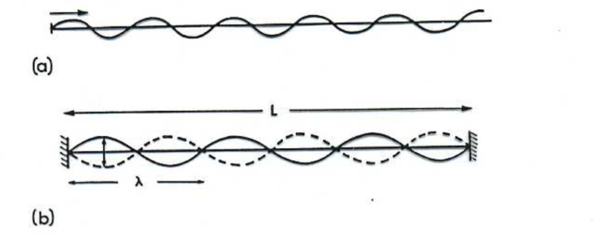
MODI DI OSCILLAZIONE
_{n}T_{l} _{n}S_{l}
n = numero di zeri dell’autofunzione lungo il raggio terrestre
l = numero di linee nodali (cioè sulle quali il modo è nullo) sulla superficie terrestre
Ad ogni modo corrisponde un periodo di oscillazione che lo caratterizza.
Notes:
47

Slide 48
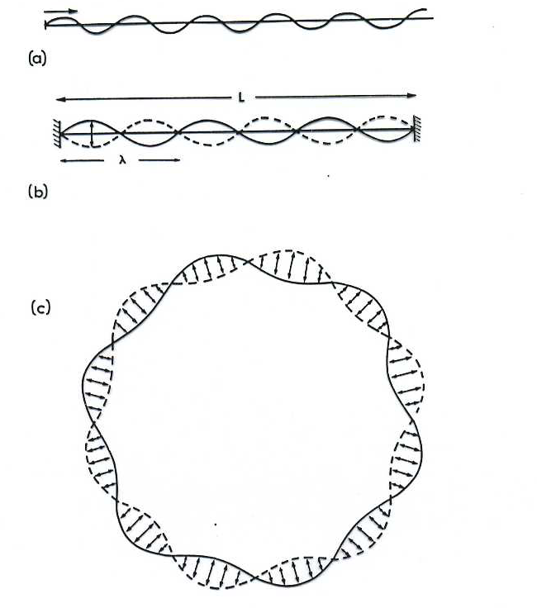
Notes:
48

Slide 49
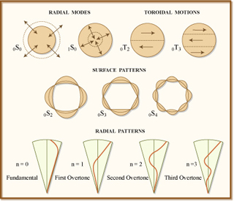
Notes:
49

Slide 50
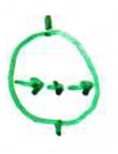
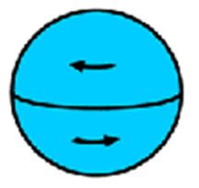
MODI TOROIDALI
₀T₀
È indefinito in quanto non è possibile un modo di torsione senza alcun punto fisso
₀T₁
L = 1 per i modi toroidali denota i poli (fissi).Questo modo non esiste in quanto implica una rotazione nel tasso di rotazione terrestre.
₀T₂
E’ il modo toroidale più semplice in cui si ha torsione in direzioni opposte nell’emisfero nord e sud.
Notes:
50

Slide 51
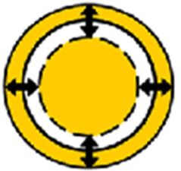
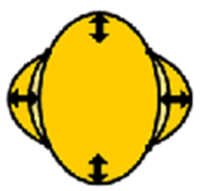
MODI SFEROIDALI
₀S₀
È il modo sferoidale più semplice: la Terra si gonfia e sgonfia.
₀S₁
È un modo indefinito, perchè implca uno spostamento del centro di gravità (può avvenire solo in presenza di una forza esterna.
₀S₂
È il modo a periodo più lungo (3233.25 s).
Notes:
51

Slide 52
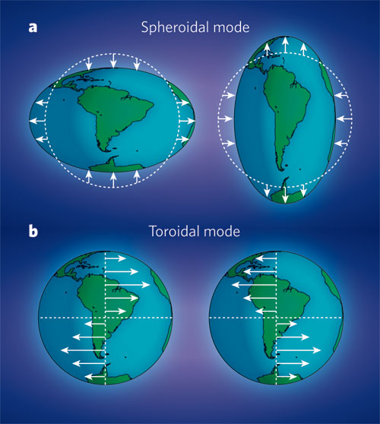
Notes:
52

Slide 53
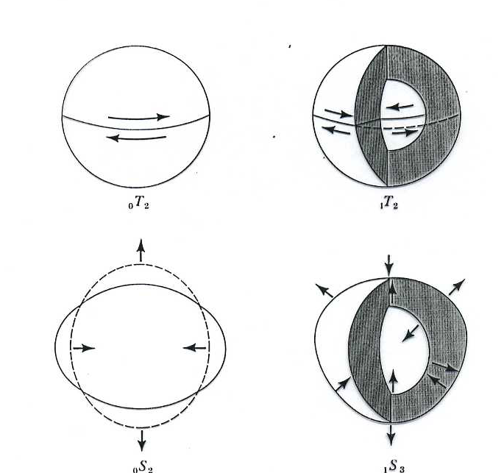
Notes:
53

Slide 54
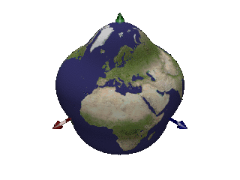
Notes:
54

Slide 55
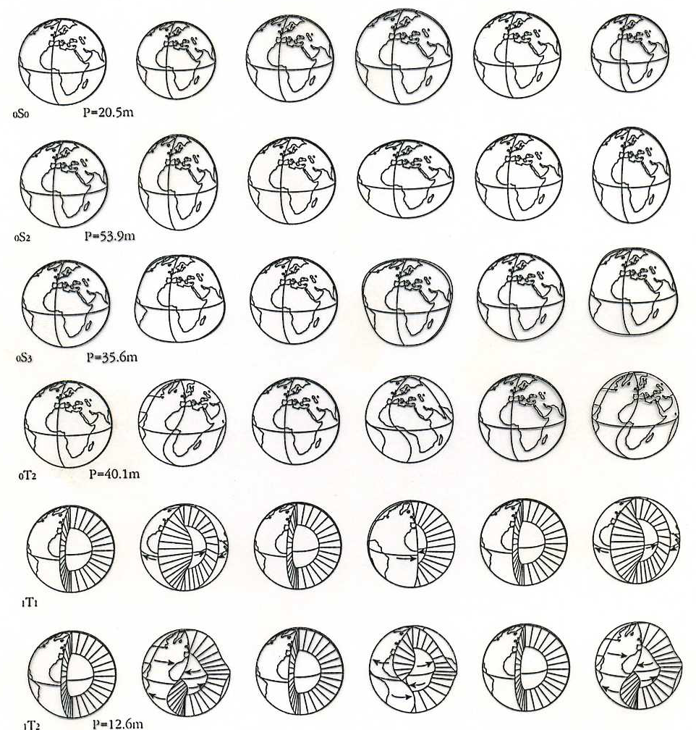


Notes:
55

Slide 56

Notes:
56

Slide 57

http://icb.u-bourgogne.fr/nano/manapi/saviot/terre/index.en.html
Notes:
57

Slide 58

Notes:
58

Slide 59

Spectral peaks of Earth's free oscillations, indicated by the shapes of vibration deformations of Earth�s sphere.
Notes:
59

Slide 60

Notes:
60

Slide 61

Notes:
61

Slide 62

Notes:
62

