Slide 1
Primary immune deficiencies: defects in acquired immunity

Slide 2
Caused by genetic defects that lead to:
blocks in the maturation of T and B lympho
impairment of lympho activation and functions

Slide 3
Primary lymphocyte immunodeficiencies

Slide 4
Primary lymphocyte imunodeficiencies

Slide 5
Primary B cell immunodeficiencies
X-linked agammaglobulinemia Bruton's syndrome
B cells in the bone marrow fail to mature beyond the preB cell stage
Severe decrease or absence of mature B lympho and serum immunoglobulins
Caused by mutations in the gene encoding the Bruton tyrosine kinase (Btk), that partecipates in delivering biochemical signals crucial for B cell maturation

Slide 7
2015: Novel targeted therapies in B-cell lymphomas

Slide 8
Primary lymphocyte imunodeficiencies

Slide 9
Defects in T cell maturation: DiGeorge syndrome
Selective T cell deficiency due to a congenital malformation that results in many developmental alterations, including hypolasia or agenesis of the thymus and consequent deficient T cell maturation
High susceptibility to mycobacterial, viral and fungal infection; severely affected patients have low Ig levels
Microdeletion on chromosome 22, approximately 40 genes
Among them, the TBX1 gene is suspected to play a major role in many of the typical features of this syndrome
Tbx-1 (transcription factor) controls genes involved in the development of the parathyroid and thymus glands
Other genes involved in DiGeorge syndrome?

Slide 10
Primary lymphocyte immunodeficiencies

Slide 11
Severe Combined Immunodeficiencies (SCIDs)
Disorders that affect both humoral (antibodies) and cell-mediated immunity
Caused by deficiencies of both B and T cells, or only T cell
In some types of SCID the defect in humoral immunity is due to absence of helper T cells
Life-threatening infections during the first year of life

Slide 12
X-linked SCID
Nearly 50% of SCID cases
Mutations in the gene encoding the common γ chain shared by the receptors for IL-2, IL-4, IL-7, IL-9 and IL-15
Impaired maturation of T and NK cells, reduced serum Ig
Failure of IL-7 receptor causes T cell deficiency due to the inability of this cytokine to stimulate the growth of immature thymocytes
NK cell deficiency is due to failure of the receptor for IL-15, a strong proliferative stimulus for NK cells

Slide 13
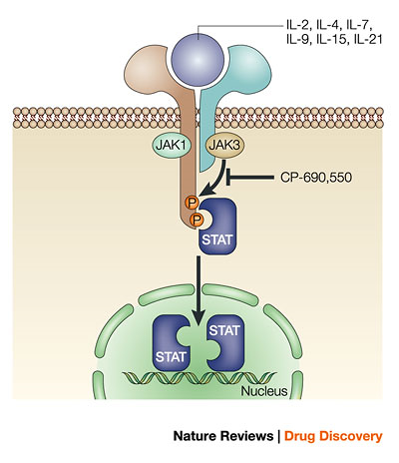
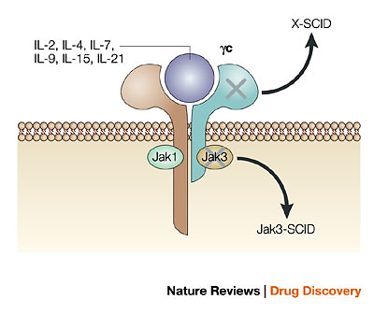
γ chain
A number of cytokines use the common gamma-chain in conjunction with a ligand-specific chain to form their receptors
These receptor subunits bind the Janus kinases JAK3 and JAK1, respectively. On ligand binding, these kinases phosphorylate signal transducers and activators of transcription (STATs)
Phosphorylated STATs translocate and accumulate in the nucleus where they regulate gene expression (proliferation, maturation)
Mutations disrupting cytokine signalling lead to severe combined immunodeficiency (SCID)

Slide 14
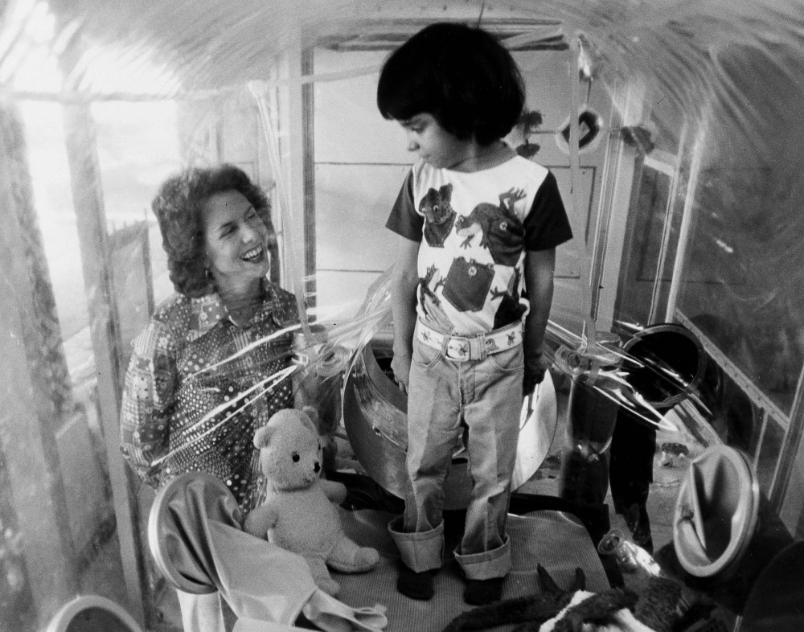
SCID: the case of the «Bubble Boy»
What's it like to live in a bubble?
David Vetter, a young boy from Texas, lived out in the real world in a plastic bubble. Nicknamed "Bubble Boy," David was born in 1971 with severe combined immunodeficiency (SCID), and was forced to live in a specially constructed sterile plastic bubble after 20 seconds of exposure to the world. At the age of 12, four months after receiving the bone marrow transfusion from his sister, David died from lymphoma, a cancer introduced into his system by the Epstein-Barr virus

Slide 15
Primary lymphocyte imunodeficiencies

Slide 16
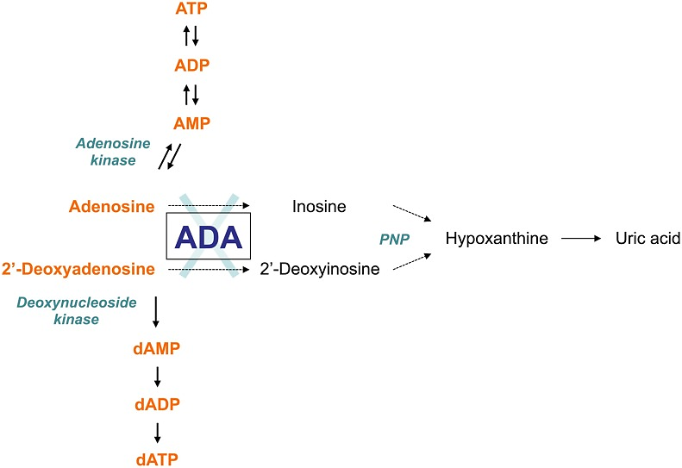
SCID caused by adenosine deaminase (ADA) deficiency
50% of SCID patients show an autosomal recessive pattern of inheritance, nearly half of these cases are due to deficiency of adenosine deaminase (ADA) that is involved in purine catabolism
dATP inhibits DNA synthesis, no cell division
Toxic effect on mitotically active T and B lymphos

Slide 17
ADA-SCID
Occurs in fewer than one in 100,000 live births
ADA deficiency leads to reduced numbers of T and B cells
profound lymphopenia and very low immunoglobulin levels of all isotypes resulting in severe and recurrent opportunistic infections
Treatments:
allogenic hematopoietic stem cell transplantation (HSCT)
enzyme replacement therapy with adenosine deaminase enzyme
gene therapy by infusion of marrow cells that have been transduced with an ADA-containing vector (18 kids treated, 100% success)

Slide 18
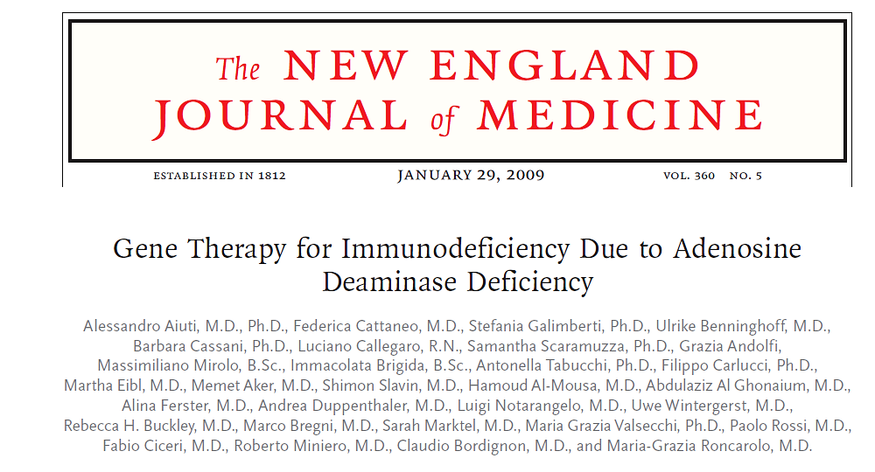
Autologous CD34+ bone marrow stem cells transduced with a retroviral vector containing the ADA gene into 10 children with SCID due to ADA deficiency who lacked an HLA-identical sibling donor

Slide 19
Caused by genetic defects that lead to:
blocks in the maturation of T and B lympho
impairment of lympho activation and functions

Slide 22
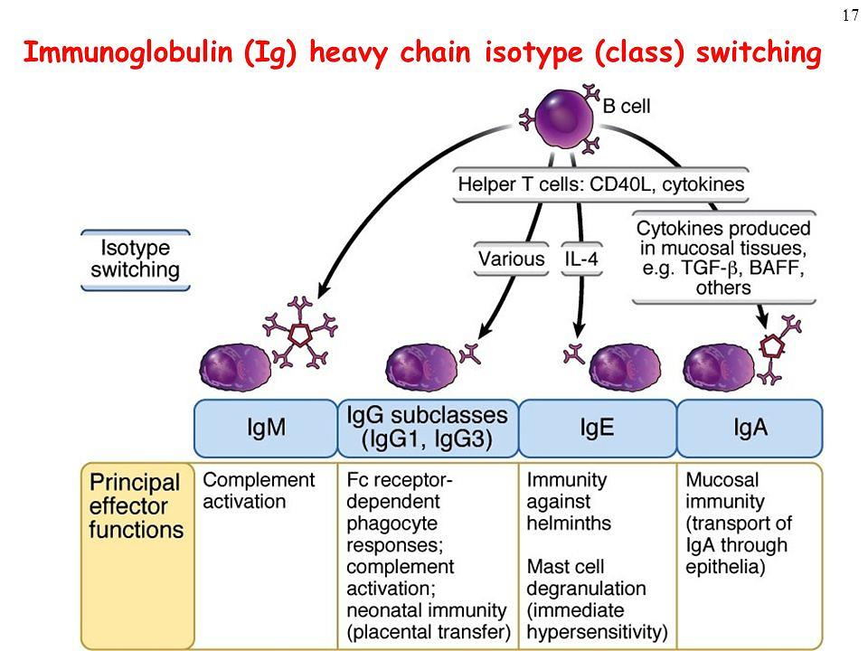
Diversification of the Ig heavy chain (IgH) constant region via isotype switching allows for remarkable plasticity in the immune response

Slide 24
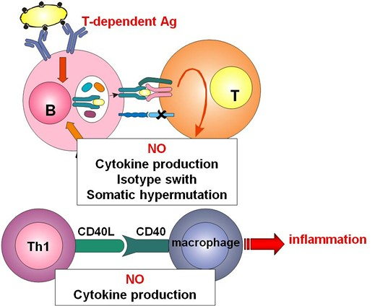
X-linked hyper-IgM syndrome
CD40 ligand
CD40 ligand exposed by Th lympho is crucial for activating:
B lympho, thereby promoting Ig isotype switch
macrophages, thereby enhancing microbial killing during the inflammatory response
switch
X
(IFN-γ)

Slide 26
INNATE IR
COMPLEMENT SYSTEM
PRIMARY DEFECTS OF IR
HUMORAL COMPONENT
CELLULAR COMPONENT
INNATE IR PHAGOCYTES
SECONDARY (ACQUIRED) DEFECTS OF IR
ACQUIRED IR LYMPHOCYTES
HETEROGENEOUS CAUSES
MAY AFFECT ANY COMPONENT OF IR

Slide 27
Secondary immunodeficiencies (1)
Also known as acquired immunodeficiencies, can result from various immunosuppressive agents

Slide 28
Secondary immunodeficiencies (2)
Aging | Defective T lymphocyte functions Defective phagocytic activity Chronic diseases common among the elderly (diabetes, nephropathy)
Drugs | antirheumatic drugs, glucocorticoids immunosuppressive drugs before and after bone marrow and organ transplants
Stress | Effects of cortisol

Slide 29
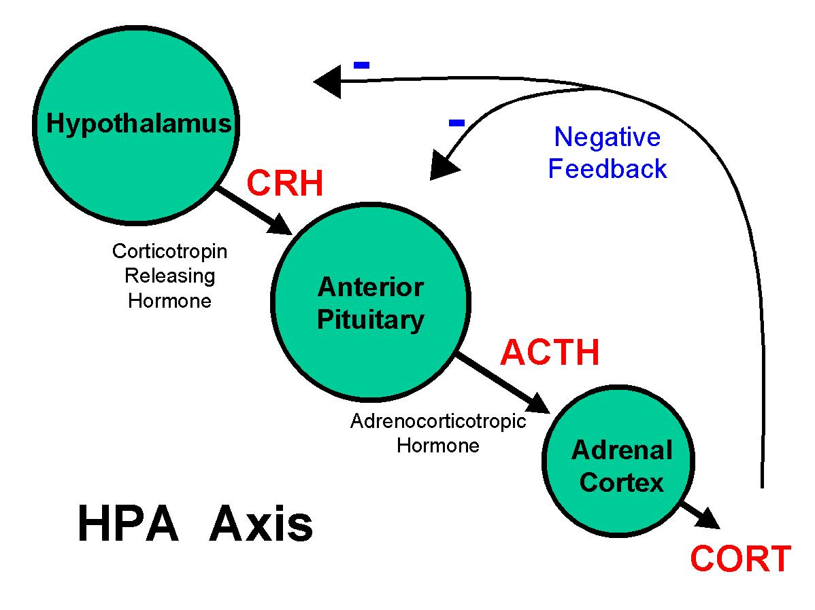
Stress-induced activation of the hypothalamus-pituitary-adrenal axis
STRESS
physical
psychological
enviromental

Slide 30
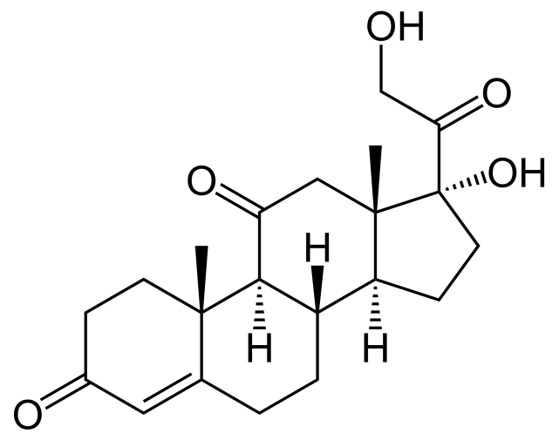
Cortisol
Chronic elevated cortisol levels can:
increase blood pressure
increase glycemia
downregulate the immune system
decrease libido
produce acne
contribute to obesity

Slide 31
Psychological stress alters cytokine production.
In medical students taking exams, psychological stress produced a shift in the cytokine balance. The data showed decreased synthesis of Th1 cytokines, including IFN-γ, and increased production of Th2 cytokines, including IL-10. This stress-induced decrease of Th1 cytokines results in dysregulation of cell-mediated immune responses
Examples:
Low response to infections
Delayed cutaneous wound healing

