Slide 1
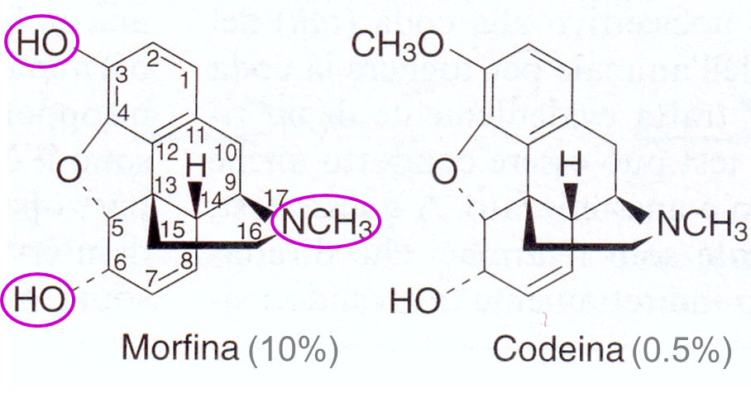
Chemical formula of morphine and its prodrug codeine

Slide 2
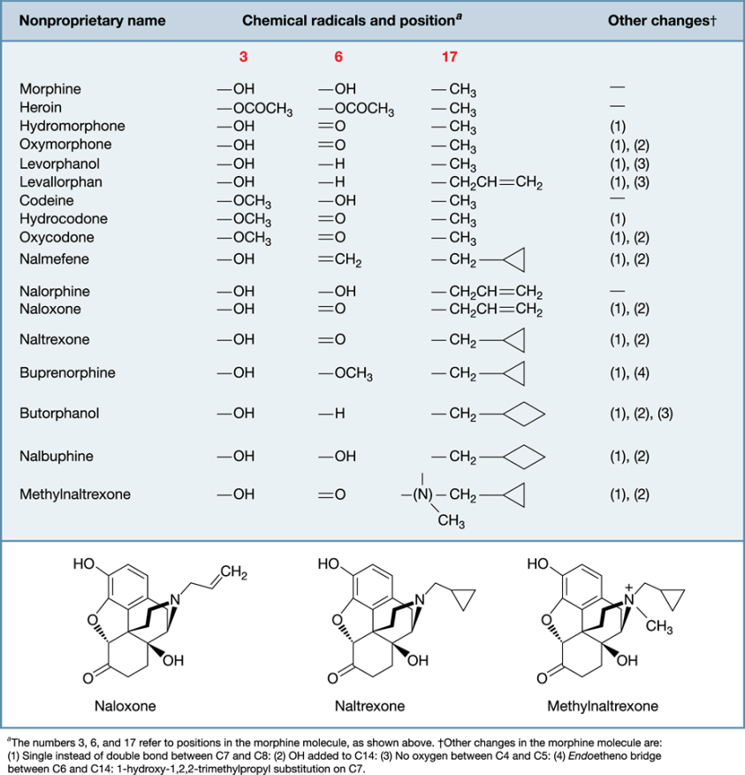
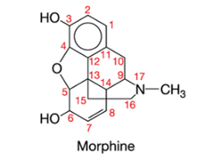
Chemical structures of opioids

Slide 4
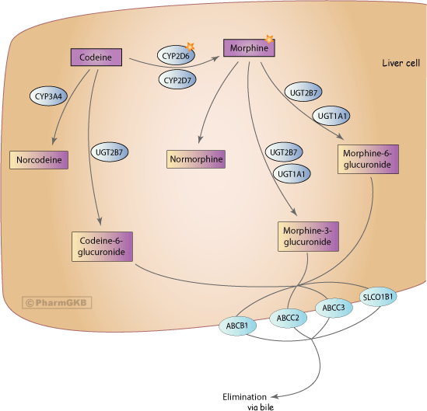
Pharmacokinetics codeine and morphine
Thorn et al., Pharmacogenetics & Genomics 2009

Slide 5
6-glucoronide metabolites of morphine is more active than morphine
Dose from 5 to 37.5 mg morphine every 6 hours
De Gregorti et al., Ther Drug Monit 2014

Slide 6
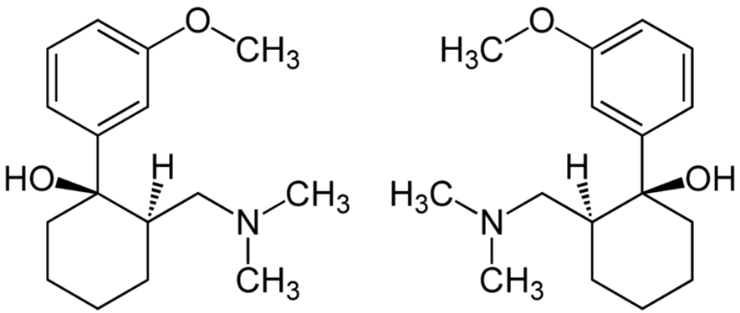
Tramadol
Synthetic opioid of the family of derivatives of amminocycloesanol.
Tramadol acts as an opioid agonist and also as an adreneric and serotoninergic agonist.

Slide 7
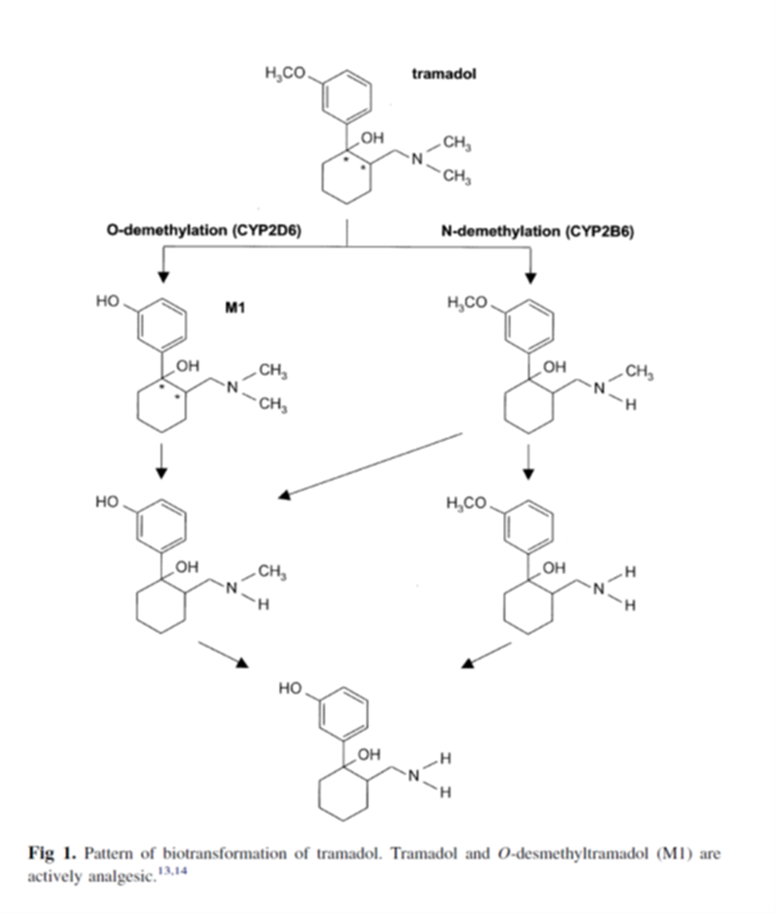
Tramadol biotransformation
(+) - M1: has an activity increased 300-400 for the μ opioid receptor

Slide 8
Pharmacokinetics codeine and morphine
Thorn et al., Pharmacogenetics & Genomics 2009

Slide 9
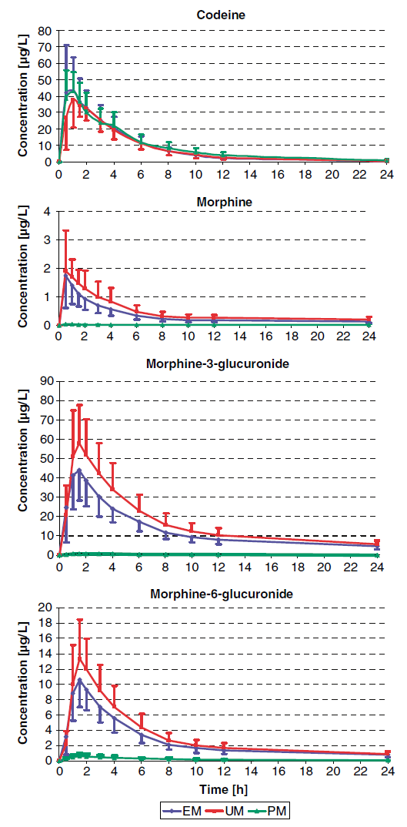
Pharmacokinetics of codeine, morphine and their metabolites and activity of CYP2D6
EM = extensive metabolizer
UM = ultra-rapid metabolizer
PM = poor metabolizer
Kirchheiner et al., Pharmacogenomics J 2007

Slide 10
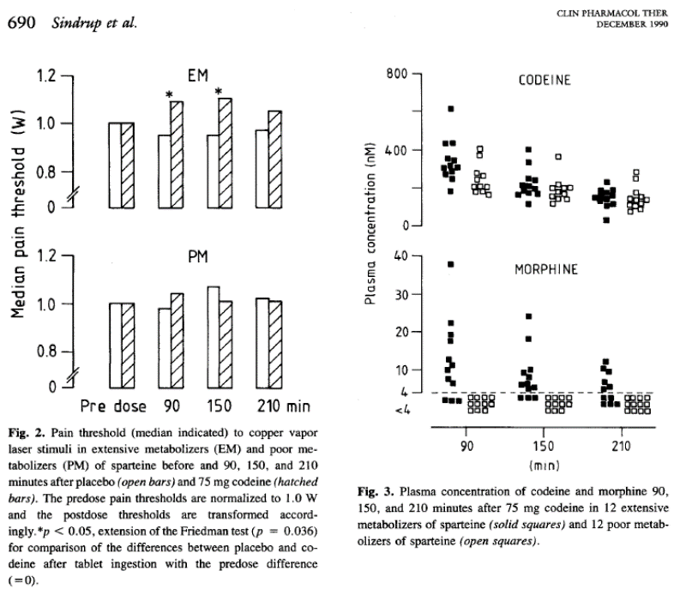
Reduced efficacy of codeine in patients with reduced activity of CYP2D6

Slide 11
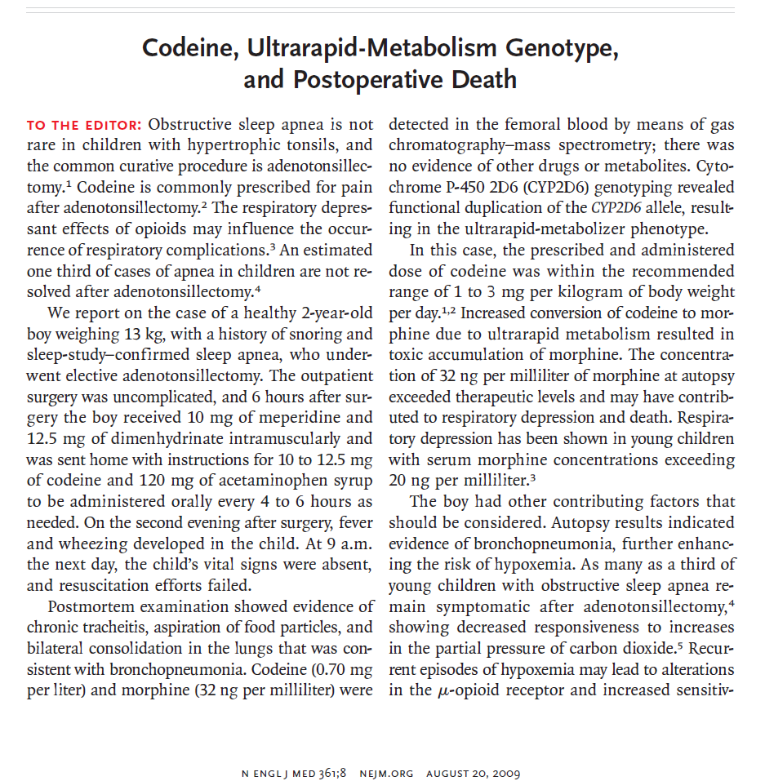

Slide 12
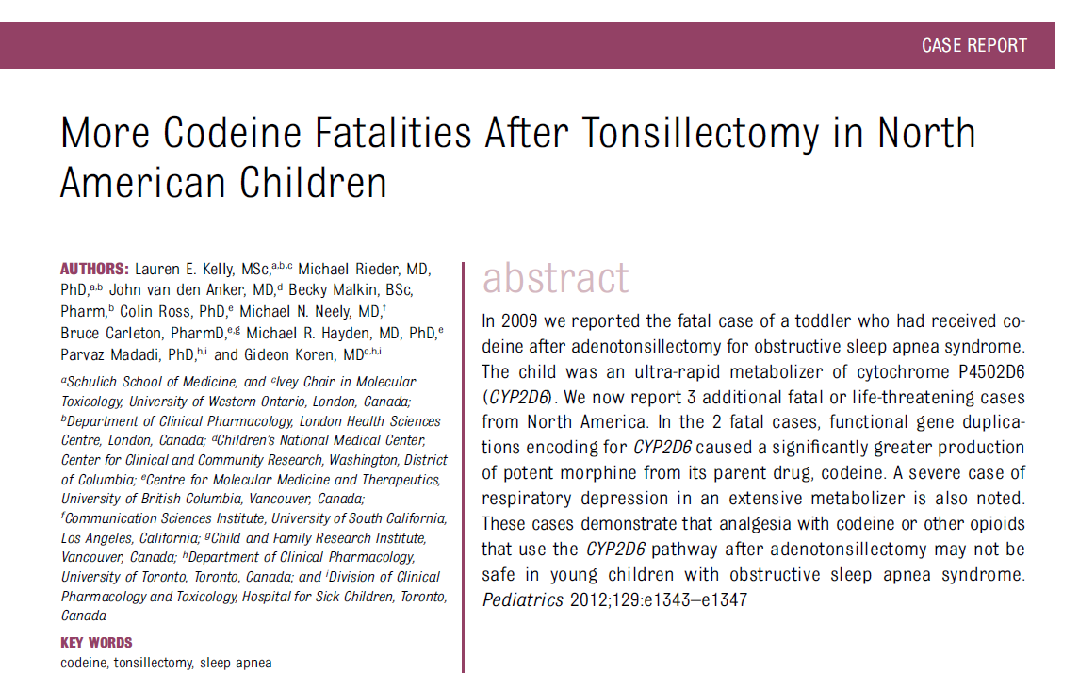
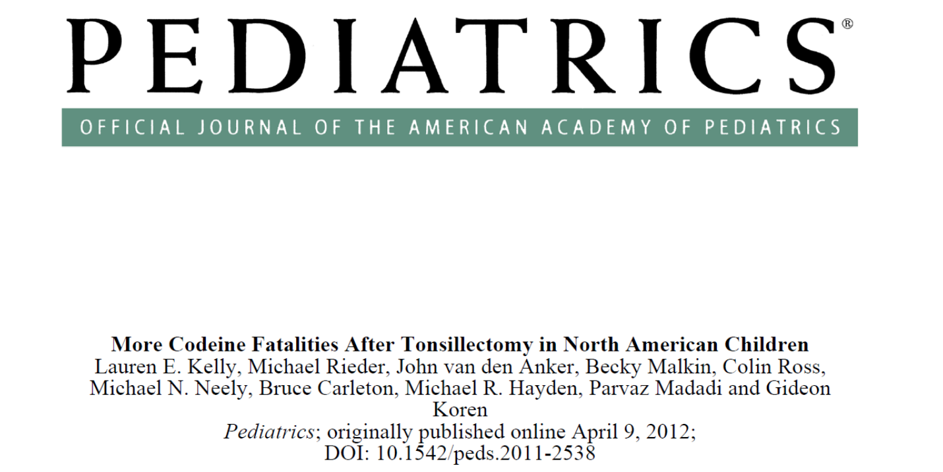

Slide 13
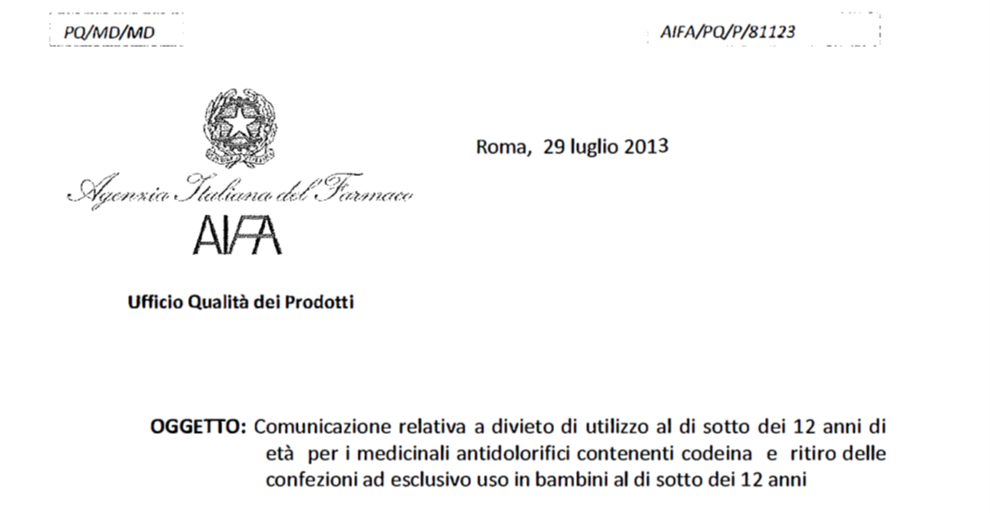

Slide 14
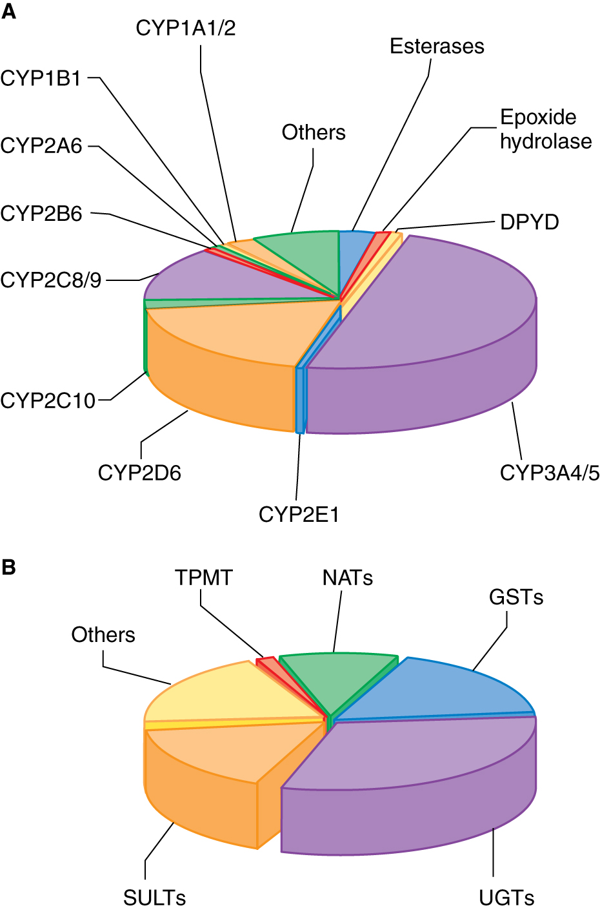
Frazione dei farmaci utilizzati in clinica metabolizzati dai piu’ importanti enzimi di fase 1 e fase 2
Goodman and Gilman, 2011

Slide 15
CYP2D6
DEBRISOCHINA
4-IDROSSIDEBRISOCHINA
Immagine presa da Weinshilboum R. et al., NEJM 348(6), 2006
Weinshilboum R. et al., NEJM 2006

Slide 16
Genetic polymorphisms of CYP2D6
Gene located on chromosome 22
More than 100 variants for this gene have been characterized (https://www.pharmvar.org/gene/CYP2D6).
SNPs and insertions/deletions may reduce the activity of this enzyme (~10% of the population).
Some subjects inherit multiple copies of the gene and display very high activity (2% or more of the population).

Slide 17
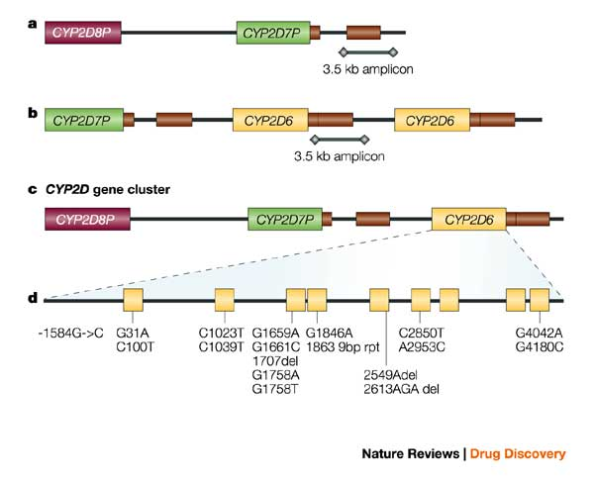
Molecular characteristic of CYP2D6 polymorphisms
- SNP
- deletions
- base repetitions
*4
*6
*3
Deletion of the gene
Amplification of the gene

Slide 18
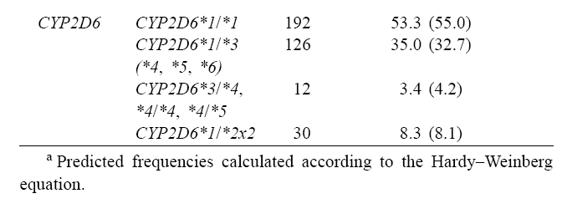
Frequency of CYP2D6 polymorphisms in the Italian population
Scordo et al., Pharm Res 2004

Slide 20
Clinical Guidelines for codeine administration
https://www.pharmgkb.org/chemical/PA449088/guideline/PA166104996

Slide 21
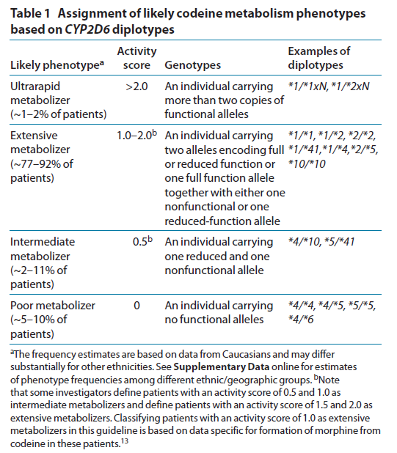
CYP2D6 genotyping and enzymatic activity
Crews et al., Clin Pharm Ther 2012

Slide 22
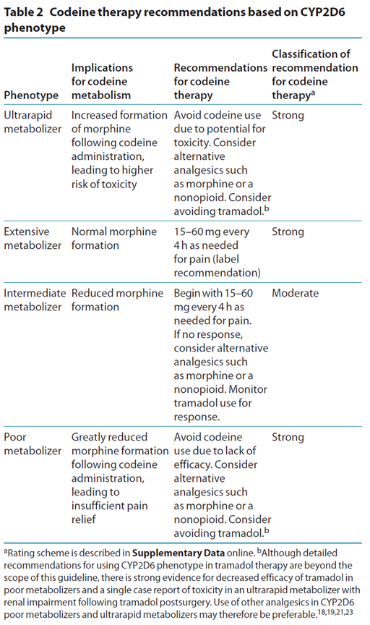
Crews et al., Clin Pharm Ther 2012

