Slide 1
Immunopatology
As a branch of Immunology, immunopathology concerns disorders caused by alterations of the immune response
3 main categories of alterations:
excessive response hypersensitivity reactions
inappropriate response autoimmune diseases
defective response immunodeficiencies

Slide 2
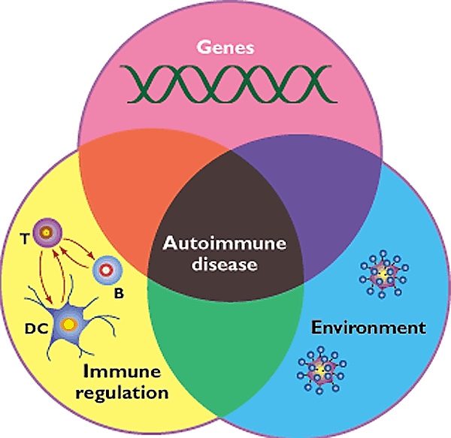
Factors involved in the aetiopathogenesis of autoimmune diseases

Slide 3
Autoimmunity
Immune reactions to self antigens (i.e., autoimmunity) are the underlying cause of numerous human diseases
Autoimmune diseases are estimated to affect 2% to 5% of the population in developed countries, and appear to be increasing in incidence
The evidence that some human diseases are indeed the result of autoimmune reactions is more persuasive for some than for others in which the role of autoimmunity is suspected but not proved

Slide 5
Evidence for the autoimmune nature of some human diseases
In many autoimmune disorders, multiple high-affinity autoantibodies have been identified, and in some cases these antibodies are known to cause pathologic abnormalities
Similarly, in some of these diseases, there is growing evidence for the activation of pathogenic self-reactive T cells
Experimental models in rodents have proved very informative, providing circumstantial evidence in support of an autoimmune etiology of selected pathologies

Slide 6
Introducing autoimmunity
Physiological unresponsiveness to self- antigens based on
Immunological tolerance (central and peripheral)
Negative selection
Role of regulatory T cells (Treg)

Slide 7
Immunological tolerance
Billions of different antigen receptors are randomly generated in developing T and B lymphocytes
It is not surprising that during this process, receptors that recognize self antigens are produced
Since these antigens cannot all be concealed from the immune system, there must be means of eliminating or controlling self-reactive lymphocytes [tolerance]
The breakdown of tolerance is the basis of autoimmunity

Slide 8
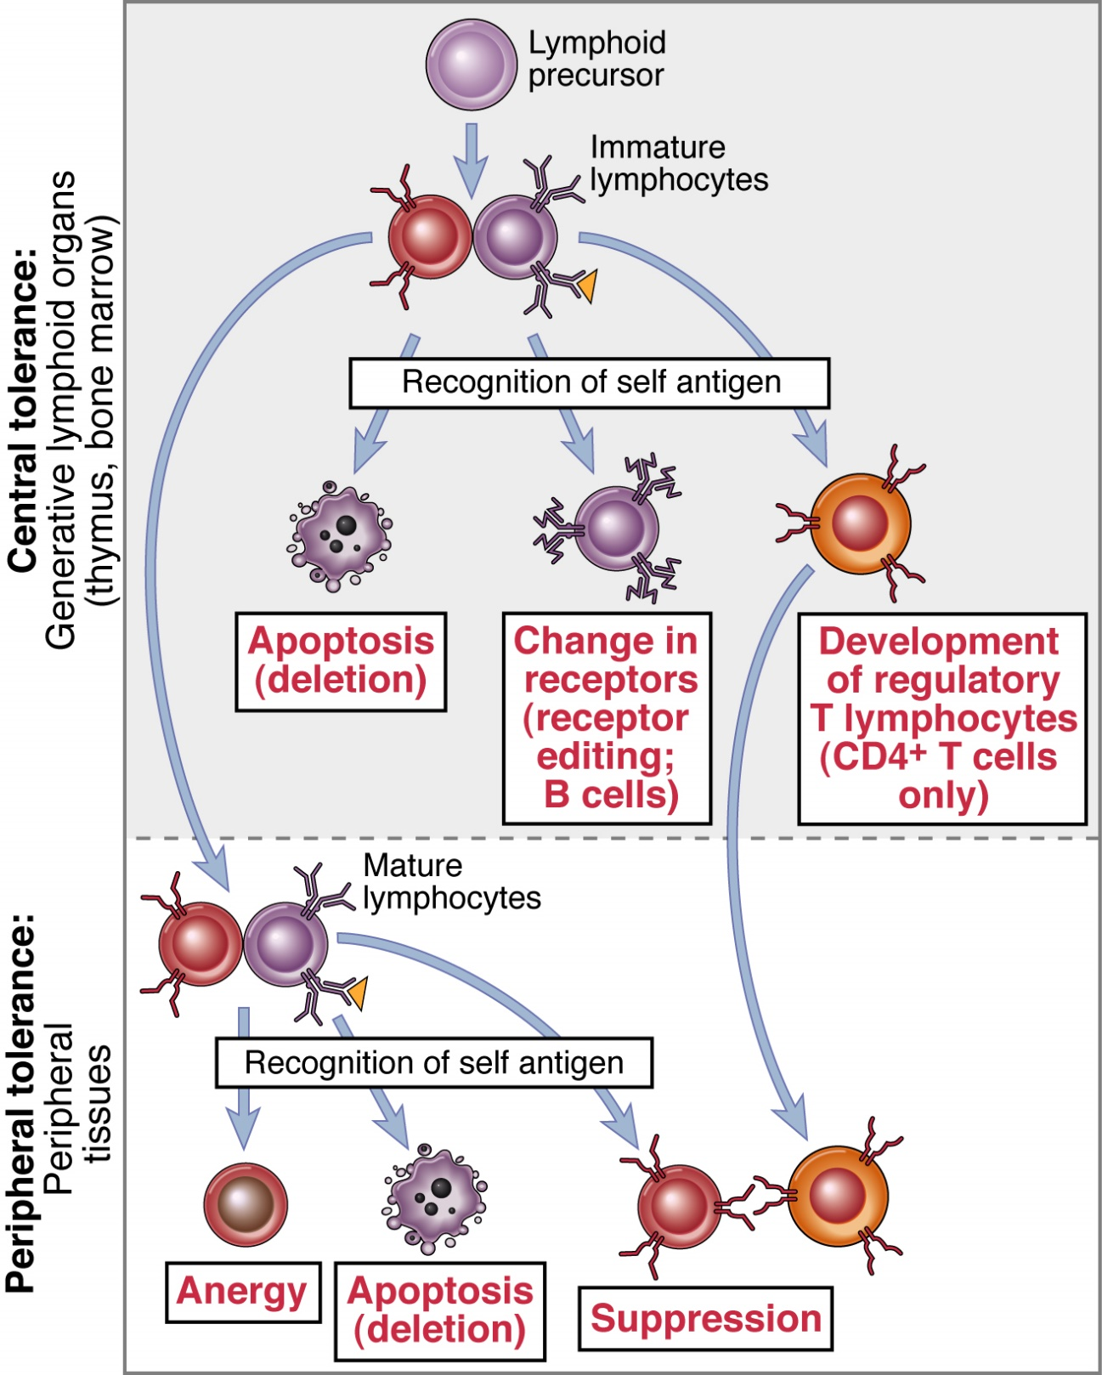
Where can lymphocytes encounter self antigens? Central and peripheral tolerance
T and B precursors
thymus, bone marrow
B
Treg

Slide 9
Central tolerance: thymus and bone marrow
The interaction of lymphoid precursors with self antigens in the central lymphoid organs may have three main outcomes:
some immature lymphos (both B and T) are killed by apoptosis (negative selection)
in the bone marrow, some self-reactive B lymphos switch to new antigen receptors that are not self-reactive (receptor editing)
in the thymus, some T lymphos differentiate into regulatory T cells (Treg)

Slide 10
Where can lymphocytes encounter self antigens? Central and peripheral tolerance
thymus, bone marrow
peripheral lymphoid tissues

Slide 11
Mechanisms of peripheral tolerance
Self-reactive mature lymphos which gain access to peripheral tissues may undergo negative selection (apoptosis) or functional inhibition (anergy)
T cells are made anergic in the absence of costimulatory signals by APC
B cells become anergic if they encounter antigen in the absence of specific helper T cells
Current investigations have not yet completely disclosed the molecular mechanisms underlying anergy

Slide 12
Peripheral tolerance of T lymphos: role of T regulatory cells (Treg)
The responses of T lymphos to self antigens may be actively suppressed by Treg, a subtype of T cells (CD4+) generated in the thymus by self antigen recognition (high IL-2 receptor number; role for IL-2?)
Main mechanisms proposed to explain how Treg control immune responses:
secretion of immunosuppressive cytokines (e.g., IL-10, TGF-β) which down-regulate T cell responses
blocking of costimulatory signals by APC leads to inhibition of T cell activation (direct contact ? undefined mechanism)

Slide 13
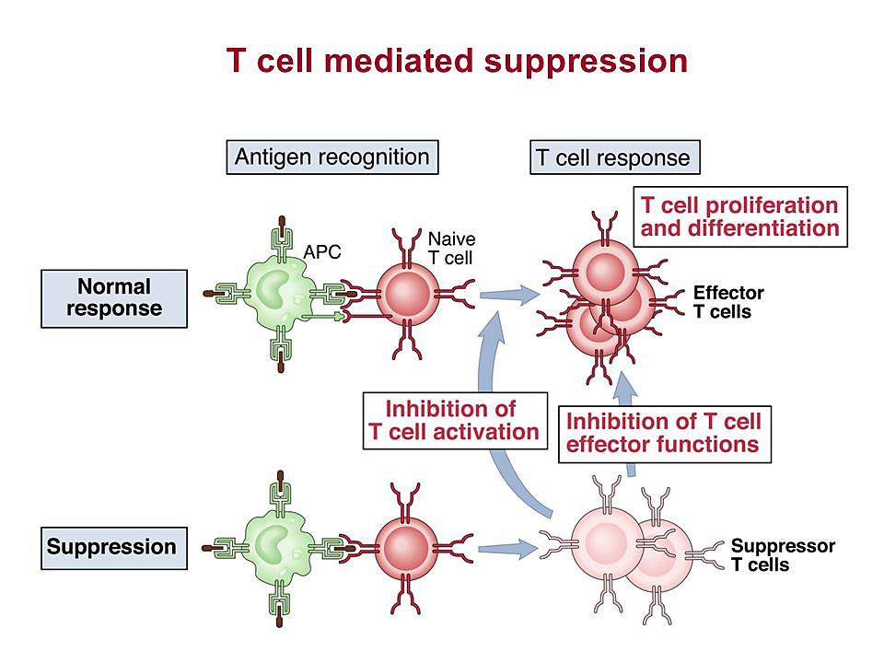
In a normal response, T cells recognize antigen, proliferate and differentiate into effector cells
IL-10, TGF-β
Treg
Tregs generated by self antigen recognition inhibit the development or functions of effector T cells (negative control of autoreactive T cells)

Slide 14
Postulated failures of Treg-mediated regulation of autoreactive T cells
Inadequate number of Treg cells owing to their inadequate development, proliferation or survival
Defects in Treg cell function (poor production of immune suppressive cytokines, e.g. IL-10, TGFβ)
intrinsic defects of Treg
Resistance of pathogenic effector T cells to suppression by Treg cells: increased production of cytokines which impede Treg function, such as TNF-α, IL-4, IL-6

Slide 15
Essential steps in the pathogenesis of autoimmunity
Environmental trigger
(e.g. infections,
tissue injury)
Susceptibility genes
Failure of
self-tolerance
?
Activation of
self-reactive
lymphocytes
Persistence of functional
self-reactive lymphocytes
Immune responses against self tissues

Slide 16
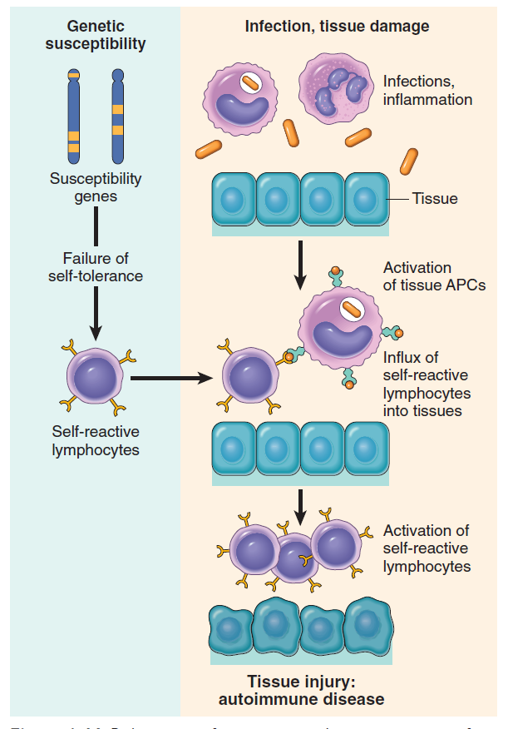
Major factors involved in the pathogenesis of autoimmunity
Autoimmunity arises from: (1) the inheritance of susceptibility genes, that may interfere with selftolerance; (2) association with environmental triggers (infection, tissue injury, inflammation) that:
alter the display of self antigens
promote entry of self-reactive lymphocyte into tissues
enhance their activation

Slide 17
Genetic susceptibility to autoimmunity (1)
Most autoimmune diseases are polygenic; affected individuals inherit multiple genetic polymorphisms that contribute to disease susceptibility
The products of many of these polymorphic genes influence the development of self-tolerance:
some are believed to influence negative selection of self-reactive T cells (central tolerance)
others control T cell anergy to self antigens (peripheral tolerance)
The mechanistic links between susceptibility genes and failure of tolerance are not yet conclusively established

Slide 18
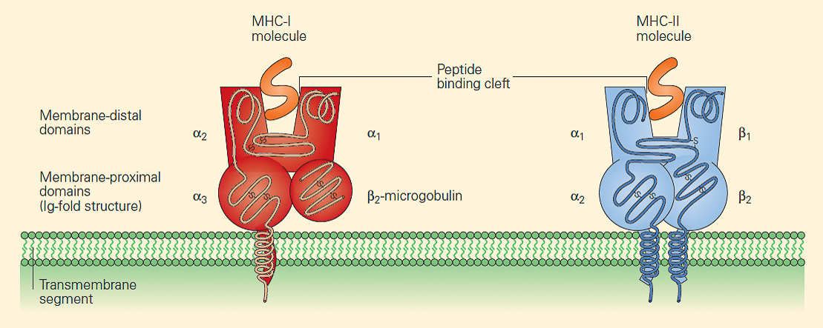
Genetic susceptibility to autoimmunity (2)
Among the genes linked to autoimmunity, the strongest associations are with MHC (human HLA) genes, especially class II MHC genes
Class II MHC genes are involved in the selection and activation of CD4+ T cells that regulate both humoral and cell-mediated immune response to protein antigens
In many autoimmune diseases, the disease-associated HLA molecules differ in their peptide binding cleft from HLA molecules that are not disease-associated
Disease-associated HLA molecules favour the binding of particular self-peptides that will ultimately be recognized by self-reactive T lymphos

Slide 19
Role of infections in autoimmunity (1)
Viral and bacterial infections may contribute to the development and exacerbation of autoimmunity
Two main mechanisms:
Microbes may activate the APC to express costimulatory molecules for T lymphos; when these APC present self antigens, the self-reactive T cells are activated
Some microbial antigens may cross-react with self antigens (molecular mimicry); immune response initiated by the microbes may activate T cell specific for self antigens

Slide 20
Role of infections in autoimmunity (2)
Example of molecular mimicry:
Rheumatic fever: after streptococcal infection, anti-streptococcus antibodies cross-react with miocardial proteins; onset of inflammatory response (myocarditis)
Myocarditis also takes place due to homologies between myocardial protein antigens and some antigens of Chlamydia and Trypanosoma cruzi
Lyme artrhritis: homologies between a surface molecule of Borrelia burgdorferi and a lymphocyte antigen (LFA-1, lymphocyte function antigen-1)

Slide 21
Other factors involved in the development of autoimmunity
Anatomic alterations in tissues, possibly induced by inflammation, ischemic injury or trauma, may lead to exposure of self antigens normally concealed from the immune system
Intra-ocular antigens (post traumatic uveitis)
Sperm proteins (orchitis after vasectomy)
Hormonal influences: many autoimmune diseases have a higher incidence in females than in males
Systemic lupus erythematosus affects women about 10 times as frequently as men

Slide 22
Organ-specific vs systemic autoimmune diseases
Organ-specific
Autoimmune attack vs. self-antigens of a given organ
It results in a damage of organ structure and function
Treatment is focused on the replacement of organ function
Systemic
Targets are widespread self-antigens
Damage affects structures as blood vessels, cell nuclei, etc.
Treatment is aimed to inhibit excessive activation of the immune system

Slide 23
Examples of organ-specific and systemic autoimmune diseases
Organ-specific
Hashimoto thyroiditis (thyroid destruction)
Grave’s disease (hypertyroidism)
Addison’s disease (adrenal g. failure)
Juvenile diabetes mellitus
Multiple sclerosis
Atrophic gastritis
Myasthenia gravis
Systemic
Systemic lupus (SLE)
Rheumatoid arthritis
Scleroderma
Dermatomyositis

Slide 24
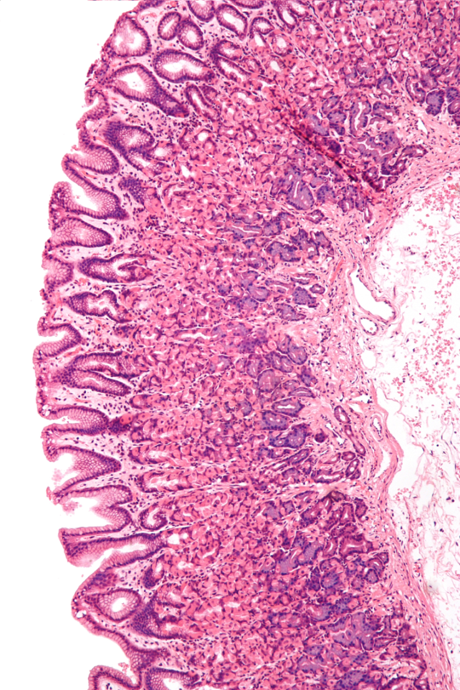
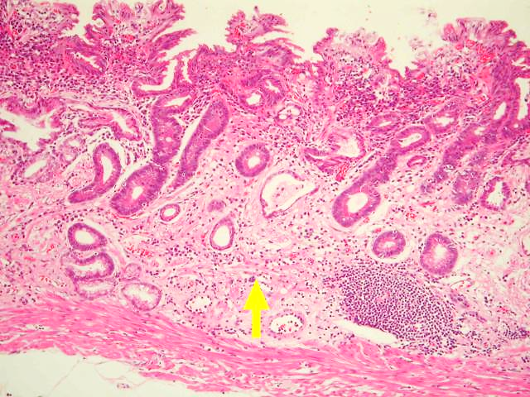
Pernicious anemia
Atrophic gastritis in pernicious anemia: loss of stomach parietal cells is due to autoimmune reaction mediated by auto-antibodies against parietal cells and intrinsic factor
Intrinsic factor: glycoprotein secreted by gastric mucosa; favours absorption of iron and vitamin B12 (essential cofactors for erythropoiesis)
normal mucosa
atrophic mucosa

Slide 25
Examples of organ-specific and systemic autoimmune diseases
Organ-specific
Hashimoto thyroiditis (thyroid destruction)
Grave’s disease (hypertyroidism)
Addison’s disease (adrenal g. failure)
Juvenile diabetes mellitus
Multiple sclerosis
Atrophic gastritis
Myasthenia gravis
Systemic
Systemic lupus (SLE)
Rheumatoid arthritis
Scleroderma
Dermatomyositis

Slide 26
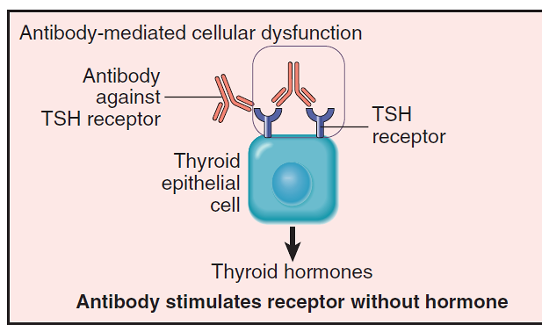
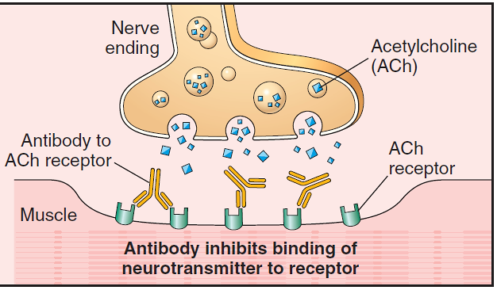
Antireceptor antibodies disturb the normal function of receptors
Graves disease
Auto-antibodies against the thyroid-stimulating hormone (TSH) receptor activate thyroid cells: hyperthyroidism
Genetic susceptibility
Bacterial and/or viral infections (?)
Myastenia gravis
Auto-antibodies against ACh receptor impair neuromuscular transmission: muscle weakness
Genetic susceptibility
Treg dysfuntion (low levels of transcription factor FOXP3, crucial for Treg function)

