Slide 1
Lesson 0
English / Italian
Timing of the course
Structure of the course / final exam
Aim of the course
Program of the course

Slide 2
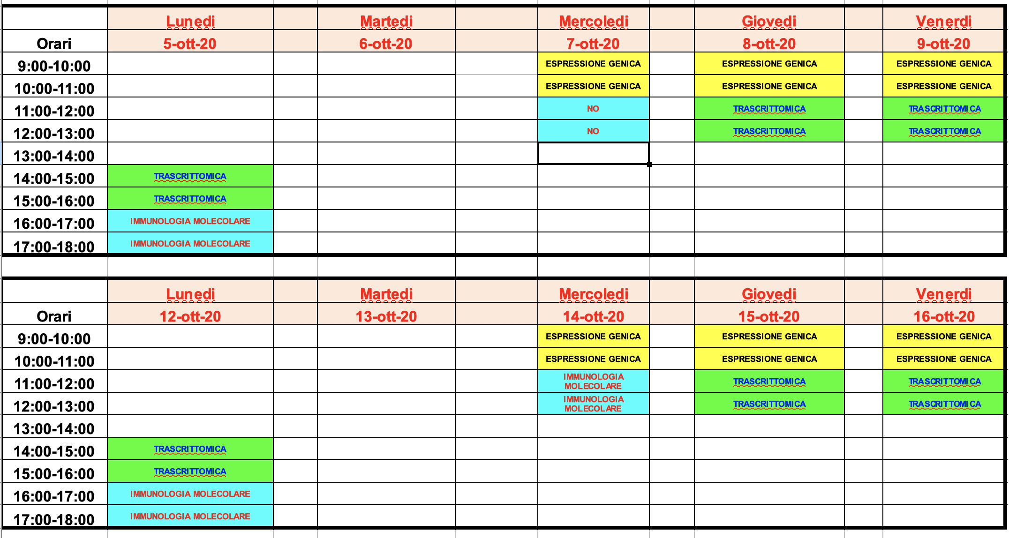
2. Timing of the course
START: Monday, Oct 5th 2020
4 hours/week

Slide 3
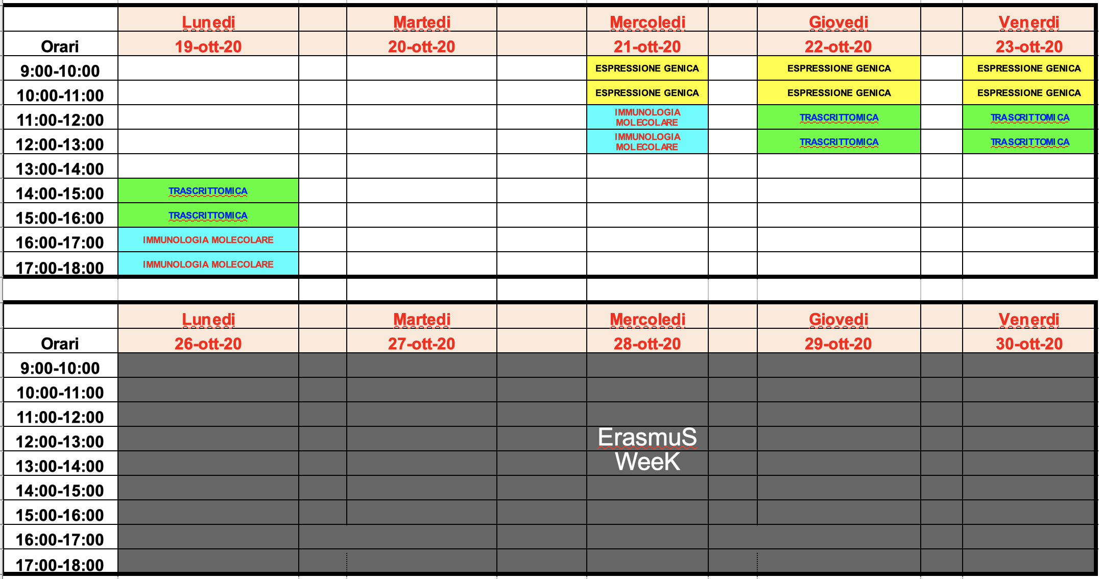
2. Timing of the course

Slide 4
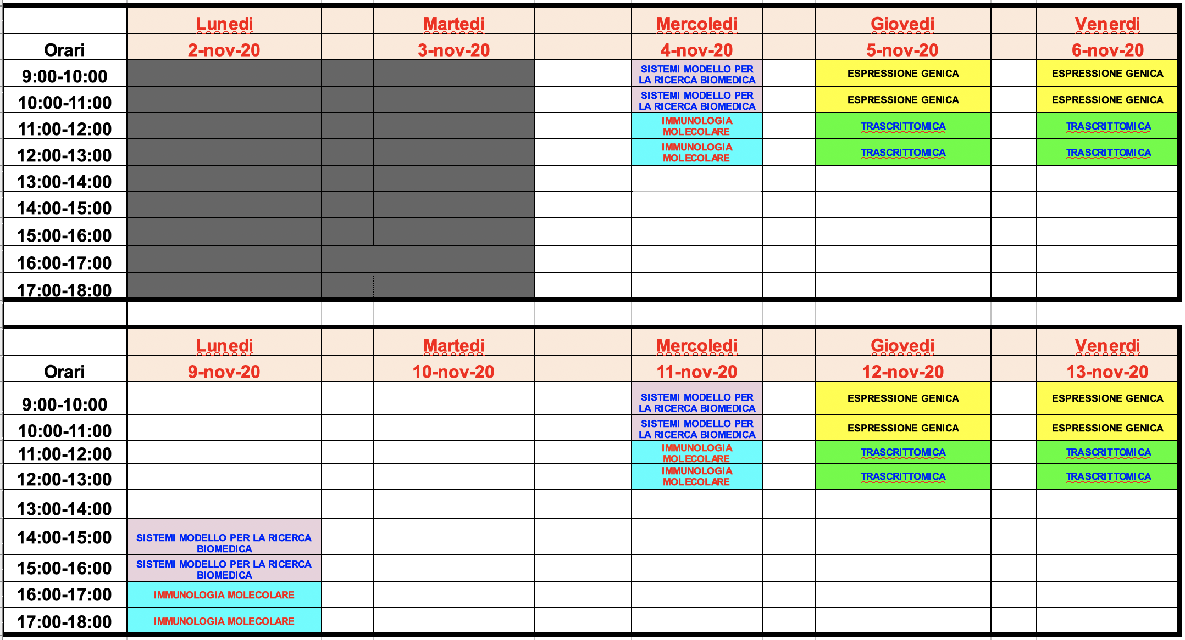
2. Timing of the course

Slide 5
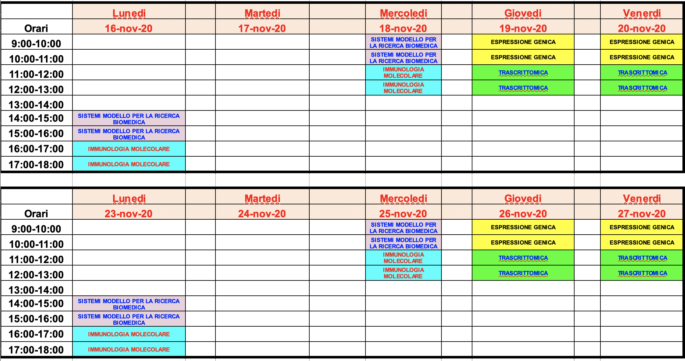
2. Timing of the course

Slide 6
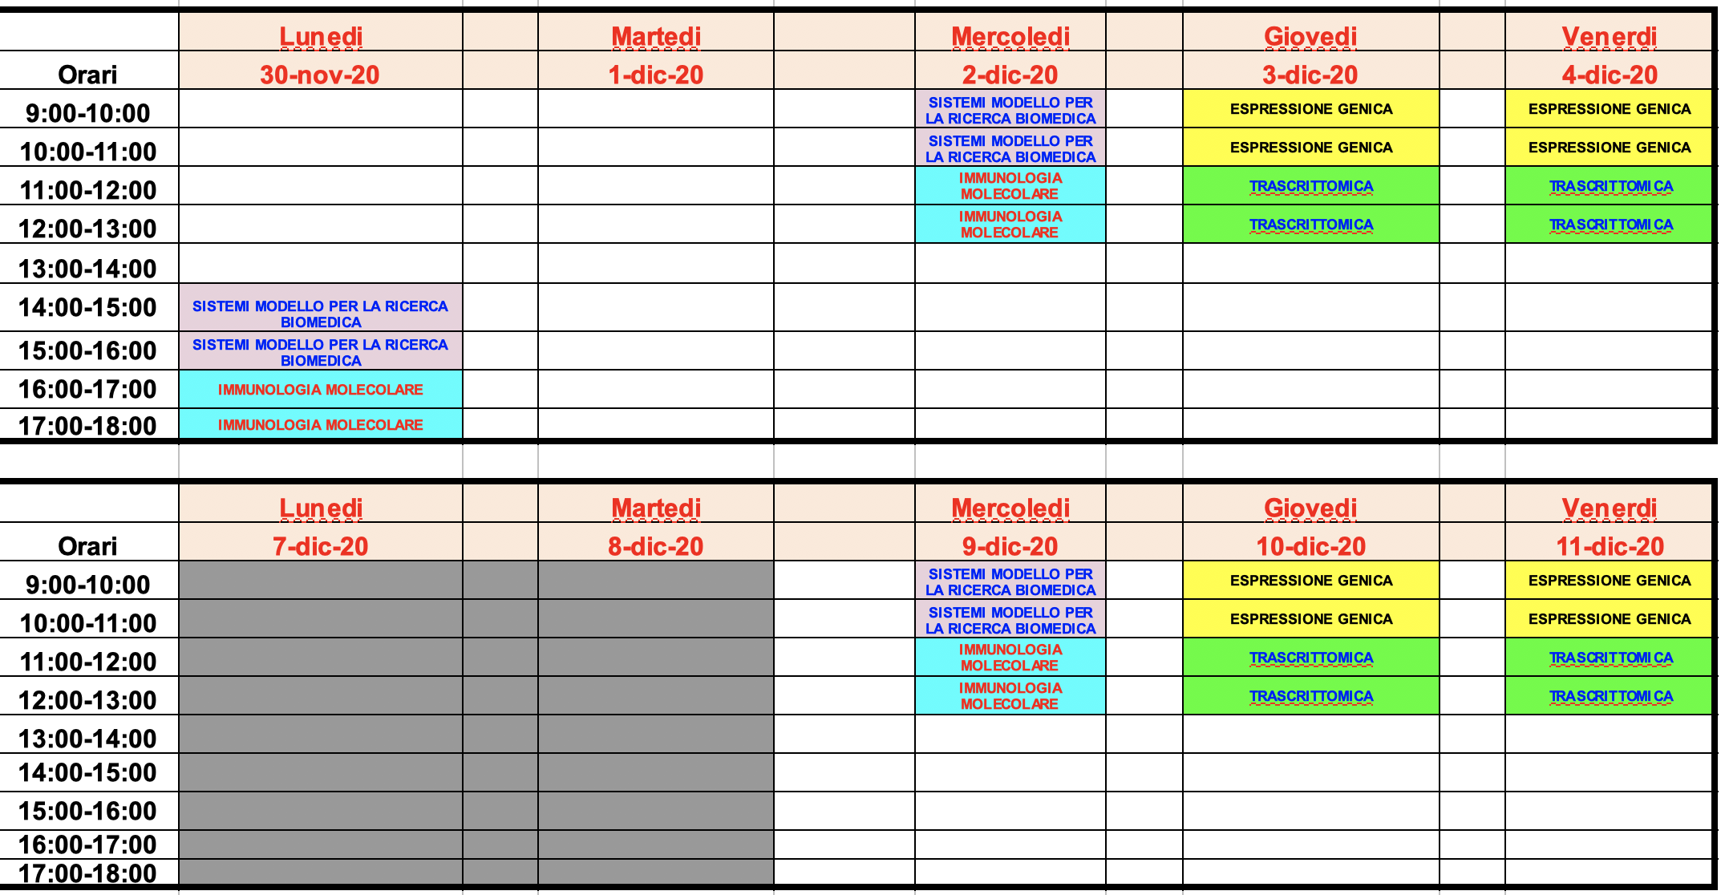
2. Timing of the course

Slide 7
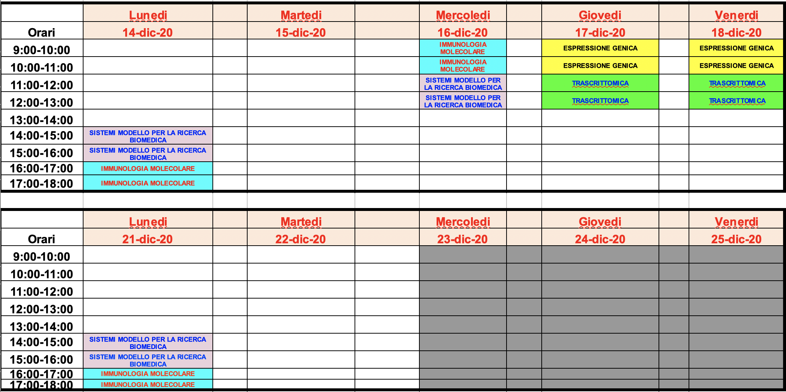
2. Timing of the course

Slide 8
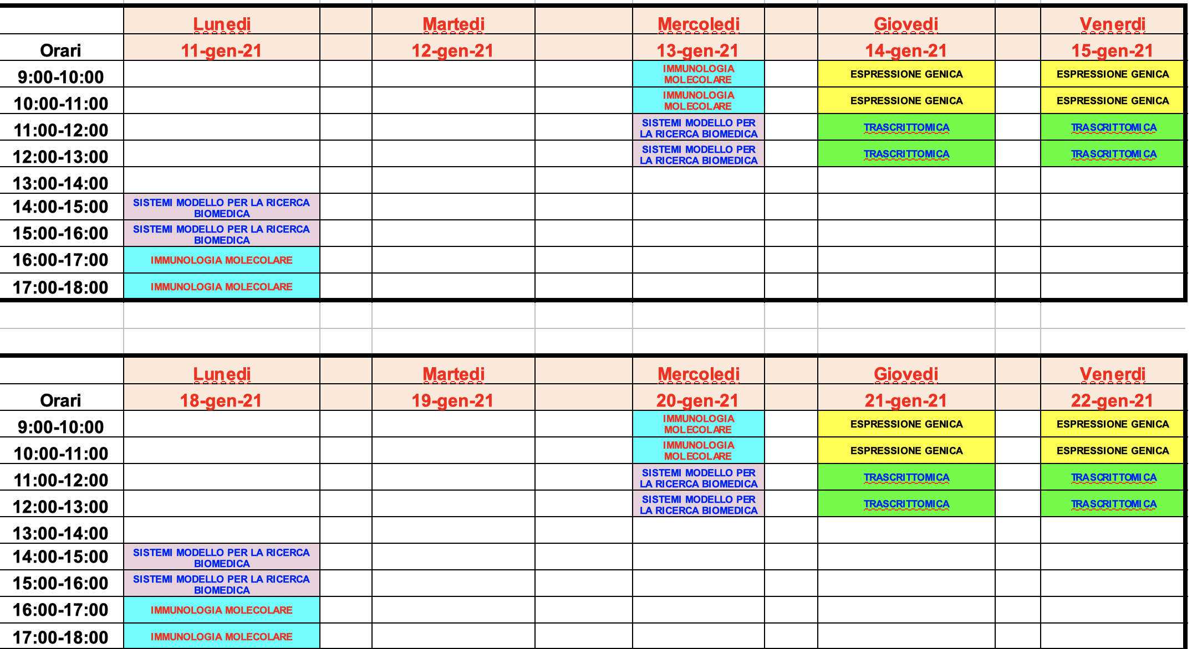
2. Timing of the course

Slide 9
2. Timing of the course
END of the course: Wed, Jan 27th 2021
Lessons
Start: 4.15 PM (or 9.15 AM)
End: 5.45 PM (or 10.45 AM) oppure 5.55 AM (45+10+45 min)

Slide 10
3. Structure of the course / final exam
Slides
Publications (Review or Journal articles)
Book: Cellular and Molecular Immunology, Abul Abbas, Andrew Lichtman, Shiv Pillai; Elsevier

Slide 11
3. Structure of the course / final exam
Final Exam:
Multiple choice - written exam (February, June/July, September) - the results can be modified through an oral exam
Multiple choice - written exam at the end of the course (- the results can be modified through an oral exam) - registration in Feb, June/July, Sept

Slide 12
4. Aim of the course
- to apply the knowledge and understanding of the students, and their problem-solving abilities, talking and discussing about molecular immunology and immunotherapy

Slide 13
5. Program of the course
- General aspects of the immune system and immune response
- Antibodies / monoclonal antibodies / recombinant antibodies / human antibodies in diagnosis and for therapeutic purposes
- Immune system and cancer / Cancer immunotherapy
- Hypersensitivity and therapeutic neutralization of the immune system
- Immunedeficiencies and therapies
- Vaccines
- Transplantation: role of the immune system and therapeutic prevention of its activation

Slide 14
Paolo Macor
Dept. of Life Sciences
University of Trieste
Building Q - Room 301
Office 040-558 8683
Lab 040-558 8682
pmacor@units.it
skype: zymosan2000

