Slide 1
Mechanisms of action of monoclonal antibodies

Slide 2
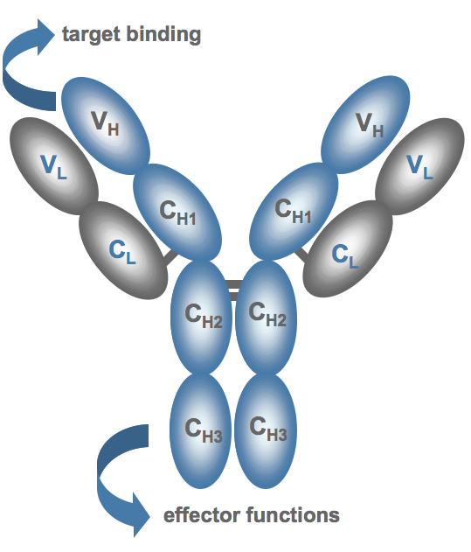
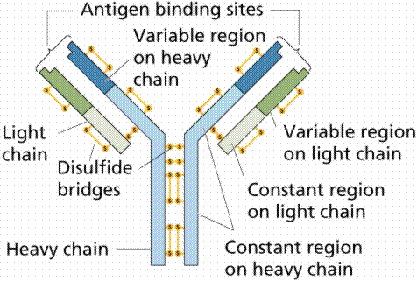
Antibody
Google Immagini

Slide 3
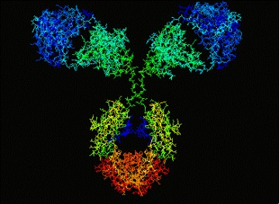
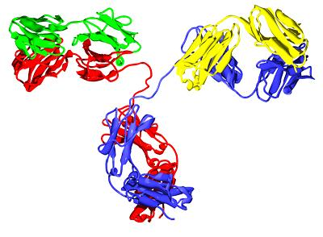
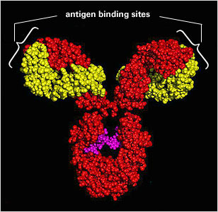

Slide 4
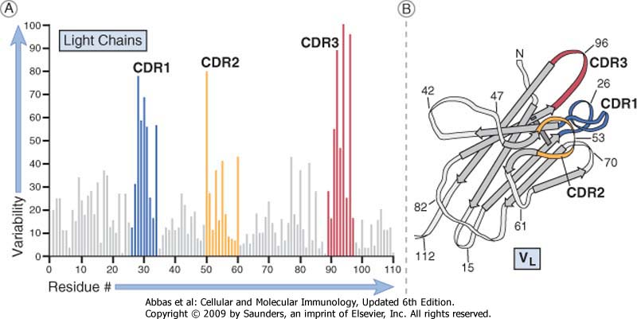
Aminoacid variability in antibody sequence

Slide 5
Antigen/antibody complex

Slide 6
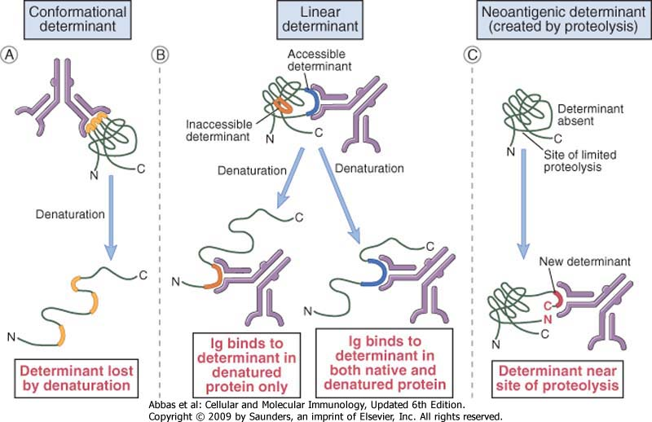
Antigenic determinant (epitope)

Slide 7
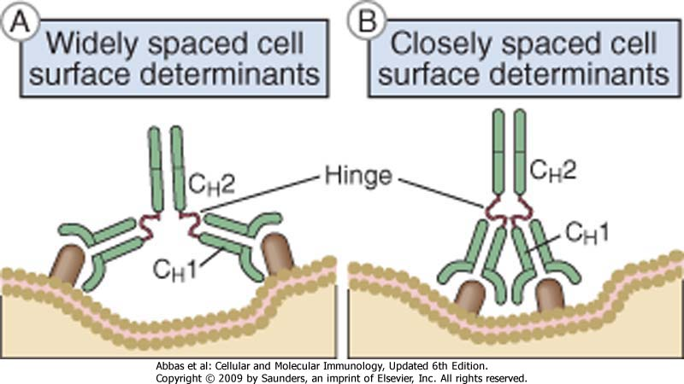
Antigen/antibody complex on cell membrane

Slide 8
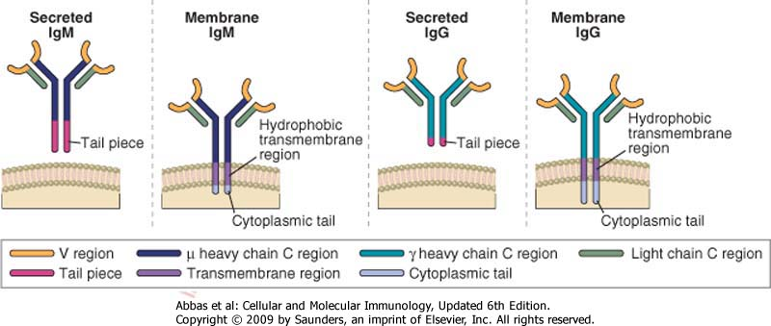
secreted and membrane antibodies

Slide 9
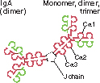
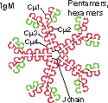
class | subclass | plasma concentration (mg/ml) | halflife in plasma (days) | Secreted form
IgA | 1,2 | 3,5 | 6
IgD | - | - | 3 | -
IgE | - | 0,05 | 2
IgG | 1-4 | 13,5 | 23
IgM | - | 1,5 | 5

Slide 10
Antibody Isotope | Isotype-specific effector functions
IgG | - Opsonization of antigens for phagocytosis by macrophages and neutrophils - Activation of the classical pathway of complement - Antibody-dependent cell-mediated cytotoxicity mediated by natural killer cells - Neonatal immunity: transfer of maternal antibody across the placenta and gut - Feedback inhibition of B cell activation
IgM | - Activation of the classical pathway of complement - Antigen receptor of naive B lymphocytes
IgA | - Mucosal immunity: secretion of IgA into the lumens of the gastrointestinal and respiratory tracts - Activation of complement by the lectin pathway or by the alternative pathway
IgE | Mast cell degranulation (immediate hypersensitivity reactions)
IgD | Antigen receptor of naive B lymphocytes

Slide 11
FcR | Affinity for immunoglobulin | Cell Distribution | Function
FcγRI (CD64) | High (Kd ∼ 10⁻⁹ M) binds IgG1 and IgG3 | Macrophages, neutrophils; also eosinophils | Phagocytosis, activation of phagocytes
FcγRIIA (CD32) | Low (Kd > 10⁻⁷ M) | Macrophages, neutrophils; eosinophils, platelets | Phagocytosis; cell activation (inefficient)
FcγRIIB (CD32) | Low (Kd > 10⁻⁷ M) | B lymphocytes, dendritic cells, macrophages | Feedback inhibition of B cells, macrophages, dendritic cells
FcγRIIIA (CD16) | Low (Kd > 10⁻⁶ M) | NK cells | Antibody-dependent cell-mediated cytotoxicity
FcγRIIIB (CD16) | Low (Kd > 10⁻⁶ M) GPI-linked protein | Neutrophils, other cells | Phagocytosis (inefficient)
FcεRI | High (Kd > 10⁻¹⁰ M) binds monomeric IgE | Mast cells, basophils, eosinophils | Cell activation (degranulation)
FcεRII (CD23) | Low (Kd > 10⁻⁷ M) | B lymphocytes, eosinophils, Langerhans cells | Unknown
FcαR (CD89) | Low (Kd > 10⁻⁶M) | Neutrophils, eosinophils, monocytes | Cell activation?

Slide 12
Characteristics of an antibody
Specificity in its action
Biodistribution/halflife
Activation of immune system

Slide 13
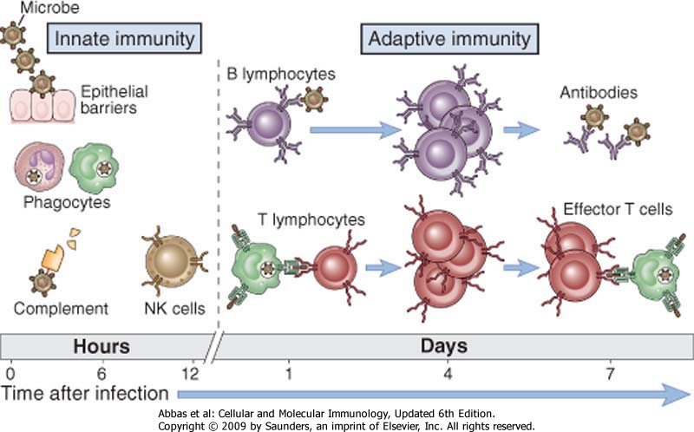
Immune response

Slide 14
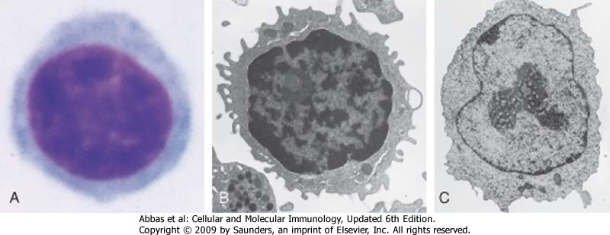
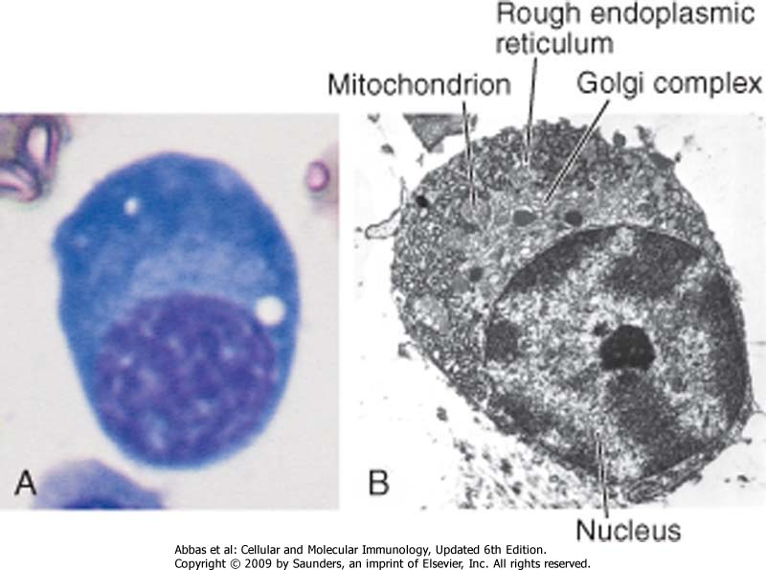
B lymphocytes and plasma cells

Slide 15
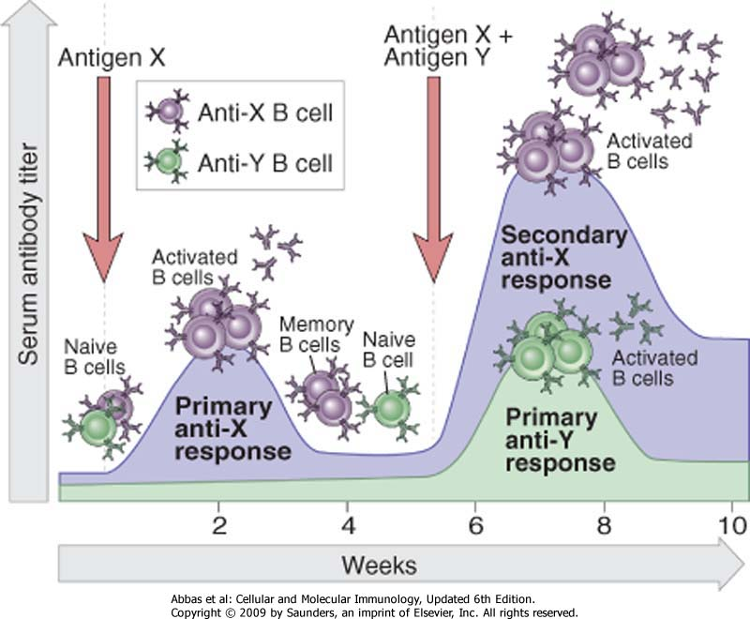
Timing for antibody production

Slide 16
Antibody engineering
transgenic mice
Phage display library
from hybridoma
Domini variabili from mouse
murine CDR
mouse
chimeric
humanized
human
induce immune-reaction; short half life; murine Fc poorly activate human immune functions
less immunogenic; longer half life; human Fc activate human immune functions

Slide 17
Types of antibodies
Antagonist/Blocker
Agonist
Immuno-activator

Slide 18
1. Blocking antibodies
An antibody able to bind an antigen and neutralize its function

Slide 19
Examples of neutralizing antibodies used in clinic
Natalizumab: humanized anti-CD49d (multiple sclerosis)
Eculizumab: humanized (IgG4) anti-C5 (PNH, Hemolytic Uremic syndrome, glomerulonephritis)
Bevacizumab: humanized anti-VEGF (colon-rectal cancer, lung carcinoma, other solid tumors, macula degeneration)
Cetuximab: chimeric anti-EGFR (colon-rectal cancer)
Infliximab: chimeric anti-TNFalfa (Rheumatoid arthritis, crohn disease and other inflammatory diseases)
Adalimumab: human anti-TNFalfa (Rheumatoid arthritis, crohn disease and other inflammatory diseases)
Pembrolizumab: Humanized anti-PD1 (cancer immunotherapy)

Slide 20
2. Agonistic antibodies
Antibodies able to bind and activate its target (usually cell membrane receptors)
these antibodies can be used to indice cell apoptosis (for cancer therapy) or to induce immune cell proliferation (in immune deficiencies)

Slide 21
Examples of agonistic antibodies
Trastuzumab: humanized anti-HER2 (breast cancer)
Tigatuzumab: humanized anti-TRAIL-R1 (creast cancer)
humanized anti-IL2R (infections, immune deficiencies, cancer immunotherapy)

Slide 22
3. Immune-activator antibodies
Antibodies able to bind their target (cell membrane receptors) and activate immune response.
Used in cancer immunotherapy (for the killing of cancer cells) or in autoimmune diseases (to eliminate B lymphocytes and, as a consequence, the production of autoantibodies)

Slide 23
Examples of immune-activators antibodies
Rituximab: chimeric anti-CD20 (B cell lymphoma and leukemia, rheumatoid arthritis)
Alemtuzumab: humanized anti-CD52 (B or T cell lymphoma and leukemia)
Ofatumumab: human (IgG3) anti-CD20 (B cell lymphoma and leukemia)
Trastuzumab: humanized anti-HER2 (breast cancer)
cMOV18 e cMOV19: umanizzati anti-folate receptor (alpha isoform) (Ovarian cancer)

Slide 24
Antibody Isotope | Isotype-specific effector functions
IgG | - Opsonization of antigens for phagocytosis by macrophages and neutrophils - Activation of the classical pathway of complement - Antibody-dependent cell-mediated cytotoxicity mediated by natural killer cells - Neonatal immunity: transfer of maternal antibody across the placenta and gut - Feedback inhibition of B cell activation
IgM | - Activation of the classical pathway of complement - Antigen receptor of naive B lymphocytes
IgA | - Mucosal immunity: secretion of IgA into the lumens of the gastrointestinal and respiratory tracts - Activation of complement by the lectin pathway or by the alternative pathway
IgE | Mast cell degranulation (immediate hypersensitivity reactions)
IgD | Antigen receptor of naive B lymphocytes

Slide 25
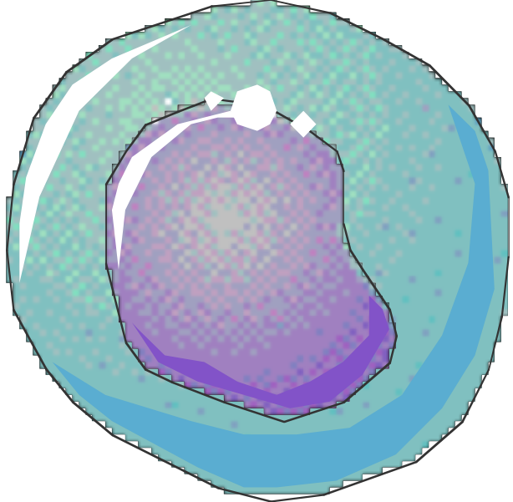
Immune-activator monoclonal antibodies: CDC (Complement-Dependent Cytotoxicity)
C1q
IgG
C1-C9
MAC
Tumor cell
Cell
lysis
Tumor
associated
antigen

Slide 26
ALTERNATIVE
PATHWAY
LECTIN
PATHWAY
CLASSICAL
PATHWAY
Activating surfaces
Carbohydrates
Immune complexes
C3b C3H₂O
MBL
C1q
MASP
C4
C2
RECOGNITION
C1r
B
C1s
D
C4
P
C2
C 3
OPSONIZATION
C3a
C3b
C5a
INFLAMMATION
C5
C6C7
C8 C9
CYTOLYSIS
INFLAMMATION
C5b-9

Slide 27
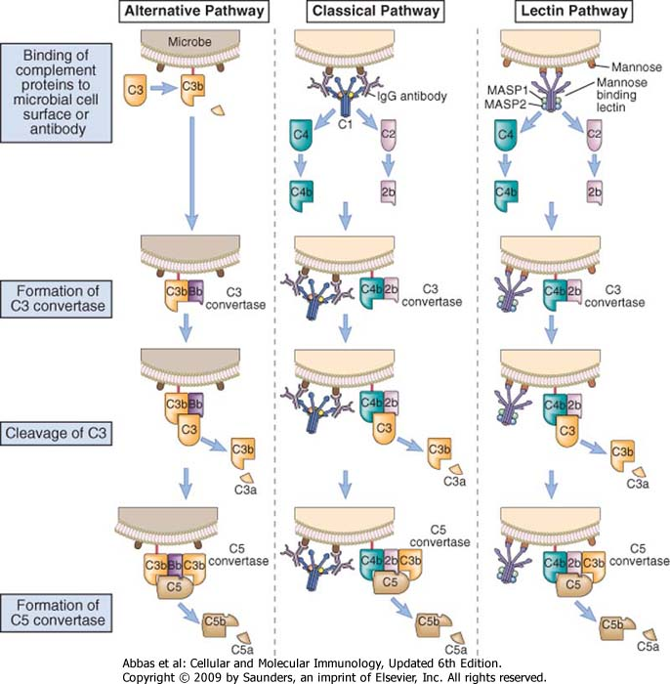

Slide 28
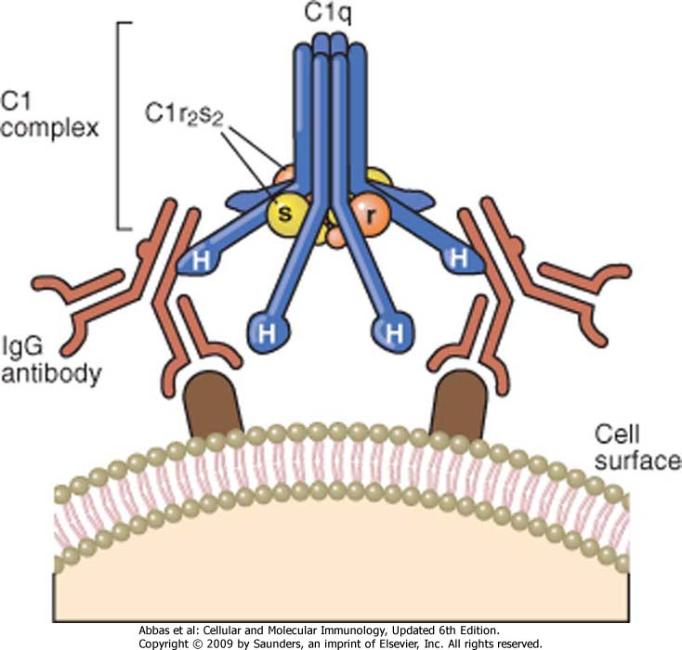
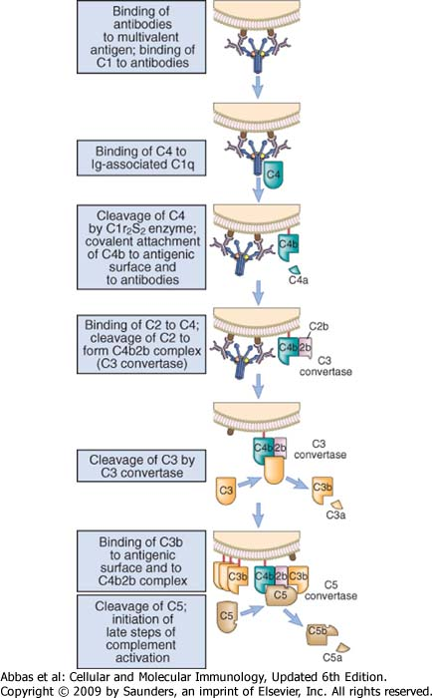

Slide 29
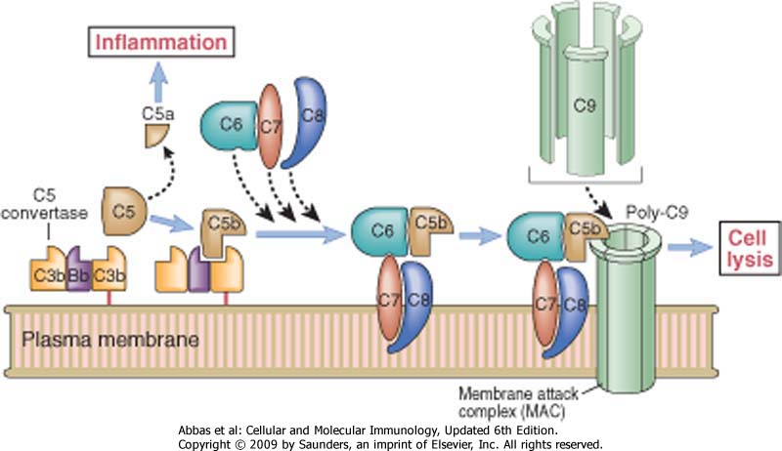

Slide 30
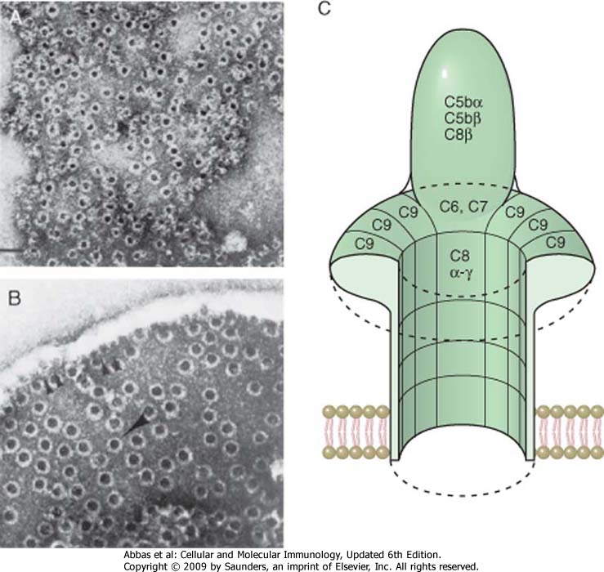

Slide 31
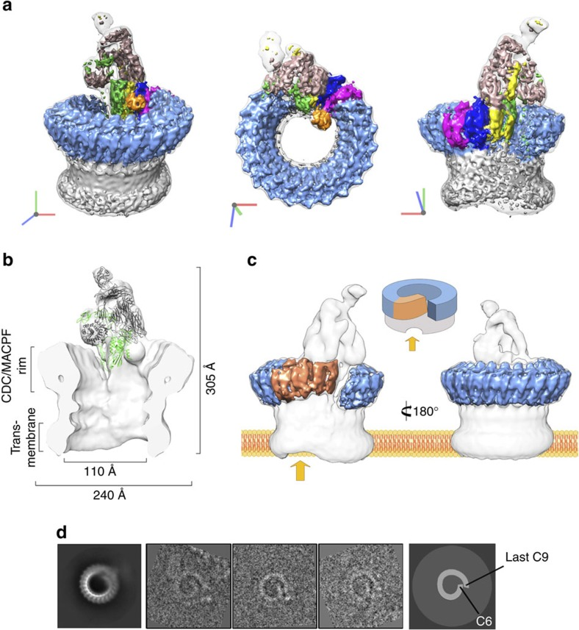
Seva et al,
Nat Comm, 2016

Slide 32
ALTERNATIVE
PATHWAY
LECTIN
PATHWAY
CLASSICAL
PATHWAY
Activating surfaces
Carbohydrates
Immune complexes
C3b C3H₂O
MBL
C1q
MASP
C4
C2
RECOGNITION
C1r
C1Inh
C4BP
B
C1s
D
C4
P
C2
CD55
C 3
OPSONIZATION
FactorH
CD46
C3a
C3b
C5a
INFLAMMATION
C5
S-Protein
Clusterin
CD59
C6C7
C8 C9
CYTOLYSIS
INFLAMMATION
C5b-9

Slide 34
FcR | Affinity for immunoglobulin | Cell Distribution | Function
FcγRI (CD64) | High (Kd ∼ 10⁻⁹ M) binds IgG1 and IgG3 | Macrophages, neutrophils; also eosinophils | Phagocytosis, activation of phagocytes
FcγRIIA (CD32) | Low (Kd > 10⁻⁷ M) | Macrophages, neutrophils; eosinophils, platelets | Phagocytosis; cell activation (inefficient)
FcγRIIB (CD32) | Low (Kd > 10⁻⁷ M) | B lymphocytes, dendritic cells, macrophages | Feedback inhibition of B cells, macrophages, dendritic cells
FcγRIIIA (CD16) | Low (Kd > 10⁻⁶ M) | NK cells | Antibody-dependent cell-mediated cytotoxicity
FcγRIIIB (CD16) | Low (Kd > 10⁻⁶ M) GPI-linked protein | Neutrophils, other cells | Phagocytosis (inefficient)
FcεRI | High (Kd > 10⁻¹⁰ M) binds monomeric IgE | Mast cells, basophils, eosinophils | Cell activation (degranulation)
FcεRII (CD23) | Low (Kd > 10⁻⁷ M) | B lymphocytes, eosinophils, Langerhans cells | Unknown
FcαR (CD89) | Low (Kd > 10⁻⁶M) | Neutrophils, eosinophils, monocytes | Cell activation?

Slide 35
FcR | Affinity for immunoglobulin | Cell Distribution | Function
FcγRI (CD64) | High (Kd ∼ 10⁻⁹ M) binds IgG1 and IgG3 | Macrophages, neutrophils; also eosinophils | Phagocytosis, activation of phagocytes
FcγRIIA (CD32) | Low (Kd > 10⁻⁷ M) | Macrophages, neutrophils; eosinophils, platelets | Phagocytosis; cell activation (inefficient)
FcγRIIB (CD32) | Low (Kd > 10⁻⁷ M) | B lymphocytes, dendritic cells, macrophages | Feedback inhibition of B cells, macrophages, dendritic cells
FcγRIIIA (CD16) | Low (Kd > 10⁻⁶ M) | NK cells | Antibody-dependent cell-mediated cytotoxicity
FcγRIIIB (CD16) | Low (Kd > 10⁻⁶ M) GPI-linked protein | Neutrophils, other cells | Phagocytosis (inefficient)
FcεRI | High (Kd > 10⁻¹⁰ M) binds monomeric IgE | Mast cells, basophils, eosinophils | Cell activation (degranulation)
FcεRII (CD23) | Low (Kd > 10⁻⁷ M) | B lymphocytes, eosinophils, Langerhans cells | Unknown
FcαR (CD89) | Low (Kd > 10⁻⁶M) | Neutrophils, eosinophils, monocytes | Cell activation?

Slide 36
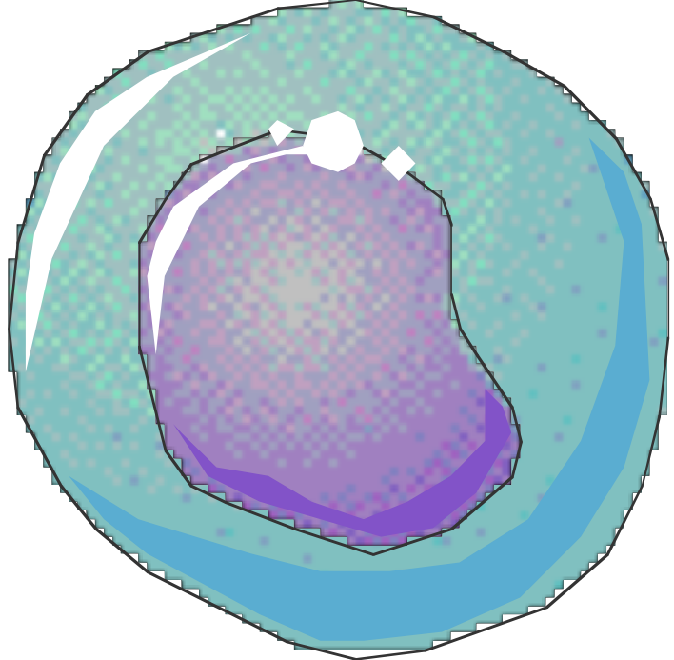
Immune-activator monoclonal antibodies: ADCC (Antibody-Dependent Cellular Cytotoxicity)
FcgRII/III
CR1
NK
FcgRI
CR3
Tumor associated
antigen
Perforine
granzimi
Cellula tumorale
Lysis Apoptosis

Slide 37
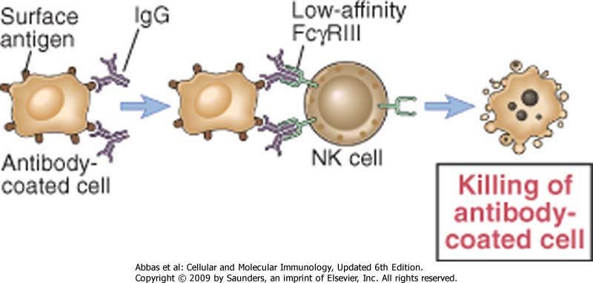

Slide 38
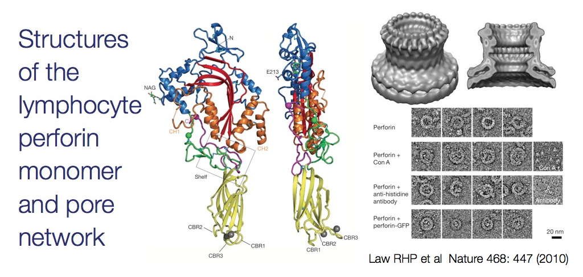

Slide 39
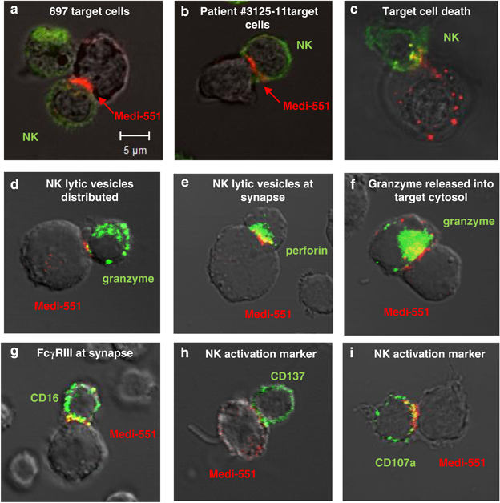

Slide 41
FcR | Affinity for immunoglobulin | Cell Distribution | Function
FcγRI (CD64) | High (Kd ∼ 10⁻⁹ M) binds IgG1 and IgG3 | Macrophages, neutrophils; also eosinophils | Phagocytosis, activation of phagocytes
FcγRIIA (CD32) | Low (Kd > 10⁻⁷ M) | Macrophages, neutrophils; eosinophils, platelets | Phagocytosis; cell activation (inefficient)
FcγRIIB (CD32) | Low (Kd > 10⁻⁷ M) | B lymphocytes, dendritic cells, macrophages | Feedback inhibition of B cells, macrophages, dendritic cells
FcγRIIIA (CD16) | Low (Kd > 10⁻⁶ M) | NK cells | Antibody-dependent cell-mediated cytotoxicity
FcγRIIIB (CD16) | Low (Kd > 10⁻⁶ M) GPI-linked protein | Neutrophils, other cells | Phagocytosis (inefficient)
FcεRI | High (Kd > 10⁻¹⁰ M) binds monomeric IgE | Mast cells, basophils, eosinophils | Cell activation (degranulation)
FcεRII (CD23) | Low (Kd > 10⁻⁷ M) | B lymphocytes, eosinophils, Langerhans cells | Unknown
FcαR (CD89) | Low (Kd > 10⁻⁶M) | Neutrophils, eosinophils, monocytes | Cell activation?

Slide 42
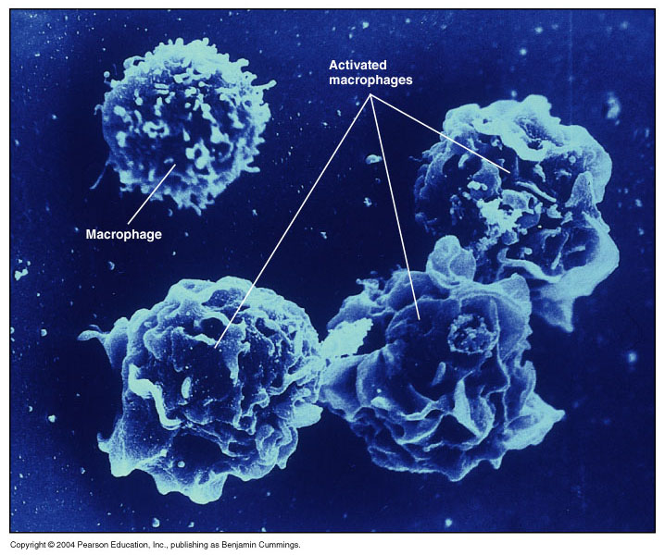

Slide 43
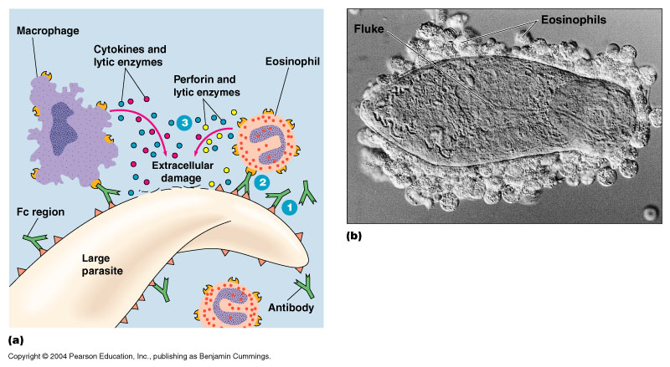

Slide 44
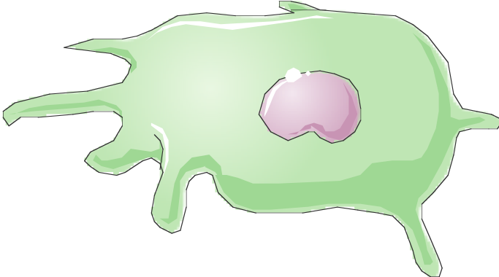
Immune-activator monoclonal antibodies: Phagocytosis
Cytokines
C3a, C5a
Neutrophiles and Macrophages
FcgRII
FcgRI
FcgRIII
Tumor cell
Phagocytosis

Slide 45
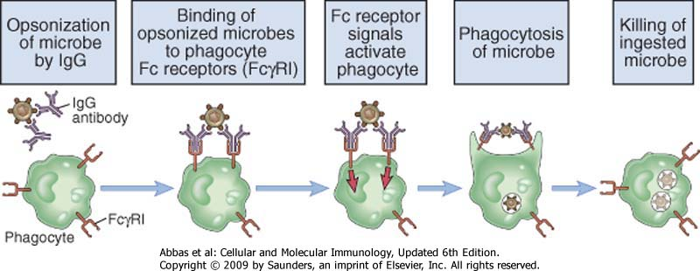

Slide 46
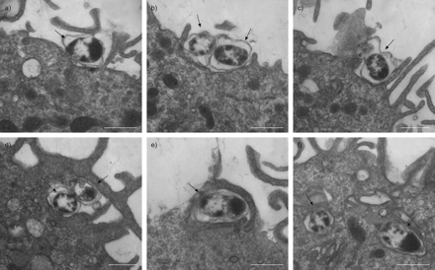

Slide 47
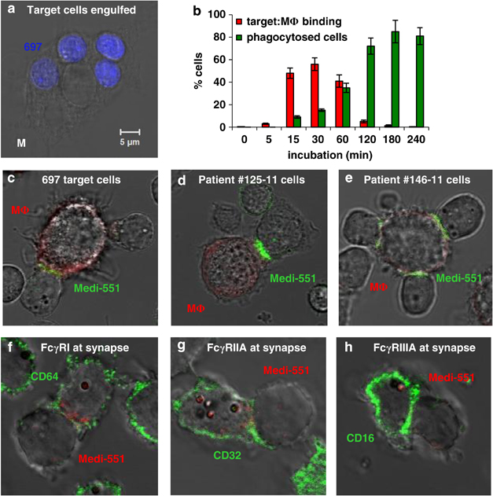

Slide 48
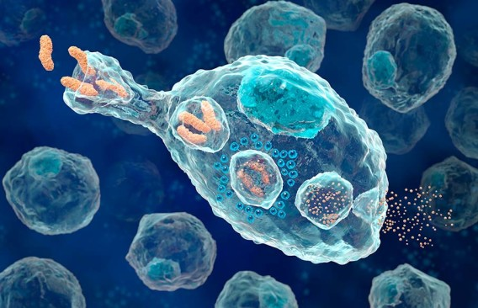

Slide 50
Immune-activator monoclonal antibodies: CDCC (Complement-Dependent Cellular Cytotoxicity)
Cytokines
C3a, C5a
Neutrophiles and Macrophages
C1qR
CR1
CR1
C3b
C4b
iC3b
CR3
CR3
NK
Perforin
Tumor cell
Phagocytosis
Lysis

Slide 51
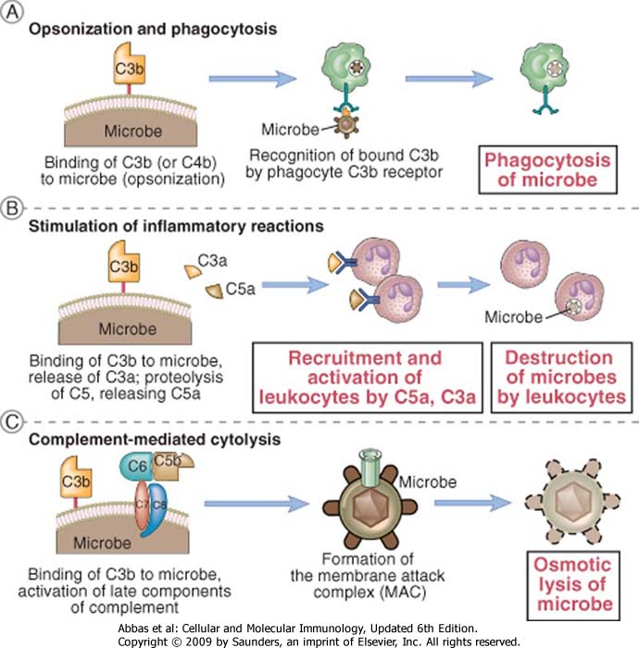

Slide 53
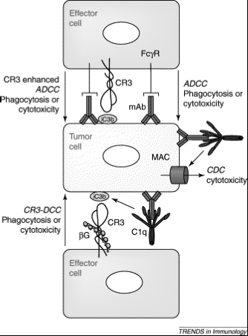
Effector mechanisms of monoclonal antibodies
ADCC
CDC
CDCC
Modified from Gelderman et al.
Trends in Immunol, 2004

Slide 54
Mechanisms of action of immune-activator antibodies
CITOTOSSICITA’ CELLULARE ANTICORPO DIPENDENTE (ADCC) | Mediata in particolare dalle cellule NK, che tramite il recettore FcgRIII riconosce la porzione Fc dell’anticorpo. Liberazione del contenuto dei granuli citoplasmatici (perforine, granzimi).
OPSONIZZAZIONE E FAGOCITOSI | Gli anticorpi rivestono la cellula tumorale e ne favoriscono l’internalizzazione da parte dei fagociti che riconoscono la porzione Fc mediante i recettori per Fc.
APOPTOSI | Da aggregazione dell’antigene sulla superficie cellulare.
ATTIVAZIONE DELLA VIA CLASSICA DEL COMPLEMENTO | Legame di C1q all’Fc dell’anticorpo; lisi cellulare (CDC); i prodotti generati dall’attivazione del complemento (anafilotossine e opsonine) inducono flogosi e promuovono la fagocitosi.

