Slide 1
Production of polyclonal and monoclonal antibodies

Slide 2
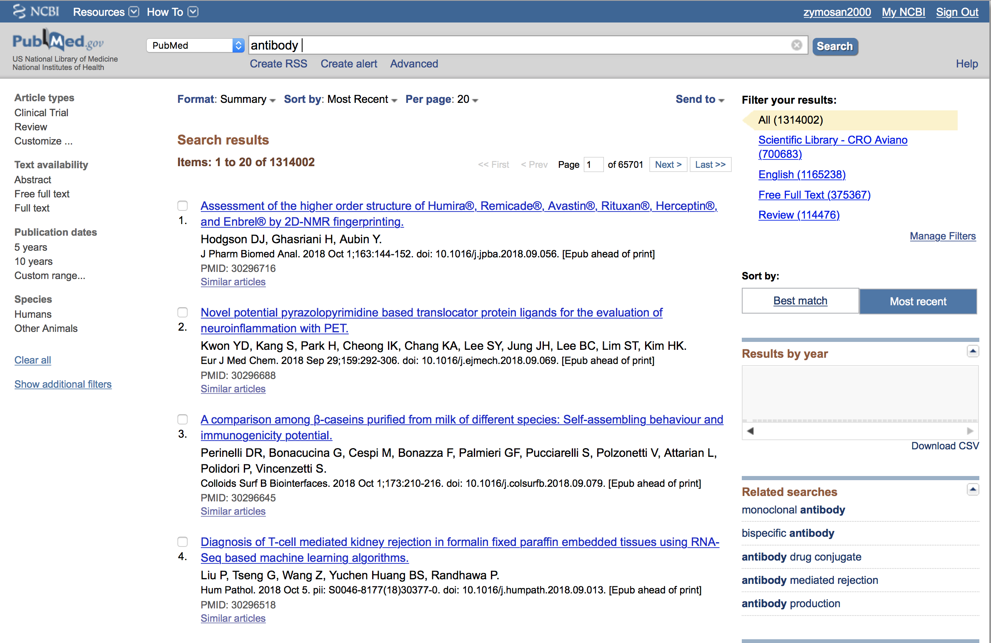
Monoclonal Antibodies
Pubmed
Oct 2018
Didascalia

Slide 3
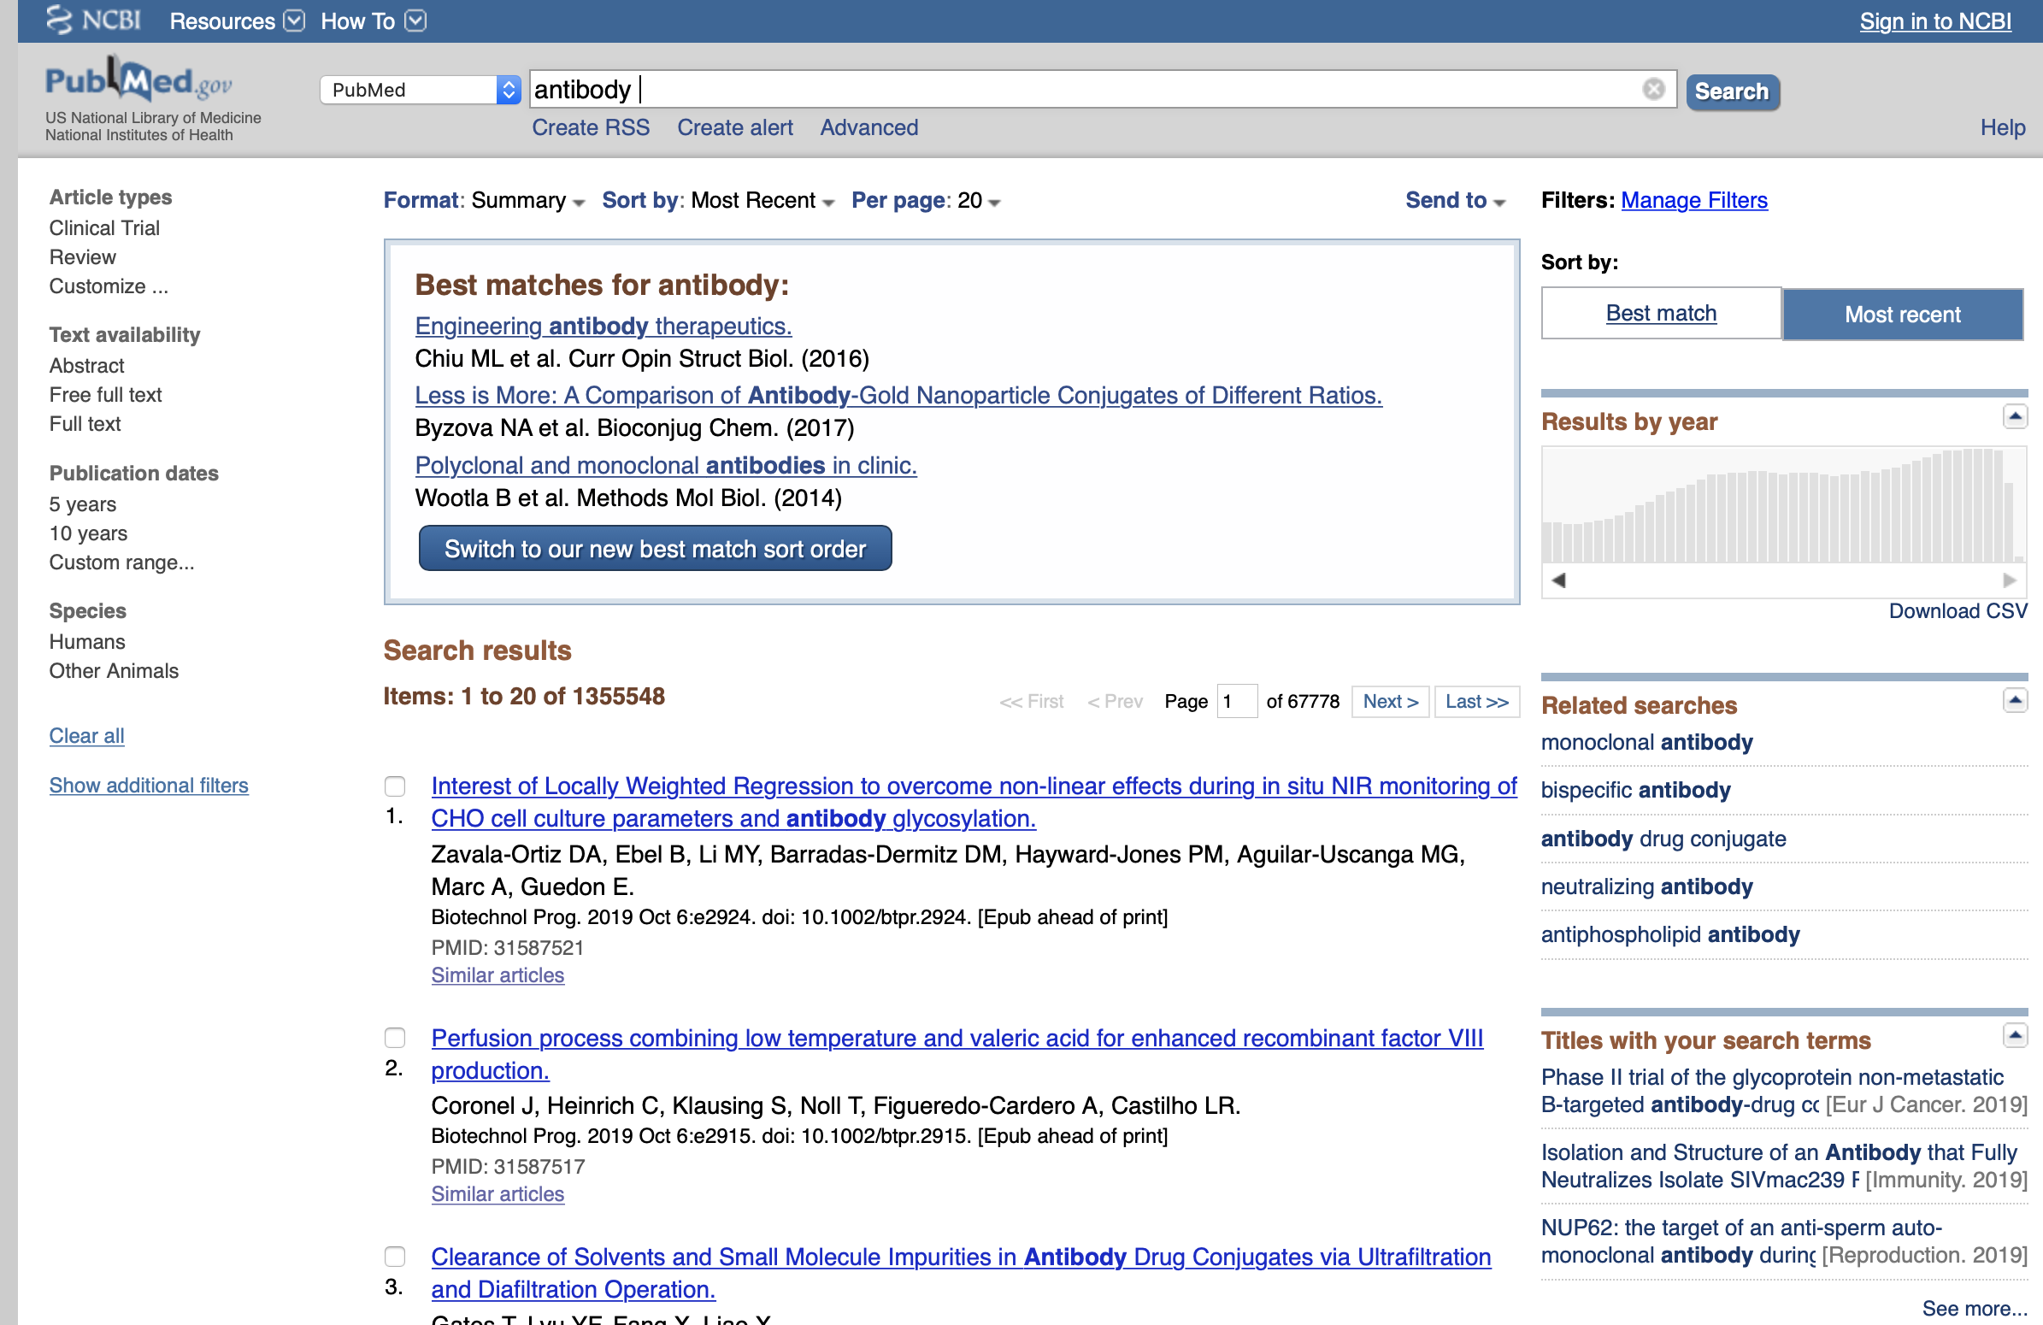
Monoclonal Antibodies
Pubmed
Oct 2019

Slide 4
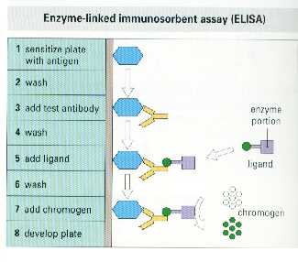
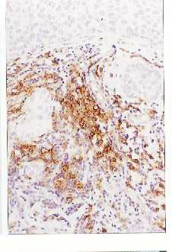
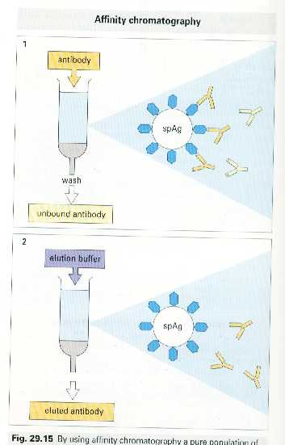
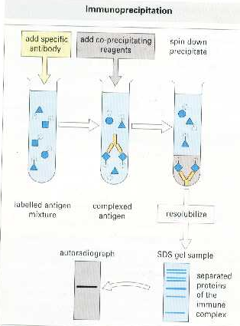
Use of monoclonal antibodies
Immuno-
histochemistry
Purification
Immuno-
precipitation
ELISA

Slide 5
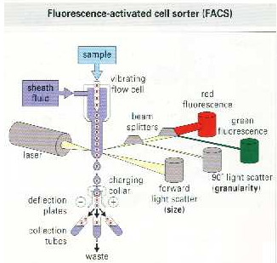
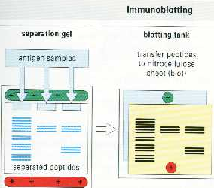
Use of monoclonal antibodies
Immuno-
fluorescence
Flow cytometry
Immunoblotting

Slide 6
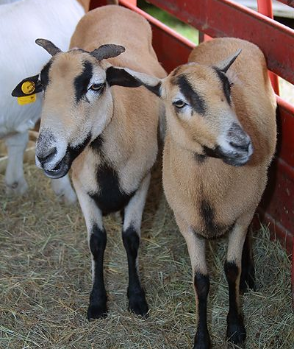
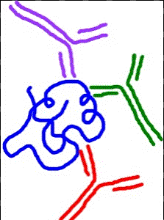
Antibody Production
Polyclonal:
Antibodies are collected from sera of exposed animal,
- or -
a combination of monoclonal colonies is combined.
Can be any animal: Rabbit, Goat, Horse, Rat, Sheep, etc…
Suite of antibodies recognizing multiple antigenic sites of injected biochemical.

Slide 7
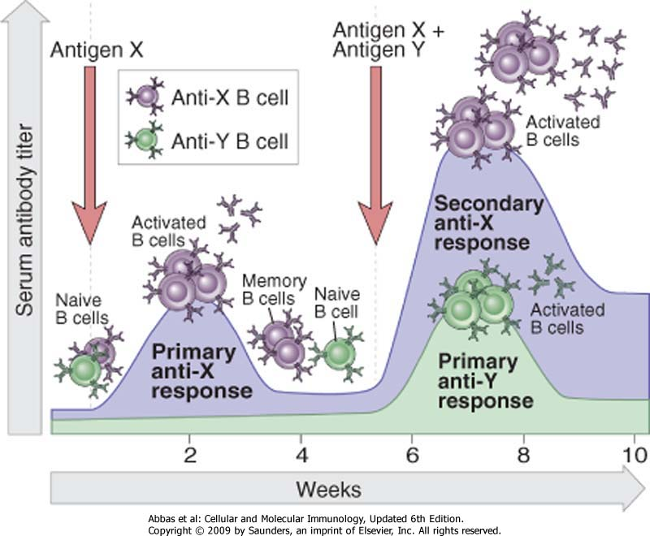
Timing for Ab production

Slide 8
Disadvantages of Polyclonal Antisera
Antiserum is composed of a mixture of high and low affinity antibody populations
Antiserum is composed of a mixture of antibodies with different specificities - not all recognize the target of interest
If the animal has had an infection, antibodies against the infecting organism will be present - can lead to “non-specific” binding
Quantity of antiserum is limited by amount of serum and life of immunized animal.
Antigen must be pure.

Slide 9
Advantages of Polyclonal Antisera
Antiserum recognizes many different epitopes on the target
Can usually be used for many different research procedures
(Immunohistochemistry, immunofluorescence, immunoprecipitation, ELISA, precipitation assays, functional assay)
Can be affinity purified to eliminate the non-specific binding antibodies

Slide 10
Production of monoclonal antibodies
One of the most important example of induction and selection of stable cell mutant and cell fusion is the production of hybridoma
Hybridomas are hybrid of cells obtained fusing lymphocytes and a tumor cell line obtained from multiple myeloma.
The aim is to obtain a stable clone of lymphocytes in order to obtain in vitro, for long time and in high amount, monoclonal antibodies that usually lymphocytes produce after their differentiation to plasma cells.

Slide 11
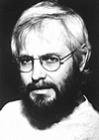
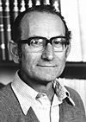
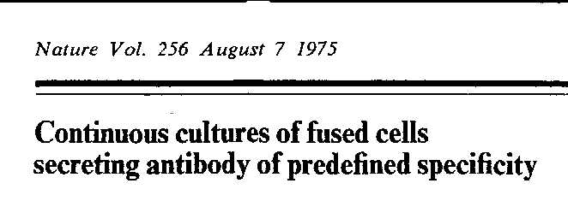
&
Georges Köhler
(1946-1995)
Cesar Milstein
(1927-2002)
Method to produce monoclonal antibodies -1975
Nobel Prize - 1984

Slide 12
How to make a monoclonal antibody
Immunize mice
Test the serum
Purify lymphocytes from the spleen
Perform a fusion
Screen the fusion for the right cells
Grow the hybridomas
Harvest the antibody
Concentrate and purify the product

Slide 13
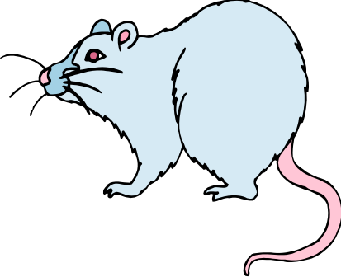
Production of Monoclonal Antibodies
Immunisation with antigen
Ab titre from serum Ab₁ Ab_{2 …} Ab_{n}

Slide 14
Immunize the mice - Inoculation
The mice are aseptically inoculated with the antigen combined with an adjuvant.
Inoculations are done either sub-cutaneously or intra-peritoneally.
Normal dose per mouse is between 20 and 100 micrograms of protein.
Inoculations are performed every 14 to 21 days.

Slide 15
Timing for Ab production

Slide 16
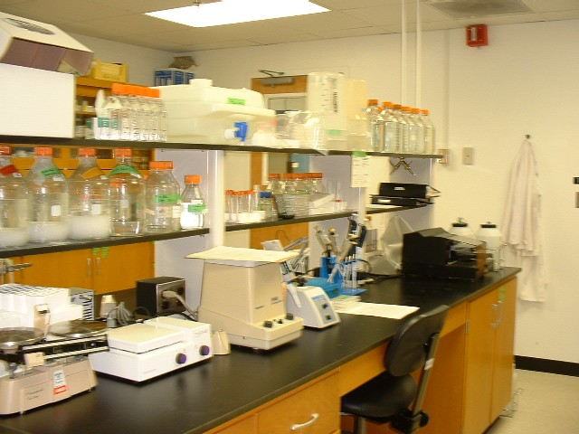
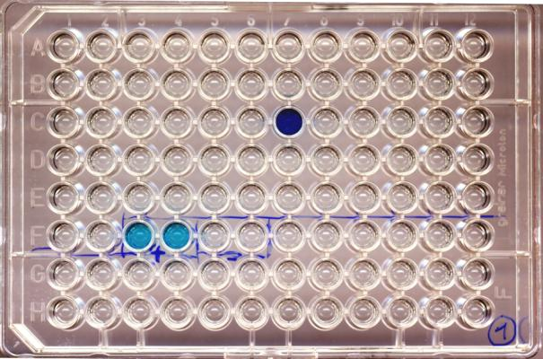
Test the serum – In the lab

Slide 17
Test the serum - Decision time
When the serum titer of the mice has reached a plateau, an additional ELISA test is performed to determine the predominant isotype present. The two isotypes that are most common in mouse serum are IgG and IgM.
A fusion is done when the IgG level is high and the IgM level is low.
Sometimes additional testing is done (Western blots, immunoflurorescence) to determine whether the serum response is specific for the selected antigen.
The mouse with the strongest, most specific response is chosen for the fusion.

Slide 18
Production of Monoclonal Antibodies
Immunisation with antigen
Spleen suspension
Ab titre from serum Ab₁ Ab_{2 …} Ab_{n}

Slide 19
Production of Monoclonal Antibodies
Immunisation with antigen
Cell line –myeloma
P3– NSI/I – Ag4 – 1
X63 – Ag8 - 653
Spleen suspension
Ab titre from serum Ab₁ Ab_{2 …} Ab_{n}

Slide 20
Production of Monoclonal Antibodies
Immunisation with antigen
Cell line –myeloma
P3– NSI/I – Ag4 – 1
X63 – Ag8 - 653
Spleen suspension
Ab titre from serum Ab₁ Ab_{2 …} Ab_{n}
Fusion with polyethylene glycol (PEG)

Slide 21
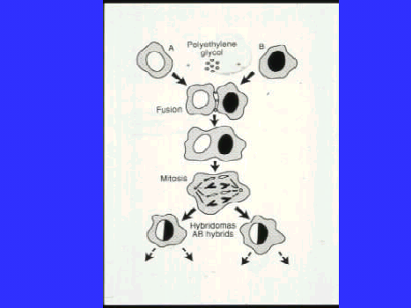

Slide 22
Cell types present after fusion
Myeloma
parents
Lymphocyte
parents
Myeloma
x
Myeloma
hybrids
Lymphocyte
x
lymphocyte
hybrids
Hybrids of myelomas and lymphocytes

Slide 23
What does HAT do?
Myeloma cell fusion partners were selected for the loss of the ability to synthesize hypoxanthine-guanine phosphoribosyl transferase (HGPRT)
HGPRT enables cells to synthesize purines using an extracellular source of hypoxanthine as a precursor.
Normally, the absence of HGPRT is not a problem because cells have an alternate biochemical pathway (termed the rescue pathway) they use to synthesize purines. The rescue pathway allows myeloma cells to divide normally.
The rescue pathway is inhibited by aminopterin. In the presence of aminopterin, HGPRT is essential for survival.
HAT contains:
Hypoxanthine
Aminopterin
Thymidine
HAT is selective for fused, (hydridoma) cells because:
Unfused myeloma cells cannot grow because they lack HGPRT
Unfused normal spleen cells cannot grow indefinitely because of their limited life span.
In hybridomas the spleen cell partner supplies HGPRT and the myeloma partner is immortal because it is a cancer cell, overcoming the growth block of spleen cells.

Slide 24
Production of Monoclonal Antibodies
Immunisation with antigen
Cell line –myeloma
P3– NSI/I – Ag4 – 1
X63 – Ag8 - 653
Spleen suspension
Ab titre from serum Ab₁ Ab_{2 …} Ab_{n}
Fusion with polyethylene glycol (PEG)
Selection with H.A.T.

Slide 25
Cell types present after fusion
Myeloma
parents
Plasma cell
parents
Die
(no HGPRT)
Myeloma
x
Myeloma
hybrids
Plasma cell
x
Plasma cell
hybrids
Die
(in a few days)
Die
(no HGPRT)
Die
(in a few days)
Hybrids of myelomas and plasma cell
Survive

Slide 26
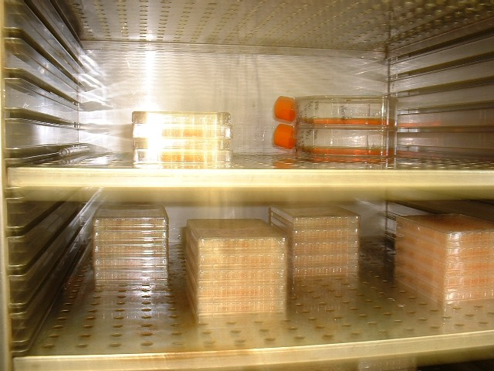
Perform a fusion - Growing the cells (hybridomas)
Cells are grown in a 37º C incubator.
Cells are kept in an atmosphere of about 5% CO₂.
The cells are fed after 7 days of incubation.
The cells are checked for growth after 10 days of incubation.

Slide 27
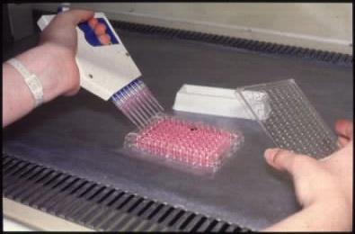

Slide 28
Production of Monoclonal Antibodies
Immunisation with antigen
Cell line –myeloma
P3– NSI/I – Ag4 – 1
X63 – Ag8 - 653
Spleen suspension
Ab titre from serum Ab₁ Ab_{2 …} Ab_{n}
Fusion with polyethylene glycol (PEG)
Selection with H.A.T.
Screen for Ab – secreting hybrids

Slide 29
Production of Monoclonal Antibodies
Immunisation with antigen
Cell line –myeloma
P3– NSI/I – Ag4 – 1
X63 – Ag8 - 653
Spleen suspension
Ab titre from serum Ab₁ Ab_{2 …} Ab_{n}
Fusion with polyethylene glycol (PEG)
Selection with H.A.T.
Screen for Ab – secreting hybrids
Clone Ab secreting hybrids

Slide 30
Production of Monoclonal Antibodies
Immunisation with antigen
Cell line –myeloma
P3– NSI/I – Ag4 – 1
X63 – Ag8 - 653
Spleen suspension
Ab titre from serum Ab₁ Ab_{2 …} Ab_{n}
Fusion with polyethylene glycol (PEG)
Selection with H.A.T.
Screen for Ab – secreting hybrids
Clone Ab secreting hybrids
Clone 1 Clone 2 Clone n
Freeze cells

Slide 31
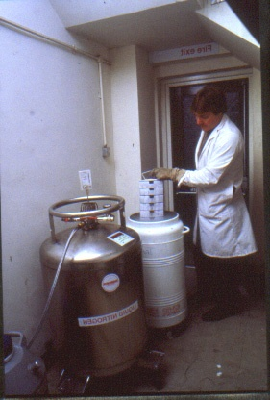

Slide 32
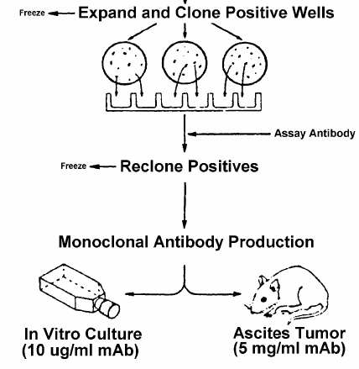
Expand in mice or expand in vitro
in vitro material is less concentrated
and contains
bovine serum
ascites fluid
contain high [mAb]
and minor contamination
with mouse Ig

Slide 33
Advantages
Possible to select mAbs with the required specificity.
Large quantities of antibodies can be obtained easily.
Pure antibodies can be obtained more easily.
Indefinite supply.
Immunogen need not be pure.

Slide 34
Disadvantages of Monoclonal Antibodies
Labour intensive.
Costly.
Longer time span.

Slide 38
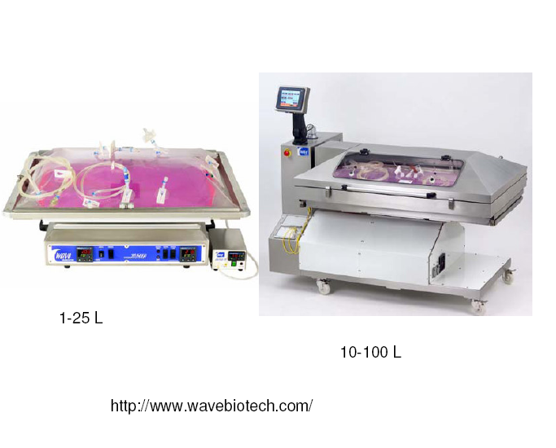

Slide 39
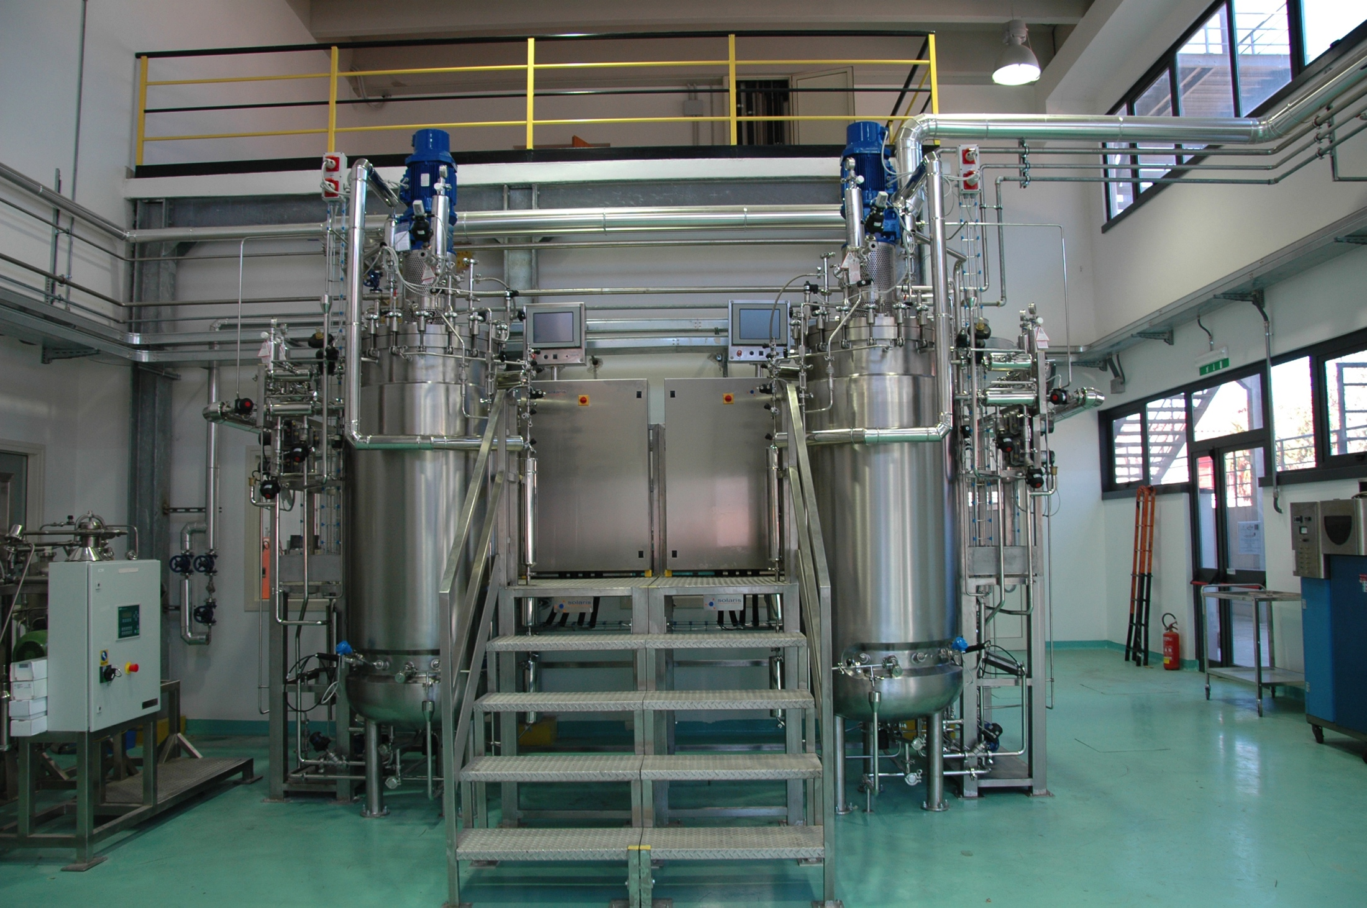
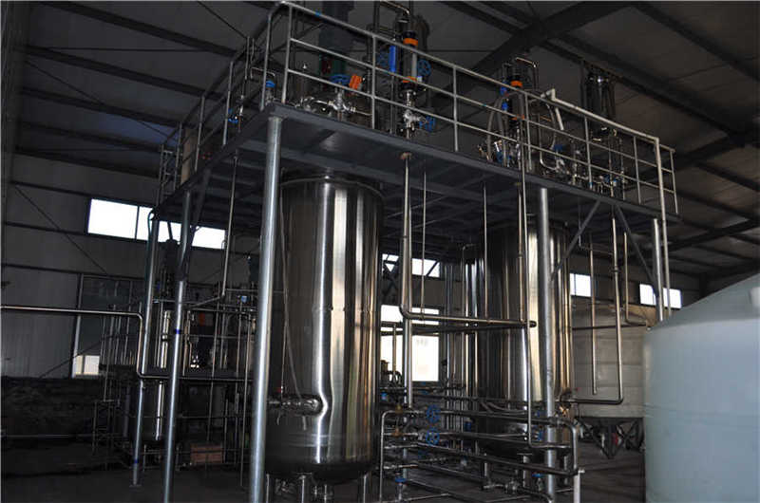

Slide 40
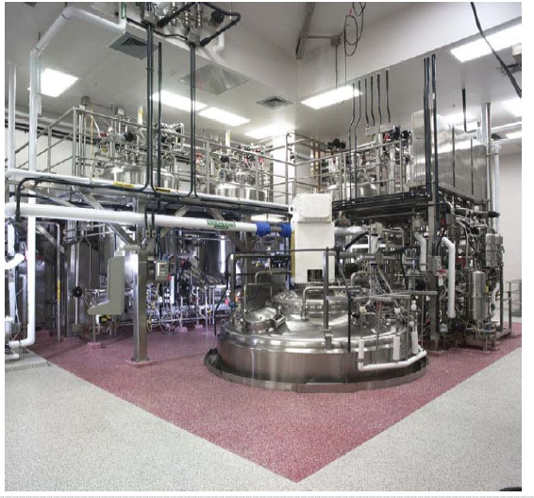
20,000 liter mammalian cell ferment or - Lonza Biologics - Portsmouth, NH

Slide 41
Cost
Facilities cost $20-50 million to build
Antibodies cost $500-1,000/gram
High costs present challenges for reimbursement in chronic diseases

Slide 42
High level production in mammalian cells: the math
Lonza (contract manufacturer) claims = 5.5 g/L yield in 24 days
30,000 L reactor:
30,000 L. X 5.5 g/L = 165 kg in 24 days,
x 12 = 1,980 kg/year = 2,000,000 g/year
One mAb dose = 500 mg = 0.5 g
2,000,000/0.5 = 4 million doses per reactor per year.
6 doses per patient per year?
4,000,000/6 = 600,000 patients per year per reactor.
At $10,000 per patient per year → $6B in sales /per 30KL reactor
Not bad!!

