Slide 1
Human antibodies

Slide 2
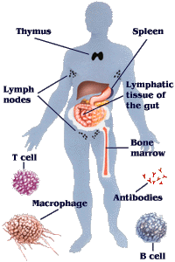
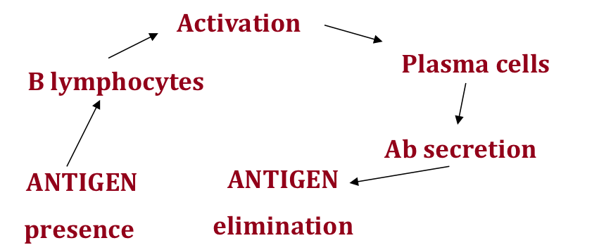
General informations
Innate Immunity (natural)
Humoral
Cell-mediated
Acquired Immunity (specific)
Humoral
Cell-mediated
Antibodies are the most important component of humoral immune system.

Slide 3
Glossary
Antibody (anti-foreign body) is a glico-protein produced by a white cell (B lymphocyte and plasma cells).
Antigen (antibody generating substance) is any agent, such as a chemical or microorganism that is recognized by the antibody.
Not all antigens are immunogens (e.g hapten).
Immunogen: Any substance to which an animal responds by making antibodies. All immunogens are antigens.

Slide 4
Immunogenicity
Ability of a molecule to induce an immune response
Proteins, peptides, carbohydrates, nucleic acids, lipids
Must be larger than 3000-5000 daltons - if not…..
Carrier protein
e.g. BSA Thyroglobulin
Antigen
(hapten)
Carbodiimide
Glutaraldehyde
MBS–Heterobifunctional reagents

Slide 5
Glossary
Antibody (anti-foreign body) is a protein produced by a white cell (B lymphocyte).
Antigen (antibody generating substance) is any agent, such as a chemical or microorganism that is recognized by the antibody. Not all antigens are immunogens (e.g hapten).
Immunogen : Any substance to which an animal responds by making antibodies. All immunogens are antigens.
Epitope : the part of a target to which an antibody binds, also known as an antigenic determinant

Slide 6
Glossary
Antibody (anti-foreign body) is a protein produced by a white cell (B lymphocyte).
Antigen (antibody generating substance) is any agent, such as a chemical or microorganism that is recognized by the antibody. Not all antigens are immunogens (e.g hapten).
Immunogen : Any substance to which an animal responds by making antibodies. All immunogens are antigens.
Epitope : the part of a target to which an antibody binds, also known as an antigenic determinant
Antigen binding site - relatively small region of an antibody that binds to the antigen.

Slide 7
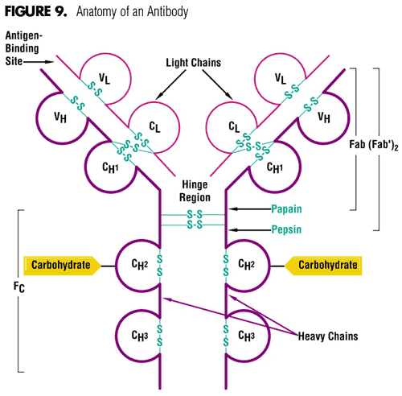
ANATOMY OF AN ANTIBODY
2 HEAVY CHAINS
1 VARIABLE DOMAIN (VH)
3 CONSTANT DOMAINS (CH1-2-3)
2 LIGHT CHAINS
1 VARIABLE DOMAIN (VL)
1 CONSTANT DOMAINS (CL)
(k or λ)

Slide 8
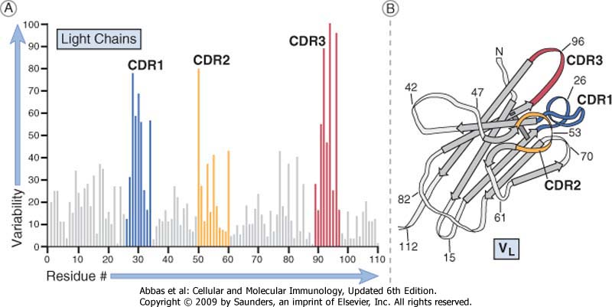
Aminoacid variability in antibody sequence

Slide 9
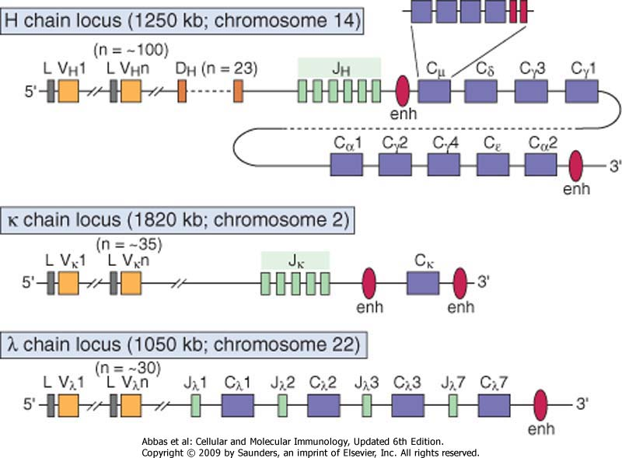

Slide 10
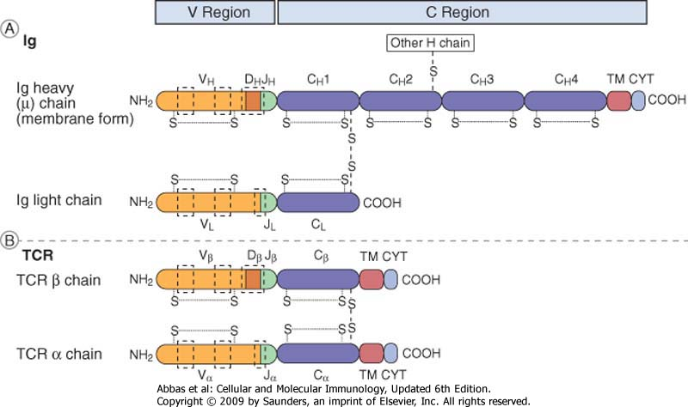

Slide 11
How VH genes are made
and used in vivo
100 V genes
27 D genes
6 J genes
CH1
Rearranged V gene
VDJ
CH1
CH2
CH3
mRNA
Math: 100 x 27 x 6= 16200 possible VH

Slide 13
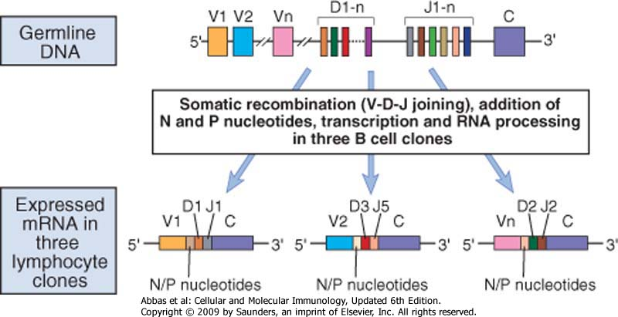

Slide 14
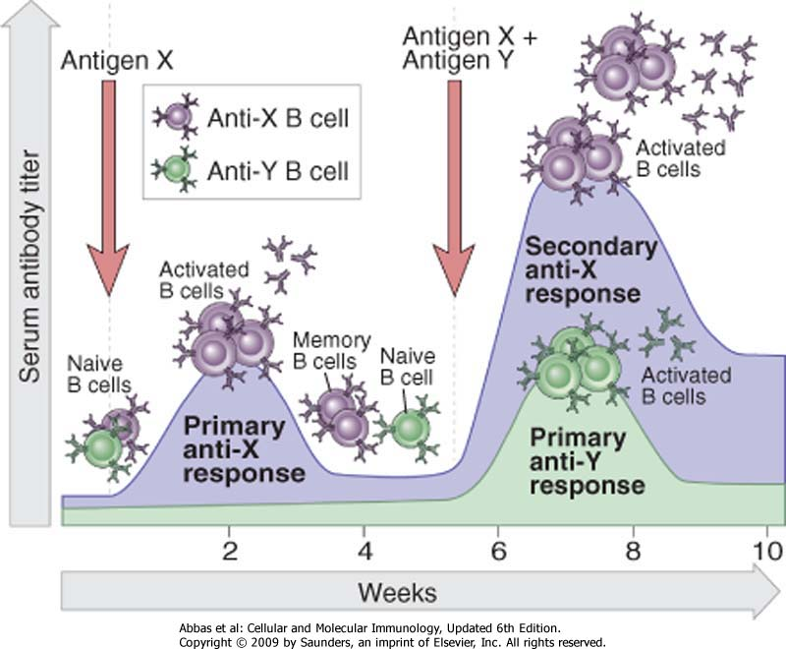
Timing for antibody production

Slide 15
How are antibody genes rearranged in vivo?

Slide 16
Timing for antibody production

Slide 17
How are antibody genes rearranged in vivo?

Slide 18
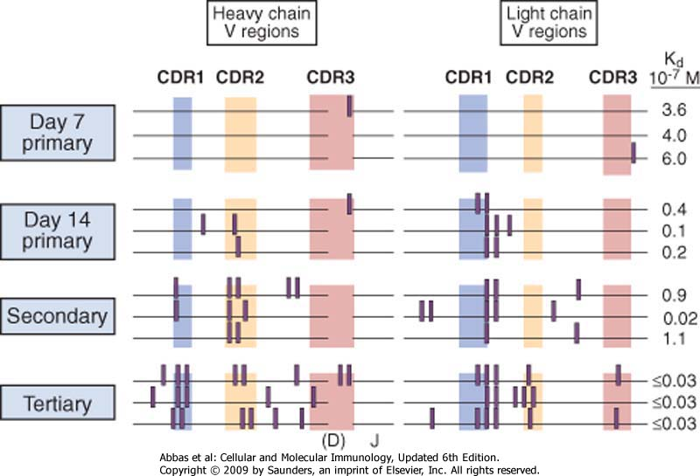
Final variability of antibodies: >10⁹

Slide 19
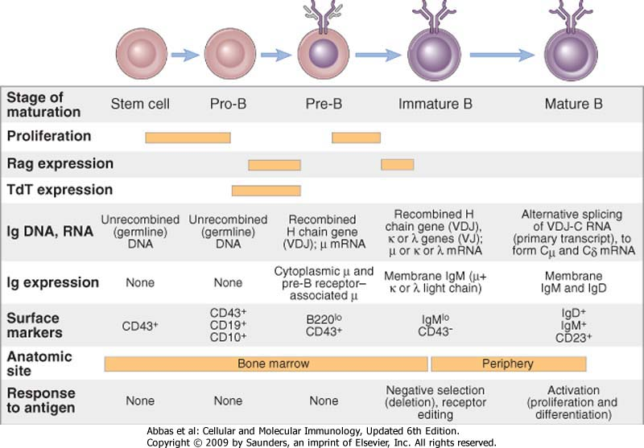
Where?

Slide 21
Monoclonal antibodies
Murine monoclonal antibodies produced by hybridomas
Human immune response to mouse antibodies
HAMA = Human Anti-Mouse Antibodies
- Endanger the patient
enhance the clearance of the Ab
reduce its therapeutic effect.
CDR murini
Regione V murina
murini
chimerici
umanizzati
umani

Slide 23
Monoclonal antibodies
Murine monoclonal antibodies produced by hybridomas
Chimeric recombinant antibodies: 70% human DNA
CDR murini
Murine V region
Murine
chimeric
umanizzati
umani

Slide 24
Rearranged V gene structure
VH
22
98
S
S
1
31
35
49
66
101
110
117
FR1
FR2
FR3
FR4
CDR1
CDR2
CDR3 (4-30)

Slide 25
Humanized antibodies (95% human DNA umano; only CDRs are murine)

Slide 26
Monoclonal antibodies
Murine monoclonal antibodies produced by hybridomas
Chimeric recombinant antibodies: 70% human DNA
Humanized recombinant antibodies: 95% human DNA
Human antibodies: 100% human DNA
murine CDR
Murine V region
Murine
chimeric
Humanized
Human

Slide 27
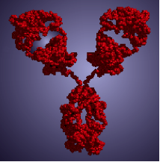
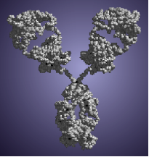
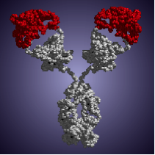
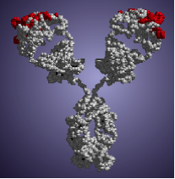
What they really look like
Mouse
Human
Chimeric
Humanized
Notes:
The participation in regulatory review allows the researcher reviewer a reality check for the real regulatory impact of the MOA data

Slide 28
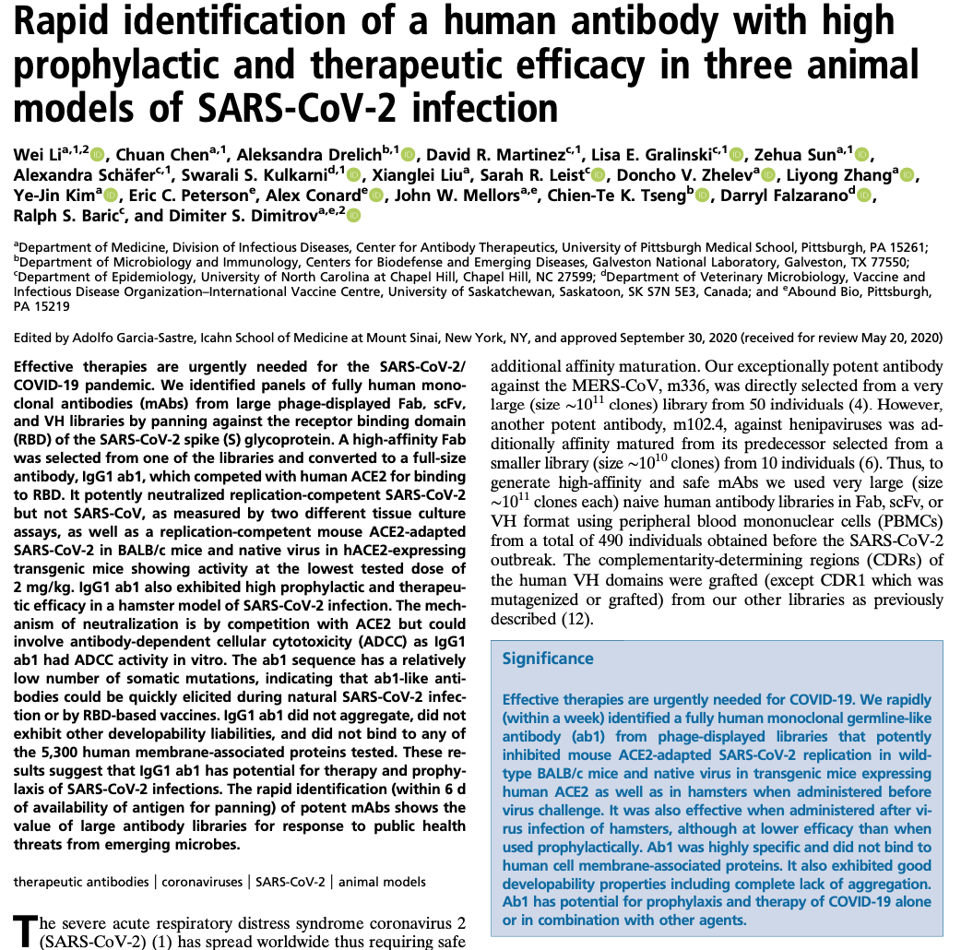
Notes:
The participation in regulatory review allows the researcher reviewer a reality check for the real regulatory impact of the MOA data

Slide 29
Notes:
The participation in regulatory review allows the researcher reviewer a reality check for the real regulatory impact of the MOA data

Slide 30
Making human antibodies
Transgenic animals
Phage/microbial/yeast display

Slide 31
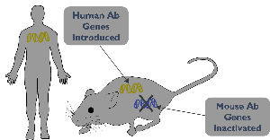
Transgenic Mouse
VH1
VH2
VH65
DH1-------27
JH1-----6
Cγ
k
H
l

Slide 32
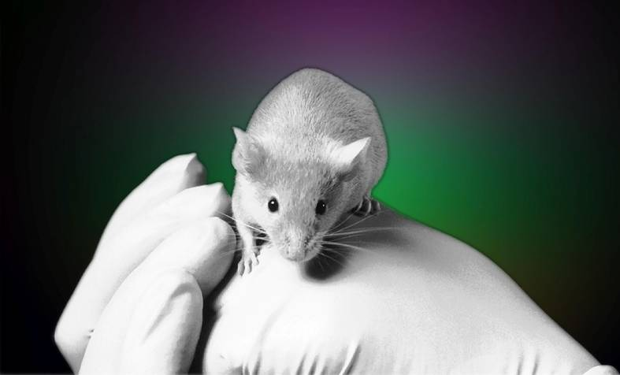
XenoMouse®-κλ Strains
IgG₁κ
IgG₂κ
IgG₄κ
IgG₁λ
IgG₂λ
IgG₄λ
Notes:
Today, XenoMouse technology consists of a collection of strains of mice. We have different strains with the different heavy-chain isotypes IgG₁, IgG₂ and IgG₄. We also have introduced both light-chain loci – the kappa and the lamda light chains.

Slide 34
Transgenic mice
These produce human antibodies following immunization
The creation of monoclonal antibodies is the same as normal mice using hybridoma technology
Antibody production is still required after selection

Slide 35
Making human antibodies
Transgenic animals
Phage/microbial/yeast display

Slide 36
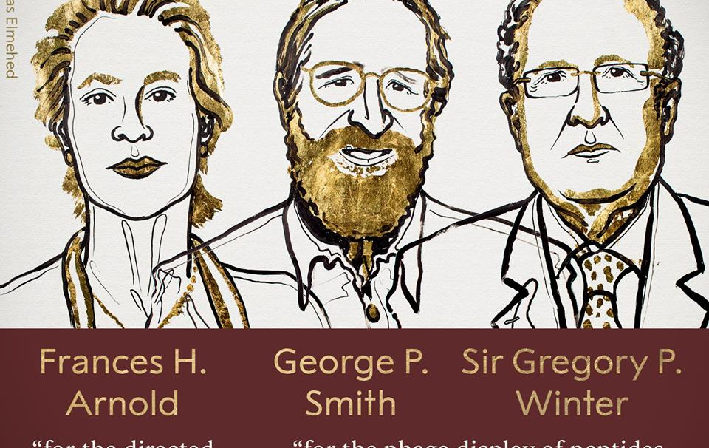
The Royal Swedish Academy of Sciences has decided to award the Nobel Prize in Chemistry 2018 with one half to Frances H. Arnold “for the directed evolution of enzymes” and the other half jointly to George P. Smith and Sir Gregory P. Winter “for the phage display of peptides and antibodies.”
The power of evolution is revealed through the diversity of life. The 2018 Nobel Laureates in Chemistry have taken control of evolution and used it for purposes that bring the greatest benefit to humankind. Enzymes produced through directed evolution are used to manufacture everything from biofuels to pharmaceuticals. Antibodies evolved using a method called phage display can combat autoimmune diseases and, in some cases, cure metastatic cancer.
This year’s Nobel Laureates have been inspired by the power of evolution and used the same principles – genetic change and selection – to develop proteins that solve humankind’s chemical problems.
Didascalia

Slide 37
Antibody libraries
AIM: to allow the possibility to work with the antibody variability in the lab and not in the animal house

Slide 38
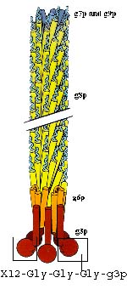
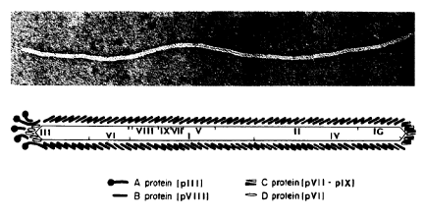
The biology of filamentous phages (f1)
g9p
g7p
900 nm
g8p
5-6 nm
5-6 nm
g6p
g3p

Slide 39
Phage Display Vector
gene X
gene X
gene3
gene3
phagemid
M13
ori
amp

Slide 40
Phage Display Vector
gene3
gene X
Gene-8
gene X
phagemid
M13
ori
amp

Slide 41
Phage production
amp
geneIII
Phagemid
Kan
VI
M13 ori
pUC ori
VIII
I
IX
XI
IV
VII
V
X
II
Infective (2. kan)
Infective (1. amp)

Slide 42
VH
VL
CH1
CL
VH
VL
Single chain Fv fragment

Slide 43
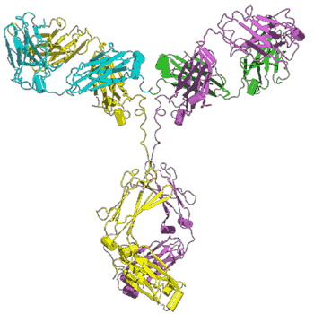
Antibody
Phage

Slide 44
Antibody
Phage
dAb

Slide 45
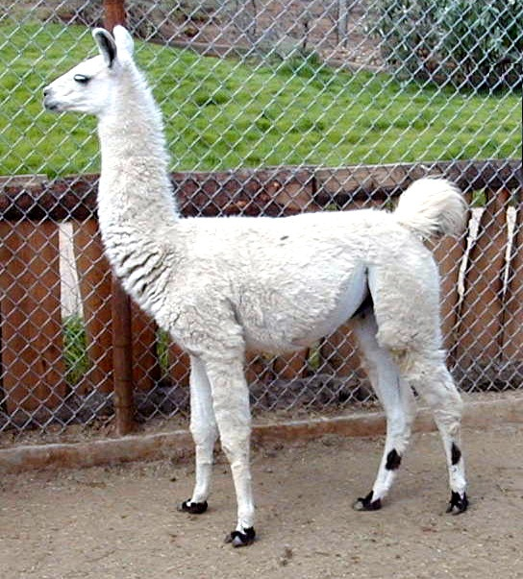
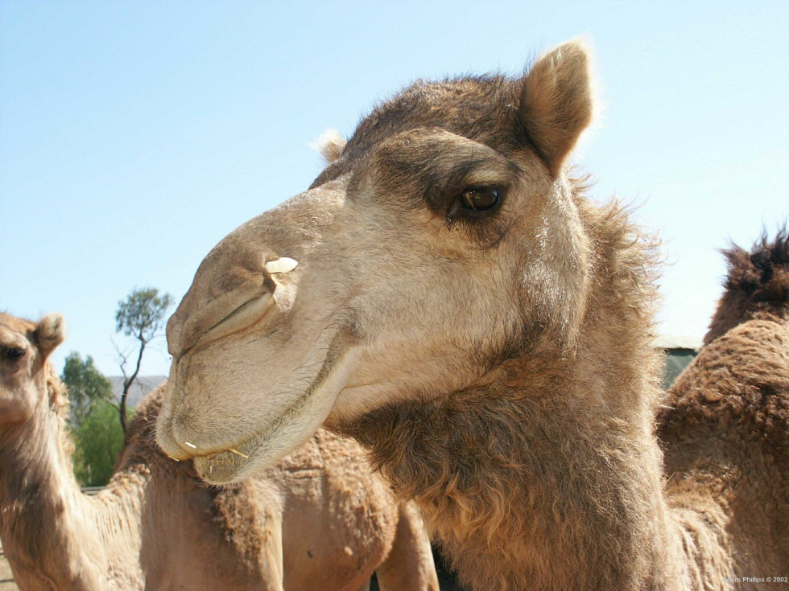
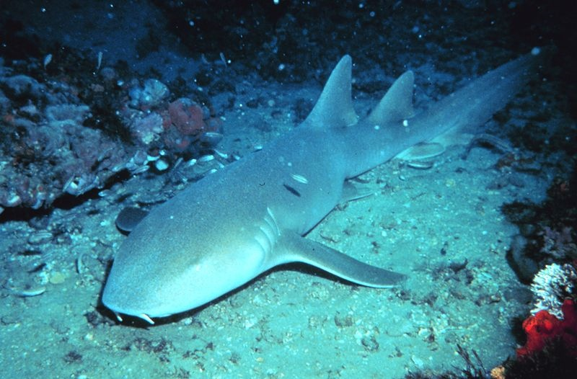
Some animals use natural dAbs
VH
VH
Shark
Camel lama

Slide 46
Points to consider when making and using antibody libraries
The source of V region diversity (natural or synthetic)
For natural V genes, the tissue source of V genes

Slide 47
V gene sources for making antibody libraries
Immune sources: IgG V genes derived from PBL, or spleen from immunized animals or patients
High affinity antibodies against single antigens
Naive sources: IgM/IgG V genes, derived from PBL, spleen, bone marrow
Antibodies against a wide diversity of antigens
Synthetic: clone all or some V genes (human or mouse) and reconstitute CDRs for both VH and VL by PCR using oligonucleotides

Slide 48
Points to consider when making and using antibody libraries
Antibody form (Single chain Fv (scFv) or Fab)
The source of V region diversity (natural or synthetic)
For natural V genes, the tissue source of V genes
How to assemble the V regions
Type of library
The display protein used (p3, p8 or p9)
Selection strategy

Slide 49
Selection
Phages
Magnetic beads
Y
Y
Antigen
Y
Y
Y
Y
Y
Y
Activated beads
Y
Y
Y
Y
Y
Reactive phage
Y
Y
Y
Y
Y
Non-reactive phage

Slide 50
Selection
Magnetic beads
Y
Y
Antigen
Y
Y
Y
Y
Y
Y
Activated beads
Y
Y
Y
Y
Y
Reactive phage
Y
Y
Y
Y
Y
Non-reactive phage

Slide 51
Selection
Sfere paramagnetiche
Y
Y
Antigene
Y
Y
Y
Y
Y
Y
Sfere attivate
Y
Y
Y
Y
Y
Reactive phage
Y
Y
Y
Y
Y
Non-reactive phage

Slide 52
Selezione
Magnetic beads
Y
Y
Antigen
Y
Y
Y
Y
Y
Y
Activated beads
Y
Y
Gene
Y
Y
Y
Reactive phage
Y
Y
Y
Y
Y
Non-reactive phage
Protein

Slide 53
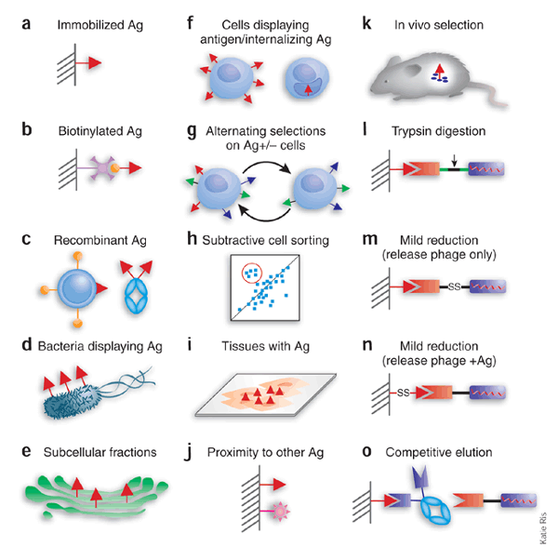

Slide 54
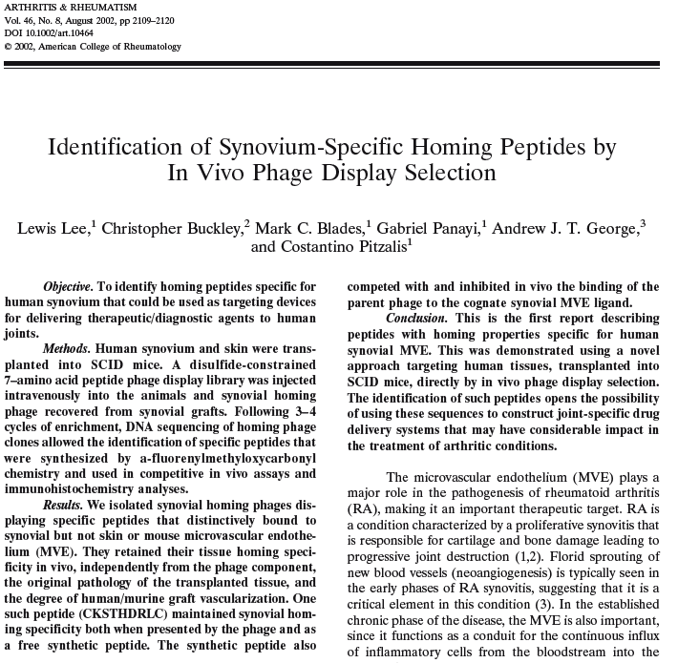

Slide 55
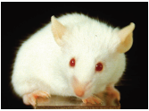
Phage antibodies vs. hybridomas
Antibodies from any species
In vitro
Immune or naive source
Billions antibodies screened
Affinities ≤10⁻⁸
Affinities can be improved ≤10⁻⁹
Libraries difficult to make and use
Conserved antigens possible
High throughput possible
Gene cloned with selection
Unusual selection strategies
Requires animals
Immune source needed
Hundreds antibodies screened
Affinities ≤10⁻¹⁰
Cannot improve affinity
Technology widely available and works well
Conserved antigens difficult
High throughput impossible
Gene must be cloned separately
Only immunization

Slide 56
Antibodies from library: advantages 1
Antibodies against self or very conserved antigens possible (e.g. thyroglobulin, TNFa, CEA, MUC1, CD4)
Impossible antibodies possible (e.g. BIP)
Antibodies with fine discrimination (e.g. estrogen, estradiol, targets differing by a single amino acid)
Antibodies with very broad specificities (e.g. post-translational modifications independently of sequence context)
Unusual selection strategies - Subtractive antibodies, cell surface antibodies
Recombinant clones: gene cloned with selection
Availability of sequence means selected affinity reagents are never lost, but archivable forever
With improvement of gene synthesis, web based distribution of clone sequences can be contemplated in the future
Easily manipulated for downstream uses
Enzyme fusions, multimerization etc.

Slide 57
Antibodies from library: advantages 2
Isolate numerous antibodies per antigen in two weeks (simple selections)
Process multiple antigens: ≥10 manually, 96 well format feasible
Antibodies isolated can be high affinity
Affinity can be further improved
Human antibodies can be isolated
Affinities 1nM-10µM
Depends upon library quality and degree of effort
Can affinity mature to picomolar
Truly monoclonal, make multimeric or polyclonal or oligoclonal as desired
Hybridomas often produce multiple different antibodies
Less than 33% of commercial antibodies recognize their targets (M. Uhlen - protein atlas)
Can be converted back to IgG of any species

Slide 58
Antibodies from library: disadvantages
Obtaining or making a library
Classical monoclonal antibodies work well
Technique can be difficult to use
ScFv are produced in bacteria after selection
Yields 100µg-10mg/litre
scFvs tend to have low stability / storage capability
Affinities 1nM-10µM
Depends upon library quality and degree of effort
Antibodies are monomeric

Slide 59
Points to consider when making and using phage based antibody libraries
Antibody form (Single chain Fv (scFv) or Fab)
The source of V region diversity (natural or synthetic)
For natural V genes, the tissue source of V genes
How to assemble the V regions
The display protein used (p3, p8 or p9)
Phage or phagemid
Selection strategy
Screening

Slide 60
scFv-Fc
?

Slide 61
Antibody screening: tests
ELISA (Using supernatant/extract)
BIACORE (affinity using purified molecules)
Western blot (or immunoistochemistry, or….)
Functional screening

Slide 62
?
scFv-Fc

Slide 63
Antibody modifications
Increase affinity
Chain shuffling
Point mutation
Modification to Fc portion
Change Fc (IgG, IgM, IgA; mouse, rat, dog, human)

Slide 64
Antibody modifications
Increase affinity
Chain shuffling
Point mutation
Modification to Fc portion
Change Fc (IgG, IgM, IgA; mouse, rat, human)
Enhance CDC
Enhance ADCC

Slide 65
Functions of Fc domain
CH1 : - structural function
CH2 : - Complement activation
- ADCC
CH2 - phagocytosis
CH3 - clearance (kidneys)
- placental activity
CH3 : - MAST-cell binding

Slide 66
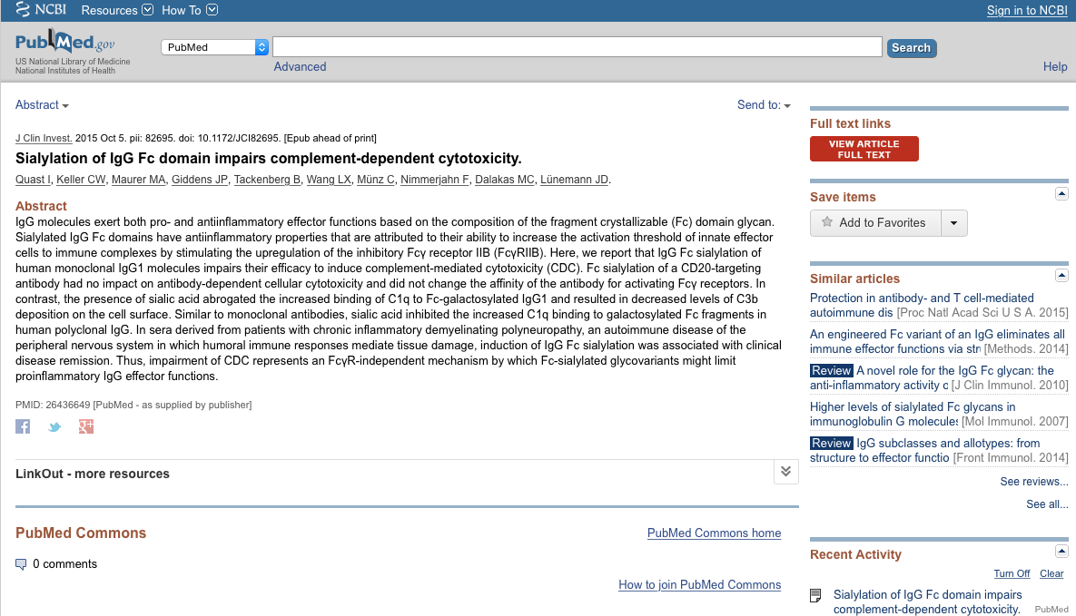

Slide 67
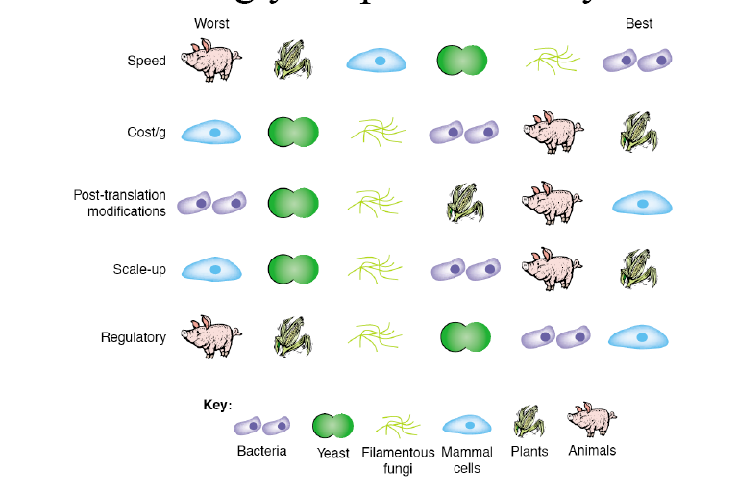
Choosing your production system

Slide 68
Antibody purification
Using Fc portion
Using specific Tag
Using the antigen

Slide 69
Antibody modifications
Increase affinity
Chain shuffling
Point mutation
Modification to Fc portion
Change Fc (IgG, IgM, IgA; mouse, rat, human)
Enhance CDC
Enhance ADCC
Production of bispecific antibody

Slide 70
Bispecific antibodies
Ag1
V_{H}
V_{H}
V_{H}
V_{L}
V_{L}
CH2
CH3
SV5
His6

