Slide 1
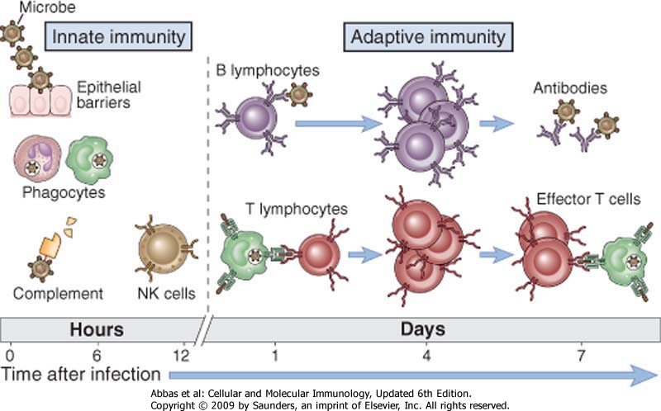
Immune response

Slide 2
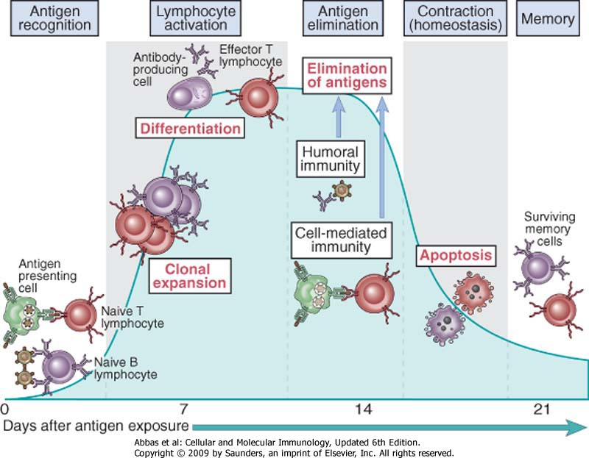
Phases of adaptive immune response

Slide 3
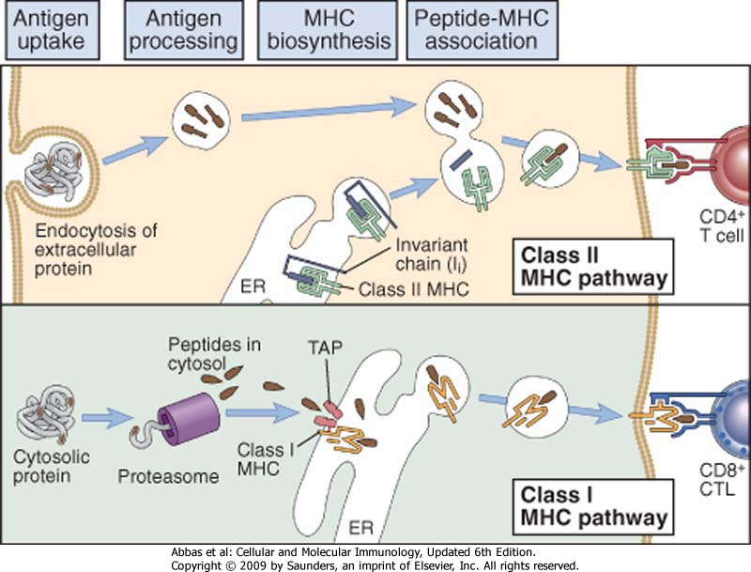

Slide 5
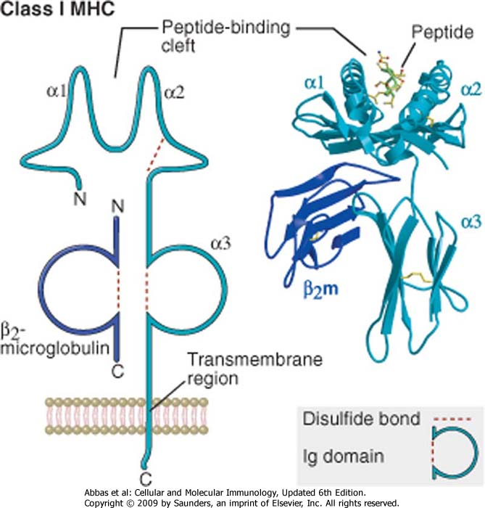
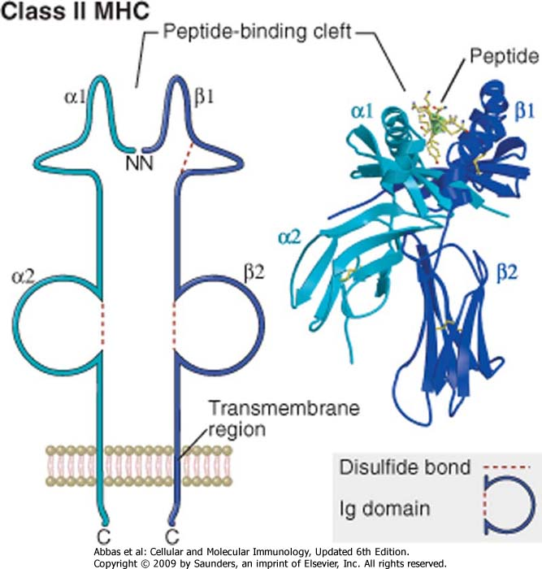

Slide 6
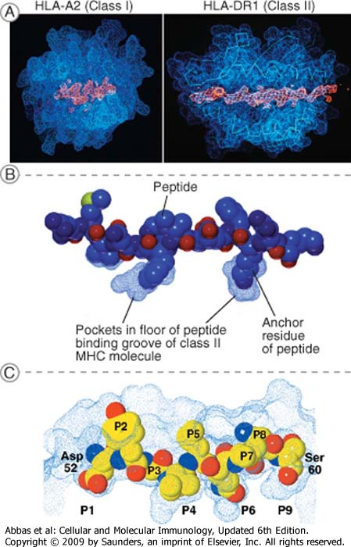

Slide 7
Antigen Presenting Cells
Dendritic cells:
costitutive MHC II; Increase with INFg
Co-stimulatory molecoles are constitutively expressed and inducible
Macrophages:
costitutive MHC II; Increase with INFg
co-stimulatory molecoles are inducible by LPS
B Lymphocytes:
costitutive MHC II; Increase with IL4
co-stimulatory molecoles are inducible by T lymphocytes interaction (CD40-CD40L)
Vascular endothelial cells:
costitutive MHC II; Increase with INFg
Co-stimulatory molecoles are constitutively expressed
Epithelial and mesenchymal cells:
costitutive MHC II; Increase with INFg
Co-stimulatory molecules seem not to be expressed

Slide 8
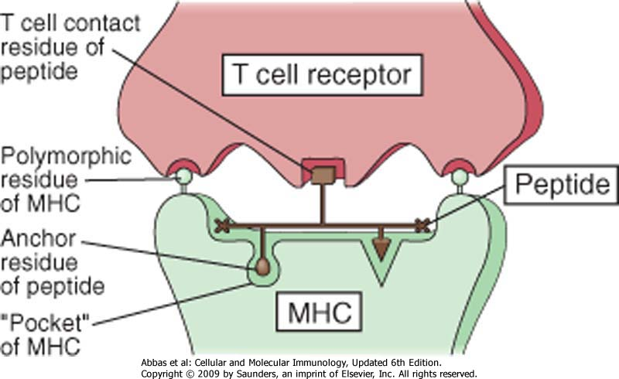

Slide 9
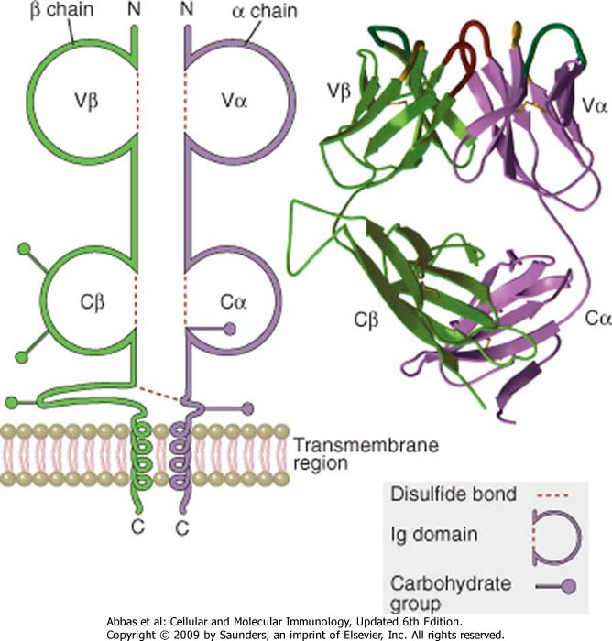
T-cell Receptor

Slide 10
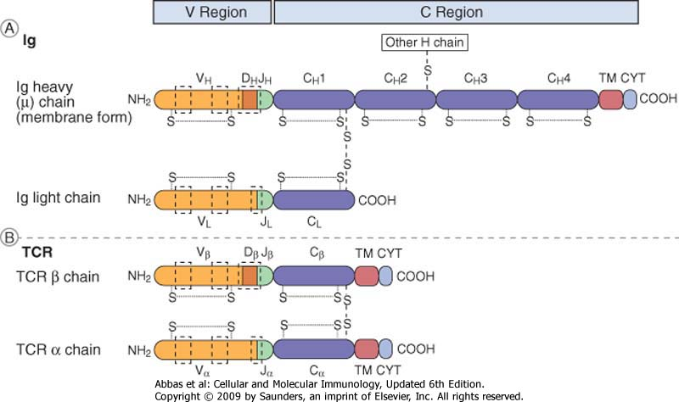

Slide 11
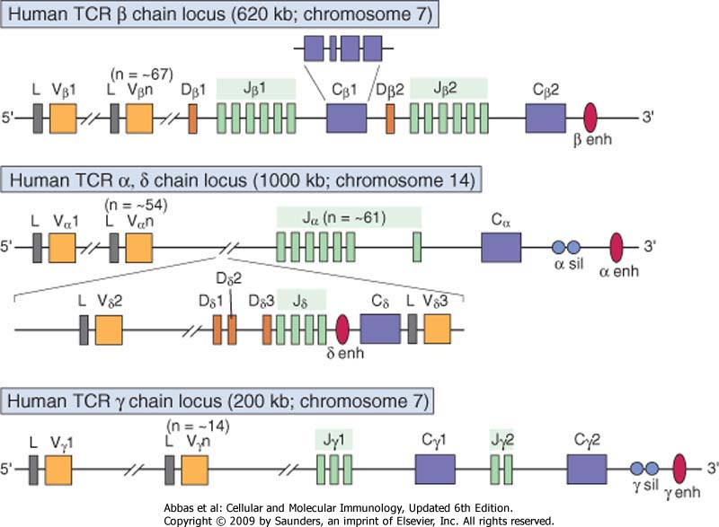

Slide 12
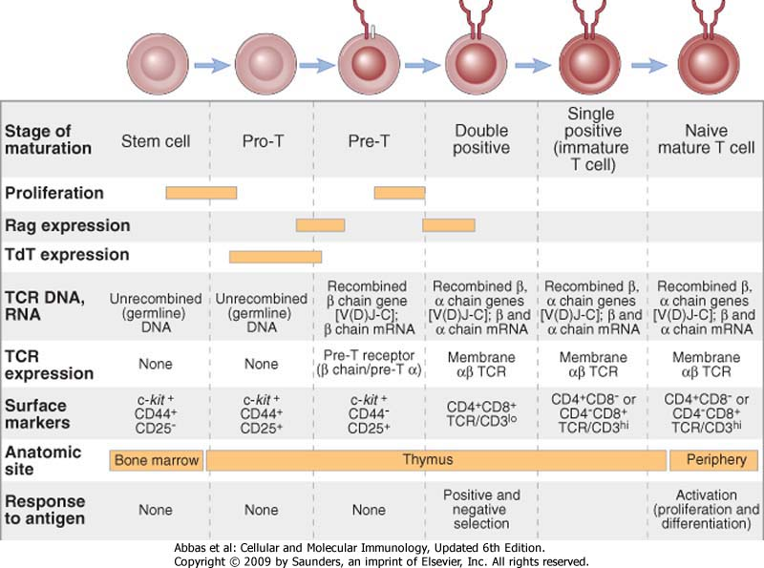
T-cell maturation

Slide 13
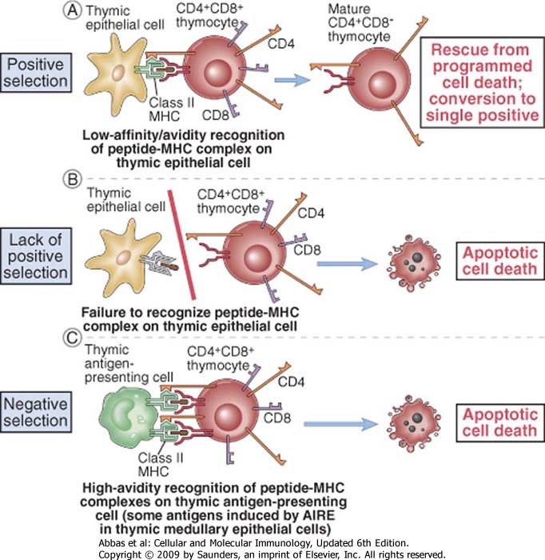

Slide 15
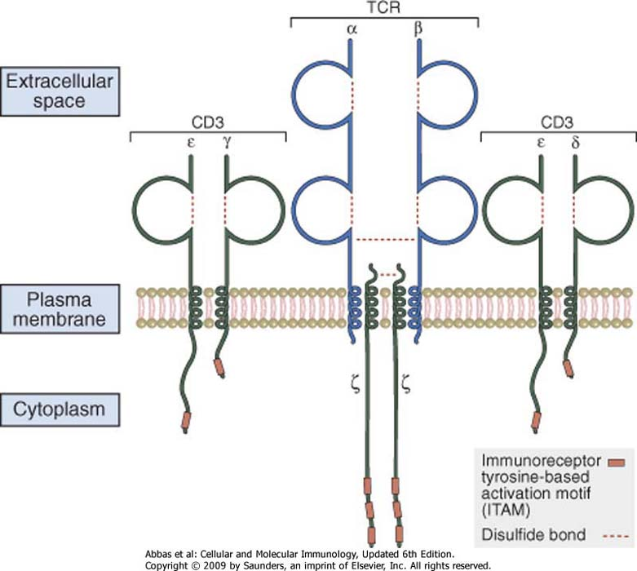

Slide 17
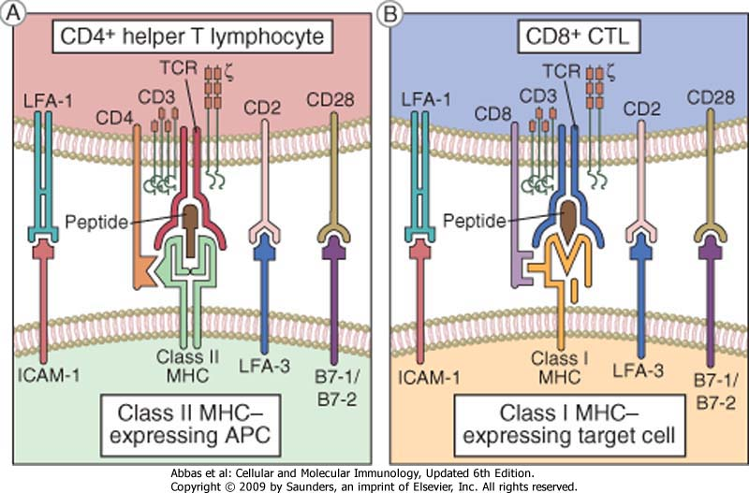

Slide 18
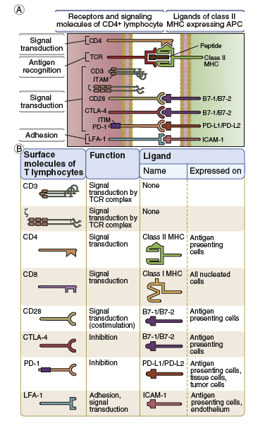
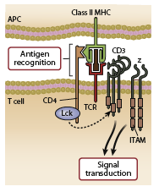

Slide 19
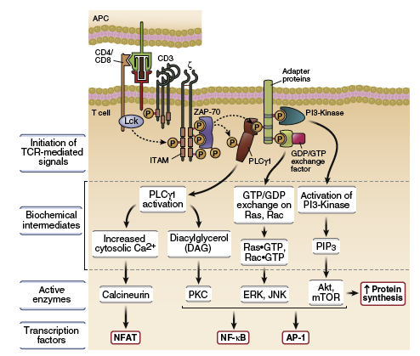

Slide 20
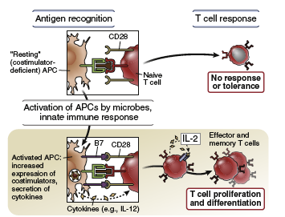
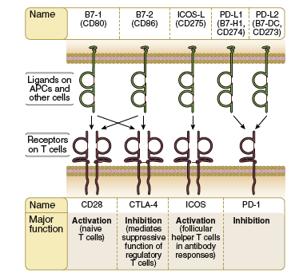

Slide 21
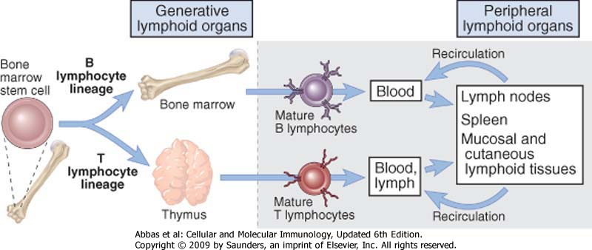
Lymphocytes maturation

Slide 22
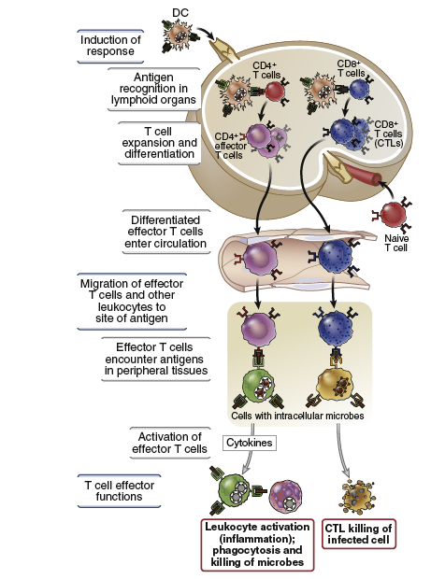

Slide 23
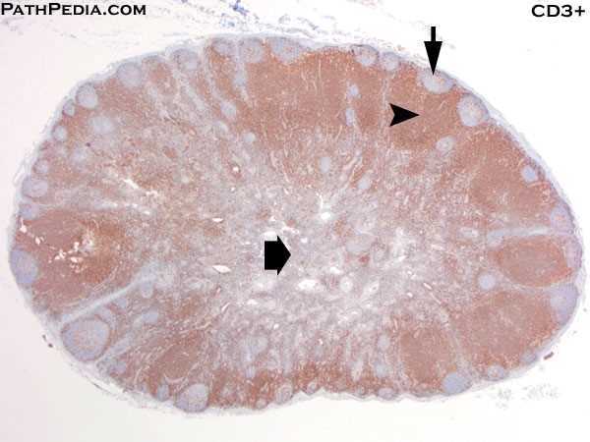
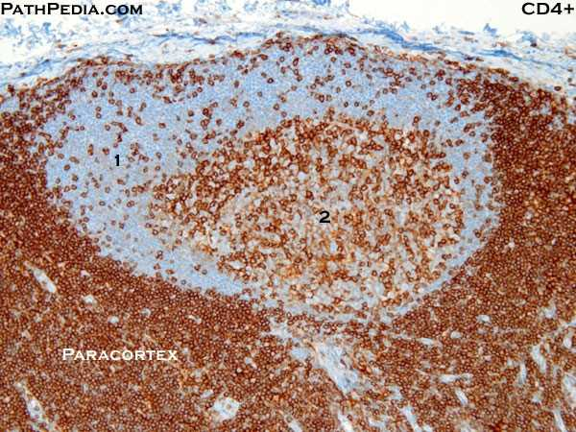

Slide 25
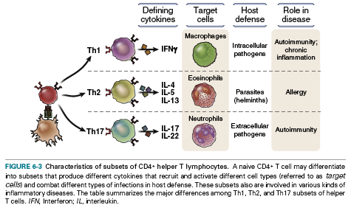

Slide 26
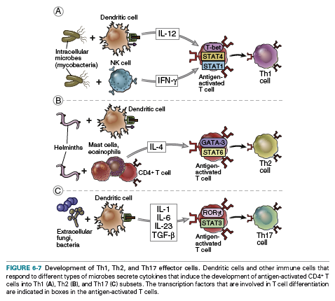

Slide 28
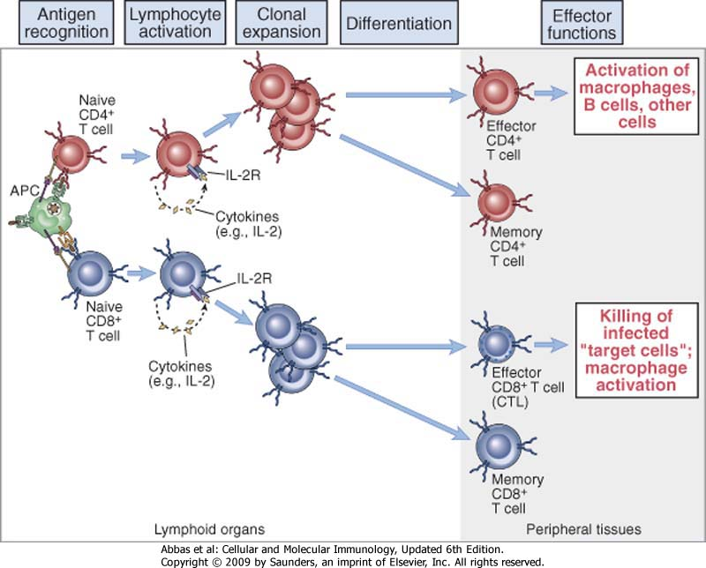

Slide 29
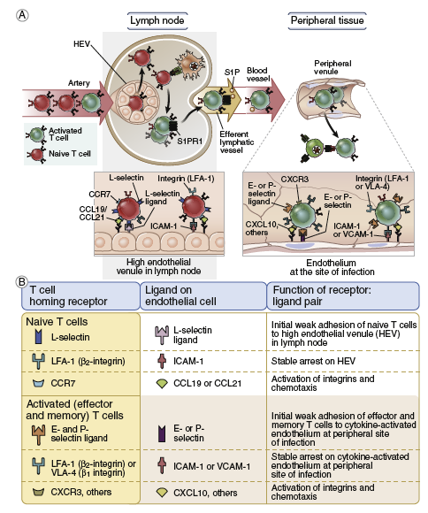

Slide 31
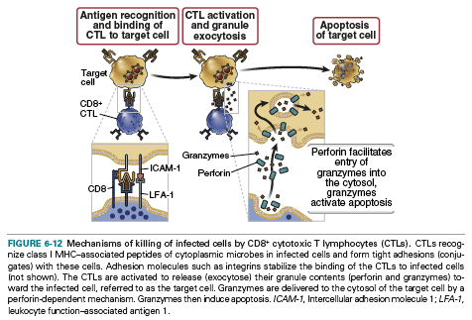

Slide 33
How APC present tumor Ags???

Slide 35
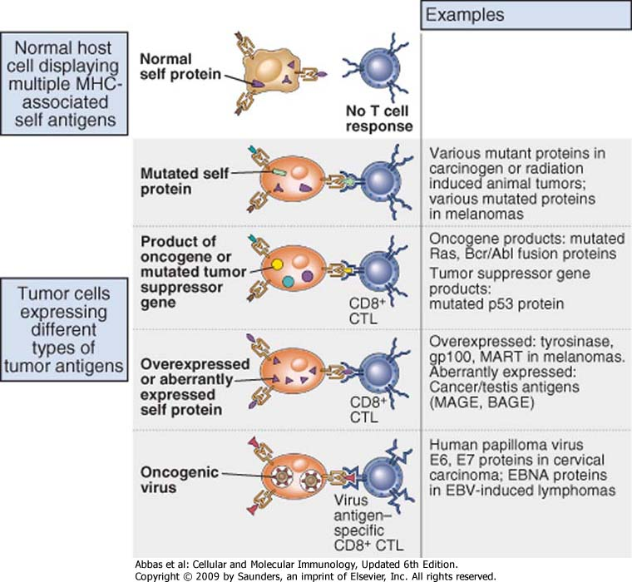
Tumor antigens recognized by CTL

Slide 37
Escape of immune response by cancer cells (tumor escape)
“Several data showed that tumors developed in immunodeficient mice were easily rejected with respect to tumors from WT mice, studying transplantation in WT mice.
It indicates that tumors developed in immune-sufficient mice generate less immunogenic tumor variants”
Abbas et al.
Molecular and cellular Immunology
6th edition

Slide 38
Escape of immune response by cancer cells (tumor escape) (1)
Tumor Ags may induce specific immune tollerance
(in particular viral Ags)

Slide 39
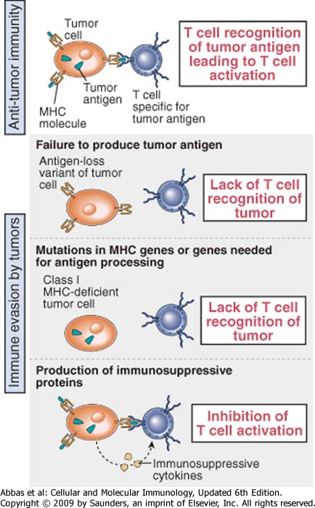
Tumor escape (2)
Tumor cells reduce the expression of tumor Ags
(particularly evident in tumor with very fast growth in which mut/del can be included in the sequence of TAA)

Slide 40
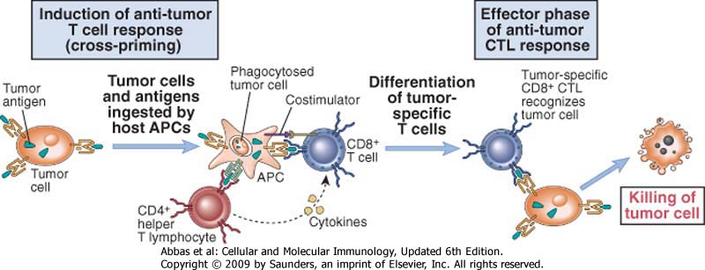
Induction of a T-response
against tumor

Slide 42
Tumor escape (3)
Some tumor cells reduce the expression of MHC I

Slide 43
Induction of a T-response
against tumor

Slide 44
Tumor escape (4)
Several tumor cells do not express the ideal co-stimulatory molecules, avoiding a correct response of CTL
(moreover, tumor cells over-expressing CD80 o CD86 induce a strong cell-mediated immune response)

Slide 46
Induction of a T-response
against tumor

Slide 47
Tumor escape (5)
products secreted by tumor cells can inhibit effector T-cell response
(es. TGF-B secreted by tumor cells inhibit proliferation and functional activation of CD8+ T-lymphocytes)

Slide 48
Induction of a T-response
against tumor

Slide 49
Tumor escape (5)
products secreted by tumor cells can inhibit effector T-cell response
(es. TGF-B secreted by tumor cells inhibit proliferation and functional activation of CD8+ T-lymphocytes)
… but also of macrophages
(APC but also part of the innate immunity)

Slide 51
Escape of immune response by cancer cells (tumor escape) (6)
Regulatory T lymphocytes inhibit T-cell response against cancer cells
(Studies in animal models or in patient’ samples evidenced and incresce number of Treg and their preferential localization in tumor microenvironment)

Slide 52
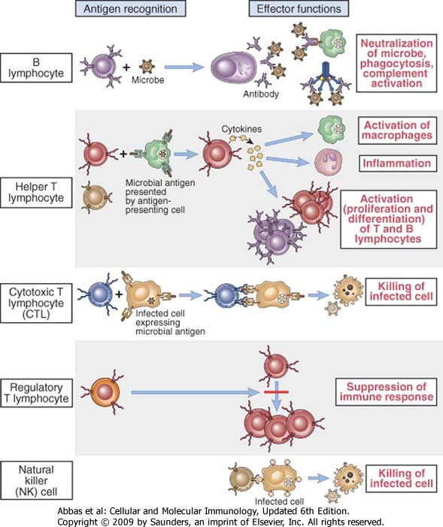
Classes of lymphocytes

Slide 53
Induction of a T-response
against tumor

Slide 55
Tumor escape (7)
increased expression of membrane complement inhibitors on tumor cells
(iper-espression of CD46, CD55 e CD59 neutralized the lytic activity of the complement system)

Slide 56
ALTERNATIVE
PATHWAY
LECTIN
PATHWAY
CLASSICAL
PATHWAY
Activating surfaces
Carbohydrates
Immune complexes
C3b C3H₂O
MBL
C1q
MASP
C4
C2
RECOGNITION
C1r
C1Inh
C4BP
B
C1s
D
C4
P
C2
CD55
C 3
OPSONIZATION
FactorH
CD46
C3a
C3b
C5a
INFLAMMATION
C5
S-Protein
Clusterin
CD59
C6C7
C8 C9
CYTOLYSIS
INFLAMMATION
C5b-9

Slide 57
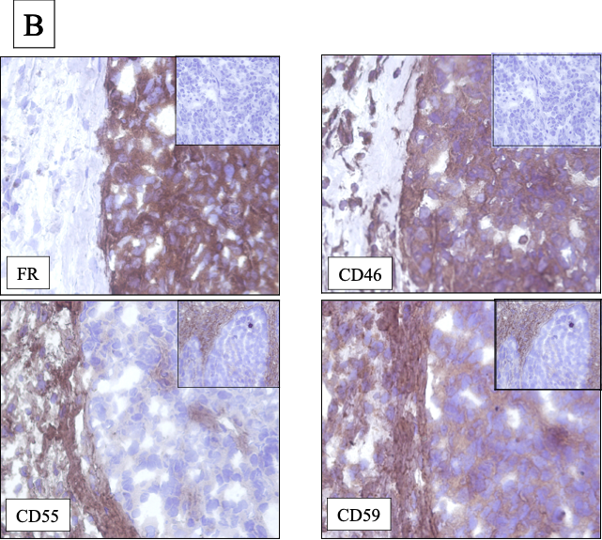

Slide 58
Question:
Is it possible enhance immune response against tumor cells and avoid tumor escape?
Answer:
Cancer Immunotherapy

