Slide 1
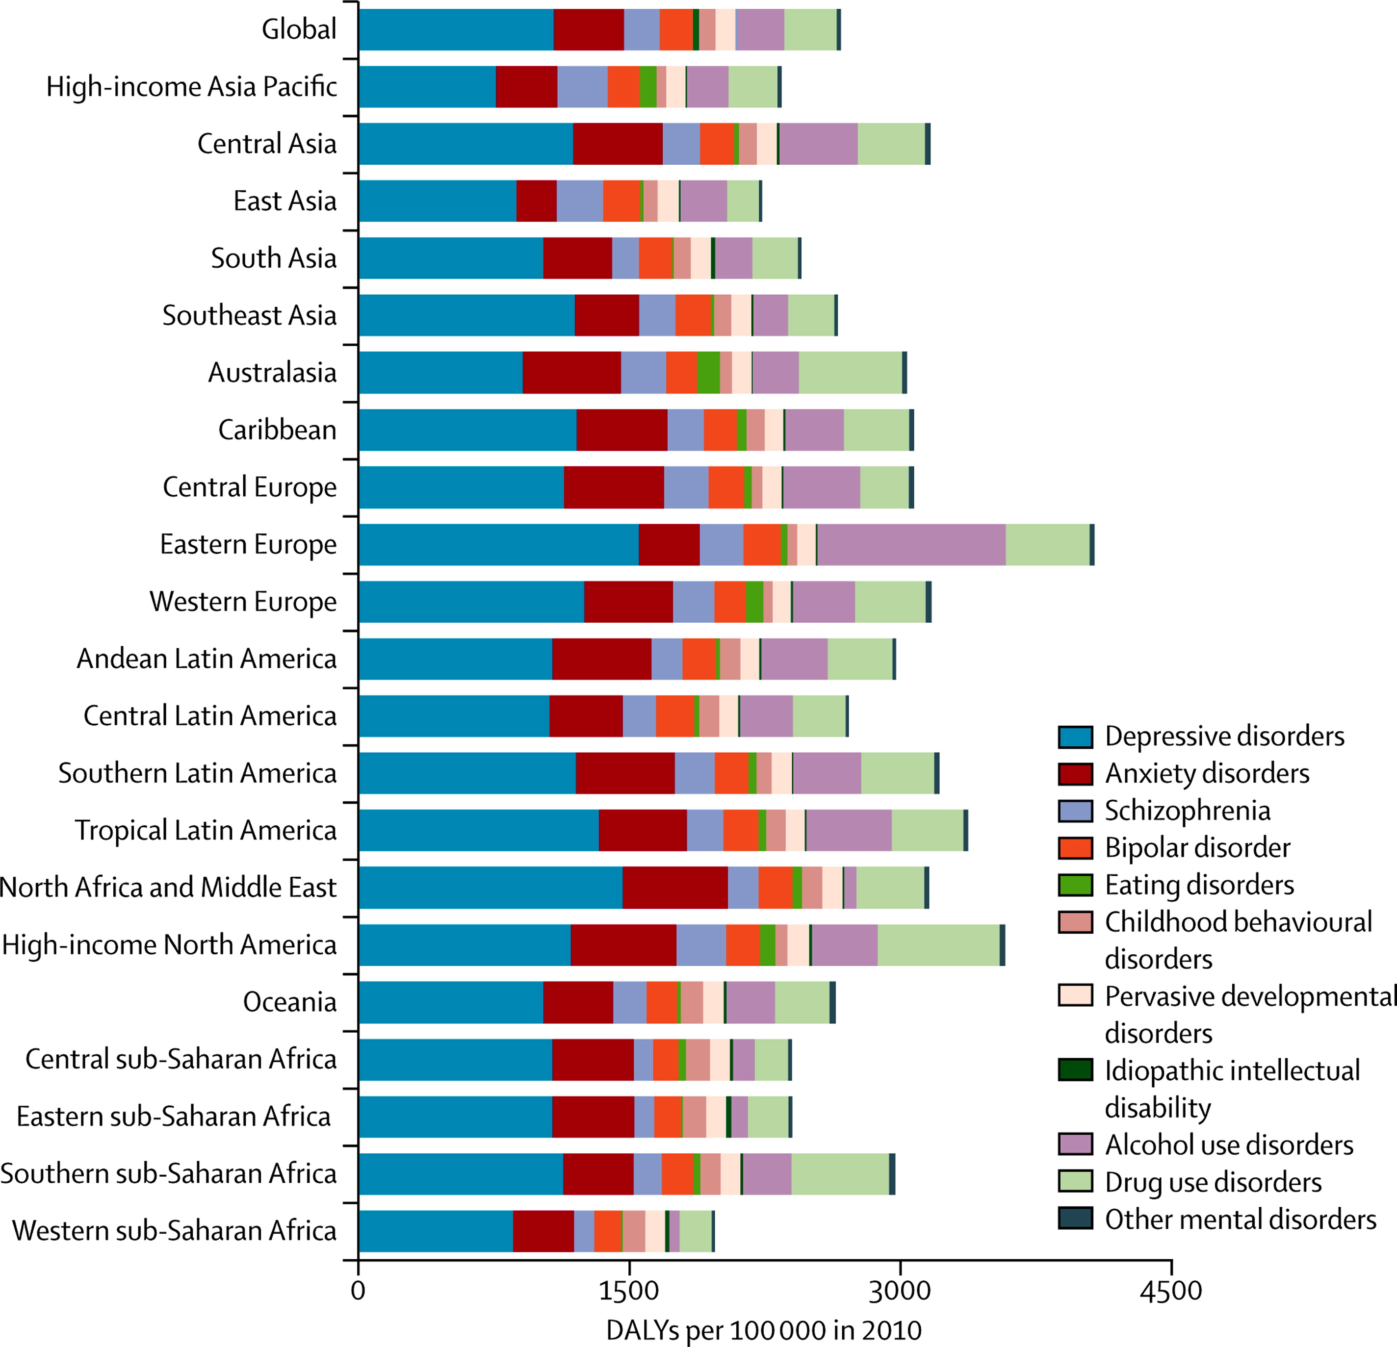
Notes:
1. comorbidity
2. Stress as a trigger
3. overlapping pharmacology
4. Different clinical simptoms
Anxiety is an adaptive response, serving to maximize survival through the avoidance of potentially harmful events. In unraveling the complexities of anxiety, it is important to distinguish anxiety from fear. Fear is a response triggered by the presence of an imminent, real threat, whereas anxiety revolves around the anticipation of potential harm in the future.
While anxiety is a necessary tool for human cognition, anxiety disorder describes the uncontrolled, excessive persistence of anxious responses such that an individual is no longer able to live a normal functioning life.

Slide 2
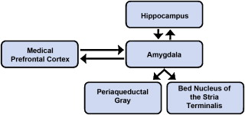
Neural systems involved in detecting threats
and regulating behavioral and autonomic responses
Hippocampus
Memory consolidation of emotional events
Medial Prefrontal Cortex
Amygdala
Medial
Periaqueductal
Gray
Bed Nucleus of the Stria Terminalis
Autonomic, somatic signs of anxiety
Autonomic, somatic signs of fear
stereotyped defensive reactions to threat (immobility and panic)
autonomic and motor responses to threat (tachicardia, sweating)
unconditioned (innate) anxiety responses
conditioned (learnt) anxiety responses
Notes:
In both A and D the neural systems involved in detecting threats, and regulating behavioral and biological responses to threat. Central to this network is the amygdala, which responds quickly to potential threats in the environment and plays a key role in determining whether environments are perceived as safe or dangerous.
It is well documented the hyperactivity of amygdala in anxiety with its interactional behavior varying across anxiety disorder subtypes . It is theorized that amygdala dysfunction may drive the inappropriate threat perception and emotional dysregulation believed to lie at the heart of many anxiety disorders.
The amygdala functions in concert with other brain regions including the hippocampus and medial prefrontal cortex, which can up-regulate or down-regulate amygdalar responses to threat. Moreover, behavioral and biological responses to threat depend on activation of other brain areas, including the bed nucleus of the stria terminalis, which coordinates autonomic and motor responses to threat, and the periaqueductal gray, which coordinates stereotyped defensive reactions to threat, such as immobility and panic. Activity in this threat-related neural network is potentiated for individuals with anxiety disorders, as well as for persons exhibiting high levels of trait anxiety.

Slide 3
ANXIETY
Anxiety is an adaptive response that enables the individual to recognize danger and deal with an unknown vague internal or external threat
Normal anxiety is an advantageous response to a threatening situation that accompanies many aspects of life
Pathological anxiety is an inappropriate response to an internal or external stimulus
Anxiety disorders are characterized by feelings of anxiety and fear and inappropriate severe and prolonged anticipation of negative event
Symptoms can range from mild to severe.
It is more a chronic than an episodic disorder
Notes:
Anxiety is an adaptive response, serving to maximize survival through the avoidance of potentially harmful events [1]. In unraveling the complexities of anxiety, it is important to distinguish anxiety from fear. Fear is a response triggered by the presence of an imminent, real threat, whereas anxiety revolves around the anticipation of potential harm in the future
Stress at work, from school, in a personal relationship such as marriage, Financial stress, Stress from a serious medical illness
Respiratory (asthma), Endocrine, Cardiovascular (heart attack), Metabolic (hypoglycemia), Neurologic, Drug Withdrawal:
Benzodiazepines, narcotics, barbiturates, alcohol
While anxiety is a necessary tool for human cognition, anxiety disorder describes the uncontrolled, excessive persistence of anxious responses such that an individual is no longer able to live a normal functioning life.

Slide 4
Anxiety Disorders
Generalized anxiety disorder (GAD): general symptoms of motor tension, autonomic hyperactivity, etc. for at least one month
Phobic anxiety:
Simple phobias (Agoraphobia, fear of animals, etc.)
Social phobias
Panic disorders: Characterized by acute attacks of fear as compared to the chronic presentation of GAD
Obsessive-compulsive behaviors (OCB): repetitive ideas (obsession: a persistent idea, image or desire) and behaviors (compulsion: a strong impulse to perform an act, especially one that is irrational or contrary to one's will)
Post-traumatic stress disorders (PTSD)
Notes:
Verbal complaints: The patient says he/she is anxious, nervous, edgy
Somatic and autonomic effects: The patient is restless and agitated, has tachycardia, increased sweating, weeping and often gastrointestinal disorders
Social effects: Interference with normal productive activities
Obsession:
a persistent disturbing preoccupation with an often unreasonable idea or feeling: fear of getting sick.Thinking about hurting a loved one or stranger.Focusing on some type of aggressive sexual act (with someone you know or strangers).Need for organization or symmetry.Worry over little things (did I lock the door, etc.).
Social anxiety is the fear of social situations that involve interaction with other people: fear and anxiety of being negatively judged and evaluated by other people. It is a pervasive disorder and causes anxiety and fear in most all areas of a person's life.
a mental health condition that's triggered by a terrifying event — either experiencing it or witnessing it. Symptoms may include flashbacks, nightmares and severe anxiety, as well as uncontrollable thoughts about the event.

Slide 5
GENERALIZED ANXIETY DISORDER
First-line therapy | Second-line therapy
SSRI (citalopram, paroxetine) SNRI (venlafaxine) with good risk/benefit ratio, efficacy and tolerability Note: slow onset of activity and early discontinuation has high risk of relapse (treatment for one year, gradual discontinuation) | benzodiazepines (early onset of action but adverse effects) partial 5-HT1A receptor agonist (buspirone) for comorbidity with alcohol dependence and add-on SSRI therapy Inhibitors of VDCC (Gabapentin and pregabalin) atypical antipsychotic drug (quetiapine) in refractory patients
OBSESSIVE-COMPULSIVE DISORDER
SSRI ( fluoxetine, paroxetine, sertraline) | glutamate- modulating agents: topiramate, riluzole (inhibition of glutamate release), memantine (blocker) and cycloserine (partial agonist) 5-HT 3 receptor antagonist (ondansedron)

Slide 6
PANIC DISORDER
First-line therapy | Second-line therapy
SSRI ( fluoxetine, paroxetine, sertraline) | MAOI (dietary restriction), benzodiazepines (alprazolam) Anticonvulsants (valproate) Novel target: adenosine receptors
POST-TRAUMATIC DISORDER
SSRI | MAOI (dietary restriction) Anticonvulsants (lamotrigine BUT available data are limited) From animal studies: prevention (beta- blockers, hydrocortisone I.v.)
SOCIAL DISORDER
SSRI | MAOI (dietary restriction), RIMA (moclobemide) clonazepan (add-on therapy)
Notes:
Prazosin nightmares

Slide 7
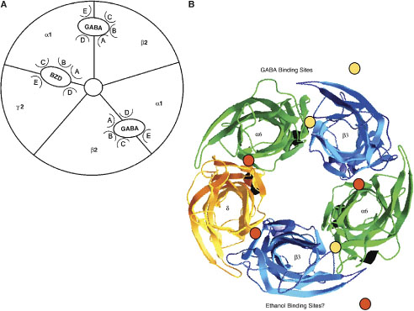
GABA-A receptors
The GABAA-R are members of the Cys-loop pentameric LGIC superfamily, including nicotinic Ach receptors, inhibitory glycine receptors, and ionotropic 5-HT3 receptors
19 different GABA_{A} receptor subunits have been identified in mammals:
α (1–6), β (1–3), γ (1–3), δ, ε, ρ (1–3), θ and π
The majority of the native receptors are composed of α, β and γ subunits with at least one of 3 general compositions subunit in a 2:2:1 stoichiometry :
2α2β1γ
2α1β2γ
1α2β2γ
Notes:
In each subunit of GABAA-R the transmembrane M2 forms the lining of the ion channel that is permeated by Cl ions
GABAA receptors are involved in anxiety, feeding and drinking behaviour, circadian rhythm, cognition, vigilance, learning and memory
GABAA receptors are a target for a variety of drugs such as benzodiazepines (BDZ), barbiturates, neuroactive steroids, anticonvulsants and anaesthetics
Deficits in the functional expression of GABAA receptors have been implicated in multiple neurological and psychiatric diseases
On the basis of the sequence similarity, these are divided into eight subunit classes:
GABAA receptor subunits assemble in a restricted and non-random way to generate a series of specific GABAA receptor subtypes (only 500 of the 150 000 theoretically possible receptor subtypes can be found in the CNS)
GABAA receptor subtypes have distinct patterns of expression in the brain, different domains of expression within the neuron and subserve different functions
GABAA receptor subtypes have different pharmacological properties
The benzodiazepine binding site occurs at the interface between the α and γ2 subunit

Slide 8
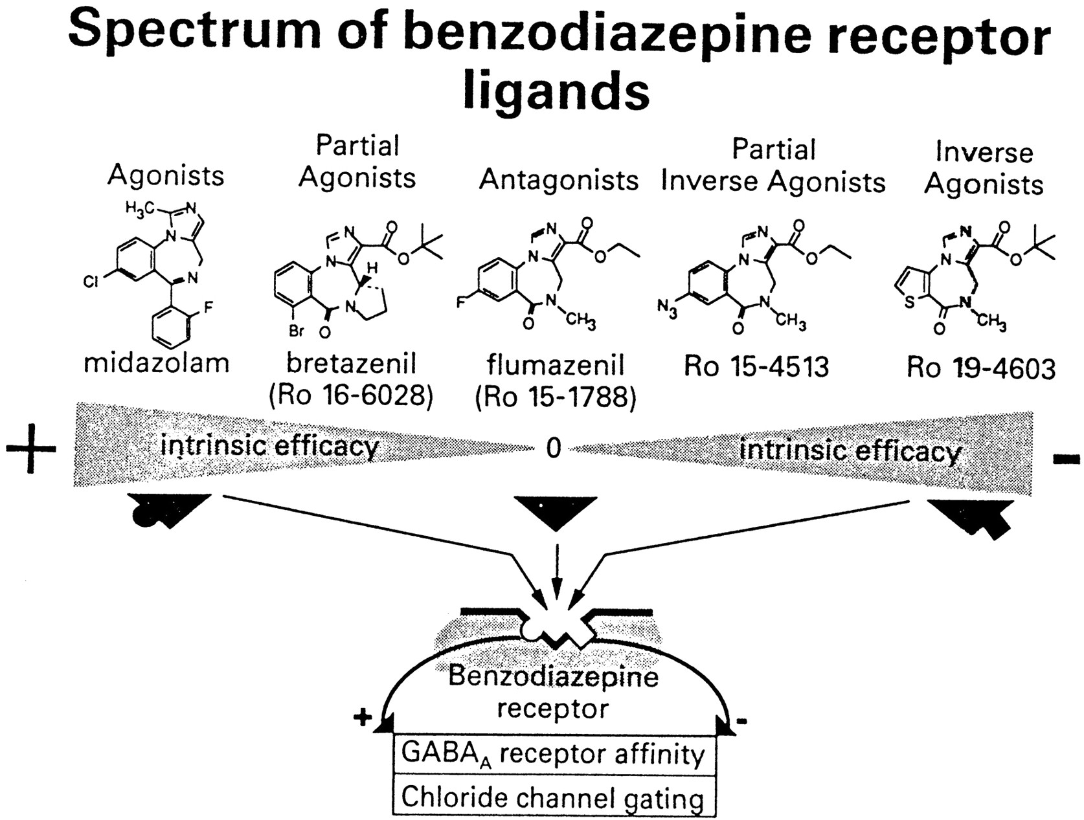
The benzodiazepine binding site
1
1
Notes:
Some BDZ are positive allosteric modulators: enhance GABAergic activity but cannot elicit chloride ion influx in the absence of GABA (have no intrinsic activity)
Compounds that reduce GABA-induced chloride flux are called inverse agonists or negative allosteric modulators
Allosteric antagonists do not elicit behavioural effects on their own, but prevent interaction of agonists or inverse agonists

Slide 9
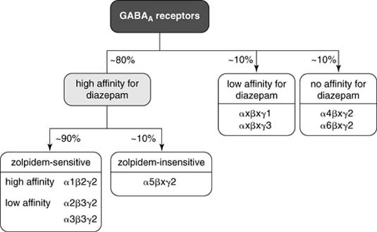
The benzodiazepine binding site
The α subunit is the main determinant of the variability of the benzodiazepine site’s
affinity and efficacy
Notes:
BDZ-site binds to two distinct classes of ligands with:
1) benzodiazepine chemical structure (e.g. diazepam)
2) non-benzodiazepine structure (e.g. zolpidem)
Both classes allosterically modulate the response of the channel to GABA

Slide 10
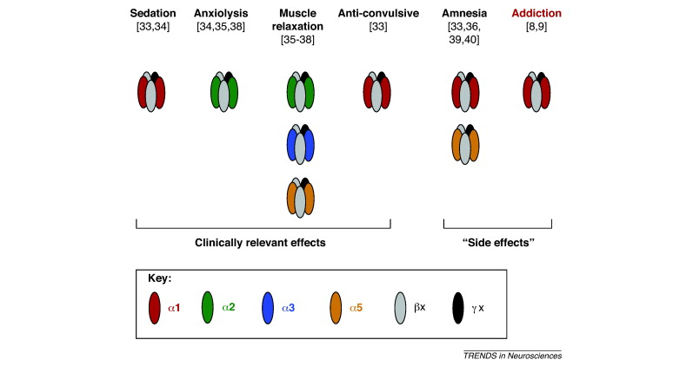
BDZs Functions associated with different
α subunits
Anti-convulsive
Sedation
/
Hypnosis
Anxiolysis
Addiction
Muscle
relaxation
Amnesia
1
2
3
5
Alfa subunits
Notes:
The GABAA receptor α1-containing subtype mediates the sedative/hypnotic, anticonvulsant, amnesic and abuse liability effect of BZDs (The α1-preferring BDZ-like drug zolpidem is much more potent hypnotic than anxiolytic)
The GABAA receptor α2-containing subtype mediate the anxiolytic effect of BDZs (highly expressed in the amygdala and cortical regions)
The GABAA receptor α5 subunits are preferentially localized in the hippocampus, suggesting its role in BDZs mediated anterograde amnesia
An inverse agonist selective for the α5 subtype may enhance hippocampally based cognitive functions
Several cognition enhancing compounds have been described, such as L-655,708, a5IA and RO4938581

Slide 11
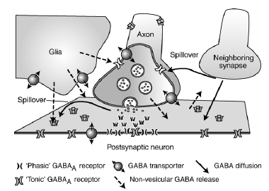
GABA-ergic synaptic and extrasynaptic neurotransmission
Phasic inhibition is mediated by release of GABA into the synaptic cleft with rapid desensitization of postsynaptic receptors
Tonic inhibition is mediated by GABA spillover from the synapse or nonvescicular pathways acting on receptors containing δ and α6 (and β) subunits with persistent conductance
These nondesensitizing currents modulate the electrical potential of pre- and postsynaptic
membranes
Notes:
Receptors containing the δ subunit also contain α6 and β subunits have extrasynaptic localization
Receptors containing δ subunits exhibit
1) a smaller single channel conductance
2) a much longer open time
3) do not desensitize on the prolonged presence of GABA
These receptors mediate tonic inhibition through a prolonged activation by GABA present in the extracellular space
TRACAZOLATE anxiolytic anticonvulsant

Slide 12
Properties of BDZs
Wanted effects | Unwanted effects
Anxiolysis | Tolerance and dependence
Sedation/hypnosis | Sedation
Amnesia | Cognitive impairment
Muscle relaxation | Ataxia
Seizure protection

Slide 13
Normal
|
Relief from Anxiety
|
SEDATION
(Drowsiness/decrease reaction time)
|
HYPNOSIS
|
Confusion, Delirium, Ataxia
|
Surgical Anesthesia
|
Depression of respiratory
and vasomotor centers in the brainstem
|
COMA and DEATH
Notes:
BDZs have a wide safety margin and indeed have little effect on respiratory or cardiovascular function compared to barbiturates and other sedative-hypnotics

Slide 14
 | Elimination half-time (h) | Clearance (ml/kg/min) | Vd (L/kg) | Plasma protein binding %
Midazolam | 1.7-2.6 | 5.8-9.0 | 1.1-1.7 | 96
Diazepam | 20-50 | 0.2-0.5 | 0.7-1.7 | 98
Lorazepam | 11-22 | 0.8-1.8 | 0.8-1.3 | 90
Flumazenil | 0.7-1.3 | 13-17 | 0.9-1.1 | 40
Notes:
Midazolam
Diazepam
Lorazepam
Flumazenil
Drug overdose is treated with flumazenil (a BDZ receptor antagonist, short half-life), but respiratory function should be adequately supported and carefully monitored

Slide 15
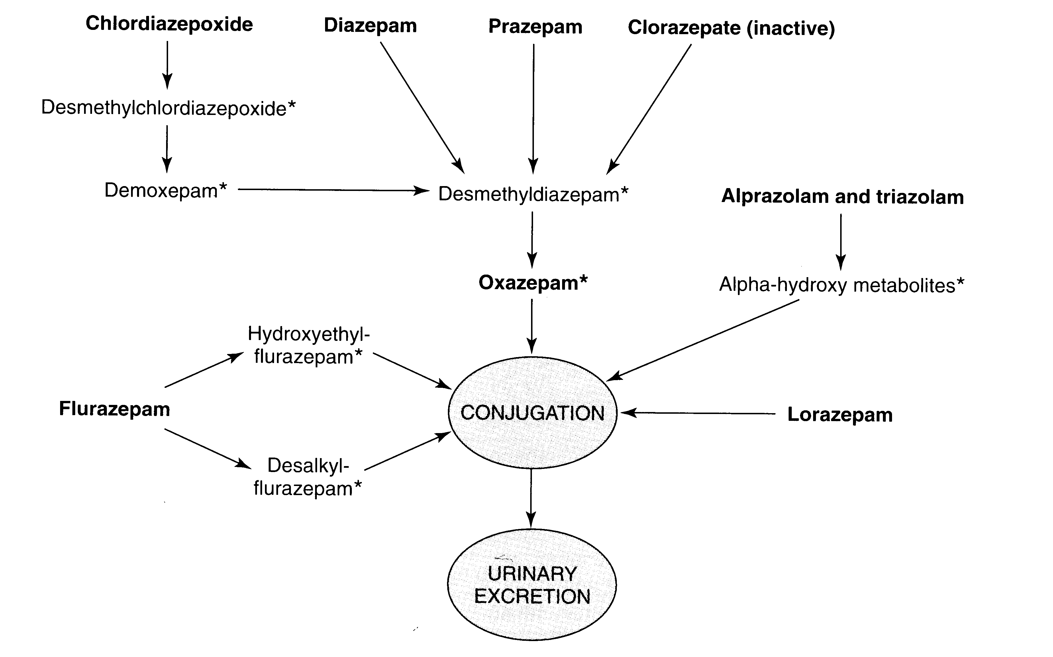
Biotransformation of BZDs
Notes:
Many BDZs have active metabolites with half-lives greater than the parent drug
Diazepam (Valium) has active metabolites (desmethyl-diazepam and oxazepam) and is long acting (t½ = 20-80 hr)
Differing times of onset and elimination half-lives (long half-life => daytime sedation)
Estazolam, oxazepam, and lorazepam, which are directly metabolized to glucoronides, have the least residual effects (drowsiness)
All of these drugs and their metabolites are excreted in urine

Slide 16
What Are BDZs for?
Hypnotic Midazolam
Anxiolytic Alprazolam (Xanax), Nitrazepam, Fluorazepam
Hypnotic - Anxiolytic Lorazepam, Oxazepam, Temazepam
Anxiolytic - Muscle relaxant Diazepam (Valium), Chlordiazepoxide (Librium)
Anticonvulsant - Anxiolytic Diazepam, Clonazepam (mania)
Notes:
Most hypnotic BDZs have rapid absorption and onset of action
More slowly absorbed BDZs are less useful for insomnia
Rate of adsorption
Clinically important differences between BDZs result from their pharmacokinetic properties

Slide 17
Side Effects of Benzodiazepines
BDZs have a wide margin of safety if used for short periods
Long-term use (> 2 weeks) increases risk for adverse effects:
Misuse, abuse, dependence
Motor impairment (reaction time)
Cognitive impairment (sedation, amnesia)
Pharmacodinamic drug interactions with other CNS depressants (alcohol, other anxiolytic drugs, OTC antihistaminic and anticholinergic drugs)
Pharmacokinetic drug interactions with SSRI’s and oral contraceptives (decrease metabolism of BDZs)
Withdrawal syndrome
Notes:
Related primarily to the CNS depression and include: drowsiness, excess sedation, impaired coordination, nausea, vomiting, confusion and memory loss
Tolerance develops to most of these effects
Dependence with these drugs may developed
BDZ's have additive effects with other CNS depressants => have a greatly reduced margin of safety
Combination of anxiolytic drugs should be avoided
Concurrent use with OTC antihistaminic and anticholinergic drugs as well as the consumption of alcohol should be avoided
SSRI’s and oral contraceptives decrease metabolism of BDZs
Serious withdrawal syndrome can include convulsions and death

Slide 18
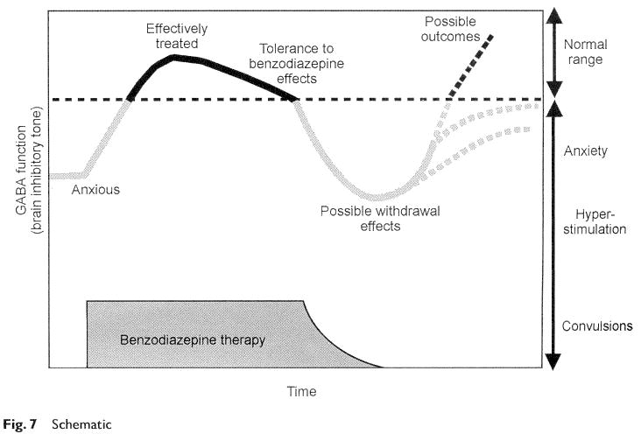
Tolerance and Withdrawal syndrome

Slide 19
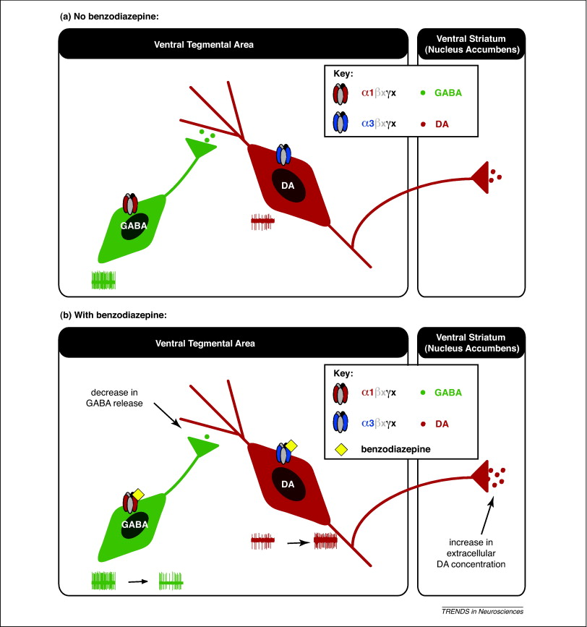
abuse and dependence
BDZs receptors in the VTA dopaminergic reward circuit

Slide 20
Hypnotic drugs
Short-acting benzodiazepines Lorazepam, temazepam
Allosteric modulator of GABA-A receptor Zolpidem, Zopiclone (BDZs site) Chlormethiazole
Melatonin receptor agonists Melatonin, Ramelteon
Orexin receptor antagonists Suvorexant
Histamine H1 receptor antagonists Prometazine, Doxepin
Notes:
Most hypnotic BDZs have rapid absorption and onset of action
More slowly absorbed BDZs are less useful for insomnia
Rate of adsorption
Clinically important differences between BDZs result from their pharmacokinetic properties

