Slide 1
Mood disorders - Depression
Depression is a common and heterogeneous psychiatric disorder
Affects approximately 15% of the population with high morbidity and mortality
Occurs at any age, is twice as common in women
The underlying causes of most mood disorders remain unknown
Clinical classification (most common)
1. Major depressive disorder (unipolar depression)
2. dysthymia, a less severe but more chronic form of depression
3. bipolar disorders or maniac-depressive disorders

Slide 2
Symptoms of depression
EMOTIONAL
Lose Interest and Motivation
Lose Self Confidence / Feelings of worthlessness
Experience Feelings of Guilt
Thoughts of Suicide (7-15% commit suicide)
Loss of ambition
Little pleasure from sex or food
Excess sadness in response to loss, failure, or disappointment
BIOLOGICAL
Sleep Disturbance
Appetite and Weight Change
Lack of Energy, fatigue
Poor Concentration and Memory

Slide 3
Diagnostic and Statistical Manual of Mental Disorders (DSM-IV): criteria for major depression
At least five of the following symptoms for at
least two weeks (symptom 1 or 2 must be present):
Depressed mood
Loss of interest or pleasure
Significant appetite or weight loss or gain
Insomnia or hypersomnia
Psychomotor agitation or retardation
Fatigue or loss of energy
Feelings of worthlessness or excessive guilt
Impaired thinking or concentration, indecisiveness
Suicidal thoughts/thoughts of death
Notes:
Absence of happiness is more reliable symptom than increased sadness

Slide 4
Depression: etiology
Emotional Trauma Rape, Assault, etc.
Other Illnesses Prescription Drugs
Genetic factors
Poor Nutrition as a Child
depression
Hormonal
Imbalances
Stress &
Aging Deplete Nutrients
Loss - Job, Home,
Divorce, Death
Endogenous –
No External Cause
Notes:
Depression is triggered by a complex pattern of genetic, developmental, and environmental factors
Heritability estimates demonstrate up to a 50% genetic component
The heritable component, coupled with environmental influences, results in increased susceptibility to develop the illness in response to stressful/adverse environmental conditions
Adverse early life experiences influence neurobiological systems, leading to the neurobiological and behavioral manifestations of depression
Similar symptoms can result from hormonal problems, head injuries, brain tumors, or other illnesses
Often comorbidity with other disorders such as schizophrenia, substance abuse, anxiety or Parkinson’s disease

Slide 5
Genetic factors
Predisposition depends on a variety of genes:
⭕️ The serotonin transporter (SERT) gene
⭕️ The serotonin 2A receptor
⭕️FK-506 binding protein (FKBP5)

Slide 6
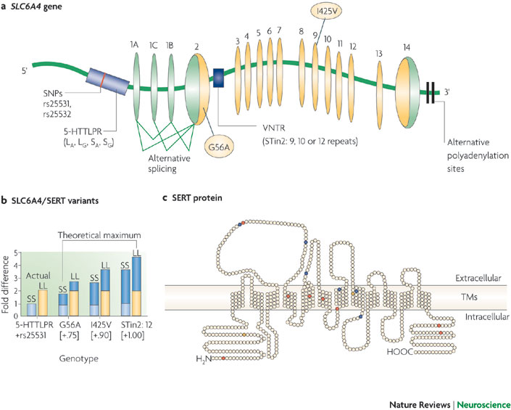
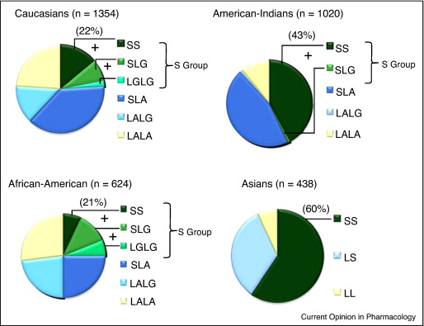
Polymorphisms in the gene encoding SERT
SNPs: single nucleotide polymorphisms
H5-HTTLPR: serotonin-transporter-gene-linked polymorphic region (Long and Short variants)
VNTR: variable number of tandem repeats
Alternative polyadenylation sites
Alternative splicing
Notes:
a The structure of the SLC6A4 gene, including the sites of the major functional variants: the serotonin-transporter-gene-linked polymorphic region (5-HTTLPR), the variable number of tandem repeats (VNTR) (between 9 and 12 repeats can be found in intron 2 (STin2)) and the single nucleotide polymorphisms (SNPs)
b | Relative potential additive SERT expression and function for the major SLC6A4 polymorphisms. There is a theoretical 4.65-fold difference in function between individuals with a combination of the less active allele of each variant and individuals with the most active variants1, 2, 4, 10, 11.
The left-most two bars bars depict the actual differences in SERT expression and function that were measured in human lymphoblasts from large numbers of individuals, with the light-blue bar representing the 5-HTTLPR short/short (SS) + rs25531 genotype and the yellow bar representing the 5-HTTLPR long/long (LL) + rs25531 genotype; the six bars on the right combine this information with the functional consequences of the additional variants (G56A, I425V and STin2) that are predicted from in vitro measurements (dark-blue segments). c |
The SERT protein, with its 12 transmembrane (TM) segments, its extracellular loops and its intracellular amino- and carboxy-terminal tails. SNPs that change amino acids are denoted by red circles (except the functionally validated G56A and I425V SNPs, which are coloured yellow); those in blue are synonymous. Panels a and c modified, with permission, from Ref. 4 © (2004) American Society for Pharmacology and Experimental Therapeutics. Data in part b from Refs 1,2,4,10,11.

Slide 7
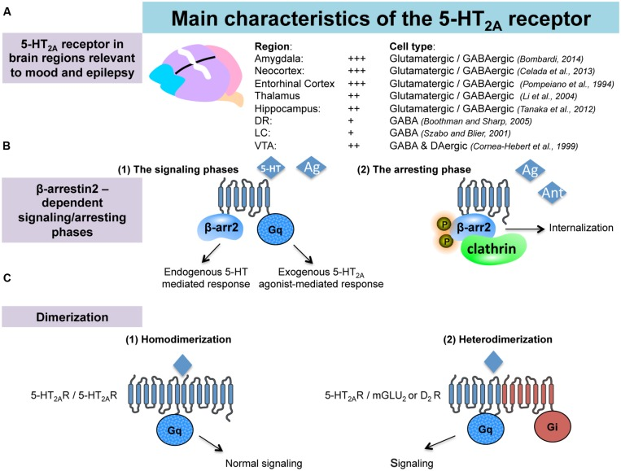
Notes:
(5-HT2A R, according to their location in the brain, have been implicated in various central physiological functions including memory, sleep, nociception, eating and reward behaviors, but also in many neuropsychiatric disorders, in particular depression and epilepsy with a bidirectional link since patients with depression and especially suicide attempters have an increased seizure risk, while a significant percentage of epileptic patients suffer from depression.
5-HT2A-R may directly or indirectly control neuronal excitability in most networks involved in depression and epilepsy through interactions with the monoaminergic, GABAergic and glutamatergic neurotransmissions.
A major feature of the 5-HT2A-Rs lies in their interactions with β-arrestin. β-arrestin-2 mediates intracellular trafficking of the 5-HT2A-Rs and the cellular events play a role in response to 5-HT and that this effect is agonist -dependent (functional agonism).
Another mechanism by which the 5-HT2-Rs can regulate their signaling: these receptors can form stable homo- and heteromeric complexes with other types of GPCRs including the mGluR2 and D2-DA Rs. The in vivo functional consequences of such oligo-dimerization of 5-HT2A-Rs has yet to be determined but it has been reported that head-twitch induced by the preferential 5-HT2A-R agonists lysergic acid diethylamide (LSD) and DOI is completely abolished in mGlu2 knock-out mice.
5-HT2A-Rs activation is associated with with depressive-like phenotypes (increased immobility time in the mouse FST). this effect was abolished by a pre-treatment with antagonists that con induce antidepressant-like activities
Genetic studies have found a significant association between MD and three single nucleotide polymorphisms (SNPs) at the gene encoding for the 5-HT2A-Rs for both susceptibility and severity of major depressive episodes in MD
role of these receptors in antidepressant and antiepileptic responses.

Slide 8
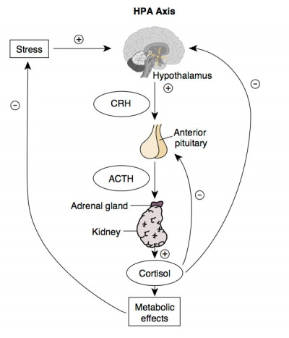
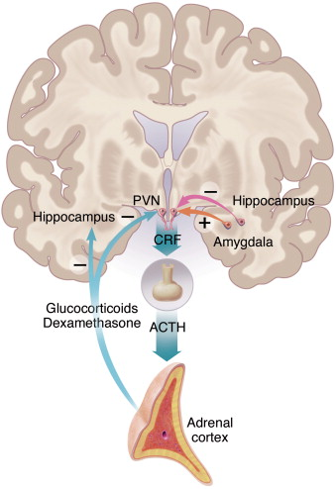
The Hypotalamic - Pituitary - Adrenal Axis
(HPA)
Negative feedback
paraventricular nucleus of the hypothalamus
PVN
Corticotropin Releasing Hormone CRH
Adrenocorticotrophin ACTH

Slide 9
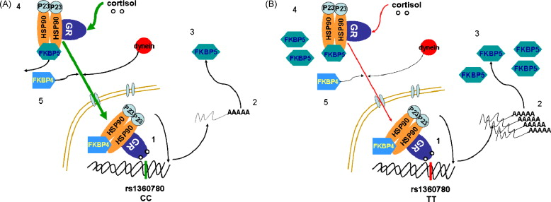
FKBP5 regulates glucocorticoid receptor (GR) sensitivity
FKBP5 mediates an ultra-short feedback negative loop for GR-sensitivity
Polymorphisms in the gene encoding FKBP5 associate with differential upregulation of FKBP5 following GR activation and differences in GR sensitivity and resistance
Notes:
FK506 binding protein 51 or FKBP5 is a co-chaperone of hsp90 which regulates glucocorticoid receptor (GR) sensitivity. When it is bound to the receptor complex, cortisol binds with lower affinity and nuclear translocation of the receptor is less efficient. FKBP5 mRNA and protein expression are induced by GR activation via intronic hormone response elements and this provides an ultra-short feedback loop for GR-sensitivity.
Polymorphisms in the gene encoding this co-chaperone have been shown to associate with differential upregulation of FKBP5 following GR activation and differences in GR sensitivity and stress hormone system regulation. Alleles associated with enhanced expression of FKBP5 following GR activation, lead to an increased GR resistance and decreased efficiency of the negative feedback of the stress hormone axis in healthy controls. This results in a prolongation of stress hormone system activation following exposure to stress. This dysregulated stress response might be a risk factor for stress-related psychiatric disorders. In fact, the same alleles are over-represented in individuals with major depression, bipolar disorder and post-traumatic stress disorder. In addition, they are also associated with faster response to antidepressant treatment. FKBP5 might thus be an interesting therapeutic target for the prevention and treatment of stress-related psychiatric disorders.

Slide 10
Theories of Depression
1. Monoamine Theory of Depression
2. Stress Theory of Depression
(The neurotrophic hypothesis)
3. Neuroinflammation hypothesis
1. Mood is controlled by the level of the biogenic monoamine Serotonin, Norepinephrine and Dopamine
Notes:
Monoamine fibers from midbrain or brainstem
a) NE fibers from the locus coeruleus
b) 5-HT fibers from the Raphé system
c) Dopamine fibers from the VTA
project to limbic system and forebrain through the medial forebrain bundle

Slide 11
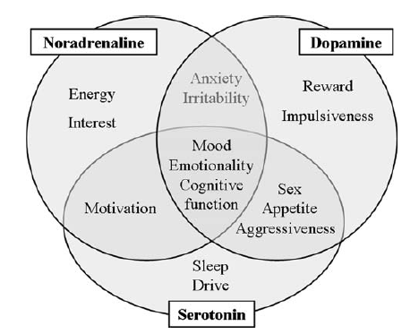
Relationship among noradrenaline, serotonin, and dopamine and behavior
VTA
(Ventral Tegmental Area)
Locus ceruleus
Noradrenaline
Dopamine
Anxiety
Irritability
Energy
Interest
Reward
Impulsiveness
Mood
Emotionality
Cognitive
function
Sex
Appetite
Aggressiveness
Motivation
Sleep
Drive
Serotonin
Raphé system

Slide 12
Monoamine Theory of Depression
Most widely accepted theory:
depression may be due to underactivity at 5-HT and NE synapses
1. All clinically effective drugs are 5-HT and/or NE agonists
or increase 5-HT and/or NE levels
2. Certain 5-HT and/or NE receptors are up-regulated in untreated depressed patients (compensatory increase in receptors due to low levels of transmitters)
Criticisms
1. Neither 5-HT nor NE depletion induce clinical depression in healthy subjects
2. Antidepressants are generally effective in only about 60% of patients
3. Most antidepressants take 3 or more weeks to take effect

Slide 13
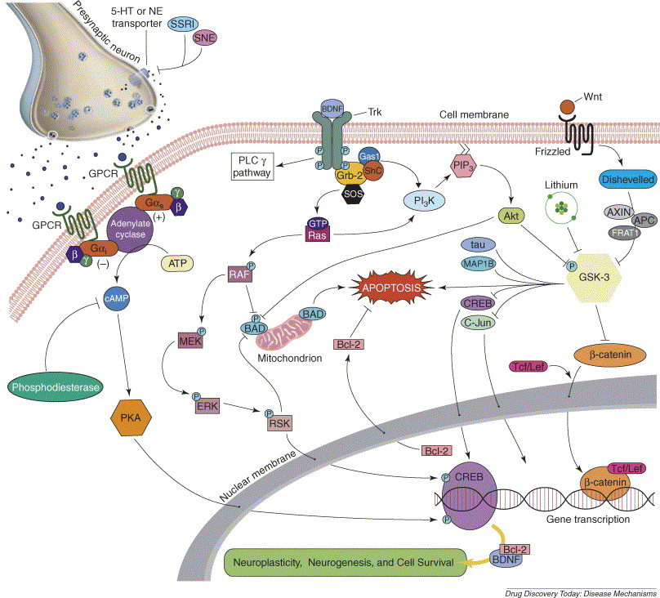
The neurotrophic hypothesis
Neurotrophic signaling pathways is involved in the actions of antidepressants
CREB (cAMP response element-binding protein)
Neuroplastiticy, Neurogenesis and Cell Survival
BDNF
Bcl-2
Notes:
Neurotrophic signaling pathways involved in the actions of antidepressants and mood stabilizers. Most currently available antidepressants act initially by increasing the concentrations of synaptic serotonin (5-HT) and norepinephrine (NE). Postsynaptic G-protein coupled receptors (GPCRs) are activated by neurotransmitters such as 5-HT or NE. GPCRs are coupled to second messengers such as adenylate cyclase via G-protein subunits. Adenylate cyclase mediates many of its cellular actions via the activation of protein kinase A (PKA), which is an activator of cAMP response element binding protein (CREB). Activated CREB then binds to the promoter cAMP response element (CRE), mediating increased transcription of brain-derived neurotrophic factor (BDNF) and Bcl-2, among other targets. BDNF, and other neurotrophic factors increase neuroplasticity and inhibit cell death by activating TrkB, a receptor tyrosine kinase which subsequently activates thephosptotidylinsitol-3 kinase (PI3K)/Akt signaling cascades which inhibit apoptosis. Among other targets, the PI3K pathway results in AKT-mediated inhibition of the proapaptotic enzyme glycogen synthase kinase 3 (GSK-3) as well as BAD. GSK-3 has multiple targets in cells. An alternate mechanism to deactivate GSK-3 is via the Wnt signaling pathway. Wnt glycoproteins interact with frizzled transmembrane receptors, resulting in inhibition of GSK-3 and subsequent activation of the transcription factor β-catenin. Lithium is a direct inhibitor of GSK-3, and both lithium and valproate increase β-catenin levels. Novel, and potentially more rapid acting, treatments for mood disorders might act directly on downstream targets of current antidepressants and mood stabilizers.

Slide 14
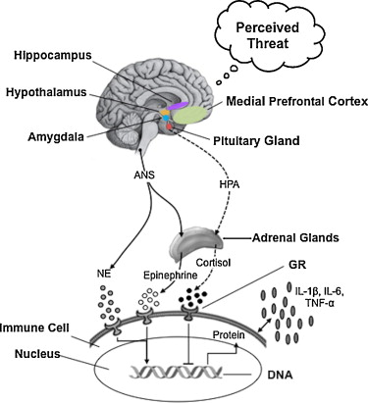
2. Stress theory of depression
Depression shares some physiologic mechanisms with chronic stress
stereotyped defensive reactions to threat (immobility and panic)
autonomic and motor responses to threat (tachicardia, sweating)
Target cells
( )
Notes:
. Hypothetical model of the neural systems involved in detecting threats, and regulating behavioral and biological responses to threat. Central to this network is the amygdala, which responds quickly to potential threats in the environment and plays a key role in determining whether environments are perceived as safe or dangerous. The amygdala functions in concert with other brain regions including the hippocampus and medial prefrontal cortex, which can up-regulate or down-regulate amygdalar responses to threat. Moreover, behavioral and biological responses to threat depend on activation of other brain areas, including the bed nucleus of the stria terminalis, which coordinates autonomic and motor responses to threat, and the periaqueductal gray, which coordinates stereotyped defensive reactions to threat, such as immobility and panic. Activity in this threat-related neural network is potentiated for individuals with anxiety disorders, as well as for persons exhibiting high levels of trait anxiety.

Slide 15
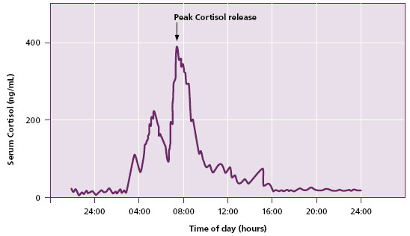
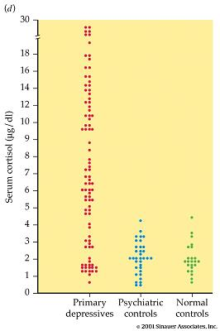
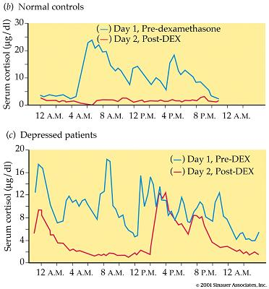
Circadian pattern of serum cortisol
Serum cortisol
Serum cortisol
Controls
Serum cortisol
Depressed Psychiatric Normal
patients controls controls
Depressed patients
Depressed patients
Serum cortisol
Dexamethasone Suppression test
Notes:
A likely trigger for an episode of depression is stress that increase the release of the hormone cortisol
Prolonged elevated cortisol levels exhaust the body’s energies, impair sleep and the immune system and set the stage for an episode of depression

Slide 16
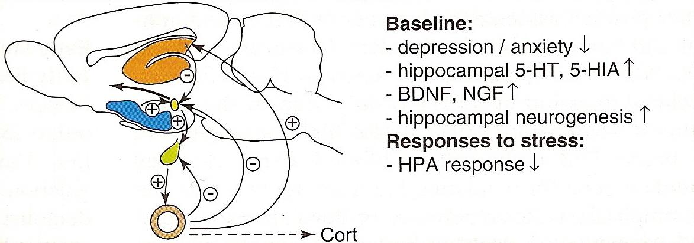
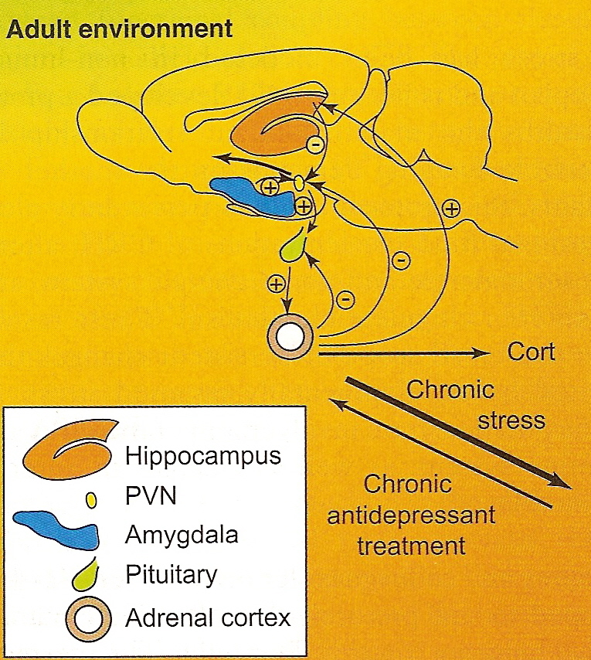
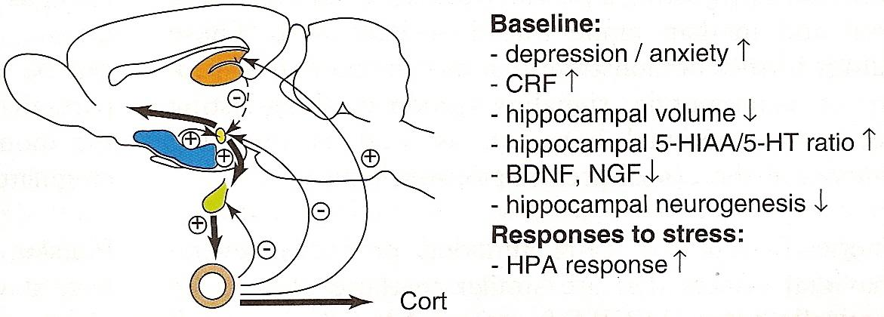
Effect of stressors on HPA Axis
Developmental environment
High levels of maternal care
Neglect
Trauma
Chronic Stress
Notes:
The ‘‘neurotrophic hypothesis’’ postulates that reduced levels of neurotrophic factors, mainly BDNF, contribute to the hippocampus atrophy observed in depressed patients
Antidepressants exert their therapeutic effects also by increasing the expression of neurotrophic factors in the hippocampus

Slide 17
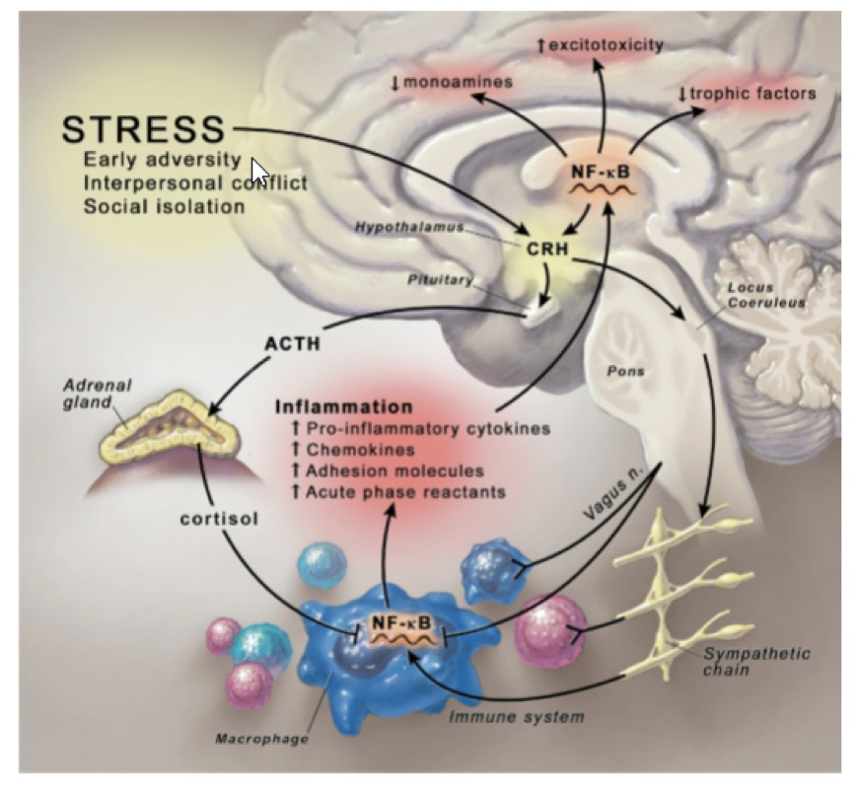
3. Stress-induced neuroinflammation
3. Loss of the auto regulation of the HPA axis
2. Cytokines enter CNS reducing the levels of NTs and trophic factors and excitotoxicity
1. ANS activation increases NF-kB synthesis

Slide 18
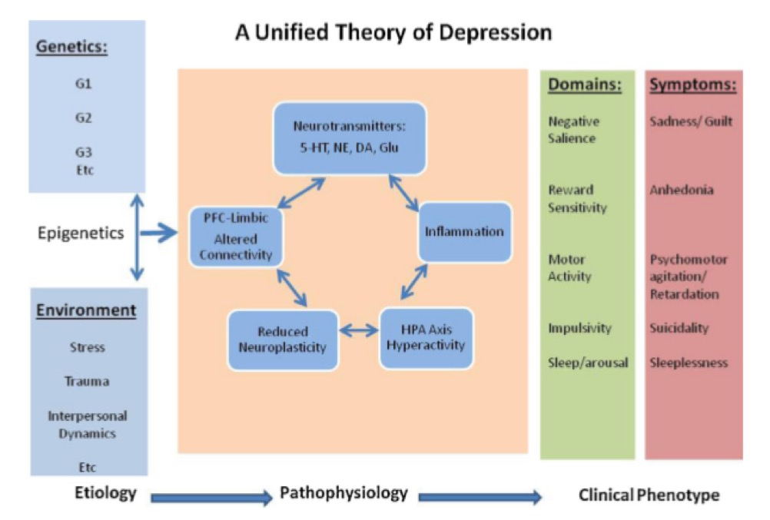

Slide 19
The life-cycle of major depression and its treatment
Prevention (self-help)
Natural swings
Network (irreversible?) phase-shifts
Stress
Environment
Adolescence
Genetic/developmental load
Residual symptoms
Early intervention
Recovery
Relapse
Collapse
Late intervention
rescue (difficult)
Time (months, years)

Slide 20
Antidepressant drugs: Main mechanisms of action
Inhibition of 5-HT and NA re-uptake
5-HT_{1A} and NA pre-synaptic (Autoreceptors) blockade
5-HT_{1A} post-synaptic receptors activation
5-HT₂ post-sinaptic receptors blockade
Inhibition of mono amino oxidases (MAO)

Slide 21
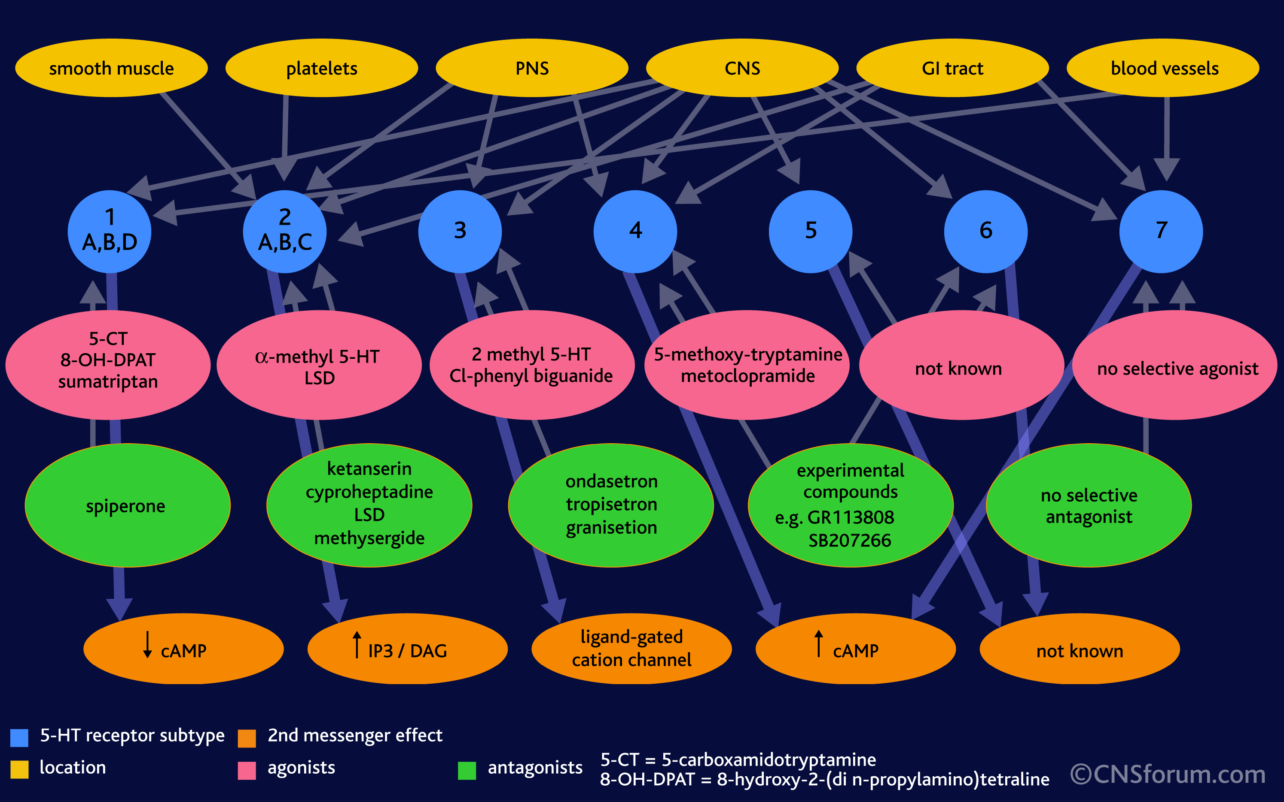
Serotonin receptors classification

Slide 22
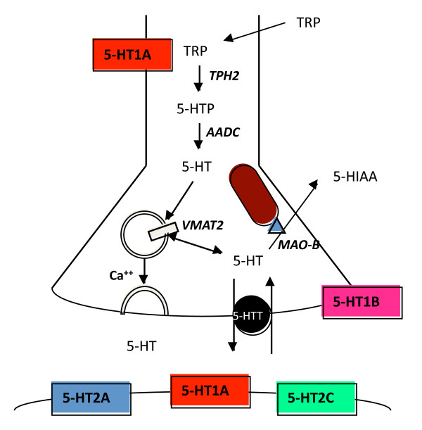
5-HT receptors expression
and the presynaptic regulation of 5-HT levels
1. Presynaptic receptors
Selective Serotonin Re-uptake Inhibitors (SSRI)
MAO
2. Postsynaptic receptors
3. 5-HT transporters

Slide 23
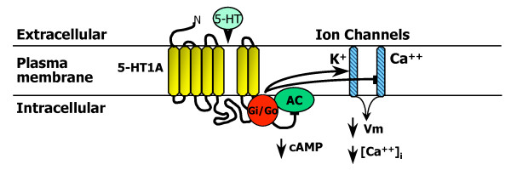
5-HT1A receptor signalling
Coupled to inhibitory G proteins (Gi/Go)
⭕️ inhibit adenylyl cyclase (AC)
⭕️ open G-protein inward rectifying potassium channels (K+) to reduce membrane potential (Vm)
⭕️ inhibit voltage-gated calcium channels (Ca++) and reduce intracellular free calcium concentration ([Ca++]i).
Presynaptic 5-HT1A somatodendritic autoreceptors expressed on 5-HT neurons act as a "brake" to inhibit the activity of the entire 5-HT system

Slide 24
In depressed individuals:
the expression of pre-synaptic 5-HT1A autoreceptors is increased
the expression of post-synaptic 5-HT1A receptors is reduced
with reduced release of 5-HT by serotoninergic neurons
with reduced response of the post-synaptic neurons to 5-HT
In agreement with the Monoamine Theory of Depression, a strategy for restoring the activity of the serotoninergic neurons is to block the re-uptake of 5-HT
Selective Serotonin Re-uptake Inhibitors (SSRI)

Slide 25
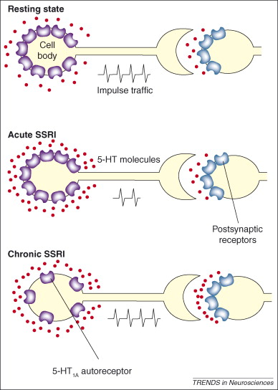
SSRIs mechanism of action:
Acute SSRIs:
SSRIs rapidly block 5-HT reuptake and cause an increase of 5-HT synthesis and release
5-HT1A autoreceptors on serotonin synapses detect excess serotonin and reduce serotonin release
Chronic SSRIs:
causes a gradual downregulation of 5-HT1A autoreceptors with gradual increase of
5-HT release

Slide 26
SSRI treatment
SSRIs take 3 or more weeks to take effect and this depends on two slow changes in the brain:
Desensitization and downregulation of 5-HT1A autoreceptors with increased release of 5-HT
Release of BDNF which promotes neuron growth and survival
Presynaptic 5-HT1A receptors delay antidepressant response but are also primarily responsible for the therapeutic effect
Postsynaptic 5-HT2 receptors are primarily responsible for the adverse effects due to the increased intrasynaptic serotonin levels
It remains to be clarified:
⭕️ The mechanisms involved in the down-regulation of 5-HT1A autoreceptors, but not of post-synaptic 5-HT1A receptors
⭕️ The mechanism by which SSRI treatment enhances 5-HT release (somatodendritic 5-HT release?)

Slide 27
Antidepressant drugs
Five Categories
Tricyclics (Serotonin and Noradrenaline reuptake inhibitors, SNRI)
Monoamine oxidase inhibitors (MAOI)
Selective serotonin reuptake inhibitors (SSRI)
Atypical – DARIs (dopamine reuptake inhibitors)
Newest

Slide 28
Newest antidepressants
2 nd generation SNRIs (serotonin and noradrenaline reuptake inhibitors) e.g. Venflaxine
SARIs (serotonin reuptake inhibitors and receptor antagonists) e.g. Nefazodone
NaSSAs (noradrenaline reuptake inhibitors and specific serotonergic antidepressants) e.g. Mirtazapine
NaRIs (selective noradrenaline reuptake inhibitors) e.g. Reboxetine

Slide 29
TRICYCLICS (TCAs): 1st generation of SNRI’s (Serotonin/Norepinephrine Reuptake Inhibitors)
Mechanisms | Drugs
5-HT and NA reuptake inhibition ‘SARI’ (5-HT₂ antagonism) Histamine and muscarinic receptors antagonists | Amitriptyline Amoxapine Desipramine Doxepine Imipramine Nortriptyline
Advantages | Disadvantages
Low cost Long clinical history Subset efficacy: Chronic pain (amitriptyline) Dyspepsia (doxepine) | Lethal in overdose (↑QT_{c}) Sexual dysfunction Weight gain Anticholinergic (sedation, constipation, dry mouth)

Slide 30
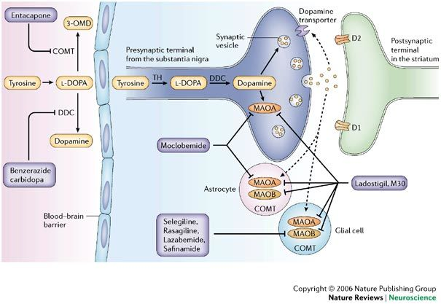
MonoAmino Oxidase Inhibitors (MAOI)
Meclobemide
Ladostigil
Selegilline
Rasagilline
Lanzabemide
Selectivity | Clinical use
MAO-A: 5-HT > NA >> DA | Depression
MAO-B: DA>> 5-HT = NA | Parkinson's disease

Slide 31
MAO-A Inhibitors (MAOI)
Mechanisms | Drugs
Inhibit monoamine oxidase Results in ↑ NE and 5-HT | Irreversible Phenelzine Tranycypromine Isocarboxazid Reversible (RIMA’s) Meclobemide
Advantages | Disadvantages
Subset efficacy: Panic disorder Social phobia | Dietary restrictions (cheese, red wine): tyramine and consequent hypertension
Notes:
Cheese reaction: tyramine is metabolised by Mao in the liver and gut but MAO inhibition allows tyramine to be absorbed acting and causing hypertension

Slide 32
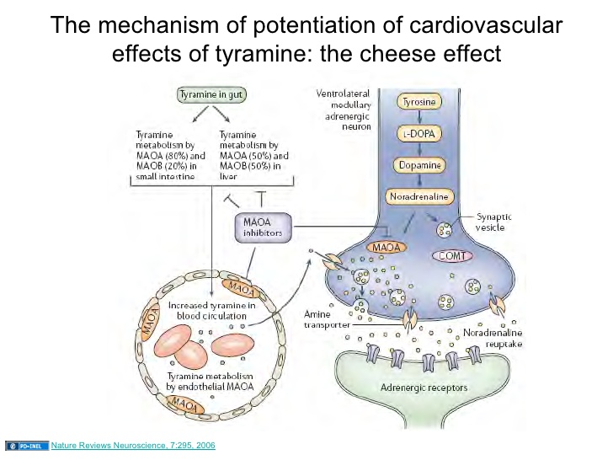

Slide 33
ATYPICAL - DARIs
Mechanisms | Drugs
Dopamine (and NA) but not serotonin uptake inhibition Presynaptic release of DA and NA | bupropion
Advantages | Disadvantages
Subset efficacy: Smoking cessation | Convulsions Nervousness

Slide 34
Selective Serotonin Reuptake Inhibitors “SSRI’s”
Mechanisms | Drugs
5-HT reuptake inhibition Stimulation of neurosteroids synthesis? | Citalopram Fluoxetine (Prozac®) Fluvoxamine Paroxetine Sertraline
Advantages | Disadvantages
Safety Anxiolysis Side effect profile favorable: Low incidence of weight gain ↓ Anticholinergic effects | nausea, headache sexual dysfunction

Slide 35
Symptoms and CNS Disorders Frequently associated with Major Depression
 | Depressed Mood | Anxiety | Cognitive Perturbation | Reduced Sleep Quality | Sexual Dysfunction | Pain
Depression Anxiety Schizophrenia Parkinson's Alzheimer's Epilepsy Chronic pain Stroke | +++ ++ + ++ + + ++ ++ | ++ +++ + + + + ++ + | ++ ++ ++ ++ +++ ++ + +++ | ++ ++ + ++ ++ ++ ++ + | + + + ++ - + ++ + | + + + ++ - + +++ ++

Slide 36
2nd gen. SNRI’s (Serotonin and Norepinephrine Reuptake Inhibitors)
Mechanisms | Drugs
Serotonin and NA uptake inhibition | Venlafaxine Milnacipram
Advantages | Disadvantages
Anxiolysis Subset efficacy: chronic pain bipolar disorders | Weight gain Sexual dysfunction NE side effects: Tachycardia Hypertension Anticholinergics: Constipation

Slide 37
SARI’s Serotonin Antagonist/ Reuptake Inhibitors
Mechanisms | Drugs
5-HT reuptake inhibition 5-HT_{2a, 2c} antagonism | Nefazodone Trazodone
Advantages | Disadvantages
Early relief of anxiety and agitation (nefazodone) Low incidence of sexual dysfunction | Sedation

Slide 38
NaSSA’s (Noradrenergic Specific Serotonergic Antidepressants)
Mechanisms | Drugs
5HT_{2a,c} 5HT₃ antagonism α₂ inhibition (blocks NA ‘brakes’) | Mirtazapine Risperidone Olonzapine
Advantages | Disadvantages
Anxiolysis (5-HT2 blockade) Low incidence of sexual dysfunction (selective blockade) Low incidence of nausea and vomiting (5-HT3 blockade) Fast onset of action | Sedation Weight gain due to: H₁ antagonism 5HT_{2c} antagonism

Slide 39
NaRIs Noradrenaline reuptake inhibitors
Mechanisms | Drugs
NA reuptake inhibition | Reboxetine
Advantages | Disadvantages
? | No more effective than NSRIs
5-HT₁ Agonists
Mechanisms | Drugs
Agonists at 5HT₁ | Buspirone Ipsapirone Gepirone
Advantages | Disadvantages
Anxiolysis | No proven efficacy as single agents for depression

Slide 40
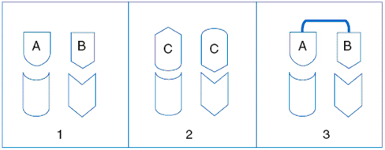
The Multitargetig approach:
Dual- and Triple-acting antidepressants
Multitarget drugs have complementary components of action and may be more effective (synergism) and better tolerated than their highly selective counterparts
Administration of two different drugs (A and B)
Administration of a non-selective bifunzional drug (C)
Administration of a bivalent drug (two drugs, A and B, liked by a spacer)
Notes:
and thus a greater chance of controlling both the mood deficits of depression and other symptoms
For example, 5-HT reuptake inhibitors with antagonism at 5-HT2C sites should have better tolerability than SSRIs, because certain of their adverse actions derive from stimulation of 5-HT2C sites

Slide 41
Dual- and Triple-acting antidepressants
Notes:
Three classes of ligand:
⭕️ Drugs with exclusively monoaminergic targets, but with 1) deletion of sites provoking adverse effects, and 2) incorporation of new targets
⭕️ Drugs acting at combinations of nonmonoaminergic targets –no one yet developed
⭕️ Drugs with a clinically validated monoaminergic mechanism, such as suppression of 5-HT reuptake or blockade of 5-HT2C receptors, plus a novel, nonmonoaminergic mechanism

Slide 42
Nonmonoaminergic mechanisms
for treatment of depression
CRF:
corticotrophin releasing factor
GR: glucocorticoid receptor
MCH: melanin concentrating hormone
NK: neurokinin
PAM:
positive allosteric modulator
PDE: phosphodiesterase
V: vasopressin

Slide 43
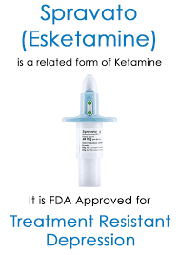
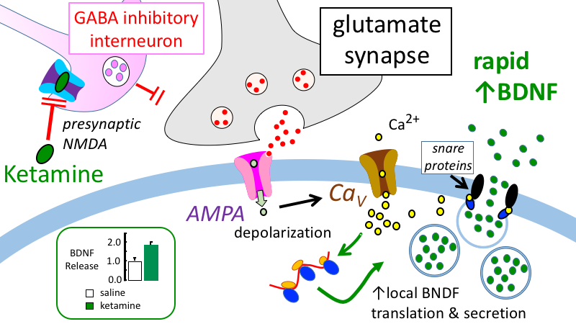
Ketamine is fast-acting antidepressant agent

Slide 44
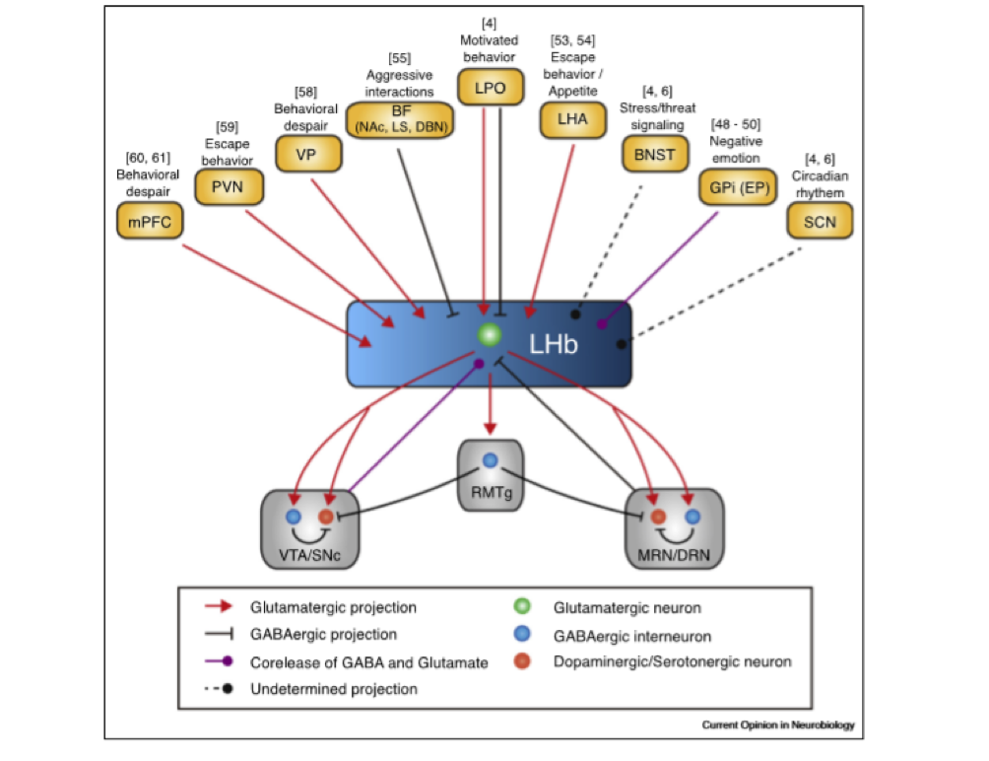
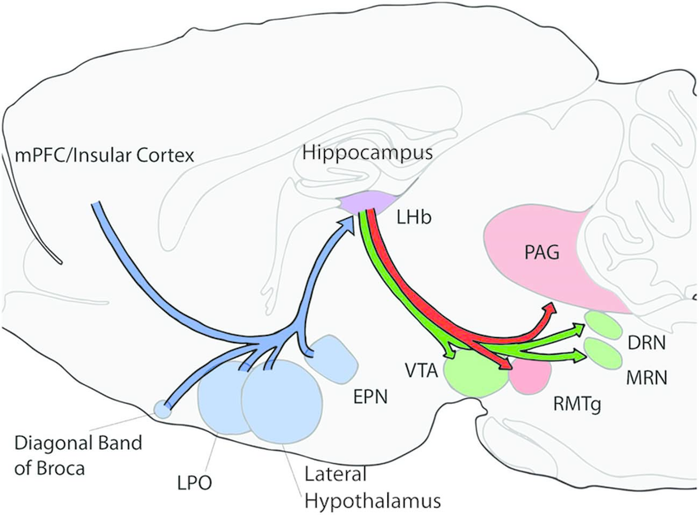
The role of Lateral Habenula in depression
The lateral habenula (LHb) is the "anti-reward" center, involved in processing aversive stimuli

Slide 45
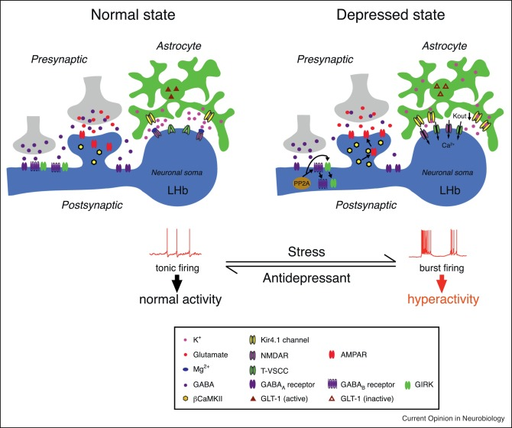
Ketamine blocks NMDAR-dependent bursting activity of LHb neurons to disinhibit downstream monoaminergic reward centres and quickly elevates mood

Slide 46
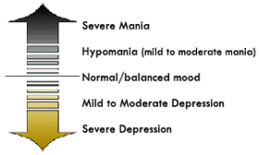
Mania -
Feeling very high on life
Talking rapidly
Feeling grandiose
Racing thoughts and speech
Erratic and impulsive actions
Delusions and hallucinations (severe)
Bipolar Disorder
Severe Mania
Hypomania (mild to moderate)
Hypomania -
Like but less severe that mania
Euphoric, energetic and productive
No hallucinations or delusions
Characterized by an unusually good mood
Normal/balanced mood
Mild to moderate Depression
Severe Depression

Slide 47
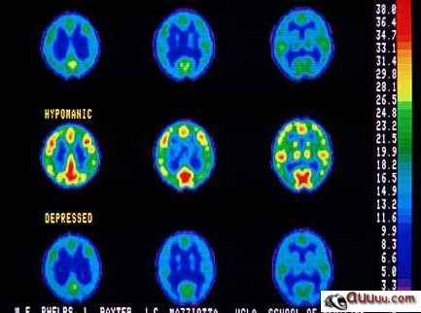
Brain scans indicating the differences in brain activity when a patient is switching between a depressive episode and hypomanic episode

Slide 48
Mood Stabilizers For Bipolar Disorders
Lithium Carbonate
Anticonvulsants:
Carbamazapine
Valproic Acid
Lamotrigine
Topiramate
Notes:
Lithium may act to prevent neuronal damage and tissue loss that occur in the brain of patients with bipolar disorders
Lithium reduces excitotoxicity through increased glutamate uptake, regulating signal transduction intermediates such as protein kinase C, phosphotidylinositol-3 kinase (PI-3K)/protein kinase B (Akt), ras-mitogen-activated protein kinase (MAPK) and glycogen synthase kinase (GSK)-3alpha

Slide 49
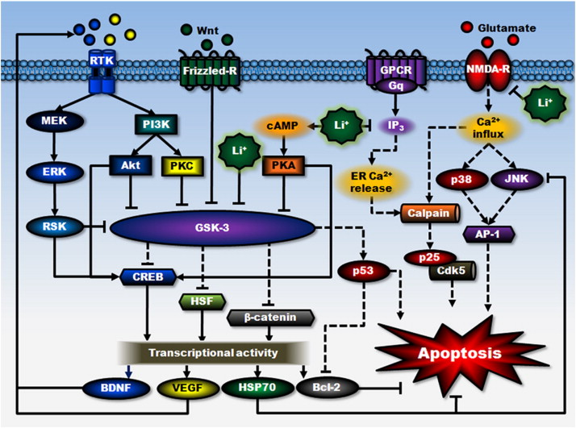
Proposed signaling mechanisms underlying lithium's neuroprotective effects
Notes:
The neuroprotective effects of lithium against glutamate excitotoxicity are proposed to result from its interactions with cell survival and apoptotic machinery, as well as inhibition of receptor-mediated calcium entry
lithium can directly and indirectly reduce the activity of constitutively activated GSK-3 by multiple mechanisms, leading to disinhibition of several transcription factors, including CREB, HSF-1, and β-catenin, and subsequent induction of major cytoprotective proteins such as BDNF, VEGF, HSP70, and Bcl-2. GSK-3 is negatively regulated by Wnt-stimulated activation of the Frizzled receptor and decreased GSK-3 activity further reduces the activity of pro-apoptotic protein p53 and its downregulating effect on Bcl-2. Second, lithium-induced neurotrophic factors such as BDNF, in turn, activates its cell surface receptor and the downstream PI3K/Akt and MEK/ERK pathways. Both pathways are strongly associated with neuroprotective effects, which stimulate CREB and inhibit GSK-3. BDNF induction is an early and essential step for neuroprotection against glutamate excitotoxicity and may contribute to lithium-induced neurogenesis. Lithium also indirectly inhibits GSK-3 activity via PI3K-dependent activation of PKC and cAMP-dependent activation of PKA. Third, lithium inhibits NMDA receptor-mediated calcium influx, which in turn decreases subsequent activation of JNK, p38 kinase, and transcription factor AP-1. This NMDA receptor-mediated signaling plays a critical role in mediating glutamate-induced caspase activation and apoptosis. JNK activity is also inhibited by overexpression of HSP70. In addition, through inositol depletion, lithium reduces IP3-mediated calcium release from the ER. Inhibition of intracellular calcium increase not only suppresses cellular stress, but also reduces the activity of calpain and calpain-mediated activation of pro-apoptotic Cdk5/p25 kinase. Lines with solid arrows represent stimulatory connections; lines with flattened ends represent inhibitory connections. Dashed lines represent pathways with reduced activity as a result of lithium treatment. Frizzled-R, Frizzled receptor; GPCR, G protein-coupled receptor; NMDA-R, NMDA receptor; RTK, receptor tyrosine kinase.

