Slide 1
Schizophrenia
Schizophrenia is a chronic remitting and relapsing or progressive psychotic syndrome
affects 1% of the population in all races and culture
associated with significant impairment in social interactions and occupational functioning
the onset of schizophrenia is in the late teens - early twenties
and an average reduction of lifespan of 15 to 25 years

Slide 2
Positive Symptoms
disturbance of reality perception
Hallucinations (false perceptions: hearing voices others do not hear; Seeing, feeling, or smelling things other do not)
Delusions (false beliefs: Intense suspicion; Thoughts controlled by Martians; Radios implanted in teeth)
Disorganized Speech and behavior (Loose associations, Word salad, Flight of Ideas)
Negative Symptoms
inappropriate or diminished affect (mood)
Apathy, social withdrawal, anhedonia, emotional blunting, extreme inattentiveness or lack of motivation to interact with the environment
(Negative symptoms are progressive and less responsive to therapy)
Cognitive impairment
Cognitive deficits and deficits in attention and executive function

Slide 3
Diagnostic and Statistical Manual of Mental Disorders (DSM-V): criteria for Schizophrenia
At least two of the following symptoms for a clinically significant portion of time during 1-month period must be present, one of them being the 1, 2 or 3 item:
Delusions
Hallucinations
Disorganized speech
Disorganized or catatonic behavior
Negative symptoms
Notes:
Absence of happiness is more reliable symptom than increased sadness

Slide 4
Etiology of Schizophrenia
1. Heritability and Genetic Factors
Genetic predisposition with multiple genes involved, estimated to explain 80% of the risk
Gene-expression profiling studies implicate pathway associated with the immune system, cytoskeleton development and synaptic plasticity
2. Environmental stressors
Maternal stress, maternal infections
Birth complications
Nutritional deficiency; Autoimmune diseases; Head injury; Childhood adversity
Substance of abuse

Slide 5
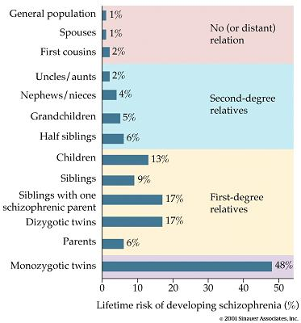
1. Heritability

Slide 6
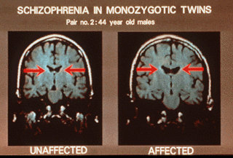
1. Heritability
Notes:
Schizophrenia is not characterized by any reproducible neurochemical abnormality
However, structural and functional abnormalities have been observed in the brains of schizophrenic patients:
Enlarged cerebral ventricles
Atrophy of cortical layers
Reduced volume of the basal ganglia

Slide 7
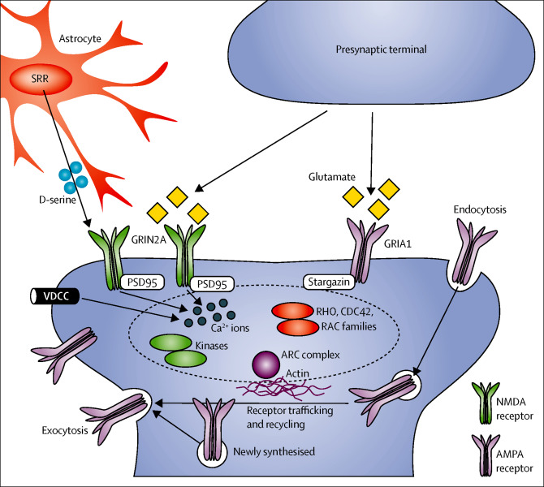
1. Genetic Factors
Schizophrenia is highly polygenic and the genetic risk is highly pleiotropic
Some genes implicated:
GRIN2A (subunit of the NMDA receptor)
GRIA1 (subunit of the AMPA receptor)
CACNA1C (encoding VDCCs)
PSD95, CACNG2 (proteins associated with the post-synaptic scaffold kinases)
SRR (serine racemase)
Notes:
Advances in human genetics support to the importance of fine-tuning of glutamatergic neurotransmission in the pathology of schizophrenia. The genes implicated in these studies include GRIN2A (which encodes a subunit of the NMDA receptor), GRIA1 (which encodes a subunit of the AMPA receptor), SRR, CACNA1C, genes encoding the ARC complex, and several genes encoding proteins located in, or associated with, the post-synaptic density of glutamatergic synapses. The NMDA-type glutamate receptors are fine-tuned by the co-agonist D-serine, which is synthesised by SRR. VDCCs (eg, the protein encoded by CACNA1C) are also likely to be involved in tuning neural excitability and synaptic transmission via intracellular calcium signalling. In response to activation of glutamate receptors, proteins associated with the post-synaptic scaffold—eg, PSD95, stargazin (also known as CACNG2), several kinases, the RHO, CDC42, and RAC family of small G proteins, and the ARC complex—convey intracellular signalling that underlies cytoskeletal regulation and receptor trafficking, which are crucial for synaptic plasticity. The dashed oval represents converged intracellular protein networks that underlie synaptic plasticity. AMPA=α-amino-3-hydroxy-5-methyl-4-isoxazole-propionic acid. NMDA=N-methyl-D-aspartate. PSD=post-synaptic density protein. SRR=serine racemase. VDCC=voltage-dependent calcium channel.

Slide 8
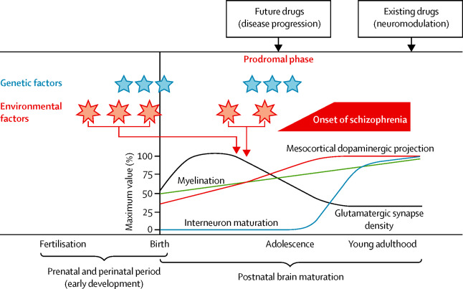
Neurodevelopmental abnormalities
During early brain development, environmental stressors can alter the normal program of brain maturation (progenitor cells proliferation, neuronal migration, dendritic arborization and outgrowth)
Notes:
leading to the manifestation of the disease later in adolescence or early adulthood
Developmental disturbances will compromise neuroplasticity affecting the maturation and function of different brain structures according to the timing of occurrence and on the basis of individual genetic susceptibility
Schizophrenia is not characterized by any reproducible neurochemical abnormality
However, structural and functional abnormalities have been observed in the brains of schizophrenic patients:
Enlarged cerebral ventricles
Atrophy of cortical layers
Reduced volume of the basal ganglia

Slide 9
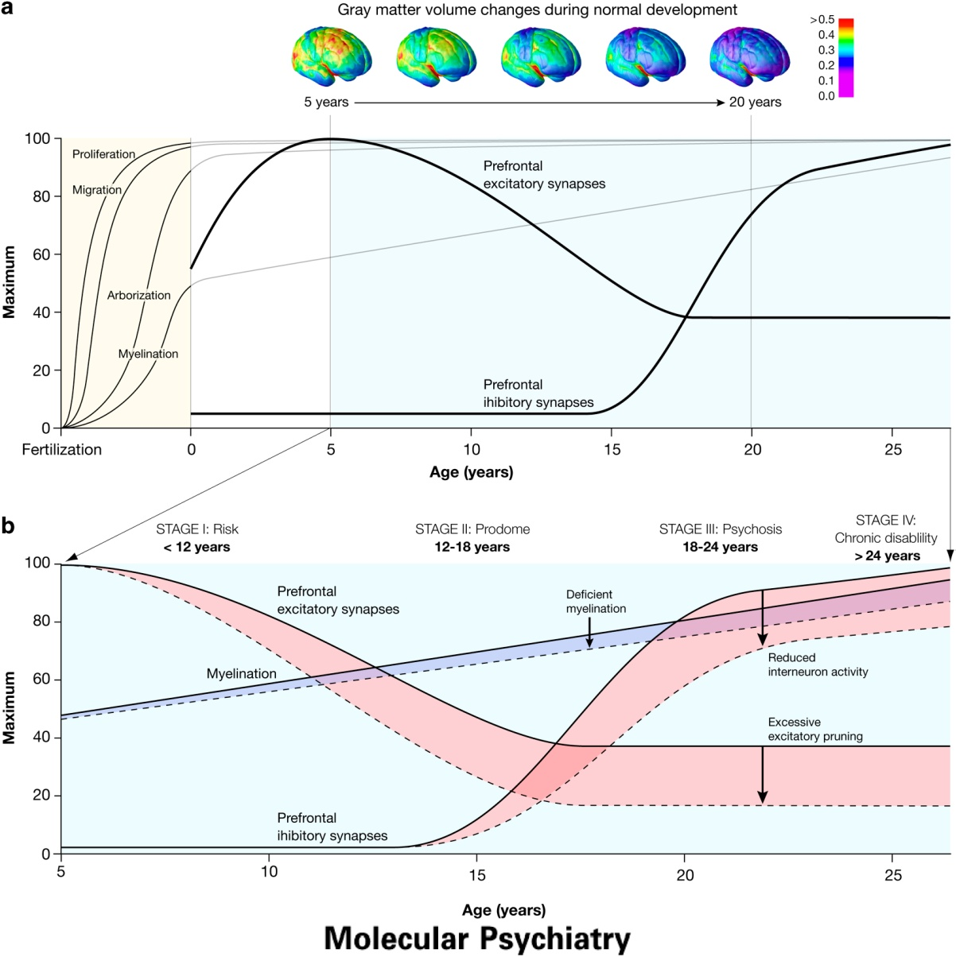

Slide 10
Neuronal anatomic abnormalities
Person with schizophrenia have lower gray-matter volumes (magnetic resonance imaging) and fewer dendrites and dendritic spines (postmortem studies)
During the prodromal phase of psychosis, there is a greater rate of gray-matter loss over time in the prefrontal and parahippocampal regions than among persons in whom psychosis does not develop
The rate of gray-matter loss has been associated with elevated levels of immunologic markers that participate in activation of brain microglia, suggesting a role for cytokines in the disease

Slide 11
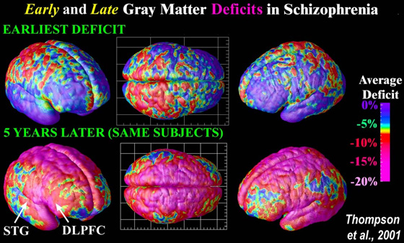
Hypofrontality: reduced frontal lobe activity
Functional imaging techniques (fPET) reveal decreased metabolic activity in frontal cortex of schizophrenics
Notes:
Difficult cognitive tasks that increase frontal lobe activity in normal controls fail to do so in schizophrenics

Slide 12
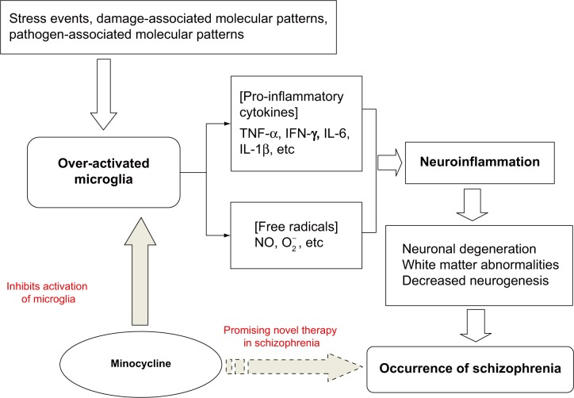
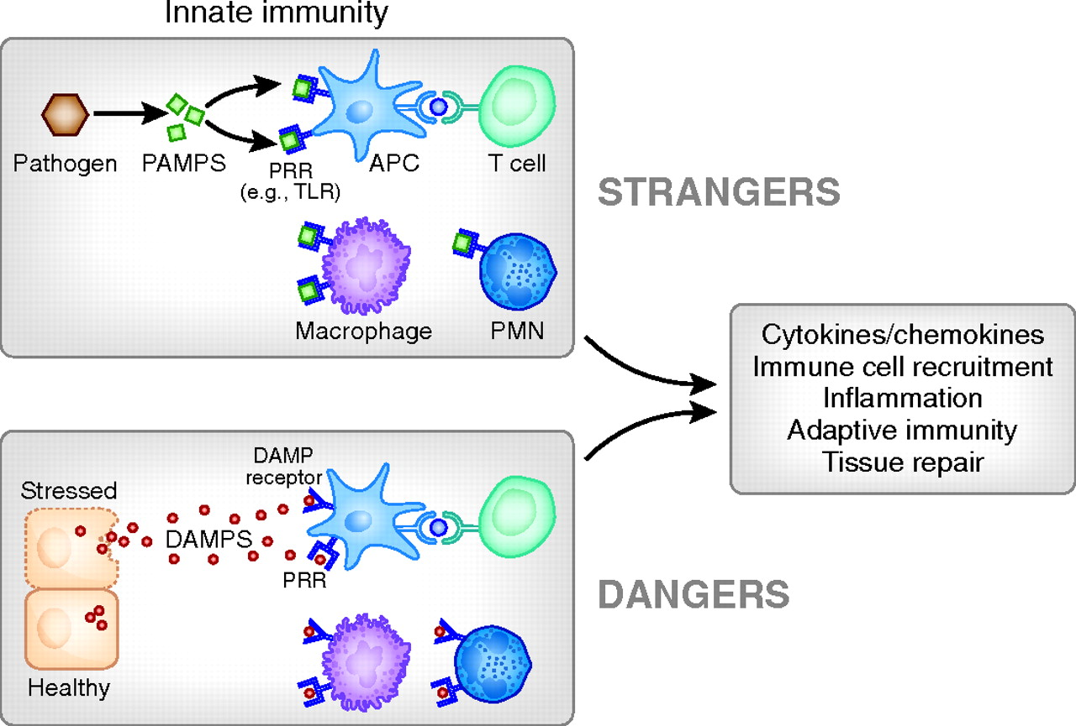
Neuronal anatomic abnormalities

Slide 13
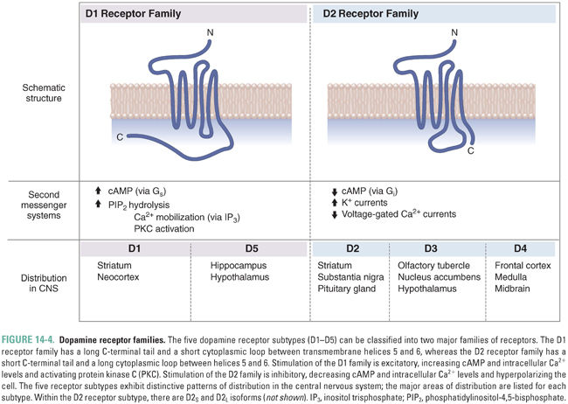
Dopamine Receptors family
 | D1 | D5 |  | D2 | D3-4
Striatum | ++ |  |  | ++
Prefrontal Cortex | ++ |  |  |  | +
Limbic system | ++ | + |  | ++ | +
Hypothalamus | ++
Pituitary gland |  |  |  | ++

Slide 14
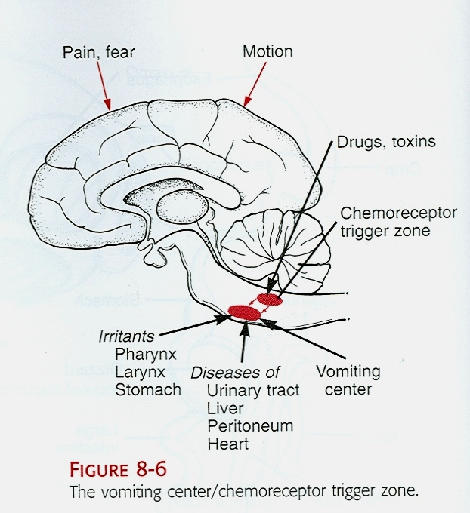
Dopamine System
Four major pathways for the dopaminergic system in the brain:
The Nigro-Striatal Pathway
The Mesolimbic Pathway
The Mesocortical Pathway
The Tuberoinfundibular Pathway
Chemoreceptor trigger zone (Emesis)

Slide 15
I. The Nigrostriatal Pathway
Projects from the substantia nigra to the basal ganglia
A part of the extrapyramidal system, is involved in the control of motility
Substantia nigra
Striatum
Reduced activity results in rigidity, tremor and difficulty initiating movement (bradykinesia)
Parkinsonism

Slide 16
II. The Mesolimbic Pathway
Projects from the VTA to limbic system via Nucleus Accumbens, amygdala and hippocampus
Involved in modulating behavioral responses to stimuli that activate feelings of reward (motivation) and reinforcement
Ventral tegmental area
Nucleus accumbens
Over-activity may produce the positive symptoms of schizophrenia (delusions and hallucinations)

Slide 17
III. The Mesocortical Pathway
Projects from the VTA to frontal cortex
Involved in motivation and emotional responses
Can be associated with both positive and negative symptoms (mood)
Frontal cortex
Ventral tegmental area
Blockade may help reduce negative symptoms of schizophrenia

Slide 18
IV. The tubero-infundibular pathway
Projects from hypothalamus to median eminence and pituitary gland
Involved in control of prolactine release (suppressed by dopamine)
Pituitary
hypothalamus
Blockade of this pathway produces galactorrhea

Slide 19
Dopamine Theory of Schizophrenia
Schizophrenia could be caused by an aberrant, increased activity of the dopaminergic system
Drugs that increase DA in the limbic system cause psychosis:
L-DOPA (dopamine precursor) can produce hallucinations
Apomorphine and bromocriptine (D₂ receptor agonists) produce behavioral abnormalities in animals (stereotyped behavior)
Amphetamine and cocaine produce a psychotic behavior similar to the ‘positive’ features of schizophrenia
Drugs that reduce DA activity in the limbic system (postsynaptic D₂ receptor antagonists) reduce psychosis and are effective in controlling the positive symptoms
Many antipsychotics block the D₂ receptor
Notes:
Stereotypy rating scale in rodents
(Creese and Iversen, 1973)
0, asleep or stationary
1, active
2, predominantly active but with bursts of stereotyped sniffing or rearing
3, stereotyped activity such as sniffing along a fixed path in the cage
4, stereotyped sniffing or rearing maintained in one location
5, stereotyped behavior in one location with bursts of gnawing or licking
6, continual gnawing or licking of the cage bars

Slide 20
Criticisms of the DA hypothesis
Normal levels of DA metabolites are present in CSF of many schizophrenics
D₂ receptor antagonists are only partially effective in most (70%) patients and ineffective for some
Delayed onset of therapeutic effects, not consistent with only an antagonism toward D2 receptors (slow developing compensatory change/adaptation?)
Atypical antipsychotics have low affinity for D2 receptors
Furthermore.....
Drugs like Phencyclidine (CPC) and ketamine (NMDA receptor blockers) or LSD (5-HT partial agonist) cause psychotic behavior

Slide 21
NMDA receptor hypofunction hypothesis
NMDA receptor hypofunction causes excessive glutamate release which triggers neuronal injury throughout corticolimbic regions
Disruption of corticolimbic glutamatergic transmission by acute PCP leads to intense and disorganized hyperactivity (model for positive symptoms)
Disruption of corticolimbic glutamatergic transmission by chronic PCP leads to deficits in long-term memory, attention and social interaction (model for cognitive impairment and negative symptoms)
PCP produces hypofrontality in nonhuman primates, and this effect is reversed by antipsychotic drugs

Slide 22
The role of Serotonin (5-HT)
5-HT has a modulatory effect on dopaminergic neurones
LSD, a partial 5-HT receptor agonist, produces hallucinations and behavioral disturbance
M-chlorophenylpiperazine (M-CPP), a 5-HT receptor agonist, worsens psychotic symptoms
Ritanserin, a 5-HT receptor antagonists, attenuates psychotic symptoms
Dopamine
Acetylcholine
Glutamate
GABA
Serotonin
Neuropeptides

Slide 23
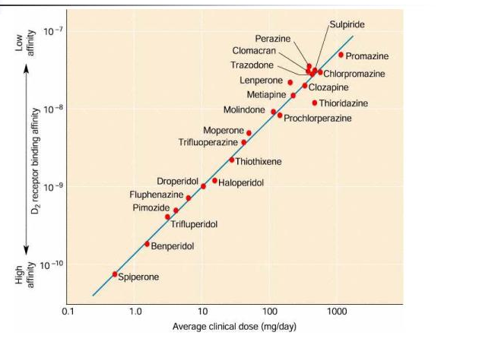
1. Clinical potency of typical antipsychotic drugs correlated with their affinity for D₂ receptors

Slide 24
Antagonism of dopamine D2 receptors is the basis for both the efficacy and side effects of typical antipsychotics
EFFICACY: D2 Receptor antagonism
in the Mesolimbic pathway decreases positive symptoms
SIDE EFFECTS: D2 Receptor antagonism
in the Mesocortical pathway can increase negative symptoms
in the Nigro-Striatal pathway causes Extra-Pyramidal Syndrome (EPS) or Parkinsonism, Dystonia, Tardive dyskinesia, Akathisia, Neuroleptic malignant syndrome
in the pituitary gland causes endocrine changes (hyperprolactinemia, amenorrhea, galactorrhea, infertility, gynecomastia and sexual dysfunction)
Notes:
Parkinsonism: rigidity, tremor, and loss of mobility and dyskinesia
Dystonia: Uncoordinated spastic movements of muscle groups (trunk, tonge, face)
Tardive dyskinesia: a late onset disorder characterized by repetitive abnormal movements of face and upper limbs. This may be due to up-regulation of D2 receptors in the striatum (supersensitivity)
Akatisia: uncontrolled inner restlessness, constant compulsive movement
Potentially fatal complication of neuroleptic therapy
It can arise at any time in the course of treatment
Temperature dysregulation: T >40°C
Muscle rigidity, impairment of sweating, hyperpyrexia, autonomic instability
Associated with polymorphism in D2 receptors
Treatment: withdraw neuroleptics, cooling, dantrolene, bromocriptine (DA agonist)

Slide 25
Typical antipsychotic are also effective antagonists at ACh, 5-HT and NE receptors
Muscarinic receptor blockade
Blurred vision, Dry mouth, Sinus tachycardia, Constipation, Urinary retention, Memory dysfunction
Histamine H1 Blockade
Sedation, drowsiness, Weight gain, Hypotension
Alpha-1 receptor blockade
Arteriolar dilation→ reduction of arterial blood pressure and Dizziness
Venodilation→ orthostatic hypotension - Reflex tachycardia

Slide 26
Typical Antipsychotic drugs
All are equally effective but differ in their tolerability
All show a significant delay before they become effective
All produce significant adverse effects (EPS occurs at clinically effective doses)
Limited efficacy against negative symptoms
A substantial portion of patients (25% to 40%) respond poorly to treatment
Drug interaction with additive effects with sedatives, anticholinergic, antihistaminergics, alfa receptor blocking agents
Efficacious for positive symptoms
Low-cost
Notes:
All block one or more types of dopamine receptor, but differ in their other neurochemical effects

Slide 27
First generation TYPICAL |  |  | Second generation ATYPICAL
1952 | 1960s | 1980s | 1990s | 2000s
Chlor promazine | Haloperidol (Serenase) Fluphenazine Thioridazine Trifluoperazine | Clozapine | Risperidone Olanzapine Quetiapine Ziprasidone | Aripiprazole Paliperidone Iloperidone Asenapine Lurasidone
Have Parkinsonian side effects
Effective against positive symptoms
Not all patients respond to drug therapy
Have minimal Parkinsonian side effects
Effective against both positive and negative symptoms
Effective in "resistant" patients

Slide 28
Atypical antipsychotic drugs
Are effective against positive and negative symptoms with some improvement in cognition
Are effective in patients refractory to typical neuroleptics
Greatly reduced or absent EPS
Disadvantage: Expensive

Slide 29
Antipsychotics: receptor order of potency
TYPICAL
Chlorpromazine | α₁ = 5-HT₂ = D₂ > D₁ > M > α₂
Haloperidol | D₂ > D₁ = D₄ > α₁ > 5-HT₂ >H₁>M = α₂
Clozapine | D₄ = α₁ > 5-HT₂ = M > D₂ = D₁ = α₂ ; H₁
ATYPICAL
Quetiapine | 5-HT₂ = D₂ = α₁ = α₂ ; H₁
Risperidone | 5-HT₂ >> α₁ > H₁ > D₂ > α₂ >> D₁
Sertindole | 5-HT₂ > D₂ = α₁

Slide 30
D2 5-HT2
D2 5-HT2
TYPICAL
ATYPICAL

Slide 31
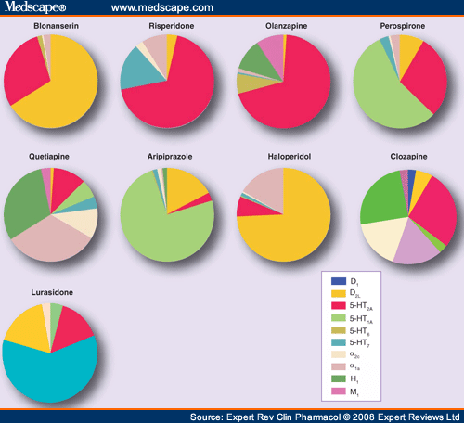
D₁
D₂
5-HT2A
5-HT1A
5-HT6
5-HT7
alfa 2
alfa 1
H1
M
Antipsychotics: selectivity

Slide 32
Atypical Antipsychotics:
Drug/Receptor Characteristics
All atypical neuroleptics have affinities for D1, D3, D4, histamine, and α-AR receptors and display balanced D2/D1 and 5-HT2 receptors antagonism
Due to the modulatory role of 5-HT on dopaminergic neurons, atypical antipsychotic drugs with 5-HT receptors affinity contributes to:
🔻 the antipsychotic action (Blockade of 5-HT2A receptors in the mesocortical pathway enhances the release of both dopamine and glutamate)
🔻 the low risk of producing EPS (Blockade of 5-HT2A receptors in the nigro-striatal pathway enhances dopamine release)
🔻 the ability to improve cognition (5-HT6 and 7 antagonists exert pro-cognitive effect

Slide 33
 | POSITIVE SYMPTOMS | NEGATIVE SYMPTOMS | SIDE EFFECTS | NOTE
CLOZAPINE | + | +/- | Sedation, hypotension, diabete | Seizure Agranulocytosis
RISPERIDONE | + | +/- | Elevated prolactin levels, EPS
OLANZAPINE | + | +/- | Diabetes
ZIPRASIDONE | +/- | + | Weight gain Uncontrolled movements
QUIETAPINE | +/- | + | Sedation Also for depression
ARIPRIPAZOLE | - | +/- | Uncontrolled movements

Slide 34
Modulation of neurotrophic factors by antipsychotic drugs
Expression of Brain-Derived Neurotrophic Factor (BDNF) and its high affinity receptor TrkB are reduced in the brain of schizophrenic patients
Neurotrophin (NTF) levels are reduced in the serum of schizophrenic patients
Antipsychotic drugs may be able to normalize levels of NTF or modulate their expression in order to enhance and promote neuronal plasticity

