Slide 1
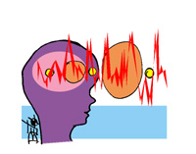
Epilepsy
Epilepsy is a disorder of neuronal excitability and comprehends any neurologic disorder that is characterized by recurrent, spontaneous seizures
Seizures is a sudden, stereotype episode with a change in motor activity, sensation, behavior or consciousness that is due to an abnormal electrical discharge in the brain
Epilepsy is the disorder and seizure is the symptomatic event
Notes:
The second most common neurological disorder after stroke
1% of the world population has epilepsy
Drug treatments control seizures in 80% of patients
Epilepsy is one of the oldest disorders known to mankind
No racial, social, cultural, economical, ethnic and geographical boundaries
Hippocrates ( Greek Physician 500 BC) wrote the first book about epilepsy
In ancient times, associated with religious experiences and demonic possessions
Epilepsy has nothing to do with mental disease or retardation
This has been proved beyond all doubt by the "epileptic geniuses", people who achieved great things in spite of suffering from epilepsy: Alexander the Great, Alfred Nobel, Julius Cesar

Slide 2
Neurobiology of Seizures
Seizures are thought to arise from the disruption of the balance between inhibitory and excitatory synaptic transmission
This impairment causes an synchronous, abnormal neuronal discharges within an area of the brain, the seizure focus. Once initiated, the abnormal discharges may (or may not) spread from one region of the brain to another
The behavioral manifestations of epilepsy are determined by the functions normally served by the cortical site at which the seizure arises
Seizures are accompanied by characteristic changes in the electroencephalogram (EEG)
Notes:
Neurons are extensively and often reciprocally interconnected. In healthy individuals, inhibitory circuits generally limits the extent of neural activity propagation
(impaired function of inhibitory synapses and/or enhanced function of excitatory synapses)
Any condition that upset the balance is likely to cause seizures

Slide 3
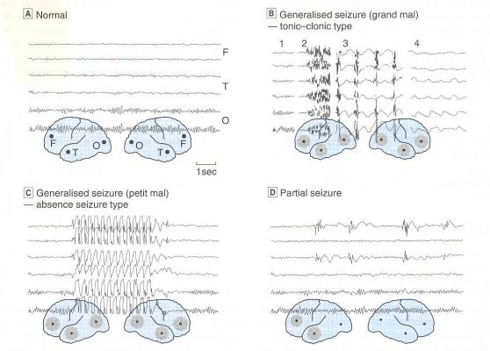
EEG records in epilepsy
A
B
C
D
A Normal EEG recorded from frontal (F), temporal (T) and occipital (O) sites on both sides, as shown in the inset diagram. B Sections on EEG recorded during a generalized tonic-clonic (grand mal) seizure. 1. Normal record. 2. Onset of tonic phase. 3. Clonic phase. 4. Post-convulsive coma. C Generalized absence seizure (petit mal) showing sudden brief episode of 3/s ‘spike and wave’ discharge. D Partial seizure with synchronous abnormal discharges in left frontal and temporal regions.

Slide 4
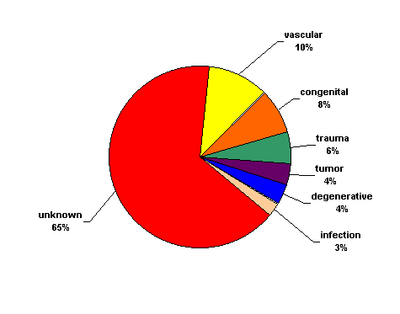
Etiology of Seizures
  Genetic (autosomal dominant genes)
  Congenital defects
  Acquired:
  Brain damages during delivery
  Severe head trauma
  Infections (Meningitis)
  Ischemic injury (stroke)
  Tumors
  Drug abuse
  Drug withdrawal
  Fever in children
  Unknown
Notes:
Physical insult to the brain leads to changes that cause seizures to develop: 50% of patients with severe head injuries will develop a seizure disorder
Latency period occurs prior to development of epilepsy
Initial seizures cause anatomical events that lead to future vulnerability

Slide 5
Genetic (or idiopathic) Epilepsies:
central role of ion channels
Mutations in genes that encode subunits of voltage-gated and ligand-gated ion channels that cause increased excitability or brain abnormality
Voltage-gated ion channels: mutations of Na+, K+ and Cl- channels (associated with forms of generalized epilepsy and infantile seizure syndromes)
Ligand-gated ion channels: mutation of nicotinic acetylcholine receptors and GABA receptor subunits (associated with frontal and generalized epilepsies, respectively)

Slide 6
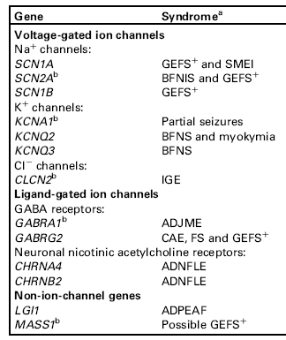
Epilepsy genes and their associated epilepsy
syndromes
ADJME: autosomal dominant juvenile myoclonic epilepsy; ADNFLE:autosomal dominant nocturnal frontal lobe epilepsy; ADPEAF: autosomal
dominant partial epilepsy with auditory features
BFNIS: benign familial neonatal infantile seizures
BFNS: benign familial neonatal seizures
CAE: childhood absence
epilepsy
FS: febrile seizures
GEFS: generalized epilepsy with febrile seizures
IGE: idiopathic generalized epilepsy
SMEI: severe myoclonic epilepsy of infancy.

Slide 7
Pathophysiology of Seizures
Multifactorial: Determining factor is the result of interaction between genetically determined seizure threshold, underlying pathological and metabolic conditions, and acute precipitating factors
Triggers: fatigue, stress, poor nutrition, alcohol and sleep deprivation
In predisposed persons, certain stimuli (Visual stimuli- flickering light, Thinking, Music - certain frequencies, Reading) can precipitate reflex seizures

Slide 8
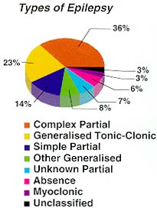
Classification of Seizures types
1. Partial (focal) seizures
- simple
- complex
2. Generalized seizures
- tonic-clonic (grand mal)
- myoclonic
- atonic
- absence (petit mal)

Slide 9
Special epileptic syndromes
Status epilepticus
  Medical emergency in which seizures are repeated continuously
    Hypoxia, hypoglycemia, acidosis, hypothermia, brain damage, death
Febrile seizures
  Tonic-clonic motor activity X 1-2 min
  During illness
  Children 3 mos- 5 yrs
  Prevention!

Slide 10
Partial Seizure
Short alteration in consciousness, repetitive unusual movements (chewing or swallowing movements), psychologic changes and confusion
Simple Partial Seizures
Complex Partial Seizures
Arise in one cerebral hemisphere (focal) with minimal spread of abnormal discharge
Normal consciousness and awareness are maintained
Motor symptoms (most commonly legs, arms, face)
Hallucinations of sight, hearing or taste, along with somatosensory changes (tingling)
Autonomic nervous system responses
Local onset, then spreads
Impaired consciousness
Clinical manifestations vary with site of origin and degree of spread
- presence and nature of aura
- automatisms
- other motor activity
Temporal lobe epilepsy most common

Slide 11
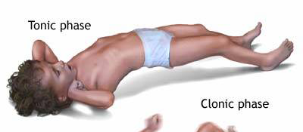
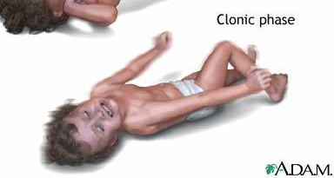
Generalized Seizures
Both cerebral hemisphere are involved with a temporary lapses in consciousness lasting a few seconds
Tonic-clonic seizures (grand mal)
Tonic Seizures: sudden stiffening of the body, arms, or legs
Clonic Seizures: rhythmic jerking movements of the arms and legs without a tonic component
http://www.nlm.nih.gov/medlineplus/ency/images/ency/fullsize/19076.jpg
Notes:
Tonic-clonic seizures (grand mal)
Most often seen in children
Tonic phase is followed by clonic phase
Tonic rigidity of all extremities followed in 15-30 sec by tremor that is actually an interruption of the tonus by relaxation; relaxation proceeds to clonic phase with massive jerking of the body, this slows over 60-120 sec followed by stuporous state
Atonic seizures: sudden loss of postural tone; most often in children but may be seen in adults
Myoclonic seizures: Brief shock-like muscle jerks generalized or restricted to part of one extremity

Slide 12
Generalized seizures
Absence seizures (Petit mal)
consciousness is altered
attack may be associated with mild clonic jerking of the eyelids or extremities, postural tone changes, autonomic phenomena and automatisms
sudden onset and abrupt cessation: duration less than 10 sec and rarely more than 45 sec
in a pediatric population, absence seizures occupy a greater proportion

Slide 13
Antiepileptic Drugs (AEDs)
A drug which decreases the frequency and/or severity of seizures in people with epilepsy
Treats the symptom of seizures, not the underlying epileptic condition
Currently no “anti-epileptogenic” drugs are available
Goal of the therapy: improve quality of life by minimizing seizures and adverse drug effects

Slide 14
Classification of Antiepileptic Drugs (AEDs)
Classical | Newer
Phenytoin Carbamazepine Valproate (valproic acid) Phenobarbital Primidone Ethosuximide | Lamotrigine Felbamate Topiramate Gabapentin Tiagabine Vigabatrin Oxycarbazepine Levetiracetam
In general, the newer AEDs have less adverse effects (e.g. CNS sedation) than the classical AEDs
Notes:
Seizure type
Pharmacokinetic profile
Drug Interactions/other medical conditions
Efficacy
Expected adverse effects
Cost

Slide 15
Cellular Mechanisms of Seizure Generation
Too much excitation
  Neurotransmitter: glutamate, aspartate
  Ionic: inward Na⁺, Ca⁺⁺ currents
Too little inhibition
  Neurotransmitter: GABA
  Ionic: inward CI⁻, outward K⁺ currents
Strategy of the AEDs Therapy
Decrease excitatory neurotransmitter system: glutamate
Increase inhibitory neurotransmitter system: GABA
Block voltage-gated inward positive currents: Na⁺ or Ca⁺⁺
Increase outward positive current: K⁺
Many AEDs are pleiotropic, i.e. act via multiple mechanisms

Slide 16
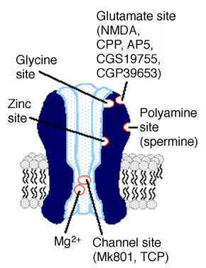
Decrease excitatory neurotransmitter system:
Modulation of glutamate ionotropic receptors
NMDA receptor
Felbamate
  Ketamine, phencyclidine: open channel blockers
  Felbamate: antagonism at the strychnine-insensitive glycine site
AMPA receptor
  Topiramate: antagonism at AMPA site
  Perampanel: non-competitive antagonist
Ketamine
Phencyclidine
Notes:
have anticonvulsant properties but also dissociative and/or hallucinogenic properties

Slide 17
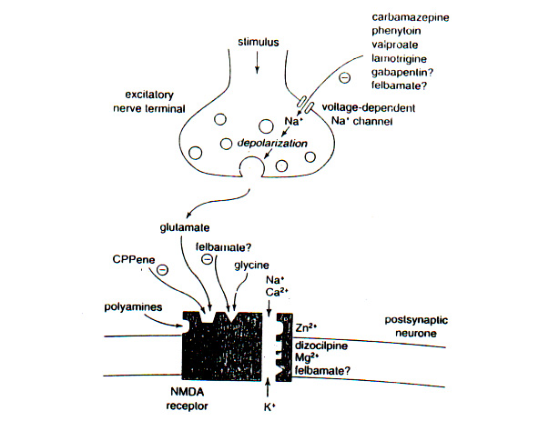
Decrease excitatory neurotransmitter system:
Modulation of glutamate-mediated transmission
Blockade of voltage-dependent
Na+ channel
Excitatory nerve terminal
Gabapentin
Blockade of voltage-dependent
Ca2+ channel
Voltage-dependent
Ca++ channel
Carbamazepine
Phenytoin
Valproic acid
Lamotrigine
Gabapentin?
Felbamate?

Slide 18
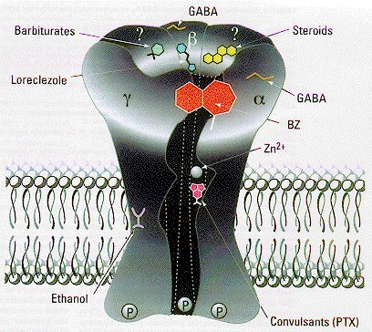
2.
Increase inhibitory neurotransmitter system:
Modulation of GABA ionotropic receptors
Benzodiazepines (diazepam, clonazepam)
  Increase frequency of GABA-mediated chloride channel openings
Barbiturates (phenobarbital, primidone)
  Prolong GABA-mediated chloride channel openings
  Some blockade of voltage-dependent sodium channels
barbiturates
benzodiazepines
Anesthetics
Topiramate

Slide 19
2.
Increase inhibitory neurotransmitter system:
Enhancement of GABAergic transmission
GAD
GABA-
Succinic
semialdehyde
Glutamic
acid
GABA
Glutamic acid
decarboxylase
transaminase
Uptake
Succinic acid
Inhibitors of GAD (isoniazide) induces convulsions
Inhibitors of GABA-transaminase are potential anticonvulsants (valproic acid, vigabatrin)
Inhibitors of GABA reuptake are potential anticonvulsants (tiagabine, vigabatrin)

Slide 20
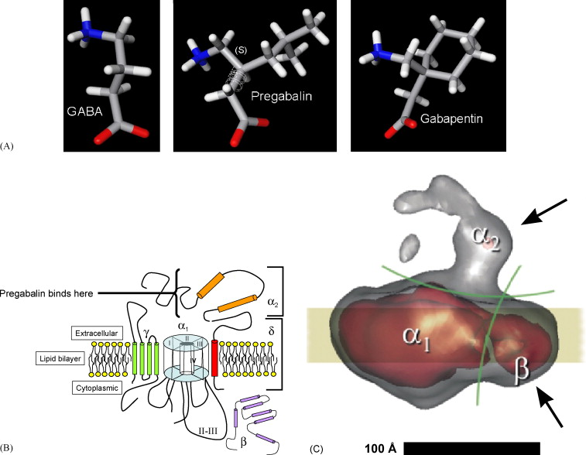
Pregabalin and Gabapentin:
a serendipitous example of drug discovery
Notes:
Figure 1. Structures of amino acid drugs and calcium channel subunits. (A) Chemical structures (derived from X-ray crystal analysis) of GABA, pregabalin and gabapentin show that GABA (the major rapid inhibitory neurotransmitter) lacks aliphatic chains attached at the 3-position; these chains are required for the pharmacology of gabapentin and pregabalin. (B) Structure and function of voltage-gated calcium channel subunits are illustrated by a schematic diagram of a single calcium channel, including the four homologous domains of the calcium channel α1 subunit (I–IV), the extracellular α2 and linked δ subunits comprising the α2–δ protein with a single transmembrane domain (red), the completely cytosolic β subunit (violet) and the less well characterized γ subunit (green; figure modified and redrawn after Arikkath and Campbell, 2003). The binding site for pregabalin and gabapentin is shown. (C) An electron microscopic image analysis of biochemically purified calcium channels from rabbit skeletal muscle reveals an approximate three-dimensional structure of a calcium channel (the yellow band represents the plasma membrane). The physical locations of α2–δ and β subunits were identified by binding of specific antibodies, shown by black arrows (reproduced with permission from Wolf et al., 2003).

Slide 21
3.
Block voltage-gated inward positive currents: Na⁺
Phenytoin, Carbamazepine
  Block voltage-dependent sodium channels at high firing frequencies (use dependent)
Oxcarbazepine
  Blocks voltage-dependent sodium channels at high firing frequencies
  Also effects K+ channels
Zonisamide
  Blocks voltage-dependent sodium channels and T-type calcium channels
Notes:
Neurons fire at high frequencies during seizures
Action potential generation is dependent on Na+ channels
Use-dependent Na+ and time-dependent channel blockers reduce high frequency firing without affecting physiological firing

Slide 22
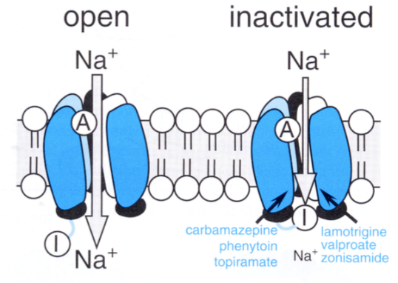
Carbamazepine
Closed
Refractory
Open
Notes:
Rallentare il recupero dei canali al sodio, sebbene abbia anche effetti metabolici importanti interferendo con il ciclo degli inositoli e con la GSK-3 (glicogeno sintasi-chinasi 3), gli stessi bersaglii molecolari degli ioni litio.
Il farmaco può essere utilizzato nelle epilessie per il trattamento delle crisi parziali e delle crisi tonico-cloniche.

Slide 23
3.
Block voltage-gated inward positive currents: Ca⁺⁺
Absence seizures are caused by oscillations between thalamus and cortex that are generated in thalamus by T-type (transient) Ca²⁺ currents
Ethosuximide is a specific blocker of T-type currents and is highly effective in treating absence seizures
4.
Increase outward positive current: K⁺
Valproic acid
Retiagabine
Notes:
K+ channels have important inhibitory control over neuronal firing in CNS—repolarize membrane to end action potentials
K+ channel agonists would decrease hyper-excitability in brain

Slide 24
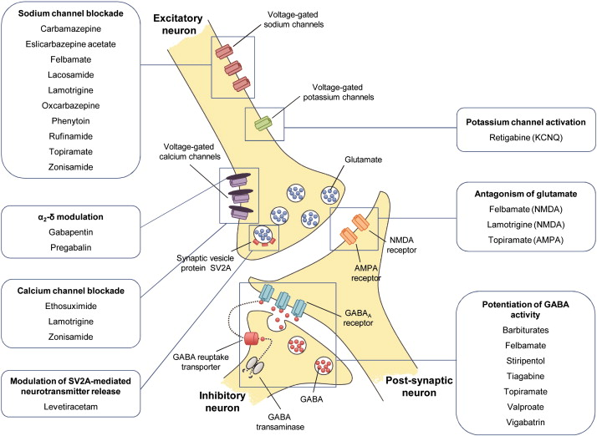

Slide 25
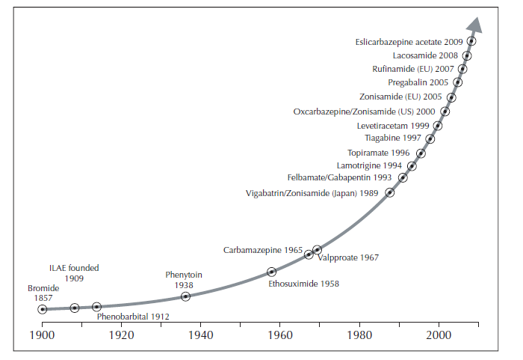
Antiepileptic drug development over the past 100 years

Slide 26
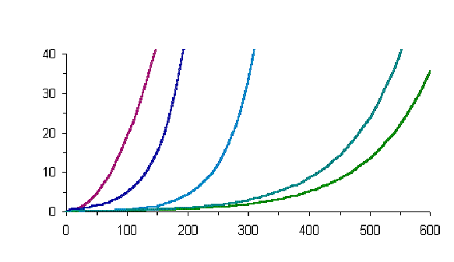
PHENYTOIN
  Saturable (zero order) kinetic in therapeutic dose range
  Potent hepatic cytochrome P-450 enzyme inducer, it can increase metabolism of other drugs
Plasma Concentration (mg/L)
Therapeutic levels
Dose (mg/day)
Relationship between Phenytoin Daily Dose and
Plasma Concentration In 5 Patients

Slide 27
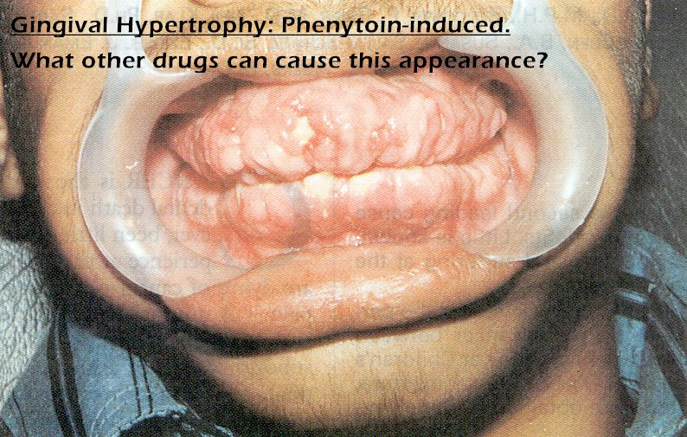
PHENYTOIN
Adverse effects
  CNS sedation (drowsiness, ataxia, confusion, insomnia)
  Impaired cognition
  Peripheral neuropathy
  Coarsening of facial features
  Hirsutism
  Gum hyperplasia
  Skin reaction

Slide 28
Newer Drugs Adverse Effects
Felbamate | aplastic anemia and severe hepatitis
Levetiracetam | Increased affective symptoms (anxiety, hostility, emotional lability)
Vigabatrin | CNS sedative, ophthalmologic abnormalities (irreversible visual loss)
Topiramate | CNS sedative (somnolence and dizziness, emotional lability, impaired concentration and psychomotor slowing, language problems)

Slide 29
