Slide 1
Interindividual variability in drug response
Treatment outcome
(same dose)
Response
No effect
Adverse effect

























Slide 2
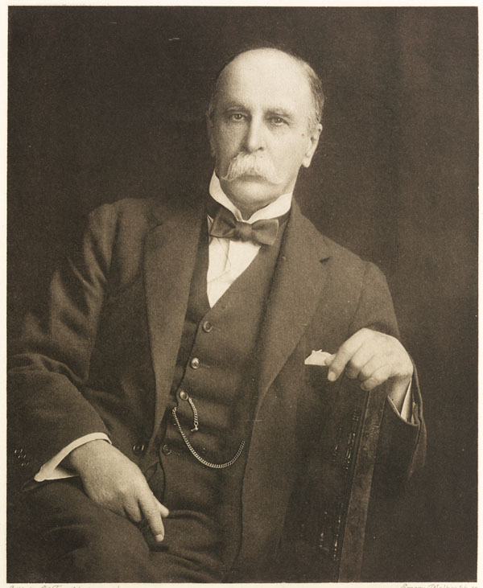
If it were not for the great variability among individuals, medicine might as well be a science and not an art.
Sir William Osler, Physician 1892
Johns Hopkins School of Medicine
The father of modern medicine
Notes:
Da qui

Slide 3
For some diseases the percentage of drug response is still unsatisfactory
US Food and Drug Administration

Slide 4
In US every year 2 million patients are hospitalized for an adverse drug reaction (ADR) to a drug that was correctly prescribed and 100.000 of these cases are fatal (4°cause of death). Lazarou J et al. JAMA 1998, 279, 1200
In UK, hospitalization for an ADR have a prevalence of 6.5%, with an annual cost of $847 millions. Pirmohamed M et al. Br Med J 2004, 329, 15.

Slide 5
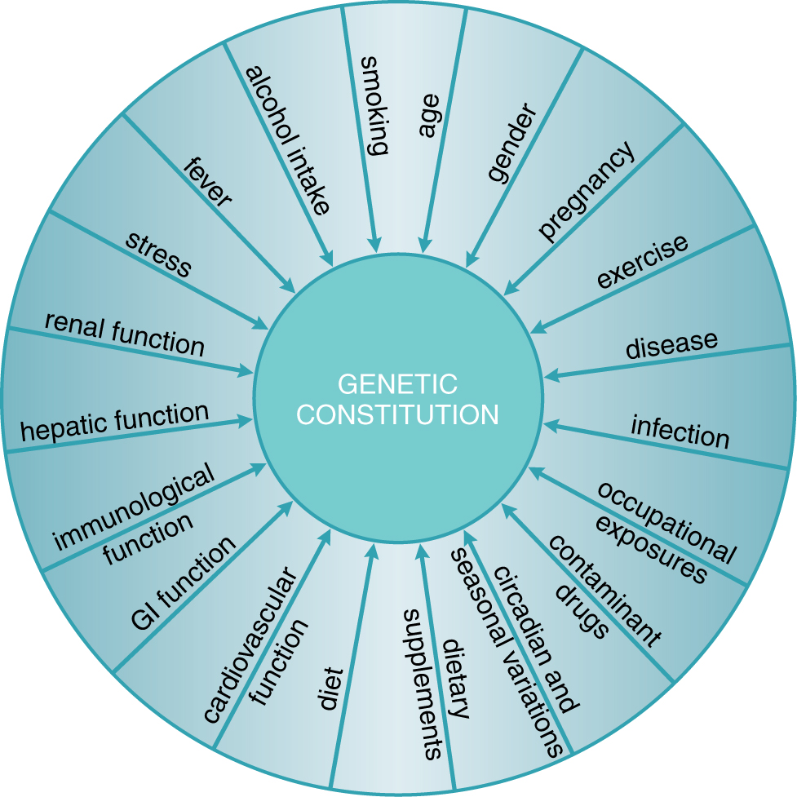
Exogenous and endogenous factors that contribute to interindividual variability in drug response
Physiological
Habits
Pathological
Genetic
Goodman and Gilman, 2011

Slide 6
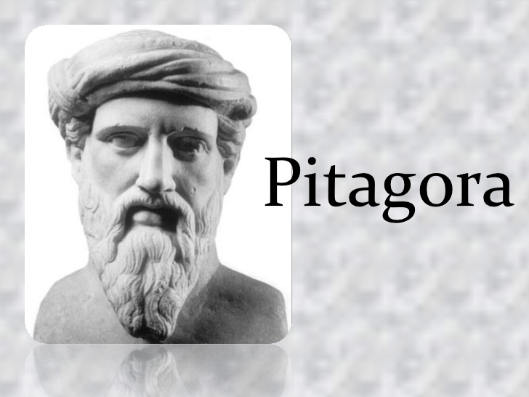
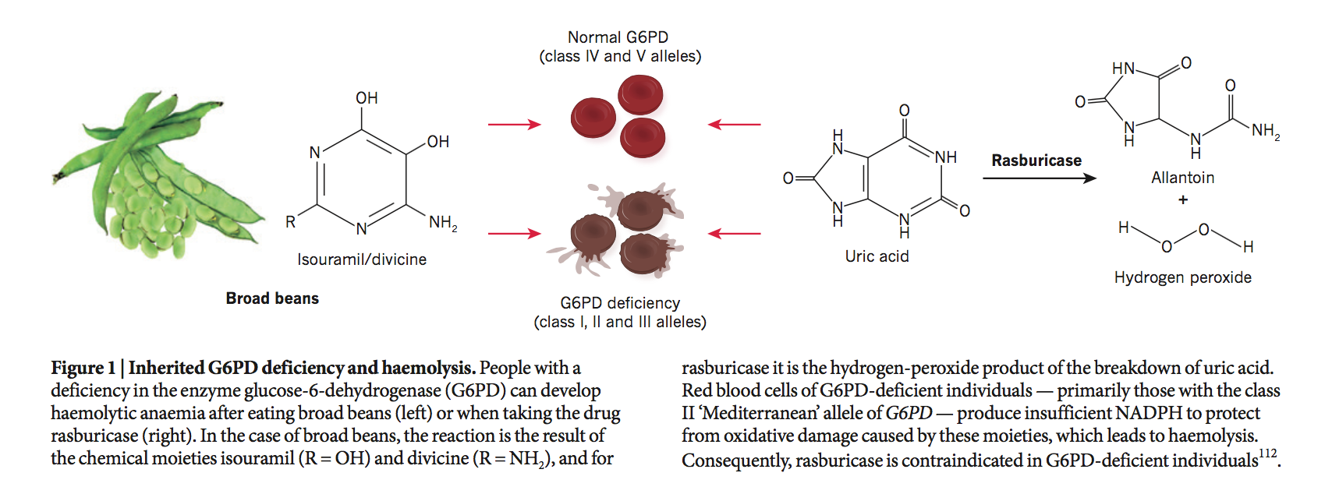
Genetic characteristics predispose to response to drugs and other substances
510 BC
Pitagora forbade his disciples to eat broad beans

Slide 7
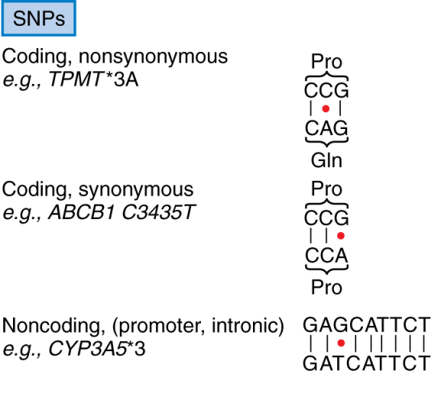

Genetic variants
Single nucleotide polymorphism (SNP)
Transition (pur→pur, pir→pir)
Transversion (pur↔ pir)
~ 1 nucleotide every 300-1000 bp
~ 17.000.000 SNPs
Deletion
Insertion
Sequence repeat
Gene copy number variation
~ 8.000 CNV
Notes:
Polimorfismo:
differenze genetiche ereditate non individuali
Differenze interindividuali e inter-etniche nel metabolismo dei farmaci

Slide 8
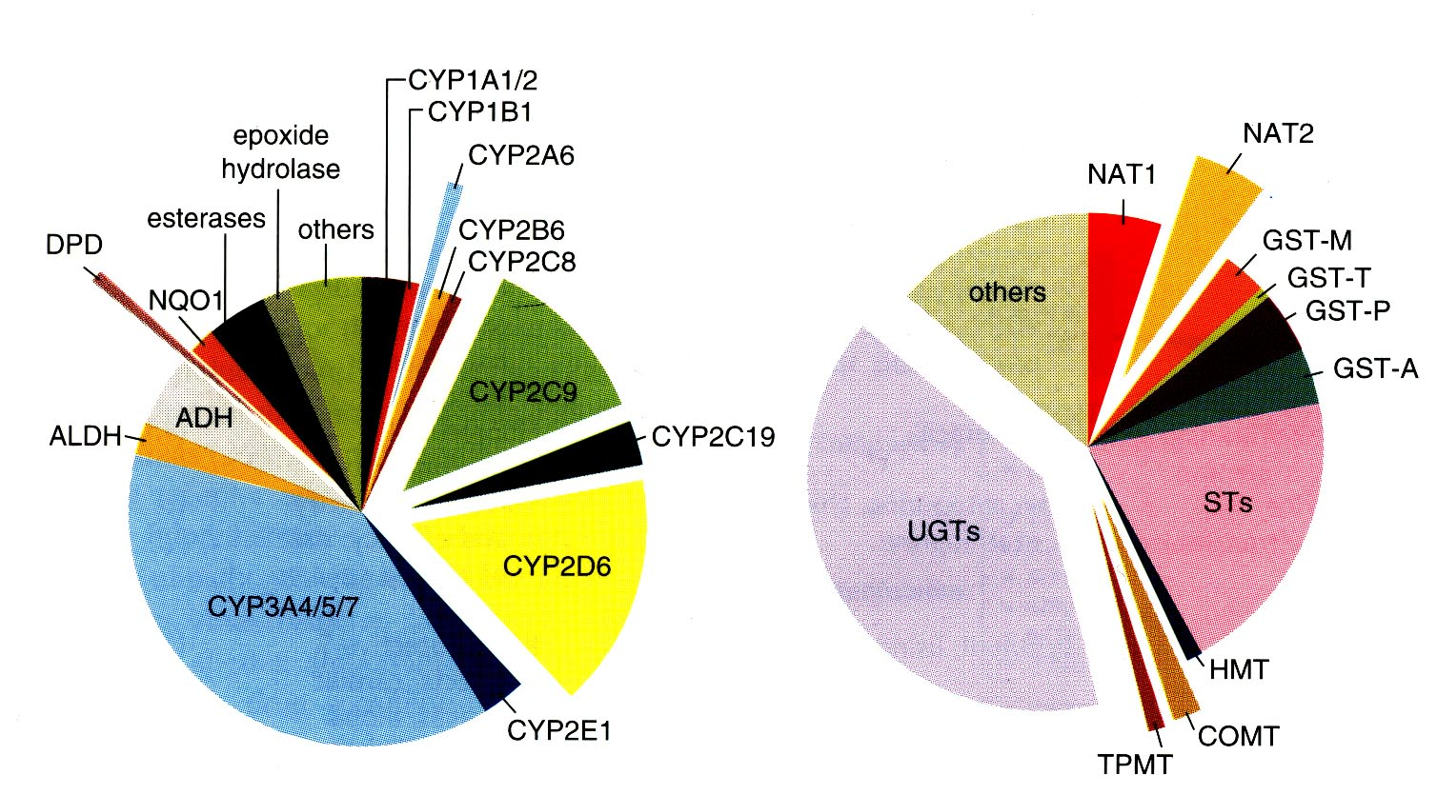
Some of the main enzymes involved in the metabolic inactivation of drugs present polymorphisms of activity that are genetically determined
Phase I
Phase II
Science 1999; 286: 487-491
Notes:
DPD: diidropirimidina deidrogenasi

Slide 9
Personalized therapy
Treatment Outcome (same dose)
Responder
No effect
Adverse event

























Slide 10
Endogenous and exogenous factors contribute to variability in drug effects
physiological
pathological
genetic
Goodman and Gilman, 2011

Slide 11
Variability can be defined as:
pharmacokinetic
pharmacodynamic
idyosyncratic

Slide 12
Factors affecting variability in drug response
Ethnic differences
Age
Pregnancy
Diseases
Drug interactions
Genetic factors

Slide 13
Ethnic differences
Ethnic means «belonging to a race». However many anthropologists are sceptical on the relevance of this concept.
Afroamericans affected from cardiac insufficiency differently from Caucasians benefit from hydralizin and nitrate.
Asiatics are more sensitive to the effects of propanolol and gefitinib, because of polymorphisms in drug targets.

Slide 15
Ethnic differences: drug metabolism

Slide 16
Ethnic differences: drug metabolism

Slide 17
Ethnic differences
Ethnic group can be considered a surrogate of typing particular variants, also involved in drug pharmacokinetics and pharmacodynamics.
However it is an approximation, therefore it is better to type directly the polymorphisms, because diversity in each ethnic group is ample.

Slide 18
Age
Age is one of the main factors affecting response to pharmacological therapy.
Children and elders present reduced drug elimination and are therefore more sensitive to drugs.
For elders also physiological (alteration of cardiovascular reflexes, increase in body fat) and pathological (hypothermia, polytherapy) factors are relevant for drug response.

Slide 19
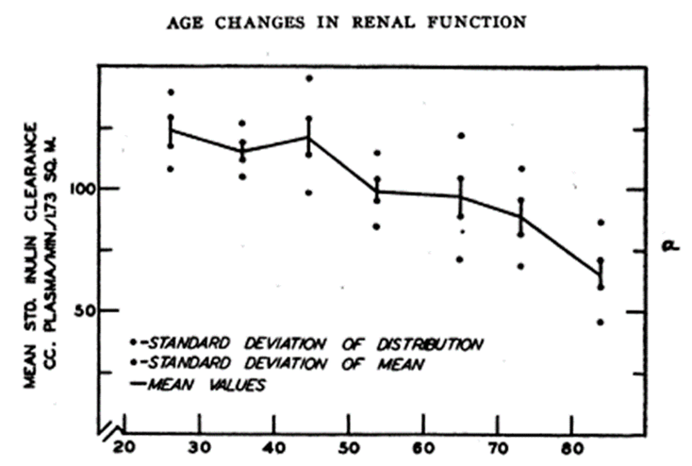
Age and drug excrection

Slide 20
Age and pharmacotherapy: pediatric patients
Pediatrics does not deal with miniature men and women, with reduced doses and the same class of disease in smaller bodies, but has its own independent range and horizon.
Dr. Abraham Jacobi

Slide 21
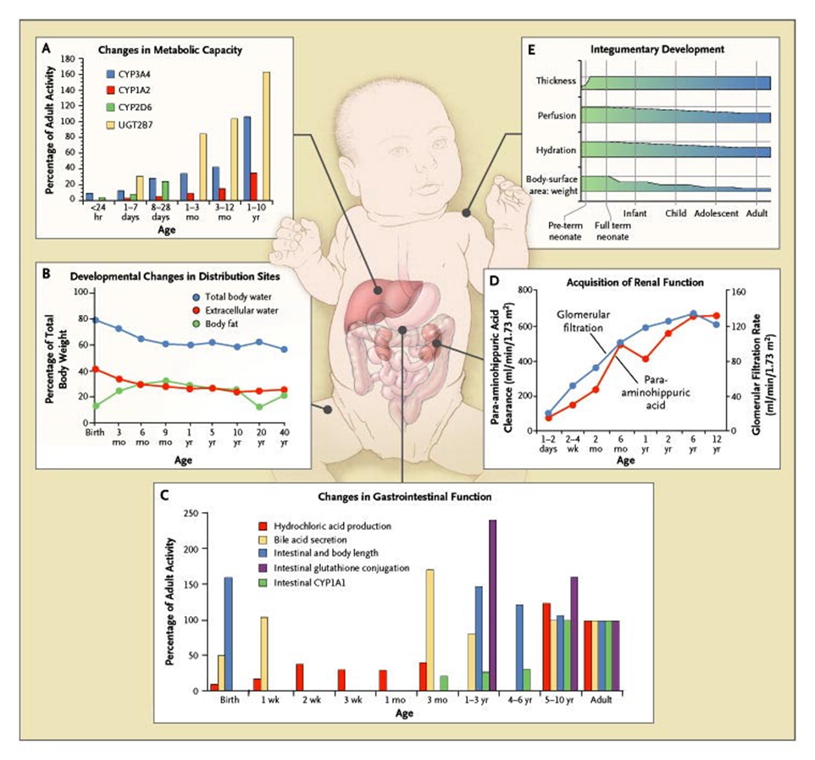
Age and pharmacotherapy: pediatric patients
Kearns GL et al. N Engl J Med 2003;349:1157-1167.

Slide 23
Epigenetic (promoter methylation) can explain age-related changes in gene expression
Kacevska et al., Biochimie 2012

Slide 24
Pregnancy

Slide 25
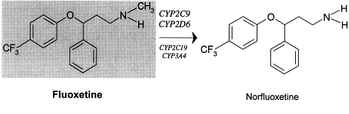
Pregnacy and cytochromes

Slide 26
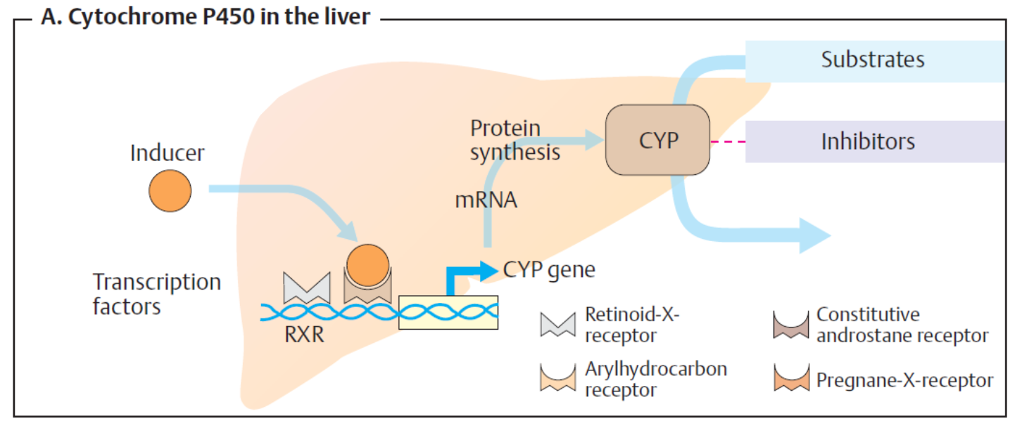
Drugs can induce expression of metabolizing enzymes

Slide 27
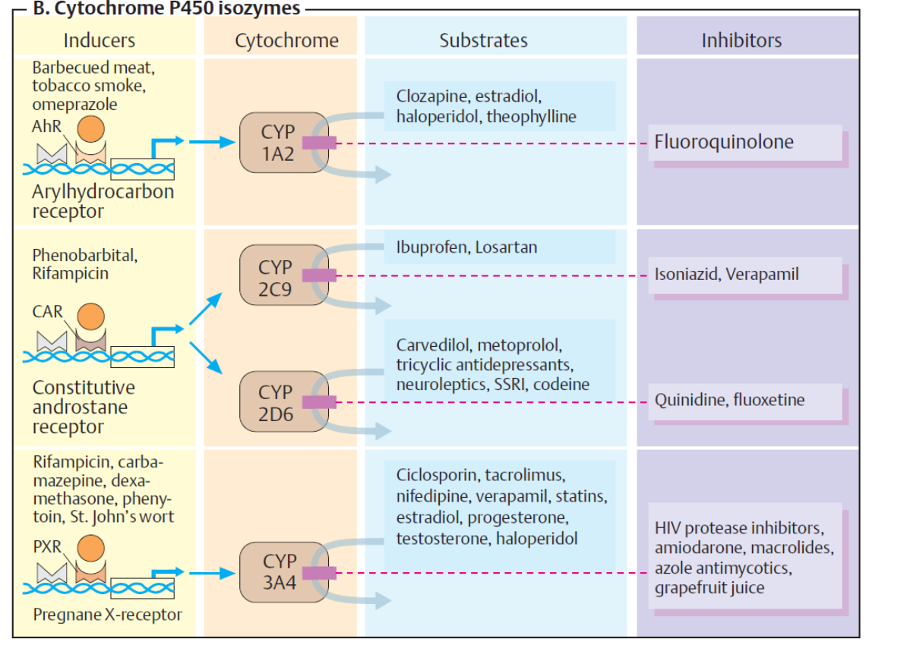

Slide 28
Personalized therapy
Treatment Outcome (same dose)
Responder
No effect
Adverse event

























Slide 29
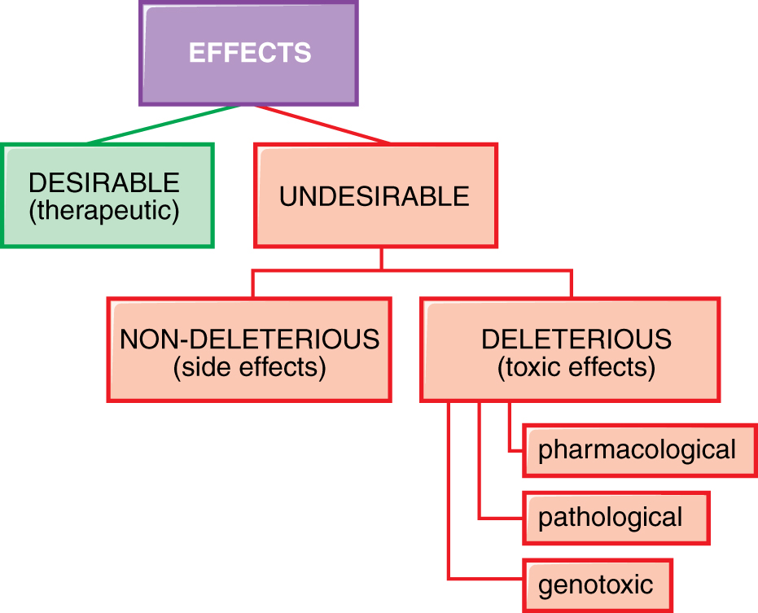
Drug effects
Goodman and Gilman, 2011

Slide 30
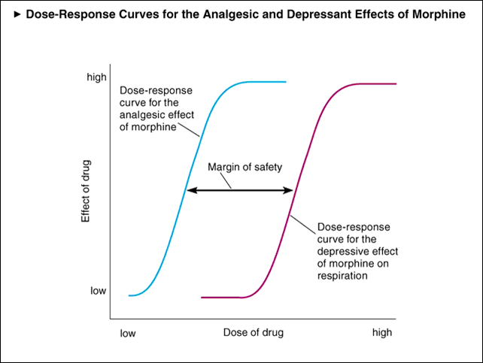
Dose dependent side effects: morphine

Slide 31
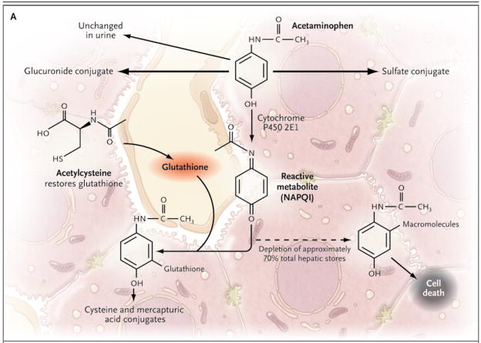
Dose dependent «off target» adverse events: paracetamol

Slide 32
Drugs that can give hypersensitivity reactions in humans

Slide 33
Hypersensitivity reactions

Slide 34
Ipotesi del meccanismo delle reazioni di ipersensibilità
"Hapten"
"Pharmacological interaction"
"Danger"

Slide 35
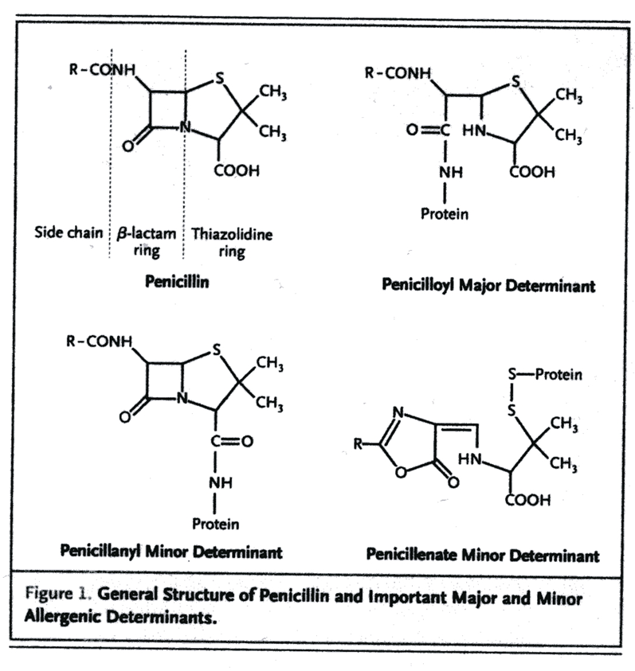
Hapten hypothesis

Slide 36
Pharmacological interaction

Slide 37
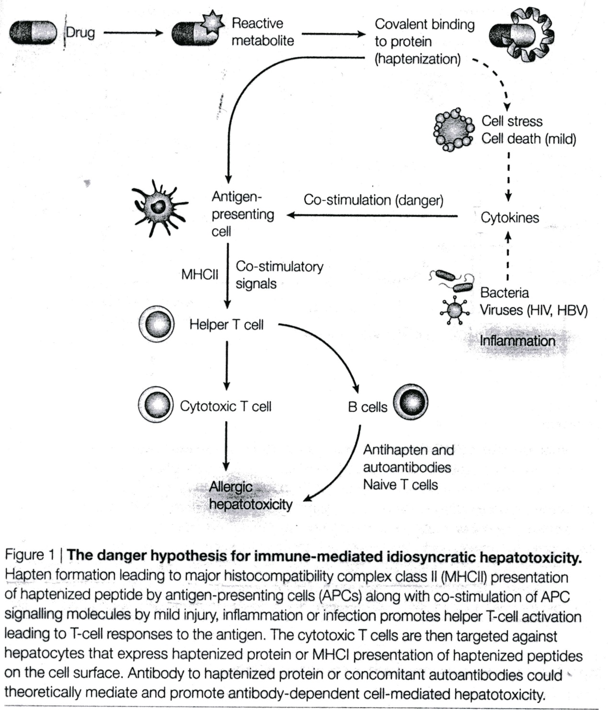
Danger hypothesis

Slide 38
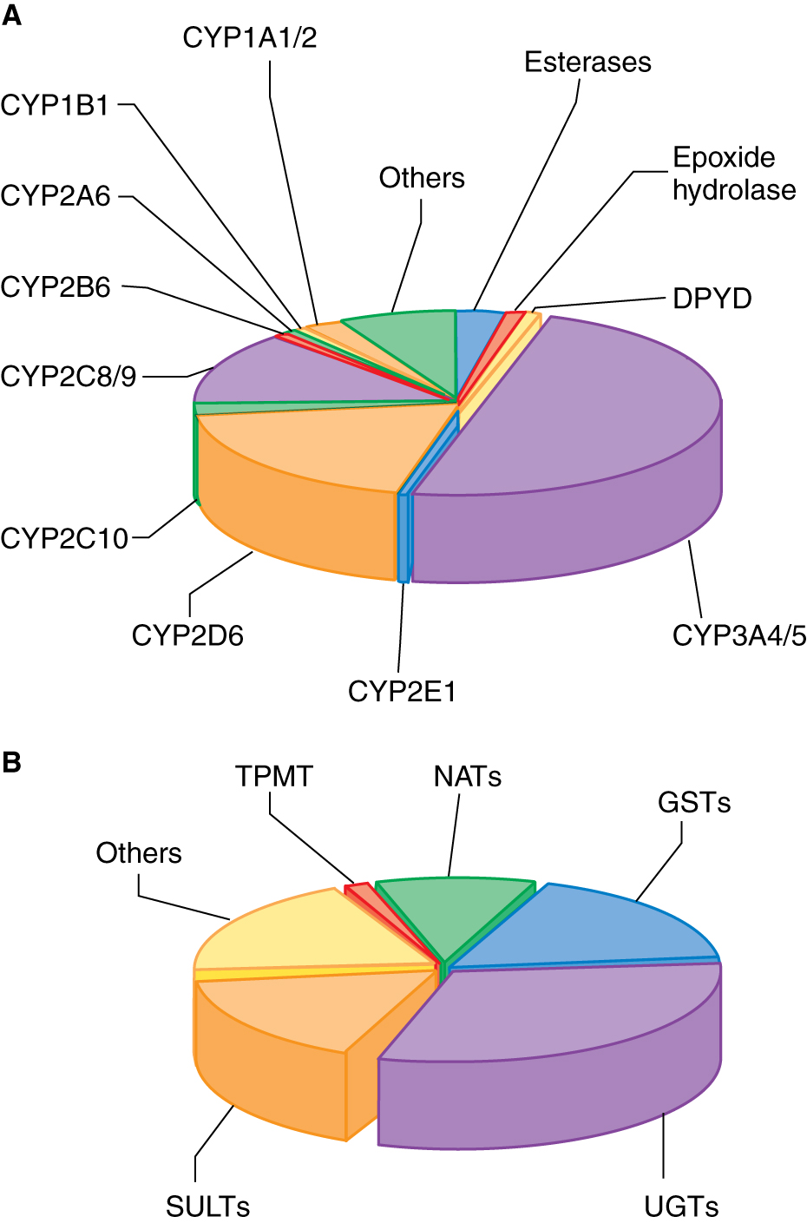
Enzymes involved in drug metabolism
Goodman and Gilman, 2011

Slide 39
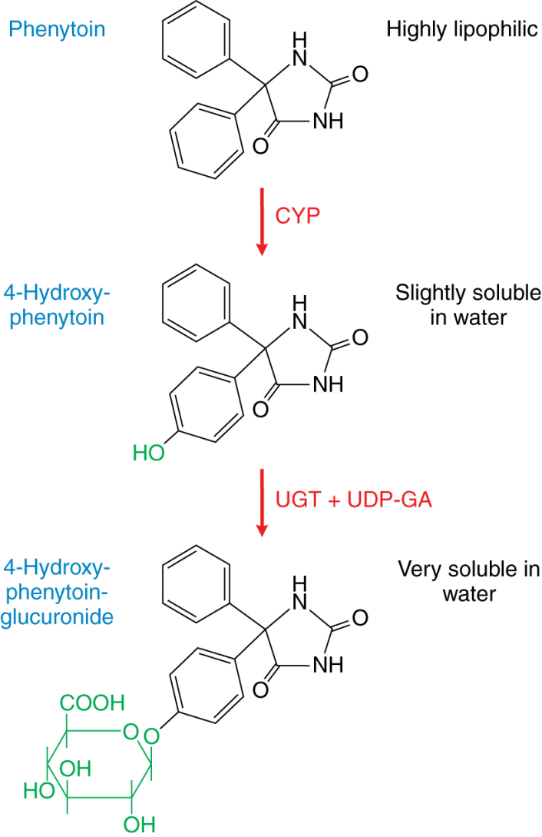
Drug metabolism: phenytoin
Goodman and Gilman, 2011

Slide 40
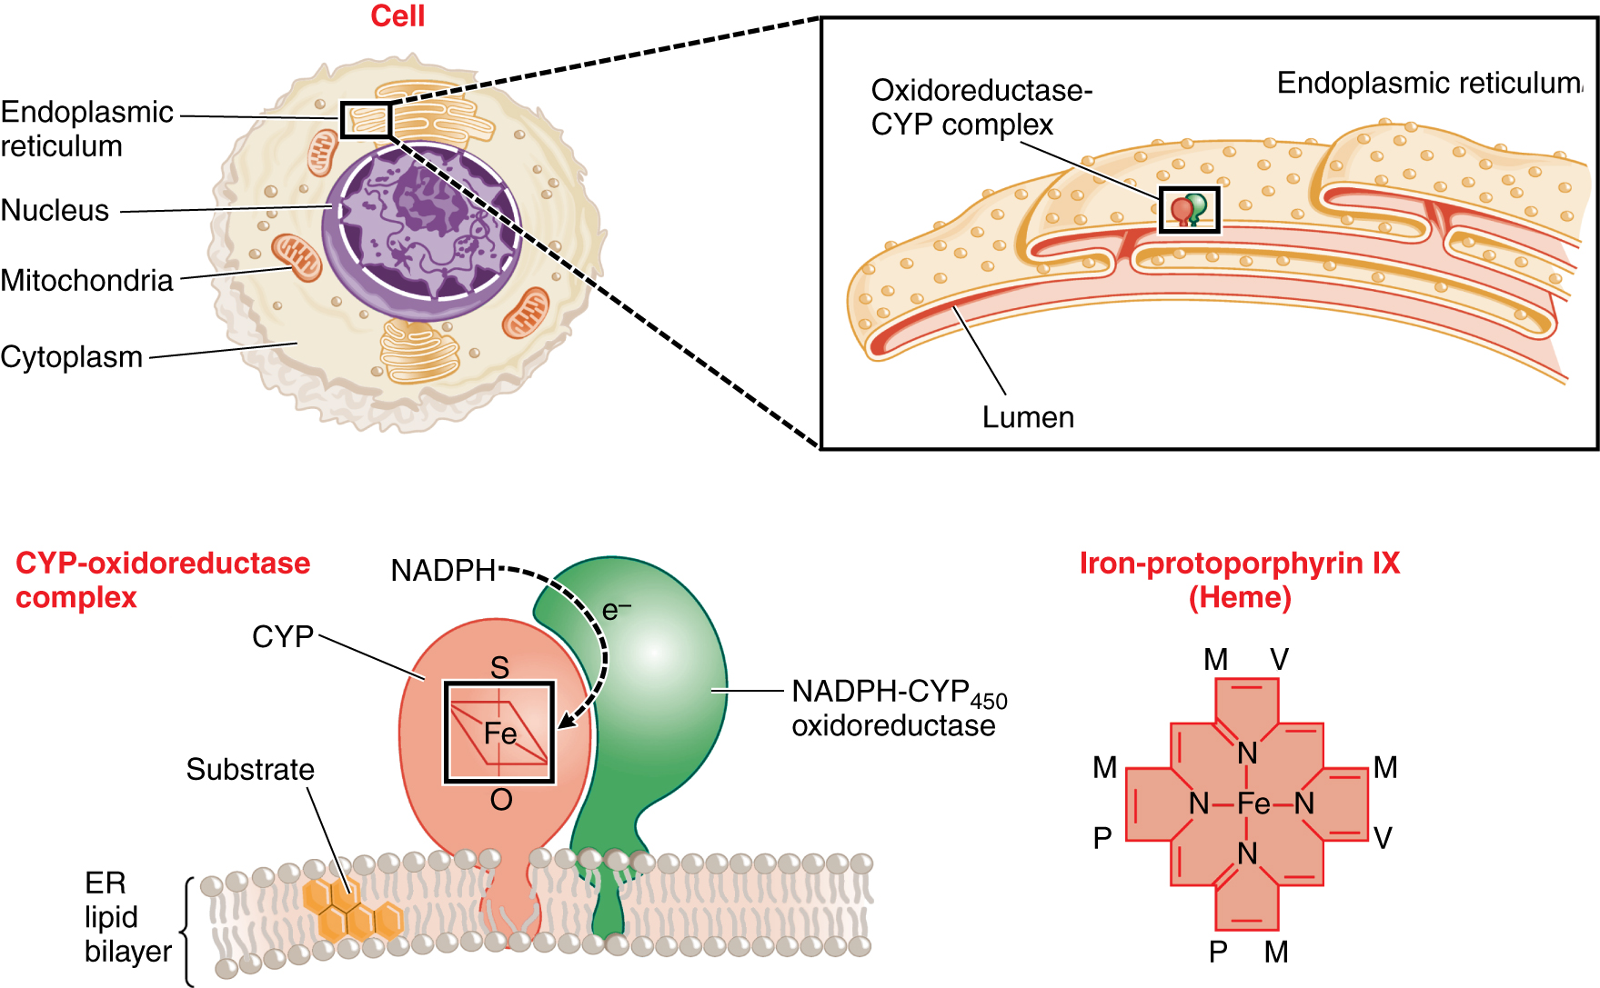
Intracellular localization of drug metabolizing enzymes
Goodman and Gilman, 2011

Slide 41
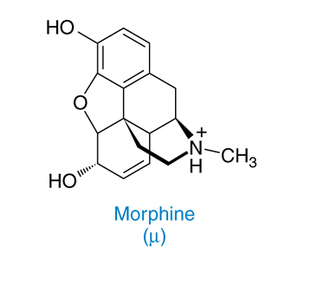
Chemical formula of morphine

Slide 42
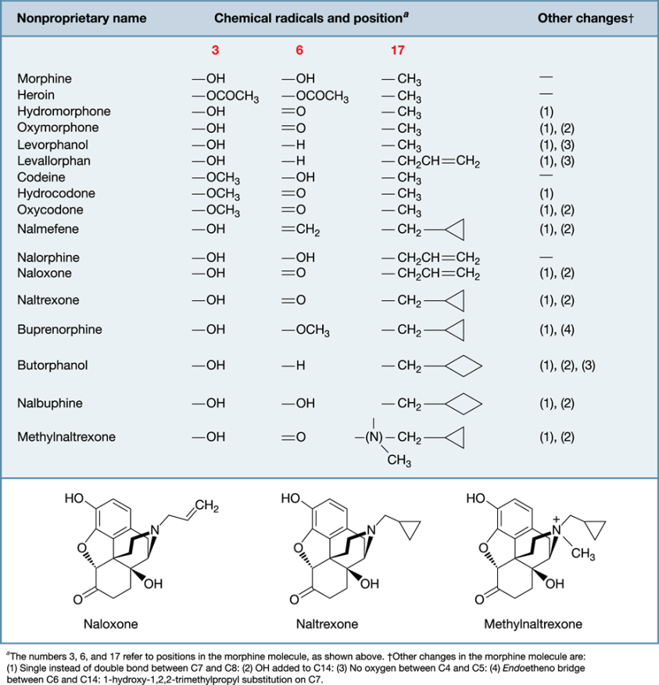
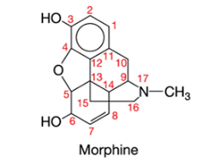
Chemical structures of opioids

Slide 43
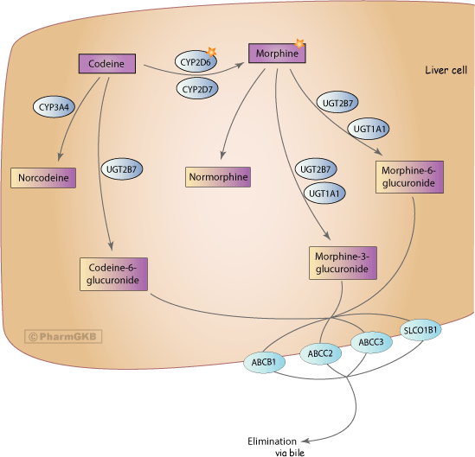
Pharmacokinetics codeine and morphine
Thorn et al., Pharmacogenetics & Genomics 2009

Slide 44
6-glucoronide metabolites of morphine is more active than morphine
Dose from 5 to 37.5 mg morphine every 6 hours
De Gregorti et al., Ther Drug Monit 2014

Slide 45
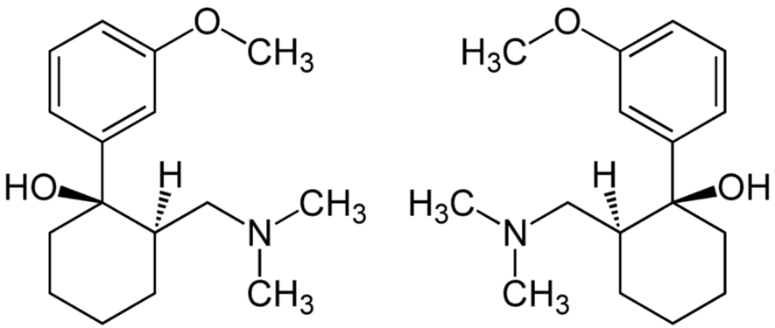
Tramadol
Synthetic opioid of the family of derivatives of amminocycloesanol.
Tramadol acts as an opioid agonist and also as an adreneric and serotoninergic agonist.

Slide 46
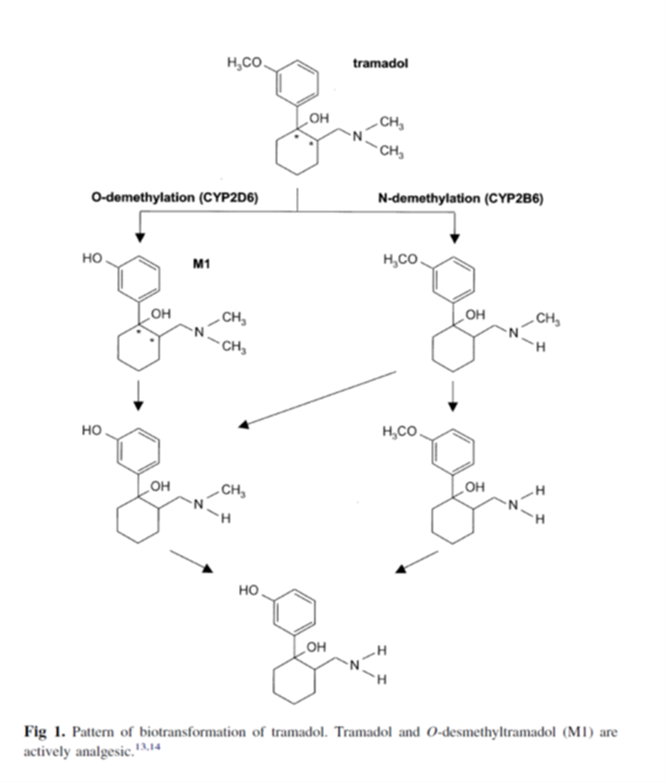
Tramadol biotransformation
(+) - M1: has an activity increased 300-400 for the μ opioid receptor

Slide 47
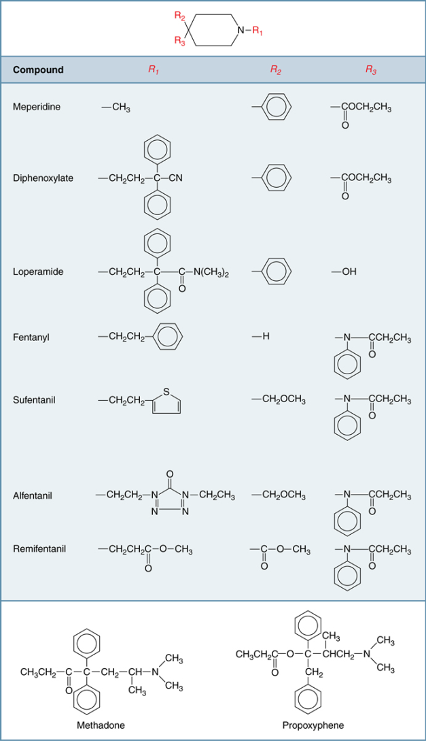
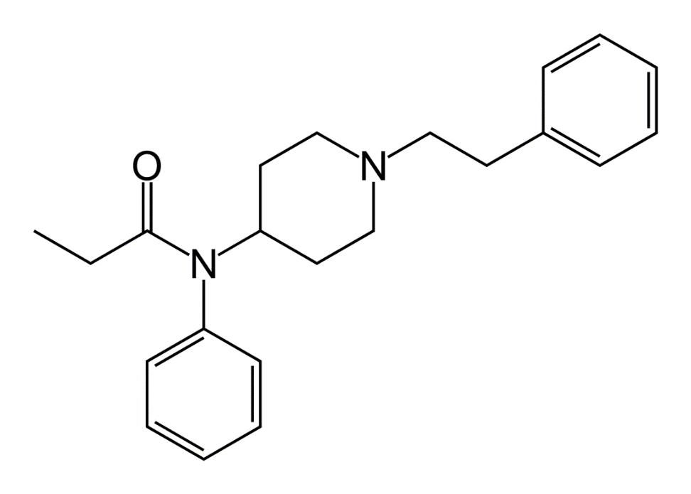
Other opioid agonists
Fentanyl

Slide 48
Pharmacokinetics codeine and morphine
Thorn et al., Pharmacogenetics & Genomics 2009

Slide 49
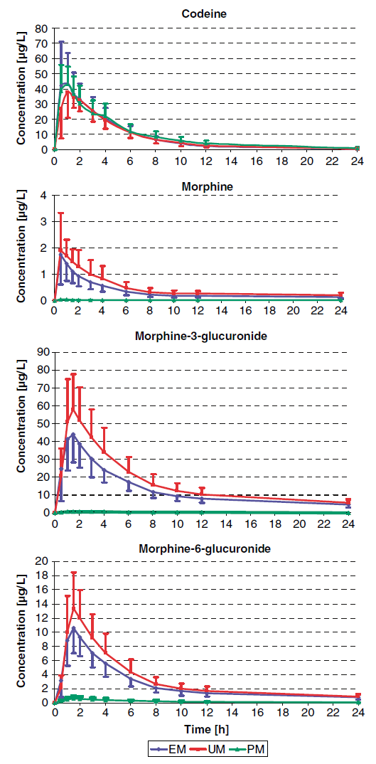
Pharmacokinetics of codeine, morphine and their metabolites and activity of CYP2D6
EM = extensive metabolizer
UM = ultra-rapid metabolizer
PM = poor metabolizer
Kirchheiner et al., Pharmacogenomics J 2007

Slide 50
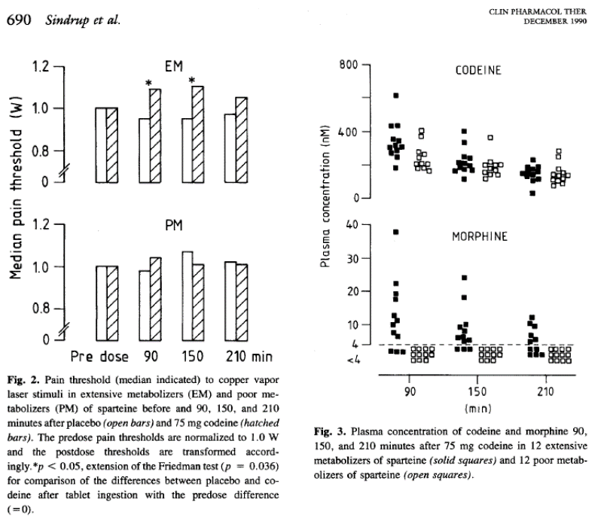
Reduced efficacy of codeine in patients with reduced activity of CYP2D6

Slide 51
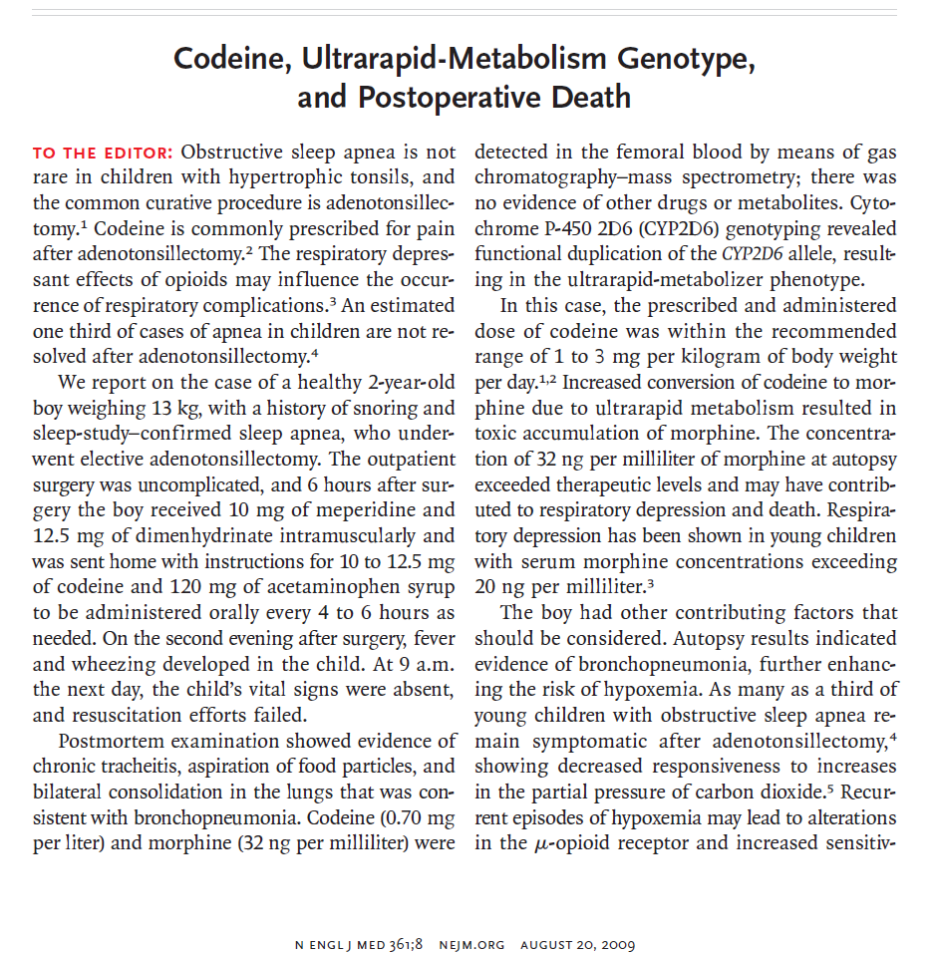

Slide 52
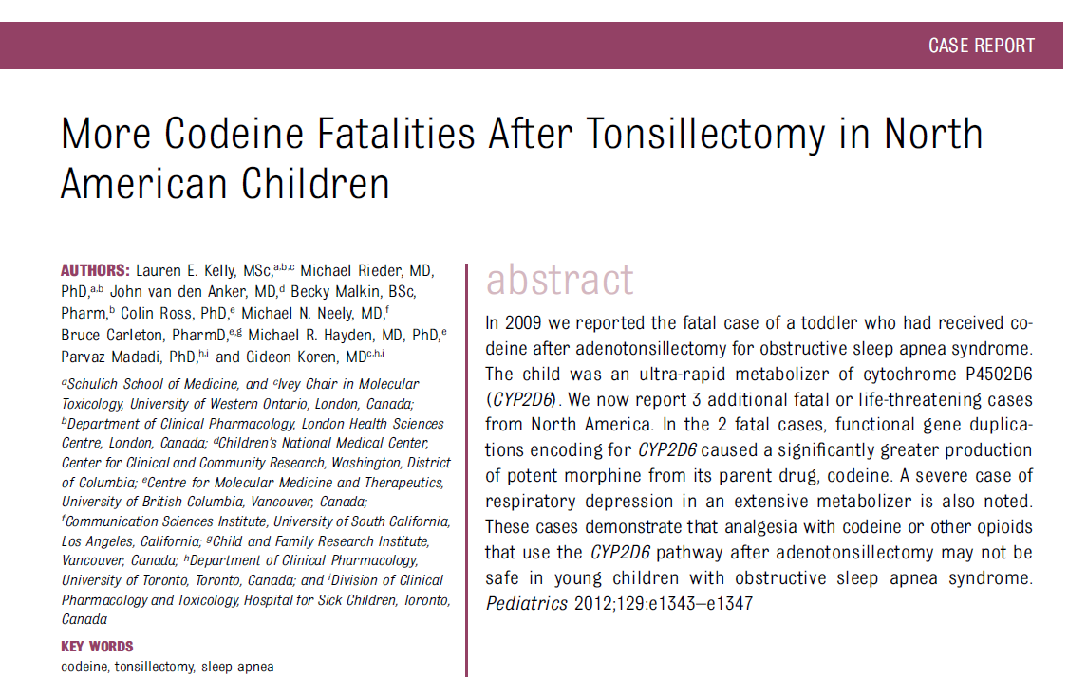
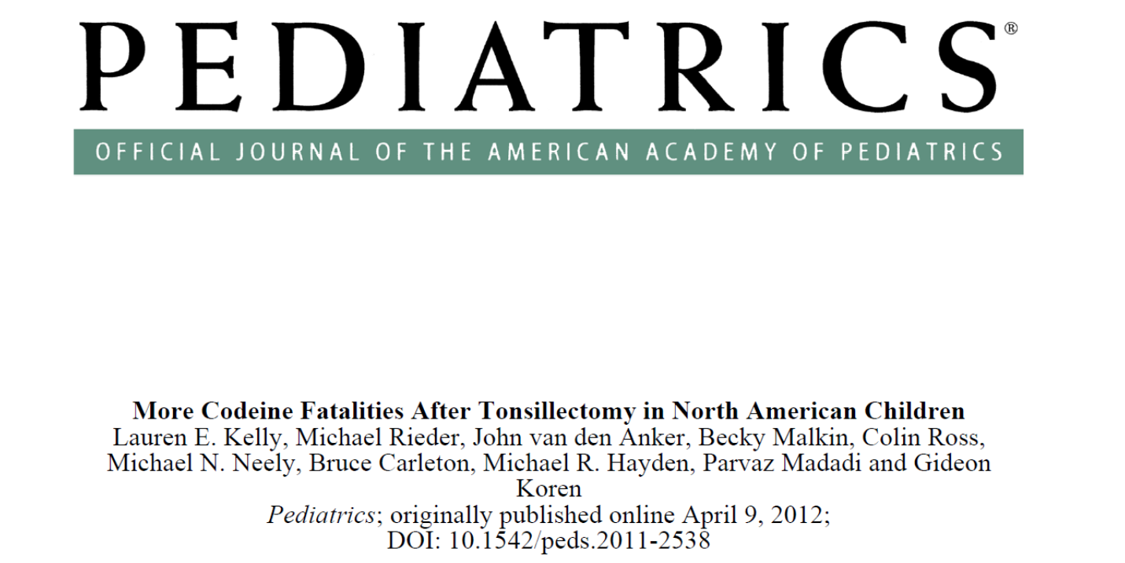

Slide 53
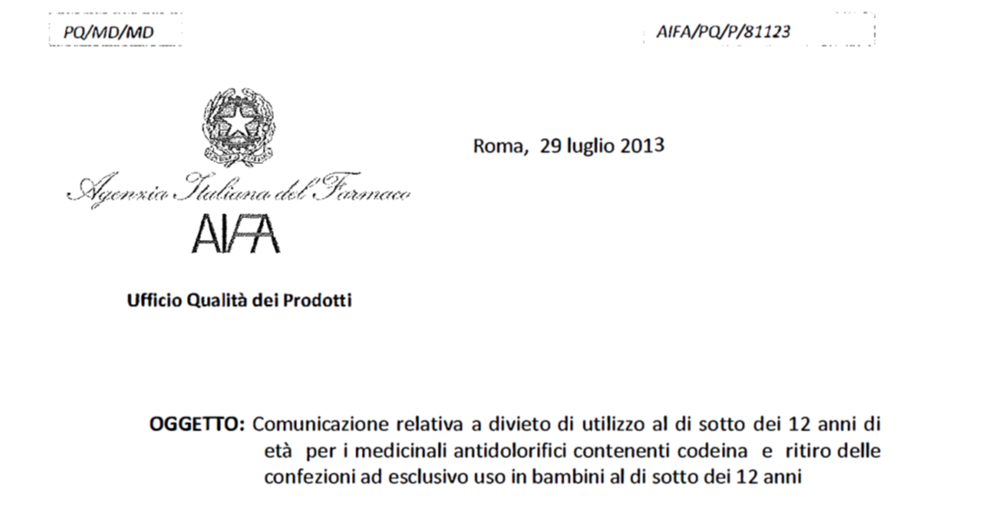

Slide 54
Frazione dei farmaci utilizzati in clinica metabolizzati dai piu’ importanti enzimi di fase 1 e fase 2
Goodman and Gilman, 2011

Slide 55
CYP2D6
DEBRISOCHINA
4-IDROSSIDEBRISOCHINA
Immagine presa da Weinshilboum R. et al., NEJM 348(6), 2006
Weinshilboum R. et al., NEJM 2006

Slide 56
Genetic polymorphisms of CYP2D6
Gene located on chromosome 22
More than 100 variants for this gene have been characterized (https://www.pharmvar.org/gene/CYP2D6).
SNPs and insertions/deletions may reduce the activity of this enzyme (~10% of the population).
Some subjects inherit multiple copies of the gene and display very high activity (2% or more of the population).

Slide 57
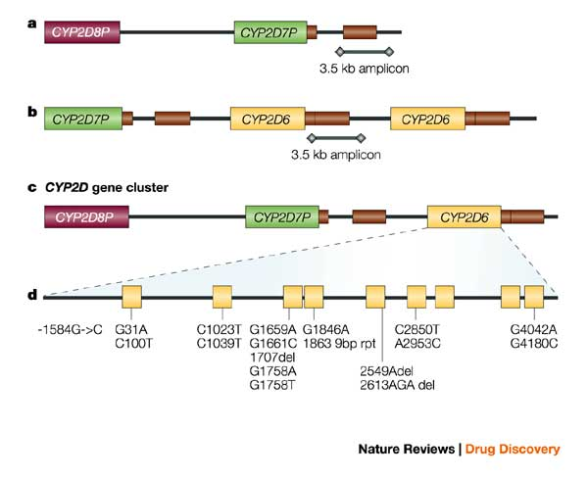
Molecular characteristic of CYP2D6 polymorphisms
- SNP
- deletions
- base repetitions
*4
*6
*3
Deletion of the gene
Amplification of the gene

Slide 58
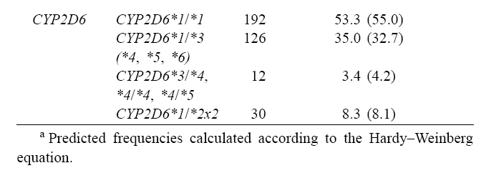
Frequency of CYP2D6 polymorphisms in the Italian population
Scordo et al., Pharm Res 2004

Slide 60
Clinical Guidelines for codeine administration
https://www.pharmgkb.org/chemical/PA449088/guideline/PA166104996

Slide 61
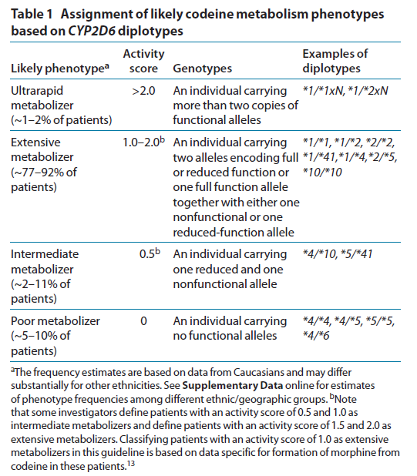
CYP2D6 genotyping and enzymatic activity
Crews et al., Clin Pharm Ther 2012

Slide 63
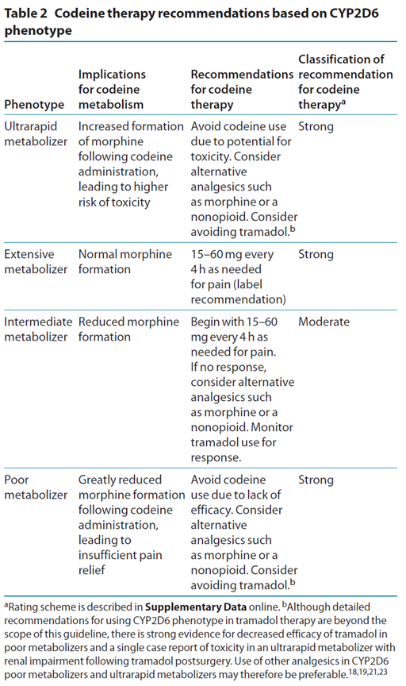
Crews et al., Clin Pharm Ther 2012

Slide 64
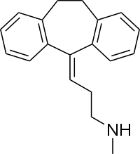
Nortriptyline pharmacokinetics and CYP2D6 genotype
Nortriptyline
Therapeutic indication: depression
Class: tricyclic antidepressant (TCA)
Mechanism of action: mixed nor-epinephrine and serotonin reuptake inhibitor
Weinshilboum R. et al., NEJM 348(6), 2006

Slide 65
Tricylic antidepressants biotransformation of pharmacogenomic relevance
Amitriptyline
Clomipramine
Doxepin
Imipramine
Trimipramine
Demethylated by CYP2C19 to differently active metabolites
Hydroxylation by CYP2D6 to less active metabolites
Desipramine
Nortriptyline

Slide 66
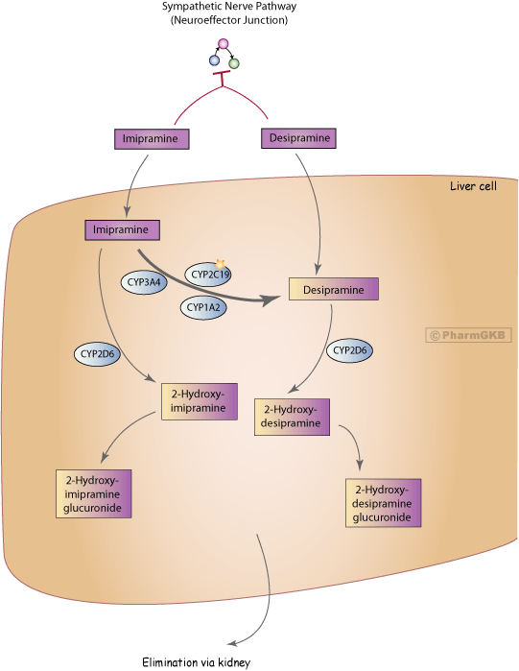
Imipramine biotransformation
https://www.pharmgkb.org/pathway/PA162359940

Slide 67
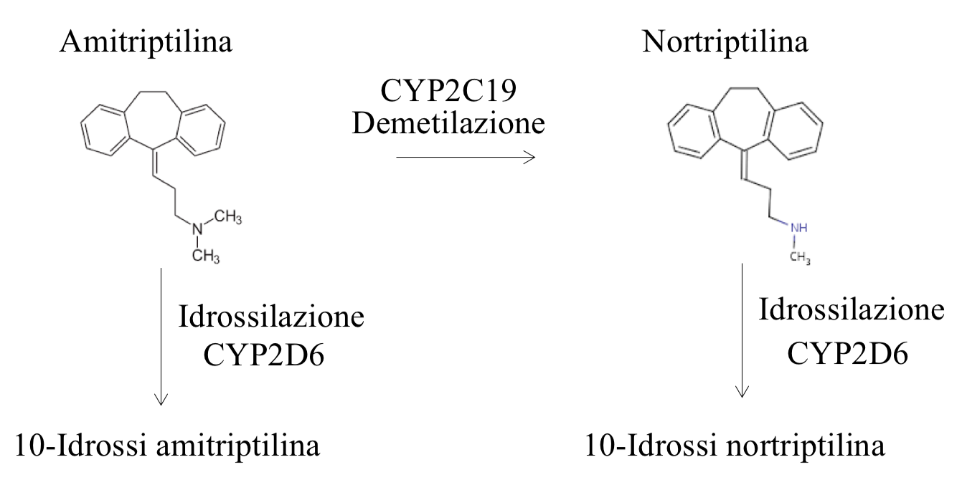
Biotransformation of tricyclic antidepressants by CYP2D6 and CYP2C19 enzymes
Amitriptylin
Nortriptylin
Demethylation
Tertiary amine more serotoninergic
Secondary amine more noradrenergic
Hydroxylation
Hydroxylation
10-hydroxy-amitriptylin
LESS ACTIVE COMPOUNDS
10-hydroxy-nortriptylin
Notes:
Dopo somministrazione orale, l’amitriptilina viene rapidamente assorbita dal tratto gastrointestinale. La velocità di assorbimento del farmaco può ridursi, specie in caso di sovradosaggio, a causa dei suoi effetti anticolinergici.
Biodisponibilità orale: 48%.
L’amitriptilina subisce effetto di primo passaggio epatico con formazione di nortriptilina, metabolita attivo
Tempo di picco plasmatico: 2,2-4,7 ore.
Concentrazioni sieriche efficaci: 60-220 ng/ml.
Dopo somministrazione orale continuata il tempo per raggiungere lo steady-state è di 3-8 ore.
Legame sieroproteico: 94,8%.
Vd: 15 L/kg.
L’amitriptilina e la nortriptilina essendo di natura molto lipofila si distribuiscono ampiamente nella maggior parte dei tessuti dell’organismo.
Permea la placenta e viene escreta nel latte materno.
L’amitriptilina possiede un attivo ricircolo enteroepatico.
L’amitriptilina viene ampiamente metabolizzata a livello epatico, principalmente attraverso reazioni di demetilazione, con formazione del metabolita attivo (nortriptilina); subisce anche reazioni di idrossilazione e N-ossidazione.
Gli isoenzimi citocromiali principali coinvolti nel metabolismo dell’amitriptilina sono 2D6, 3A4.
L’isoenzima CYP2D6 è responsabile delle reazioni di idrossilazione,
L'isoenzima CYP2C19 è coinvolti nella reazione di demetilazione dell’amitriptilina che porta alla formazione di nortriptilina.
L’amitriptilina è anche substrato della glicoproteina-P. In studi in vivo è stato dimostrato come l’inibizione del sistema di trasporto della glicoproteina-P aumenti di circa tre volte la biodisponibilità orale dell’antidepressivo. E’ probabile che la glicoproteina-P intervenga anche nella ricaptazione intestinale dell’amitriptilina.
Clearance: 11,5 ml/min/kg.
Emivita: 12,9-36,1 ore.
L’amitriptilina viene escreta principalmente attraverso le urine; è eliminata sottoforma di metaboliti in forma libera o coniugata (solo una piccola percentuale di farmaco viene escreto immodificato). Circa il 30-50% della dose somministrata è eliminata nelle urine nelle 24 ore.
Né l’emodialisi, né la dialisi peritoneale modificano le concentrazioni ematiche dell’amitriptilina e dei suoi metaboliti; il rene non ha di conseguenza un ruolo di primaria importanza nell’inattivazione di questo farmaco.

Slide 68
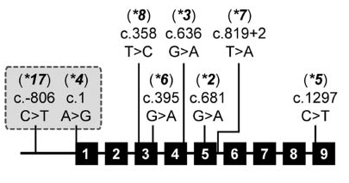
CYP2C19: alleles and frequency
Allele | SNP | Functional effect
*1 (wt) | Nessuna | Normal activity
*2 | G₆₈₁→A (coding) | Splice variant
*3 | G₆₃₆→A (coding) | W212X
*4 | A₁→G (coding) | M1V
*5 | C₁₂₉₇→T (coding) | R433W
*6 | G₃₉₅→A (coding) | R123Q
*7 | +2T₈₁₉→A (intronic) | Splice variant
*8 | T₃₅₈→C (coding) | W120R
*17 | C₋₈₀₆→T (promoter) | Increased expression
https://www.pharmvar.org/gene/CYP2C19
Notes:
SONO TUTTE SNP (SUL SINGOLO NUCLEOTIDE!)
*17, già citato nel metabolismo del Tamoxifene, UM; metabolismo elevato

Slide 69



CYP2C19 variant alleles frequency
Caucasians / African
Allele | Allele frequency
*1 (wt)
*2 | ~15% Caucasians and Africans; ~30% Asians
*3 | <1% in Caucasians and Africans; 2-9% in Asians
*4 | < 1%
*5 | < 1%
*6 | < 1%
*7 | < 1%
*8 | < 1%
*17 | ~3-21%
Asians

Slide 70
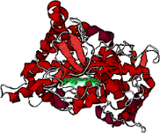

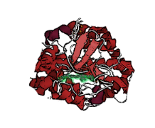

CYP2C19 variant alleles enzymatic activity
CYP2C19: LOF e GOF
Allele | Enzyme activity
*1 (wt) | Functional, normal activity
*2 - *3 - *4 *5 - *6 - *7 - *8 | Loss of function, reduced activity
*17 | Increased activity?
Notes:
*4 ATTIVITA’ PERDUTA, negli altri casi diminuita

Slide 72
Hicks et al., Clin Pharm Ther 2016

Slide 73
Hicks et al., Clin Pharm Ther 2016

Slide 74
Hicks et al., Clin Pharm Ther 2016

Slide 75
Therapeutic ranges for antidepressants
Hiemke, C. et al. AGNP consensus guidelines for therapeutic drug monitoring
in psychiatry: update 2011. Pharmacopsychiatry 44, 195–235 (2011)

Slide 76
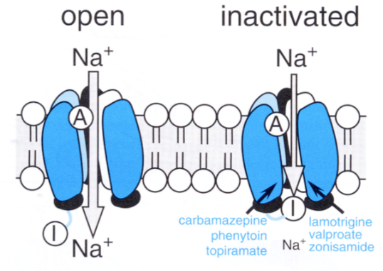
Carbamazepine
- Aromatic anticonvulsant
- Active by inhibition of sodium channels in the refractory state, therefore with an higher specificity for neurons that are hyperactive
- the allele HLA-B*15:02 is associated with severe dermatological reaction in Asian patients
- the allele HLA-A*31:01 is associated with hypersensitivity in Caucasian patients
Notes:
Rallentare il recupero dei canali al sodio, sebbene abbia anche effetti metabolici importanti interferendo con il ciclo degli inositoli e con la GSK-3 (glicogeno sintasi-chinasi 3), gli stessi bersaglii molecolari degli ioni litio.
Il farmaco può essere utilizzato nelle epilessie per il trattamento delle crisi parziali e delle crisi tonico-cloniche.

Slide 77
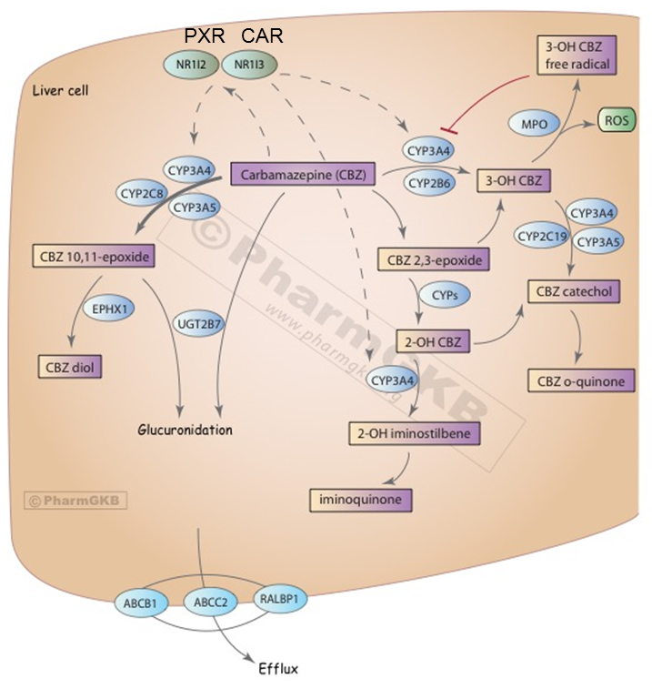
Carbamazepine biotransformation pathway

Slide 78
CPIC guidelines for carbamazepine

Slide 79
Pharmacogenetic testing my affect clinicians behaviour
Chen et al., Neurology 2014

