Slide 1
Earthquake: size
There are two methods of describing how large an earthquake is. The intensity of the earthquake is a subjective parameter that is based on an assessment of visible effects.
It therefore depends on factors other than the actual size of the earthquake. The magnitude of an earthquake is determined instrumentally and is a more objective measure of its size, but it says little directly about the seriousness of the ensuing effects.
Illogically, it is usually the magnitude that is reported in news coverage of a major earthquake, whereas the intensity is a more appropriate parameter for describing the severity of its effects on mankind and the environment.

Slide 2
Earthquake: intensity
Large earthquakes produce alterations to the Earth’s natural surface features, or severe damage to man-made structures such as buildings, bridges and dams. Even small earthquakes can result in disproportionate damage to these edifices when inferior constructional methods or materials have been utilized. The intensity of an earthquake at a particular place is classified on the basis of the local character of the visible effects it produces.
It depends very much on the acuity of the observer, and is in principle subjective. Yet, intensity estimates have proved to be a viable method of assessing earthquake size, including historical earthquakes.
The first attempt to grade earthquake severity was made in the late eighteenth century by Domenico Pignataro, an Italian physician, who classified more than 1000 earthquakes that devastated the southern Italian province of Calabria in the years 1783–1786. His crude analysis classified the earthquakes according to whether they were very strong, strong, moderate or slight.
In the mid-nineteenth century an Irish engineer, Robert Mallet, produced a list of 6831 earthquakes and plotted their estimated locations, producing the first map of the world’s seismicity and establishing that earthquakes occurred in distinct zones. He also used a four-stage intensity scale to grade earthquake damage, and constructed the first isoseismal maps with lines that outlined areas with broadly equal grades of damage.

Slide 3
The Rossi–Forel intensity scale, developed in the late nineteenth century by the Italian scientist M. S. de Rossi and the Swiss scientist F. Forel, incorporated ten stages describing effects of increasing damage.
In 1902 a Italian seismologist, G. Mercalli, proposed a still more extensive, expanded intensity scale which reclassified earthquake severity in twelve stages.
A variation, the Modified Mercalli (MM) scale, was developed in 1931 to suit building conditions in the United States, where a later modification is in common use. The Medvedev–Sponheuer–Karnik (MSK) scale, introduced in Europe in 1964, and modified in 1981, also has twelve stages and differs from the MM scale mainly in details.
A new European Macroseismic Scale (EMS-98) was adopted in 1998; an abridged version. The new 12-stage EMS scale is based on the MSK scale but takes into account the vulnerability of buildings to earthquake damage and incorporates more rigorous evaluation of the extent of damage to structures with different building standards.

Slide 4
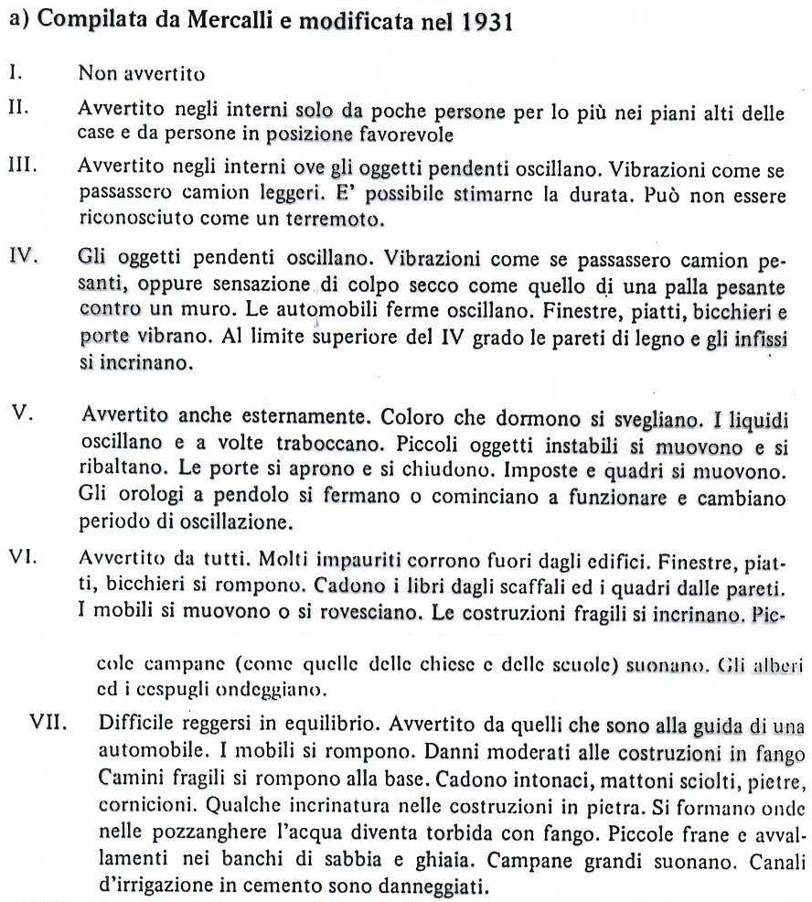
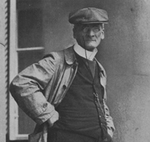
Notes:
4

Slide 5
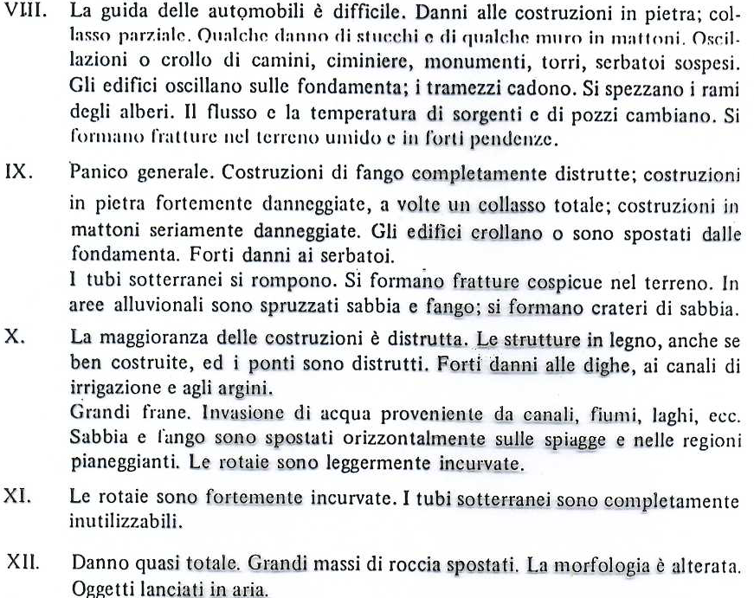
Notes:
5

Slide 6
The scale focuses especially on the effects on people and buildings. It takes into account classifications of both the vulnerability of a structure (i.e., the materials and method of construction) and the degree of damage.

Slide 7
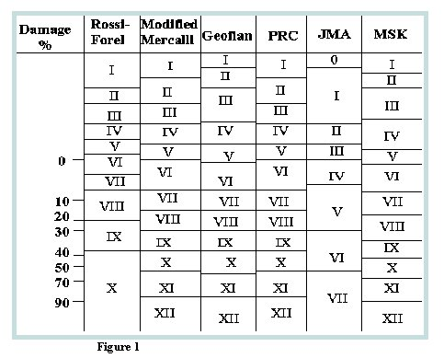

Slide 8
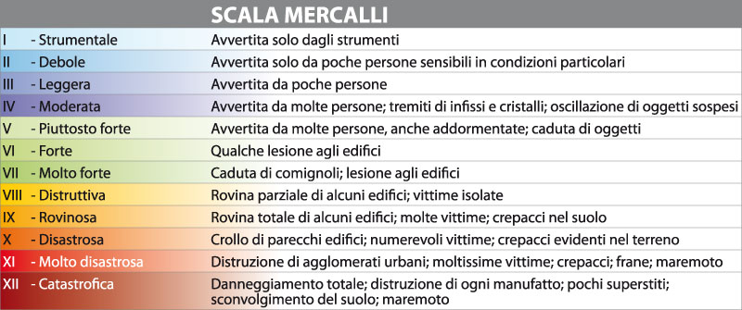
Intensità
Misura gli effetti di un terremoto sulle persone, sugli edifici e sul territorio.

Slide 9
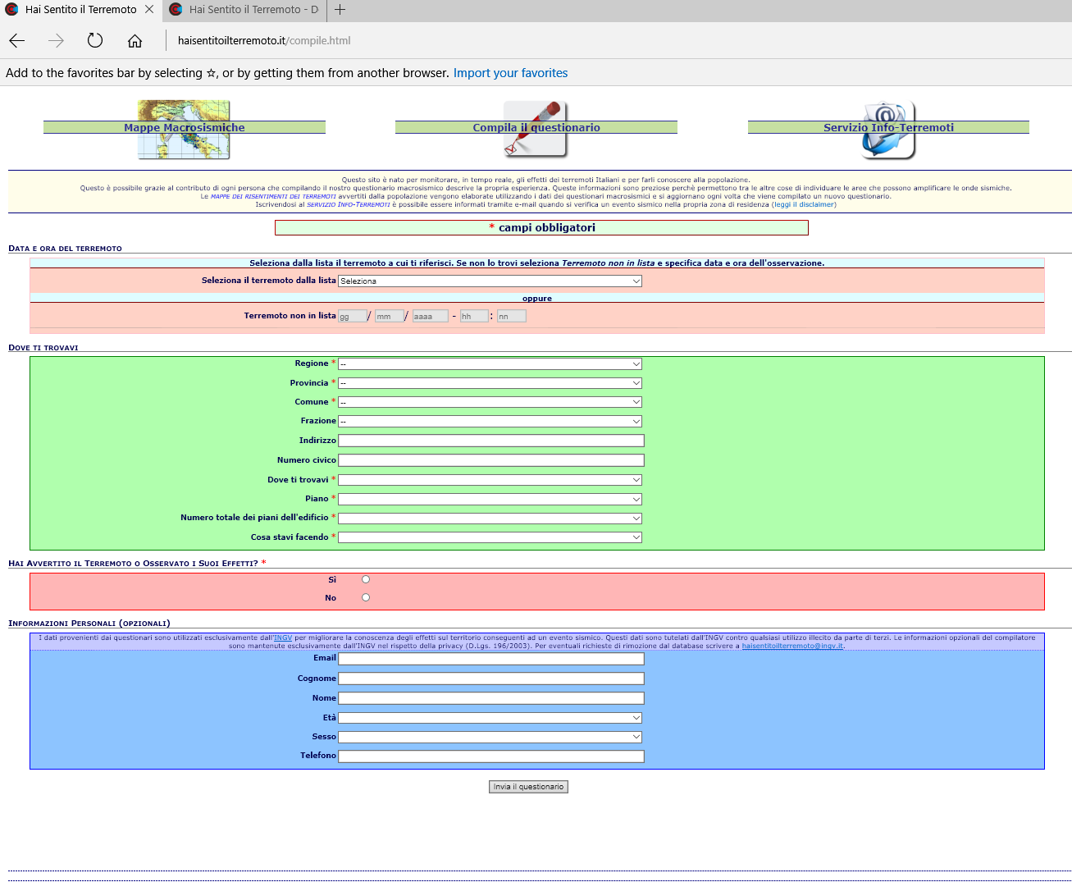
Intensità

Slide 10
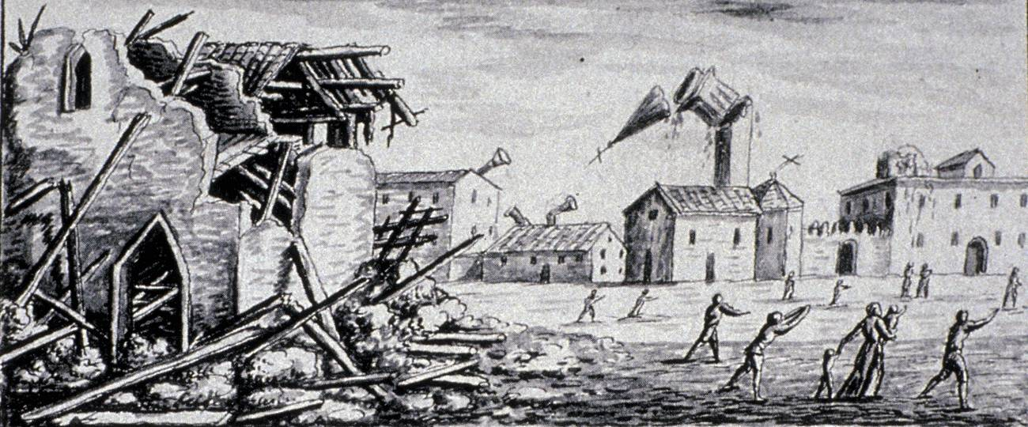
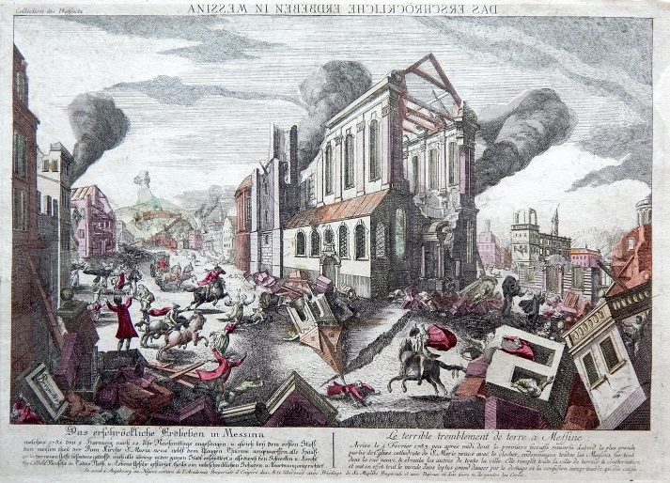
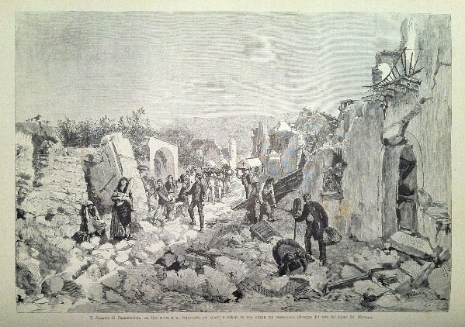
Intensità

Slide 11
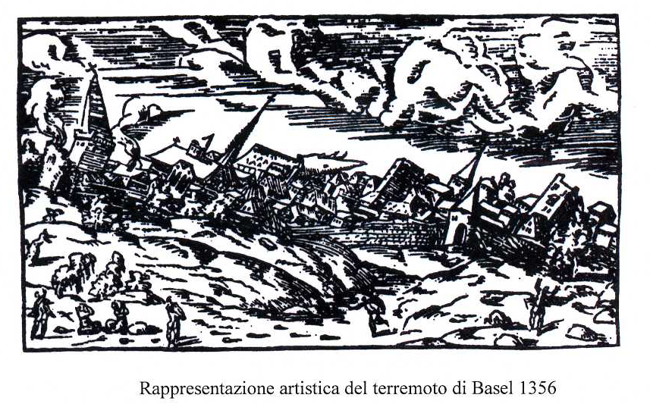
Notes:
11

Slide 12
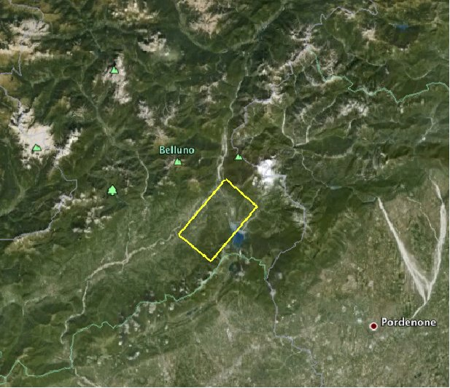
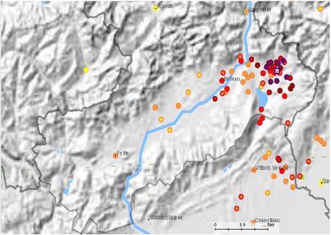

Intensità
Terremoto di Belluno del 29 giugno 1873, Mw 6.3

Slide 13
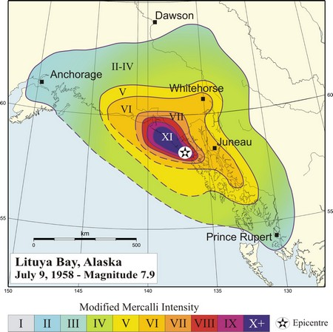
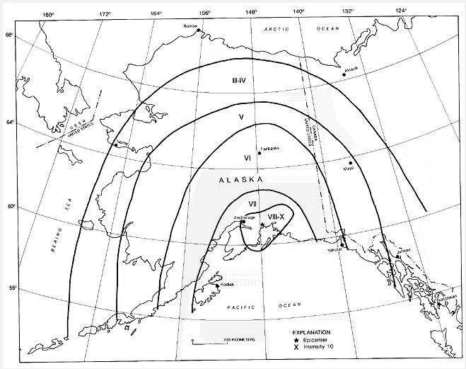
In order to evaluate the active seismicity of a region questionnaires may be distributed to the population, asking for observations that can be used to estimate the intensity experienced. The questionnaires are evaluated with the aid of an intensity scale, and the intensityrecorded at the location of each observer is plotted on a map.
Continuous lines are then drawn to outline places with the same intensity, in the same way that contour lines are used on topographic maps to show elevation.

Slide 14
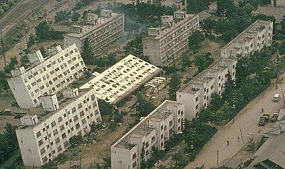
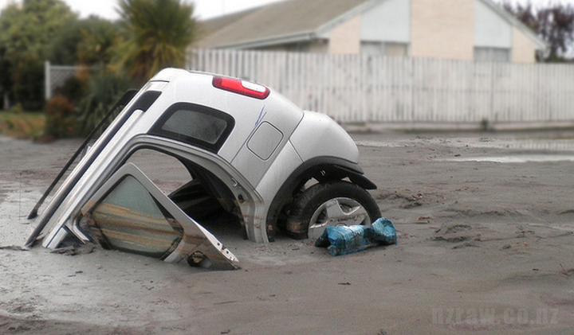
Comparison of the isoseismal maps with geological maps helps explain the response of the ground to the shake of an earthquake. This is valuable information for understanding earthquake risk. The foundation on which structures are erected plays a vital role in their survival of an earthquake. For example, soft sediments can amplify the ground motion, enhancing the damage caused. This is even more serious when the sediments have a high water content, in which case liquefaction of the sediments can occur, robbing structures built on them of support and promoting their collapse.

Slide 15
Intensity data play an important role in determining the historic seismicity of a region. An earthquake has dramatic consequences for a population; this was especially the case in the historic past, when real hazards were augmented by superstition.
The date (and even the time) of occurrence of strong earthquakes and observations of their local effects have been recorded for centuries in church and civil documents. From such records it is sometimes possible to extract enough information for a given earthquake to estimate the intensity experienced by the observer.
If the population density is high enough, it may be possible to construct an isoseismal map from which the epicenter of the tremor may be roughly located.
An interesting example of this kind of analysis is the study of the New Madrid earthquakes of 1811–1812, which caused devastation in the Mississippi valley and were felt as far away as the coastlines along the Atlantic and Gulf of Mexico. There were probably three large earthquakes, but the events occurred before the invention of the seismograph so details of what happened are dependent on the subjective reports of observers. Historical records of the era allow development of an intensity map for the settled area east of the Mississippi, but the pioneering population west of the river was at that time too sparse to leave adequate records for intensity interpretation. On the basis of the available evidence these earthquakes are estimated to have had magnitudes of 7.8–8.1.

Slide 16


Slide 17
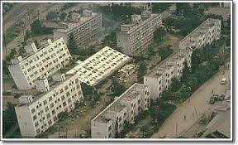
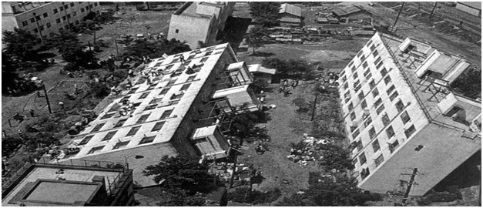
Effetti di sito

Slide 18

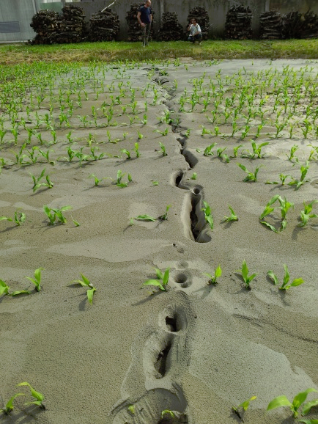
EFFETTI LOCALI INDOTTI DA UN EVENTO SISMICO
Emilia
20 maggio 2012 ore 04:03
M=5.9

Slide 19
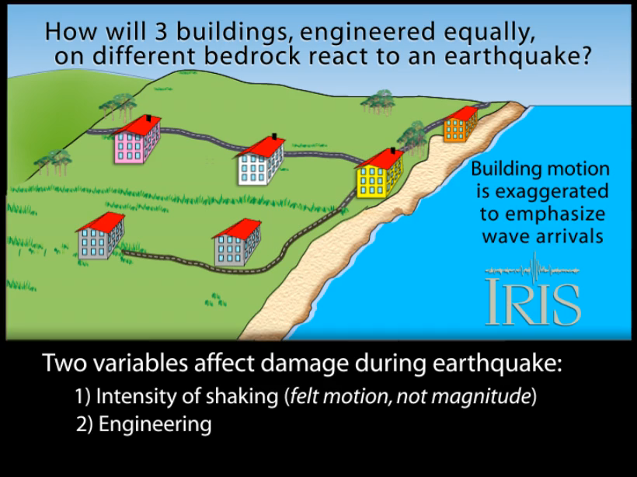
Effetti di sito

Slide 20
EFFETTI LOCALI INDOTTI DA UN EVENTO SISMICO

Slide 21
EFFETTI LOCALI INDOTTI DA UN EVENTO SISMICO

Slide 22
EFFETTI LOCALI INDOTTI DA UN EVENTO SISMICO

Slide 23
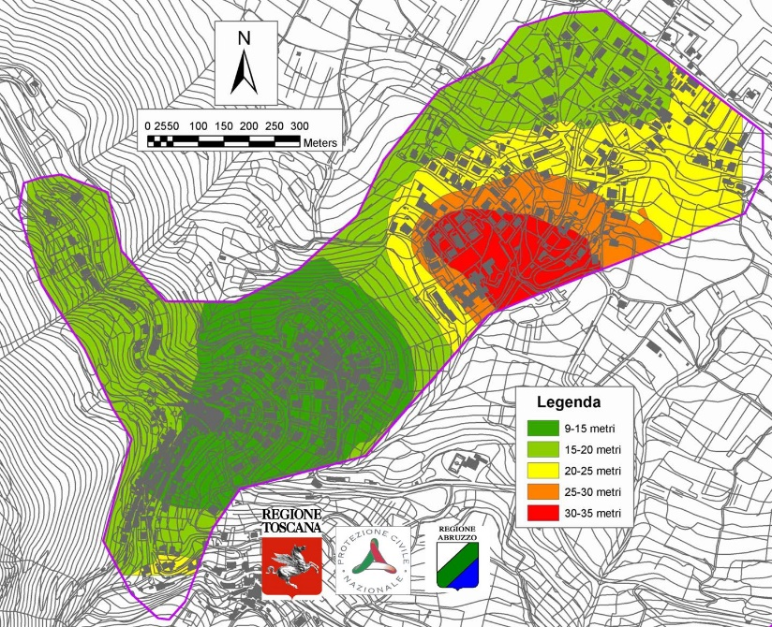
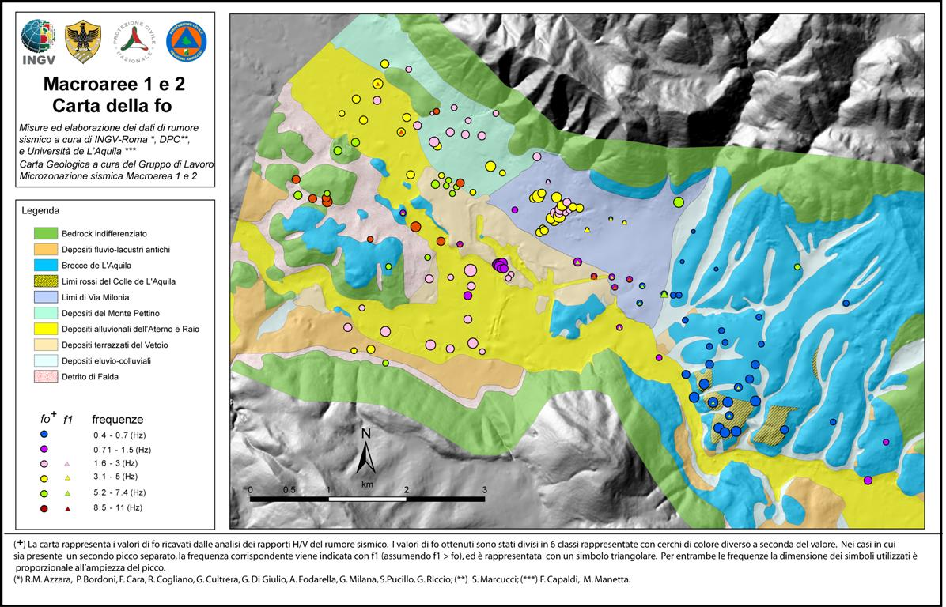
Microzonazione sismica

Slide 24
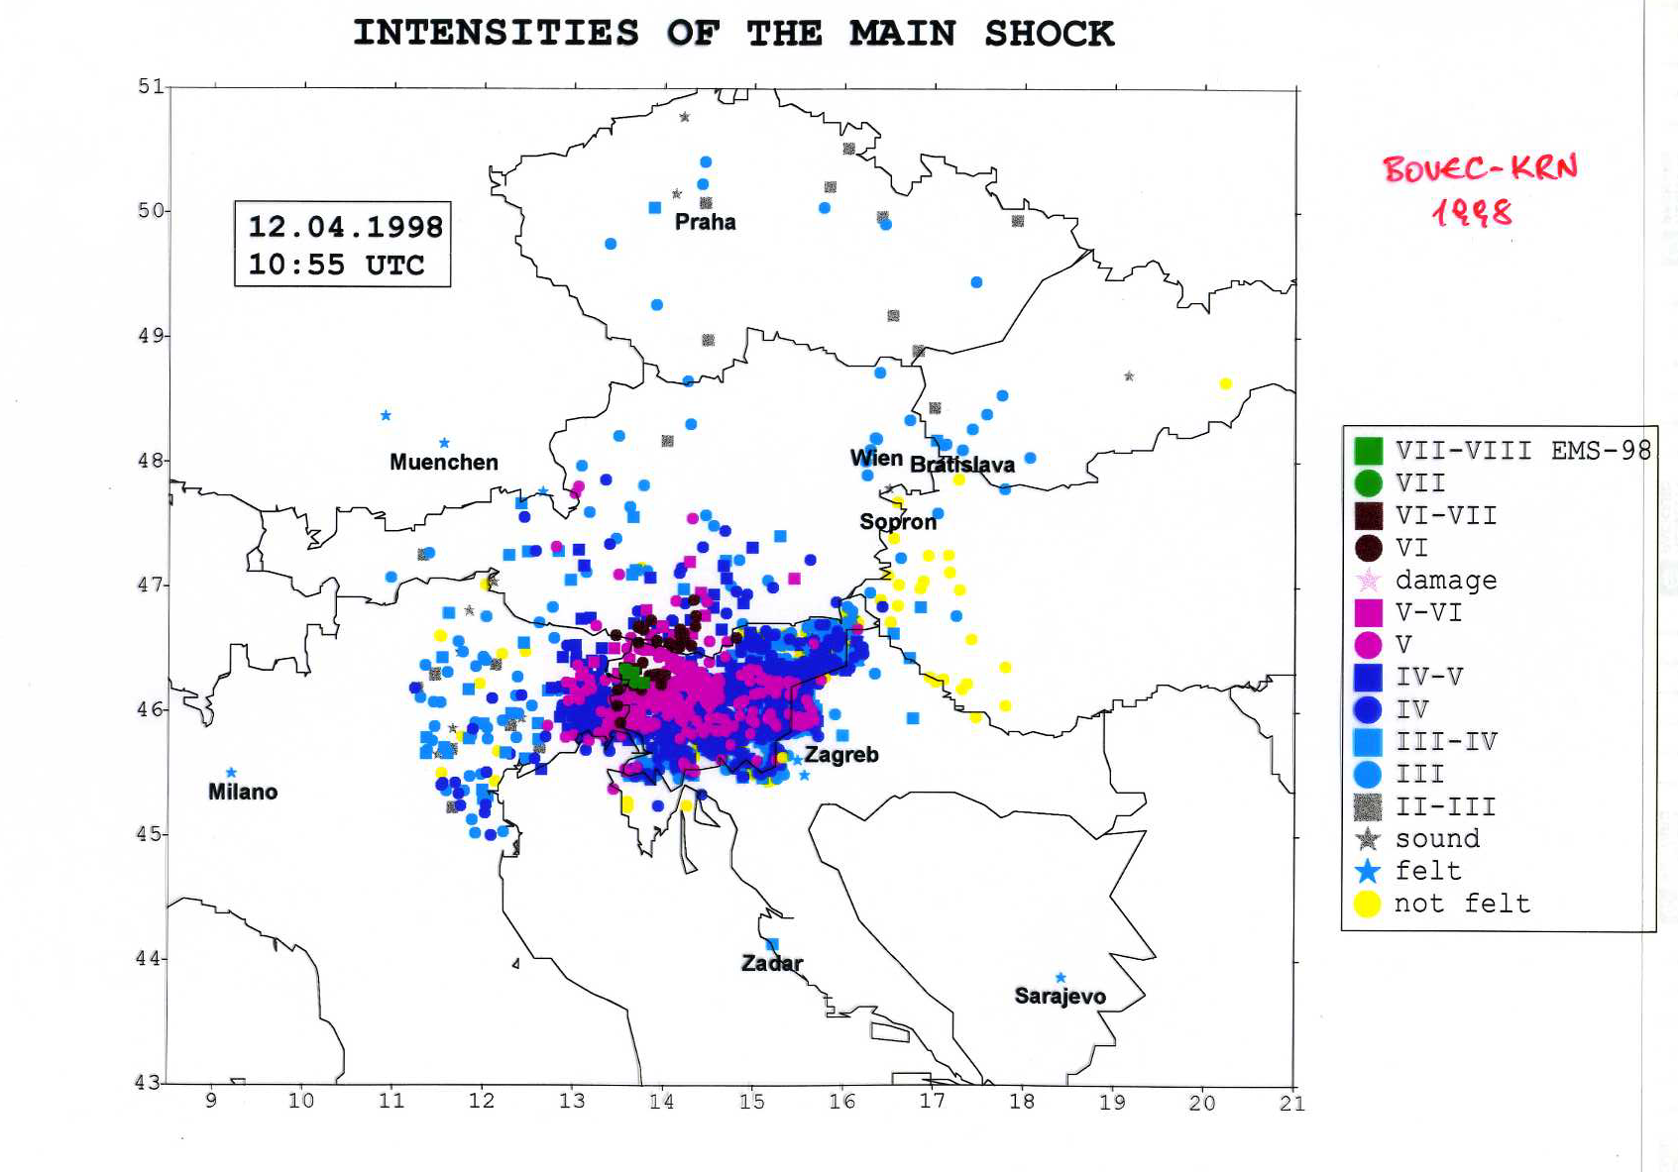

Slide 25
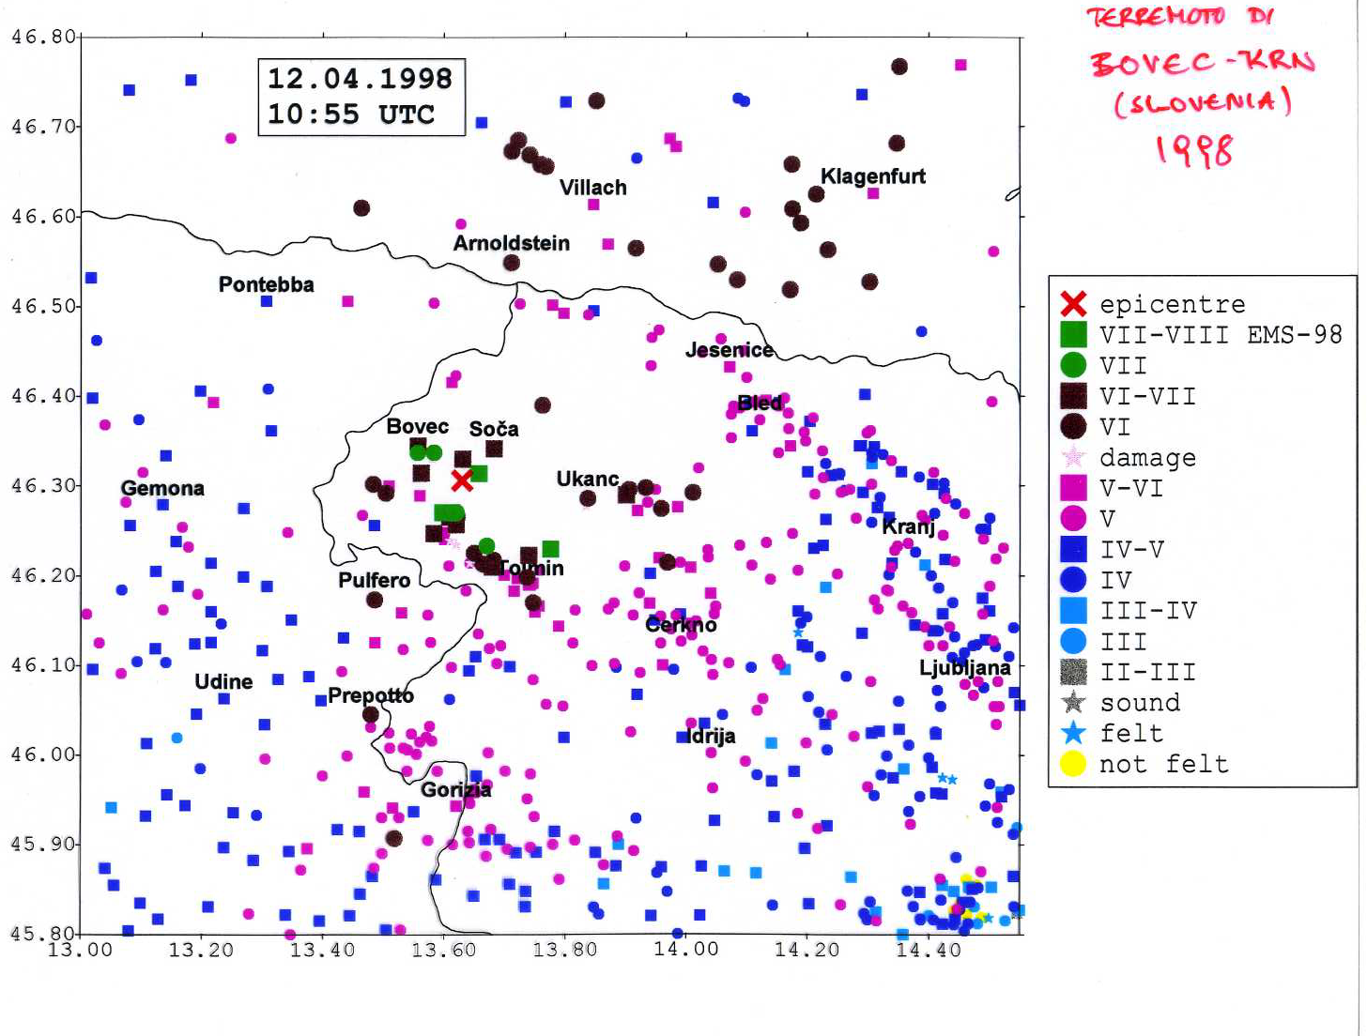

Slide 26
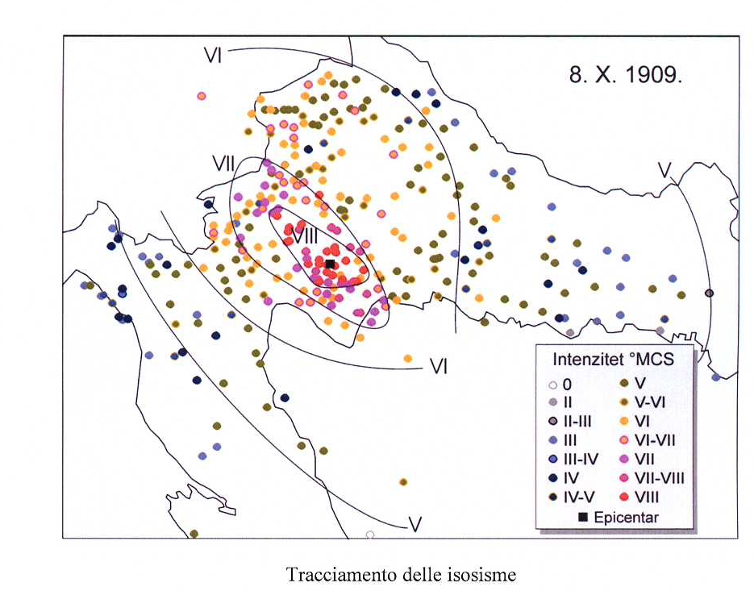

Slide 27
