Slide 1
Cancer
Immunotherapy (2)

Slide 2
Adaptive Cell Transfer Therapy
Adoptive cell therapy (ACT) is a treatment that uses a cancer patient’s own T lymphocytes with anti-tumor activity, expanded in vitro and re-infused into the patient with cancer.

Slide 3
Adaptive Cell Transfer Therapy
TIL (Tumor infiltration T-lymphocytes therapy)

Slide 4
TIL
The first paper to demonstrate the regression of cancer using TIL for the immunotherapy of patients with metastatic melanoma.
Rosenberg, S. A.et al.Use of tumor infiltrating lymphocytes and interleukin-2 in the immunotherapy of patients with metastatic melanoma. Preliminary report. N. Engl. J. Med. 319, 1676–1680 (1988).

Slide 5
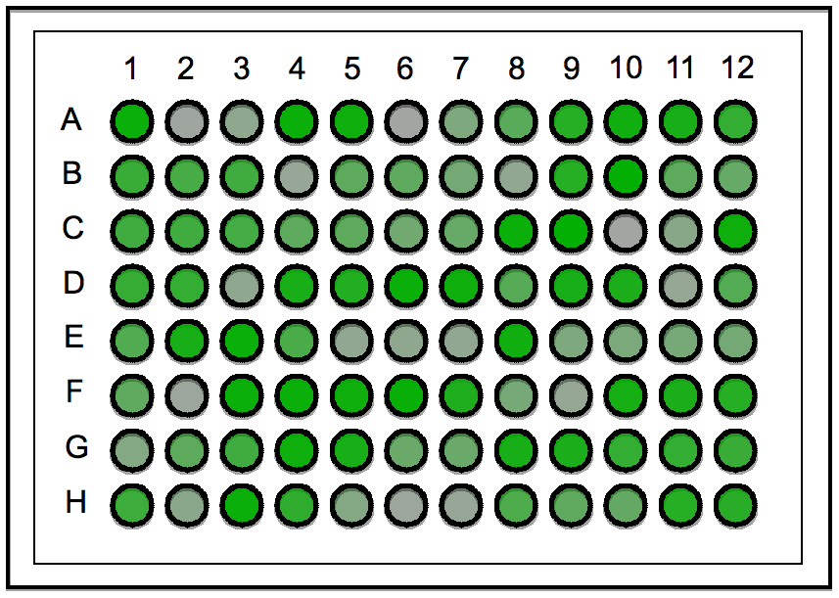
TIL
Target therapy with Tumor specific T cells
Cancer: Melanoma
Autologous tumor infiltrating lymphocytes (TILs); “Live drug”
Advantages
High response rate (>50%),
Long-term remission,
Less toxic & gentler to the patient
Limitation:
Extraction of TILs,
Cell manufacturing
2. Expand and activate T-cells ex vivo
3. Infuse the "boosted" T-cells into the patient.
1. Isolation of TILs or tumor specific T-cells from blood
Rosenberg SA & Dudley ME 2009 Current Opinion of Immunology

Slide 6
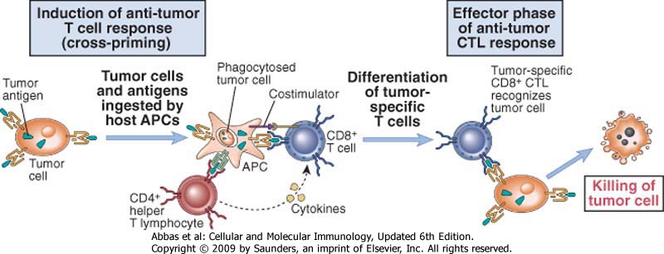
Induction of a T-response
against tumor

Slide 7
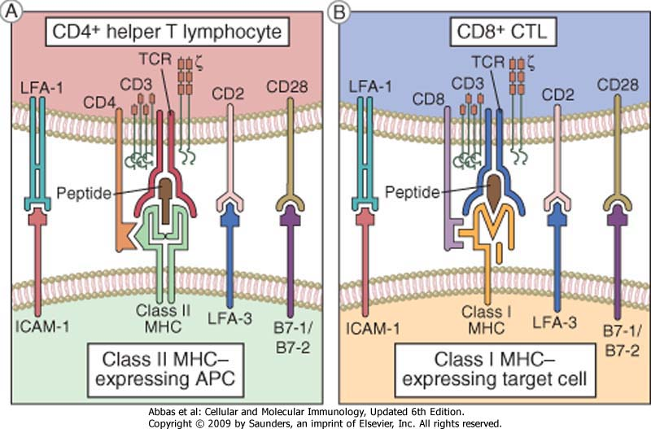
Low number of TIL

Slide 8
Adaptive Cell Transfer Therapy
TIL (Tumor infiltration T-lymphocytes therapy)
TCR (T-cell receptor therapy)

Slide 9
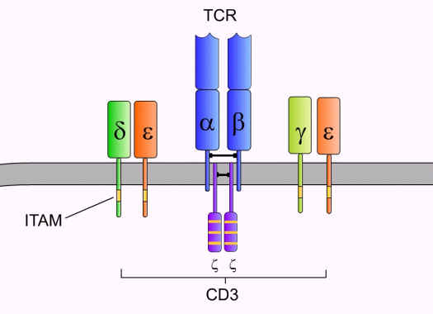
TCR
TCR complex :TCR, CD3, ζ
ITAM: immunoreceptor tyrosine-based activation motif

Slide 10
TCR
The first paper demonstrating the adoptive cell transfer of lymphocytes transduced with a retrovirus encoding TCRs that recognize a cancer antigen can mediate anti-tumour responses in patients with metastatic melanoma.
Morgan, R. A.et al. Cancer regression in patients
after transfer of genetically engineered lymphocytes.
Science 314, 126–129 (2006).

Slide 11
HLA-restricted response – tumor escape

Slide 12
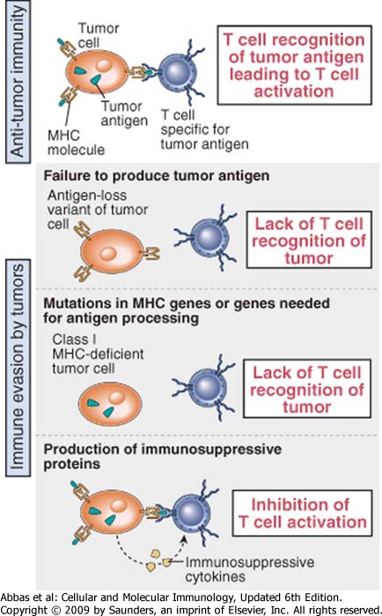
Tumor escape (4)
Some tumor cells reduce the expression of MHC I

Slide 13
Any possibility to design an immunotherapeutic approach able to work independently from class I MHC?

Slide 14
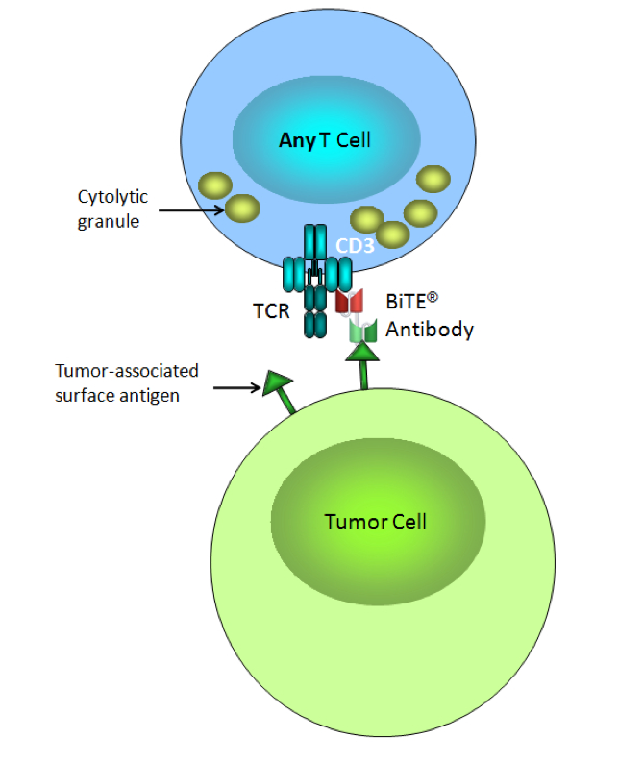
Bispecific T-Cell Engaging (BiTE) Antibody

Slide 15
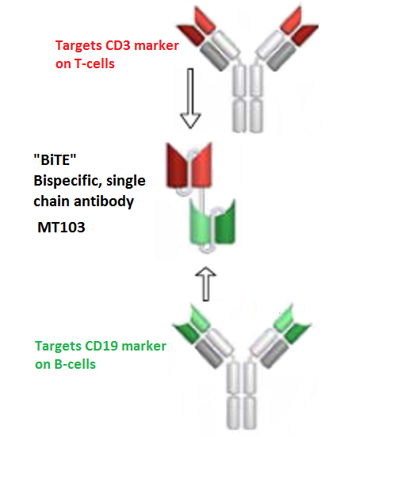
Blinatumumab

Slide 16
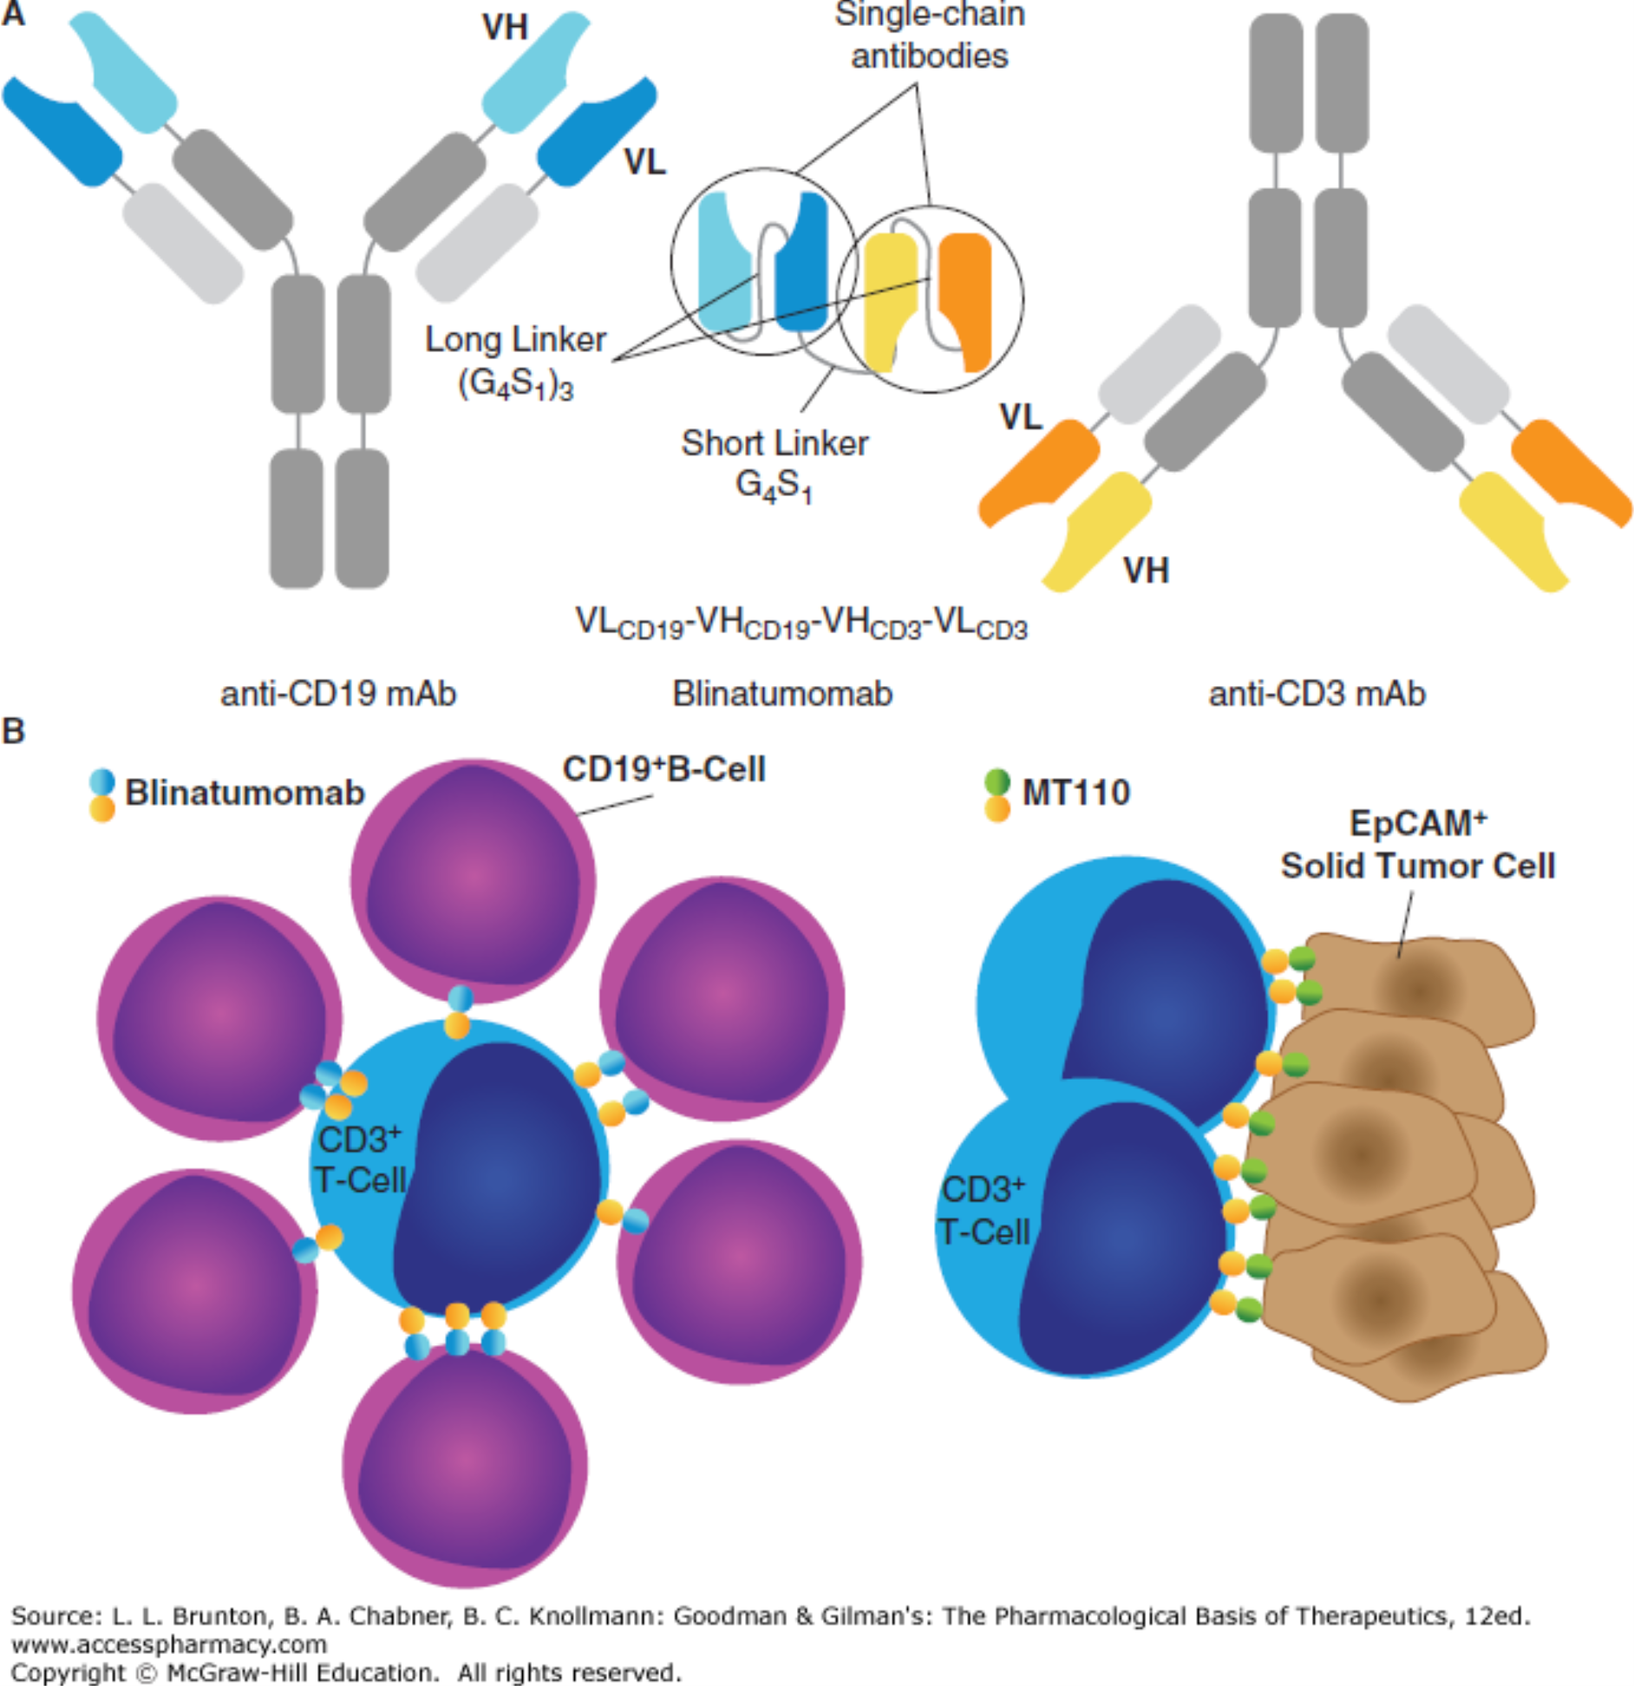
Structure and function of blinatumomab. A. The structural features of blinatumomab (MT103, AMG103) arise from monoclonal antibodies (mAbs) directed against CD19 and CD3. Single-chain antibodies are constructed from the light and heavy variable immunoglobulin domains (VL and VH) for each protein and connected using a long amino acid linker (Gly₄Ser₁)₃.^{4, 12} Two single-chain antibodies are joined using a short amino acid linker (Gly₄Ser₁)₁.³¹ B. Aggregation of T and B cells in the presence of blinatumomab. A cytotoxic T lymphocyte (blue) is associated with chronic lymphocytic leukemia cells (pink).¹⁴ The EpCAM BiTE MT110 can facilitate T-lymphocyte interaction with solid tumor cells, which have high expression levels of the EpCAM antigen (e.g., pancreatic cancer cells³²).

Slide 17
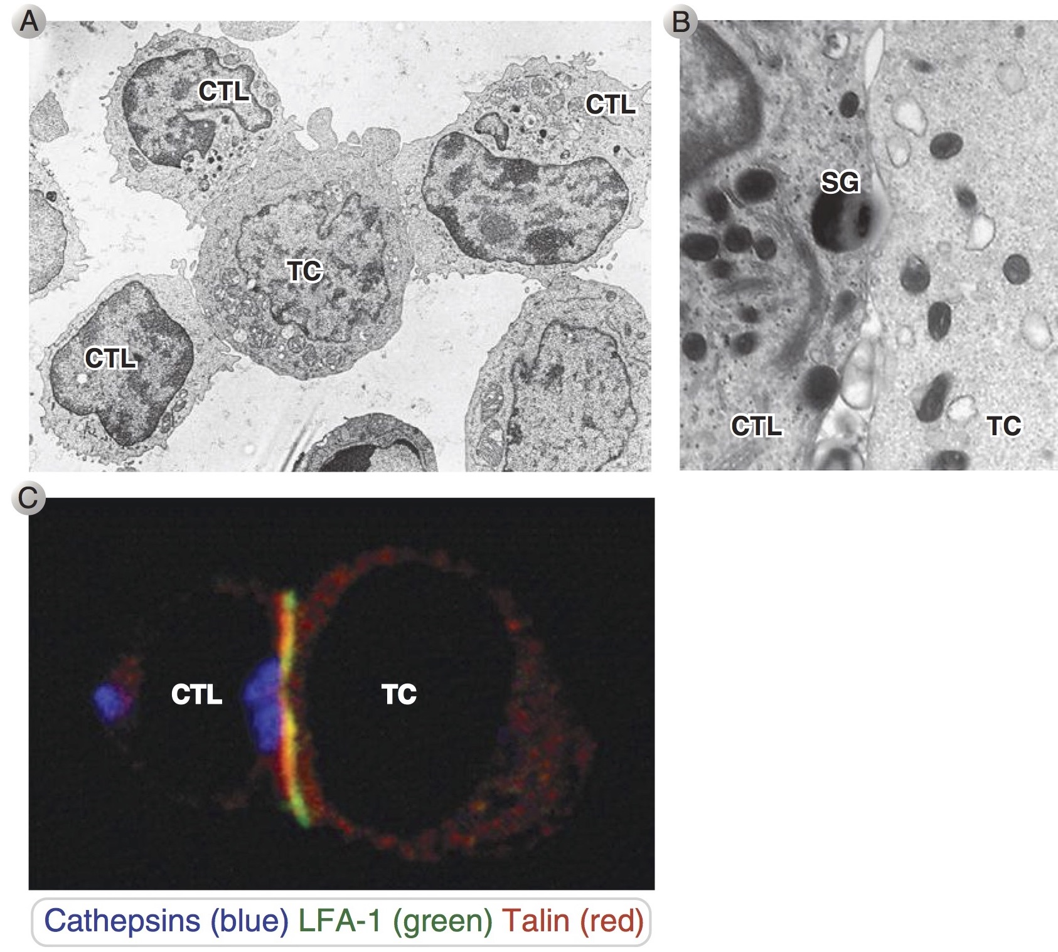
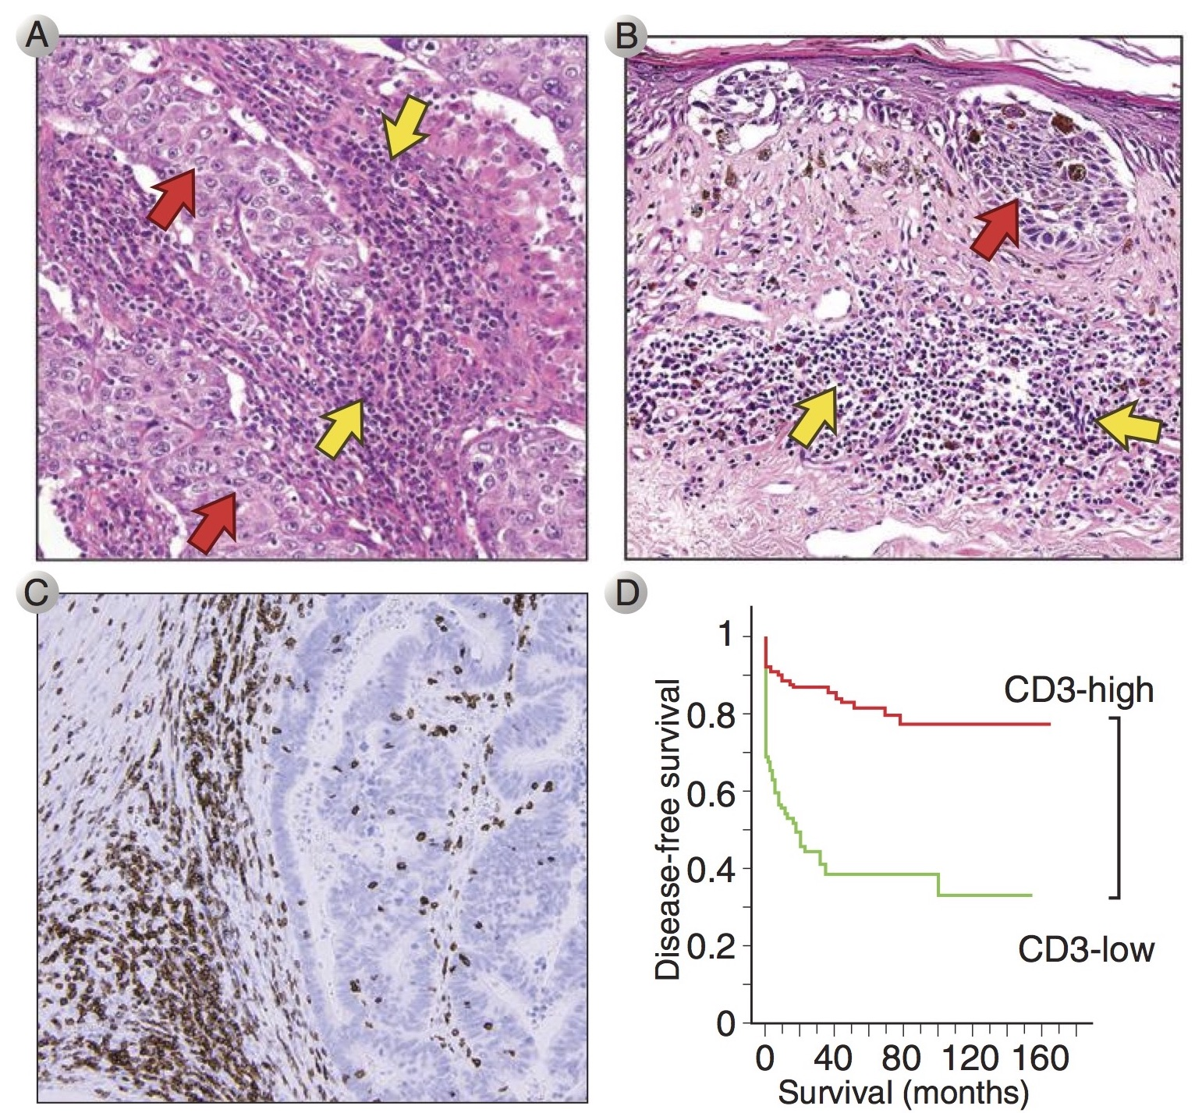
Induction of a T-response
against tumor

Slide 19
Limit of BsAb (BITE)
Molecular weight (have to be low MW)
Manufacturing (purification)
Number of TIL

Slide 20
Adaptive Cell Transfer Therapy
TIL (Tumor infiltration T-lymphocytes therapy)
TCR (T-cell receptor therapy)
CAR-T (Chimeric antigen receptor T-cell therapy)

Slide 21
CAR-T
CAR-T cells have to recognize tumor cells independently of their expression of human leukocyte antigen (HLA) molecules, tumors that escape conventional T cells by down-regulating HLA and/or mutating components of the antigen processing machinery can be eliminated.

Slide 22
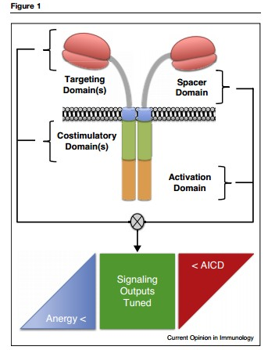
CAR-T
CARs consist of fusion molecules and are typically comprised of:
an extracellular single chain variable fragment (scFv) of a monoclonal antibody (mAb) specific for a surface molecule on the tumor cell,
a spacer domain that provides flexibility and optimizes T cell and target cell engagement,
a transmembrane domain,
signaling modules that trigger T cell effector functions.
Michael et al, Designing chimeric antigen receptors to effectively and safely target tumors. Current Opinion in Immunology 2015

Slide 23
CAR-T
T cells transduced with tumor-specific CAR
CAR: Single fusion molecule with antigen specificity plus signaling domain
Cancer: Solid tumor & hematological malignancies
Antigen specific domain
Advantages of CAR T cells
Multiple anti-tumor immuno-modulators can be engineered
Target variety of antigens (self-protein, carbohydrate, glycolipid)
Tumor recognition independent of HLA (no HLA typing needed)
“Live drug”
Maus M V et al. Blood 2014;123:2625-2635

Slide 24
Generation of a tumor targeted chimeric antigen receptor (CAR)
α-TAA mAb
TCR complex
α-TAA scFv—CD8-ζ
ψ
α-tumor scFv
5’ LTR
V_{H}
V_{L}
CD8
ζ chain
3’ LTR
SD
SA
CAR retroviral vector
(??why a retrovirus??)

Slide 25
Generation of TAA-targeted T cells for treatment of Cancer
TAA CAR
Native TCR
αTAA scFv
1. Construct a chimeric antigen receptor (CAR)
CD8
CD3 ζ
3. Transduce and expand patient T cells ex vivo
4. Infuse transduced T cells to eradicate TAA⁺ tumor cells
TAA CAR
2. Subclone CAR gene into a retroviral vector (SFG)
ψ
αTAA scFv
5’ LTR
V_{H}
V_{L}
CD8
ζ chain
3’ LTR
SD
SA
TAA
SFG-CAR

Slide 26
Induction of a T-response
against tumor

Slide 27
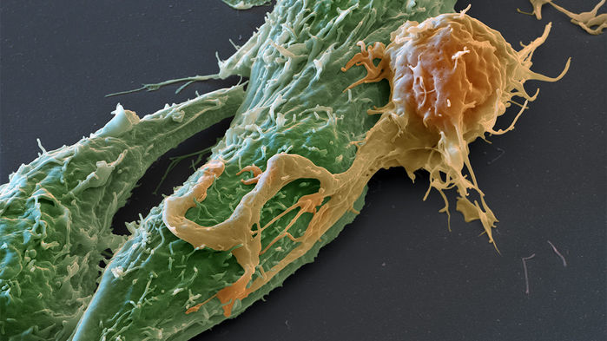

Slide 28
T-cell response independent from the expression of MHC, CD80/86, etc

Slide 29
Challenges of CAR-T
1. Target selection

Slide 30
CAR-T cells: target selection
Target | CAR | Cancer | Objective response
CD19 | CAR:CD28-CD3ζ | Lymphoma and CLL | N=7: 1CR, 5 PR & 1SD
 | CAR:CD137-CD3ζ | ALL | 2CR
 | CAR:CD28-CD3ζ | ALL | 5CR
CD20 | CAR:CD137-CD28-CD3ζ | NHL | N=3: 1PR, 2NED
CEA | CAR-CD3ζ (1st gen) | Colorectal & breast | N=7: minor responses in two patients
GD2 | CAR-CD3ζ (1st gen) | Neuroblastoma | N=19: 3CR
ERBB2 | CAR:CD28-CD137-CD3ζ | Colorectal cancer | N=1, patient died
Kershaw et. al. Nature Reviews Cancer, 2013

Slide 31
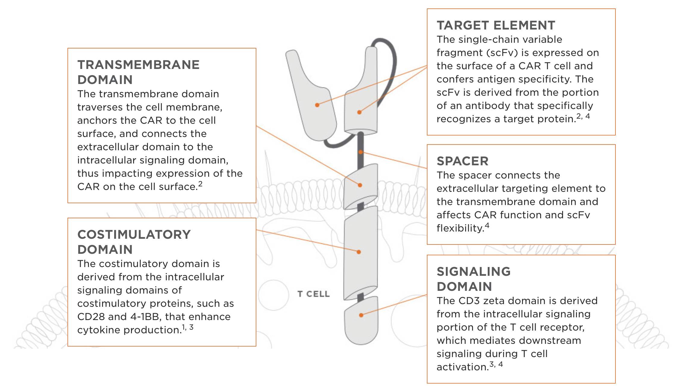
Notes:
Caratteristiche spacers

Slide 33
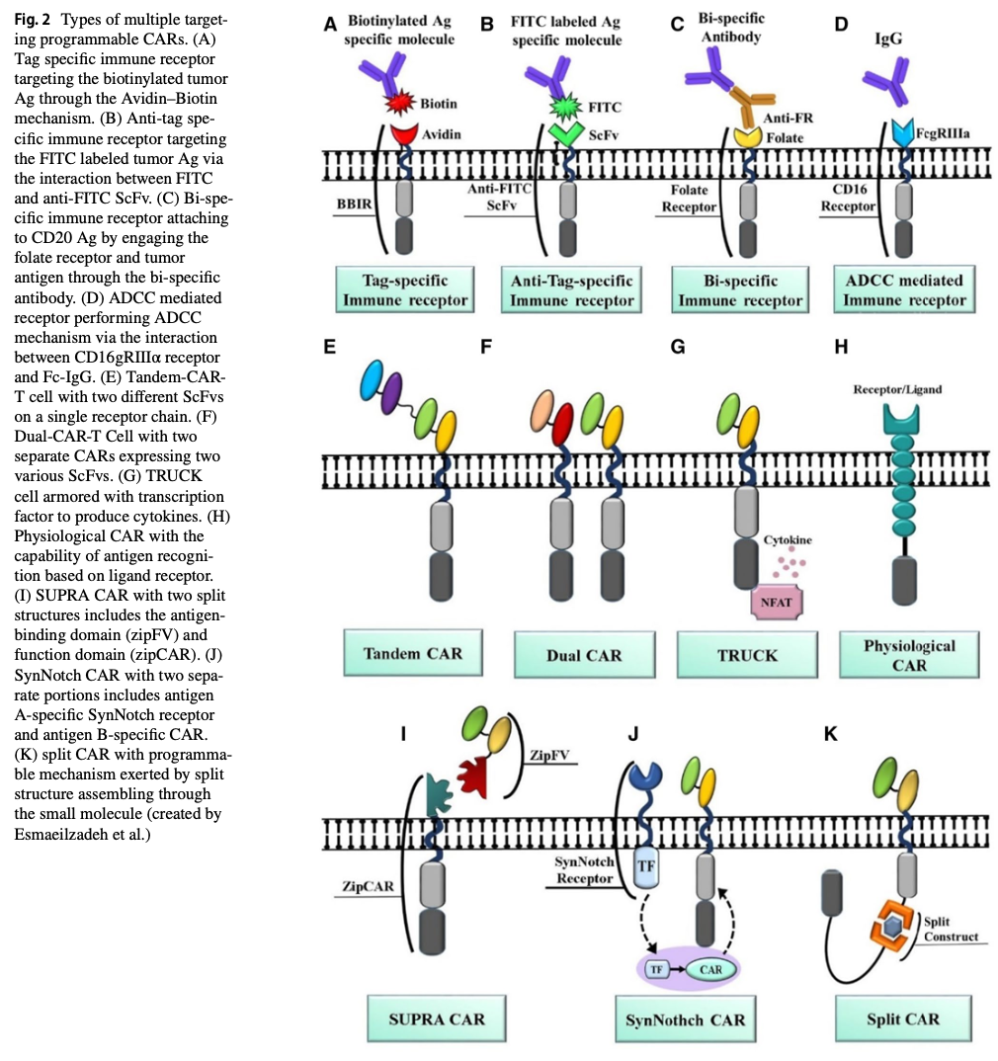
CAR-T cells: target selection
Tahmasebi, et al.
Clinical and Translational Oncology
2020

Slide 34
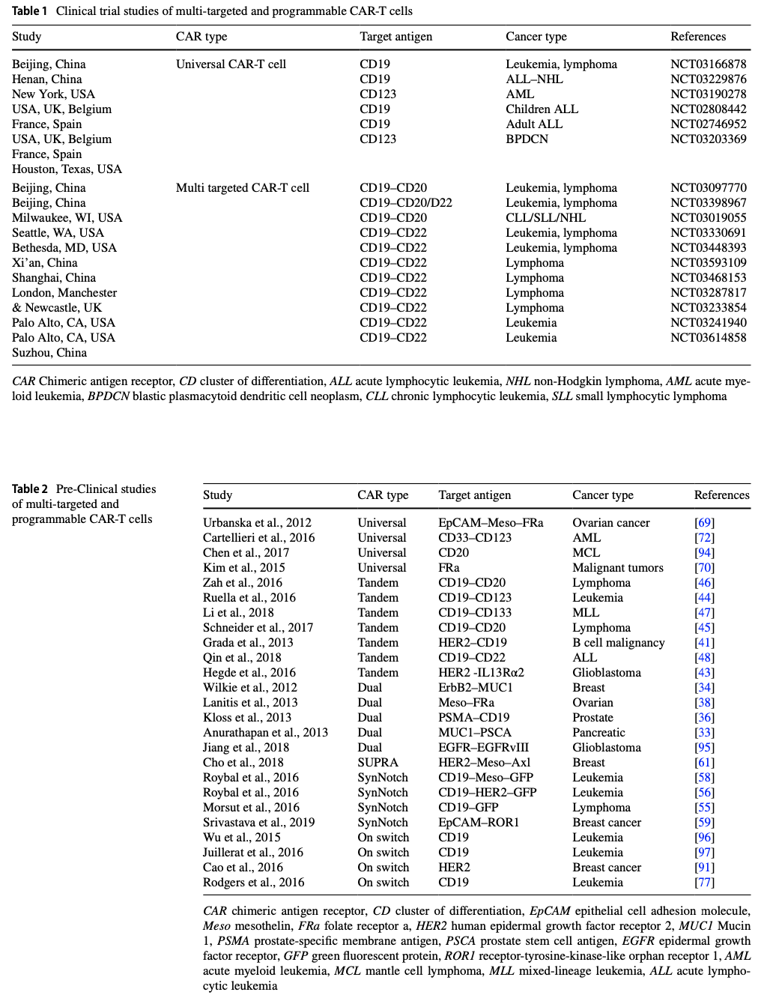
CAR-T cells:
target selection
Tahmasebi, et al.
Clinical and Translational Oncology
2020

Slide 35
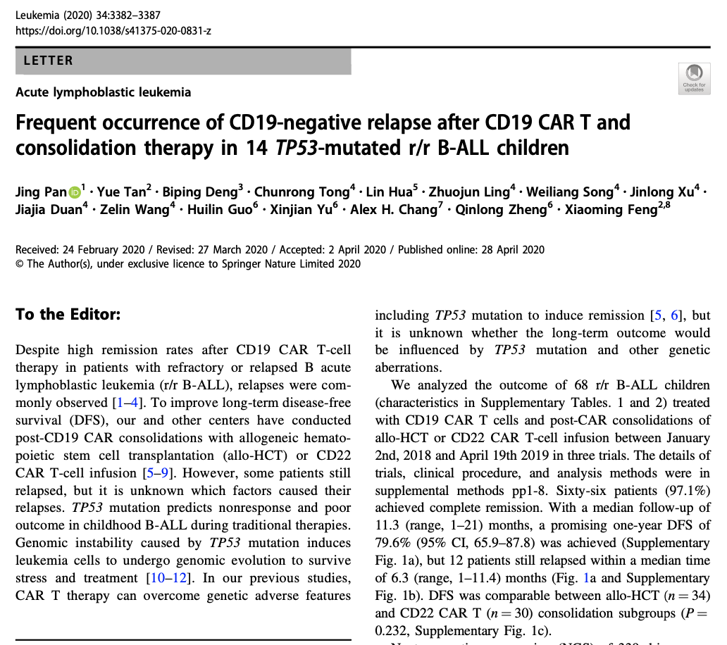
CAR-T cells: target selection

Slide 36
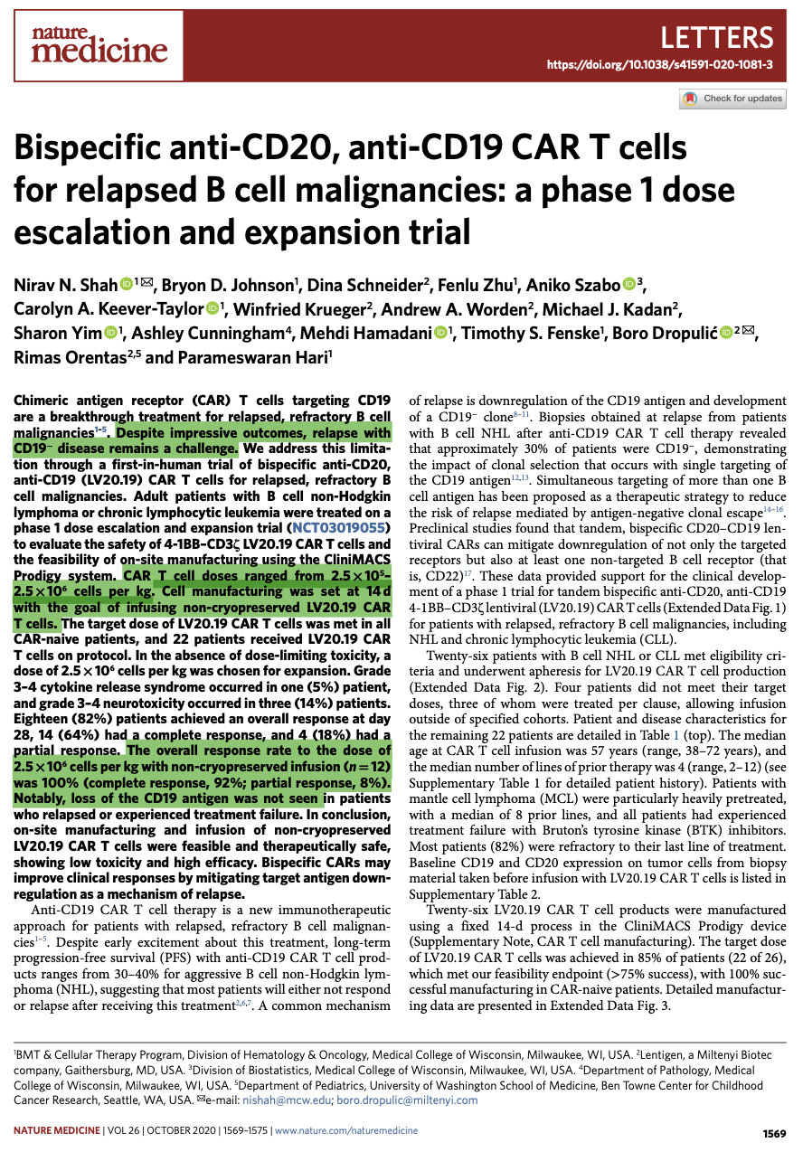
CAR-T cells:
target selection

Slide 37
Challenges of CAR-T
1. Target selection
2. Optimize co-stimulatory signaling of T cell effector functions

Slide 39
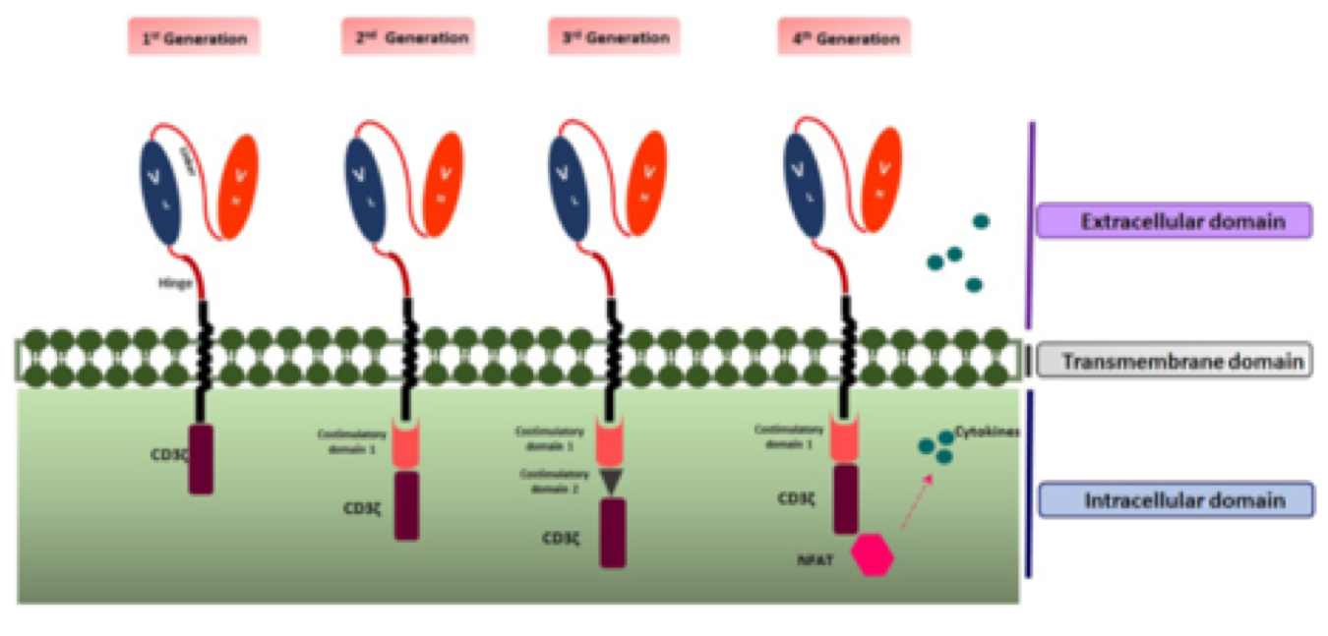
Evolution in CAR design
First-generation CARs: including activating receptors such as CD8/CD3-ζ fusion receptors;
Second-generation CARs: providing dual signaling to direct combined activating and co-stimulatory signals;
Third-generation CARs: comprising more complex structures with 3 or more signaling domains.

Slide 40
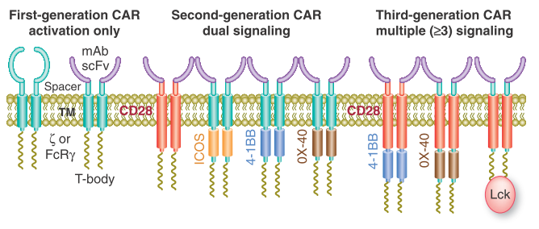
Evolution in CAR design
First-generation CARs: including activating receptors such as CD8/CD3-ζ fusion receptors;
Second-generation CARs: providing dual signaling to direct combined activating and co-stimulatory signals;
Third-generation CARs: comprising more complex structures with 3 or more signaling domains.

Slide 41
The third generation of CARs
A third generation of CARs in which a second co-stimulatory molecule is fused in the intra-cellular motif with the co-stimulatory signals, therefore, generating triple-signaling CARs, is under development
Third-generation CARs seem to have improved proliferation, cytokine secretion and a better persistence in circulation
Unfortunately, this last generation of CARs may also be dangerous and the activation can be too strong leading to cytokine storm and eventually to death

Slide 42
Advantages of CAR-T cell therapy
HLA-independent antigen recognition, therefore universal application
Active in both CD4⁺ and CD8⁺ T cells
Target antigens include proteins, carbohydrates and glycolipids
Rapid generation of tumor specific T cells
Minimal risk of autoimmunity or GvHD
A living drug, single infusion

Slide 43
Challenges of CAR-T
1. Target selection
2. Optimize co-stimulatory signaling of T cell effector functions
3. Toxicities (on-target but off-tumor toxicity)
(The on-target toxicities result from the inability of engineered T cells to distinguish between normal cells and cancer cells that express the targeted Ag)

Slide 44
Challenges of CAR-T
Toxicities
On target/off tumor toxicities
Metastatic colon cancer patient died after 5 days of infusion of ERBB2+CAR-T cells
Low levels of ERBB2 express on lung epithelium (lung tox)
Renal cell carcinoma: 5/11 patients developed liver toxicity
Cytokine syndrome
Elevated levels of pro-inflammatory cytokines
Treatable by anti-IL-6 mAb and steroid
Tumor lysis syndrome

Slide 47
Determinants of successful CAR-T cells
Tumor target
Target antigen is critical determinant for efficacy & safety
Ideal target uniquely express on tumor cells or on cells which are not essential for survival
Efficacy & Long-term persistence
Subtypes of CD4+T cells (Th1, Th2, Th17, Th9 cells),
CD8+T cells
naïve, central memory; long-term
effector; active but short lived
Trafficking of CAR T cells to tumor
Expression of addressins
Route of CAR-T cell infusion
Intra-tumoral/intravenous
Optimal co-stimulation of T cells

Slide 48
Classification of T-cell
Cytotoxic T-cell (CD8)
Helper T-cell (CD4)
Regulatory/suppressor T-cell (T-Reg)
Memory T-cell

Slide 49
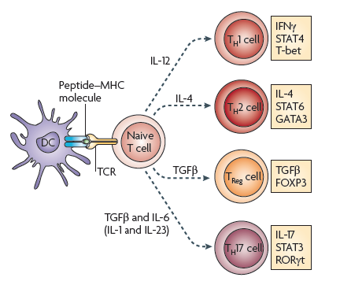
Adoptive T cell therapy: Right T cell population?
Zou W & Restifo NP Nature Reviews Immunology 2010

Slide 50
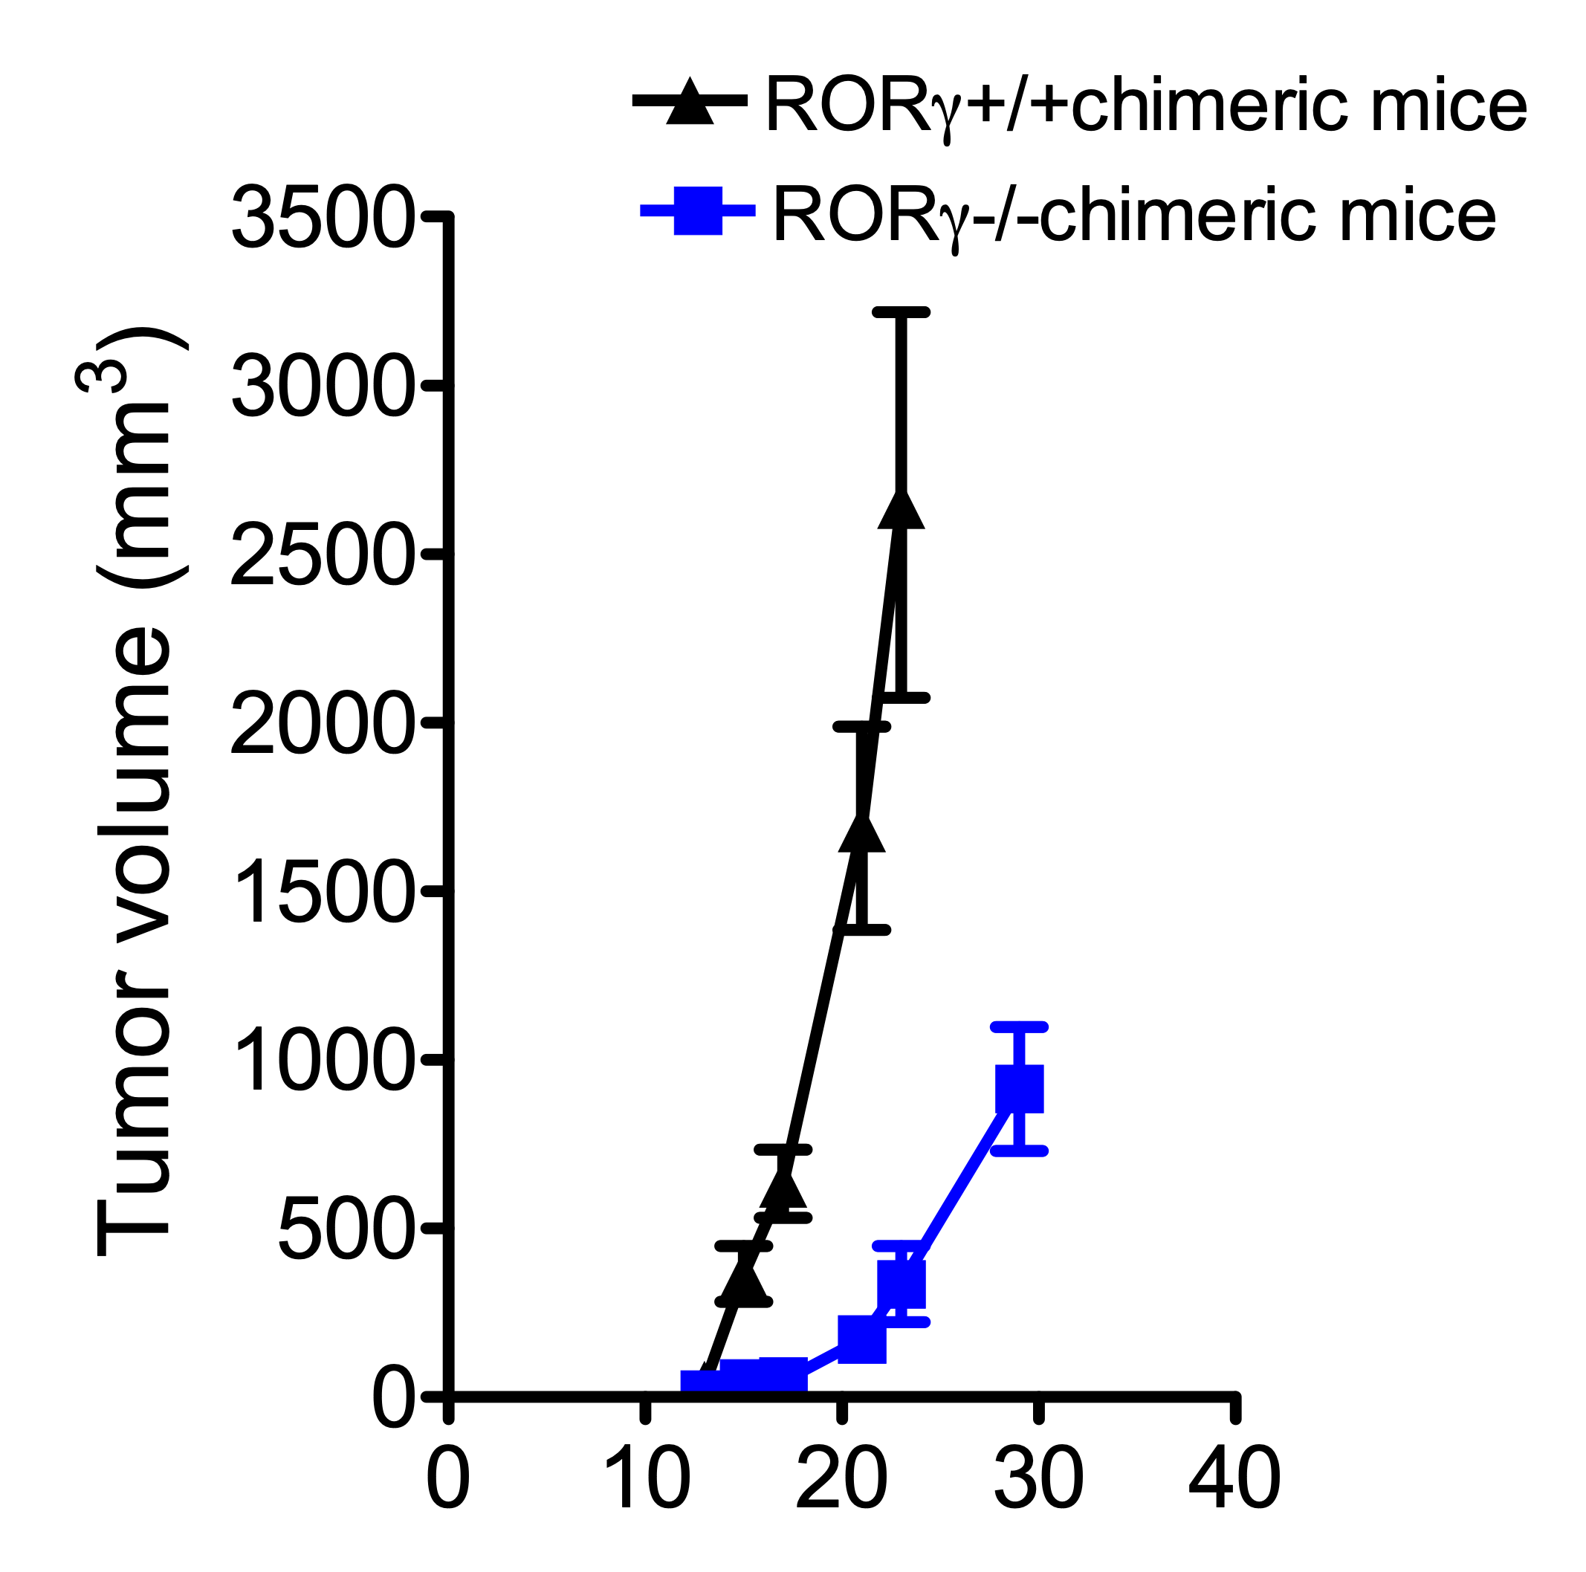
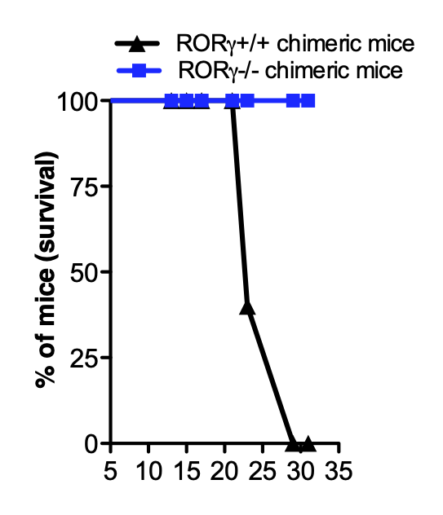
Tumor growth suppression in RORγ-/- mice (Th17 cell deficient)
Melanoma tumor growth
Survival of tumor bearing host
**
***
Days after tumor induction
Days after tumor induction
Abrogation of Th17 pathways promotes anti-tumor immune responses

Slide 52
Evolution in CAR design
(Elahi, Khosh, Tahmasebi, & Esmaeilzadeh, 2018)
First-generation CARs: including activating receptors such as CD8/CD3-ζ fusion receptors;
Second-generation CARs: providing dual signaling to direct combined activating and co-stimulatory signals;
Third-generation CARs: comprising more complex structures with 3 or more signaling domains.
Fourth-generation: ….

Slide 53
IL-12
A heterodimeric cytokine secreted by activated APCs, neutrophils and macrophages.
Induces Th1 CD4⁺ T cell response enhancing IL-2 and IFN-γ secretion
Enhances T cell clonal expansion and effector function in concert with TCR signaling (signal 1) and CD28 co-stimulation (signal 2), serving as a signal 3.
Avoids/reverses T cell anergy
May overcome Treg mediated effector T cell inhibition
Recruits and activates NK cells
Clinical trials in cancer using systemic IL-12 therapy has been limited by severe inflammatory side effects

Slide 54
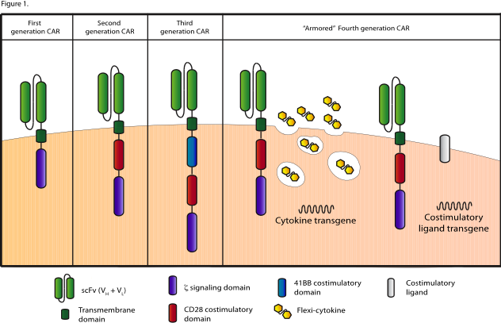
Moving Forward: Armored CARs

Slide 56
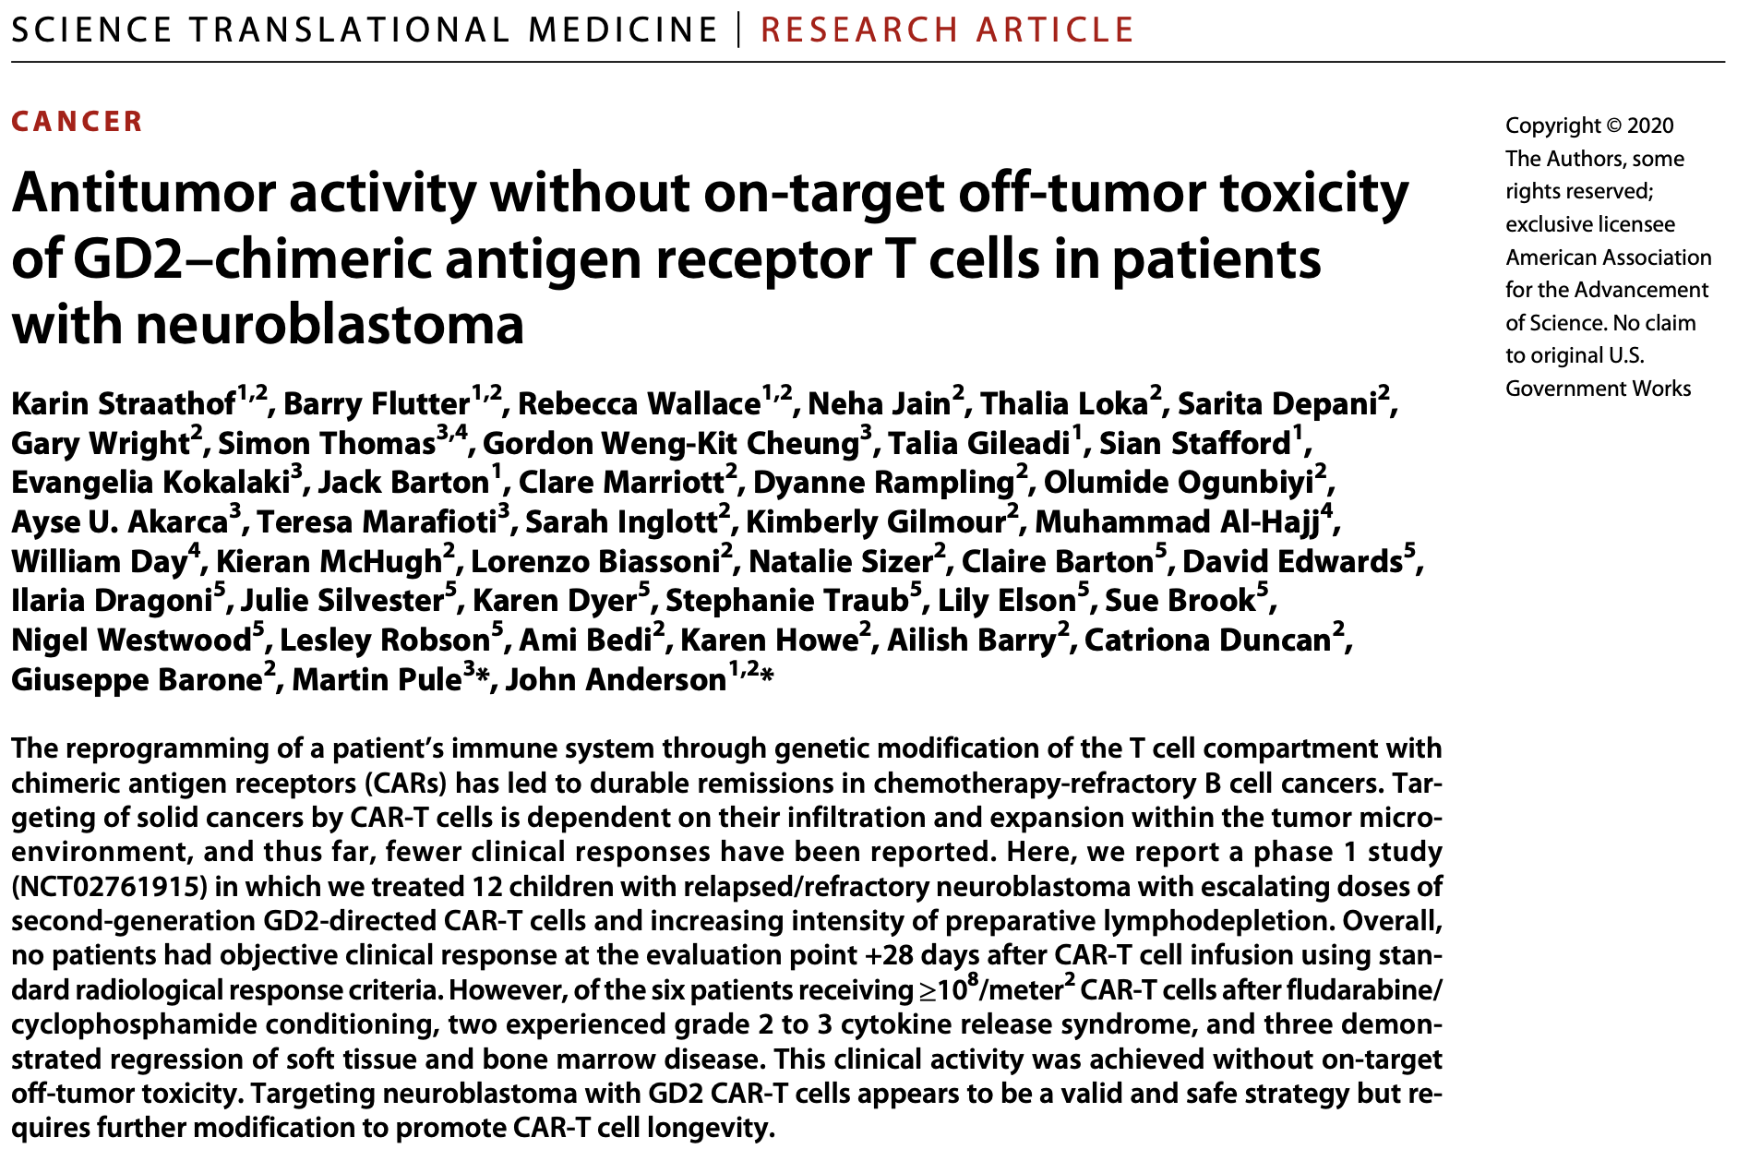

Slide 57
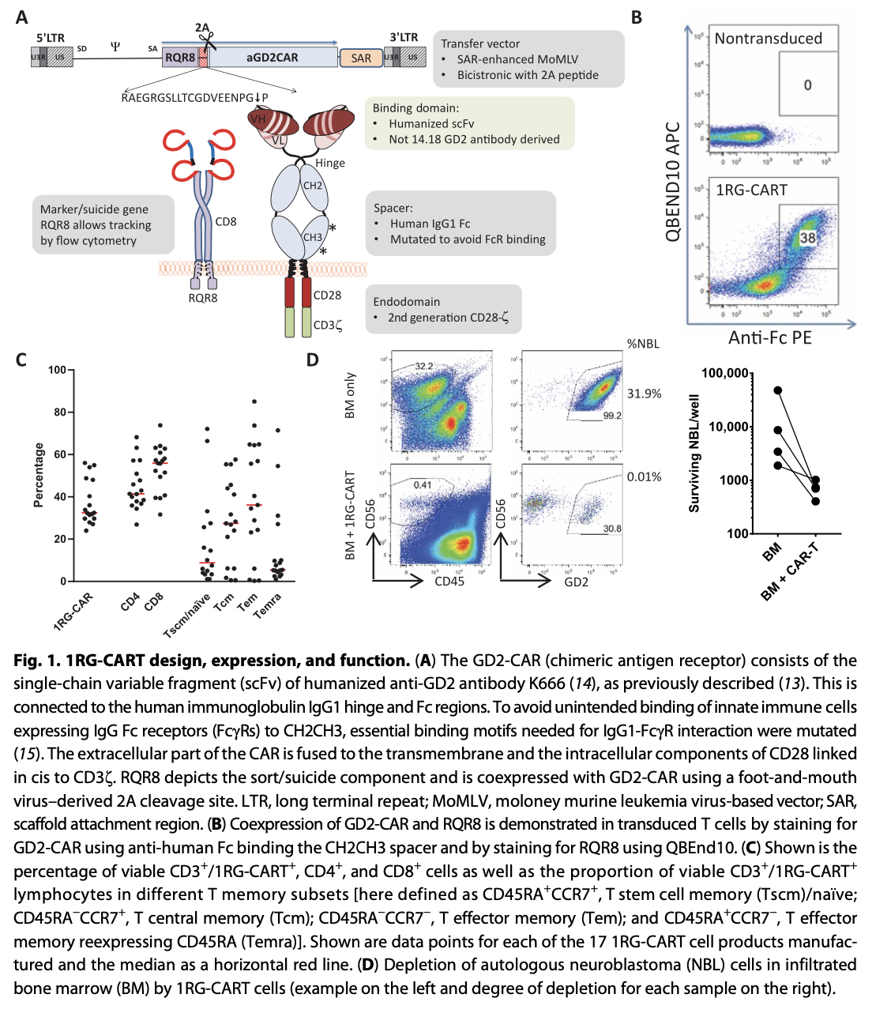

Slide 58
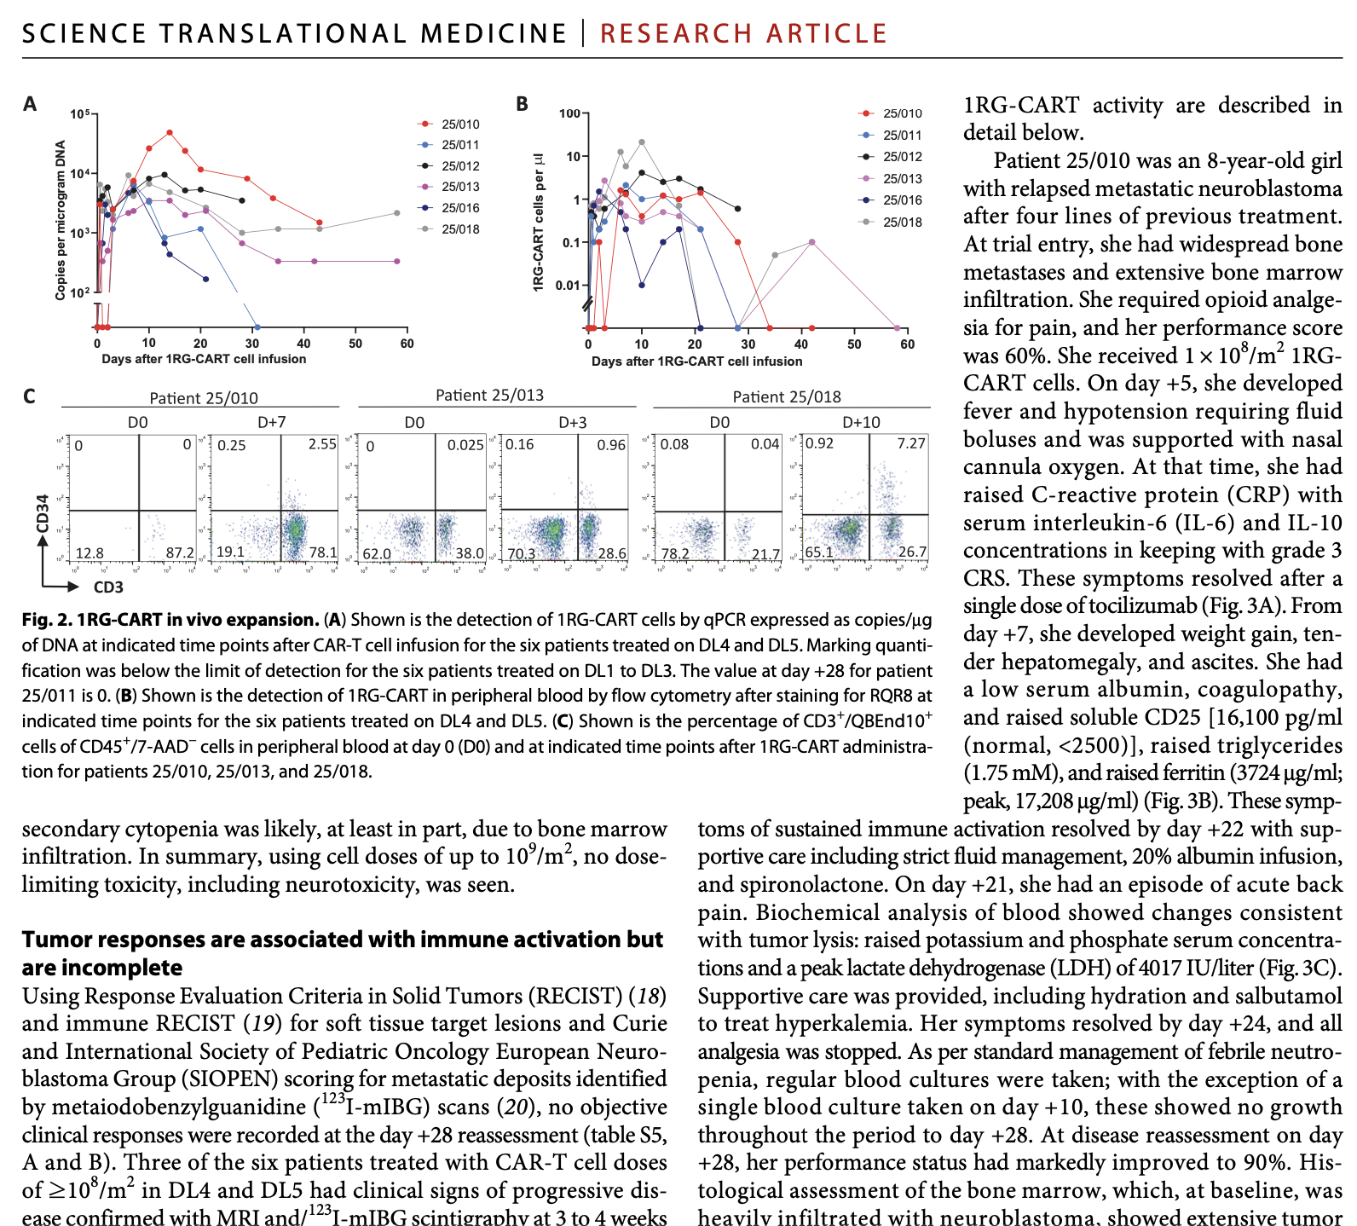

Slide 59
Summary
CAR-T cells
T cells transduced with tumor-specific Chimeric Antigen Receptor (CAR)
Tumor recognition independent of HLA (no HLA typing needed)
Target: variety of tumor antigens (protein, carbohydrate, glycolipid)
High response rate (up to 88%): pre-clinical and clinical findings
Limitation of CAR-T cells
Toxicities
On target/off tumor toxicities
Cytokine syndrome
Tumor microenvironment
Presence of MDSCs & Treg in tumor
Immunosuppressive agents

Slide 60
The hostile tumor microenvironment
The tumor microenvironment contains multiple inhibitory factors designed to potentially suppress effector T cells.
CD4⁺ CD25^{hi} FoxP3⁺ regulatory T cells (Tregs)
MDSCs
TAMs
Expression of inhibitory ligands by tumor (PD-L1)
Tumor secretion of T cell suppressive cytokines (TGF-β and IL-10)

Slide 61
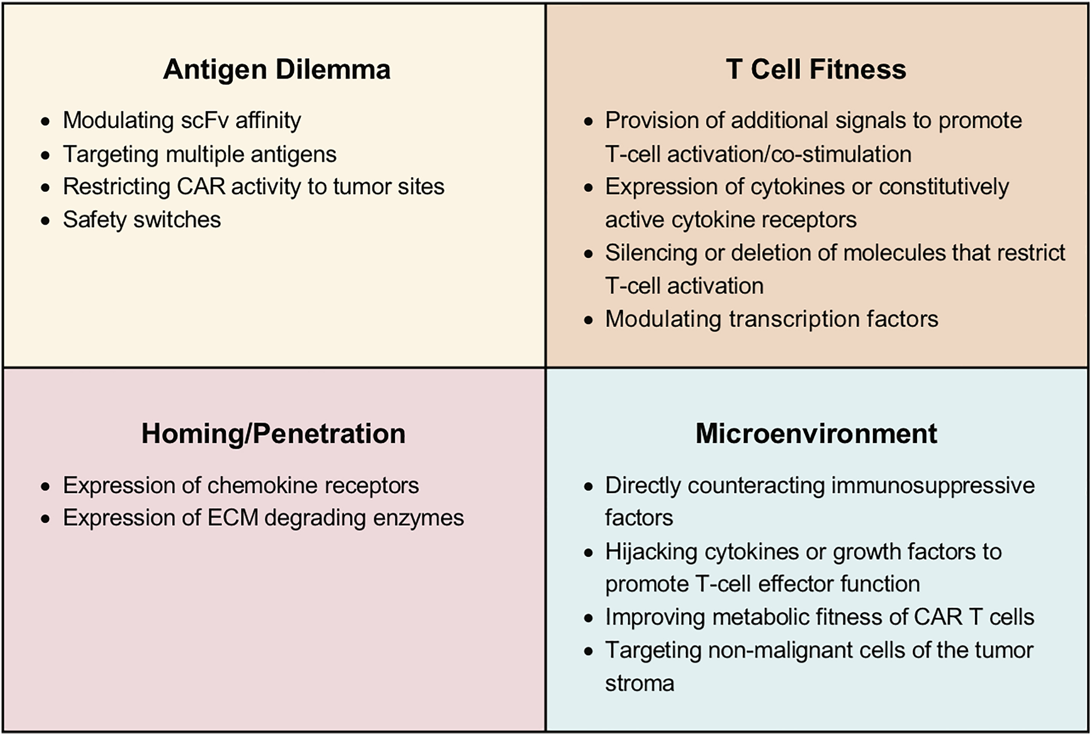
Molecular Therapy 2020 282320-2339; DOI: (10.1016/j.ymthe.2020.09.015)

Slide 62
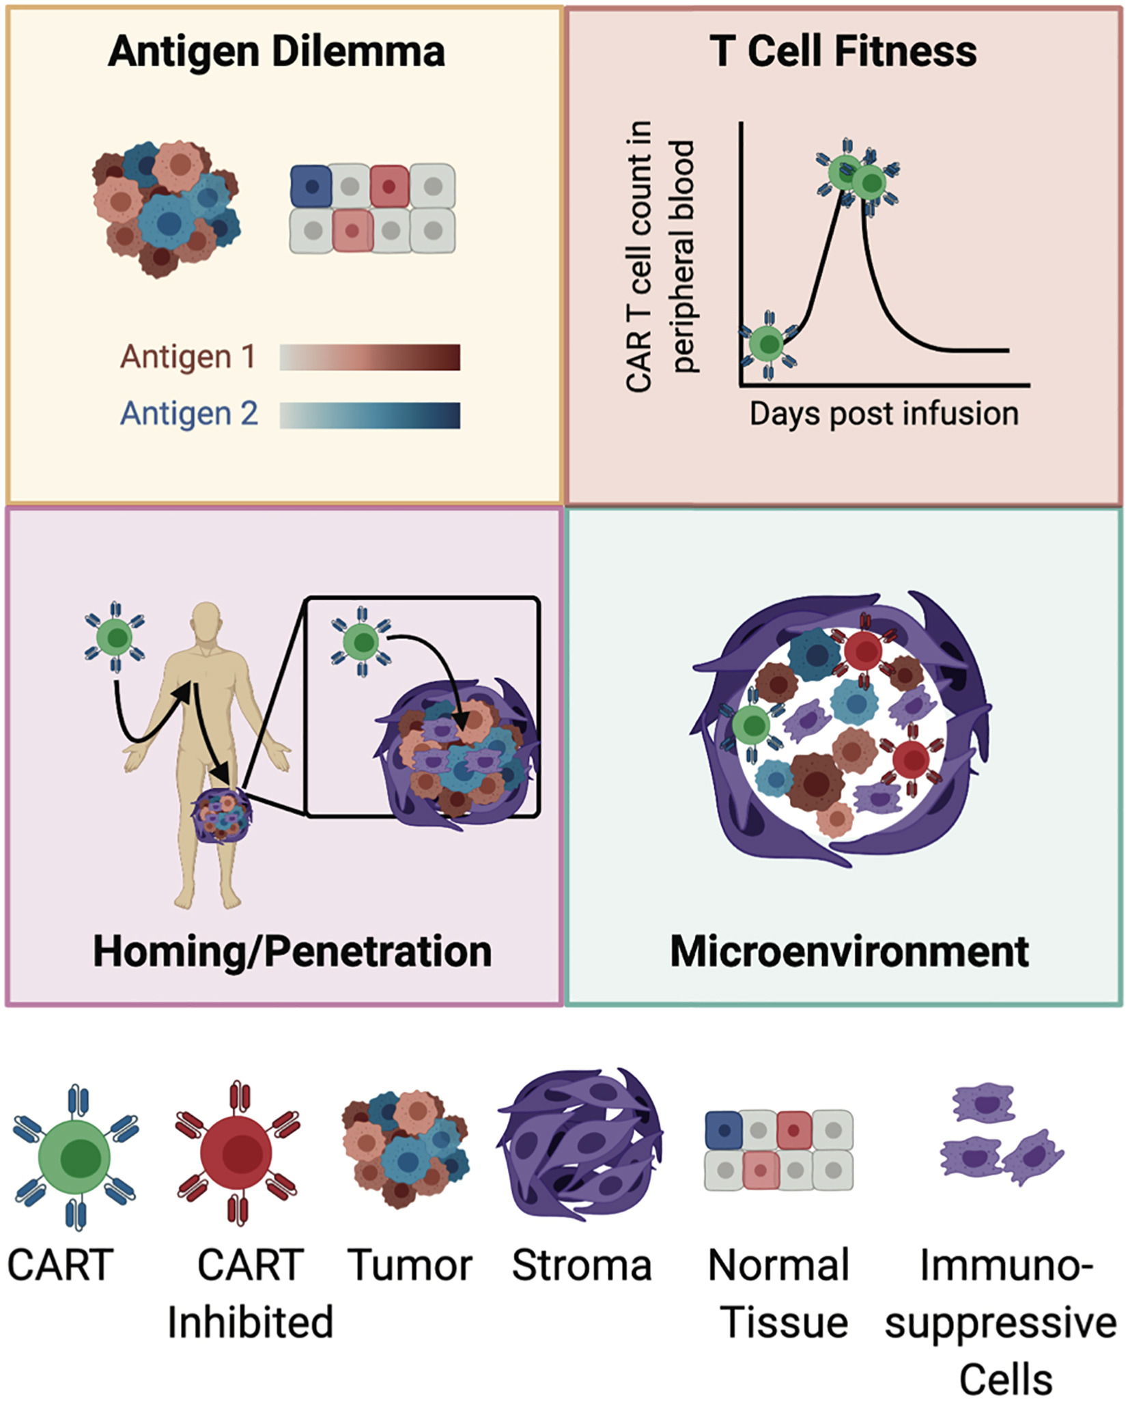
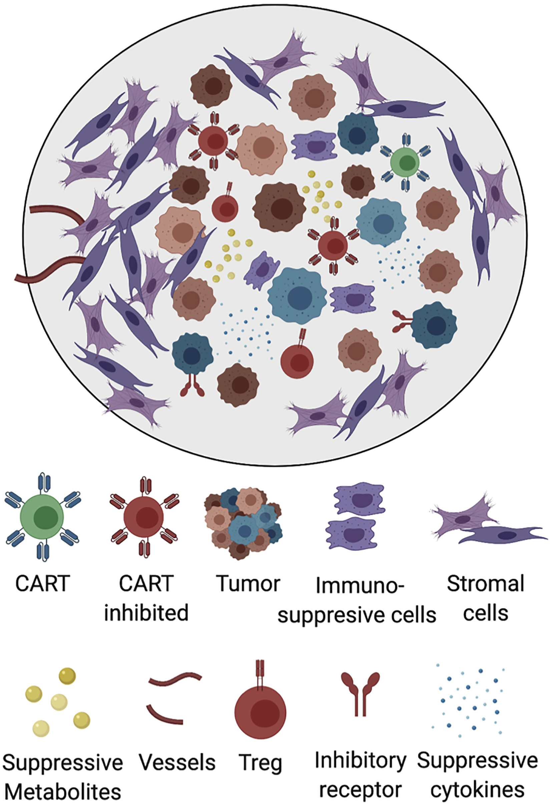
Molecular Therapy 2020 282320-2339; DOI: (10.1016/j.ymthe.2020.09.015)

Slide 64
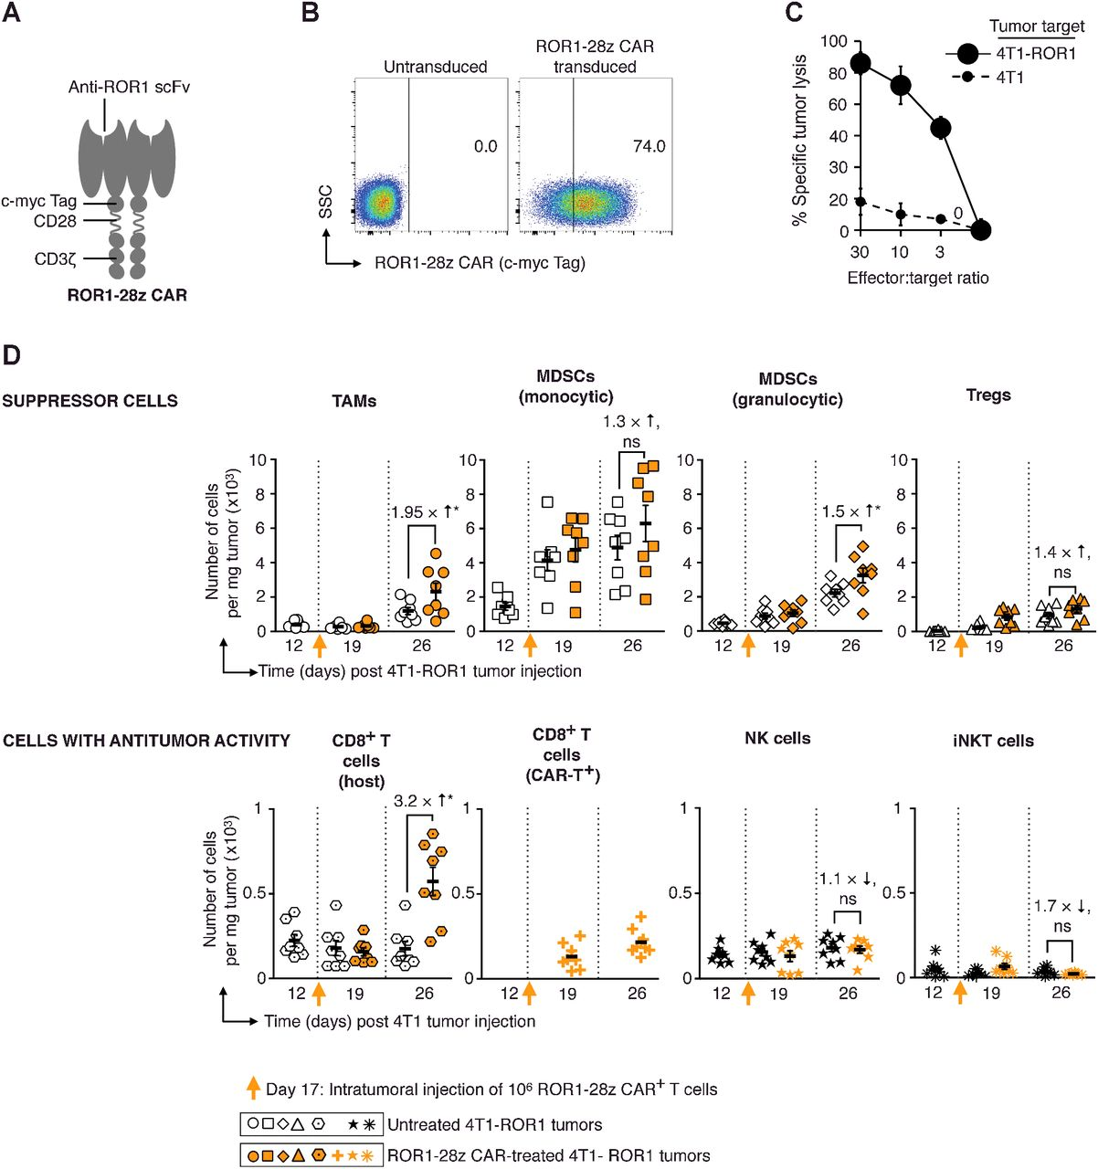
Fan Zhang et al.
Cancer Res 2018;78:3718-3730

