Slide 1
IPERsensitivity

Slide 2
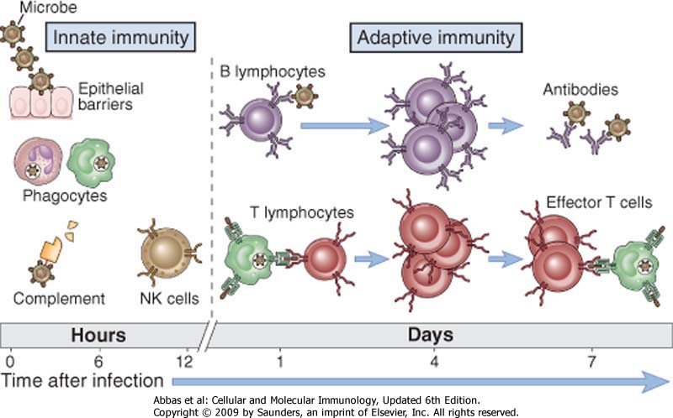
The immune system

Slide 3
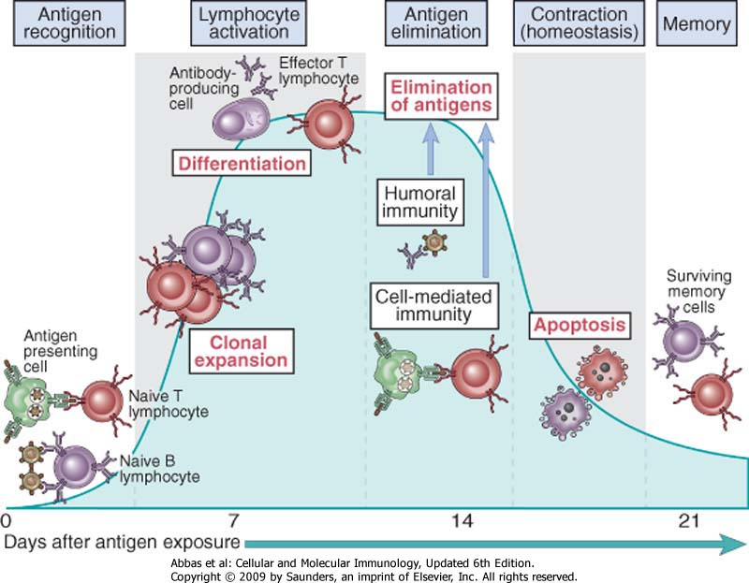
Phases of adaptive immune response

Slide 4
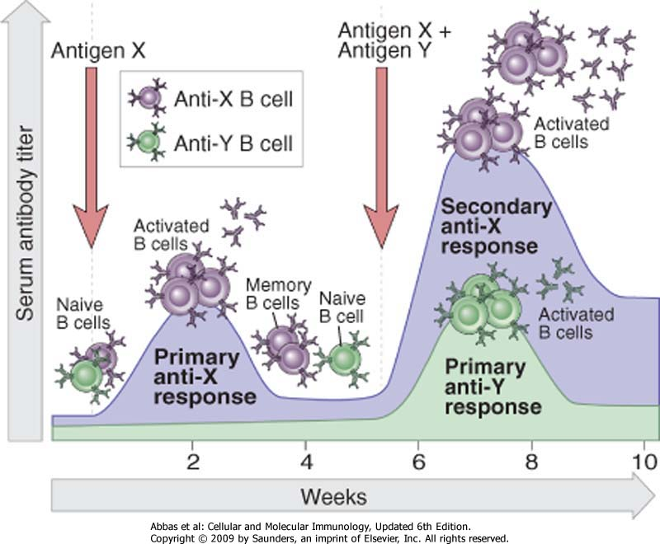
Specificity, resolution and memory

Slide 5
Control of Immune Response
Antigen

Slide 6
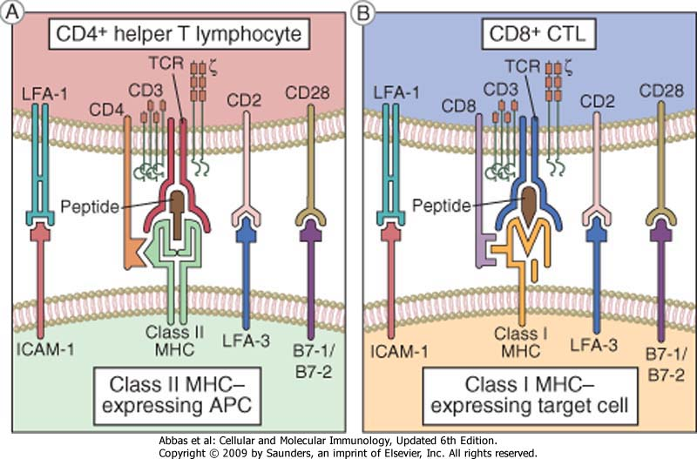

Slide 7
Control of Immune Response
Antigen
Lymphocytes half-life
Treg Lymphocytes
Complexity of the system (request of several costimulatory molecules)

Slide 9
Hypersensitivity disorders: disorders caused by immune responses
….. Normally, immune responses eradicate infectious pathogens without serious injury to host tissues. However, these responses are sometimes inadequately controlled, inappropriately targeted to host tissues, or triggered by commensal microorganisms or environmental antigens that are usually harmless. In these situations, the normally beneficial immune response is the cause of disease.

Slide 12
Type II Hypersensitivity
Target antigens are found on cell or tissues
Antibody binds to Target Antigen
complement activated cell destruction (CDC)

Slide 13
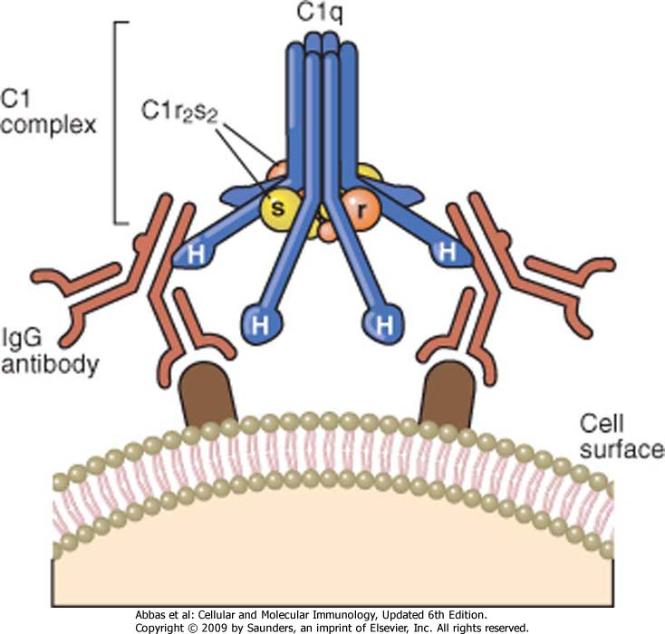

Slide 14
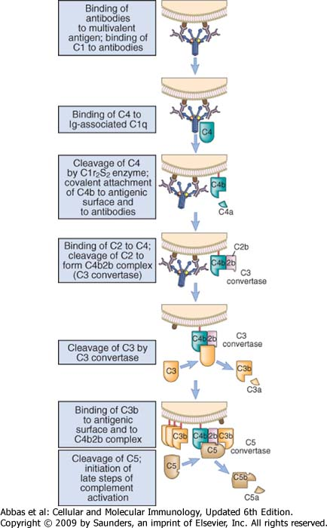

Slide 15
ALTERNATIVE
PATHWAY
LECTIN
PATHWAY
CLASSICAL
PATHWAY
Activating surfaces
Carbohydrates
Immune complexes
C3b C3H₂O
MBL
C1q
MASP
C4
C2
RECOGNITION
C1r
C1Inh
C4BP
B
C1s
D
C4
P
C2
CD55
C 3
OPSONIZATION
FactorH
CD46
C3a
C3b
C5a
INFLAMMATION
C5
S-Protein
Clusterin
CD59
C6C7
C8 C9
CYTOLYSIS
INFLAMMATION
C5b-9

Slide 16
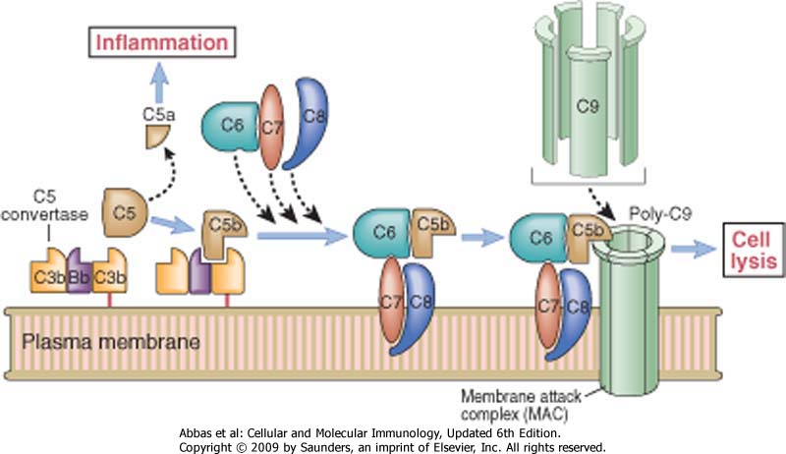

Slide 17
ALTERNATIVE
PATHWAY
LECTIN
PATHWAY
CLASSICAL
PATHWAY
Activating surfaces
Carbohydrates
Immune complexes
C3b C3H₂O
MBL
C1q
MASP
C4
C2
RECOGNITION
C1r
C1Inh
C4BP
B
C1s
D
C4
P
C2
CD55
C 3
OPSONIZATION
FactorH
CD46
C3a
C3b
C5a
INFLAMMATION
C5
S-Protein
Clusterin
CD59
C6C7
C8 C9
CYTOLYSIS
INFLAMMATION
C5b-9

Slide 18
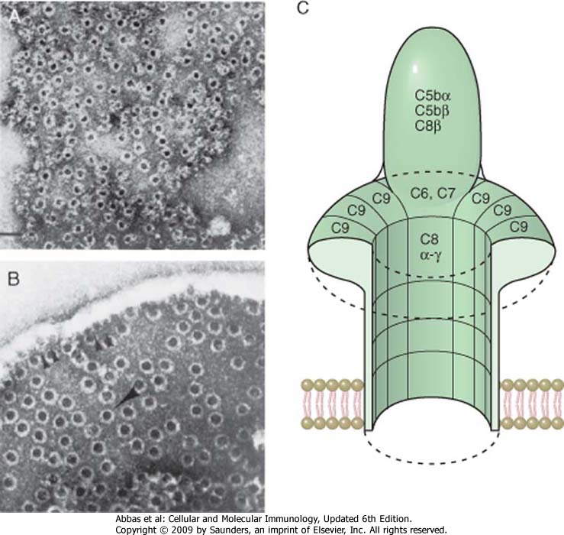

Slide 20
Type II Hypersensitivity
Target antigens are found on cell or tissues
Antibody binds to Target Antigen
- complement activated cell destruction
- Ig binds to Fc receptors on effector cells

Slide 21
FcR | Affinity for immunoglobulin | Cell Distribution | Function
FcγRI (CD64) | High (Kd ∼ 10⁻⁹ M) binds IgG1 and IgG3 | Macrophages, neutrophils; also eosinophils | Phagocytosis, activation of phagocytes
FcγRIIA (CD32) | Low (Kd > 10⁻⁷ M) | Macrophages, neutrophils; eosinophils, platelets | Phagocytosis; cell activation (inefficient)
FcγRIIB (CD32) | Low (Kd > 10⁻⁷ M) | B lymphocytes, dendritic cells, macrophages | Feedback inhibition of B cells, macrophages, dendritic cells
FcγRIIIA (CD16) | Low (Kd > 10⁻⁶ M) | NK cells | Antibody-dependent cell-mediated cytotoxicity
FcγRIIIB (CD16) | Low (Kd > 10⁻⁶ M) GPI-linked protein | Neutrophils, other cells | Phagocytosis (inefficient)
FcεRI | High (Kd > 10⁻¹⁰ M) binds monomeric IgE | Mast cells, basophils, eosinophils | Cell activation (degranulation)
FcεRII (CD23) | Low (Kd > 10⁻⁷ M) | B lymphocytes, eosinophils, Langerhans cells | Unknown
FcαR (CD89) | Low (Kd > 10⁻⁶M) | Neutrophils, eosinophils, monocytes | Cell activation?

Slide 22
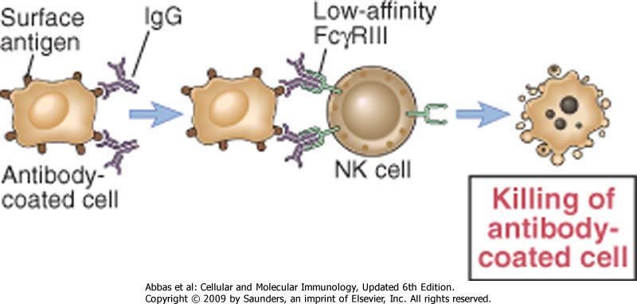

Slide 23
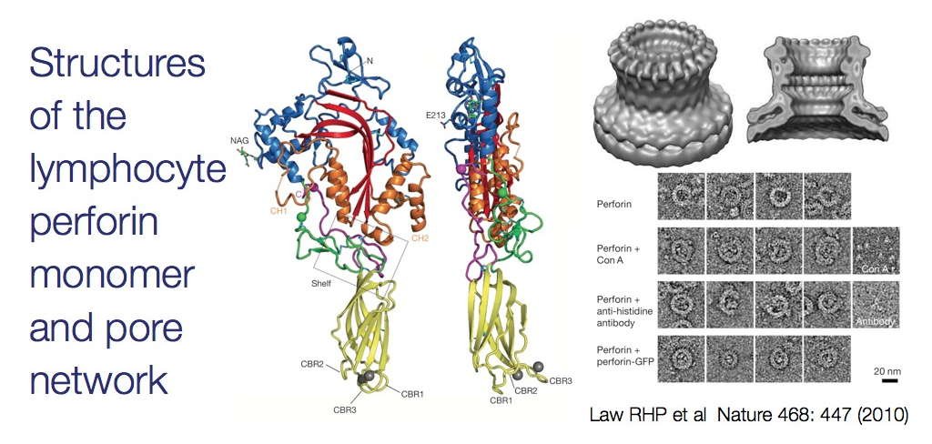

Slide 24
Type II Hypersensitivity:
Antibody mediated cytotoxic
Transfusion reactions
Hemolytic disease of the newborn
Drug induced hemolytic anemia
Nephrotoxic (Masugi type) nephtris
Autoimmune hemolytic anemias
Anti receptors/ hormone autoimmune diseases
(Graves Disease / myasthenia gravis)

Slide 25
Transfusion Reactions
Major Incompatibility
(recipient has Abs to donor RBCs)
chills, fever, pain & shock
large amounts of hemoglobin released
blood pressure drops, renal failure, coagulation
Minor Incompatibility
(donor has Abs to recipient RBCs)
slowly falling hematocrit

Slide 26
ABO Blood Group Antigens
A
NAG
Gal
NAcGA
H
Fuc
NAG
Gal
NAG
Gal
A antigen
Fuc
B antigen
Precursor
oligosaccharide
H antigen
NAG
Gal
Gal
B
Fuc
NAcGA (N-acetylgalactoseamine)
Gal (galactose)

Slide 28
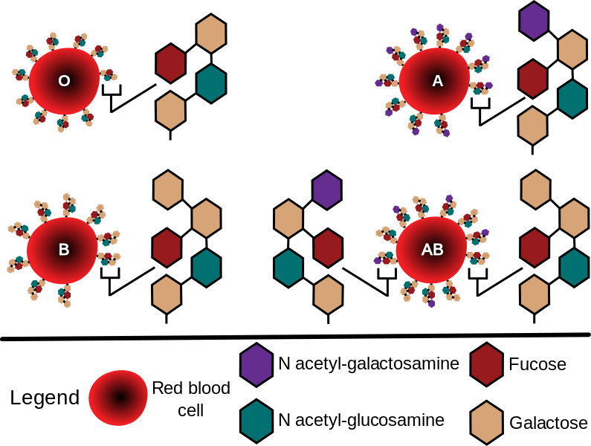
ABO Blood Group Antigens

Slide 29
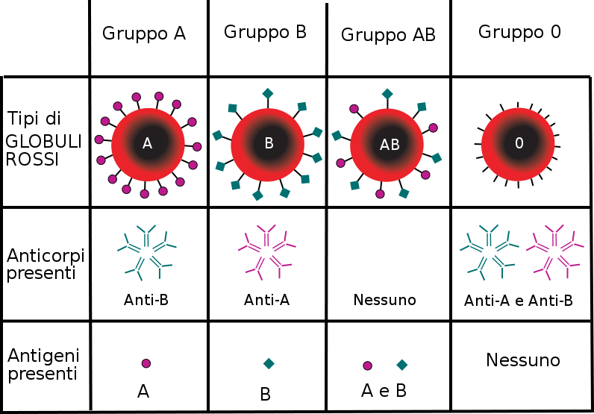
ABO Blood Group Reactivity

Slide 30
AB0 distribution
Grup | Population
 | White | Black | Eastern
A | 45 | 29 | 35,4
B | 8 | 17 | 22,5
AB | 4 | 4 | 12,6
0 | 43 | 50 | 29,5

Slide 31
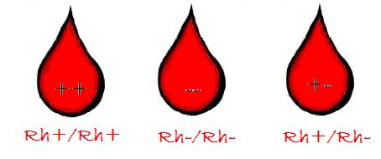
Ag Rhesus (Rh)

Slide 32
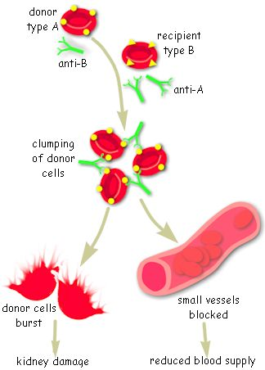
Type II Hypersensitivity: Transfusion reactions
Produced by mismatched blood types
Destroys foreign RBC by complement-mediated lysis triggered by IgG
Produces fever, intravascular clots, lower back pain, Hgb in urine
Free Hgb produced has 2 fates:
passes to the kidneys – hemoglobinuria
Breaks down to bilirubin..can be toxic

Slide 33
Type II Hypersensitivity: Hemolytic Disease of the Newborn
Occurs via maternal IgG Ab’s crossing the placenta
In severe cases causes erythroblastosis fetalis
Most commonly develops in Rh- mother with Rh+ fetus
Exposure to Rh+ fetal RBC’s stimualtes production of memory/plasma cells
Activation of memory cells in subsequent pregnancy stimulate IgG production which can cross the placenta
mild-severe hemolytic anemia ensues along with bilirubin which affects the brain/CNS

Slide 34
Type II Hypersensitivity: Hemolytic Disease of the Newborn
Occurs via maternal IgG Ab’s crossing the placenta
In severe cases causes erythroblastosis fetalis
Most commonly develops in Rh- mother with Rh+ fetus
Exposure to Rh+ fetal RBC’s stimualtes prod of memory/plasma
Activation of memory cells in subsequent pregnancy stim IgG Ab’s which can cross the placenta
mild-severe hemolytic anemia ensues along with bilirubin which affects the brain/CNS
Treatment centers on anti-Rh antibodies (RhoGAM)
Mothers can be tested for anti-Rh antibodies to check for a rise in titre
Isolated fetal RBC’s can be checked for anti-Rh IgG w/ Coombs test

Slide 35
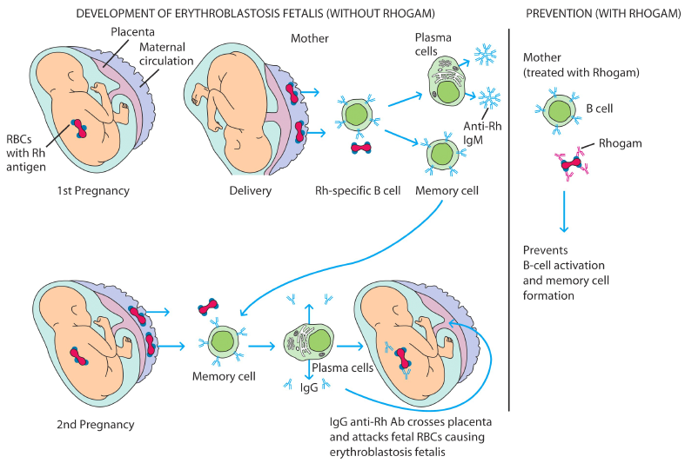
Hemolytic Disease of the Newborn
RhoGAM is purified from human plasma containing anti-Rh
RhoGAM is administered by intramuscular (IM) injection

Slide 36
Type II Hypersensitivity: Drug-induced hemolytic anemia
Drugs such as aspirin and antibiotics can bind to the surfaces of RBC’s
These interactions act similar to hapten-carrier conjugation
Such complexes can trigger Ab-mediated cell lysis by complement activation

Slide 37
Type II Hypersensitivity: Nephrotoxic Nephritis
Antibodies against glomerular basement membrane
Goodpasture’s syndrome
(also lung basement membrane)
Linear binding of Ab
fixation of complement
Inflammatory cells

Slide 38
Type II Hypersensitivity: Thyroiditis
Graves Disease
Antibodies to receptor of Thyroid Stimulating Hormone (TSH-R)
Hyperthyroidism
Hashimoto’s Thyroiditis
Autoantibodies to thyroid proteins
T_{DTH} cells: lymphocyte infiltration
hypothyroidism- Goiter

Slide 39
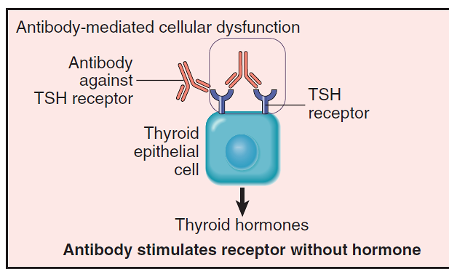
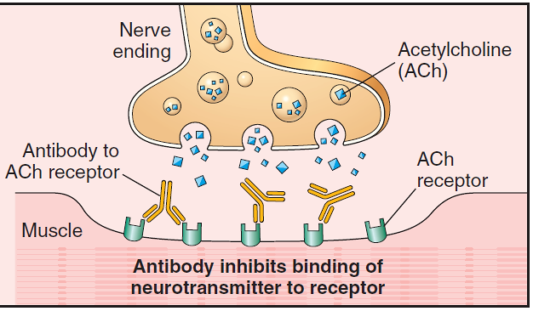
Antireceptor antibodies disturb the normal function of receptors
Graves disease
Auto-antibodies against the thyroid-stimulating hormone (TSH) receptor activate thyroid cells: hyperthyroidism
Genetic susceptibility
Bacterial and/or viral infections (?)
Myastenia gravis
Auto-antibodies against ACh receptor impair neuromuscular transmission: muscle weakness
Genetic susceptibility
Treg dysfuntion (low levels of transcription factor FOXP3, crucial for Treg function)

Slide 40
Effector mechanisms of Ab-mediated disorders

Slide 43
Type III Hypersensitivity
Immune Complex Reactions
Antigens are in solution in plasma or interstitial fluids. Abs combine with these Ags, fix complement and initiate the consequences of the complement cascade

Slide 44
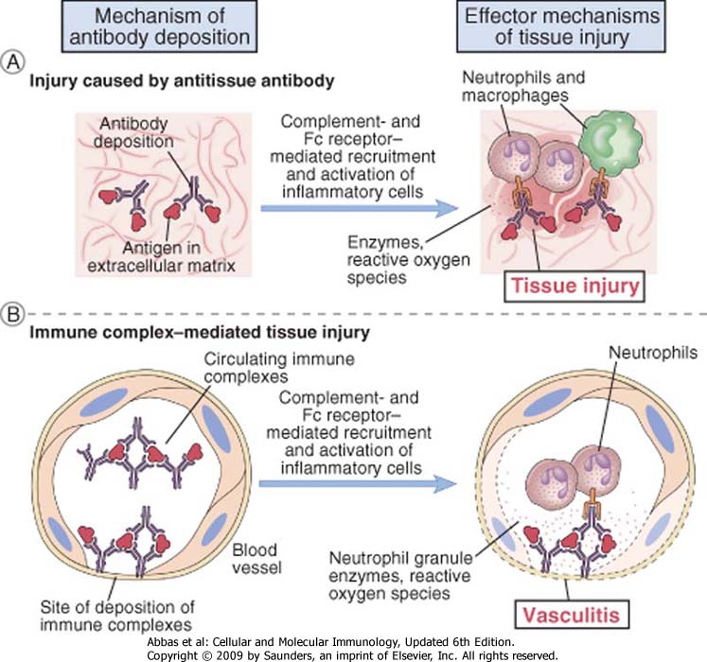
Examples of Ab-mediated disorders

Slide 45
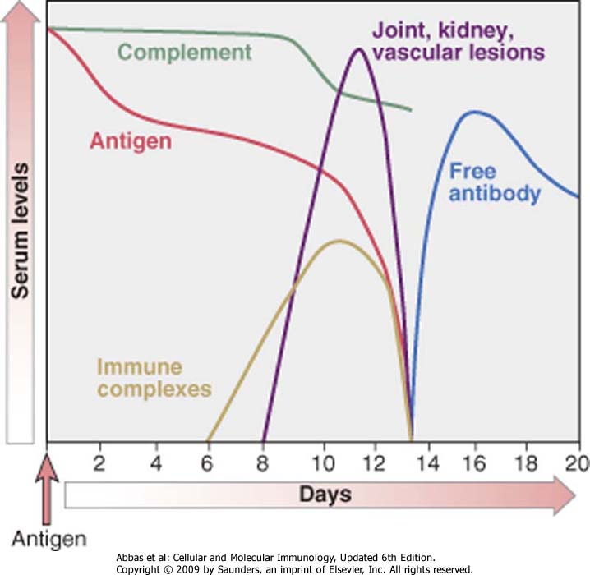
Sequence of the immunological response

Slide 46
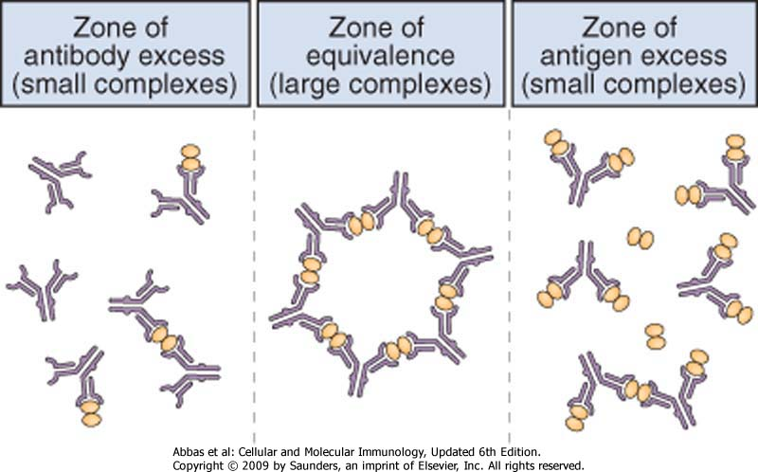

Slide 47
ALTERNATIVE
PATHWAY
LECTIN
PATHWAY
CLASSICAL
PATHWAY
Activating surfaces
Carbohydrates
Immune complexes
C3b C3H₂O
MBL
C1q
MASP
C4
C2
RECOGNITION
C1r
C1Inh
C4BP
B
C1s
D
C4
P
C2
CD55
C 3
OPSONIZATION
FactorH
CD46
C3a
C3b
C5a
INFLAMMATION
C5
S-Protein
Clusterin
CD59
C6C7
C8 C9
CYTOLYSIS
INFLAMMATION
C5b-9

Slide 48
Inflammatory Mechanisms in Type III
Complement activation
Anaphylatoxins
Chemotactic factors
Neutrophils attracted
difficult to phagocytize tissue-trapped complexes
frustrated phagocytosis leads to tissue damage

Slide 49
Diseases associated with immune complexes
Persistent infection
microbial antigens
deposition of immune complexes in kidneys
Autoimmunity
self antigens
deposition of immune complexes in kidneys, joints, arteries and skin
Extrinsic factors
environmental antigens
deposition of immune complexes in lungs

Slide 51
Type III Hypersensitivity
Localized reactions
Arthus type skin reactions
complex mediated glomerulonephritis
bumpy deposits

Slide 52
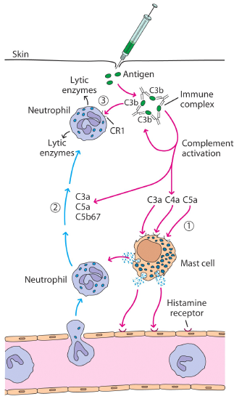
Type III Hypersensitivity: Localized reactions
Arthus reactions:
Exposure to an Ag for which there already is a high concentration of Ab
Produces edema/erythema from damage
Insect bites
Inhalation of bacteria, fungi, dried fecal matter

Slide 53
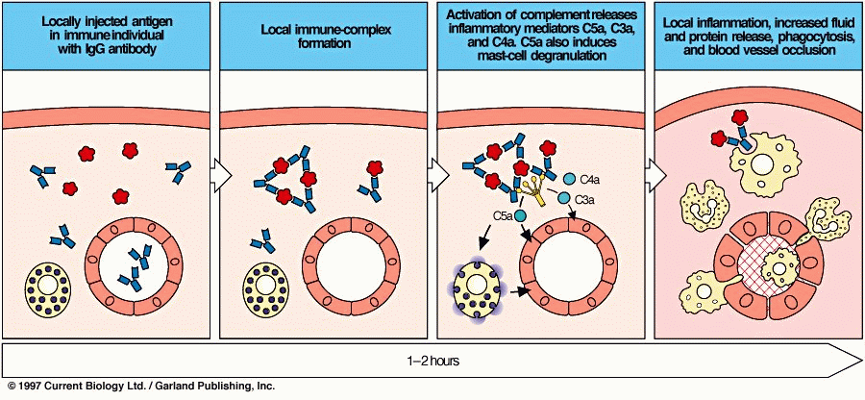
Arthus Reaction

Slide 54
Type III Hypersensitivity
Localized reactions
Arthus type skin reactions
complex mediated glomerulonephritis
bumpy deposits
Generalized reactions
Serum sickness (injection of large amount of Ag)

Slide 55
Generalized or Systemic Type III
Acute Systemic Reactions
drug reactions penicillin
Post streptococcal acute glomerulonephritis
Aggregate “anaphylaxis”- cyro-precipitates
Chronic Systemic Reactions
Infections
Autoimmune conditions SLE or RA
Cutaneous vasculitis

Slide 56
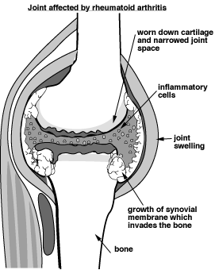
Type III Hypersensitivity: Systemic (generalized) reactions
Produced when large amounts of Ag enter the bloodstream
The sites of deposition vary; usually in tissues where plasma is filtered
Esp. in kidneys, blood vessels, and joints
Can cause tissue damaging reactions:
Serum sickness
Autoimmune diseases
Drug reactions
Infectious diseases

Slide 58
Antigen induced model of arthritis in rats
Immune-complexes
(BSA-antiBSA)
Saline

Slide 59
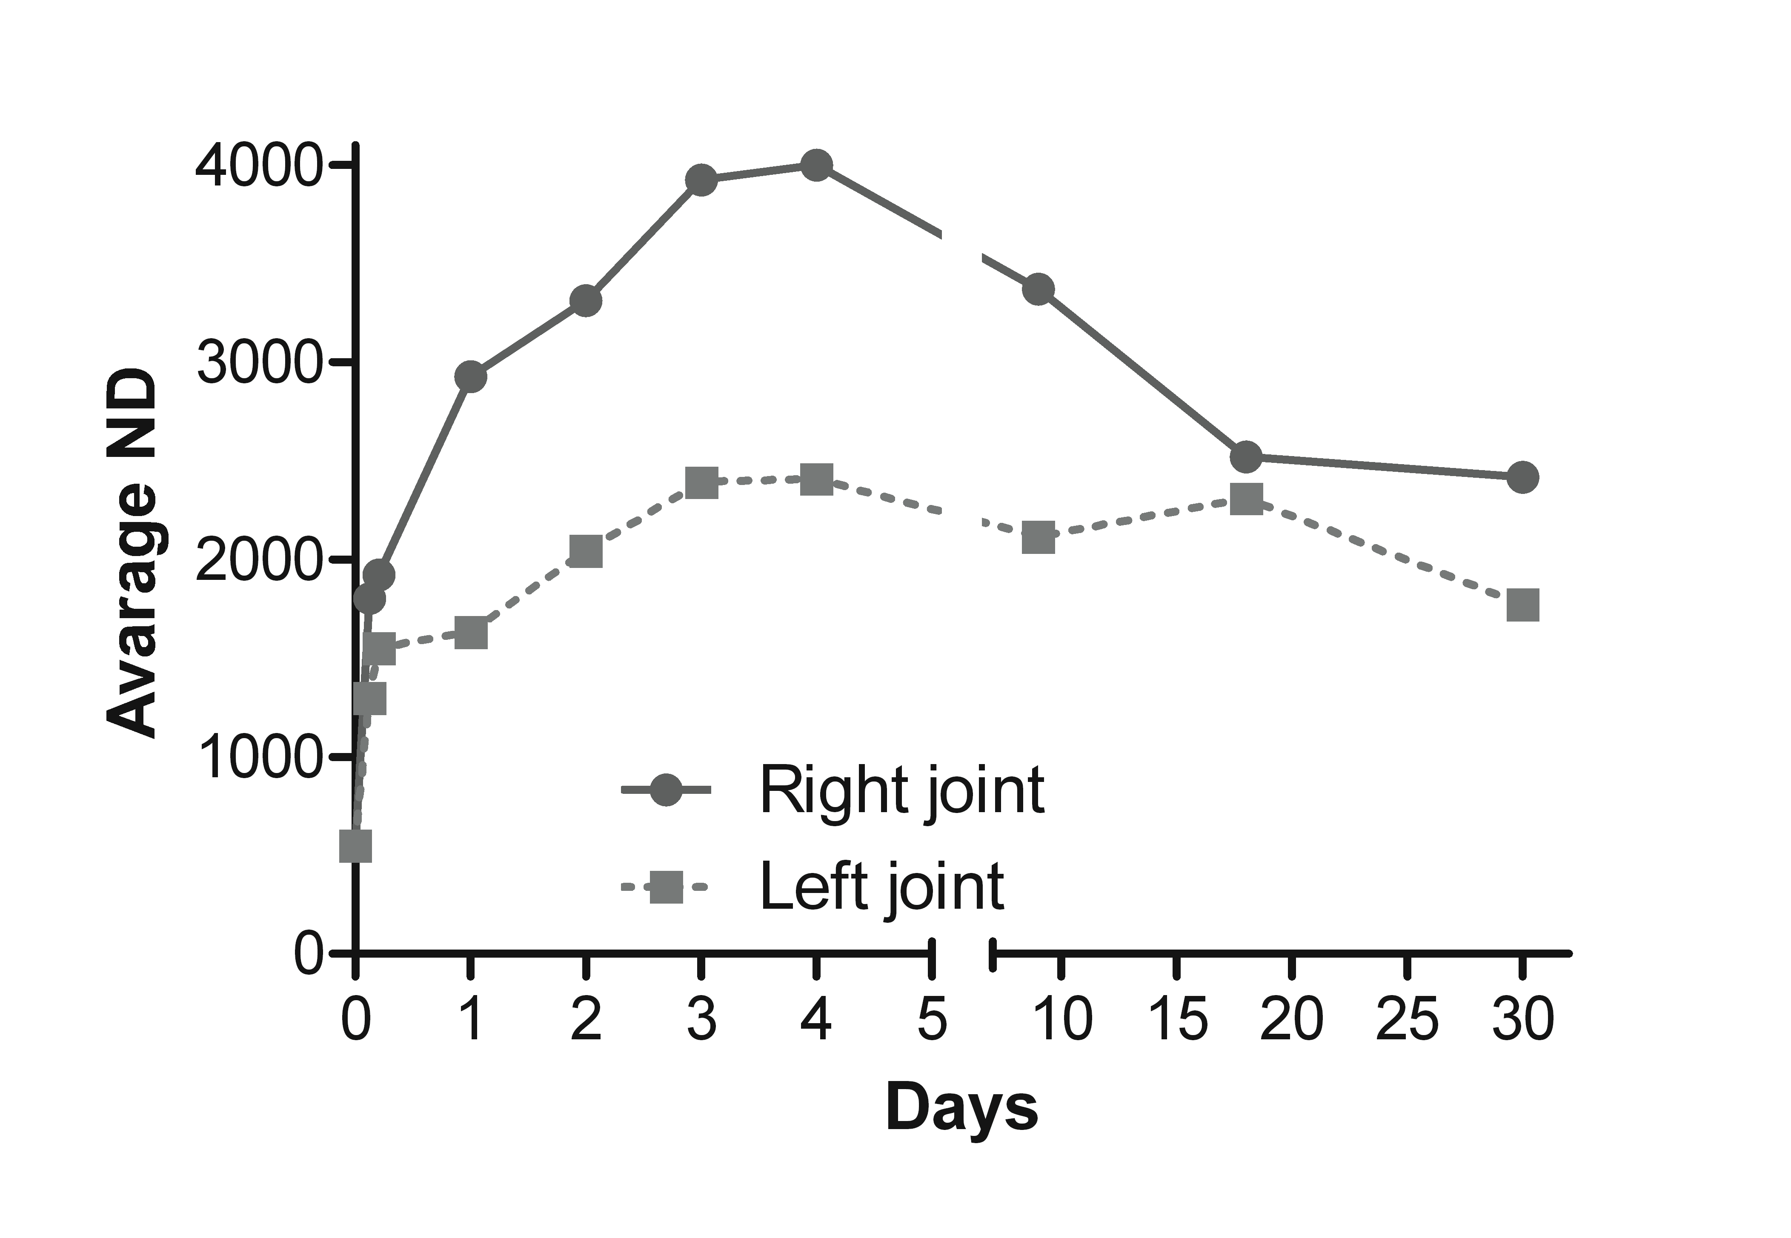
UNIV. OF TRIESTE
DEPT OF LIFE SCIENCES
INTRODUCTION
Bio-distribution of MT07 in a rat model of antigen-induced arthritis
mBSA
(intradermal)
mBSA
(i.a.)
MT07
(e.v.)
In vivo analysis
Days
-21
-14
0
3
33
t0 5h 2days 4days 9days 18days 30days

Slide 60
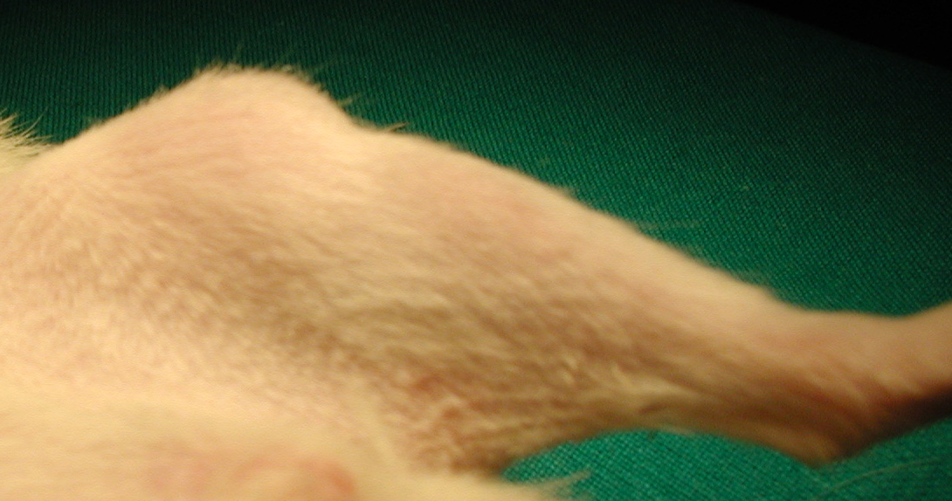
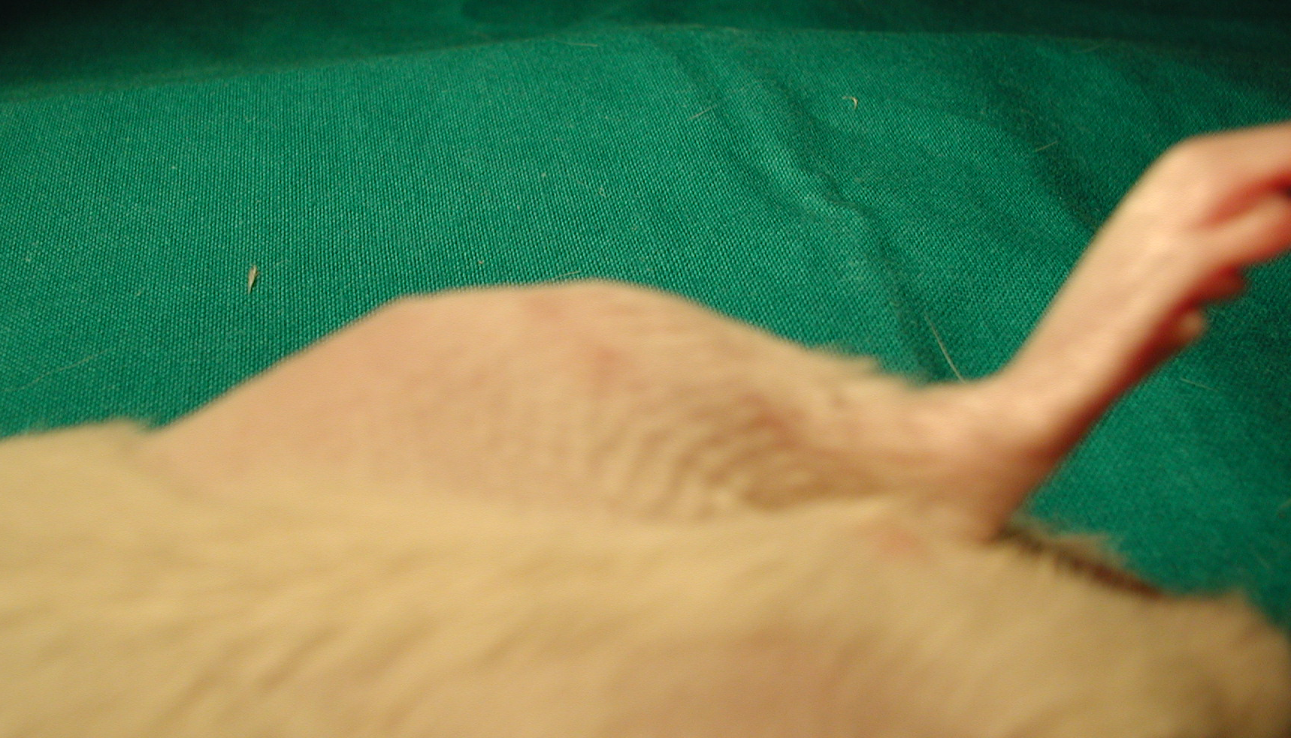
Knee joint 60 hr after intraarticular injection of mBSA
Knee joint 60 hr after intraarticular injection of mBSA + MB anti-C5

Slide 61
Joint swelling
(21 days after induction of arthritis)
SALINE
mBSA
mBSA+unrelated MB
mBSA+MB anti-C5
(injected together)
mBSA+MB anti-C5
(injected after 7 days)
0
20
40
60
% of increase compared with basal values

Slide 62
PMN in the synovial fluid washings
(21 days after induction of arthritis)
SALINE
mBSA
mBSA+unrelated MB
mBSA+MB anti C5
(injected together)
mBSA+MB anti C5
(injected after 7 days)
0
10
20
30
40
50
cells x 10³ / ml

Slide 63
TNF-α concentration in the synovial fluid washings
(21 days after induction of arthritis)
SALINE
mBSA
mBSA+unrelated MB
mBSA+ MB anti C5
(injected together)
mBSA+ MB anti C5
(injected after 7 days)
0
10
20
30
40
pg/ml

Slide 64
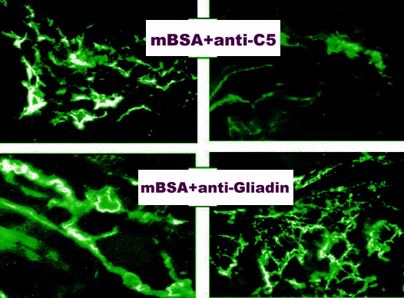
C3
C9
mBSA+ MB anti C5
mBSA+unrelated MB
Immunofluorescence analysis of rat synovial tissue 48 hr after mBSA injection

Slide 65
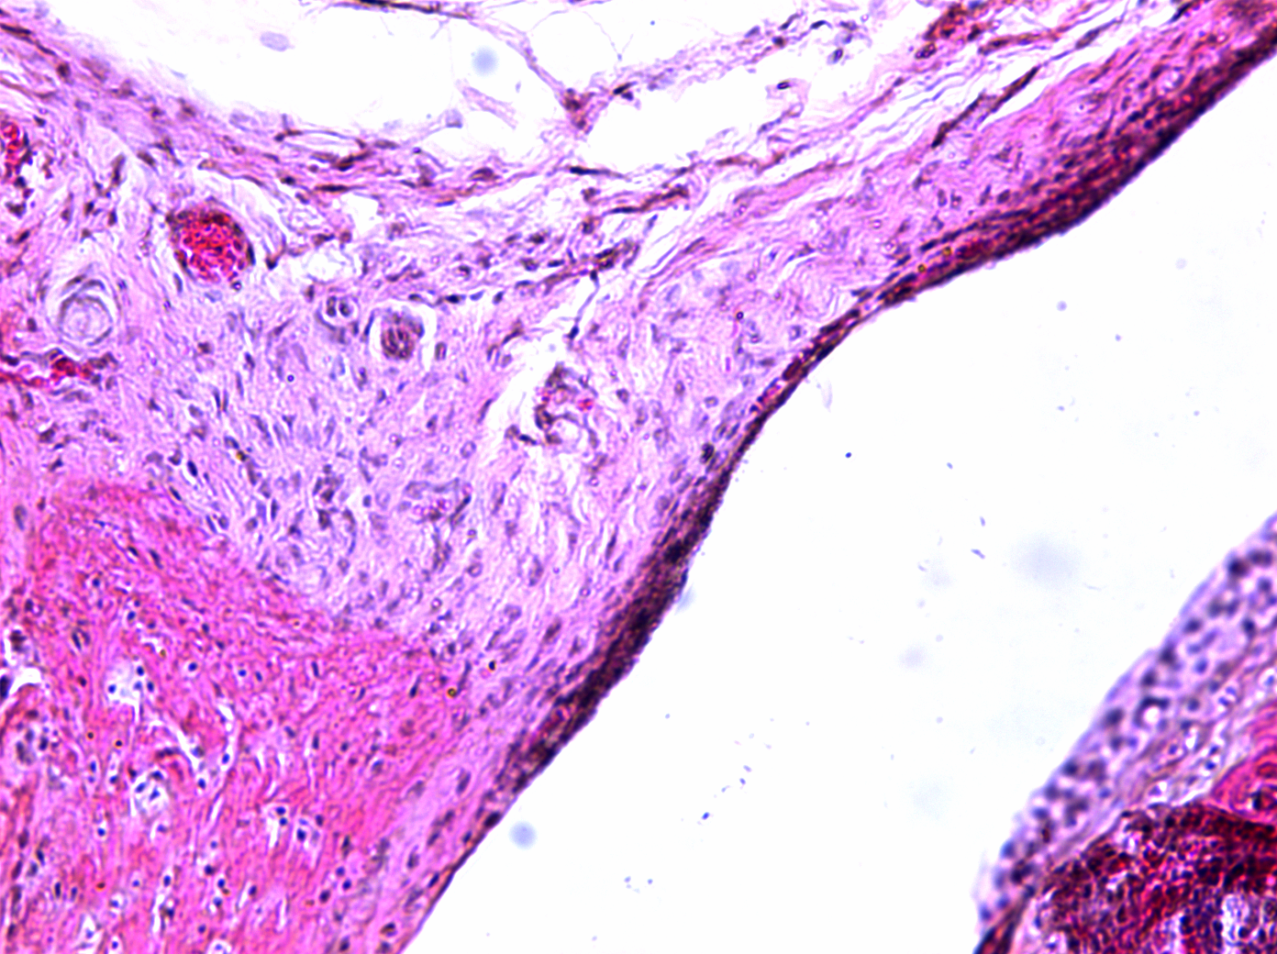
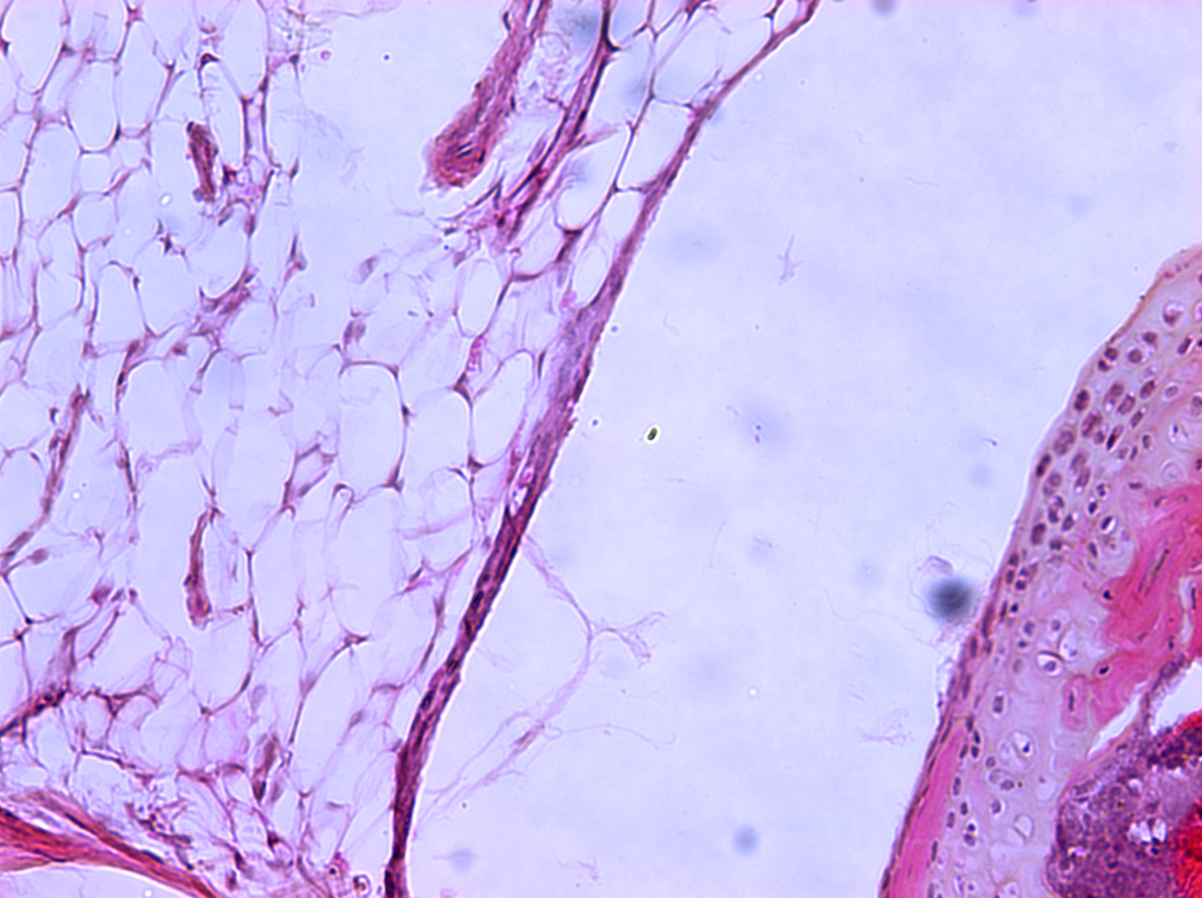
Treatment of mouse model of anti-Anti-CII arthritis (Arthrogen)
UNIV. OF TRIESTE
DEPT OF LIFE SCIENCES
INTRODUCTION
Anti-CII Abs
(i.p.)
MT07
(e.v.)
LPS
(i.p.)
Days
0
1
3
14
Saline
MT07

