Slide 1
Type IV Hypersensitivity

Slide 4
Cell-Mediated Immunity
The effector cells involved in these processes are cytotoxic T-lymphocytes (CTLs), NK-cells, Macrophages and Th cells
Phagocytosis and killing
- Direct cell killing by cytotoxic T cells
- Direct cell killing by NK cells

Slide 5
Killing by cytotoxic T cells
release some substances known as perforin, granzyme A,B,C and serglycin and granulysin
the CTL may release cytokines

Slide 7
Type IV hypersensitivity
DTH (Delayed Type hypersensitivity)
Cell-mediated hypersensitivity
Is a T cell mediated inflammatory response, in which stimulation of T cells leads to macrophage activation and localized inflammation and edema within tissues
This effector T cell response is essential for the control of intracellular and other pathogens.

Slide 8
Examples of Microbial-Induced DTH
Viruses (destructive skin rashes)
smallpox
measles
herpes simplex
Fungi
candidiasis
dematomycosis
coccidioidomycosis
histoplasmosis
Parasites (against enzymes from the eggs lodged in liver)
leishmaniasis
schistosomiasis

Slide 9
How Important is the DTH Response?
The AIDS virus illustrates the vitally important role of the DTH response in protecting against various intracellular pathogens.
The disease cause severe depletion of CD4+ T cells, which results in a loss of the DTH response.
AIDS patients develop life-threatening infections from intracellular pathogens that normally would not occur in individuals with intact DTH responses.

Slide 10
Type IV hypersensitivity
DTH (Delayed type hypersensitivity)
Is a T cell mediated inflammatory response, in which stimulation of T cells leads to macrophage activation and localized inflammation and edema within tissues.
This effector T cell response is essential for the control of intracellular and other pathogens.
If the response is excessive or against self Ags it can damage host tissues

Slide 11
Type IV Hypersensitivity
What is delayed type hypersensitivity (DTH)?
A hypersensitive response mediated by sensitized T cells, which release various cytokines and chemokines
Generally occurs 2-3 days after T cells interact with antigen

Slide 12
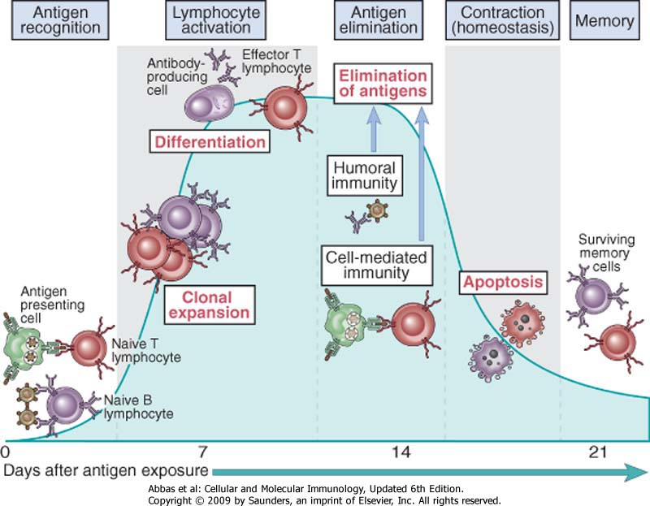
Phases of adaptive immune response

Slide 13
Phases of the DTH Response
Sensitization – TH1 cells triggered by contact with APC

Slide 14
Stages of Type IV DTH sensitization-Effector stage
Th1 memory cells are activated and produce cytokines.
IFN-γ, TNF-α, and TNF-β which cause tissue destruction, inflammation.
IL-2 that activates Th cells and CTLs.
Chemokines- for macrophage recruitment.
IL-3, GM-CSF for increased monocyte/macrophage

Slide 15
Phases of the DTH Response
Sensitization – TH1 cells triggered by contact with APC
Effector response – produces huge influx of activated MØ
Activated MØ is more efficient at antigen-presentation
Release of lytic enzymes lead to non-specific destruction of cells
Works well against intra-cellular pathogens
If pathogen/particle lingers -> can lead to granuloma formation
Ex: Mycobacterial pathogens in TB and Leprosy

Slide 16
Stages of Type IV DTH Effector stage
Inflamed area becomes red and fluid filled can form lesion.
From tissue damage there is activation of clotting cascades and tissue repair.
Continued exposure to antigen can cause chronic inflammation and result in granuloma formation.

Slide 17
Variants of type IV HyperSensitivity
There are 3 variants of type IV HS reaction
Contact HS
Tuberculin type HS
Granulomatous HS

Slide 18
Fig 5
Type | Reaction time | Clinical appearance | Histology | Antigen and site
contact | 48-72 hr | eczema | lymphocytes, followed by macrophages; edema of epidermis | epidermal ( organic chemicals, poison ivy, heavy metals, etc.)
tuberculin | 48-72 hr | local induration | lymphocytes, monocytes, macrophages | intradermal (tuberculin, lepromin, etc.)
granuloma | 21-28 days | hardening | macrophages, epitheloid and giant cells, fibrosis | persistent antigen or foreign body presence (tuberculosis, leprosy, etc.)

Slide 19
Contact hypersensitivity
Occur within 72 hrs of Ag challenge
Characterized by an eczematous reaction in the skin at the point of contact with an antigen
Organic chemicals and inorganic metals such as nickel, chromate and rubber accelerator in latex gloves

Slide 20
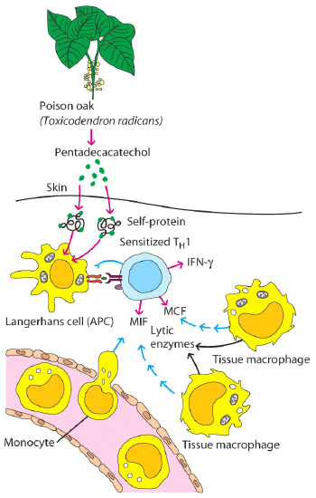
Contact Dermatitis
Produced by a variety of substances
Mostly small molecules attach to a protein in the skin
The Ag-protein complex is processed and presented → sensitize TH1 cells
Subsequent exposure activates TH1 cells → 48-72 hrs later MØ infiltrate
Activation of MØ causes the inflammation that characterizes the disorder

Slide 21
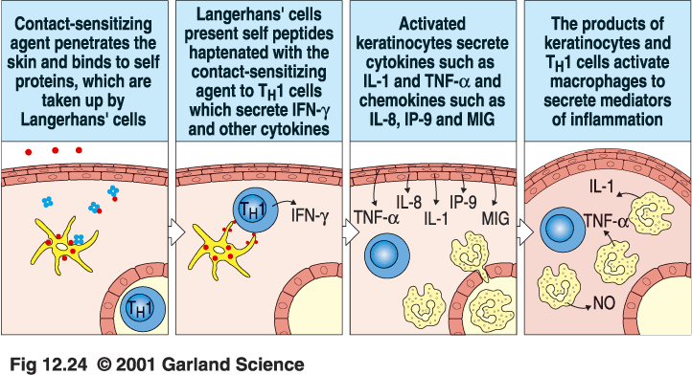
Type IV Hypersensitivity
May be caused by metals (zirconium) or poison ivy
Contact dermatitis

Slide 22
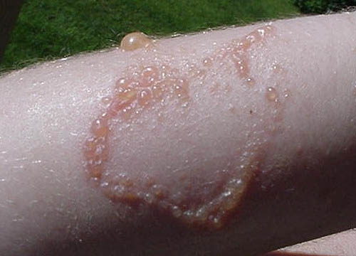

Slide 23
TUBERCULIN TYPE
Is induced by soluble antigens from organisms such as Mycobacterium Tuberculosis and Leprae and Leishmania tropica
Following Intradermal tuberculin challenge, memory T cells are recruited and activated to secrete IFN-γ, which activates macrophages to produce TNF and IL-1
The initial influx at 4 hrs is neutrophils but replaced at 12 hrs by monocytes and T cells.

Slide 24
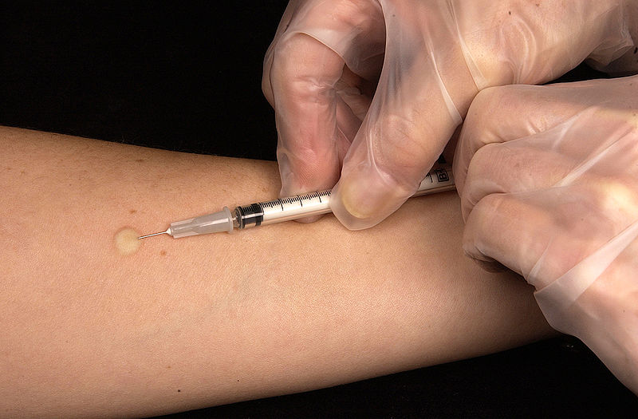

Slide 25
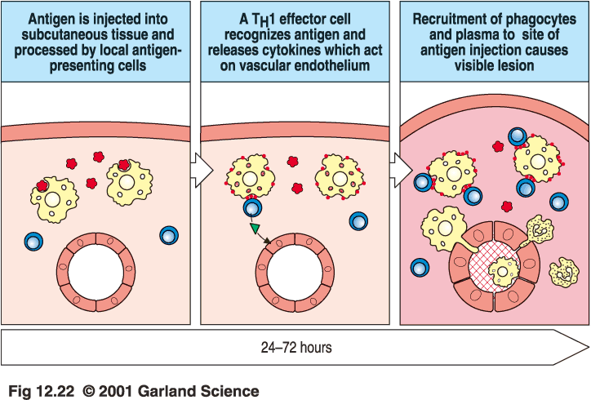
Type IV hypersensistivity
(Tubercolin reaction)
T_{H}1 from a previous immunization (memory)

Slide 26
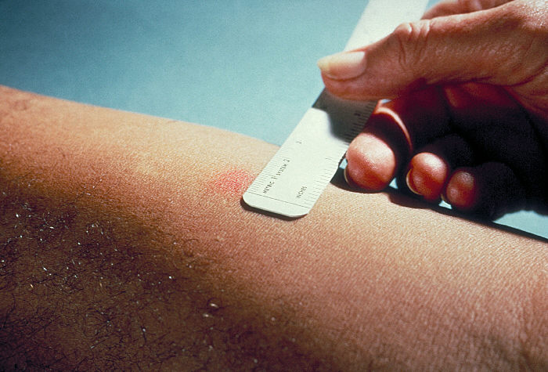

Slide 27
Granulomatous HS
Clinically the most important form of type IV HS.
If the Ag persist (intracellular microorg., other particles such as zirconium and beryllium, talc, silica), chronic activation of T cells and macrophages lead to granuloma formation and tissue damage.

Slide 28
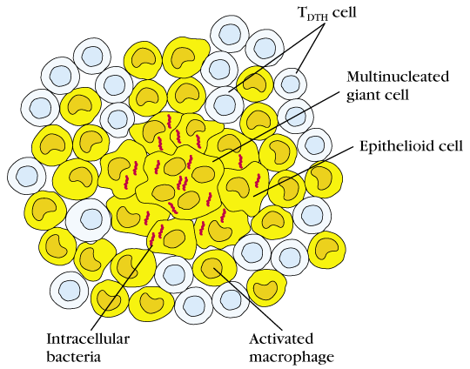
What happens if the DTH response is prolonged?
A granuloma develops…
Continuous activation of macrophages induces the macrophages to adhere closely to one another, assuming an epithelioid shape and sometimes fusing together to form giant, multinucleated cells.

Slide 29
Epitheloid Cell Granuloma Formation
Large flattened cells with increased endoplasmic reticulum
Multinucleate giant cells with little ER
May see necrosis
Damage due to CD8+ T-cells recognizing antigen-coated macrophages, cytokine-activated macrophages
Attempt by the body to wall-off site of persistent infection

Slide 30
Granulomatous HS
Leishmaniasis
Sarcoidosis
Leprosy
Tuberculosis

Slide 31
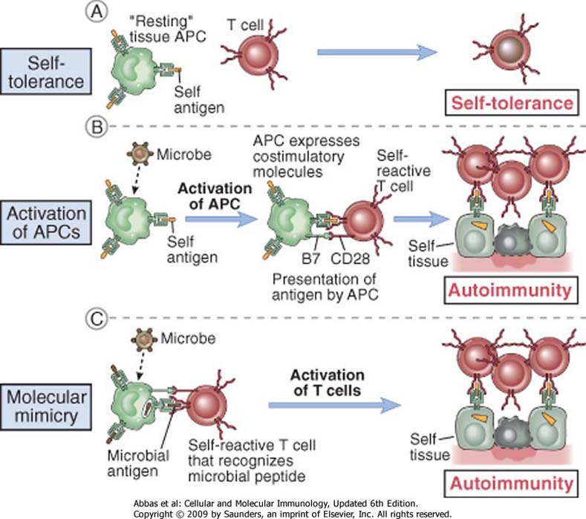
Infection
and autoimmunity

Slide 33
Rheumatoid Arthritis (RA)
Incidence of 0.5% to 1% in Europe and USA
Some native Americans have high prevalence (6%)
Positive family history increase risk 3 to 5 times
Reduction from urban to rural areas
More common in women than men (ratio 3:1)

Slide 34
From: https://rheumatoidarthritis.net/what-is-ra/ra-statistics/

Slide 35
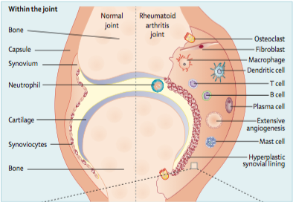
Rheumatoid Arthritis (RA)
is a chronic autoimmune disease
which cause cartilage and bone damage as well as disability
Clinical manifestations
Early
Intermediate
Late
Morning stiffness
Joints swelling
Articular pain
Joints deformity
Extra-articular manifestations
Josef S Smolen, Daniel Aletaha, Iain B McInnes Lancet, 2016
Adapted from http://www.physio-pedia.com/RA_(Rheumatoid_Arthritis)

Slide 36
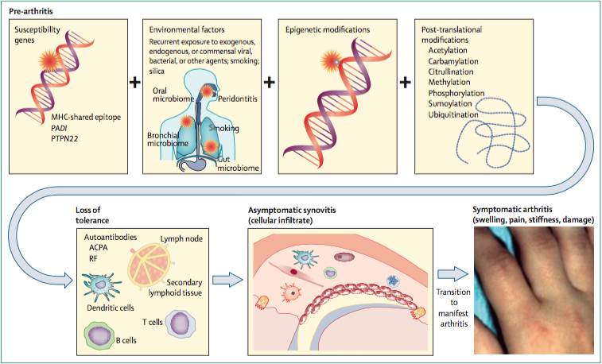
Rheumatoid Arthritis (RA)
Unknown etiology…just hypothesis
McInnes et al. NEJM 2001

Slide 37
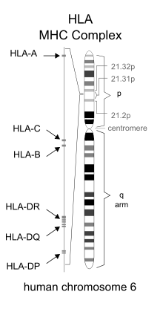
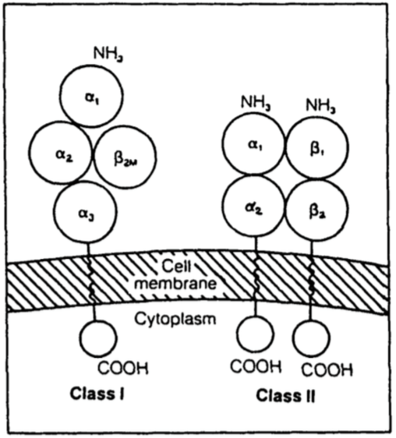
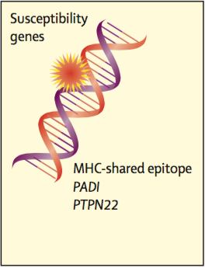
Rheumatoid Arthritis (RA)
Genome wide association studies have characterized more than 100 loci associated with RA risk implicated with immune mechanisms and shared with other pathology
IB McInnes, G Schett - New England Journal of Medicine, 2011
PK Gregersen, J Silver, RJ Winchester - Arthritis & Rheumatism, 1987

Slide 38
Rheumatoid Arthritis (RA)
Specific binding to the RA-associated P4 pocket has been demonstrated for peptides from vimentin, fibrinogen, α-enolase, aggrecan and type II collagen
Aminoacids 11, 71 and 74 confer a positive charge to the P4. However, when arginine is converted in a neutral citrulline the peptide is able to fit in the P4
V Malmström et al. Nature Reviews Immunology, 2016

Slide 39
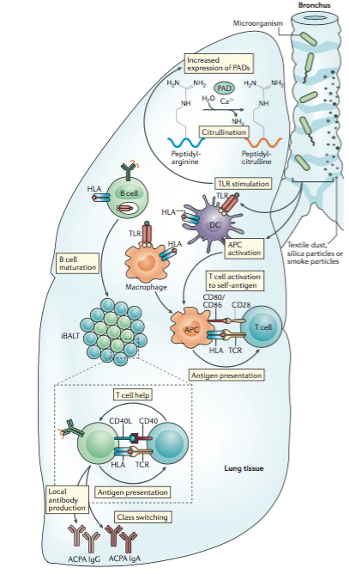
First step
Local early immune activation
…..probably lungs, gums, intestine
induced bronchus-associated lymphoid tissue
V Malmström et al. Nature Reviews Immunology, 2016

Slide 40
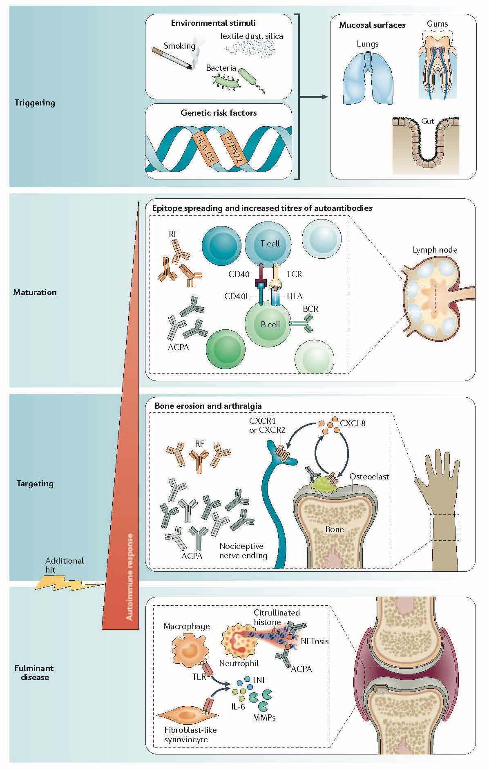
V Malmström et al. Nature Reviews Immunology, 2016

Slide 41
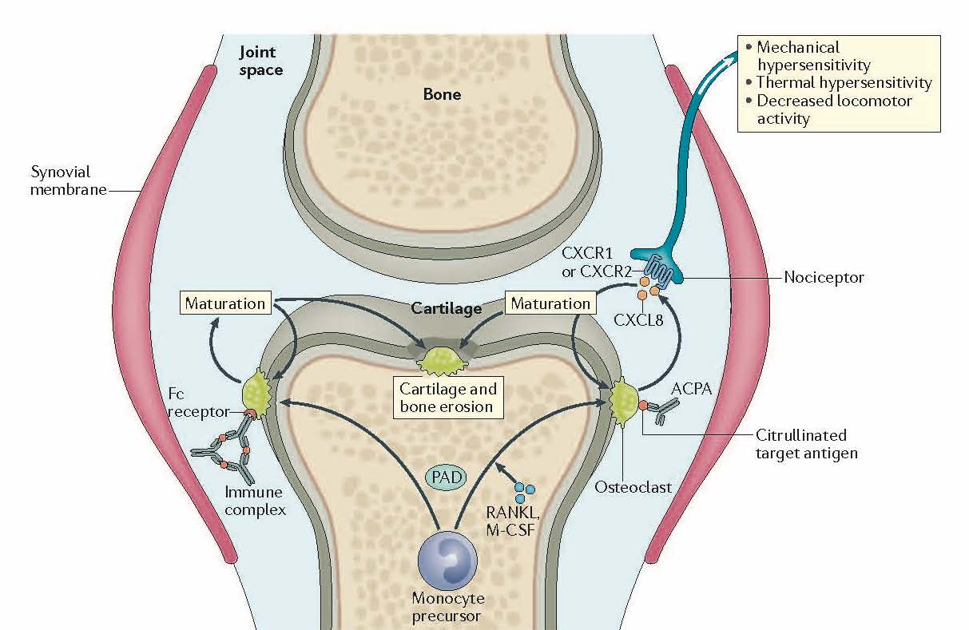
V Malmström et al. Nature Reviews Immunology, 2016

Slide 42
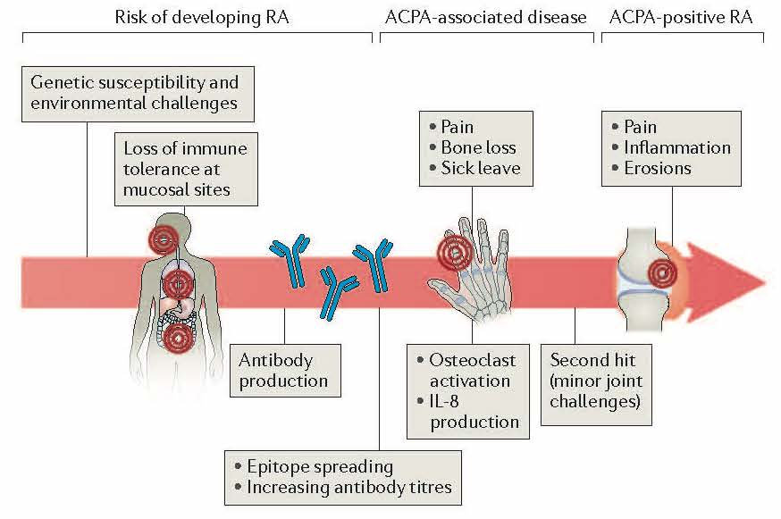
Catrina et al. Nature Review Rheumatology 2017

Slide 43
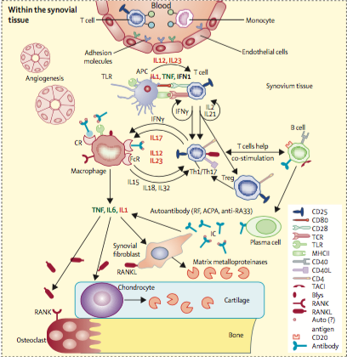
Rheumatoid Arthritis
Second step
Within the synovial tissue
Josef S Smolen, Daniel Aletaha, Iain B McInnes Lancet, 2016

Slide 44
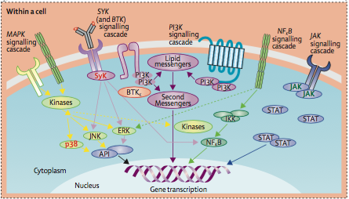
Rheumatoid Arthritis
Cytokines
Proliferation, migration, adhesion and cytokines’ production
Josef S Smolen, Daniel Aletaha, Iain B McInnes Lancet, 2016

Slide 45
Rheumatoid Arthritis (RA)
Unknown etiology…just hypothesis
IB McInnes et al. NEJM 2001

Slide 46
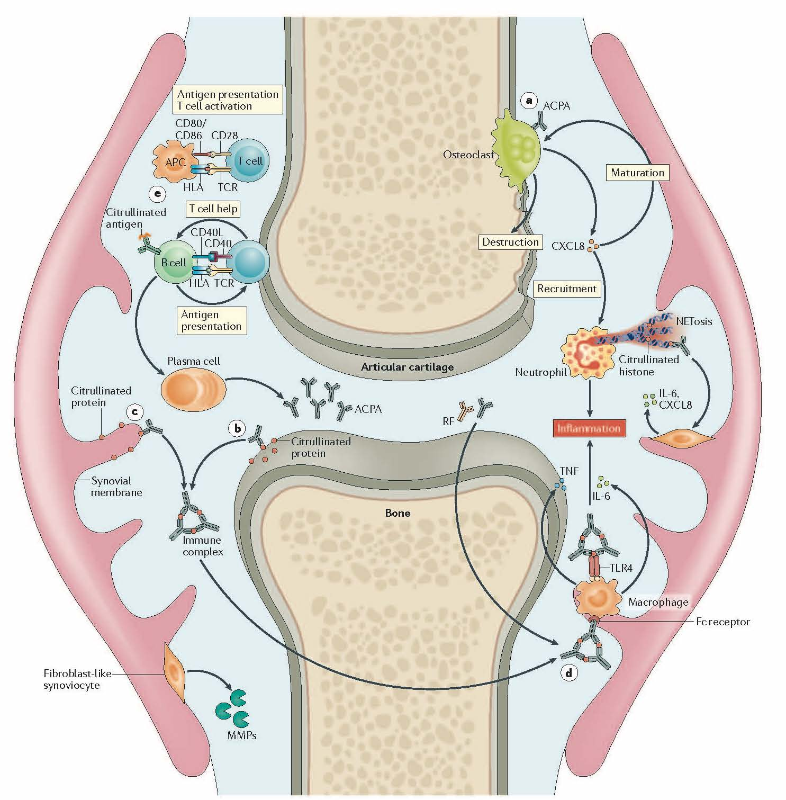
V Malmström et al. Nature Reviews Immunology, 2016

