Slide 1
Immunosuppressive
drugs

Slide 2
Drug | Mechanism of action
Cyclosporin (FK-506) | Block of cytokine production by T lymphocytes (inhibits NF-AT)
Azathioprine | Block of lymphocytes precursor proliferetion
Mofetil-mycofenolate | Block of lymphocytes proliferation (inhibits guanine synthesis)
Rapamycin | Block of lymphocytes proliferation (inhibits signal transduction of IL2)
Corticosteroids | Reduce inflammation (inhibit cytokine production by Macrophages)
Anti-CD3 Ab | T lymphocytes elimination
Anti-IL2 receptor | Inhibit T lymphocyte proliferation
CTLA-4-Ig | Inhibit T lymphocyte activation (neutralizing B7 (APC) al CD28 (linfociti T) interaction)
Anti-CD40L | Inhibit also macrophages end endothelial cells activation blocking CD40L (T lymphocyte) and CD40 (macrophage) interaction

Slide 3
IMMUNODEFICIENCY CAUSED BY DRUGS
CORTICOSTEROIDS
Inhibit cytokine synthesis
Cause changes in circulating leukocytes
Depletion of CD4 cells
Monocytopenia
Decreased in circulating eosinophils and basophils
Inhibition of T cell activation and B cell maturation

Slide 4
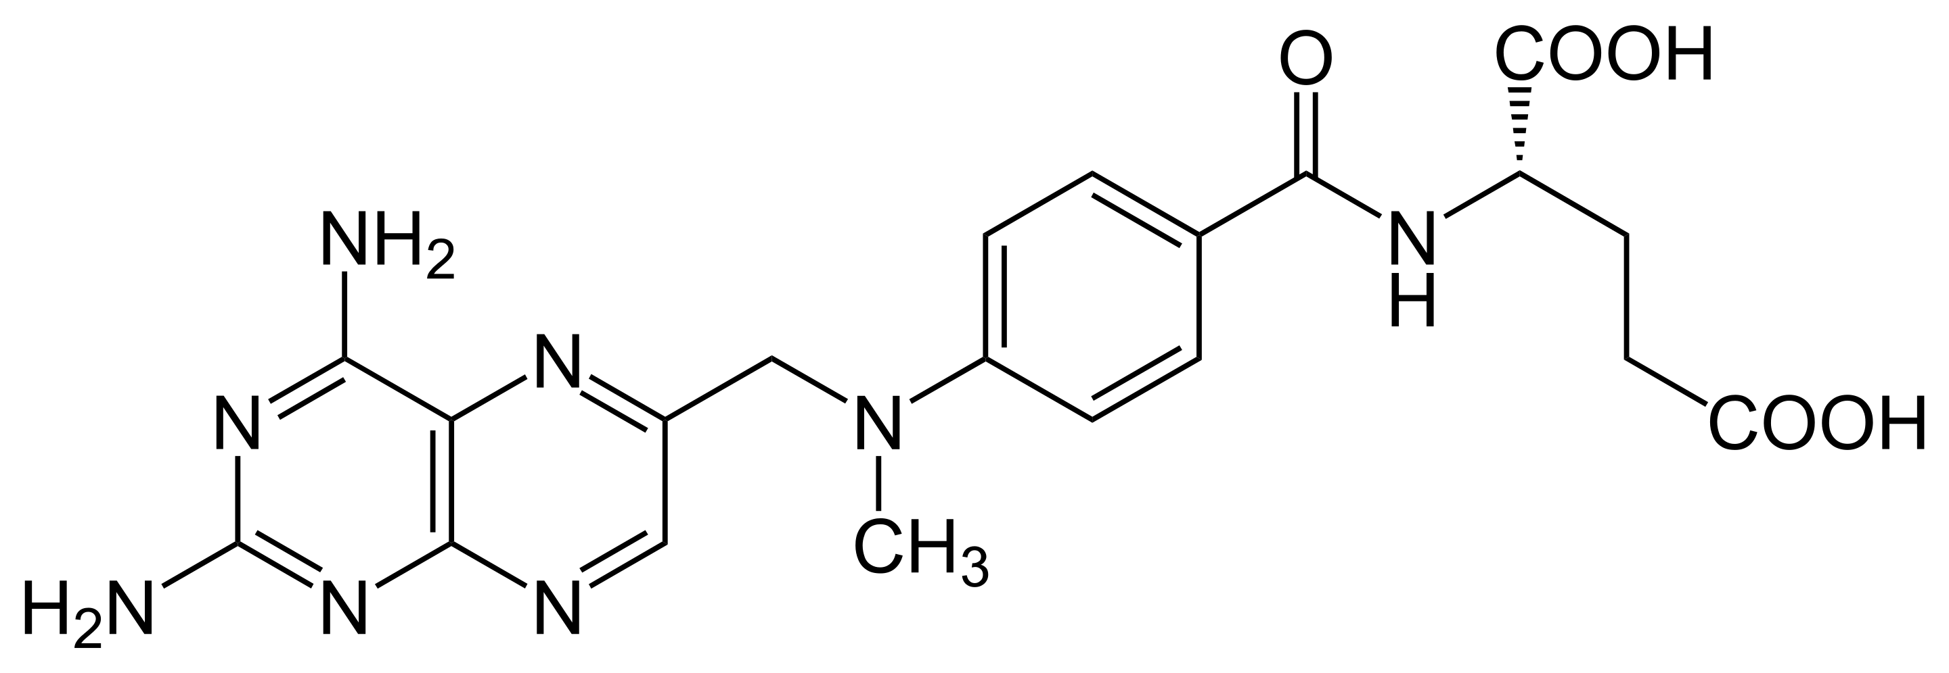
IMMUNODEFICIENCY CAUSED BY DRUGS
METHOTREXATE
Structural analogue of folic acid
Blocks folic acid dependent-synthetic pathways essential for DNA synthesis
Prolonged use for treatment reduces immunoglobulin synthesis

Slide 5
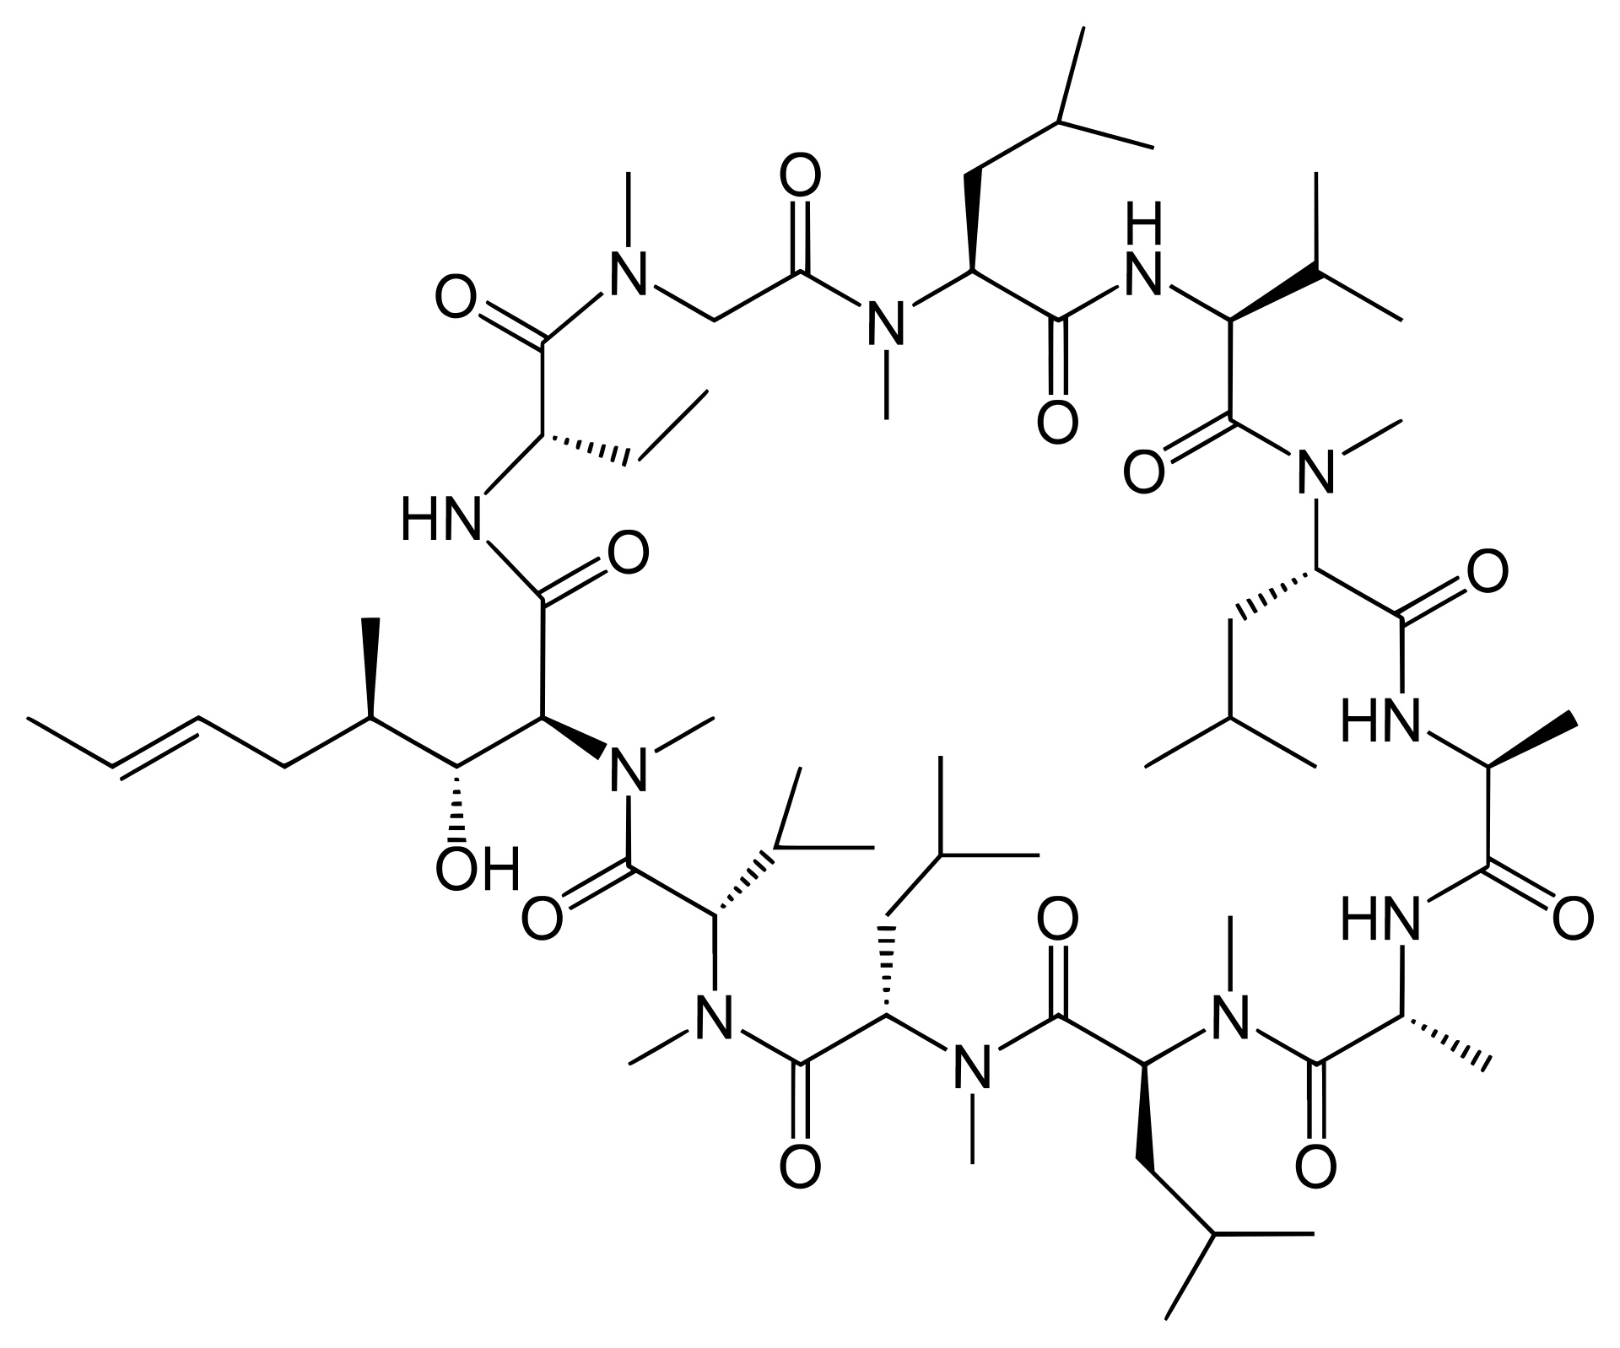
IMMUNODEFICIENCY CAUSED BY DRUGS
CYCOLOSPORIN
Inhibit IL 2 dependent signal transduction blocking calcineurin
Have severe effects on T cell signaling and functions

Slide 6
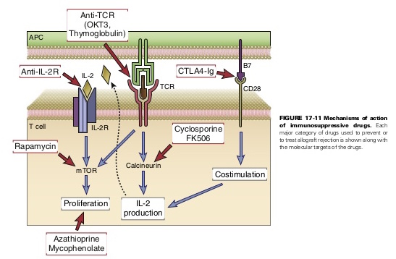

Slide 7
Drug | Mechanism of action
Cyclosporin (FK-506) | Block of cytokine production by T lymphocytes (inhibits NF-AT)
Azathioprine | Block of lymphocytes precursor proliferetion
Mofetil-mycofenolate | Block of lymphocytes proliferation (inhibits guanine synthesis)
Rapamycin | Block of lymphocytes proliferation (inhibits signal transduction of IL2)
Corticosteroids | Reduce inflammation (inhibit cytokine production by Macrophages)
Anti-CD3 Ab | T lymphocytes elimination
Anti-IL2 receptor | Inhibit T lymphocyte proliferation
CTLA-4-Ig | Inhibit T lymphocyte activation (neutralizing B7 (APC) al CD28 (linfociti T) interaction)
Anti-CD40L | Inhibit also macrophages end endothelial cells activation blocking CD40L (T lymphocyte) and CD40 (macrophage) interaction

Slide 11
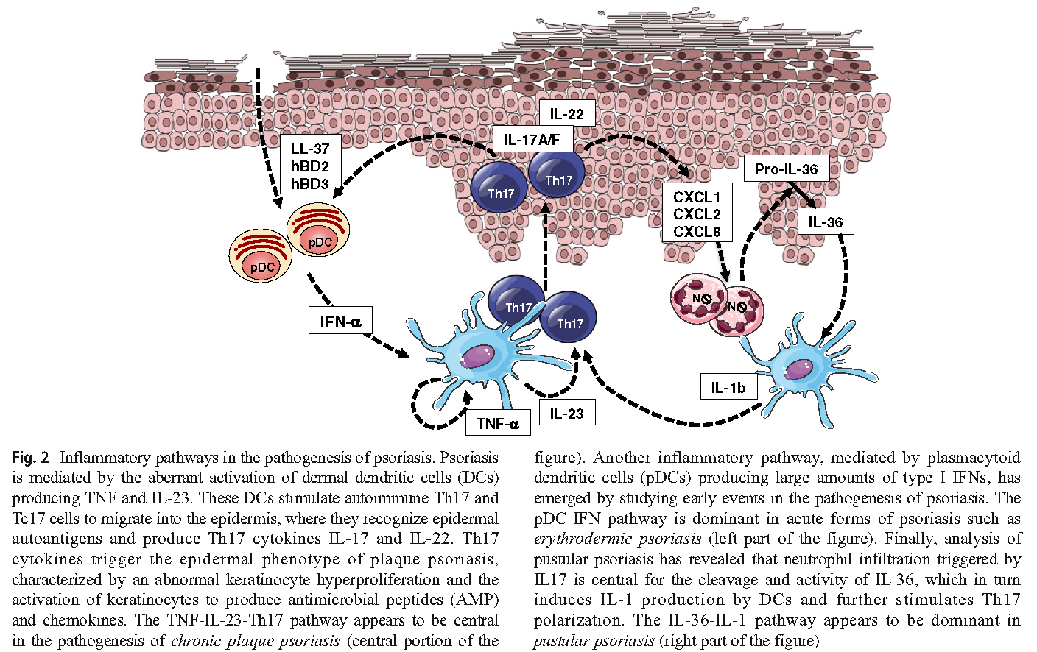
Pathogenesis of psoriasis
from Conrad et al, Clin Rev Allerg Immunol, 2018

Slide 12
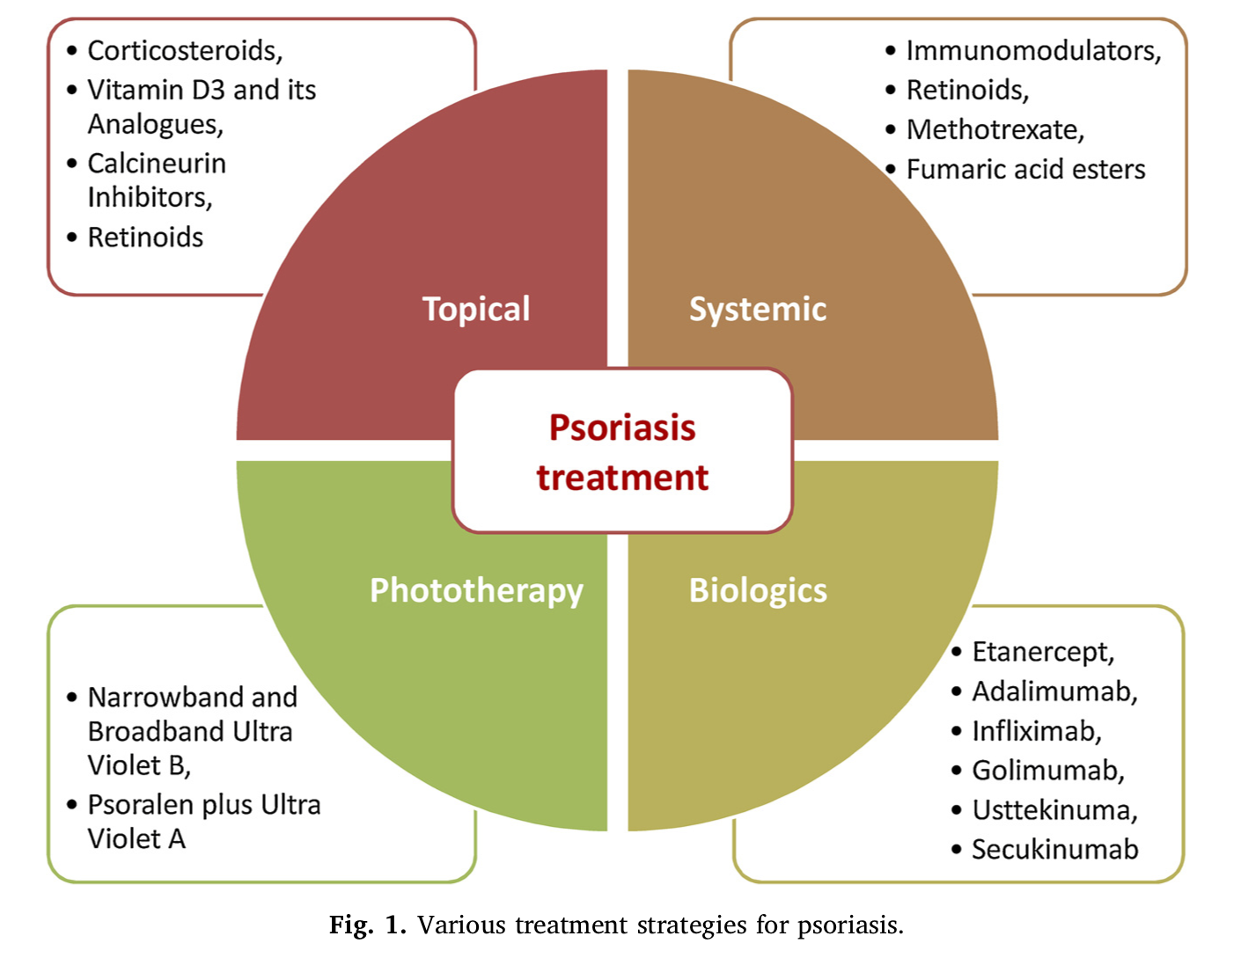
from Rapalli et al, Biomedicine &Pharmacology, 2018

Slide 13
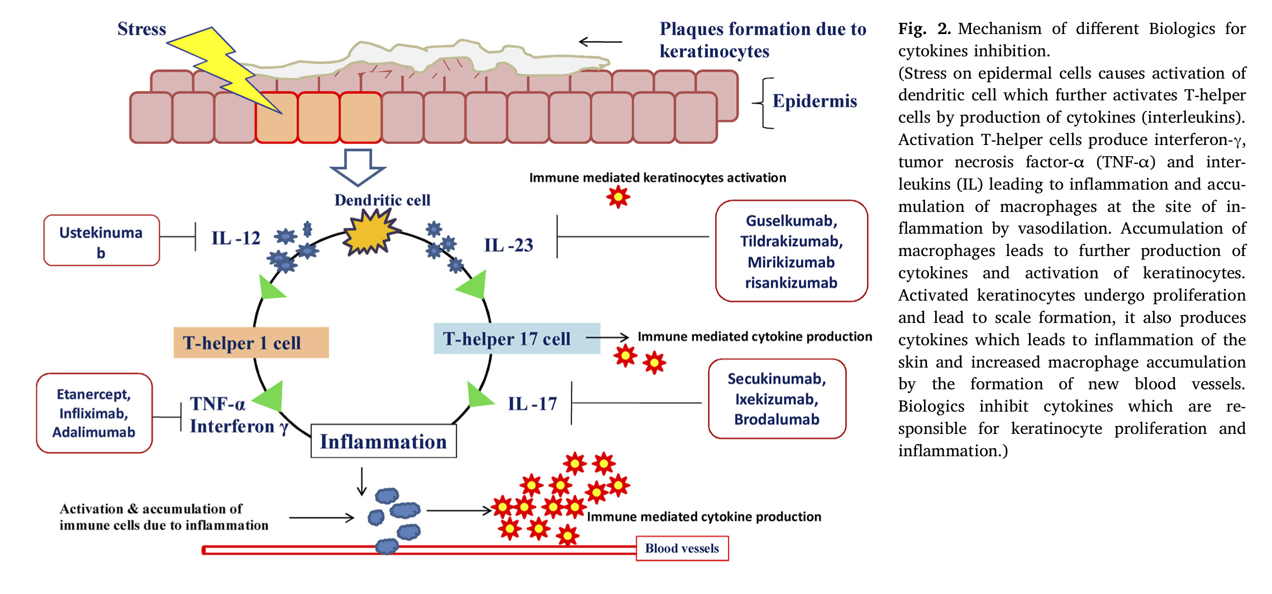
from Rapalli et al, Biomedicine &Pharmacology, 2018

Slide 14
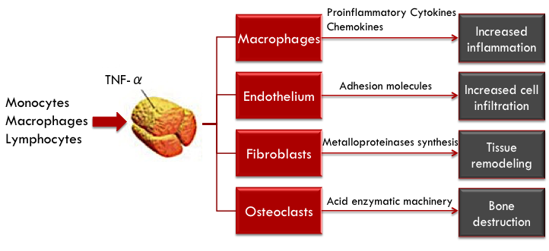
TNF-α

Slide 15
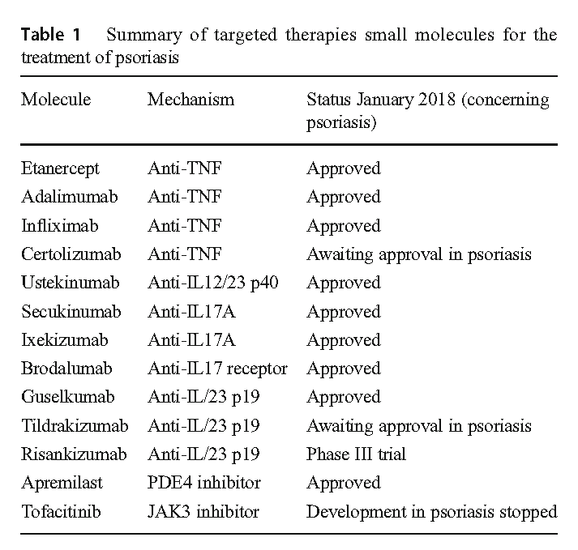

Slide 16
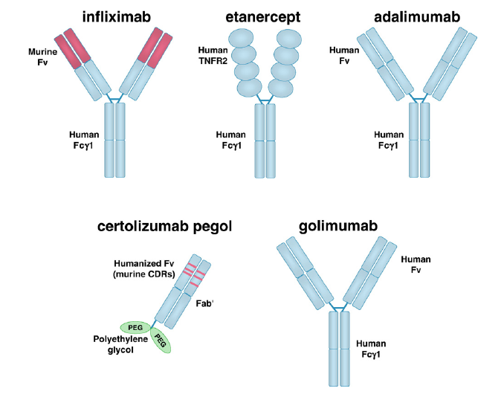
Farmaci biologici bloccanti il TNFα
Tracey D, et al. Pharmacology & Therapeutics 117 (2008) 244–279.
Notes:
IgG1: emivita di 3 settimane

Slide 17
from Conrad et al, Clin Rev Allerg Immunol, 2018

Slide 19
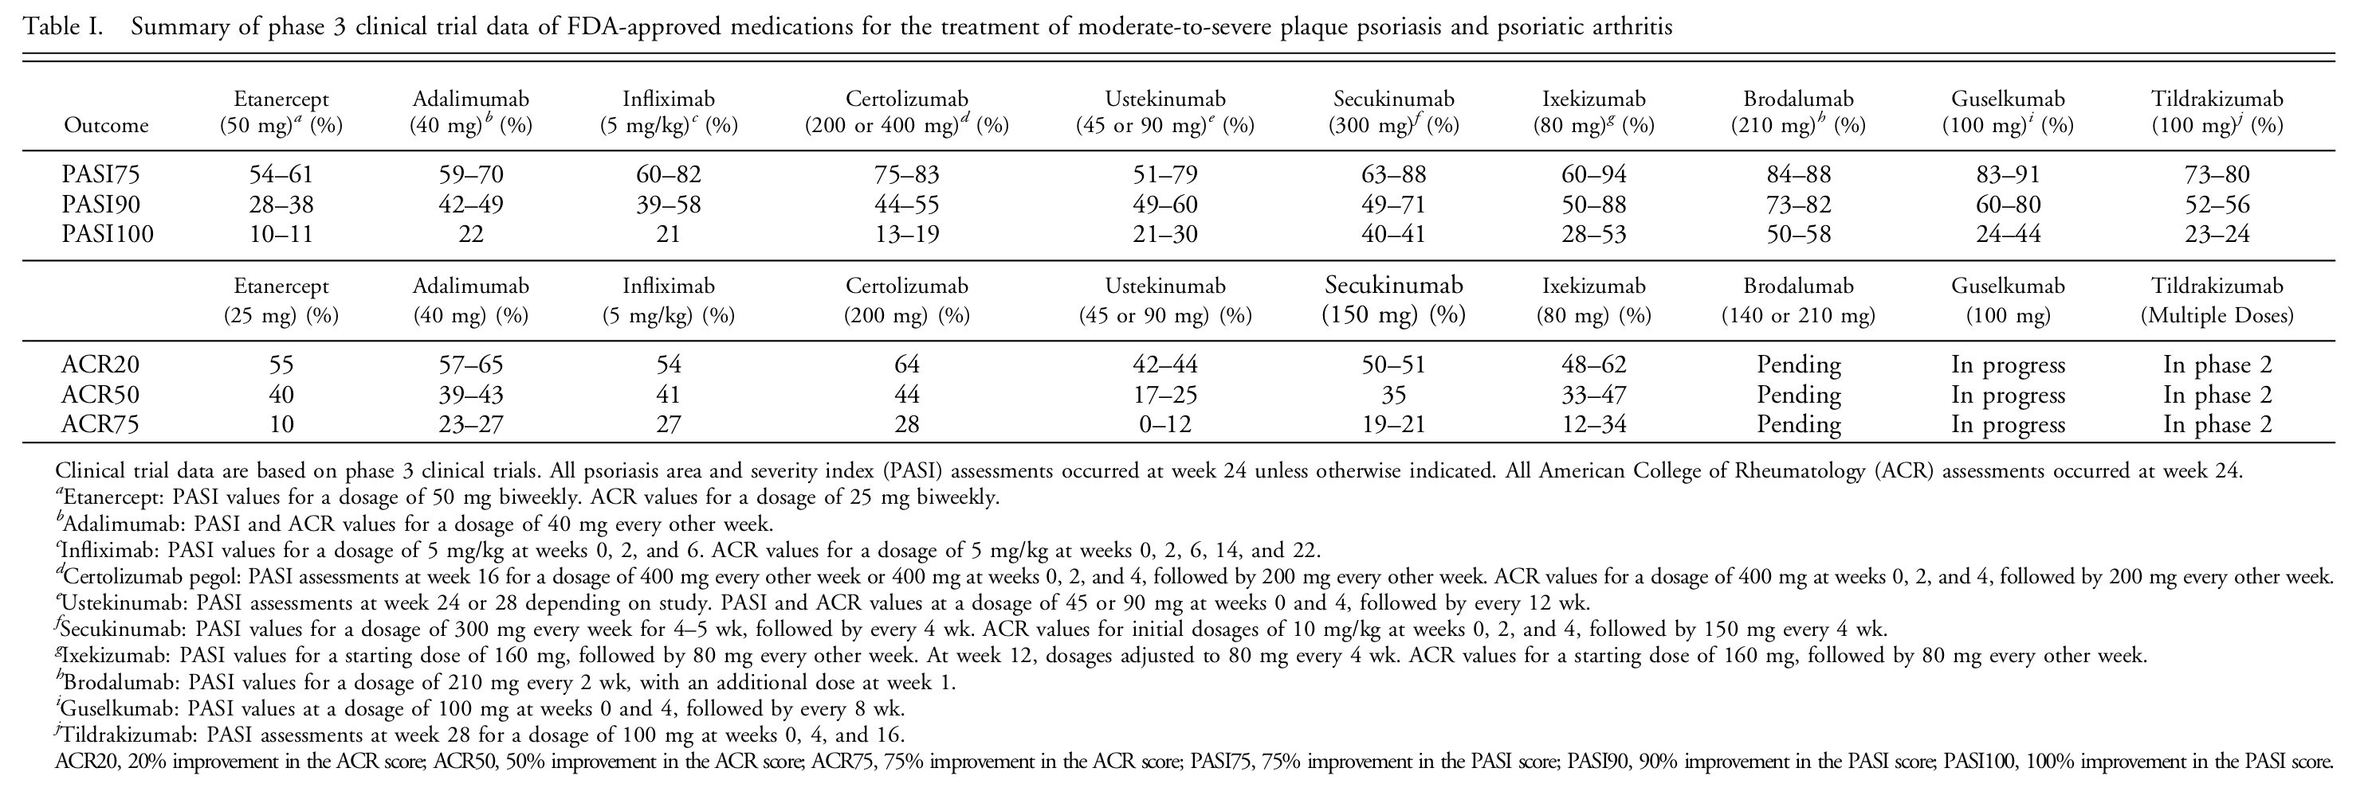
TNF
TNF
TNF
TNF
IL12p40
IL17
IL17
IL17R
IL23
IL23
from Hawkes et al, J Immunol, 2018

Slide 21
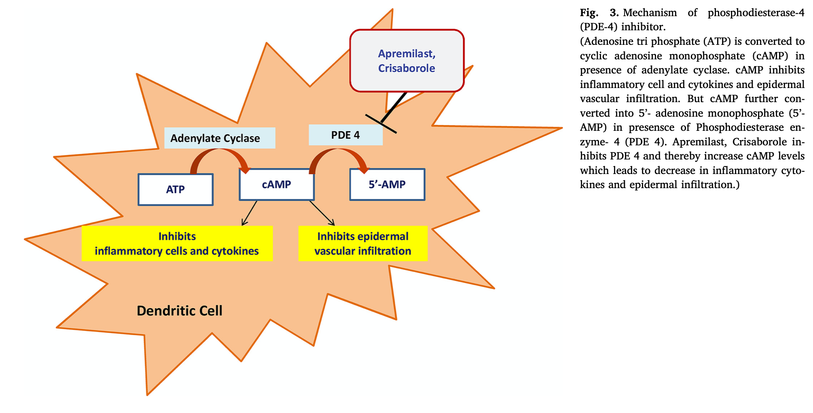
from Rapalli et al, Biomedicine &Pharmacology, 2018

Slide 22
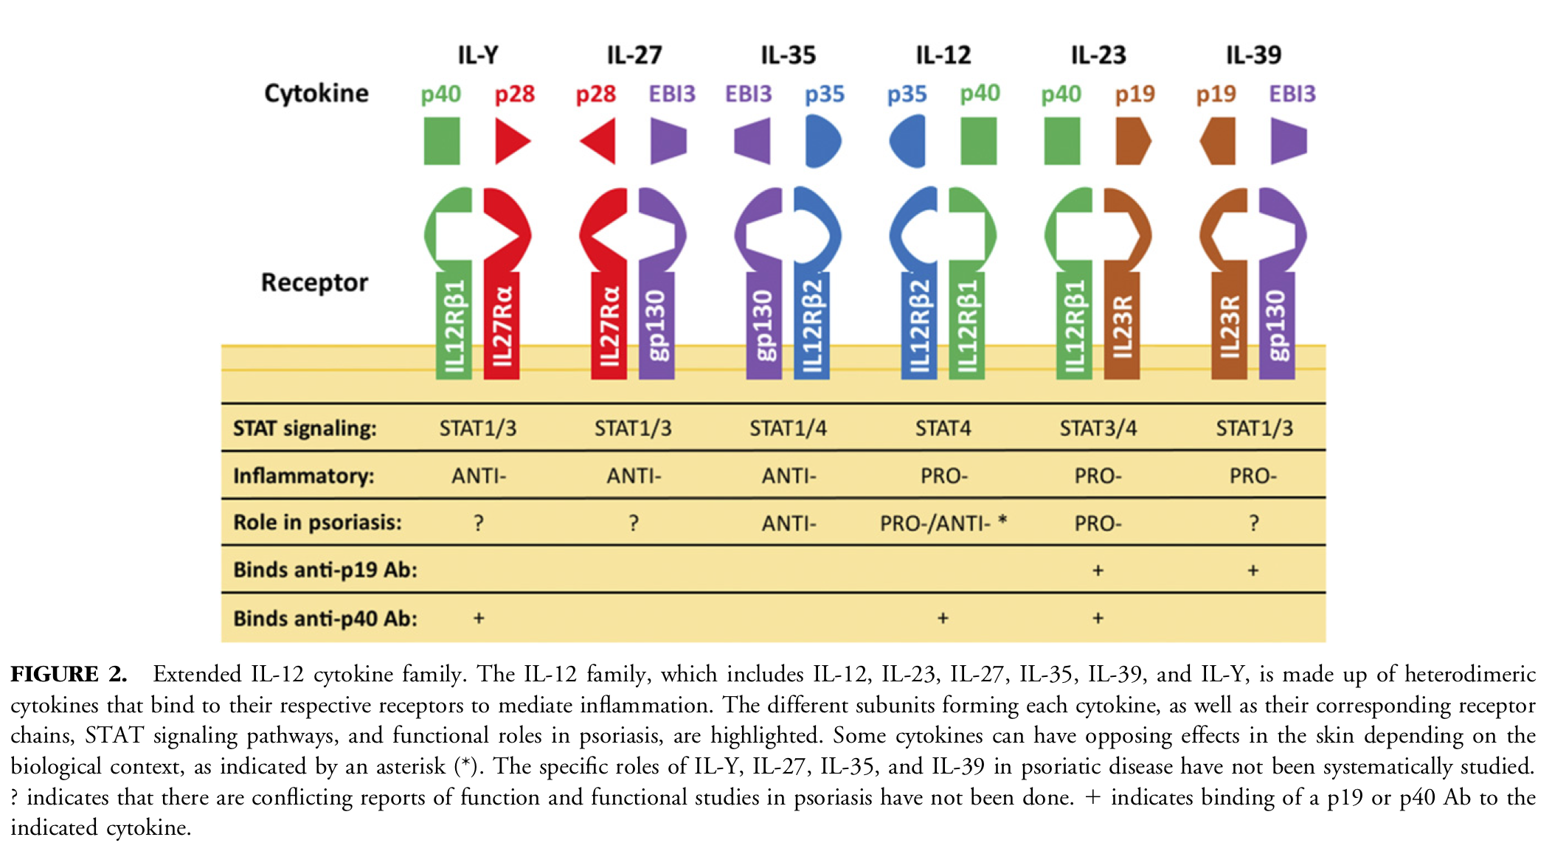
from Hawkes et al, J Immunol, 2018

Slide 23
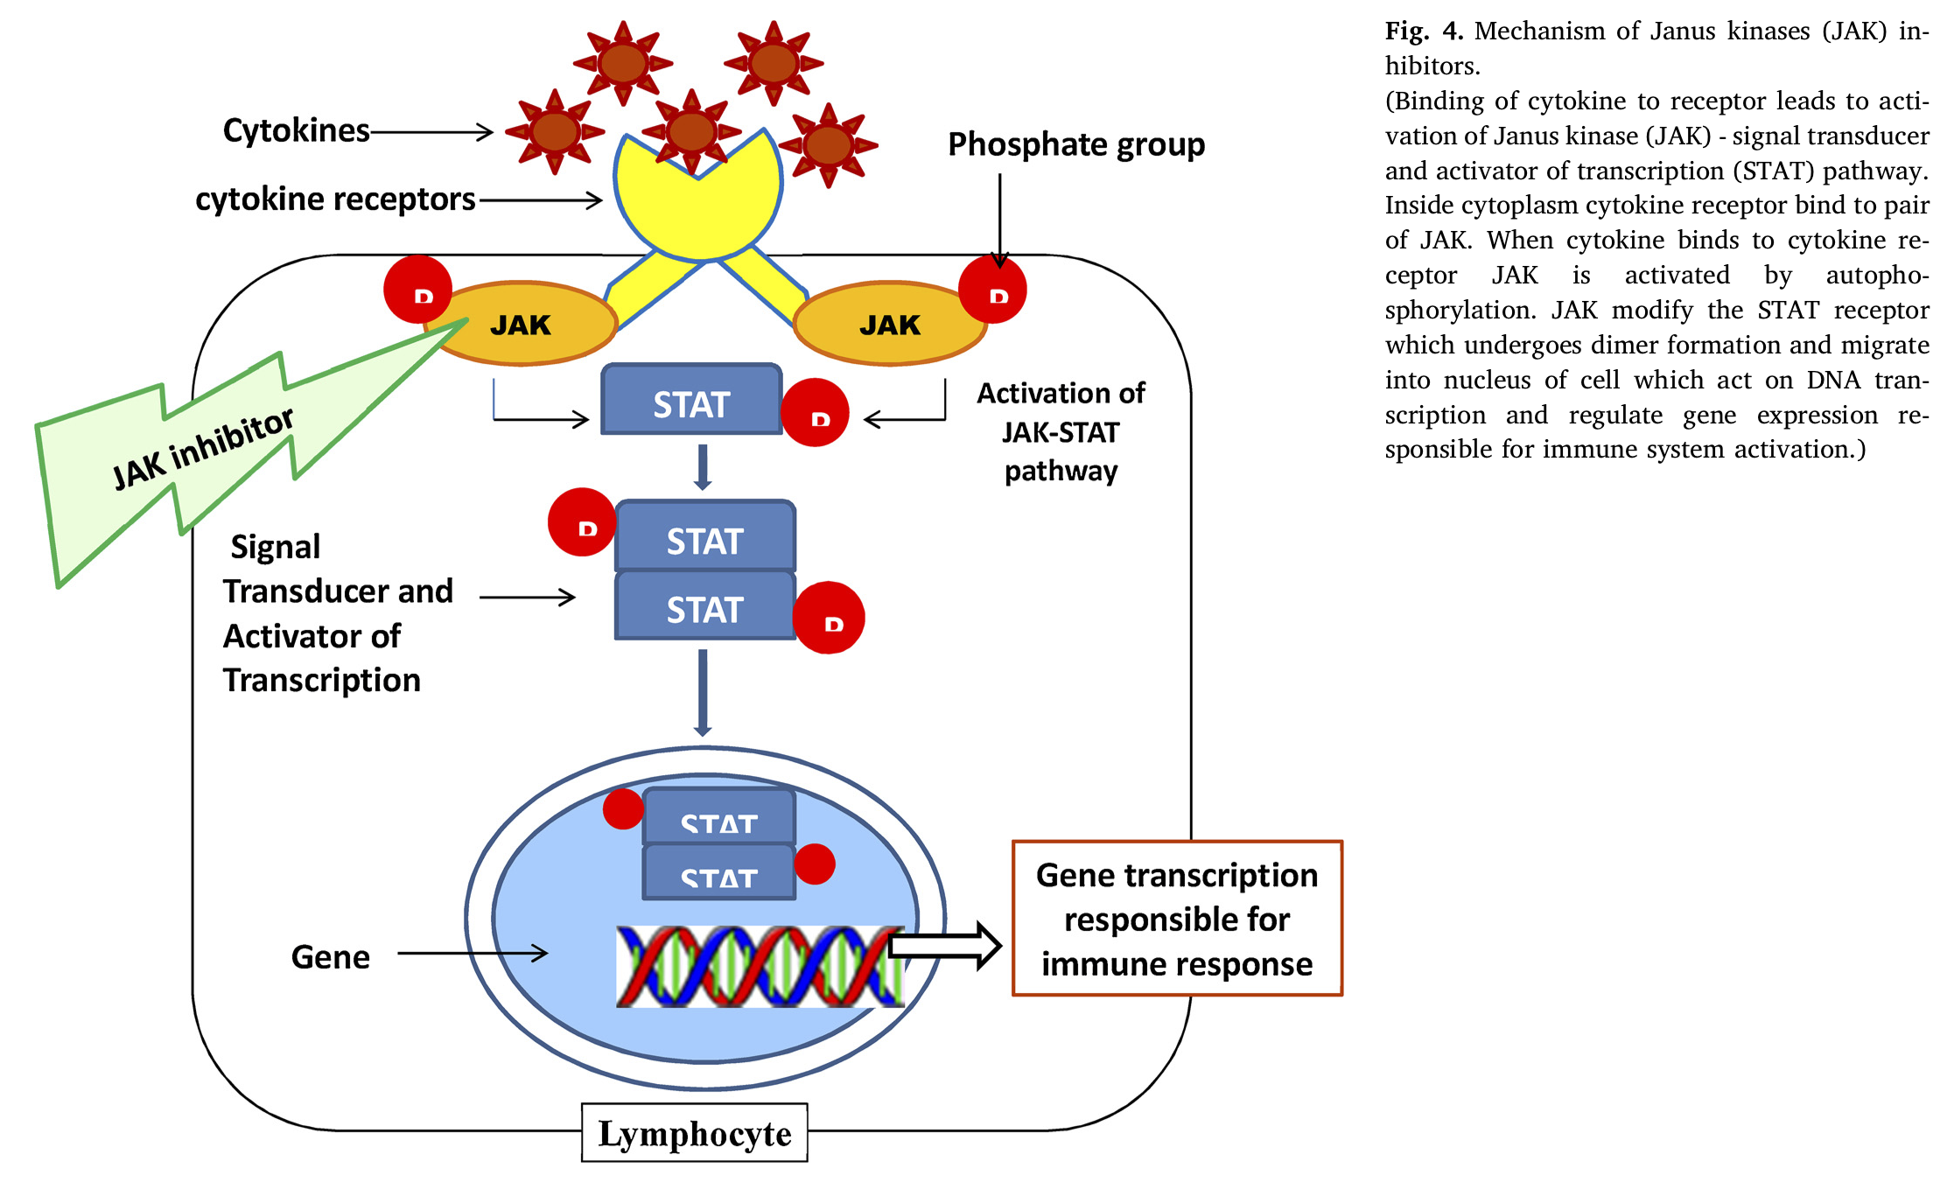
from Rapalli et al, Biomedicine &Pharmacology, 2018

Slide 25
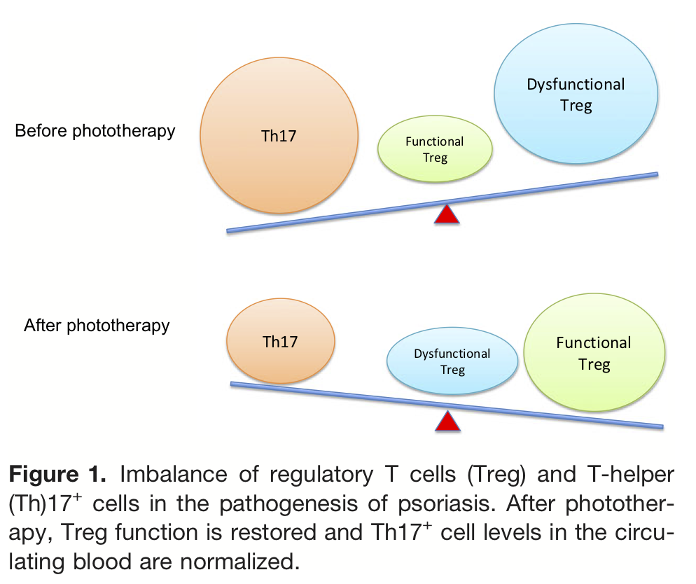
from Morita et al, J Dermatol, 2018

Slide 27
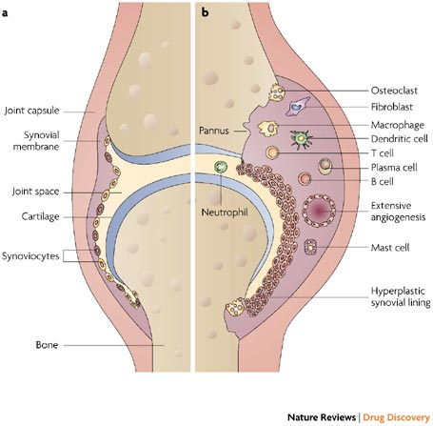
Rheumathoid arthritis
(Strand, Kimberly et al. 2007)

Slide 28
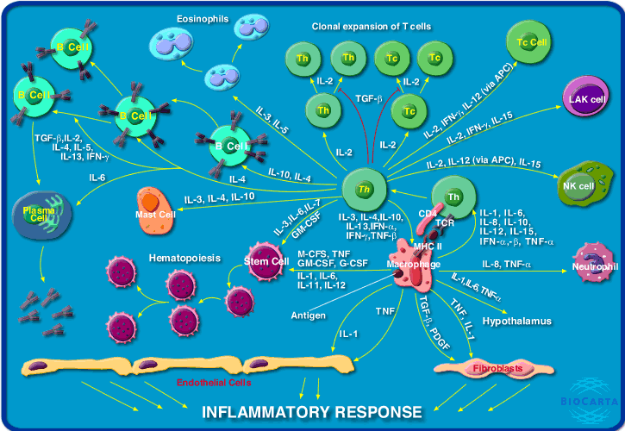

Slide 29
anti-TNFα drugs
Tracey D, et al. Pharmacology & Therapeutics 117 (2008) 244–279.
Notes:
IgG1: emivita di 3 settimane

Slide 30
Blockers of T lymphocyte response
Other drugs

Slide 31
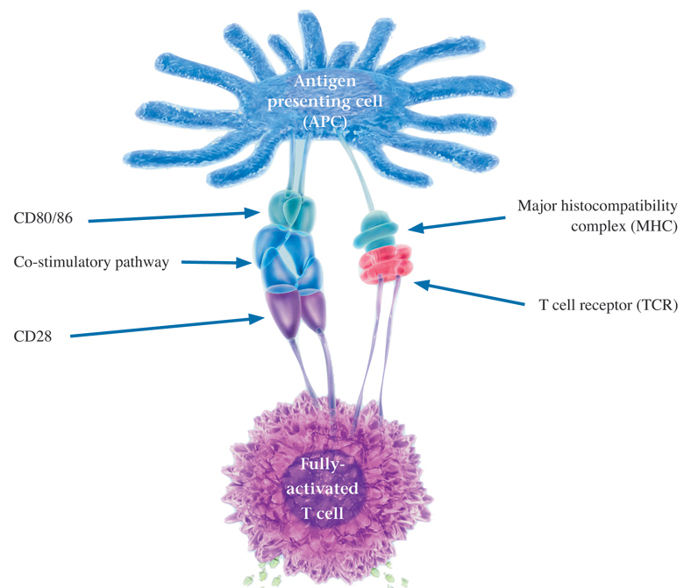
Other biological drugs in RA

Slide 32
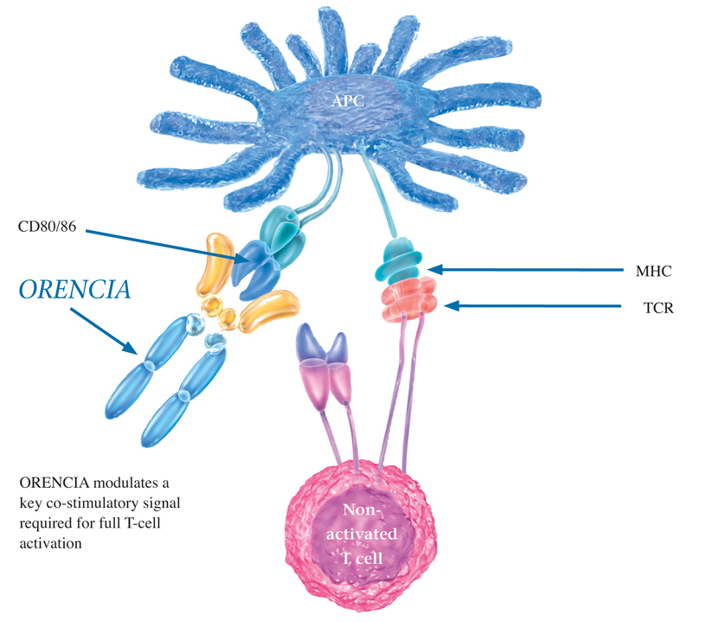
Abatacept

Slide 33
B-Cell depletion
Other immune-suppressive drugs

Slide 34
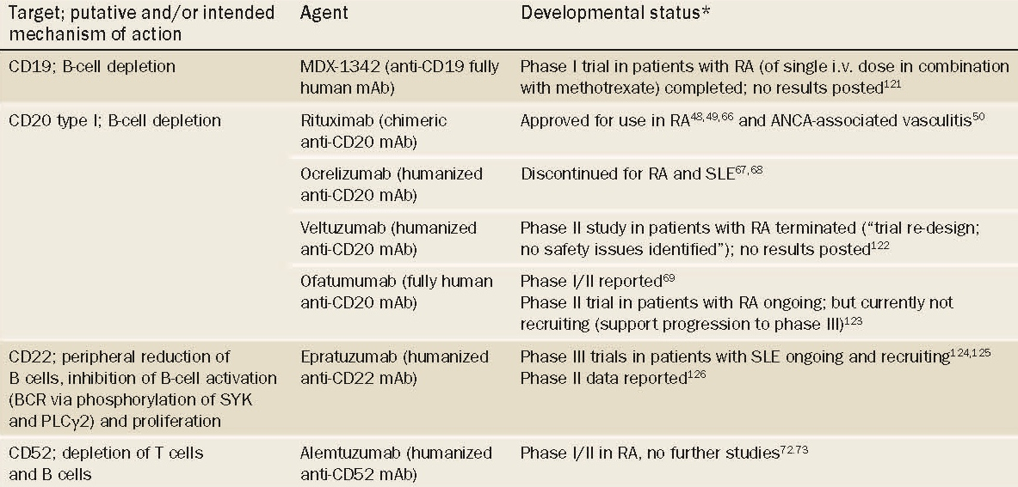
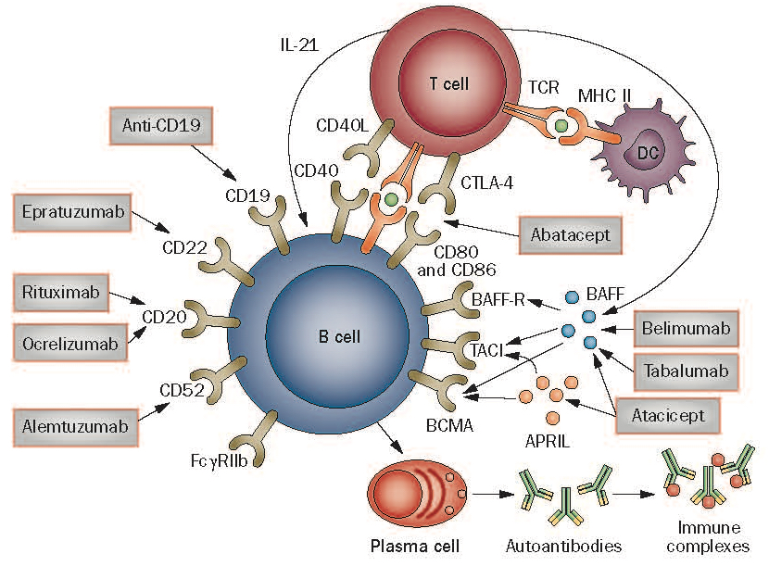
(Burmester et al. 2014)

