Slide 1
Logistic system of Friuli Venezia Giulia Region
December 14, 2020

Slide 2
Mission, Strategic Vision and Actions
MISSION
Building a Regional Logistic Platform integrated in order to promote a unic infrastructure for Italian, European and third countries investors and operators.
STRATEGIC VISION
We offer to the international market a System managing maily dry ports but, with a direct connection with the Port Autority and all the actors involved.
ACTIONS
Strenghtening of the Regional dryports in the European and Mediterranean market
Infrastructure management centralized in a new goods flow scenario
Planning a development of the existing infrastructures and coordination for the projects of new ones

Slide 3
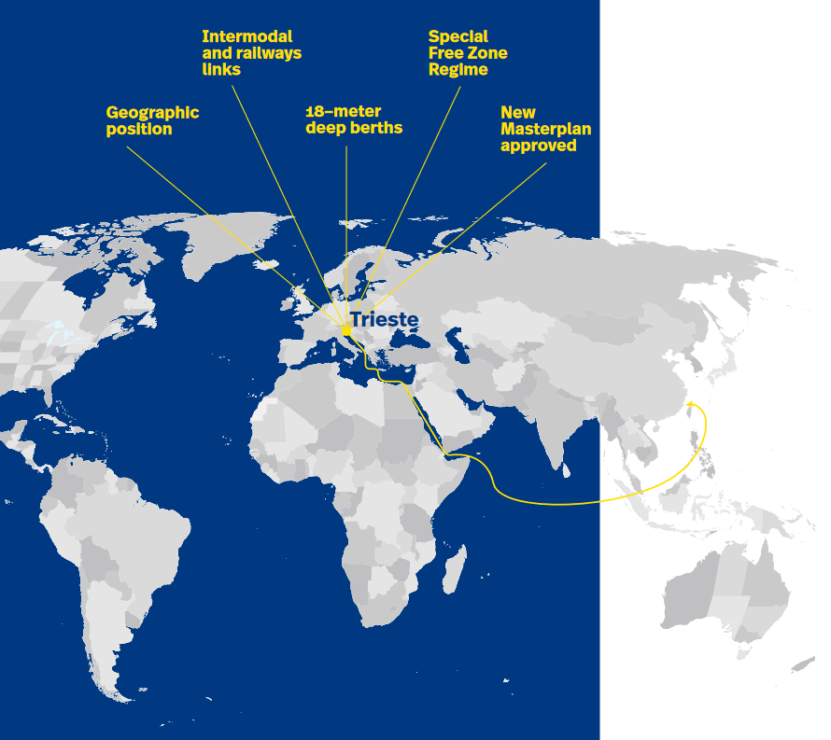
Porto di Trieste – Success factors
(https://www.porto.trieste.it/wp-content/uploads/2020/07/20200120_APT_opuscoliA4_sito.pdf)

Slide 4
Porto di Trieste – Success factors
INTERNATIONAL FREE ZONE (https://www.porto.trieste.it/eng/port/free-port)
Est. in 1719 - Dedicated only to the Trieste’s Free Port Areas (According to the Annex VIII of the Paris peace Treaty – 1947)
Free Port regime: third country origin goods will maintain their status as long as they are kept in the free port areas:
No transit documents (and related guarantees) to move the goods from the port to the customs warehouse
No duties to be paid as long as the goods stay in the free port area
No guarantee for the customs duties and VAT
No customs declaration for the storage of the goods in the free port areas
The storage is allowed for an unspecified period
These advantages allows to manage a warehouse in the heart of Europe without unnecessary costs and provide a delivery of the goods in few days to the client (reseller or production plant): i.e.: long-time warehousing (also for trading purposes): non ferrous metals (e.g. London Metal Exchange), Coffee (LIFFE) etc.
Great advantage for non EU goods, which has not yet been sold, but can be sold at the „most appropriate“ moment (and destined to an EU or non EU -Country).
IMPORT: when goods are imported payment of duty and VAT to the import after 180 days at a special rate of interest (50% Euribor6M, floor 0,1%)
PROCESSING OF THE GOODS:
processing without change of the goods customs classification: No VAT and duties to be paid on the gained value (e.g.: selection, sampling, labelling, drying and qualitative improvement in general)
processing with change of the goods customs classification: According to the recent Italian legislation (July 2017) the activity (incl. industrial production) is authorized by the President of the Free Port with the approval of the Customs Authorities

Slide 5
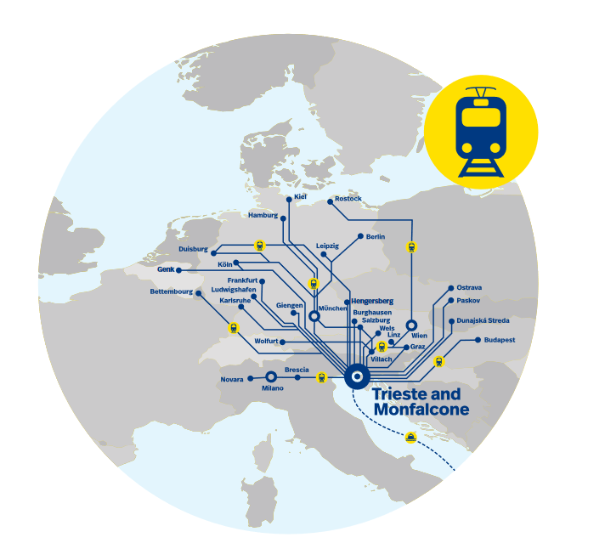
Porto di Trieste – Success factors
EXISTING RAIL INFRASTRUCTURE AND LINKS

Slide 6
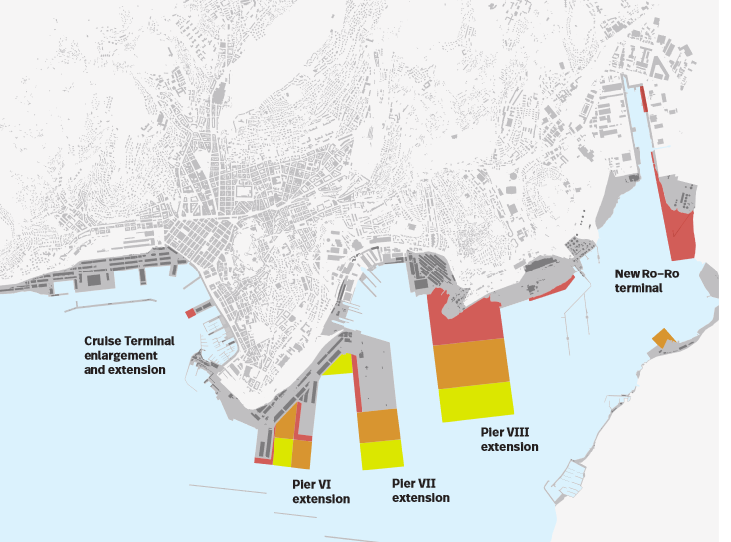
Porto di Trieste – Success factors
MASTER PLAN APPROVED

Slide 7
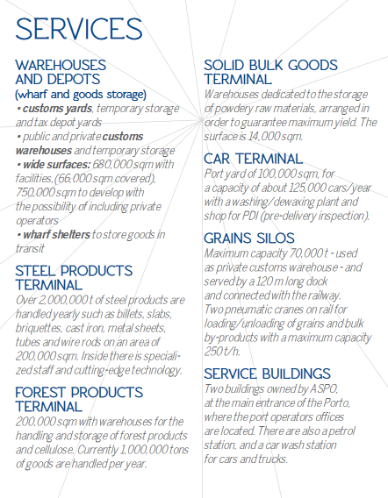
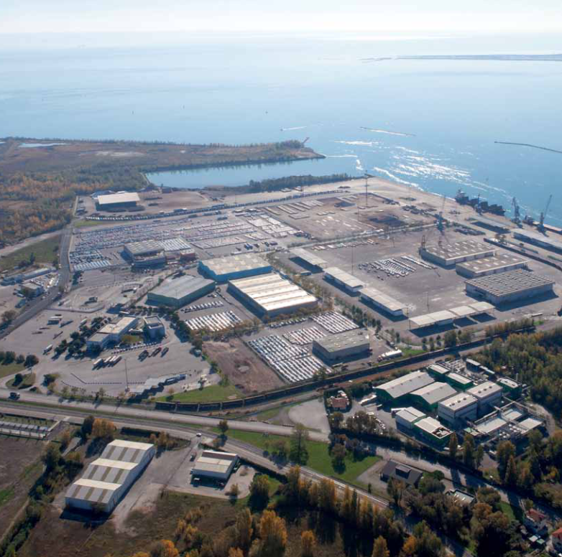
Porto di Monfalcone (http://www.porto.monfalcone.gorizia.it/brochurePORTO.pdf)

Slide 8
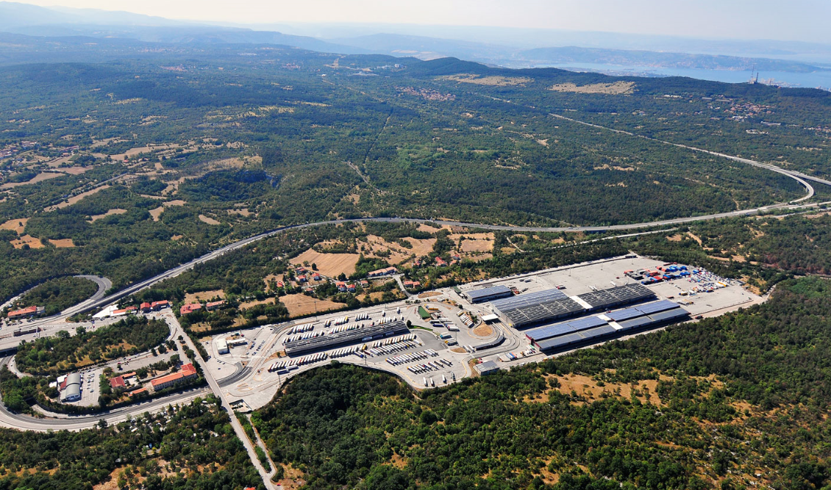
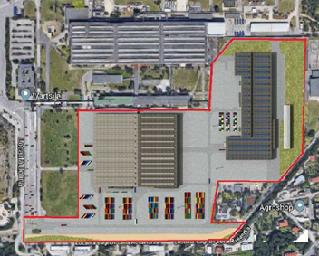
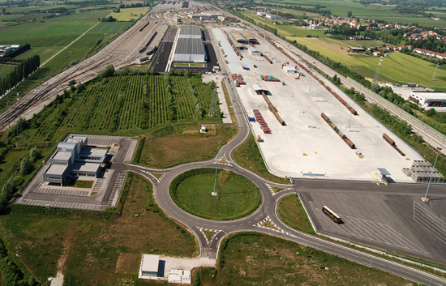
Interporto di Trieste. 3 Terminals
Fernetti | 2015 | 2016 | 2017 | 2018
Total area (sqm) | 232,000 | 232,000 | 232,000 | 232,000
Operating areas (sqm) | 50,000 | 50,000 | 50,000 | 50,000
Vehicle parking areas (sqm) | 80,000 | 80,000 | 80,000 | 80,000
Railway (n. tracks*m) | 3*450 + 3*450 | 3*450 + 3*450 | 3*450 + 3*450 | 3*450 + 3*450
Warehouses (sqm) | 30,000 | 33,000 | 33,000 | 33,000
Roofed surfaces (sqm) | 2,000 | 2,000 | 2,000 | 2,000
Cold storage (sqm) | - | - | - | -
Other warehouses (sqm) | - | - | - | -
Other | - | - | - | -
Fernetti
Bagnoli della Rosandra | 22/12/2017 | 2018
Total area (sqm) | 240,000 | 240,000
Operating areas (sqm) | - | -
Vehicle parking areas (sqm) | - | -
Railway (n. tracks*m) | - | -
Warehouses (sqm) | 74,000 | 74,000
Roofed surfaces (sqm) | - | -
Cold storage (sqm) | - | -
Other warehouses (sqm) | - | -
Other | - | -
Bagnoli - FREEeste
(ex Wartsila)
Interporto di Cervignano SpA | 2018
Total area (sqm) | 460,000
Operating areas (sqm) | 160,000
Vehicle parking areas (sqm) | 67,000
Railway (n. tracks*m) | 6*750 + 2*450
Warehouses (sqm) | 24,000
Roofed surfaces (sqm) | -
Cold storage (sqm) | 600
Other warehouses (sqm) | -
Other | -
Interporto di Cervignano S.p.A.

Slide 9
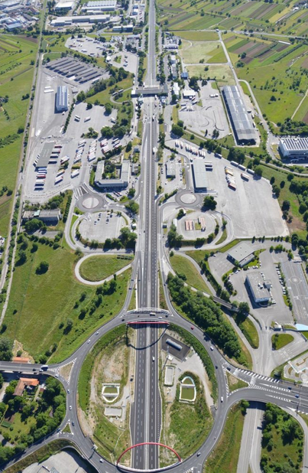
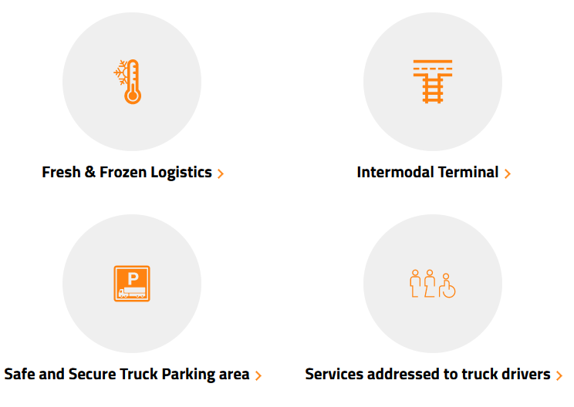
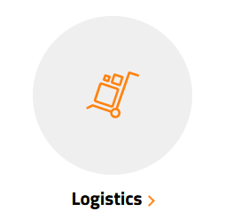
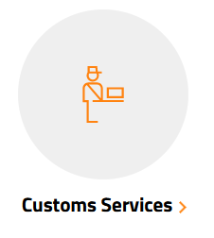
Interporto di Gorizia – SDAG (https://www.sdag.it/en/servizi/)

Slide 10
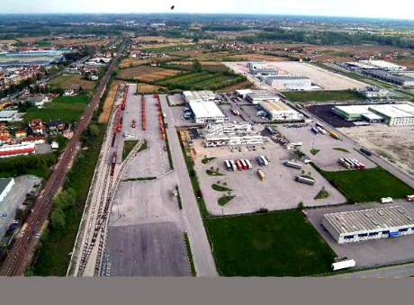
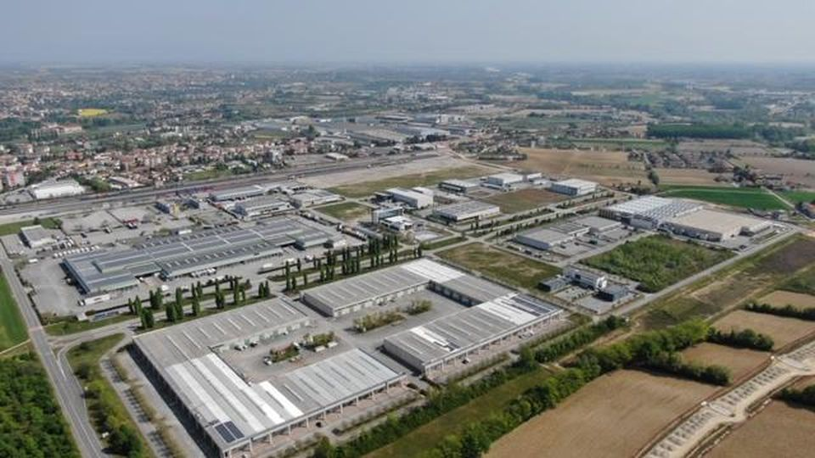
Interporto di Pordenone
Services
Infrastructures:
4,150 sqm of offices
65 companies
840,000 sqm total
Logistic center
72,0000 sqm total
30,000 sqm of warehouses
Railway services
140,000 sqm rail terminal
7 railway track of 750 m
Rail capacity: 10 trains/day
Maintenance
Truck services

Slide 11
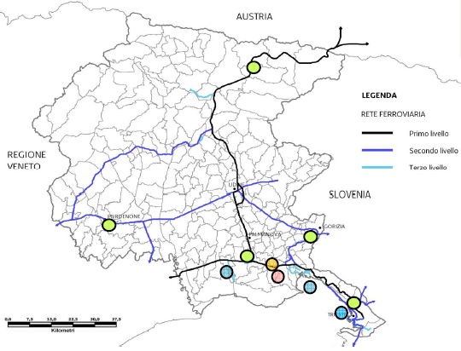
Logistics facilities in FVG Region
Dry Ports
Ports
Airport intermodal center
International visibility and only one coordination to attract more investments thanks also to the integrated dimension.

Slide 12
Example: the wine export paltform
The wine Export management via Free Port is an example of coordination between:
Primary sector: agricolture
Secondary sector: the wine production
Tertiary sector: logistic facilities an fiscal advantages.

Slide 13
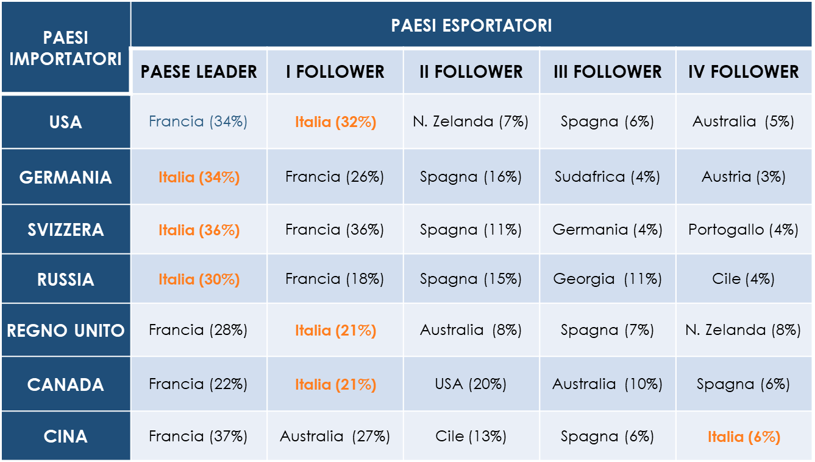
Issue: the position in the Chinese market
Ranking in valore nel 2018*
Fonte: elaborazione ISMEA su dati IHS-Gta; *provvisorio/stima

Slide 14
Tools: the Free Port regime
Fiscal advantage to close the Export document inside Free Zone
Smart shipping services from Trieste to China
The FREEeste assets to organize any logistics issues

Slide 15
Actions: connect demand and supply
Fix a collaboration with the Regional agency for the agricolture developements «Cluster Agroalimentare FVG»
Organize a capillar information at producers houses
Involve everybody can be a resource (banks, insurances)
Present a investment plan in logistic specific assets

Slide 16
Example: rail service Trieste Port - Cervignano
A new rail service connection between Trieste Port and Cervignano

Slide 17
Issues: the bottleneks
RORO
Lack of space to park the trailer inside Port
Congestion on the Port Gate and RORO Terminals
CONTAINER
Congestion on the Port Gate and A4

Slide 18
Tools: a team to solve a common problem
Alpeadria as MTO
Adriafer as Rail Company and Shunting operator indide the port
Interporto di Cervignano as a efficient rail terminal
Interporto di Trieste as a coordinator

Slide 19
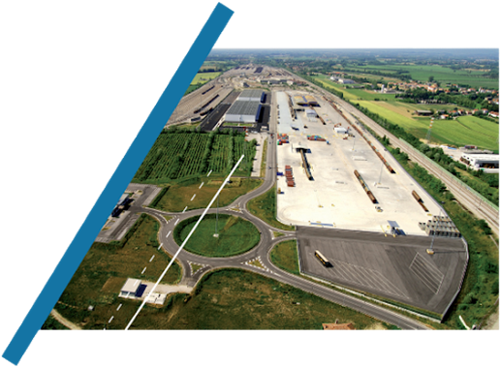
DRAFT
Extended quay of Cervignano

Slide 20
Problems
01
Traffic and congestions at the access to the Port Terminals
02
Constant increase in heavy vehicles IN/OUT at port gates
03
Timing and efficiency loss

Slide 21
Solution
The implementation of an “extended quay” function of the Port of Trieste composed by :
‘’BUFFER FUNCTION’’ in Cervignano freight village with parking/storage area
RAILWAY CONNECTION as complementary service

Slide 22
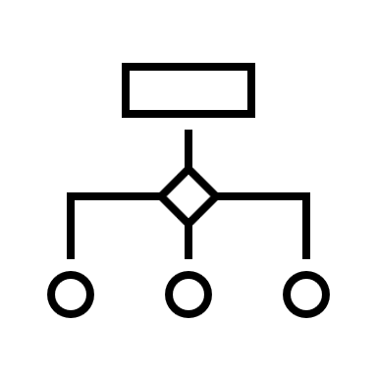
Value proposition
Logistics chain efficiency!
Optimisation of vehicle access to port terminals
Optimisation of work/travel times of conveyors
Half reduction in emissions from all trucks
Anticipate some port activities / functions Streamline the logistic process
Encourage the implementation of possible ancillary services (warehousing, stuffing, vehicle services, etc.).

Slide 23
HOW IT
WORKS
Buffer Service
To use for
Surface
Services offered by Cervignano freight village
Parking dock (medium term)
Temporary train buffer
Gate-in/out service
Security/guard
Management and communication of necessary data and info
About 20.000-30.000 sqm (fenced and video-surveyed)
Stalls to be obtained: 70/80 at least

Slide 24
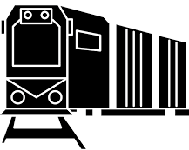
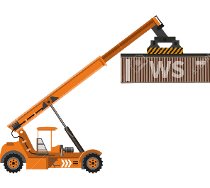
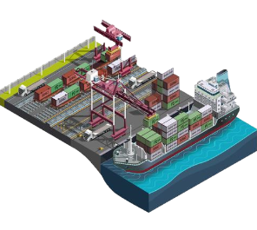
HOW IT
WORKS
Intermodal buffer in Cervignano freight village
3 RT x week
Cargo transportion to/from the freight village
Container/semitrailer loading/unloading in Cervignano
Rail connection to /from Trieste Port with direct access to the terminals
Cargo loading/unloading at Trieste Port

Slide 25
Trans-European Transport Network (TEN-T)
Implementation and development of a Europe-wide network of railway lines, roads, inland waterways, maritime shipping routes, ports, airports and railroad terminals
The objective is to close gaps, remove bottlenecks and technical barriers, as well as to strengthen social, economic and territorial cohesion in the EU.
The TEN-T policy supports the construction of new physical infrastructure, the application of innovation, new technologies and digital solutions to all modes of transport.
TEN-T comprises two network ‘layers’:
The Core Network includes the most important connections, linking the most important nodes, and is to be completed by 2030.
The Comprehensive Network covers all European regions and is to be completed by 2050.
The backbone of the Core Network is represented by nine Core Network Corridors, which were identified to streamline and facilitate the coordinated development of the Core Network. Two horizontal priorities, the European Rail Traffic Management System (ERTMS) and Motorways of the Sea complement these. Oversight of the Corridors and of the two Horizontal Priorities lies with European Coordinators, nominated by the European Commission.

Slide 26
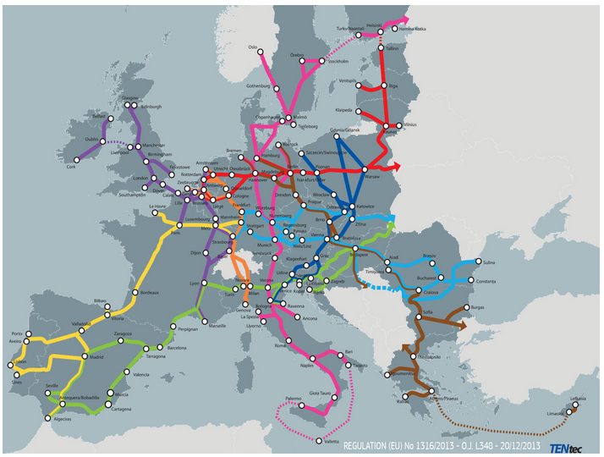
The Core Network Corridors

Slide 27
Mediterranean Corridor

Slide 28
Baltic Adriatic Corridor

Slide 29
ADRIUP
PROJECT | ADRIUP - Adriatic MoS Upgraded Services
 | CEF - Connecting Europe Facility
PARTNERS | MIT, Port Authorities, Inland terminals
LEAD PARTNER | Igoumenitsa Port
ROLE | Partner
PERIOD | 1/1/2016 – 31/12/2023, 96 months
ACTION ELIGIBLE COSTS | 2.870.000 €
% CONTRIBUTION | 30%
CONTRIBUTION | 861.000 €
ACTIVITY OF THE PROJECT | Works for infrastructures (INT: Warehouse + work on railwaytracks)

Slide 30
PROMARES
PROJECT | PROMARES - Promoting maritime and multimodal freight transport in the Adriatic Sea
 | 2014 - 2020 Interreg V-A Italy - Croatia CBC Programme
PARTNERS | Port Authorities and Universities
LEAD PARTNER | ADSPMAO
ROLE | Partner
PERIOD | 01/01/2019 – 30/06/2021, 30 months
ACTION ELIGIBLE COSTS | 229.875 €
% CONTRIBUTION | 100 %
CONTRIBUTION | 229.875 €
ACTIVITY OF THE PROJECT | The cross-border action plan for enhancing maritime and multimodal freight transport. (INT: railway gate)

Slide 31
FENIX
PROJECT | FENIX - A European FEderated Network of Information eXchange in Logistics
 | CEF TRANSPORT 2018 - GENERAL ENVELOPE CEF Transport Call 2018 - Funding Objective 3: 3.2 “ensuring sustainable and efficient transport systems in the long run, with a view to preparing for expected future transport flows, as well as enabling all modes of transport to be decarbonized through transition to innovative low-carbon and energy –efficient transport technologies, while optimizing safety” – 3.2.2 Deployment of innovation and new technology actions, including a focus on safety - priorità specifica 8: "digital information system
PARTNERS | MIT, Port Authorities, Commercial partners, Univerisites
LEAD PARTNER | MIT
ROLE | Implementing body
PERIOD | 01/04/2019 – 31/03/2022, 36 moths
ACTION ELIGIBLE COSTS | 550.000 €
% CONTRIBUTION | 50 %
CONTRIBUTION | 275.000 €
ACTIVITY OF THE PROJECT | Interporto has participated to COGISTICS and AEOLIX and the implementation developed in the projects are available for the FENIX federative platform.

Slide 32
Geopolitical role of FVG: America, China or?
The agreements signed in 2019 with China
Hhla (Port of Hamburg) got the control of Piattaforma Logistica
The role of Europe?

Slide 33
Let’s immagine the future
Friuli Venezia Giulia Region: only one real operative management of all the logistic hub and network
Italy: some differents regional managements with a central control with a long term strategic vision
Europe: a real geopolitic role in contraposition to USA and Cina

Slide 34
Conclusions
Please…… let’s make some questions

Slide 35
Thank you! Fabio Predonzani Shirin Mahdavi Sales & Operation Manager Communication & EU Projects predonzani@interportotrieste.it mahdavi@interportotrieste.it

