Slide 1
Type I hypersensitivity

Slide 2
Gell & Coombs Classification
Type I Hypersensitivity: IgE mediated
Type II Hypersensitivity: Ab-mediated cytotoxic
Type III Hypersensitivity: ImmuneComplex-mediated cytotoxic
Type IV Hypersensitivity: DTH mediated (cellular cytotoxicity)

Slide 3
IgE-mediated immune responses are much like any other immune
response and involves the same regulators
Non self protein from
allergen or pathogen
Barrier: Skin, gut, lung, eye, nose etc
Dendritic cells to site of inflammation

Slide 4
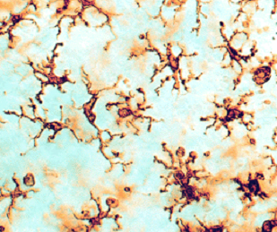
Tracheal Dendritic Cells
Langerhan’s cells
In-vitro differentiated monocyte-derived Dendritic Cell

Slide 5
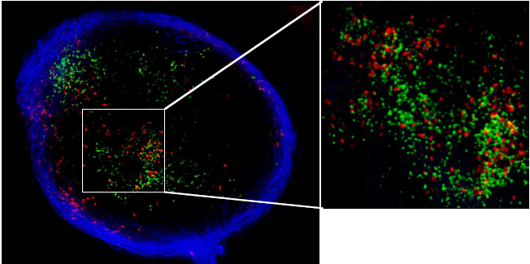
Early entry of DC to the lymph node Mempel, T.R et al Nature 427: 154-159, 2004.

Slide 6
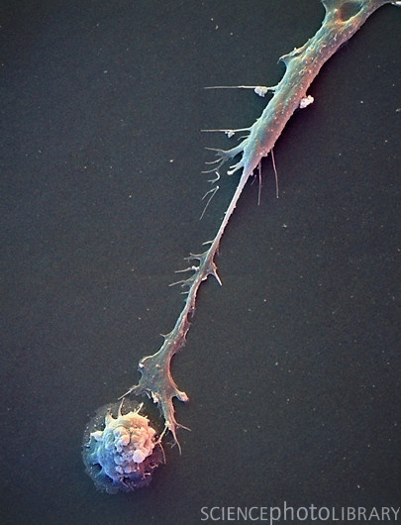
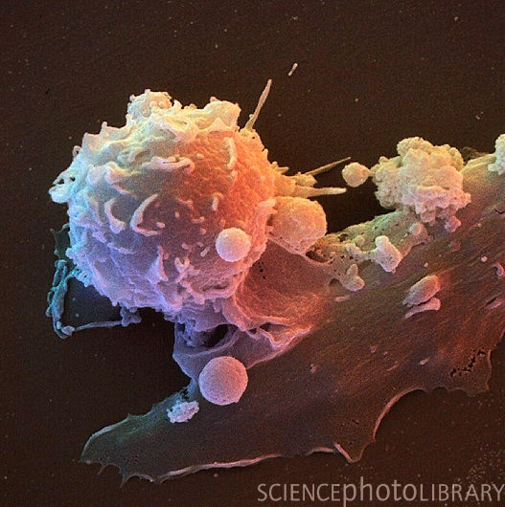
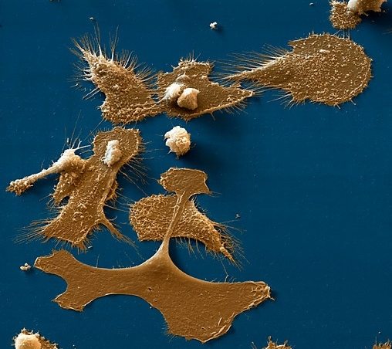
More information than is provided by the antigen is exchanged between the DC and T cell
DC have a profound influence on the properties of the T cell that develops

Slide 7
Signal 1 antigen &
antigen receptor
DC
Th
Signal 2
B7 - CD28
Costimulation
Signals 1 & 2 activate T cells to proliferation and effector function
But what ‘tunes’ the response to Th1 or Th2?
Signal 3 - pathogen polarised DC

Slide 8
Polarised DC subsets
Signal 1
DC
Th
Signal 2
Signal 3
Th polarising signal
Integration of signals from pathogen/allergen and the extracellular milieu polarise the DC to produce qualitatively different signals 3
The properties of the Ag influences the DC to drive the development of appropriate Th cells

Slide 9
Microbial Patterns
Janeway & Medzhitov 2002 Ann Rev Immunol 20 197-216
Pathogen-associated molecular patterns (PAMPS)
Conserved microbial molecules shared by many pathogens
Include:
Bacterial lipopolysaccharides
Peptidoglycan
Zymosan
Flagellin
Unmethylated CpG DNA
Pathogen-associated molecular patterns (PAMPS)
Conserved microbial molecules shared by many pathogens
Include:
Bacterial lipopolysaccharides
Peptidoglycan
Zymosan
Flagellin
Unmethylated CpG DNA
Pattern Recognition Receptors (PRR)
Include:
Toll like receptors
Receptors for apoptotic cells
Receptors for opsonins
Receptors for coagulation and complement proteins

Slide 10
Type 1 and 2 DC Polarising PAMPS
+
T
+
Type 1 PAMPS bind to PRR
CD80/CD86
+
Class II
CD40
Th1 polarising factor IL-12
Type 2 PAMPS bind to PRR
Th2 polarising factor CCL2 (MCP-1)

Slide 11
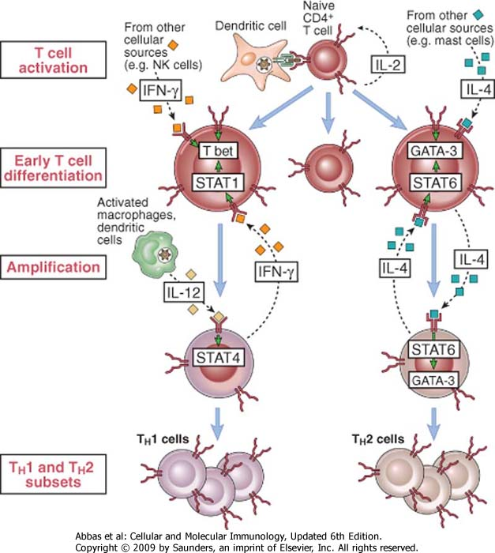

Slide 12
Switch recombination to IgE
A three signal process:
Antigen – controls entire process
Soluble help via IL-4 or IL-13 from T helper cells
Cognate help via CD40 L from T helper cells

Slide 13
Switch recombination to IgE
A three signal process:
Antigen
Soluble help via IL-4 or IL-13 from T helper cells
Cognate help via CD40 L from T helper cells

Slide 14
T cell help to B cells
IL-4 and IL-13
B
Th
Th
Y
Y
Y
Antigen
CD40
CD40 Ligand

Slide 15
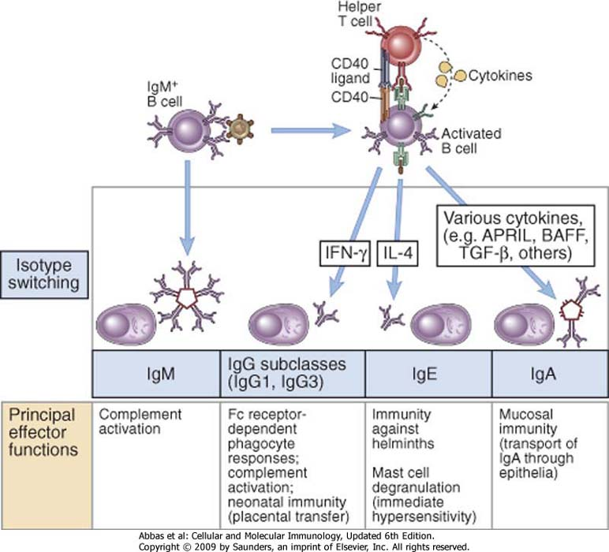
T-dependent
T-independent

Slide 16
T-independent
T-dependent

Slide 17
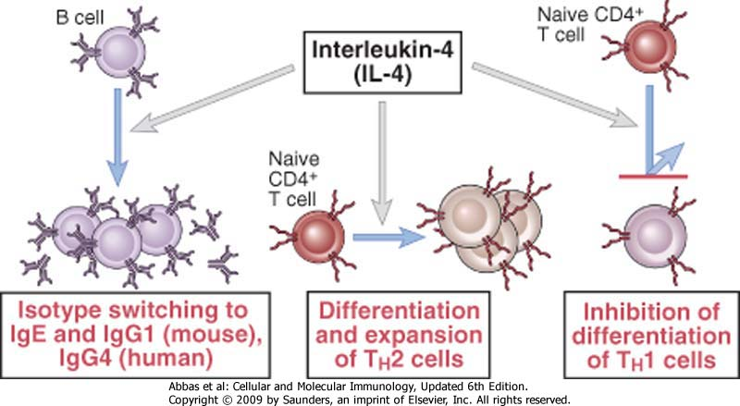

Slide 18
Soluble help via IL-4 or IL-13 from T helper cells
IL-4R
IL-13R
IL-4
IL-13
IL-4
IL-13
IL-4Rα
gC
IL-4Rα
IL-13Rα1/2
JAK1
JAK3
JAK1
P
TYK1
P
TYK2
P
P
Stat-6
Stat-6
P
P
P
P
P
P
P
Stat-6
Dimerised Stat-6
translocates to nucleus
Stat-6
Stat-6
Stat-6
Stat-6
P
P
P
P

Slide 19
Switch recombination to IgE
A three signal process:
Antigen
Soluble help via IL-4 or IL-13 from T helper cells
Cognate help via CD40 L from T helper cells

Slide 21
Cognate help via CD40 L from T helper cells
Ligation promotes aggregation in lipid rafts
CD40
2
3
TNF receptor associated factors
5
6
Uninhibited NFkB translocates to the nucleus
IκB
IκB
NF
kB
NF
kB

Slide 22
NF-kB responsive elements
GGGCTGGG TGAGCTGRGCTGAGCTGRGCTGAGCTRARNT
CCCGACCCGACTCGACYCGACTCGACYCGA TCGAYTYNA
GGGCTGGG
CCCGACCCGACTCGACYCGACTCGACYCGA
Exonuclease activity
End fill-in reactions
TGAGCTGRGCTGAGCTGRGCTGAGCTRARNT
TCGAYTYNA
ACTCGACYCGACTCGACYCGAC
Cμ
Cδ
Cγ3
Cγ1
Cα1
Cγ2
Cγ4
Cε
Cα2
Sμ
Sγ3
Sγ1
Sα1
Sγ2
Sγ4
Sε
Sα2

Slide 23
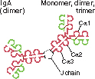
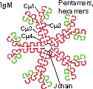
isotiopo | Sottotipo | Concentrazione nel siero (mg/ml) | Emivita nel siero (giorni) | Forma secreta
IgA | 1,2 | 3,5 | 6
IgD | - | - | 3 | -
IgE | - | 0,05 | 2
IgG | 1-4 | 13,5 | 23
IgM | - | 1,5 | 5

Slide 24
FcR | Affinity for immunoglobulin | Cell Distribution | Function
FcγRI (CD64) | High (Kd ∼ 10⁻⁹ M) binds IgG1 and IgG3 | Macrophages, neutrophils; also eosinophils | Phagocytosis, activation of phagocytes
FcγRIIA (CD32) | Low (Kd > 10⁻⁷ M) | Macrophages, neutrophils; eosinophils, platelets | Phagocytosis; cell activation (inefficient)
FcγRIIB (CD32) | Low (Kd > 10⁻⁷ M) | B lymphocytes, dendritic cells, macrophages | Feedback inhibition of B cells, macrophages, dendritic cells
FcγRIIIA (CD16) | Low (Kd > 10⁻⁶ M) | NK cells | Antibody-dependent cell-mediated cytotoxicity
FcγRIIIB (CD16) | Low (Kd > 10⁻⁶ M) GPI-linked protein | Neutrophils, other cells | Phagocytosis (inefficient)
FcεRI | High (Kd > 10⁻¹⁰ M) binds monomeric IgE | Mast cells, basophils, eosinophils | Cell activation (degranulation)
FcεRII (CD23) | Low (Kd > 10⁻⁷ M) | B lymphocytes, eosinophils, Langerhans cells | Unknown
FcαR (CD89) | Low (Kd > 10⁻⁶M) | Neutrophils, eosinophils, monocytes | Cell activation?

Slide 25
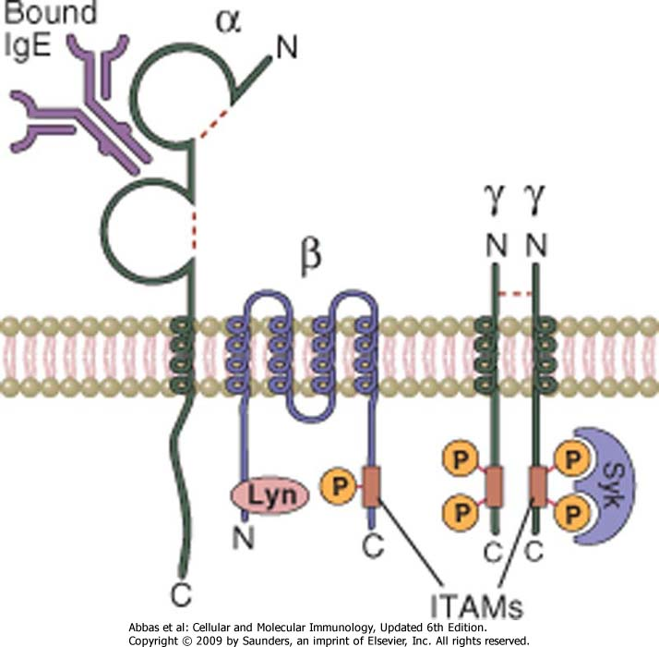

Slide 27
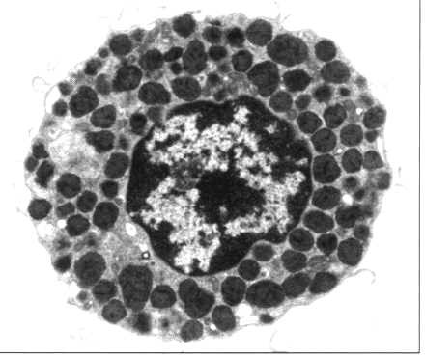
Mast cell (resting condition)

Slide 29
Antibody Isotope | Isotype-specific effector functions
IgG | - Opsonization of antigens for phagocytosis by macrophages and neutrophils - Activation of the classical pathway of complement - Antibody-dependent cell-mediated cytotoxicity mediated by natural killer cells - Neonatal immunity: transfer of maternal antibody across the placenta and gut - Feedback inhibition of B cell activation
IgM | - Activation of the classical pathway of complement - Antigen receptor of naive B lymphocytes
IgA | - Mucosal immunity: secretion of IgA into the lumens of the gastrointestinal and respiratory tracts - Activation of complement by the lectin pathway or by the alternative pathway
IgE | Mast cell degranulation (immediate hypersensitivity reactions)
IgD | Antigen receptor of naive B lymphocytes

Slide 30
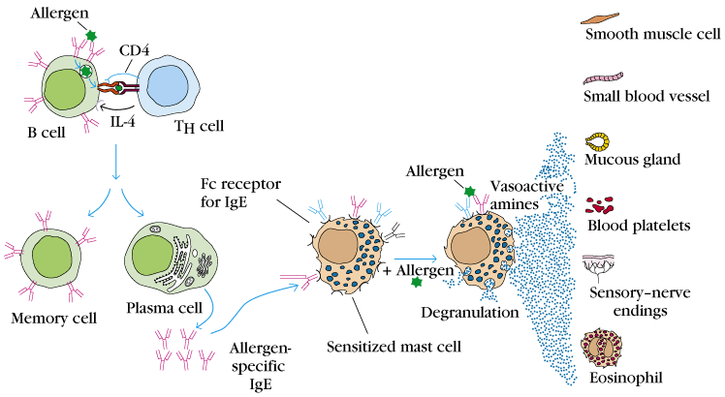
What is the sequence of events in an IgE-mediated hypersensitive response?
The plasma cells secrete IgE.
These IgE bind to Fc receptors on sensitized mast cells and blood basophils.
When the allergen appears again it cross-links the mIgEs and causes degranulation, releasing granules.
Mediators within these granules act on the surrounding tissues such as smooth muscle, small blood vessels, and mucous glands.

Slide 31
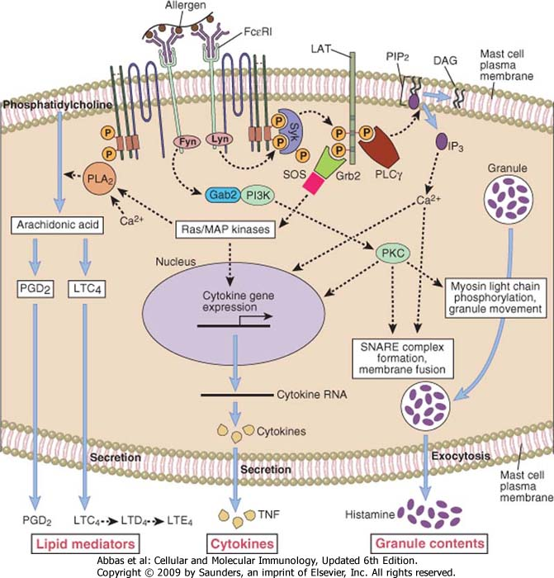

Slide 33
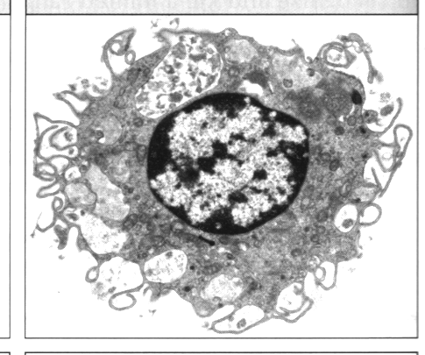
Resting Mast cell
Degranulated mast cell

Slide 34
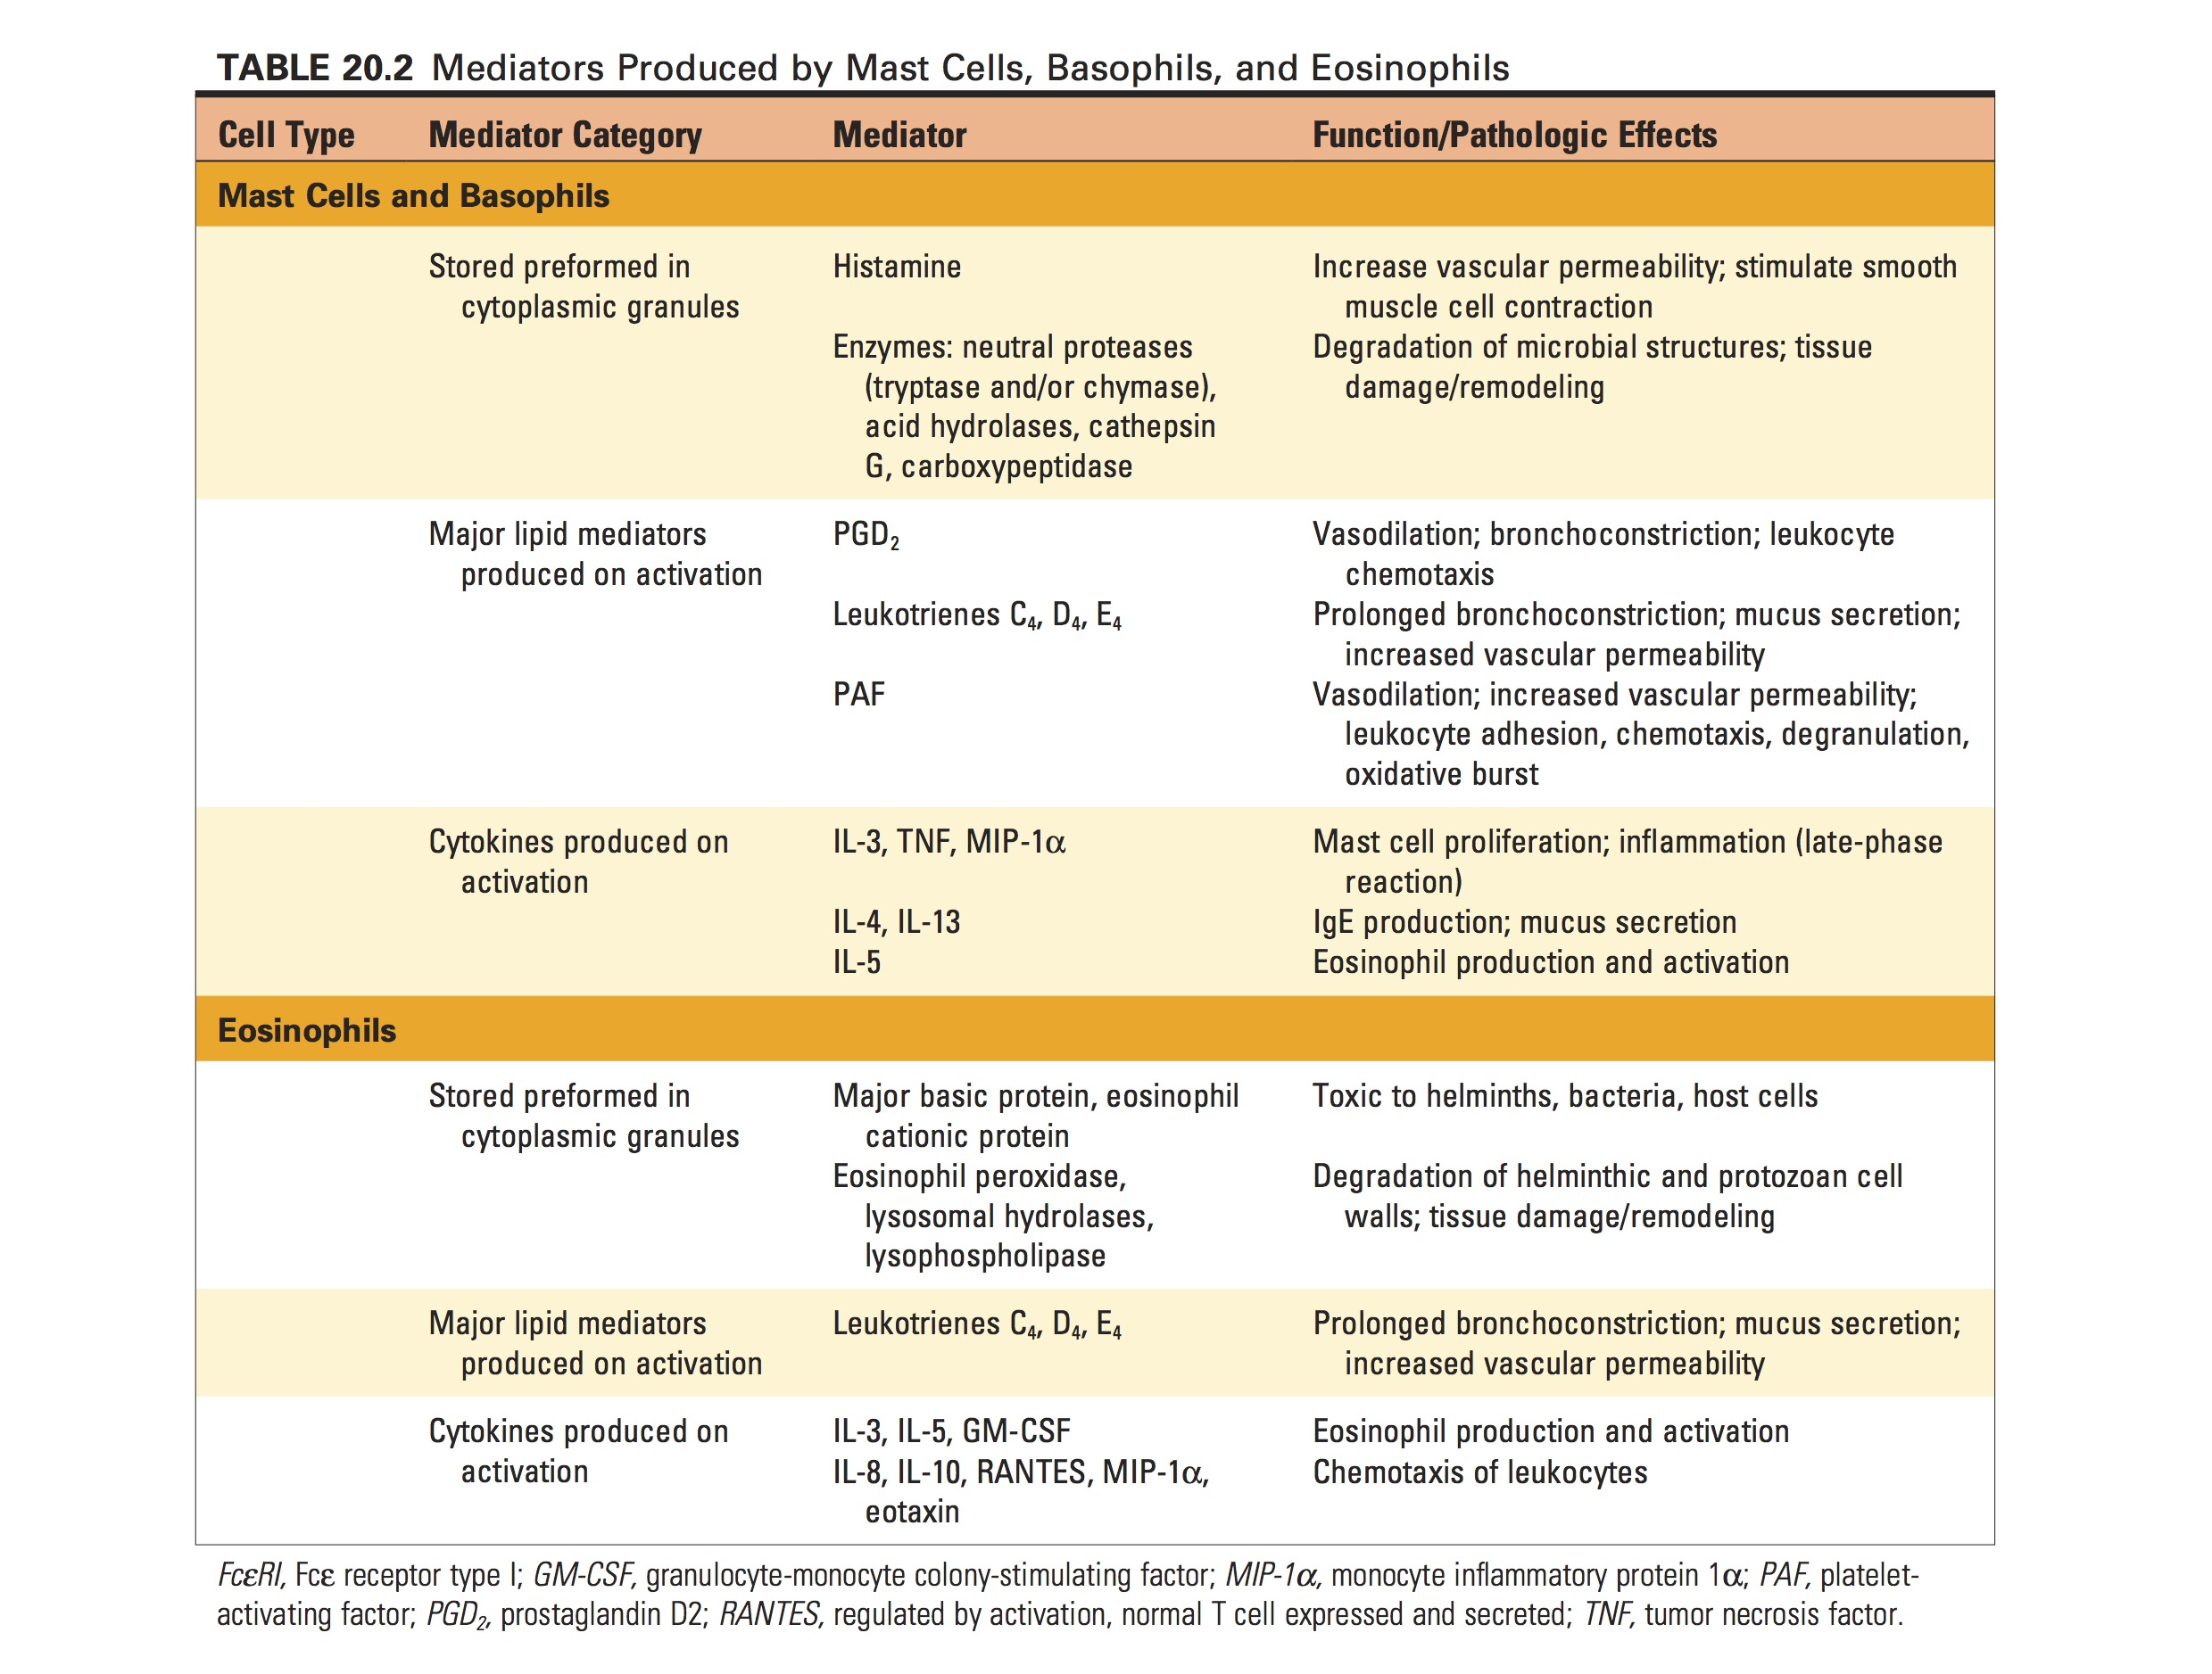

Slide 38
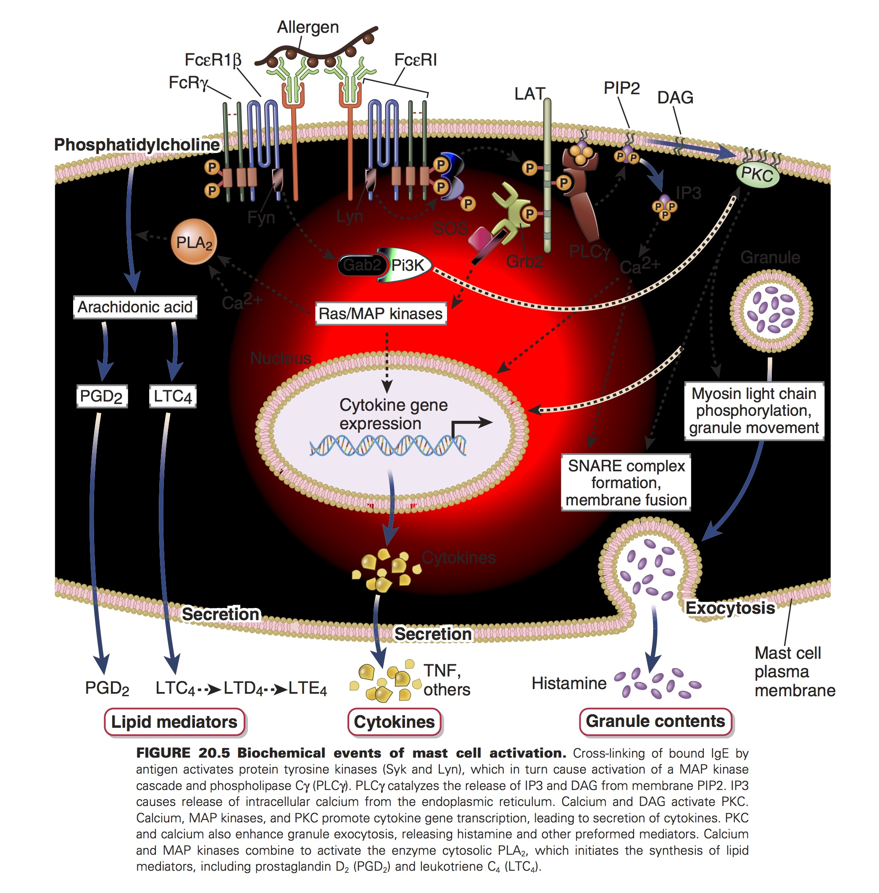

Slide 40
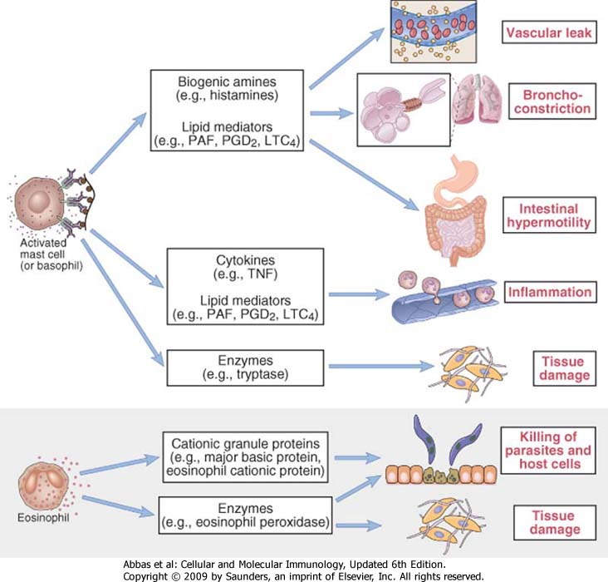
Biological effects of different mediators in type I HS

Slide 41
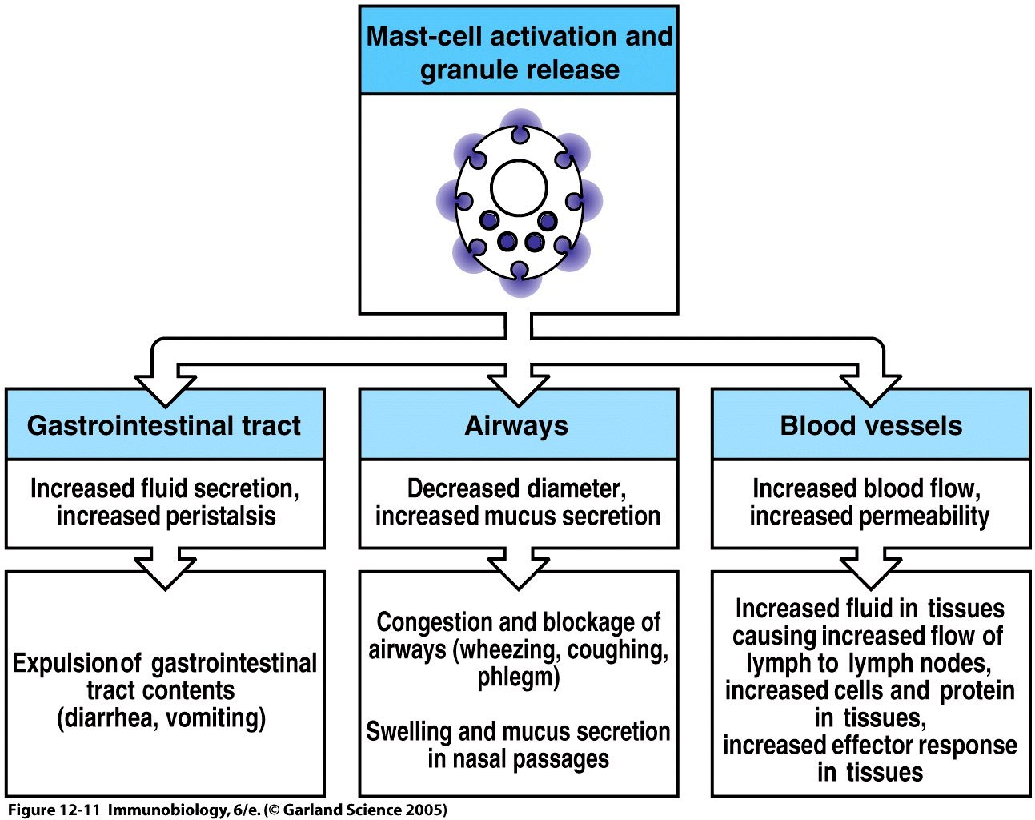
Mast cell activation affects many tissues

Slide 42
Take-home messages on mast cells:
Located in nearly all vascularized peripheral tissues
Contain many packets of membrane-bound granule, ready for release upon activation by an allergen
Can also release cytokines (thus they wear multiple immunological hats)

Slide 43
…and their Fc receptors…
High affinity receptor FcRI binds to IgE at extremely low serum concentrations (1 X 10⁻⁷ M). This receptor has ITAM as its cytosolic domain, thus it can initiate the process of degranulation via tyrosine phosphorylation.

Slide 44
Of course, these effects can be good…
Vasodilation and increased vascular permeability usher in plasma and inflammatory cells (such as esinophils, neutrophils) to attack the pathogen
However, when these effects go overboard, the result is problematic:
Anaphylactic shock – extreme smooth muscle contraction compromises control of the bladder and GI tract and causes bronchiole constriction
Allergic rhinitis – excess mucous is released. More commonly known as hay fever, this ailment affects 10% of the US population
Food allergies – a variety of symptoms
Asthma – bronchoconstriction and excess mucous

Slide 46
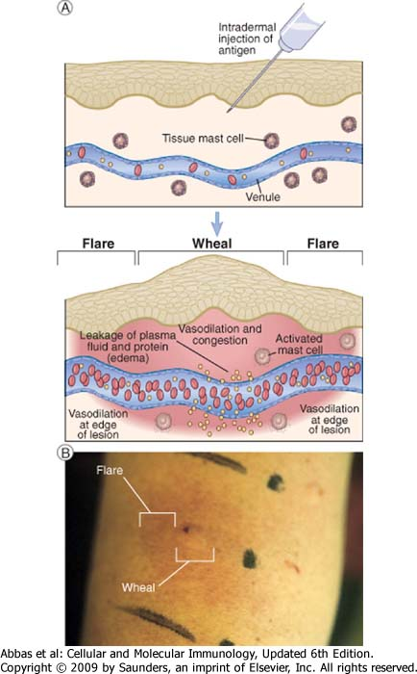

Slide 47
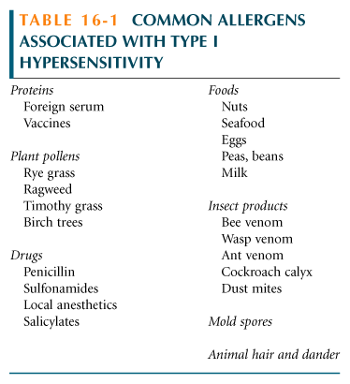
And just look at all these popular allergens!

Slide 48
What’s available in the Western medicine arsenal of drugs?
Anti-histamines – block the binding of histamine on target cells
Immunotherapy – treat the patient with increasing doses of the allergen (hyposensitization) to reduce severity of the response.

Slide 49
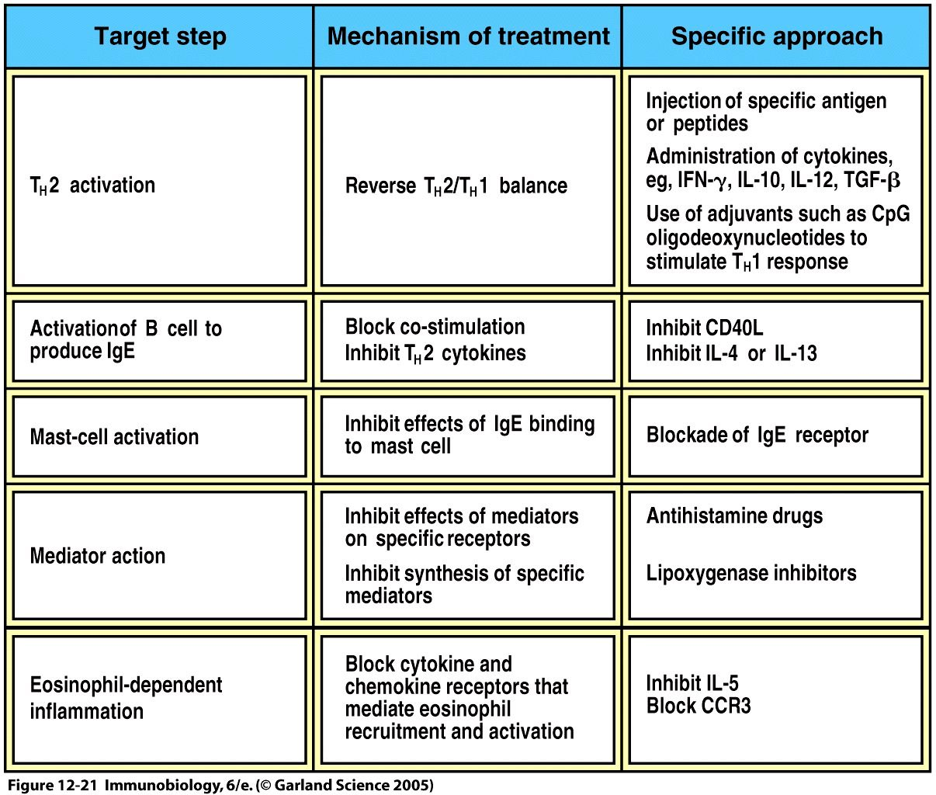
Treatment approaches for IgE-mediated Allergy

Slide 51
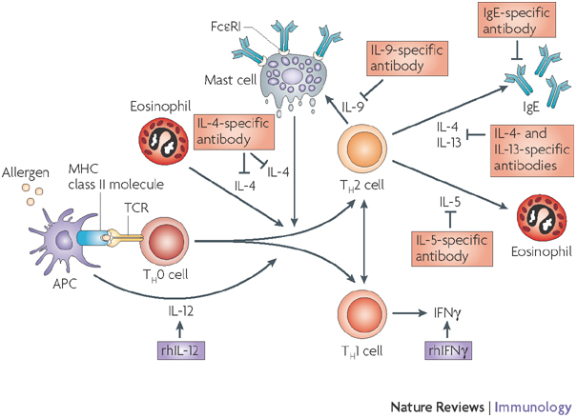

Slide 52
What’s available in the Western medicine arsenal of drugs?
Anti-histamines – block the binding of histamine on target cells
Immunotherapy – treat the patient with increasing doses of the allergen (hyposensitization) to reduce severity of the response.
Or, PREVENTION, find another home for Fido, and don’t eat those strawberries!

Slide 54
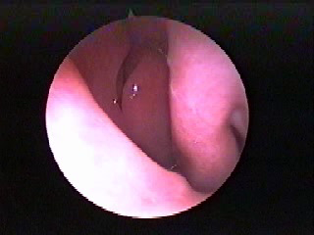
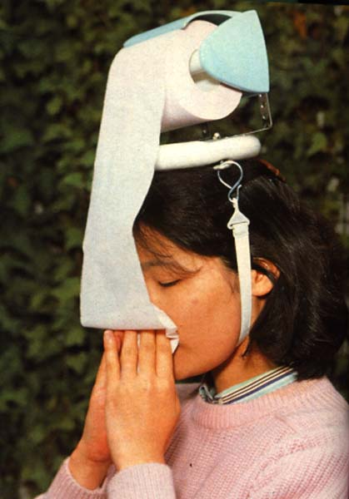
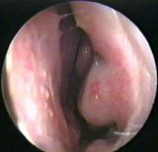

Slide 56
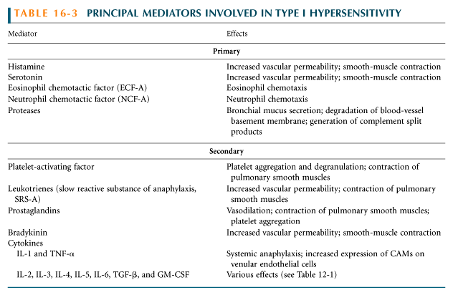
The chemically active effectors within the granules released via degranulation are called mediators. This group includes:
Histamines
Leukotrienes
Prostaglandins
Cytokines

