Slide 1
Immunology and transplantation

Slide 2
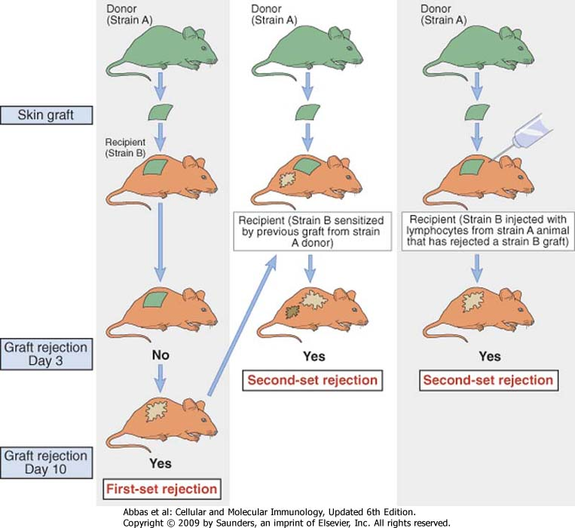

Slide 3
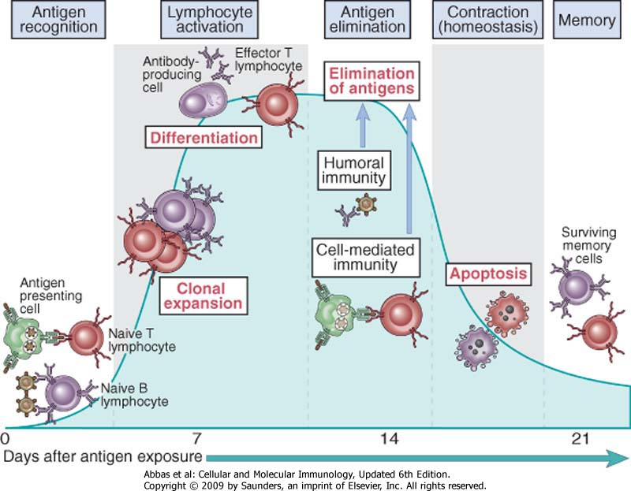
Phases of the adaptive immune response

Slide 4
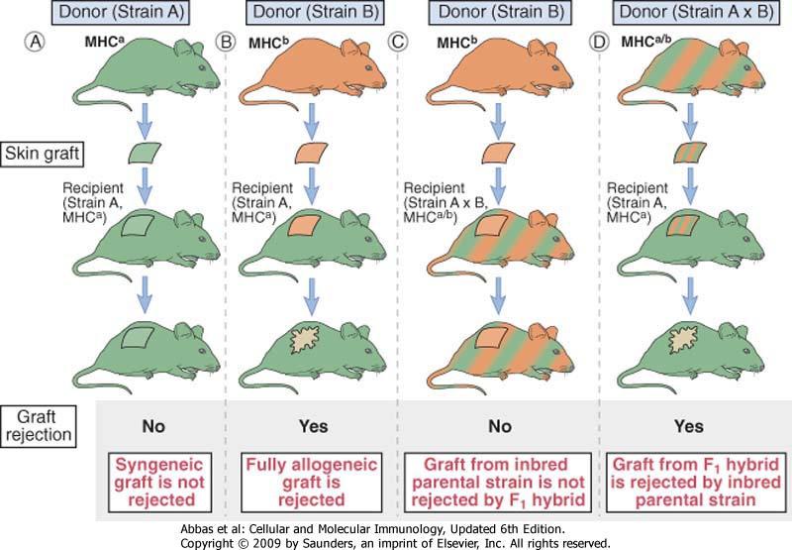
10 days

Slide 5
10 days

Slide 6
10 days

Slide 7
10 days

Slide 8
10 days

Slide 9
10 days

Slide 10
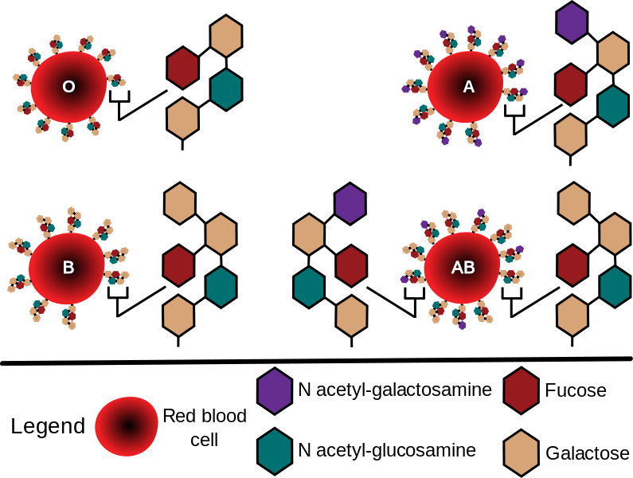
Ag del sistema AB0

Slide 11
ABO Antigen Biosynthetic Pathway
H Antigen Precursor = N-acetyl lactosamine
Galβ1-3GlcNAcβ1-
α-1,2-fucosyl transferase
(FUT1 Enzyme)
H Antigen
Galβ1-3GlcNAcβ1-
Fuc α1-2
α-1,3-galactosyltransferase (B Transferase Enzyme)
α-1,3-N-acetylgalactos- aminyltransferase (A Transferase Enzyme)
A Antigen
B Antigen
GalNAc-α1,3-Galβ1-3GlcNAcβ1-
Gal-α1,3-Galβ1-3GlcNAcβ1-
Fuc α1-2
Fuc α1-2

Slide 12
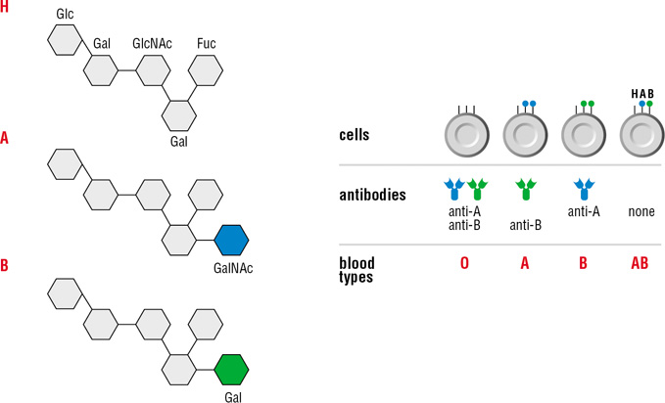
ABO compatibility between donor and recipient is crucial to avoid rapid graft rejection
Notes:
Figure 14-11 The ABO blood cell antigen system Top: schematic representation of the carbohydrate structures corresponding to the A, B and H antigens. The H antigen is modified by the addition of a single sugar residue by the allelic glycosyltransferase enzymes that create the A and B antigens. The H antigen is present on the surface of A, B, AB and O individuals, as indicated in the lower panel, because not all H antigens are modified by the A or B glycosyltransferase. The H antigen is only recognized by antibodies made in rare individuals who lack enzymes that make this oligosaccharide structure, which is present on glycolipids and glycoproteins of red blood cells and some other cell types including endothelial cells. Also shown in the lower panel is the antibody to the A and B antigens present in individuals of different blood types.

Slide 13
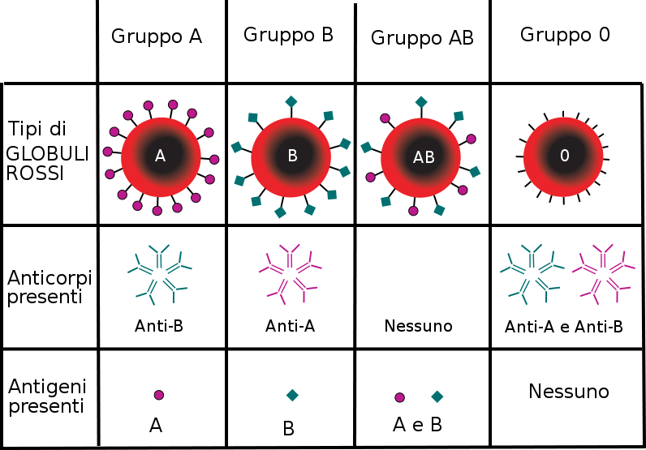

Slide 14
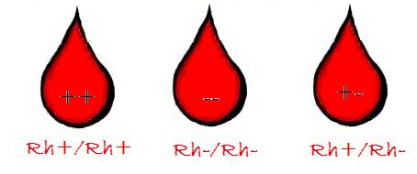
Ag Rhesus (Rh)

Slide 15
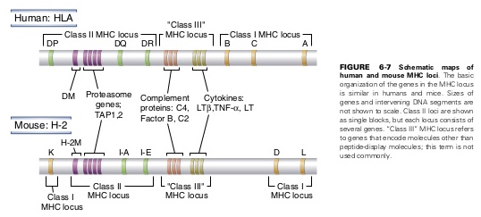
Human Leukocyte Antigens (HLA)
Chromosome 6

Slide 16
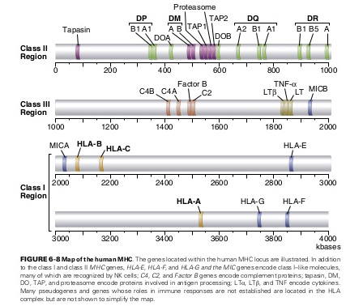

Slide 17
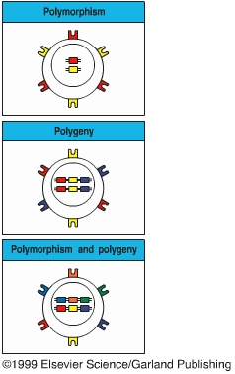
Polymorphism and polygeny
MHC genes are polymorphic: that is, there are large numbers of alleles for each gene
MHC genes are polygenic: that is, there are a number of different MHC genes.

Slide 18
Class I polymorphism
Locus | Number of alleles (allotypes)
HLA - A | 451
HLA - B | 782
HLA - C | 238
There are also HLA - E, HLA - F and HLA - G | Relatively few alleles

Slide 19
Class II polymorphism
Locus | Number of alleles (allotypes)
HLA - DP_{A} HLA - DP_{B} | 147
HLA - DQ_{A} HLA - DQ_{B} | 105
HLA - DR_{A} HLA - DRB1 HLA – DR_{B3} HLA – DR_{B4} HLA – DR_{B5} | 525
There are also HLA - DM and HLA - DO | Relatively few alleles

Slide 20
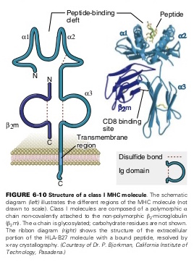
Class I MHC

Slide 21
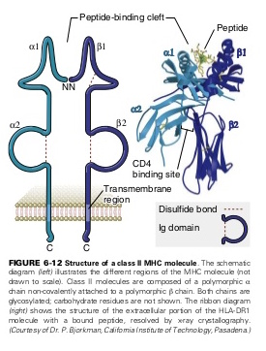
Class II MHC

Slide 22
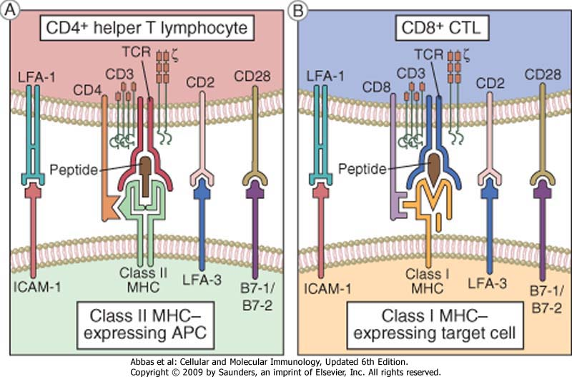

Slide 23
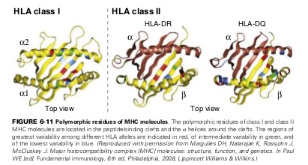

Slide 24
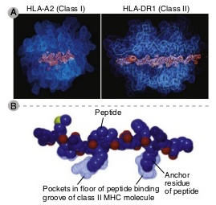
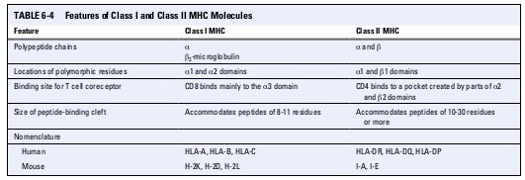

Slide 27
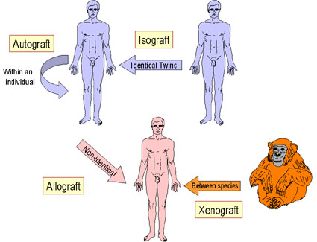
2006-7year
Immunology

Slide 28
Classification of grafts
Autologous grafts
Grafts transplanted from one part of the body to another in the same individual
Syngeneic grafts (Isografts)
Grafts transplanted between two genetically identical individuals of the same species
Allogeneic grafts (Allografts)
Grafts transplanted between two genetically different individuals of
the same species
Xenogeneic grafts (Xenografts)
Grafts transplanted between individuals of different species

Slide 29
IMMUNE RESPONSES TO TRANSPLANTED TISSUES
Transplant rejection caused by genetic differences between donor and recipient
HLA and blood group antigens
Alloantigens
Antigens which vary between members of same species
Alloreaction
Immune response to an alloantigen
Alloreactions in transplantation
Host-versus-graft (transplant rejection)
Graft-versus-host

Slide 30
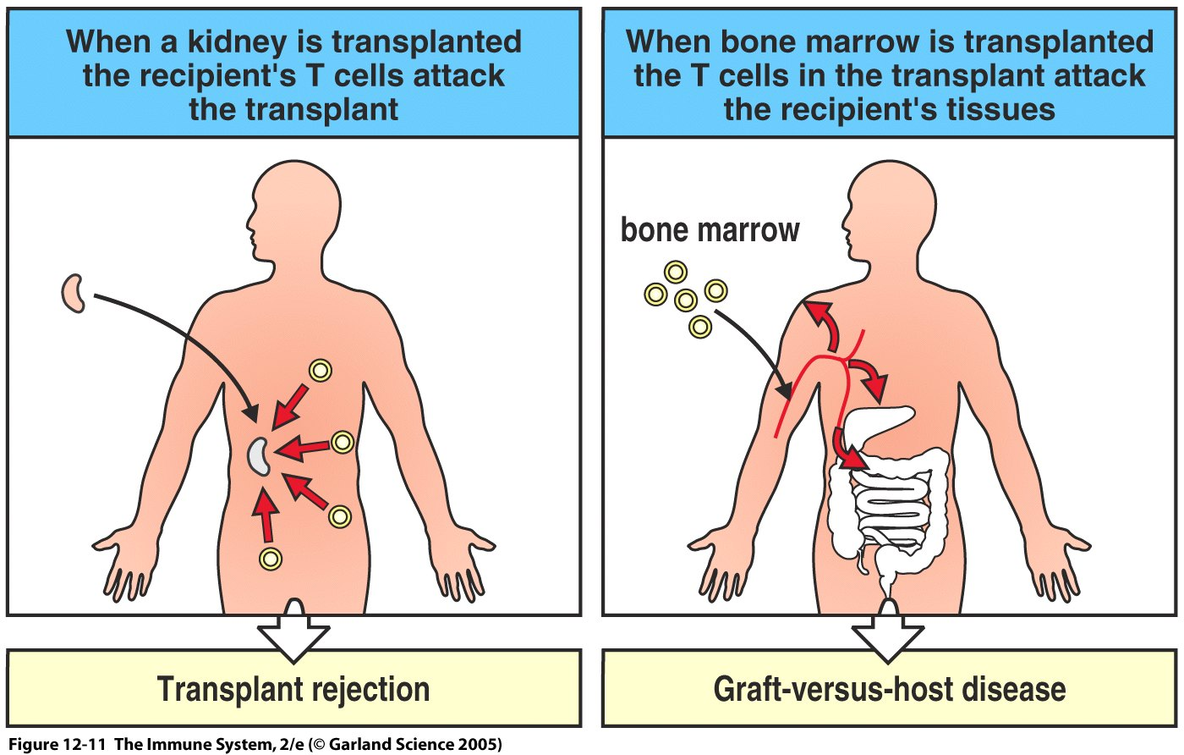
Figure 12-11

Slide 31
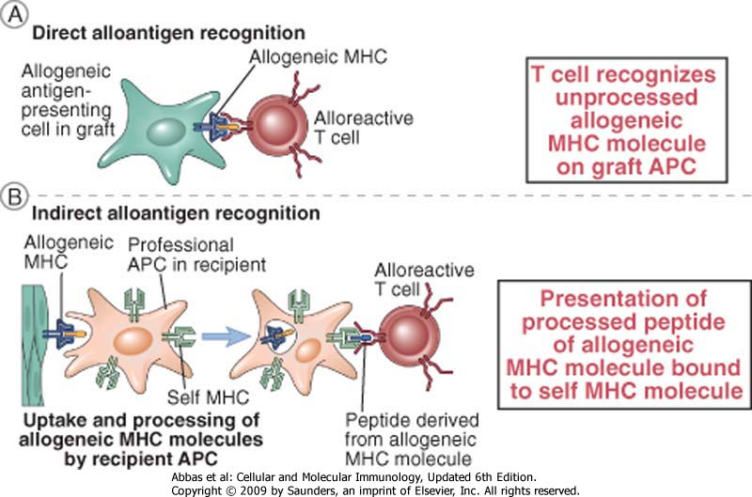

Slide 32
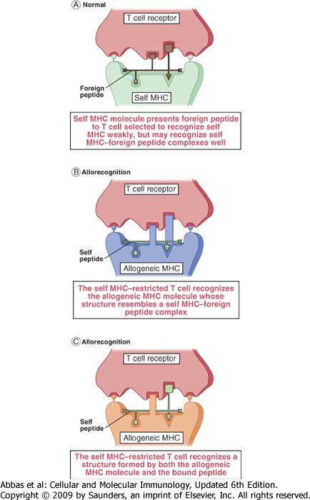

Slide 34
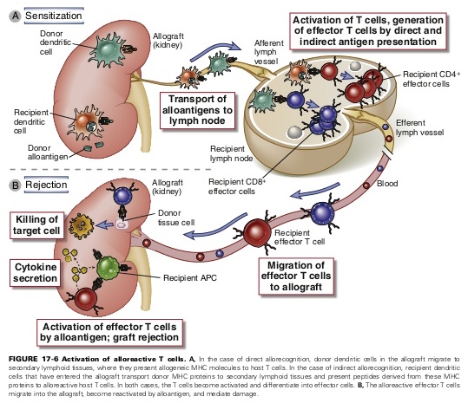

Slide 35
Hyperacute rejection
In 24 h
Cross-reactivity donor serum vs recipient cells
Presence of anti-Class I MHC/AB0 antibodies
Worst prognosis (100 % loss of function)

Slide 36
The ABO blood group barrier in organ transplantation
‘ABO’ antigens: carbohydrate structures expressed on many tissues and organs, including endothelium of organ transplants
Recipient pre-formed ‘natural’ anti-A or anti-B antibodies to non-self A/B antigens
Transplantation of ABO-incompatible organs:
‘Hyperacute’ rejection

Slide 37
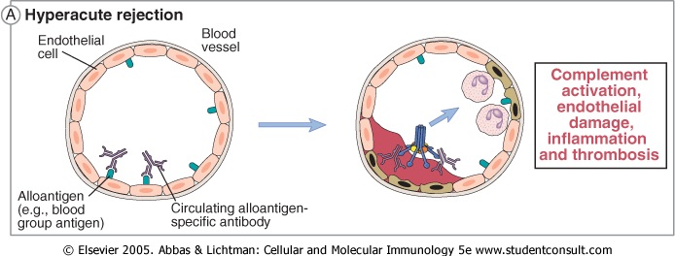
Hyperacute rejection:
immunological mechanism

Slide 38
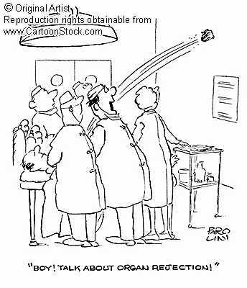

Slide 39
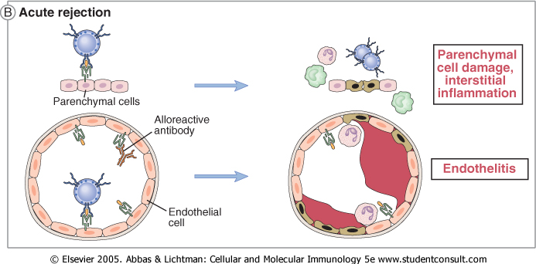
Acute rejection:
immunological mechanism

Slide 40
Mechanisms of cellular damages in acute rejection A- Cytokines produced by Macrophages and PMN
B- Specific T-cells produce TNF-α and perforine-granzyme
C- Bound antibodies induce CDC and ADCC

Slide 41
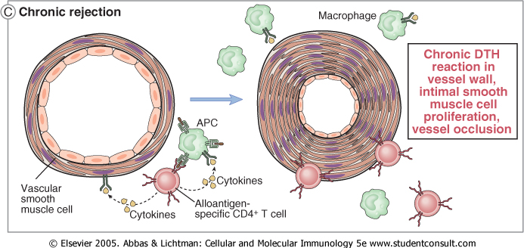
Chronic rejection:
immunological mechanism

Slide 42
Chronic rejection in kidney
After 60 gg
Cell proliferation in intima, fibrosis and occlusion of vessels
Hypertension
atrofia (tubulo-interstitial)
atrofia (glomerular)
reduction of renal functionality

Slide 44
Compatibility tests
AB0 - Rh
(IgM in AB0 system are the typical cause of hyper acute rejection)
Tissue characterization: HLA
(mainly HLA-A, HLA-B, HLA-DR.
Study on lymphocytes, incubated with known Abs and a source of complement. Evaluation of killed cells.
Now using PCR)
Screening of preformed Abs
(donor serum + known HLA cells)
Crossmatching
(donor serum + patient cells)

Slide 45
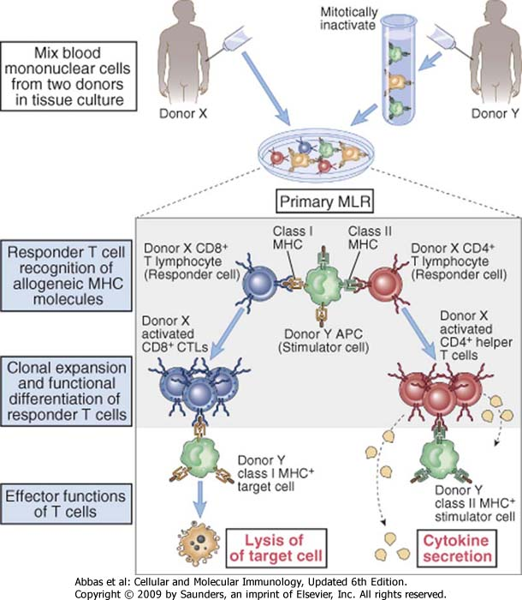
Mixed Lymphocytic Reaction

Slide 46
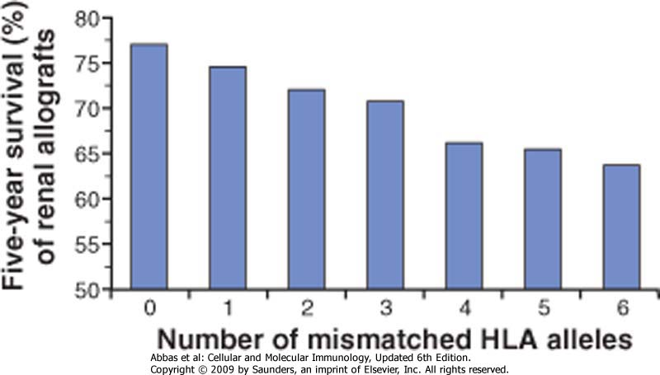

Slide 47
Transplantable organs
Blood
Kidney
heart
Lung
Liver
Bone marrow
Placenta (Umbilical cord)
Cornea

Slide 48
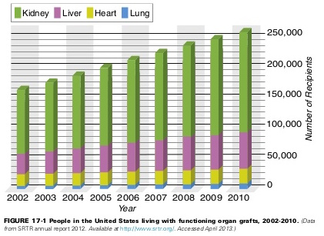

Slide 49
Transplantation (Type)
Auto-transplantation
Allo-transplantation
Xeno-transplantation

Slide 50
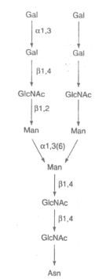
xenotransplant

Slide 51
Blood transfusion
Blood
Autotransplantation
ABO system ed Rh system
HLA system
Plasma
Autotransplantation
ABO system ed Rh system

Slide 52
Bone marrow transplantation
……… to allow hematopoietic stem cell transplantation
patient stimulation with GM-CSF to increase cell recovery
treatment of diseases of the hematopoietic and immune system
to collect stem cells to induce their differentiation in specific cells (treatment of diseases in other organs)

Slide 53
Procedure in solid organ transplantation
transplantation request
patient treatment waiting for the transplantation
compatibility tests
organ explant
organ transportation
organ transplantation
evaluation of the function
evaluation of the reject

Slide 54
Fetal immune response
No immune response to the fetus.
absence of classic MHC
privileged microenvironment from an immunological point of vie, like CNS, eye, testis ( high concentration of immunosuppressive cytokines - like TGF-β - and resident Treg lymphocytes)

Slide 56
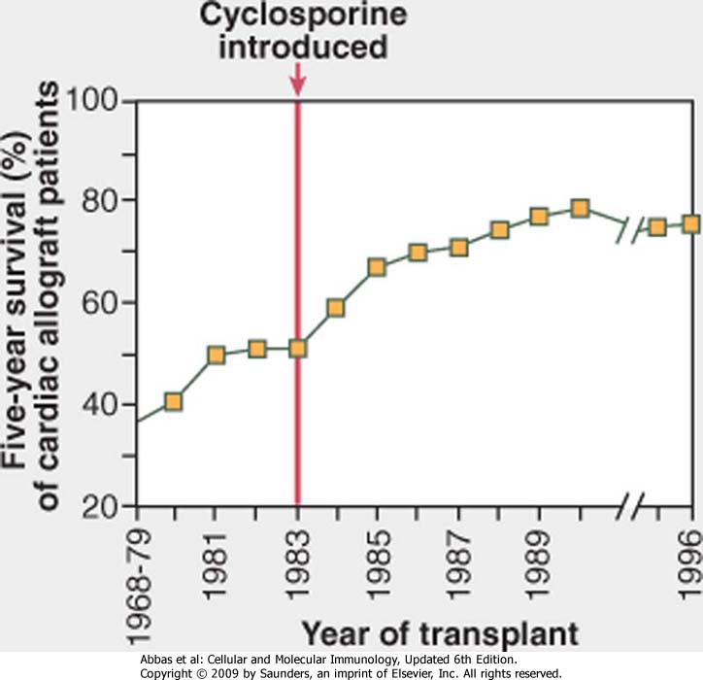

Slide 57
Metodi di immunosopressione usati in clinica
Farmaco | Meccanismo d’azione
Ciclosporina e FK-506 | Blocca la produzione di citochine da parte dei linfociti T inibendo il fattore NF-AT
Azatioprina | Blocca la proliferazione dei precursori dei linfociti
Mofetil-micofenolato | Blocca la proliferazione dei linfociti inibendo la sintesi di guanina
Rapamicina | Blocca la proloferazione linfocitaria inibendo la trasduzione del segnale dell’IL2
Corticosteroidi | Riducono l’infiammazione inibendo la secrezione di citochine da parte dei macrofagi
Ab anti-CD3 | Elimina i linfociti T promuovendo fagocitosi e attivazione del complemento
Ab anti-recettore dell’IL2 | Inibisce la proliferazione dei linfociti T bloccando il legame di IL2
CTLA-4-Ig | Inibisce l’attivazione die linfociti T il legame della molecola costimolatrice B7 (APC) al CD28 (linfociti T)
Ab anti-CD40 ligando | Inibisce l’attivazione dei macrofagi e dell’endotelio bloccando l’interazione il legame CD40L (linfociti T) al CD40 (macrofagi)

Slide 58
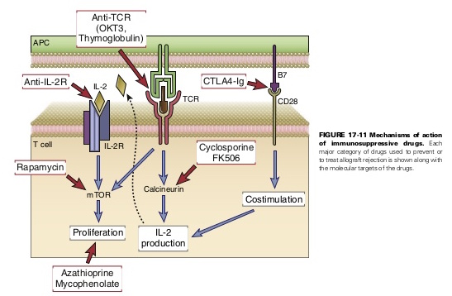

Slide 59
Infezioni potenzialmente trasmissibili dall’organo trapiantato
CMV (sangue, polmoni, cuore, cute, fegato, cervello)
EBV (idem)
HHV8 (Kaposi)
HBV / HCV (fegato)
Candida (sangue, polmone, fegato, cute)
Toxoplasma (polmone, cuore, cervello)
Strongiloides

Slide 60
Rischio di tumori nel trapiantato (rene)
L’incidenza è del 5-6 % (100 volte quella della popolazione generale)
Sedi:
cute
labbra
collo dell’utero
linfomi NH

Slide 61
Infezioni precoci (< 1 mese) dopo trapianto di rene
Vie urinarie:
batteri : E.coli, Klebsiella, Pseudomonas, Enterococco spesso con batteriemia
Candida
Polmone:
batteri (Legionella)

Slide 62
Profilaxis – before transplantation
Metilprednisolone (250 mg il giorno prima ; a scalare fino a 10-15 mg/die; 1 g in pulse dose x 3 gg nell’acuto)
Micofenolato mofetil (azatioprina )
Ciclosporina-A
Tacrolimus
Siero anti-linfocitario (anti-CD3) nell’acuto

