Slide 1
ELF at the European Commission: a survey-based study on interpreters’ perceptions
Cristina Scardulla
Università degli Studi di Udine
Università degli Studi di Trieste

Slide 2
Outline
ELF
ITELF
PhD: Key concepts & Research Questions
Multilingualism & interpreting at the EU
IPE: Interpreters’ Perceptions of ELF
Quantitative and qualitative results
CSS: DG SCIC’s Customers’ Satisfaction Survey
Conclusions
English as a Lingua Franca
Interpreting, Translating and English as a Lingua Franca

Slide 3
Outline
ELF
ITELF
PhD: Key concepts & Research Questions
Multilingualism & interpreting at the EU
IPE: Interpreters’ Perceptions of ELF
Quantitative and qualitative results
CSS: DG SCIC’s Customers’ Satisfaction Survey
Conclusions

Slide 4
ELF Jenkins (2000) and Seidlhofer (2001)
The common language of choice among speakers who come from different linguacultural backgrounds (Jenkins 2009: 200)
Any use of English among speakers of different first languages for whom English is the communicative medium of choice, and often the only option (Seidlhofer 2011: 7)
A contact language between speakers or speaker groups when at least one of them uses it as a second language (Mauranen 2018: 8)
A vehicular language which allows inter-comprehension among people speaking different mother tongues, as a neutral language or jargon of which nobody can claim ownership, but also as the mother tongue of one of the parties in the exchange (European Commission 2011: 8)

Slide 5
Jenkins 2015
VOICE
Vienna Oxford International Corpus of English
EXAMPLE
ELFA
English as a Lingua Franca in the Academic setting
ACE
Asian Corpus of English
ELF1
Belief that it would be possible to describe and possibly codify ELF varieties
ELF2
Fluidity in the use of features…which functions do the identified forms fulfil?
ELF3
Multilingual nature of ELF communication. ELF as a multilingual practice
ELF as a number of varieties, each with its own features
ELF neither linguistically nor geographically definable, «situated negotiation of meaning» (Seidlhofer 2009)
«English as a Multilingua Franca» -> multilingual communication in which EN is available but not necessarily chosen (Jenkins 2015)

Slide 6
ELF
ELF & pragmatics:
Collaborative nature of interaction (negotiation of meaning).
Proactive strategies such as clarification, self-repair, repetition (Pitzl 2005, Mauranen 2006, Cogo 2009, House 2009).
‘Let it pass’ approach (House 2009, Seidlhofer 2001).
Linguistic creativity («cooperative convergence on shared meaning» Seidlhofer 2009).
ELF & identities:
Intercultural communication -> linguistic dimension cannot be dissociated from notions such as identity, community and culture.
Different linguistic and cultural flows converge in a given context, where interlocutors cooperate to negotiate meaning.

Slide 7
Outline
ELF
ITELF
PhD: Key concepts & Research Questions
Multilingualism & interpreting at the EU
IPE: Interpreters’ Perceptions of ELF
Quantitative and qualitative results
CSS: DG SCIC’s Customers’ Satisfaction Survey
Conclusions

Slide 8
ITELF
(Albl Mikasa 2018)
ELF, translation and interpretation (T&I)
Communication across language barriers
Translators and interpreters are multilingual and multicultural communicators vs. ELF speakers are untrained multilinguals (T&I is based on native or native-like linguistic competence)
Non professional ELF speakers/writers
Massive increase in translation worldwide (more contacts and exchanges) BUT markets are becoming increasingly two-way

Slide 9
ITELF
ELF and Translation
English B different than ELF (NOT a variety) BUT can occur in non professional ELF context (editing by native speaker)
Stark increase in NNS-produced ELF source texts
Localization vs internationalization processes
ELF and Interpretation
The professionals’ perception of the phenomenon
The impact on the profession itself
ELF- related problems affecting interpreters’ performance

Slide 10
Outline
ELF
ITELF
PhD: Key concepts & Research Questions
Multilingualism & interpreting at the EU
IPE: Interpreters’ Perceptions of ELF
Quantitative and qualitative results
CSS: DG SCIC’s Customers’ Satisfaction Survey
Conclusions

Slide 11
ELF at the European Commission
ELF
Multilingualism
Interpretation
Communicative effectiveness

Slide 12
Research Questions
What is the EU interpreters’ stance on the impact the use of ELF has on :
multilingualism and participation rights?
their interpreting?
communicative effectiveness?

Slide 13
Why interpreters?
«First-hand witnesses to actual language use» (Donovan 2009: 62)
Trained multilinguals/communicators
Participants to a great variety of meetings
Observers+recipients of ELF communication
Homogeneous community of practice

Slide 14
Outline
ELF
ITELF
PhD: Key concepts & Research Questions
Multilingualism & interpreting at the EU
IPE: Interpreters’ Perceptions of ELF
Quantitative and qualitative results
CSS: DG SCIC’s Customers’ Satisfaction Survey
Conclusions

Slide 15
Multilingualism at the EU De jure vs de facto multilingualism
Outwards
Primary legislation
Translation of documents
Language-promoting programmes
Inwards
Working arrangements
Recruitment policies
Meetings/Interpretation
OFFICIAL LANGUAGES
WORKING LANGUAGES

Slide 16
European
Commission
WL: English, French, German
European
Parliament
European
Court of
Justice
French
European Council
CoM:full multilingualism
Controlled full multilingualism
Language of the proceeding
WG: varying degrees of multllingualism
Official meetings: varying degrees of multilingualism
EU

Slide 17
DG SCIC (Service Commun Interprétation-Conférences)
provide interpretation services for the Commission, European Council, Council of the EU, Committee of the Regions, European Economic and Social Committee, European Investment Bank as well as agencies and offices in EU countries
allocate Commission meeting rooms and provide support for multilingual meetings and conferences
advise on the construction and renovation of conference facilities with installations for simultaneous interpretation
help to put the Commission's multilingualism strategy into practice
bring together partners from non-EU countries to share expertise in the field of interpretation and pass on best practices from their respective fields
MISSION: to facilitate the democratic EU decision-making process through provision of high-quality conference interpretation […]

Slide 18
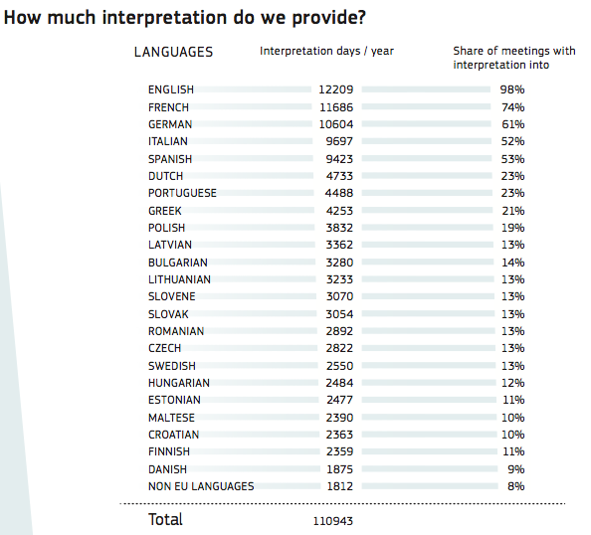
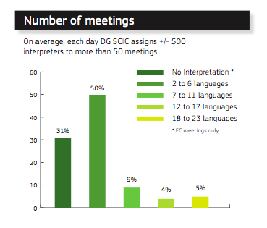

Slide 19
Outline
ELF
ITELF
PhD: Key concepts & Research Questions
Multilingualism & interpreting at the EU
IPE: Interpreters’ Perceptions of ELF
Quantitative and qualitative results
CSS: DG SCIC’s Customers’ Satisfaction Survey
Conclusions

Slide 20
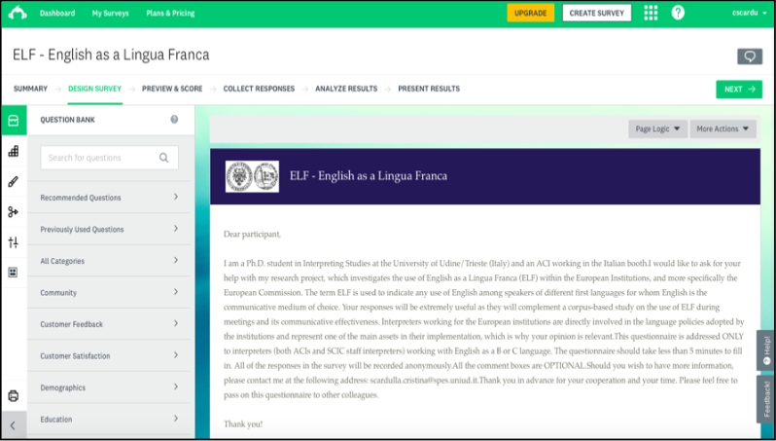
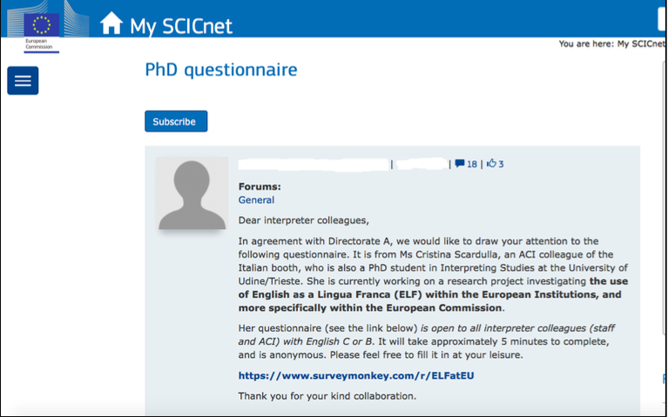
Respondent-friendly
Customisable features
Analisys tools
Only EU interpreters have access
SCIC-approved
Only active interpreters consult SCICnet

Slide 21
Q1, Q2, Q3
Demographic data: years of experience as interpreter (Q1), years of experience as EU interpreter (Q2), workload distribution per institution (Q3).
Q9, Q10
Participation rights and language policies: ELF enables participants to fully participate? (Q9), the use of ELF as threat to the principle of multilingualism? (Q10).
Q11
Open-ended question: respondents are offered the chance to add any comment they deem relevant on the topic.
Q4, Q5, Q6
Q7, Q8
ELF and ELF speakers in meetings: tendency to use ELF (Q4), ELF and communicative effectiveness (Q5), speakers’ competence (Q6).
The interpreter’s task: is ELF more demanding (Q7)? What are the most demanding features (Q8).
COMMENT BOX AFTER QUESTIONS Q4 TO Q10

Slide 22
Outline
ELF
ITELF
PhD: Key concepts & Research Questions
Multilingualism & interpreting at the EU
IPE: Interpreters’ Perceptions of ELF
Quantitative and qualitative results
CSS: DG SCIC’s Customers’ Satisfaction Survey
Conclusions

Slide 23
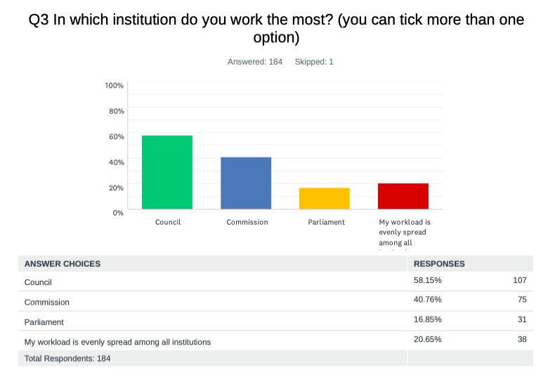
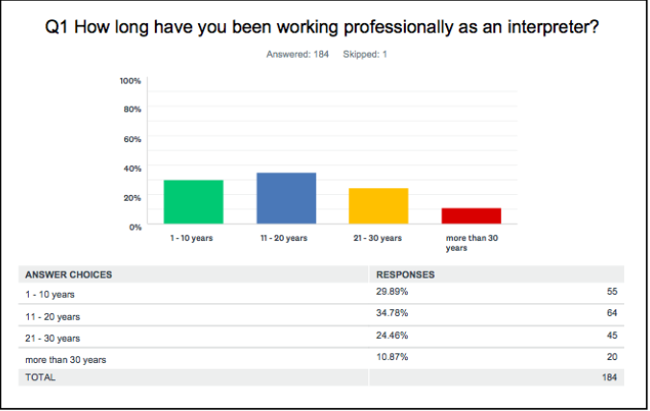
RESPONDENTS: 185
Demographic data: Q1, Q2, Q3

Slide 24
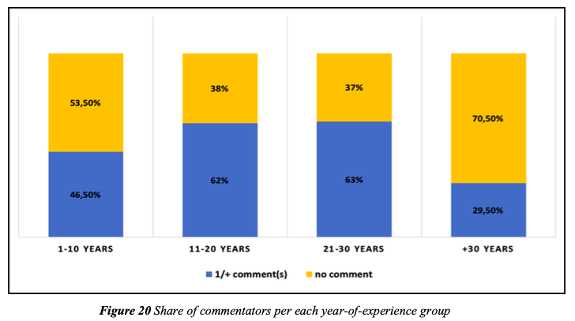
COMMENTATORS:

Slide 25
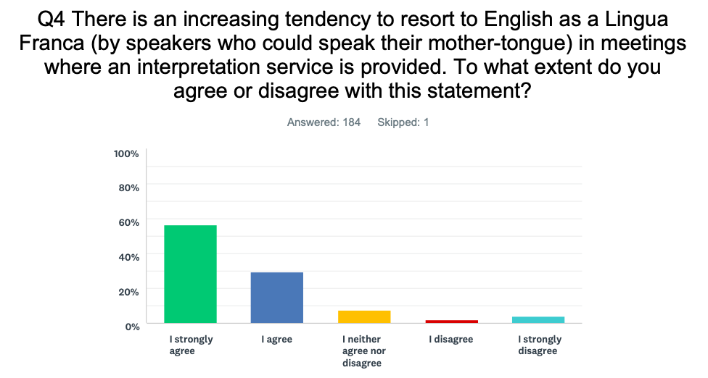
ELF and ELF speakers in meetings: Q4

Slide 26
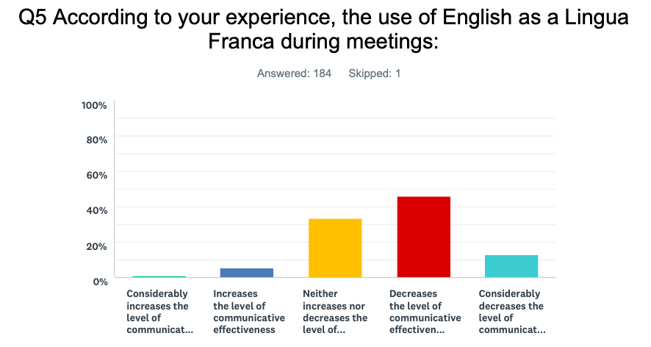
ELF and ELF speakers in meetings: Q5

Slide 27
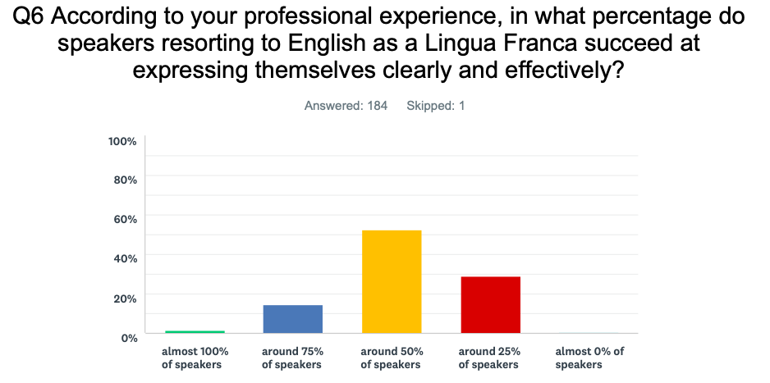
ELF and ELF speakers in meetings: Q6

Slide 28
The interpreter’s task: Q7

Slide 29
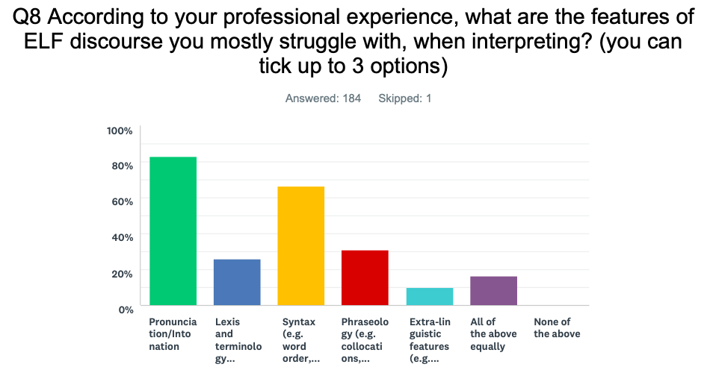
The interpreter’s task: Q8

Slide 30
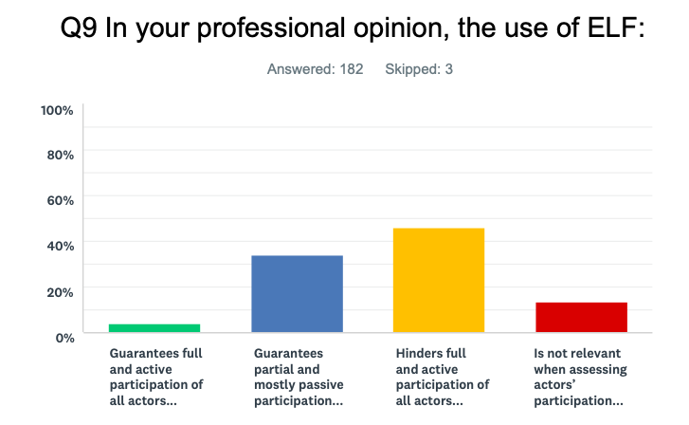
Participation rights and language policies: Q9

Slide 31
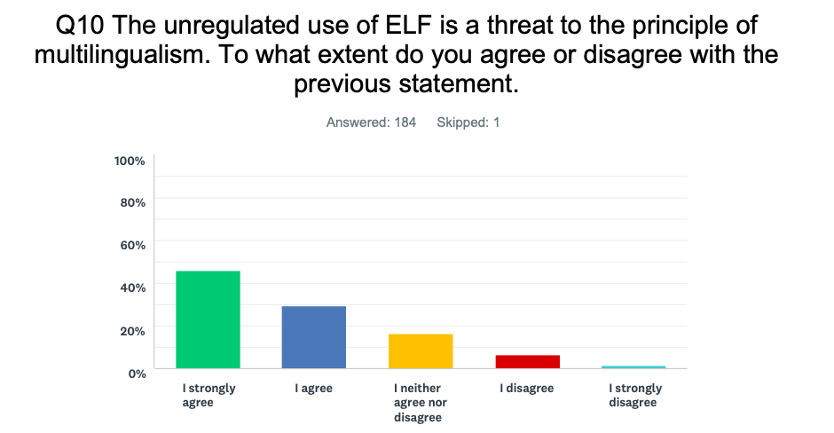
Participation rights and language policies: Q10

Slide 32
Any other comment: Q11
It’ s a losing battle. [C11.4]
ELF easily kills all spontaneous, ‘real’ discussions because the participants just read out their speeches written in English - probably because their knowledge of English is not sufficient so as to allow them to express their ideas freely... highly frustrating to interpreters and delegates equally, I think! [C11.43]
Just say no to Globish. [C11.1]
[...] I find it hard to cope with a language that doesn’t exist and changes form
from delegate to delegate. It is hard to interpret also because it doesn’t betray/convey the cultural aspects of the language which usually help grasp the true meaning with native speakers. [C11.4]
The widespread use of ELF is also undermining the role and status of interpreters, whose professional competence is becoming less and less appreciated […] while their assistance is often perceived as something to be ashamed about (by those who need interpretation). [C11.31]
ELF has made the profession more challenging and less rewarding [C11.23]
It puts everyone who does not perfectly master English at a disadvantage and reduces their right of expression compared to others. [C11.48]
How can you ensure the respect of every language if you make it easier to use only one of the 24 official languages? [C11.2]

Slide 33
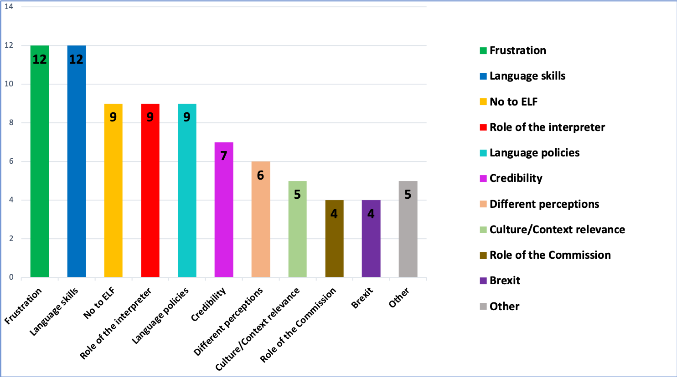
Any other comment: Q11

Slide 34
Outline
ELF
ITELF
PhD: Key concepts & Research Questions
Multilingualism & interpreting at the EU
IPE: Interpreters’ Perceptions of ELF
Quantitative and qualitative results
CSS: DG SCIC’s Customers’ Satisfaction Survey
Conclusions

Slide 35
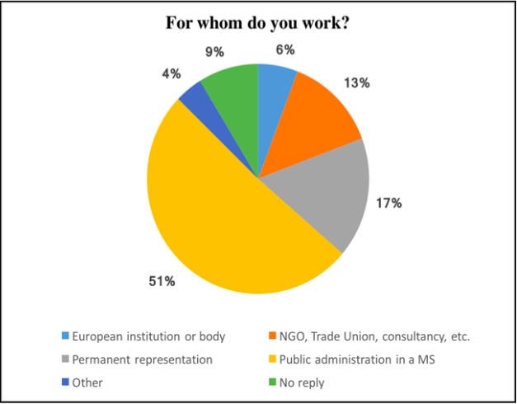
CSS 2017 edition
2372 REPLIES
230 MEETINGS

Slide 36
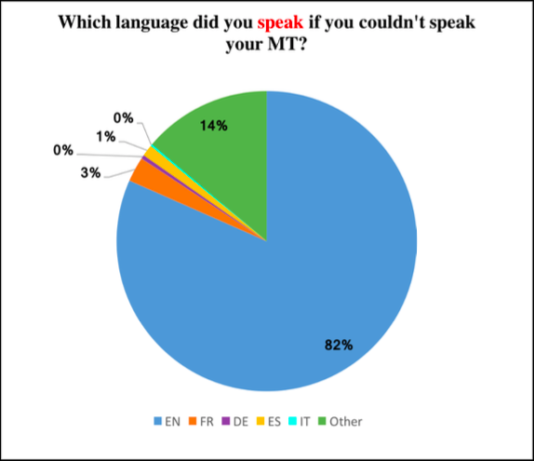
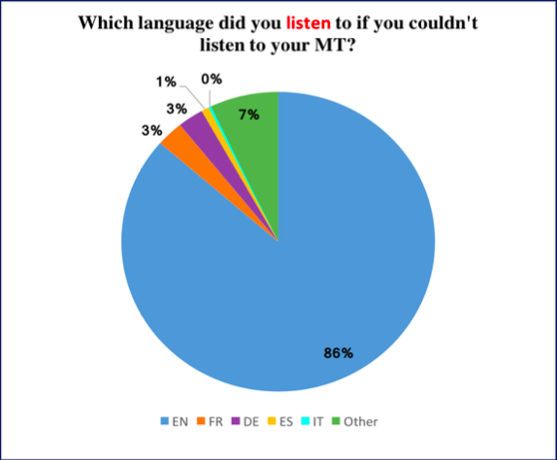
CSS 2017 edition

Slide 37
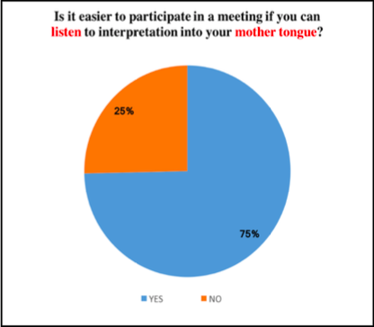
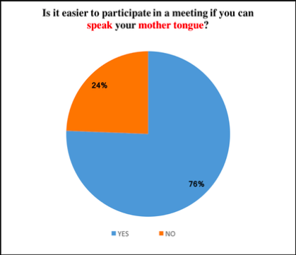
CSS 2017 edition

Slide 38
CSS 2017 edition

Slide 39
Outline:
Key concepts
Research Questions
ELF & ITELF
Multilingualism at the EU
Interpreting at the Commission: DG SCIC
IPE: Interpreters’ Perceptions of ELF
Quantitative and qualitative results
CSS: DG SCIC’s Customers’ Satisfaction Survey
Conclusions

Slide 40
ELF, multilingualism and participation rights
82% of of IPE respondents -> (strongly) agree that participation tends to be partial and passive
Interpreters do not dismiss the validity and communicative potential of ELF altogether, but they invite to some caution when taking for granted the benefits of its use
75% of of IPE respondents -> (strongly) agree that the unregulated use of ELF is a threat to the principle of multilingualism
Considering all languages equal and then failing to acknowledge that there is one which holds a dominant position creates a vicious circle: English and ELF are not addressed directly, so as not to single out one language, all the while letting the other languages slowly fade out of EU meeting rooms and future-shaping debates

Slide 41
ELF as an additional ‘effort’
80.5% of IPE respondents -> (strongly) agree that interpreting speakers who use ELF tends to be more demanding than interpreting native speakers
99.4% of IPE respondents -> pronunciation/intonation is the main obstacle
Gile’s Effort Model:
SIM = LA + M + P + C ≤ A
ELF

Slide 42
ELF and communicative effectiveness
60% of IPE respondents -> the use of ELF (considerably) decreases the level of communicative effectiveness (Q5)
Where is the bar of communication effectiveness placed? Communication is not always just about getting the message across.
84% of IPE respondents -> only 25% to 50% of speakers express themselves effectively when resorting to ELF (Q6)
Interpreters refer to an elusive competence level, below which communication struggles.
Interpretation and communicative effectiveness
93% of CSS respondents -> (very) satisfied with the interpretation service.

Slide 43
Future research avenues
Impact-assessment and thorough evaluation of how these two communication modes interact.
Study involving meeting participants and interpreters: same questions on a specific set of events, representing the whole range of interpreter-mediated meetings organized by DG SCIC.
Relationship between language regime and active participation or the participants’ reasons for using ELF.
DG SCIC involvement on identifying language patterns and participants’ needs.
“ELF is a fact of life and is there to stay”

Slide 44
References:
Albl-Mikasa, Michaela. 2018. ELF and translation/interpreting. In Jennifer Jenkins, Will Baker & Martin Dewey (eds.) The Routledge Handbook of English as a Lingua Franca, London/New York: Routledge, 369-383.
Cogo, Alessia. 2009. Accomodating difference in ELF conversations: A study of pragmatic strategies. In Anna Mauranen & Elina Ranta (eds.) English as a Lingua Franca: Studies and Findings. Cambridge: Cambridge Scholars Publishing, 254-273.
European Commission. 2011. Lingua franca: Chimera or reality? Studies on translation and multilingualism 1/2011. Luxemburg: Directorate-General for Translation.
House, Juliane. 2009. Introduction. The pragmatics of English as a lingua franca. Special Issue of Intercultural Pragmatics 6.2, 141-145.
Jenkins, Jennifer. 2015. Repositioning English and multilingualism in English as a Lingua Franca. Englishes in Practice, 2(3), 49-85.
Jenkins, Jennifer. 2000. The phonology of English as an international language. Oxford: Oxford University Press.
Mauranen, Anna. 2018. Conceptualising ELF. In: Jennifer Jenkins, Will Baker & Martin Dewey, The Routledge Handbook of English as a Lingua Franca. London/New York: Routledge, 7-24.
Mauranen, Anna. 2006. Signalling and preventing misunderstandings in ELF communication. International Journal of the Sociology of Language, 177, 123-150.
Pitzl, Marie-Luise. 2005. Non-understanding in English as a lingua franca: examples from a business context. Vienna English Working PaperS 17.2, 21-46.
Scardulla, Cristina. 2020. ELF at the European Commission: a survey-based study on interpreters’ perceptions. University of Udine/University of Trieste. PhD thesis.
Seidlhofer, Barbara. 2011. Understanding English as a Lingua Franca. Oxford: Oxford University Press.
Seidlhofer, Barbara. 2009. Orientations in ELF research: form and function. In Anna Mauranen & Elina Ranta (eds.) English as a Lingua Franca: Studies and Findings. Cambridge: Cambridge Scholars Publishing, 37-59.
Seidlhofer, Barbara. 2001. Closing a conceptual gap. The case for a description of English as a lingua franca. International Journal of Applied Linguistics. International Journal of Applied Linguistics. 11.2, 133-158.
VOICE. Vienna Oxford International Corpus of English (https://voice.acdh.oeaw.ac.at/index.xql)

Slide 45
Thank you for your attention
Cristina Scardulla
scardulla.cristina@spes.uniud.it
cscardulla@hotmail.com

