Slide 1
Immune-deficiencies

Slide 2
Immune deficiencies
Primary
Hereditary
Can be categorized based on clinical presentation
Cell mediated (T cell)
Antibody mediated (B cell)
Non specific (phagocytes, NK cells)
Complement activation

Slide 3
Major clinical manifestations of immune disorders
Disorder | Associated Disease
Deficiency
B cell deficiency – deficiency in Ab mediated immunity | Recurrent bacterial disease (otitis media, recurrent pneumonia)
T Lymphocyte deficiency – deficiency in cell mediated immunity | Increased susceptibility to viral, fungal,protozoal infection
T and B lymphocyte deficiency – combined deficiency of Ab- and cell-mediated immunity | Acute and chronic infections with viral, bacterial, fungal, and protozoal organisms
Phagocytic cell deficiency | Systemic infections with bacteria of usually low virulence, infections with pyogenic bacteria, impaired pus formation and would healing
NK cell deficiency | Viral infections, associated with several T cell disorders and X-linked lymphoproliferative syndromes
Complement component deficiency | Bacterial infections; autoimmunity

Slide 4
Severe Combined Immunodeficiency Disease (SCID)
Life threatening infections soon after birth
Lack of Thymic shadow
Lack of CD3+, CD4+, CD8+ and lymphocyte response to antigens (also B-cell response)

Slide 5
Primary immunodeficiencies
Severe Combined Immunodeficiency Disease
T- B+
X-linked SCID (40-50% of cases)
Lack γ chain (CD25) for common cytokine receptor
Autosomal recessive SCID
Mutation in gene that encodes JAK3 tyrosine kinase

Slide 6
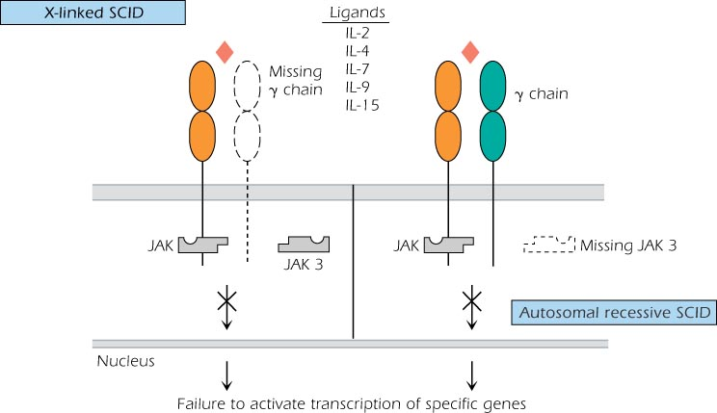
X linked and autosomal recessive

Slide 7
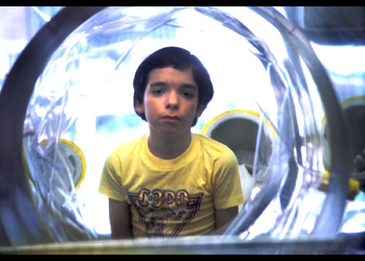
“The Boy in the Bubble”

Slide 8
Primary immunodeficiency
Severe Combined Immunodeficiency Disease
T- B-
Adenosine deaminase deficiency (20% of cases)
Missing housekeeping enzyme in purine salvage pathway, autosomal recessive, buildup of toxic wastes affects B and T cells
Purine nucleoside phosphorylase deficiency
Purine salvage pathway, toxic wastes affect neurologic system and T cells (these patients have autoimmunity?!)
Recombinase deficiency
RAG 1 and 2 required for the rearrangement of Ig genes and TCR. Cells are stuck in pre-B and pre-T stages. NK cell function OK

Slide 9
Primary Immunodeficiency
Severe Combined Immunodeficiency Disease
T+ B-
Omenn syndrome
“leaky” SCID with partial RAG activity. Th2 imbalance and a tendency towards hyper IgE syndrome
T+ B+
Bare lymphocyte syndrome
Failure to express HLA molecules
ZAP-70 mutation
Unable to signal through TCR and BCR

Slide 10
Management of SCID patients
Bone marrow/ stem cell transplant
IV Ig if necessary
Supportive care
Avoid live viral vaccines!
Gene therapy, if possible

Slide 11
Future research directions….
Notes:
Attempt to treat SCID by transfer of the normal gene for IL-2 rganna
Some patients had integration sites for the viral vector, and this led to leukemia

Slide 12
Other immunodeficiencies of T cells
and cell -mediated immunity

Slide 13
Other immunodeficiencies of T cells
and cell -mediated immunity
Patients are susceptible to viral, fungal, and protozoal infections
Often exhibit selective defects in Ab production
Can be difficult to distinguish from SCID patients

Slide 14
T cell deficiencies with normal peripheral T cell numbers
Functional, rather than numerical defect in T cell population
Susceptible to opportunistic infections, high incidence of autoimmune disease
Autosomal recessive
Deficient expression in:
ZAP-70 tyrosine kinase (phenotype includes CD8 deficiency and SCID-like symptoms
CD3ε
CD3γ

Slide 15
Autoimmune LymphoProliferative Syndrome
(ALPS)
Systemic autoimmune disease, susceptible only to chronic viral infections
Increased CD4-/CD8- T cells, can develop B cell lymphomas
Most patients have a mutation in gene encoding for Fas (CD95)

Slide 16
B cell or Ig-associated Immunodeficiency
May be associated with defective B cell development (absence of all Ig subclasses) or deficiency in subclass or class of Ig
Patients suffer from recurrent or chronic infections

Slide 17
Brunton’s agammaglobulinemia
X-linked infantile agmmaglobulinemia
1:100,000
Noticed in infants at 5-6 months of age
Serious and repeated bacterial infections
Defect in BTK gene
Pre-B cells cannot develop into mature B cells
Treatment consists of IvIg injections, but chronic lung disease is a problem

Slide 18
Phagocytic dysfunctions
Affect the innate and acquired response to pathogens
Dysfunction in:
Action required to phagocytize
Migration and adhesion of phagocytic cells

Slide 19
Leukocyte adhesion deficiency
(LAD)
Autosomal recessive
Group of disorders in which the leukocyte interaction with vascular endothelium is disrupted
b subunit of integrins
Selectin ligands
Consequences:
Recurrent soft tissue bacterial infection
Increased blood WBC counts
No pus formation or effective wound healing

Slide 20
Chronic Granulomatous Disease
X-linked, autosomal recessive
Skin, lymph node, lung infections
High WBC in blood
Phagocytes unable to complete respiratory burst
Treatments include antibiotics, antifungals, IFNγ
Notes:
S. aureus, S. marcescens, aspergillis infections

Slide 21
Complement Abnormalities
Deficiencies inherited in autosomal fashion, heterozygotes have 50% of given complement protein
Complement is required for:
Opsonization and killing of bacteria
Chemotaxis
B cell activation
Elimination of Ag-Ab complexes

Slide 22
INCIDENCE OF COMPLEMENT DEFICIENCIES IN NORMAL POPULATION
POPULATION | SWISS | BRITISH | JAPANESE
N° OF SUBJECTS EXAMINATED | 40,000 | 2,000 | 145,640
N° OF SUBJECTS WITH C DEFICIENCY | 14 | 1 | 154
DEFECTIVE COMPONENT | C2, C4 | C6 + C7 | C5(2), C6(4), C7(6), C8(4), C9 (138)
REFERENCE | Hessing et al, 1964 | Lachman et al, 1978 | Fukumori et al 1989; Inai et al 1989

Slide 23
THE INHERITED DEFICIENCIES OF C COMPONENTS AND REGULATORS ARE RARE IN THE GENERAL POPULATION
The estimated frequency is 0.03%
(3 per 10,000)

Slide 24
MBL DEFICIENCY IS COMMON IN THE GENERAL POPULATION
Estimated frequency is 5-10%
(Asymptomatic)

Slide 25
Early complement protein deficiencies
C1, C2, C4 or C3 deficiency
Pyogenic infections
Autoimmunity – SLE very common

Slide 26
Late complement protein deficiencies
C5 - C9
Prevents formation of membrane attack complex
Gram negative bacterial infections

Slide 27
Immune deficiencies
Primary
Hereditary
Can be categorized based on clinical presentation
Cell mediated (T cell)
Antibody mediated (B cell)
Non specific (phagocytes, NK cells)
Complement activation
Secondary
Immune deficiency is the result of another disease

Slide 28
Acquired Immunodeficiencies
Secondary immune deficiencies that are the consequences of other diseases
Viral Infection

Slide 29
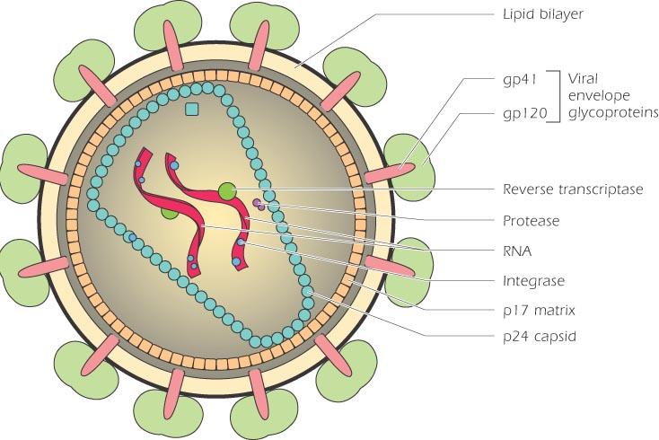
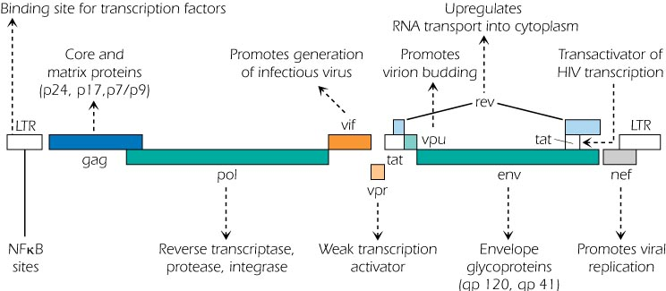
HIV

Slide 30
Immuno-pathogenesis of HIV-Infection
HIV infects and ultimately destroys CD4+ , CCR5+ or CXCR4+ T cells, monocytes, & dendritic cells.
Primary HIV Infection: A vigorous immune response to HIV controls the primary infection (clonal Cytotoxic T cells, suppressive chemokines, poorly neutralizing antibody)

Slide 31
Immuno-pathogenesis of HIV-Infection (continued)
Chronic Asymptomatic Phase: Viral trapping & replication in lymphoid tissues, high rate turnover of virus and CD4 T cells, loss of CD4 functional help to CTL and antibody responses, destruction of lymph tissue, viral mutation and escape from recognition, exhaustion or viral inhibition of CD4 T cell renewal.

Slide 32
Immunopathogenesis of HIV-Infection (continued)
Overt AIDS: CD4 count declines, viral load increases, opportunistic infections.

Slide 33
Acquired Immunodeficiencies
Secondary immune deficiencies that are the consequences of other diseases
Viral Infections
Chemotherapeutic agents

Slide 34
IMMUNODEFICIENCY CAUSED BY DRUGS
CORTICOSTEROIDS
Inhibit cytokine synthesis
Cause changes in circulating leukocytes
Depletion of CD4 cells
Monocytopenia
Decreased in circulating eosinophils and basophils
Inhibition of T cell activation and B cell maturation

Slide 35
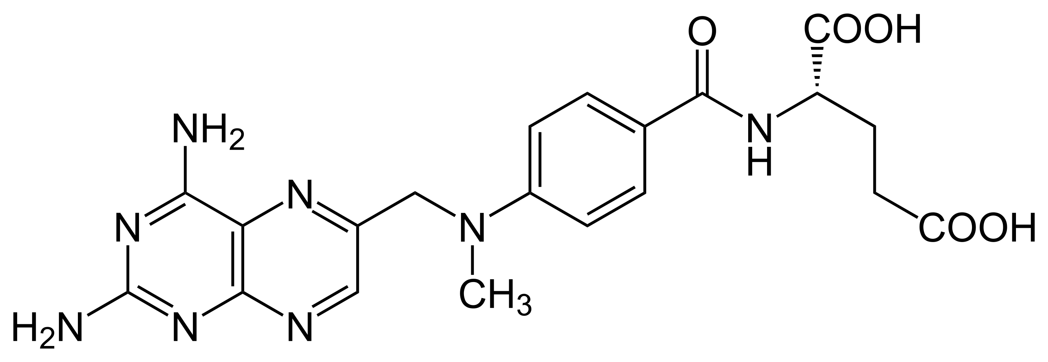
IMMUNODEFICIENCY CAUSED BY DRUGS
METHOTREXATE
Structural analogue of folic acid
Blocks folic acid dependent-synthetic pathways essential for DNA synthesis
Prolonged use for treatment reduces immunoglobulin synthesis

Slide 36
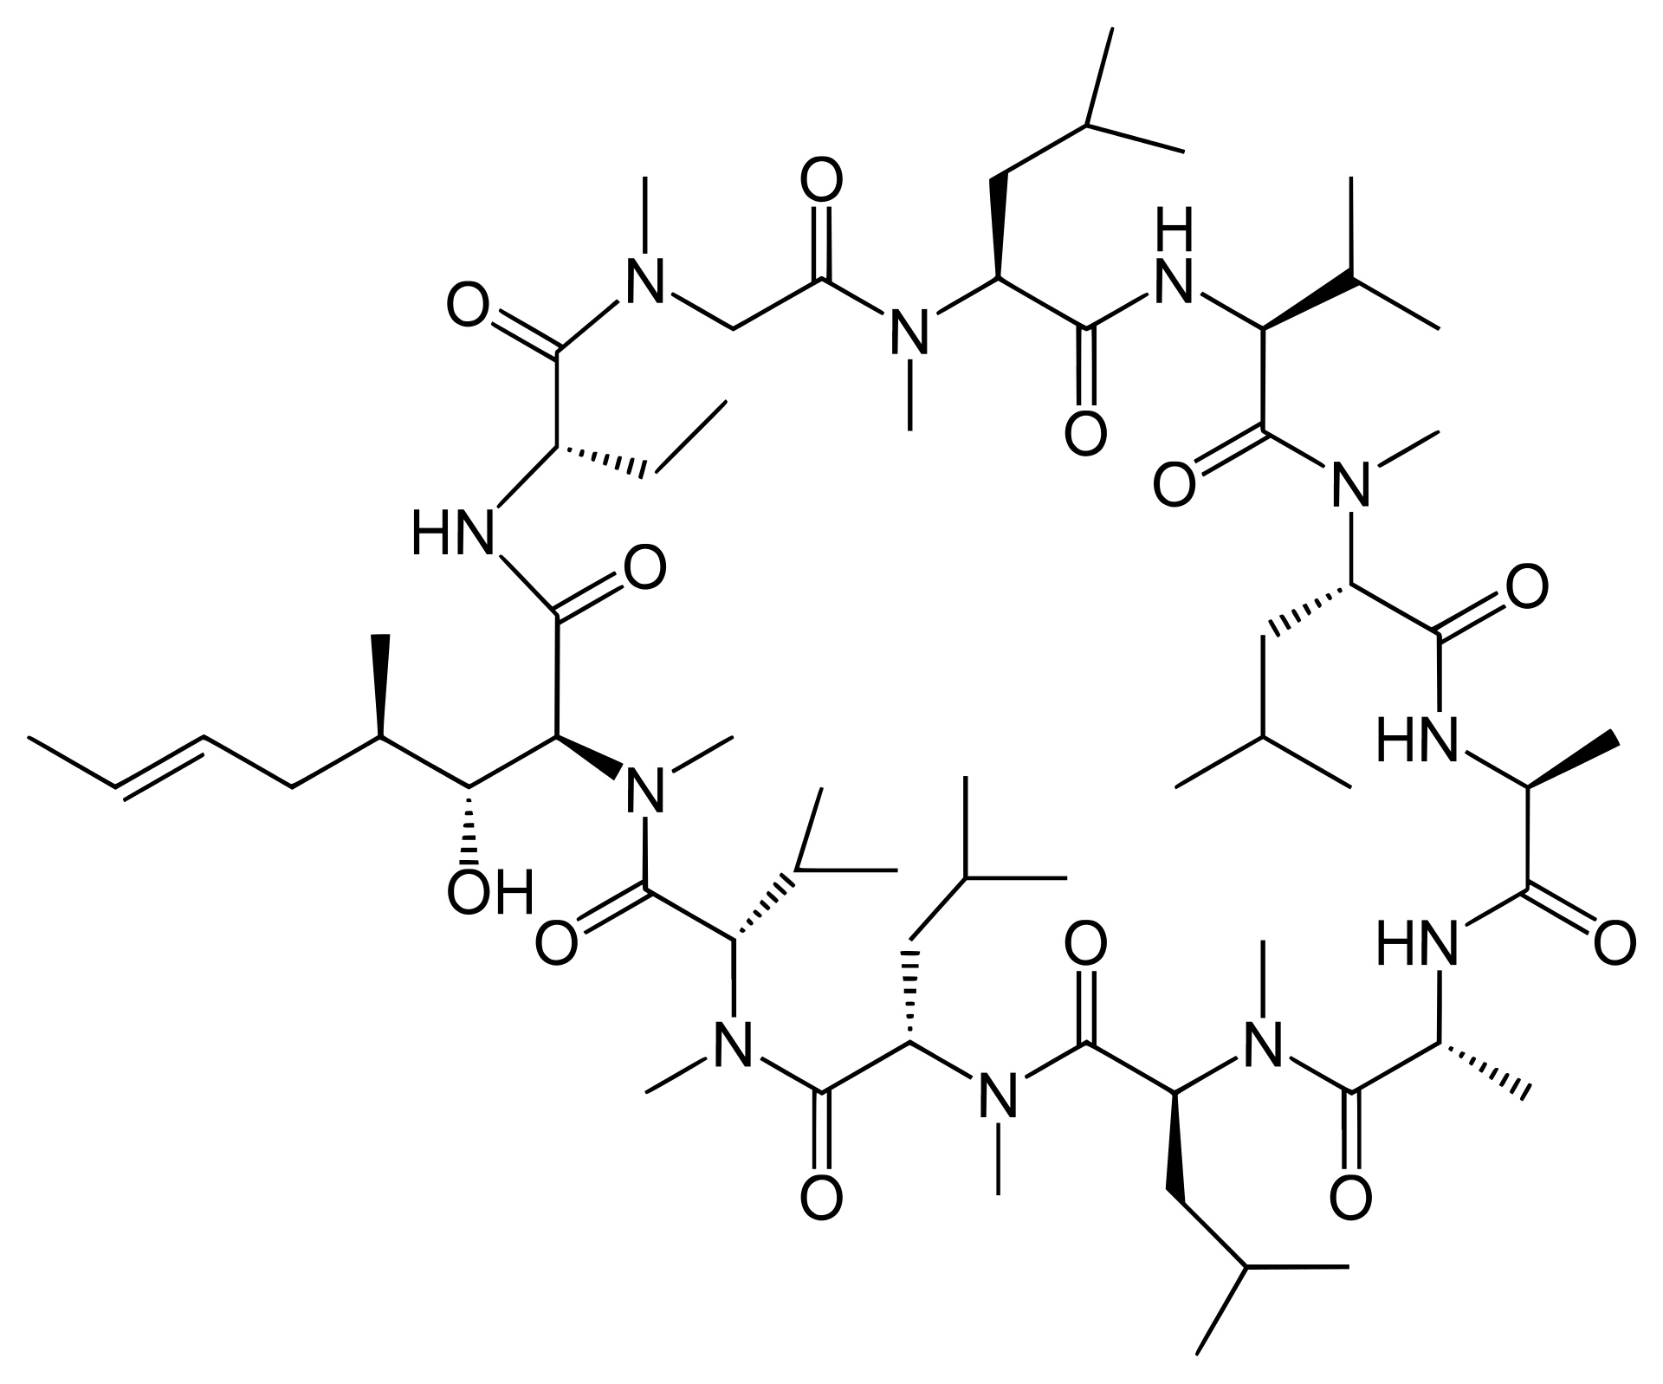
IMMUNODEFICIENCY CAUSED BY DRUGS
CYCOLOSPORIN
Inhibit IL 2 dependent signal transduction blocking calcineurin
Have severe effects on T cell signaling and functions

Slide 37
Acquired Immunodeficiencies
Secondary immune deficiencies that are the consequences of other diseases
Viral Infections
Chemotherapeutic agents
Malnutrition
Untreated autoimmunity
Overwhelming bacterial infection

Slide 38
Take Home Message
Immunodeficiency may be congenital or acquired
It can involve any component of the immune system such as cells, antibodies, complement etc.
Most common presentation of immunodeficiency is recurrent infections that may be fatal due to delay in diagnosis and lack of appropriate therapy

Slide 39
Animal models in Immunology
Immunedeficency studies (genetic, acquired, temporary o induced) and its consequences
Infective diseases
Autoimmune diseases
Cancer

Slide 40
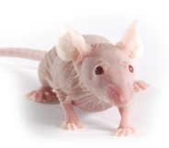
Nude mice
Topi Nudi: mutazione autosomica recessiva del locus nu sul cromosama 11.
Porta ad aplasia timica (detti topi atimici), perdita di pelo (topi nudi).
Mancanza di cellule T attive ma presenza di normali cellule B, NK, macrofagi, granulociti e complemento.

Slide 41
SCID mice
SCID: Severe combined immunodeficiency
Topi SCID: Ceppo di topi derivante dai C57/Bl privi totalmente di linfociti B e T per blocco precoce della maturazione linfocitaria dai precursori midollari. Tali topi presentano una mutazione a carico di un componente di un enzima (protein kinasi DNA-dipendente) necessario per la riparazione delle rotture del DNA a doppia elica. Il deficit enzimatico comporta alterazioni nelle giunzioni dei segmenti genici del TCR e delle Ig nel corso della ricombinazione dei geni dei recettori antigenici; ne consegue impossibilità di proseguire la maturazione da parte dei linfociti T e B per la mancata espressione di TCR e BCR.
Rimane “immutata” l’immunità innata.

Slide 42
NOD mice
NOD: Diabetici non obesi. Topi mostrano una suscettibilità allo sviluppo della forma spontanea autoimmune di diabete mellito insulino-dipendente (IDDM).
Topi NOD: Topi NOD possiedono polimorfismi nel locus Idd3 che è collegato a IL-2. IL-2 promuove o l'immunità o la tolleranza in un modo dipendente dalla concentrazione, agendo sulle cellule helper T, cellule NK e CTL. Basse quantità di IL-2 sono necessari per promuovere la sopravvivenza dei Treg nei topi. Perdita di IL-2 può quindi contribuire allo sviluppo di autoimmunità nei topi NOD.
Incrociati per ottenere topi NOD-SCID

Slide 43
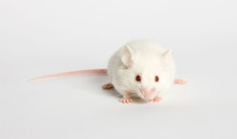
NSG mice
NSG: NOD SCID Gamma
Topi NSG:
The NOD.Cg-Prkdcscid Il2rgtm1Wjl/SzJ mice, commonly known as NOD SCID Gamma (NSG), are severely immunocompromised, featuring absence of mature T or B cells, lack of functional NK cells and deficiency in cytokine signaling. The strain combines the features of the NOD/ShiLtJ background, the severe combined immune deficiency mutation (scid, which is caused by a spontaneous mutation in the Prkdc gene), and IL2 receptor gamma chain deficiency. Defect in C5 was also described.
As a result, engraftment of human hematopoietic stem cells and peripheral-blood mononuclear cells in the NSG mice is greater than that in any other mouse strain.

Slide 44
Applications of immune-deficient mice
1. human tissue implantation

Slide 45
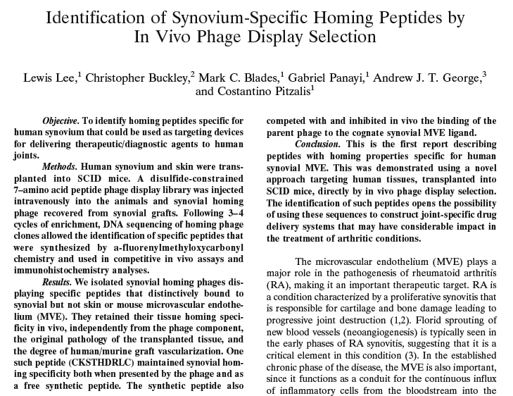

Slide 46
Applications of immune-deficient mice
2. implantation of non-murine cells in mice
transplantation of human hematopoietic stem cells
human cancer models in mice

