Slide 1
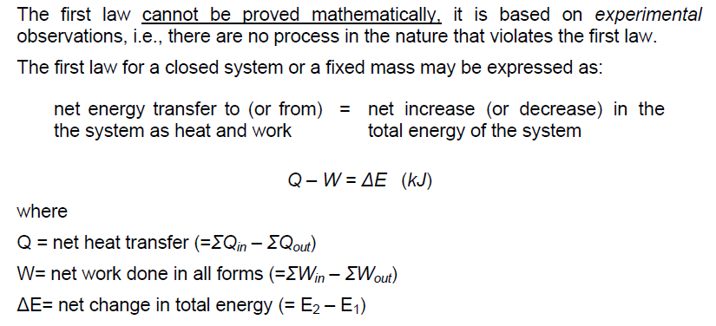
The First Law of Thermodynamics
(= Σ W_{out} – Σ W_{in})

Slide 2
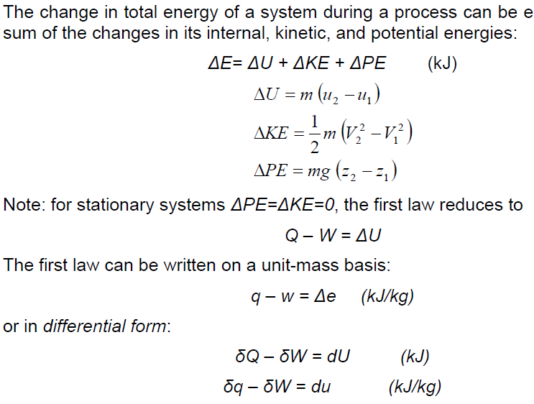
The First Law of Thermodynamics

Slide 3
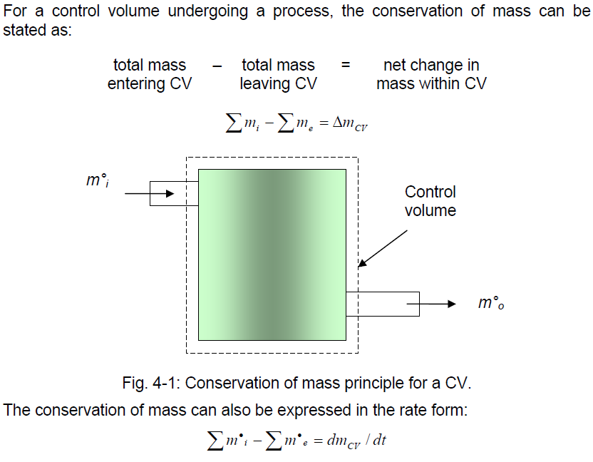

Slide 4
Energy Balance

Slide 5
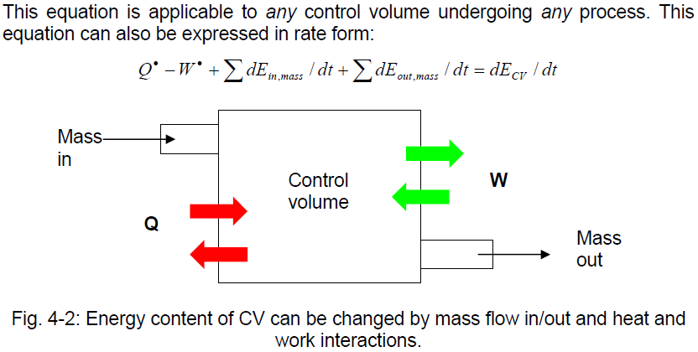

Slide 6
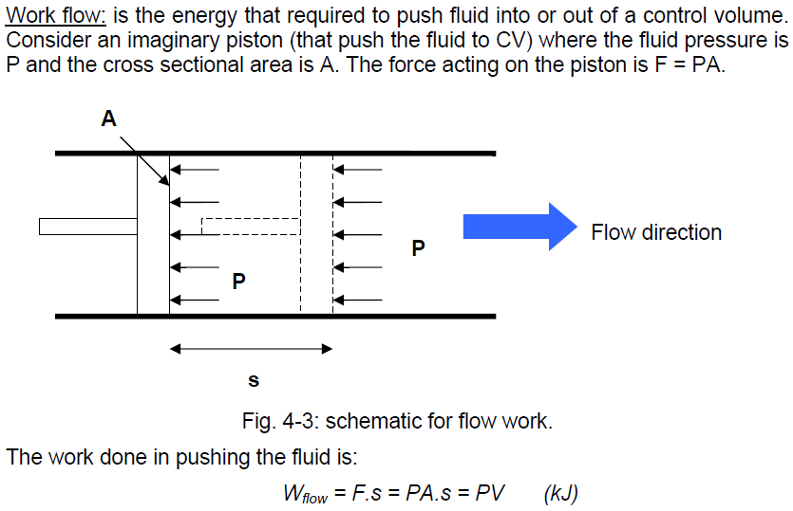
Pushing the fluid in the CV

Slide 7
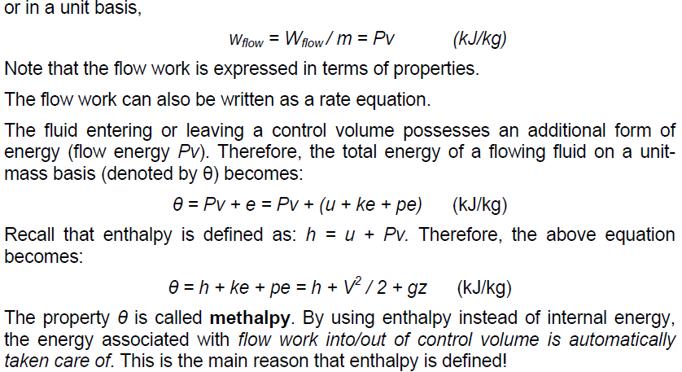
Pushing the fluid in the CV

Slide 8
Steady state flow process

Slide 9
Adiabatic process of a single stream
= g
= g (u/g +P/ρg); Δh_{f} + Δh_{m} = Δu/g
Enery (Bernoulli group) entering the contrlol volume / at the beginnig of the process.
Enery supplied to the control volume (to the fluid) by a Pump.
Enery (Bernoulli group) exiting the contrlol volume / at the end of the process.
(mechanical) Energy converted into internal one by friction and «minor» causes.

