Slide 1


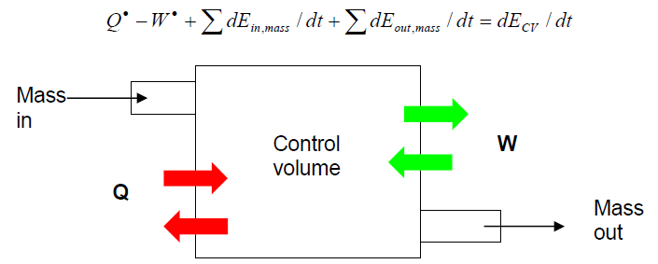
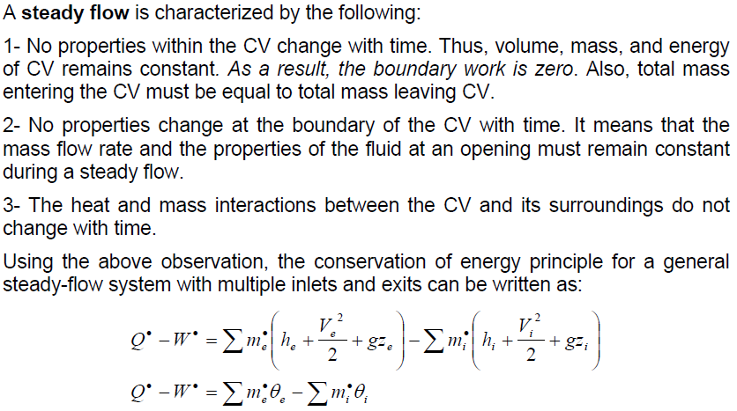
Losses in Pipes
A quick review of piping losses, starting with energy conservation - Bernoulli's Equation
+
+
Steady state conditions & ADIABATIC control volume

Slide 2
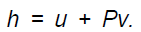

Adiabatic process of a single stream
= g (u/g +P/ρg); Δh_{f} + Δh_{m} = Δu/g
= g

Slide 3
Adiabatic process of a single stream
= g (u/g +P/ρg); Δh_{f} + Δh_{m} = Δu/g
= g
Enery (Bernoulli group) entering the contrlol volume / at the beginnig of the process.
Enery supplied to the control volume (to the fluid) by a Pump.
Enery (Bernoulli group) exiting the contrlol volume / at the end of the process.
(mechanical) Energy converted into internal one by friction and «minor» causes.

Slide 4
Friction Losses in Pipes
The basic approach to all piping systems is to write the Bernoulli equation between two points, connected by a streamline, where the conditions are known.
For example, between the surface of a reservoir and a point in the pipe, or the pipe outlet.
The total head at point 0 must match with the total head at point 1, adjusted for any increase in head due to pumps, losses due to pipe friction and so-called "minor losses" due to entries, exits, fittings, etc. Pump head developed is generally a function of the flow through the system, with head rise decreasing with increasing flow through the pump.

Slide 5



Friction Losses in Pipes
Friction losses are a complex function of the system geometry, the fluid properties and the flow rate in the system. By observation, the head loss is roughly proportional to the square of the flow rate in most engineering flows (fully developed, turbulent pipe flow). This observation leads to the Darcy-Weisbach equation for head loss due to friction:
which defines the friction factor, f. It is insensitive to moderate changes in the flow and is constant for fully turbulent flow. Thus, it is often useful to estimate the relationship as the head being directly proportional to the square of the flow rate to simplify calculations.
Reynolds Number is the fundamental dimensionless group in viscous flow.
Relative Roughness relates the height of a typical roughness element to the scale of the flow, represented by the pipe diameter, D.
Pipe Cross-section is important, as deviations from circular cross-section will cause secondary flows that increase the pressure drop. Non-circular pipes and ducts are generally treated by using the «hydraulic diameter» in place of the diameter.

Slide 6

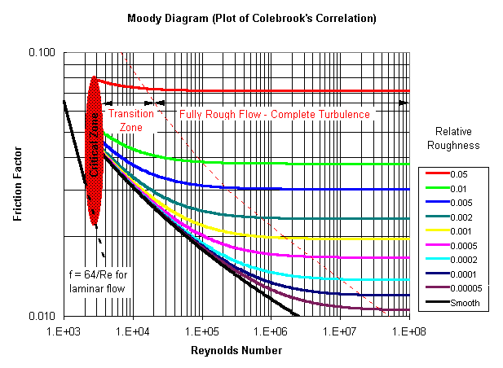
Colebrook correlation & Moody Diagram
Colebrook (1939) found an implicit correlation for the friction factor in round pipes.
The Moody Diagram is a log-log plot of the Colebrook correlation on axes of friction factor and Reynolds number, combined with the f=64/Re result from laminar flow.

Slide 7

Minor Losses
The minor losses are any head loss present in addition to the head loss for the same length of straight pipe.
Although they often account for a major portion of the head loss, especially in process piping, the additional losses due to entries and exits, fittings and valves are traditionally referred to as minor losses.
These losses represent additional energy dissipation in the flow, usually caused by secondary flows induced by curvature or recirculation.
Like pipe friction, these losses are roughly proportional to the square of the flow rate. The proportionality is closer to reality if the effect of the Reynolds number can be neglected and the effect of the Relative Roughness can be regarded as constant, for the specific kind of component.
The loss coefficient, K, is defined consistently with the previous friction losses relation:
K varies also with proximity to other fittings. In fact, tabulated values of K are for components in isolation - with long straight runs of pipe upstream and downstream.

Slide 8
Minor Losses
The head loss when water from a pipe enters a tank is KL=1 irrespective of the geometry. The fluid from the pipe mixes with the fluid and its kinetic energy is dissipated through viscous effects as the fluid eventually comes to rest.

Slide 9
Minor Losses
About 50% of the energy is lost when the fluid enters a pipe with a square edged entrance. Rounding the entrance corner will reduce the loss coefficient.
If the pipe protrudes into the tank the loss coefficient will be even larger.
The pressure drop associated with increase in fluid speed not entirely recovered by kinetic energy. Most of energy loss is due to shear stress within fluid.

Slide 10
Minor Losses
r/D
The loss factor is generally larger for curved pipes than for straight pipes. The diagram shows loss factor for large Re . This loss factor is additional to
that of the equivalent straight line length of the pipe.

Slide 11
Pipe flow scenarios
The real world pipe flow design scenarios are divided into 3 types, I, II and III.
I - We know the fluid, pipe size and desired flow rate. We need to determine the pressure drop or head loss. In effect we want to know how large a pump needs to be installed.
II - We know the fluid, pipe size and head loss. We want to determine the flow rate.
III - We know the fluid, flow rate and head loss. We want to determine pipe size.
Type II and III scenarios are generally regarded as more complicated to solve since they involve a non-linear equation. They need to adjust v and there is complicated dependence between f and v.
Notice that, if the flow is fully turbulent, the friction factor does not depend on the Reynolds number (on v), so that elementary calculations become easier.

