Slide 1


Cogeneration and trigeneration:
STEADY-STATE MODELING OF INDUSTRIAL ENERGY SYSTEMS
prof. Mauro REINI
docente di sistemi per l’energia e l’ambiente
Università di Trieste – Polo di Pordenone

Slide 2
Nozzles
A nozzle is a tube of varying cross-section area (usually axisymmetric) aiming at increasing the speed of an outflow, and controlling its direction and shape.
Nozzle flow always generates forces associated to the change in flow momentum.

Slide 3
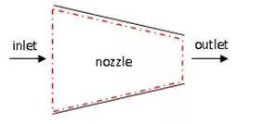
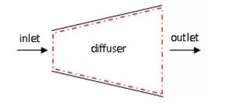
Difference between nozzle and diffuser
A nozzle increases the velocity of a fluid, while a diffuser decreases the velocity of a fluid. Nozzles can be used by jets and rockets to provide extra thrust.
At the same time, many jet engines use diffusers to slow air coming into the engine for a more uniform flow.

Slide 4
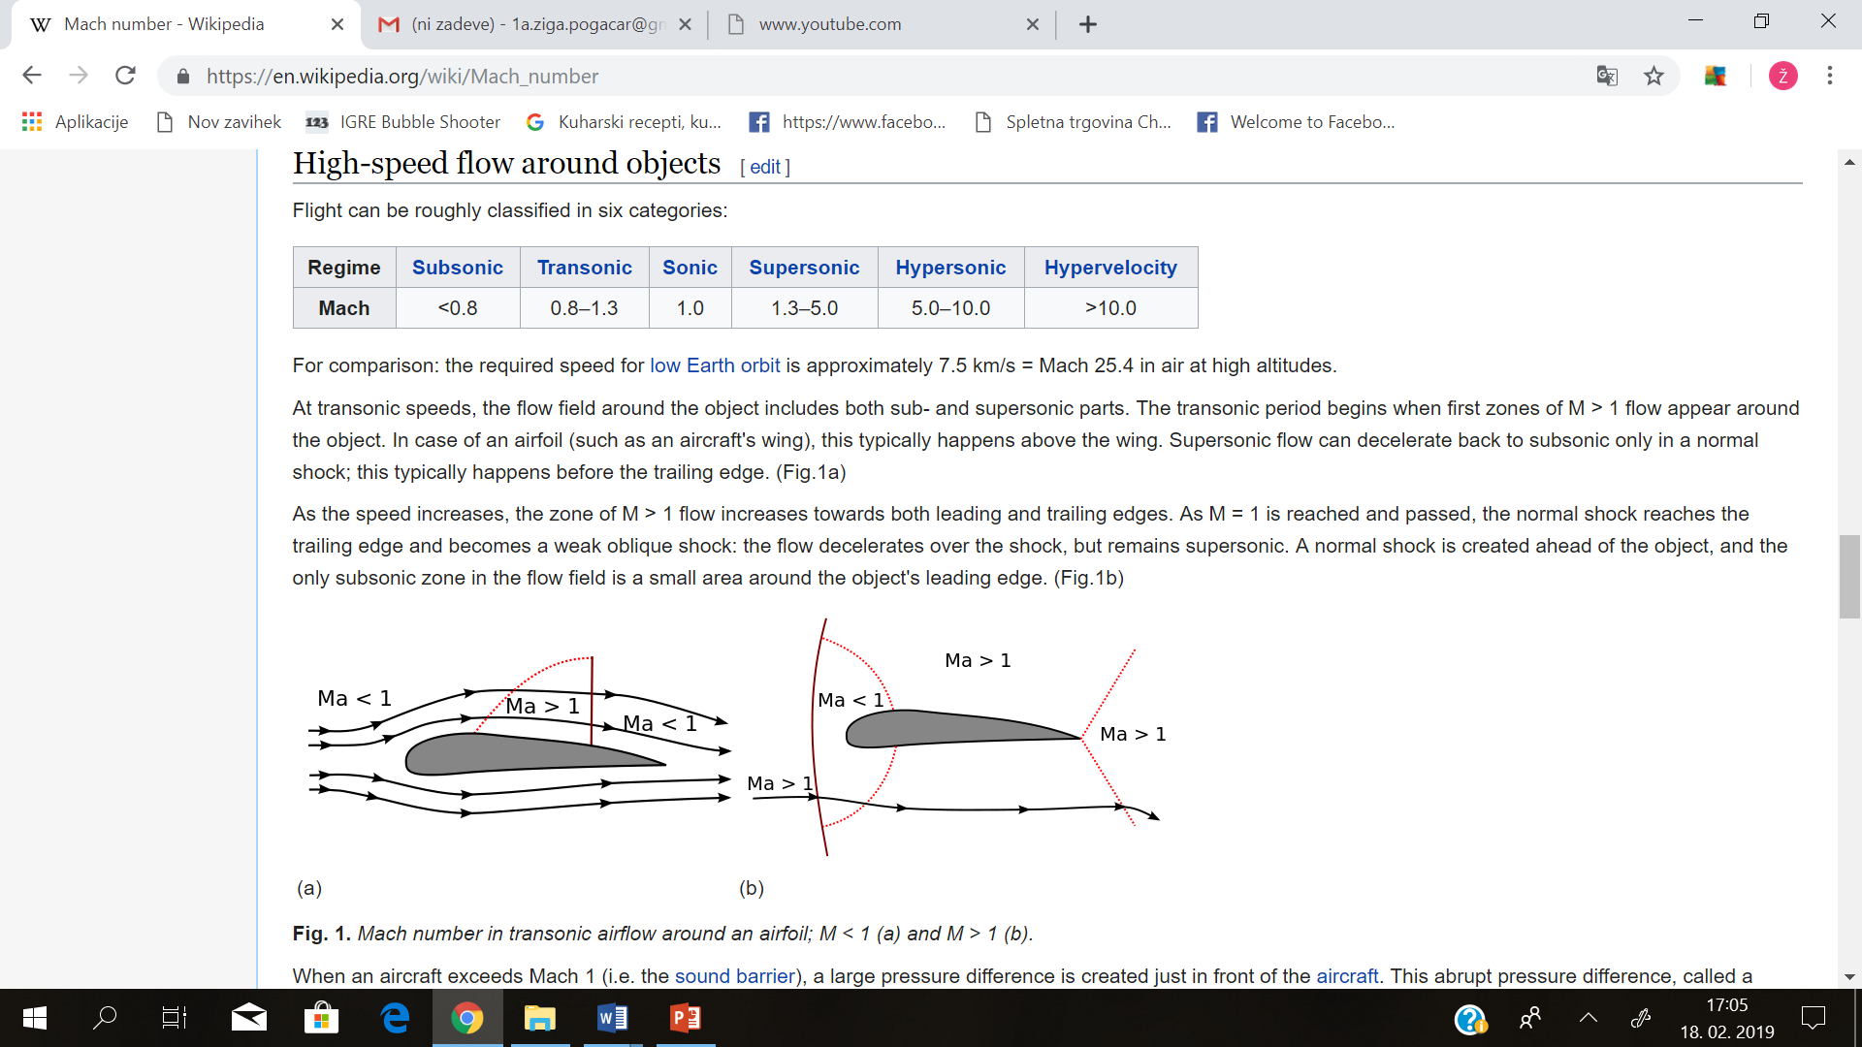
Mach number
Mach number is a ratio between local flow velocity and speed of the sound in a particular medium. It tells us how the flow looks like
From 0-0.3 we can regard the regime as imcompresible liquid, which means the density of the liquid is constant.
Subsonic flow is quite parallel and dont have many disturbances.
Transsonic has different zones, some with subsonic and some with supersonic flow.
Supersonic flow has presence of shockwaves, which make to change flow discountiniously.
Jets operate at 2 flow regimes. Either subsonic or supersonic.

Slide 5
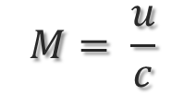
Mach number
In fluid dynamics, the mach number (M) is a dimensionless quantity representing the ratio of flow velocity past a boundary to the local speed of sound.
M is the Mach number
u is the local flow velocity with respect to the boundaries (either internal, such as an object immersed in the flow, or external, like a channel)
c is the speed of sound in the medium.
$$M= \frac{u}{c}$$

Slide 6
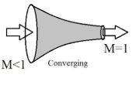
Types of nozzles
Converging nozzle
In a converging nozzle, cross-section area smoothly decreases from a larger value to a smaller value.

Slide 7

Types of nozzles
Diverging nozzle
Diverging nozzles spread the fluid stream as it leaves the nozzle. Cross-sectional area at the discharge orifice is increased to cause the flow rate to decelerate into a wide, low velocity spray.

Slide 8
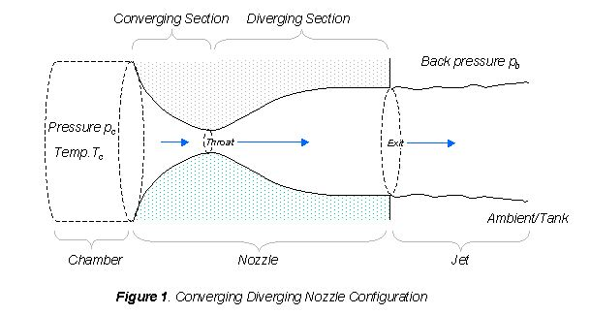
Types of nozzles
Converging diverging nozzle
A converging-diverging nozzle must have a smooth area law, with a smooth throat, for the flow to remain attached to the walls. The flow starts from rest and accelerates sub sonically to a maximum speed at the throat, where it may arrive at M<1 or M=1, as for converging nozzls and then enters the diverging nozzle zone.

Slide 9
Types of flows
If the Mach number is small (less than about 0.3), compressibility effects are unimportant. For 0.3 < Ma < 1.0, the flow is still subsonic (meaning velocity V is lower than the speed of sound) but compressibility effects are important.
At Ma = 1.0, the flow is called sonic, since V = a. At Mach numbers greater than 1.0, the flow is called supersonic, since the velocity is greater than the speed of sound. Bullets fired from a gun travel at supersonic speeds, as do certain jet aircraft.
When Mach number becomes very large (greater than about 3.0), the flow is called hypersonic.

Slide 10
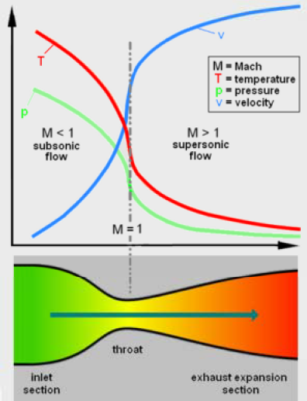
The flow pattern
Temperature and pressure drop as Mach number of exhaust gasses increases
Higher Mach number of exhaust gasses means greater thrust

Slide 11
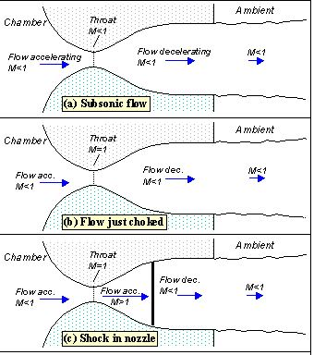
The flow pattern

Slide 12
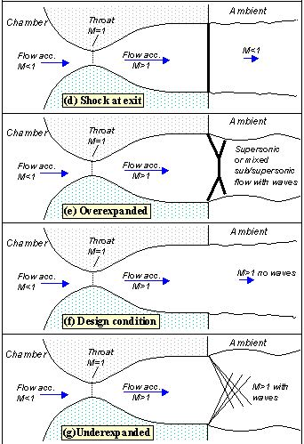
The flow pattern

Slide 13
Real nozzle flow departs from ideal isentropic flow
There are three aspects with which the real nozzle flow departs from the isentropic flow:
Non-adiabatic effects
There is viscous dissipation within the boundary layer, and erosion of the walls, what can be critical if the erosion widens the throat cross-section, greatly reducing exit-area ratio and consequently thrust.
There is viscous dissipation within the boundary layer, and erosion of the walls, what can be critical if the erosion widens the throat cross-section, greatly reducing exit-area ratio and consequently thrust.

Slide 14
Choked flow
Choking is a compressible flow effect that obstructs the flow, setting a limit to fluid mass flow rate because the flow becomes supersonic and perturbations cannot move upstream; in gas flow, choking takes place when a subsonic flow reaches M=1, whereas in liquid flow, choking takes place when an almost incompressible flow reaches the vapour pressure and bubbles appear, with the flow suddenly jumping to M>1.

Slide 15
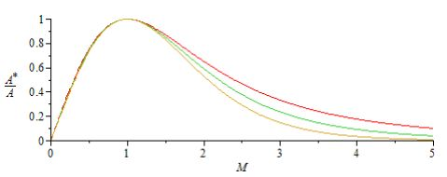
Area ratio of nozzle
Nozzle area ratio ε (or nozzle expansion ratio) is defined as nozzle exit area divided by throat area, ε≡ A*/A, in converging-diverging nozzles, or divided by entry area in converging nozzles. The graph shows the relation between area ratio and mach number.

Slide 16

Nozzle efficiency
Obviously nozzles are not perfectly efficient and there are several ways to define the nozzle efficiency. One of the effective way is to define the efficiency as the ratio of the energy converted to kinetic energy and the total potential energy could be converted to kinetic energy. The total energy that can be converted is during isentropic process is

Slide 17



Nozzle efficiency
where $h_{exits}$is the enthalpy if the flow was isentropic. The actual energy that was used is
The efficiency can be defined as

