Slide 1
CLASSIFICATION OF FLUID MACHINERY

Slide 2
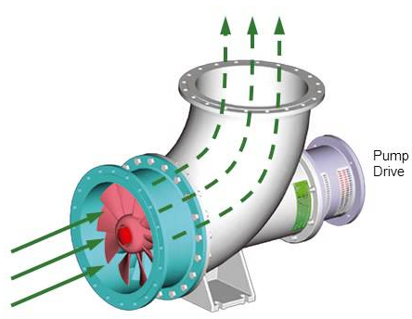
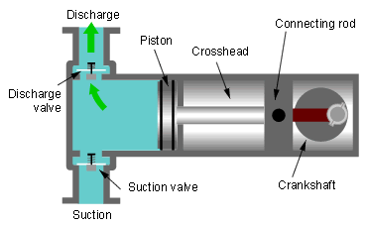
“Fluid machinery” is an umbrella term used to describe all machines that convert energy with the help of a fluid.
For the purpose of classification, fluid energy machines can be divided into groups of machines. There are two basic criteria:
we distinguish between driven machines and driving machines based on the energy flow and the direction of energy transfer. Driving machines are also known as prime movers.
2. turbomachines differ from positive displacement (volumetric) machines in their mode of operation and pressurization.

Slide 3
Moreover, the following differentiations are made:
• depending on the physical properties of the fluid: compressible, incompressible
• depending on the mode of operation: rotating or oscillating (with a displacer moving in an alternate way), normal suction or self-priming, single-stage, multi-stage…
• depending on the direction of flow of the fluid: radial, axial, diagonal (mixed)…
• depending on the design: reciprocating engine, membrane, gear…
• depending on use: supply, drainage, circulation, site of operation…
• depending on the source of energy: thermal power, hydroelectric power, wind energy, electrical energy

Slide 4
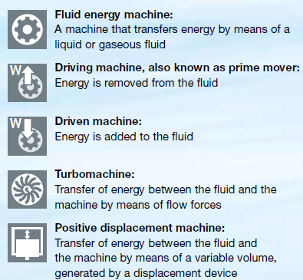
A fluid energy machine can belong to several groups.
The decision about which group the fluid energy machine is assigned to depends on the perspective of the observer.
If the focus is, on the working medium, the categorization is made by differentiating between hydraulic fluid energy machines with incompressible fluids and thermal fluid machinery with compressible fluids.

Slide 5
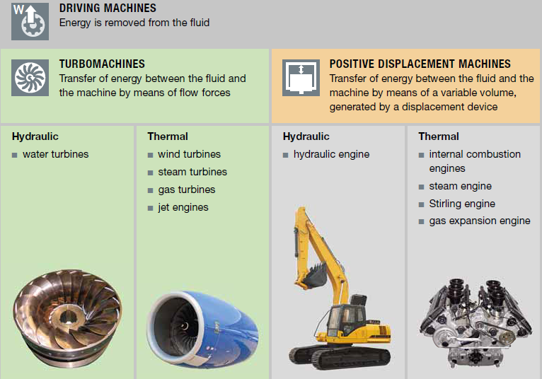

Slide 6
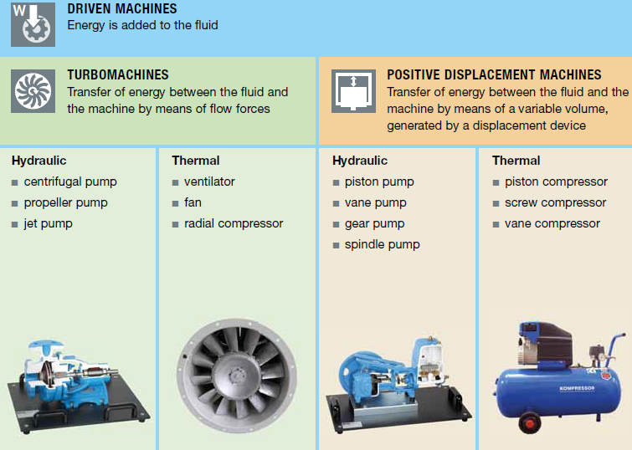

Slide 7
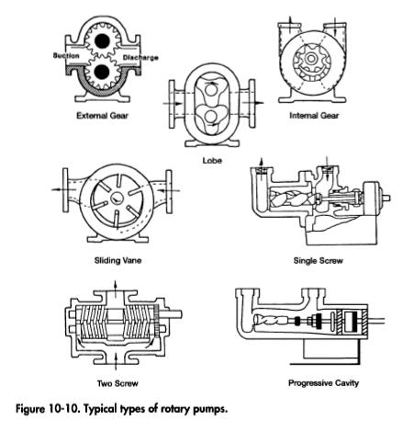

Slide 8
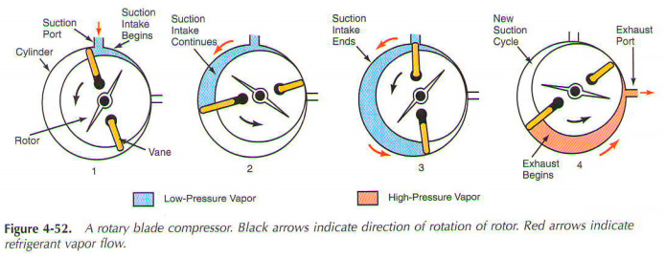
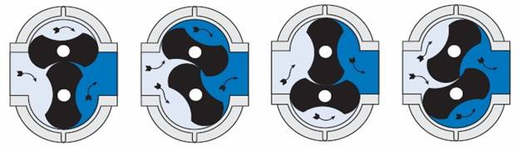

Slide 9
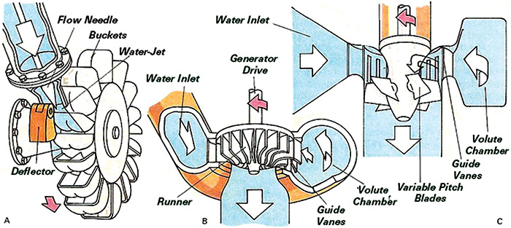
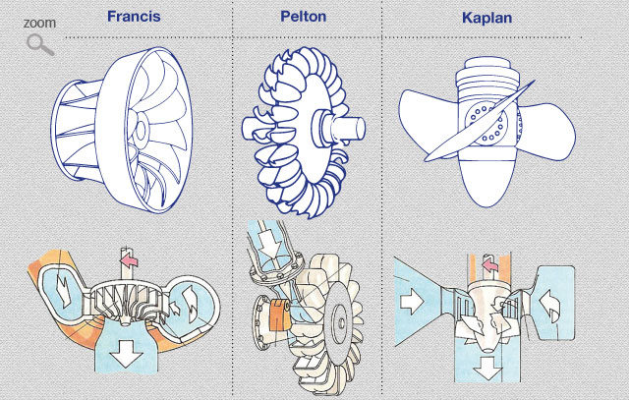

Slide 10
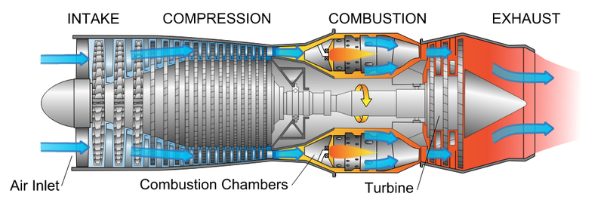
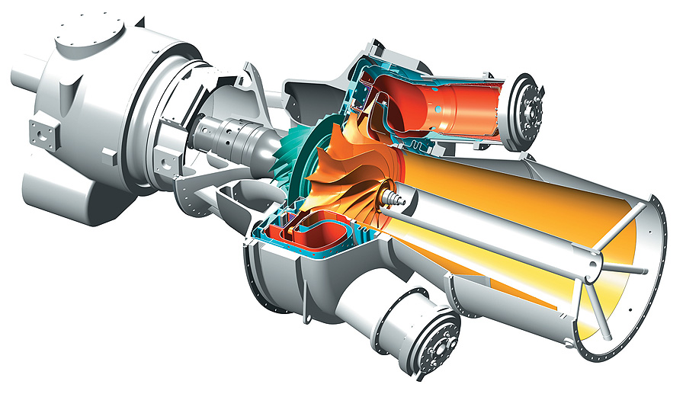

Slide 11
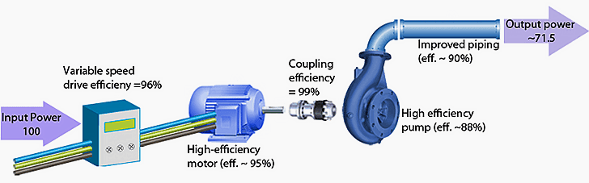

Slide 13
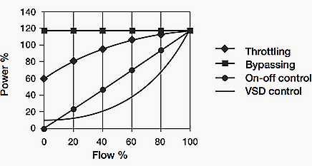
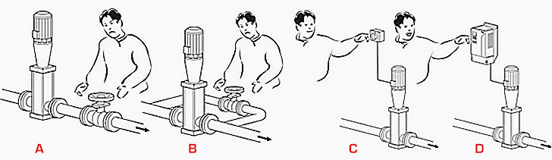
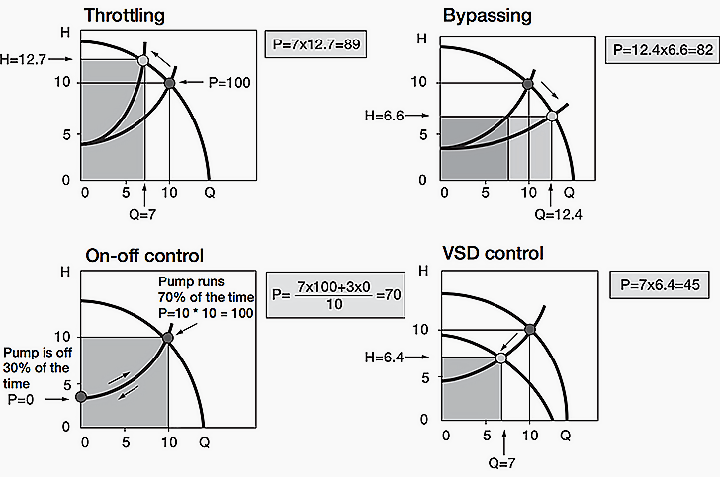
A
B
C
D
Dissipated in the bypass
Required by the circuit
is the flow rate in the pump related to
reduced head required by the crcuit

