Slide 1
Heat Exchangers- HEX
Shell & Tube
Plate type
Double Pipe
Compact heat exchangers

Slide 2
Heat Exchanger is ……
A device that is used to transfer thermal energy (enthalpy) between two or more fluids, between a solid surface and a fluid, or between solid particulates and a fluid,
at different temperatures
and in thermal contact.

Slide 3
HEAT EXCHANGERS FUNCTIONS
Heating / Cooling / Evaporation
Cooling of lubricants
Heating of boiler feed water
Condensing steam for re-use
Pasteurization
Sterilization
Preheating

Slide 4

Classification on the basis of
Direction of Flow
HEAT EXCHANGERS
COUNTERFLOW
PARALLEL FLOW
CROSS FLOW
HYBRID FLOW

Slide 5
CLASSIFICATION
On the basis of Fluid Type:
Gas to Gas
Gas to Liquid (evaporator, condenser)
Liquid to liquid
On the basis of Flow Pattern:
Single Pass
Multi Pass
On the basis of Shape & Geometry:
Shell & Tube
Double Pipe
Plate type

Slide 6
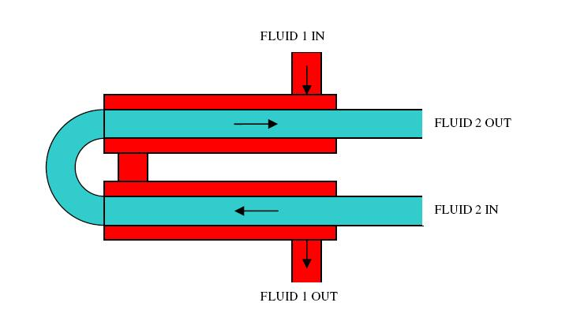
Double Pipe Heat Exchanger
It is also known as concentric tube heat exchanger
In this heat exchanger the fluid to be cooled or heated passes through the tube 2(green) and the other fluid is passed through tube 1 (red)to absorb or release the heat.
Advantages: Cheap for both design and maintenance.
Disadvantages: Low efficiency (if the T of the fluids is much higher than T°) high cost per surface unit, and large space required.

Slide 7
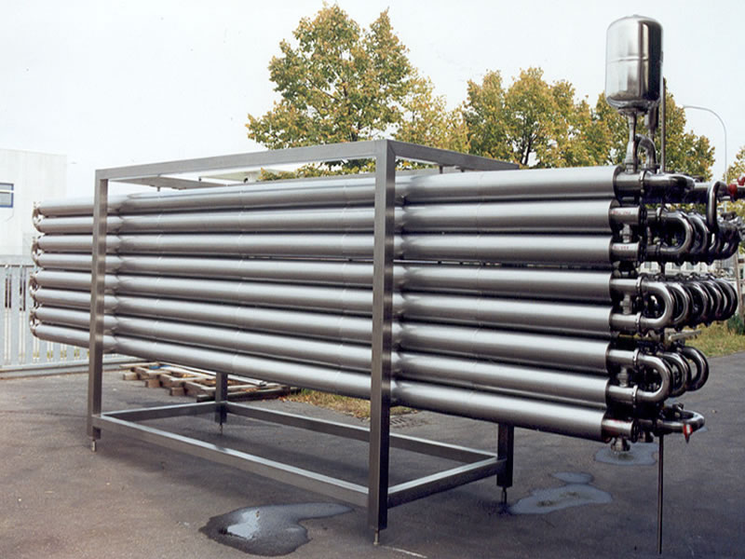
Double Pipe Heat Exchanger

Slide 8
Double Pipe HEX as a reference case
(parallel current)
Thermal isolation
Therma conduction

Slide 9
Double Pipe HEX as a reference case
(parallel current)

Slide 10
Double Pipe HEX as a reference case
(counter current)

Slide 11
Double Pipe HEX as a reference case
(counter current)

Slide 12
Double Pipe HEX as a reference case
(counter current)

Slide 13
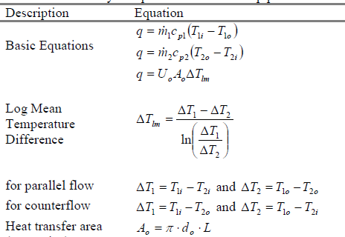
Double Pipe HEX as a reference case
(parallel / counter current)

Slide 14
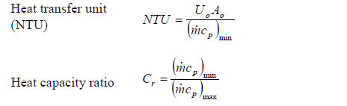
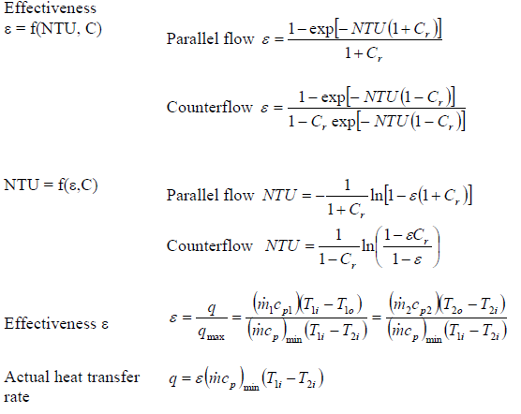
Double Pipe HEX as a reference case

Slide 15
Selection
High/low pressure limits
Thermal performance
Temperature ranges
Product mix (liquid/liquid, particulates or high-solids liquid)
Pressure drops across the exchanger
Fluid flow capacity
Cost
Cleanability, maintenance and repair
Materials required for construction
Ability and ease of future expansion

Slide 16
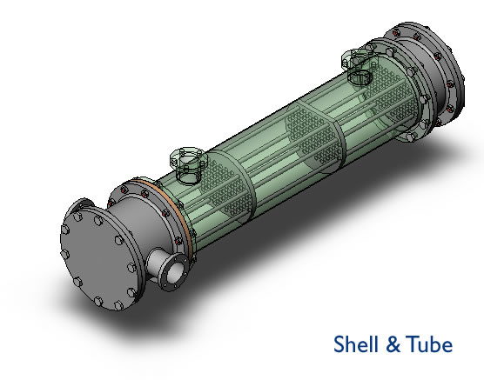
SHELL AND TUBE HEAT EXCHANGER
A Shell and tube heat exchanger is the most common type of heat exchanger used in oil refineries and other large chemical process plants. As its name implies, this type of heat exchanger consists of a shell (a large vessel) with a bundle of tubes inside it.

Slide 17
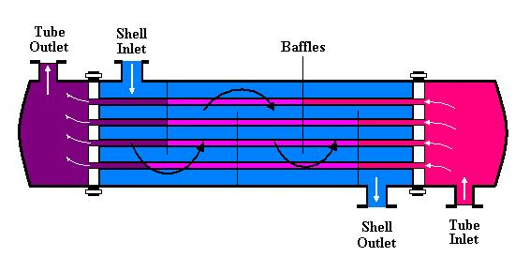
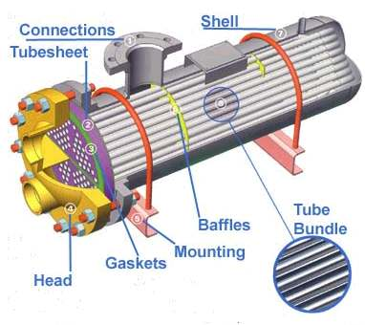
SHELL AND TUBE HEAT EXCHANGER

Slide 18
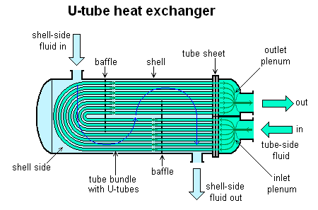
TYPES OF SHELL AND TUBE HEAT EXCHANGER

Slide 19
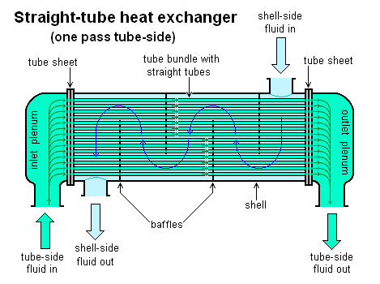
TYPES OF SHELL AND TUBE HEAT EXCHANGER

Slide 20
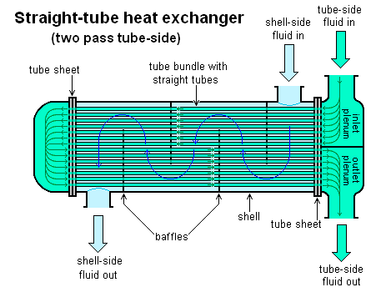
TYPES OF SHELL AND TUBE HEAT EXCHANGER

Slide 21
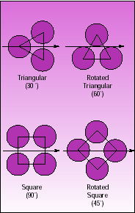
TUBE LAYOUT PATTERNS
TRIANGULAR
  Accommodates more tubes
  Produces high Turbulence
  Limited to Clean Shell side Services
SQUARE
  Where cleaning is required
  It produces low turbulence
  Accommodates low No of tubes

Slide 22
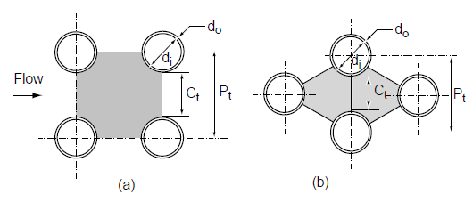


TUBE LAYOUT PATTERNS equivalent diameters
(a) Square-pitch layout, (b) triangular-pitch layout.

Slide 23

HEAT EXCHANGER COMPONENTS
Channel partition plates.
For exchangers with multiple tube passes, the channels are fitted with flat metal plates which divide the head into separate compartments.
Shell baffles. -Use
Shell cross baffles support the tubes at intervals
  Prevent sag and vibration.
  Force the shell side fluid back and forth across the bundle.
Type:Segmental single cut baffles are the most common

Slide 24
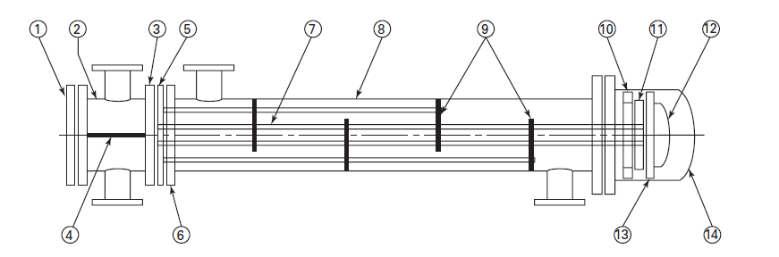
Components
Tube fluid in
Shell fluid out
Tube fluid out
Shell-fluid nozzle
Shell fluid in
1-Channel cover
2-Stationary head channel
3-Channel flange
4-Pass partition plate
5- Tube sheet
6-Shell flange
7-Tube
8-Shell
9-Baffles
10-Floating head backing device
11-Floating tube sheet
12-Floating head
13-Floating head flange
14-Stationary head bonnet
15-Heat exchanger support
16-Shell expansion joint

Slide 25
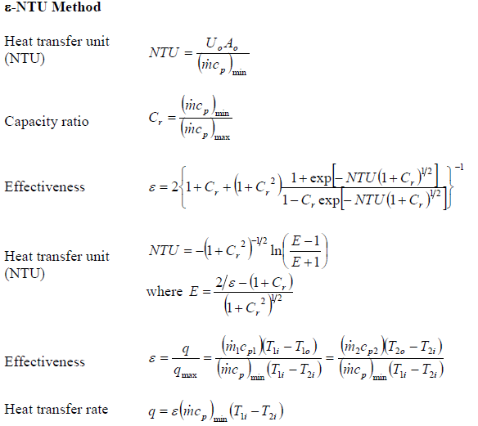
Shell And Tube Heat Exchanger

Slide 26
Shell And Tube Heat Exchanger Application
SHELL AND TUBE HEAT EXCHANGERS are used in all industrial plants to transfer thermal energy between different fluids.
They are distinguished mainly by the technique adopted to counteract the thermal stresses between the bundle of tubes and the shell.
The simplest and cheapest type has a fixed tube sheet.
The tubes may be finned, externally, or even internally (fins parallel to the axial direction of the tubes).
The indicative values of the heat transfer coefficient, relative to the side of each fluid, are obtained with fluid velocities between 10 and 20 m/s for gas or for vapors and between 0.5 and 2 m/s for liquids. The pressure drops corresponding to a good design are between 20 and 60 kPa for single-phase fluids and are about the half in the case of condensing vapors.

Slide 27
Shell And Tube Heat Exchanger Application
Generally the fluids used are both in the liquid state, but evaporating or condensing fluids may be used, usually on the outside of the pipes.
Sometimes one evaporating and the other condensing.
More rarely gaseous fluids are used.
Cooling of hydraulic fluid, or Cooling of engine oils.
Cool or heat swimming pool water or charged air.
Evaporators.
Heating of chemicals.
High pressure fluids inside the tube

Slide 29
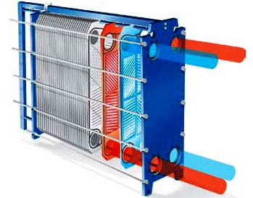
Plate Heat Exchanger

Slide 30
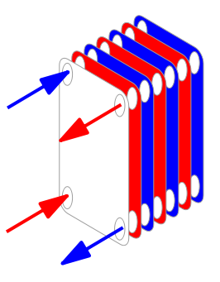
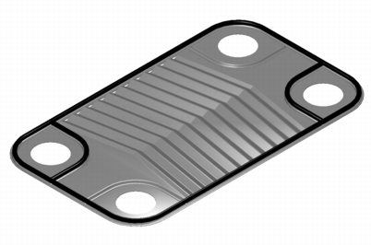
Plate Heat Exchanger
It is composed of multiple, thin, slightly separated plates that have very large surface areas and fluid flow passages for heat transfer.
The plates are often spaced by rubber sealing gaskets which are cemented into a section around the edge of the plates. The plates are pressed to form troughs (“channels”) at right angles to the direction of flow of the liquid which runs through the channels in the heat exchanger. These troughs are arranged so that they interlink with the other plates which forms the channel with gaps of 1.3–1.5 mm between the plates.

Slide 31
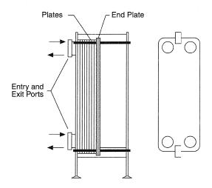
PLATE TYPE HEAT EXCHANGER
Plates with chevron-type corrugation pattern for a plate heat exchanger

Slide 32
FLOWS INSIDE PLATE TYPE HEAT EXCHANGER
The vain among plates, where the fluids flow, can be connected in series, in parallel, or in a mixed arrangement.

Slide 33
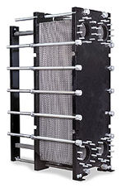
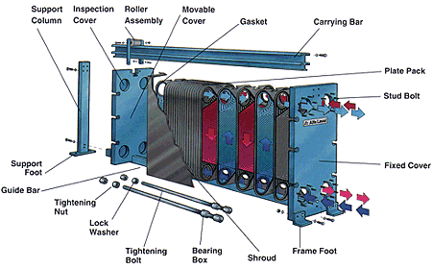
PLATE TYPE HEAT EXCHANGER

Slide 34
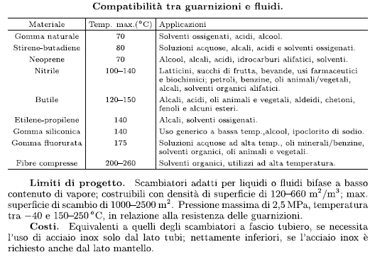
PLATE HEAT EXCHANGERS

Slide 35
COMPARISON OF HEAT EXCHANGERS
PLATE TYPE
Corrugated plates mounted and fasten together.
Used for low temperature and pressure.
Larger surface area per unit volume.
They are modular, can be disassembled and the heat transfer surface can be modified.
Handles non-contaminated fluids.
Cooling media can be any non corrosive fluid.
TUBULAR TYPE
Stainless Steel or Carbon Steel Tubes in side a SS or CS Shell. or other tubular arrangement.
Used for high temperature and pressure.
Low surface area per unit volume.
The heat transfer surface can be only reduced (by closing a sub-set of the tubes).
Suitable for handling contaminated fluids.
Cooling media can be any fluid.

Slide 36
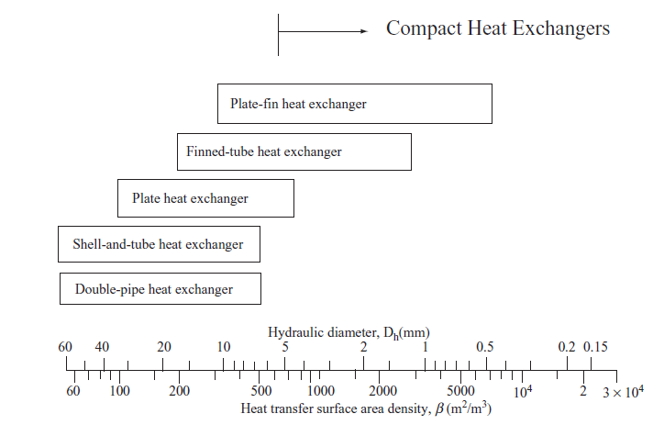
COMPARISON OF HEAT EXCHANGERS

Slide 37
compact heat exchangers

Slide 38
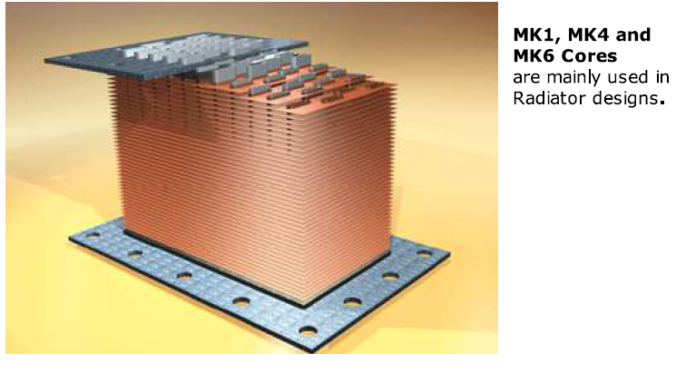
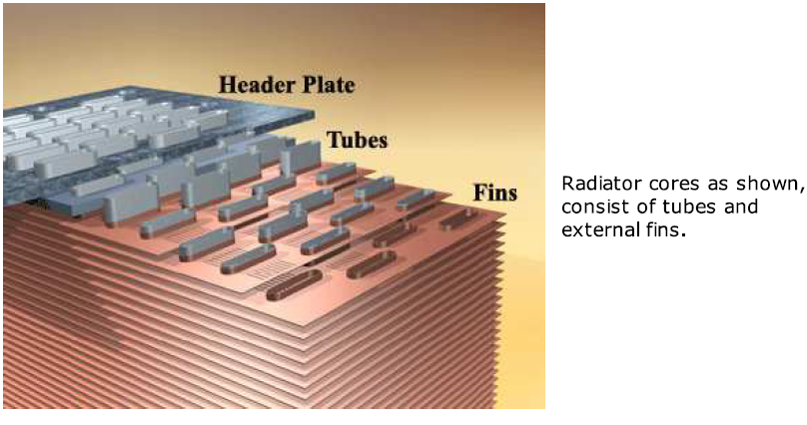
compact heat exchangers

Slide 39
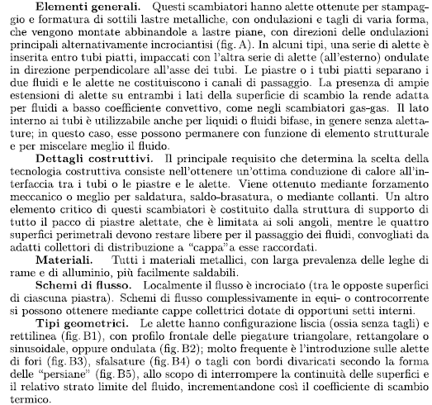
compact heat exchangers

Slide 40
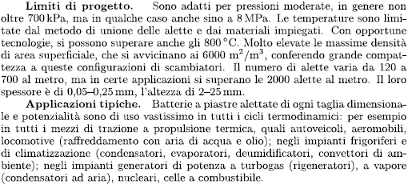
compact heat exchangers

