Slide 1


UNIVERSITÀ DEGLI STUDI DI TRIESTE
DIPARTIMENTO DI INGEGNERIA E ARCHITETTURA
Turbomachinery
Mauro Reini
Based on:
Prime movers, turbomachinery, Euler equation and the Bukingam Theorem
by
By E. Savory - Department of Mechanical and Material Engineering University of Western Ontario
reini@units.it

Slide 2
Definition
Turbomachinery describes machines that transfer energy between a rotor and a fluid, including both turbines and compressors.
A turbine transfers energy from a fluid to a rotor, a compressor transfers energy from a rotor to a fluid.
The two types of machines are governed by the same basic relationships including Newton's second law of motion and Euler's energy equation.
Centrifugal pumps are also turbomachines that transfer energy from a rotor to a fluid, usually a liquid.
Energy is converted from kinetic to potential and vice versa with the ‘aid’ of mechanical energy.

Slide 3
Pump classes and types
Class | Type
Centrifugal (rotating impeller; increases the pressure energy of a fluid) | Volute Diffuser Regenerative turbine Mixed flow Axial flow
Rotary (positive displacement pump; produces the same volume output regardless of pressure) | Gear Vane Cam and piston Screw Lobe
Reciprocating (pistons or plungers displace the fluid) | Direct acting Diaphragm Rotary piston

Slide 4
Examples of positive displacement pumps:
External gear pump
Reciprocating piston
Double screw pump
Sliding vane
Three-lobe pump (left)
Double circumferential piston (centre)
Flexible tube squeegee
(peristaltic)

Slide 5
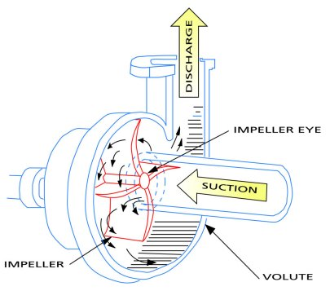
Centrifugal pump cutaway schematic

Slide 6
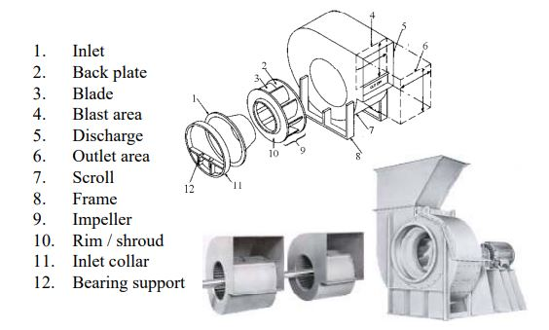
Parts of a Centrifugal Fan / Blower

Slide 7
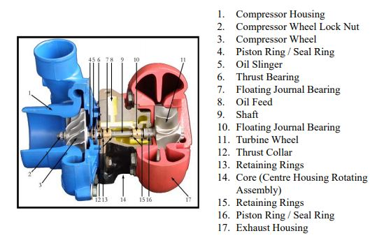
Parts of a Turbocharger

Slide 8
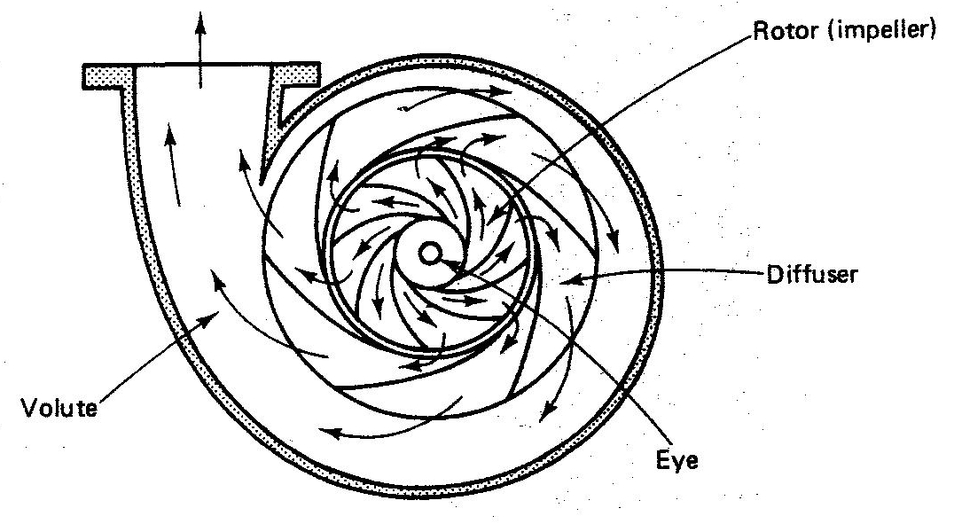
Formulation of the concept
We will focus on the ‘centrifugal pump’. However, the principles are the same for compressors and turbines with a geometry change and appropriate boundary conditions.
The dominant direction of the flow during the energy transfer process is radial.
Rotor (impeller) – rotating element where the energy transfer process occurs.
Diffuser – stationary element which is responsible for the transformation of the velocity head into static pressure.
Velocity head - V²/2g
Centrifugal pump
with volute and diffuser

Slide 9
Energy transfer mechanism
The energy transfer mechanism results from the change in angular momentum of the fluid:
The torque on the shaft is:
Where V_{u} denotes the component of the vector V in the direction of U, the tangential wheel speed (at a given U=rω), assuming steady-state frictionless flow.
Further assumptions of uniform flow at the inlet and outlet and an ‘effective’ mean radius, give:

Slide 10
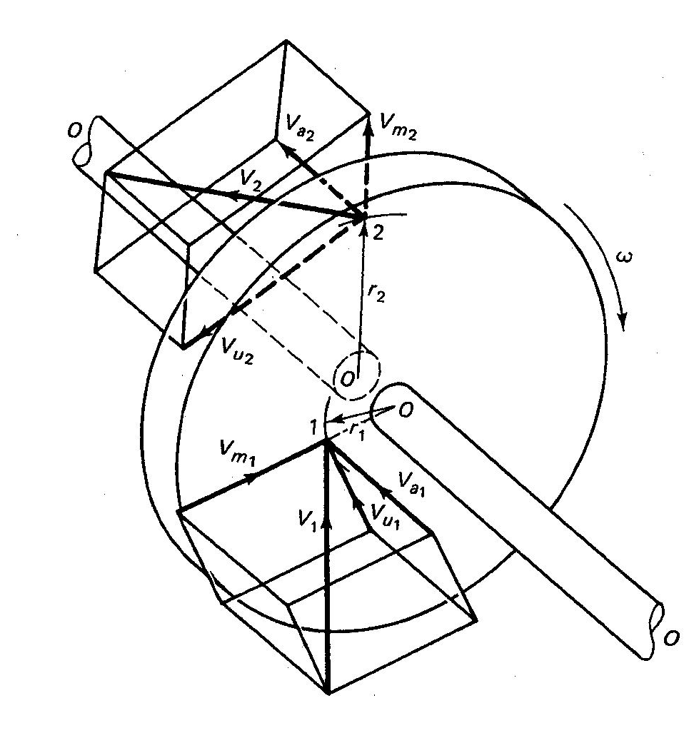
Power becomes:
The increase in Head is
(Euler pump equation):
U₂V_{u2} > U₁V_{u1} – the device functions as a compressor
U₂V_{u2} < U₁V_{u1} – energy is extracted from the flow and the device function as a turbine

Slide 11
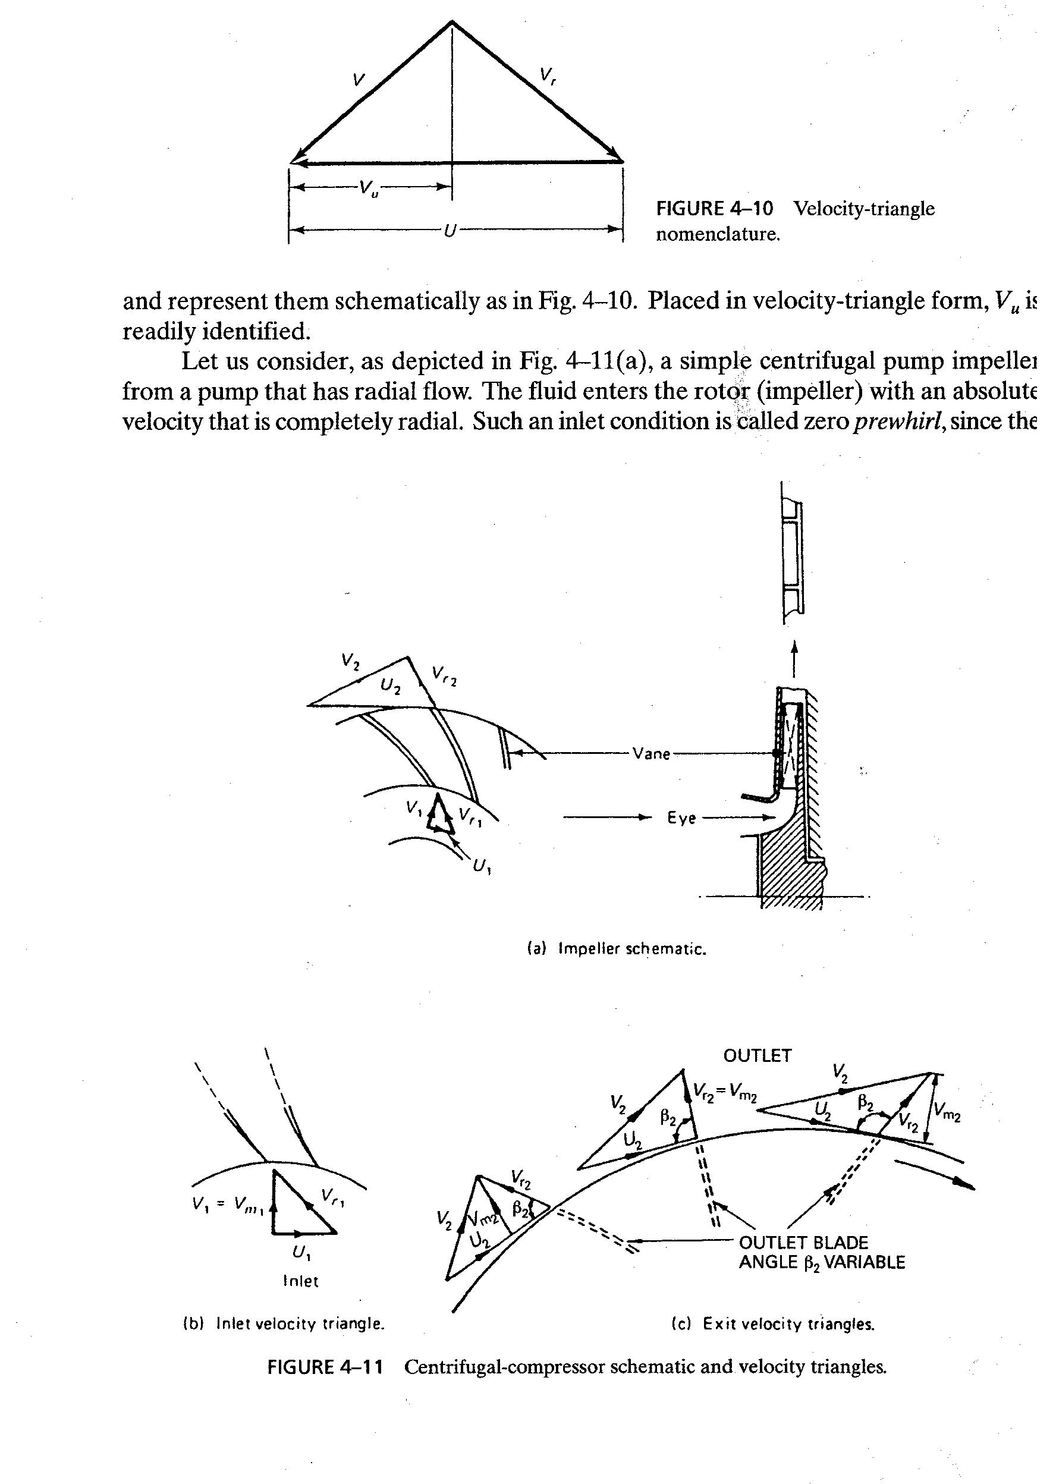
The velocity triangle
V - absolute velocity
U - tangential velocity
V_{r} - relative velocity

Slide 12
Centrifugal- compressor schematic and velocity triangles

Slide 13
From figure (a) in previous slide, fluid enters the rotor with an absolute velocity that is completely radial (‘zero pre-swirl’), therefore, V_{u1} is zero. The increase in Head is:
Denoting the radial component of the exit velocity as V_{m}, then:
And from the exit velocity
triangle fig. (c):
For an impeller of width w, the volume flow rate is:

Slide 14
Head (H) versus Volume flow rate (Q) relationships
The increase in Head is a function of the volumetric flow rate, Q:
Defining:
We obtain:
The sign on K₂ (which depends on the exit angle β₂) establishes the characteristics of the machine

Slide 15
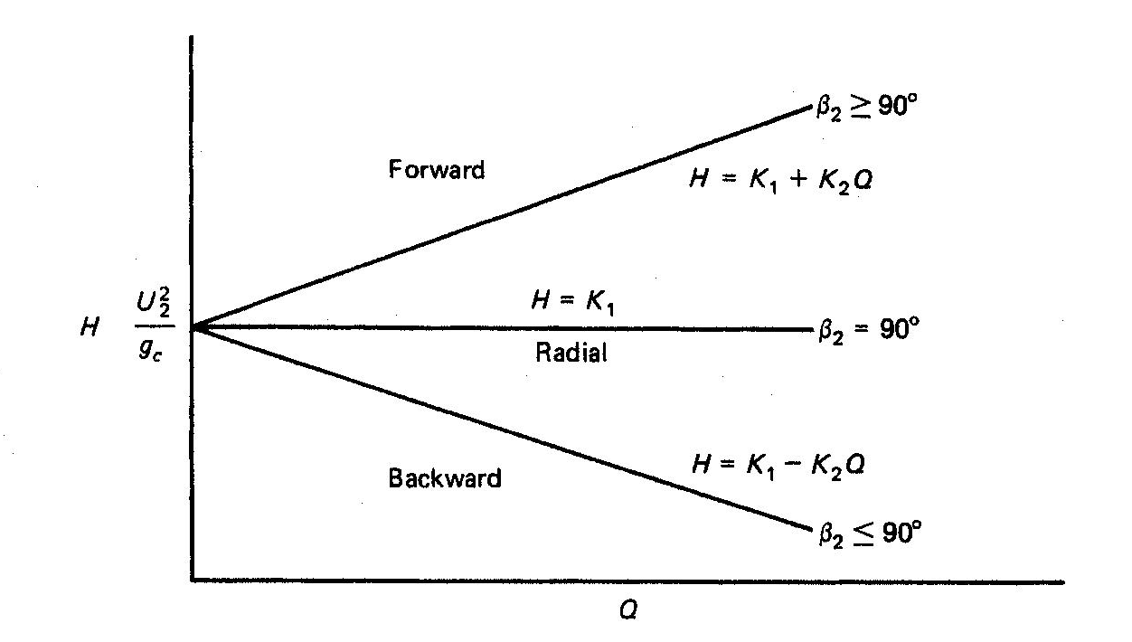
H - Q characteristics
Three separate cases can be considered:
(1) Radial exit blades (β₂ = 90º)
(2) Backward-curved blades (β₂ < 90º)
(3) Forward-curved blades (β₂ > 90º)
“Ideal” H versus Q curves

Slide 16
Actual H - Q Characteristics relationships

Slide 17
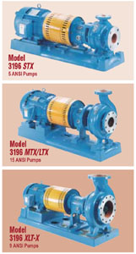
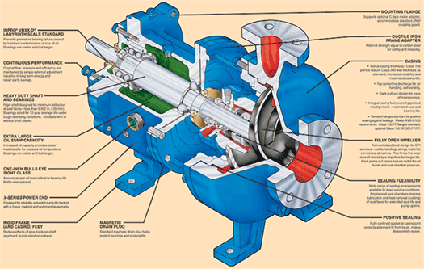
The
“Goulds 3196” family of pumps

Slide 18
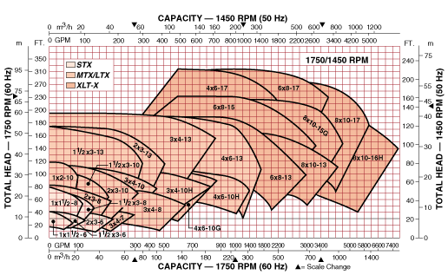
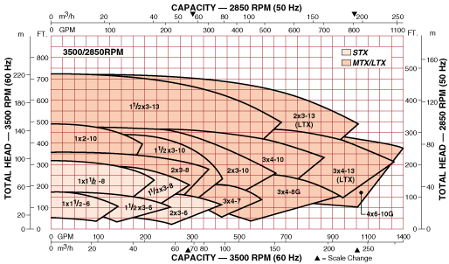
Composite rating charts for the
“Goulds 3196” family of pumps

Slide 19
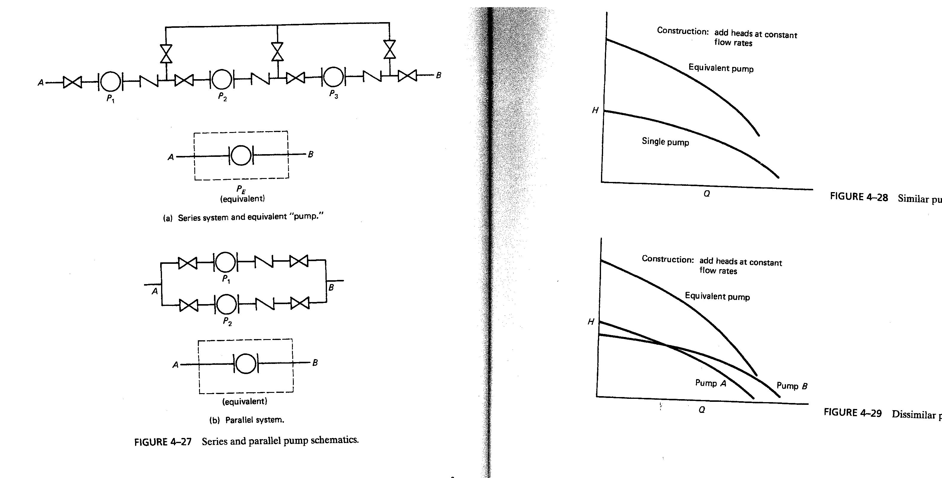
Pumps in Series
Add the heads (H) at each flow rate (Q)
For example, for two identical pumps the head will be double that of a single pump.

Slide 20
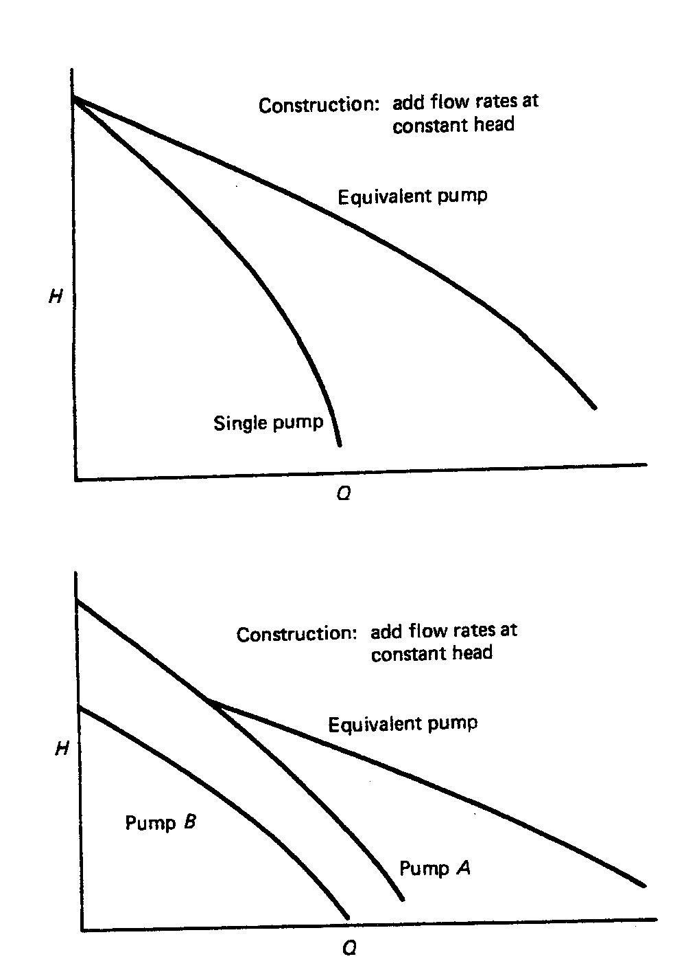
Pumps in Parallel
Add the flow rates (Q) at each head (H)
For example, for two identical pumps the flow rate will be double that of a single pump.

Slide 21
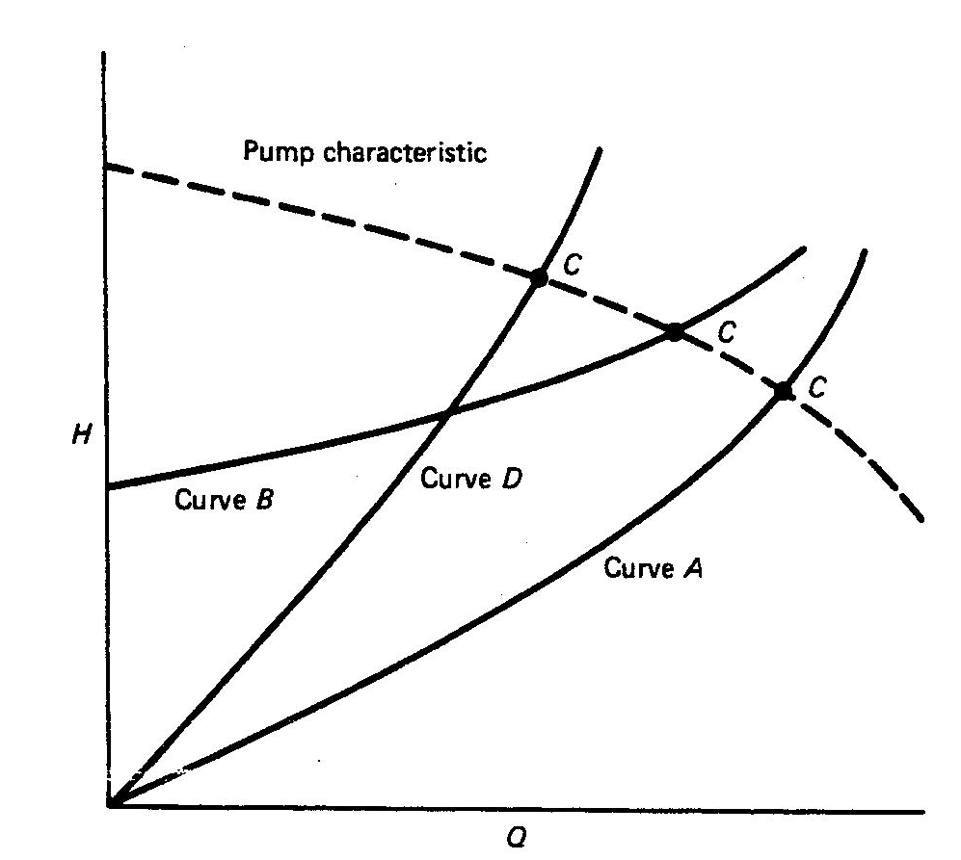
Pump-system operation
System resistance (losses) curves (typically H ∝ Q²)
C = operating point

Slide 22
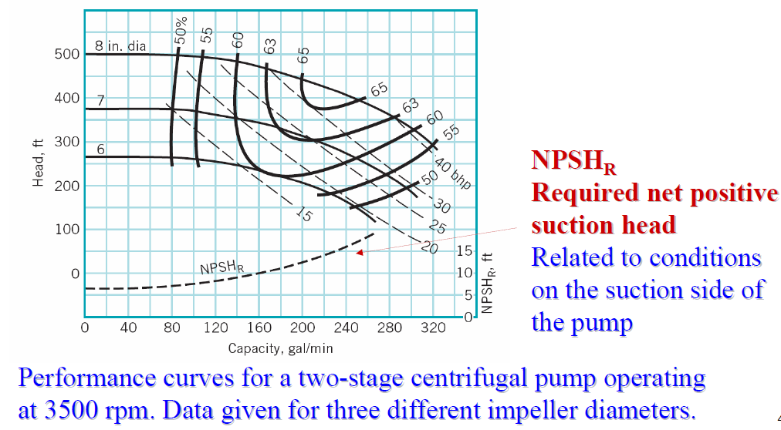
Pump Performance Characteristics

Slide 23
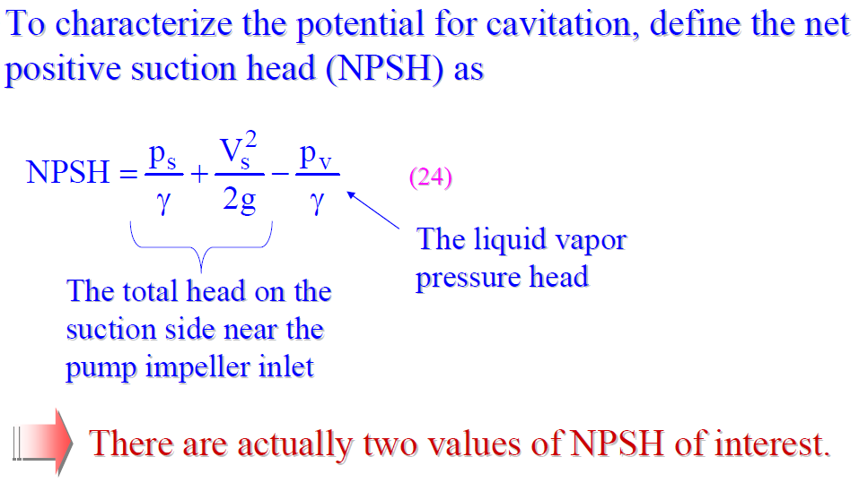
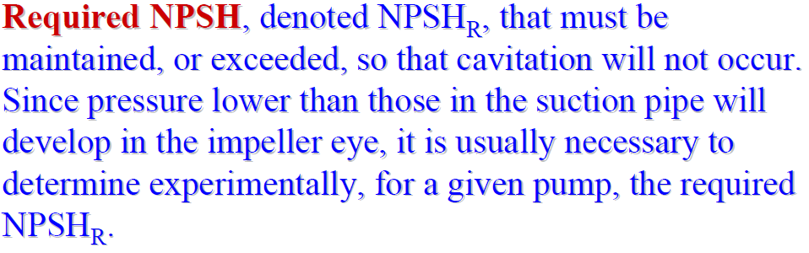
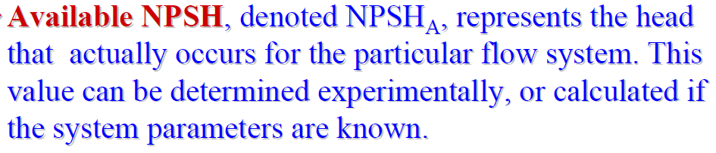
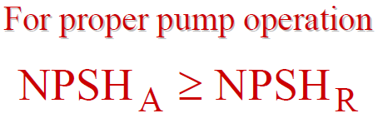
Net Positive Suction Head

Slide 24
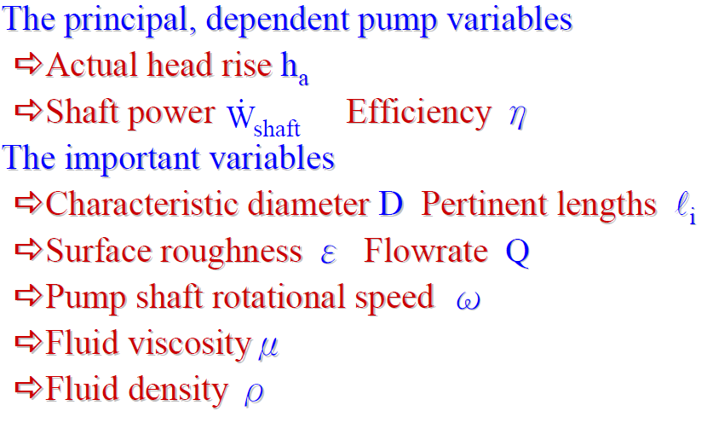
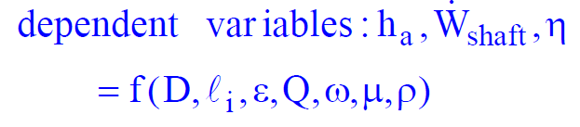
Performance characteristics and Dimensionless Parameters

Slide 25
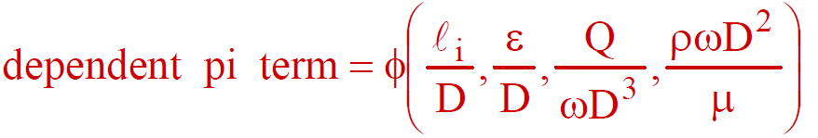
Buckingham Π theorem
The same physical process (energy exchange between fluid and impeller or rotor) can be expressed by using less Π_{i} dimensionless variables:
n°(Π_{i}) = n°(physical dimensional variables) - n°(fundamental magnitudes required for defining dimensions: length mass, time)
Π_{i}
Shape factor
Reynolds number Re
(only for laminar flows)
dimensionless roughness
Flow coefficient C_{Q}

Slide 26
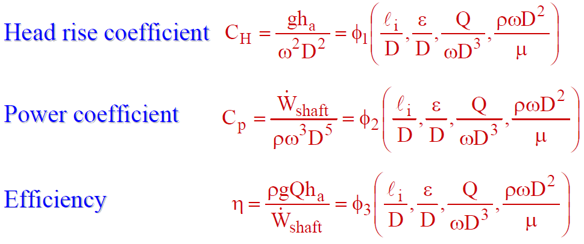
Dimensionless Parameters
Π_{i}
Shape factor
Reynolds number Re
(only for laminar flows)
dimensionless roughness
Flow coefficient C_{Q}

Slide 27
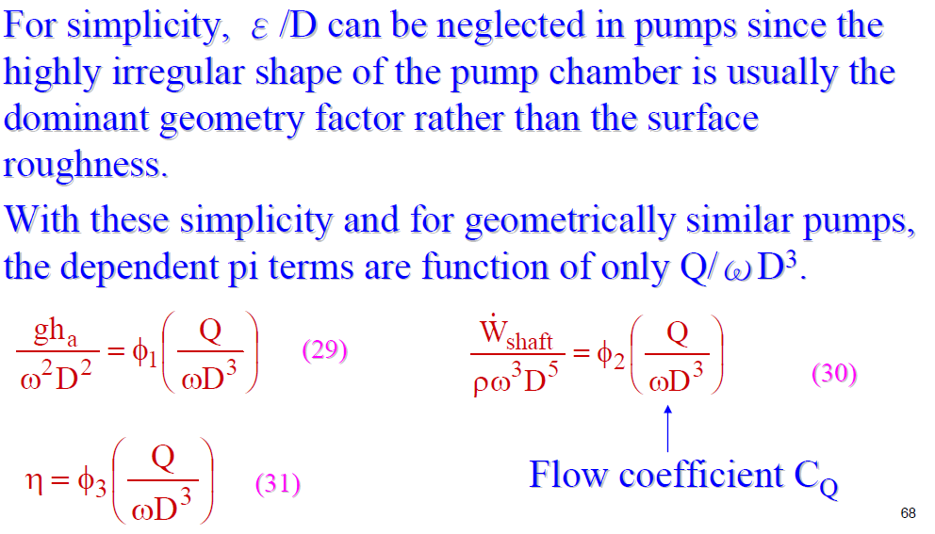
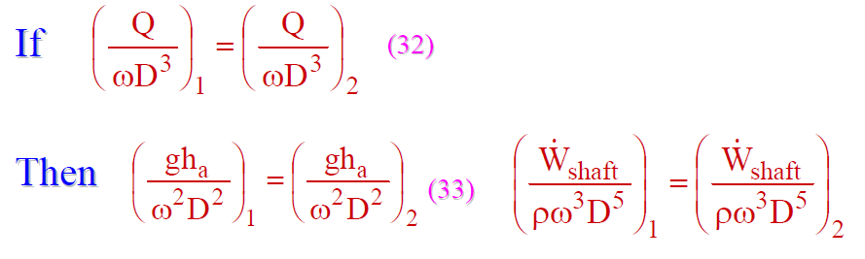

Dimensionless Parameters
Subscripts 1 and 2 refer to any two pumps from the family of geometrically similar pumps.

Slide 28
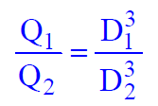

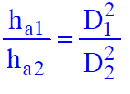
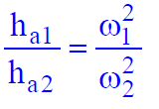
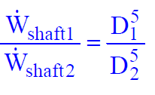
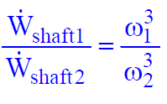
Scaling relationships for turbomachines of the same geometry (geometrical similarity)
For a change in diameter only | For a rotational speed change only
These scaling laws are based on the condition that, as the impeller diameter is changed, all other important geometric variables are properly scaled to maintain geometric similarity.
Power consumption in pumps (and fans) is very sensitive to the rotational speed. A variable speed regulation may allow important energy saving!

Slide 29
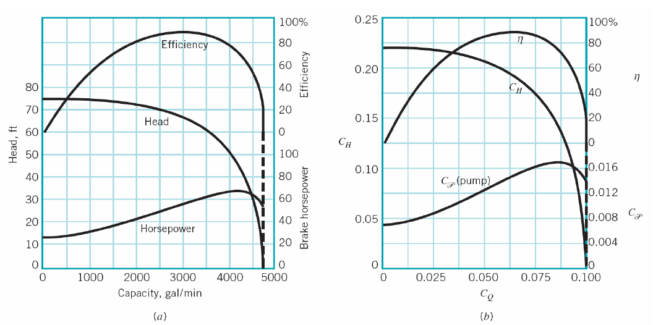
Pump dimensionless Characteristics
Typical performance data for a centrifugal pump:
characteristic curves for a 12-in. centrifugal pump operating at 1000 rpm,
(b) dimensionless characteristic curves.

Slide 30
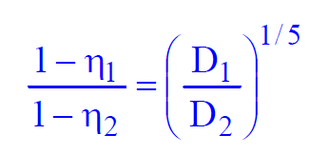
Scale effect on efficiency
Geometric scaling is not always possible. It has been found that as the pump size decreases, this significantly affects efficiency because of smaller clearance, blade thickness and higher relative roughness.
An approximate, empirical relationship to estimate the influence of diminishing size on efficiency is:

Slide 31
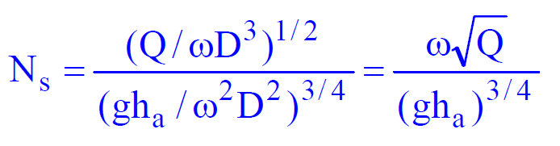
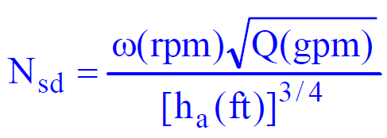
Specific Speed
Specific speed is a useful Π_{i} term obtained by eliminating diameter D between the flow coefficient and the head rise coefficient.
Specific speed varies with flow coefficient just as the other coefficients and efficiency.
In the United States a modified, dimensional form of specific speed, Nsd:

Slide 32
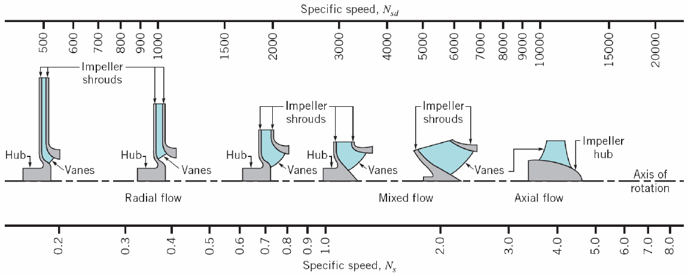
Specific Speed
Each family of pumps has a particular range of values of N_{s} and N_{sd} associated with it, allowing good efficiency.
Pumps that have low-capacity, high-head characteristics will have small N_{s} (high-capacity, low-head implies high N_{s}).
As N_{sd} increases beyond about 2000 the peak efficiency of the purely radial-flow centrifugal pump starts to fall off, and other type of more efficient pump design are preferred.

Slide 33
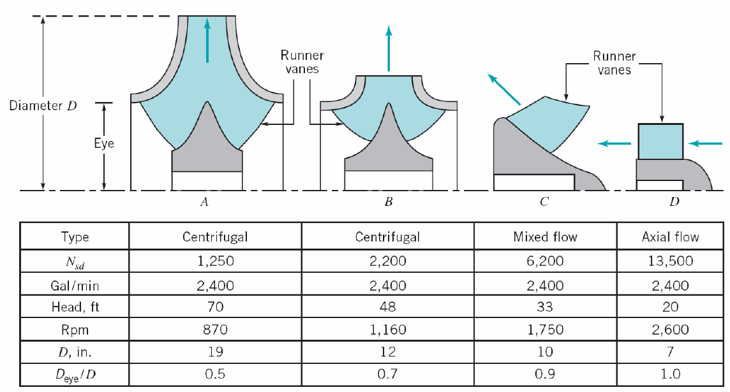
Comparison of different types of impellers

Slide 34
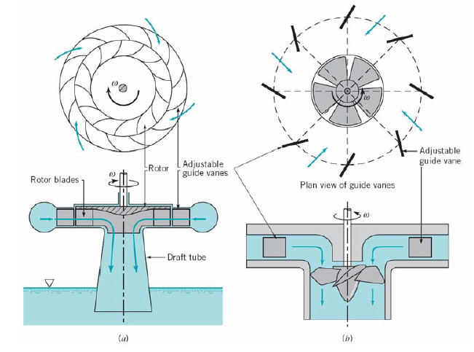
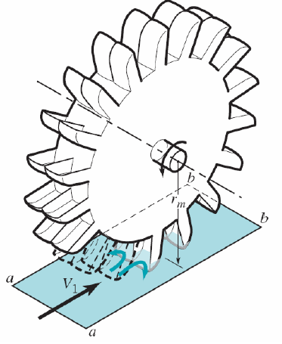
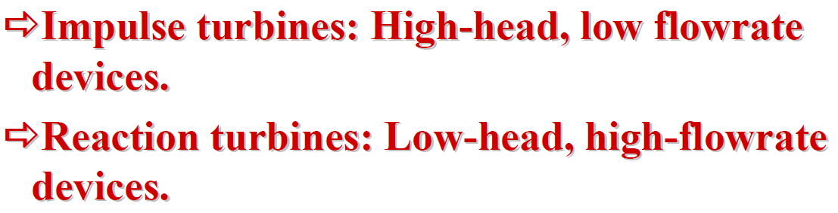
Hydraulic Turbines main design options
(a) Typical radial-flow Francis turbine. (b) typical axial-flow Kaplan turbine.

Slide 35
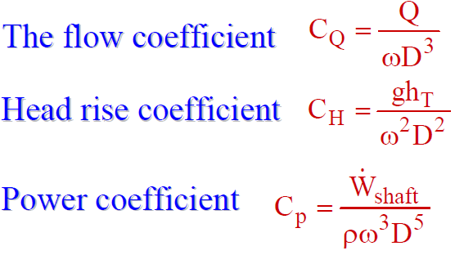
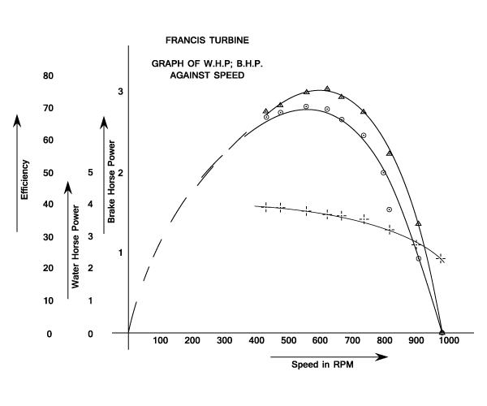
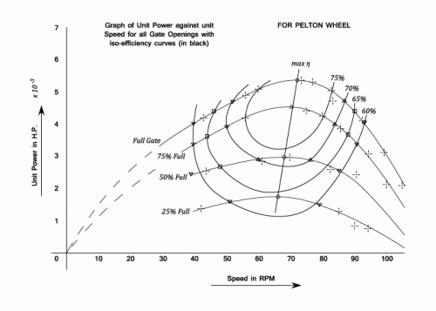
Hydraulic Turbines Characteristics
As for pumps, incompressible flow turbine performance is often specified in terms of appropriate dimensionless Parameters:

Slide 36
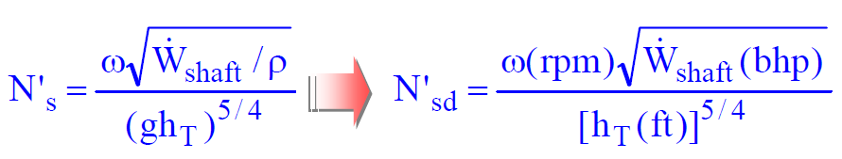
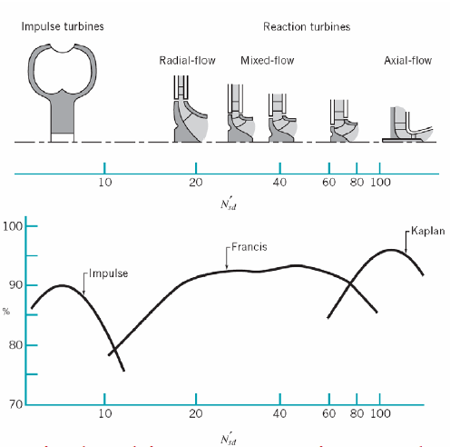
Hydraulic Turbines specific speed
It is necessary to determine which type of turbine would best fit the job before detailed design work is attempted.
As with pump, the use of a specific speed may provide this information.
η

Slide 37
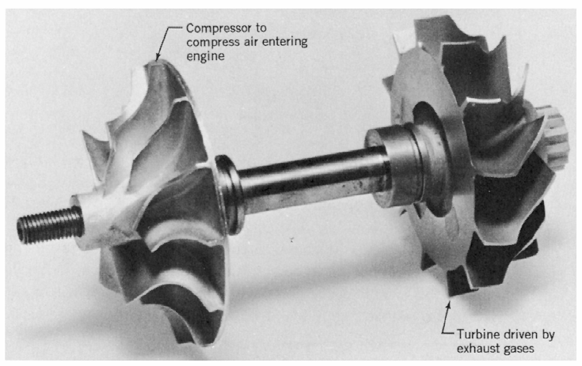
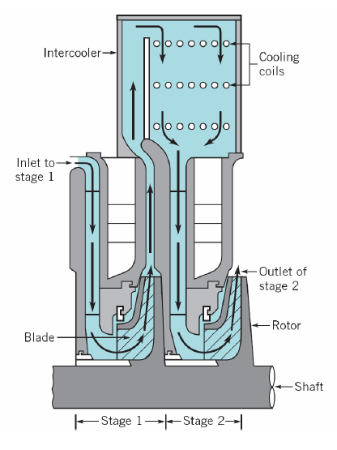
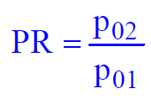
Compressible Flow Turbomachines
Radial-Flow Compressor and two-stage Radial-Flow Compressor Turbine on the same shaft with intercooling
The total pressure ratio is the “Head dimensionless coefficient” for compressible flow Turbomachines:

Slide 38
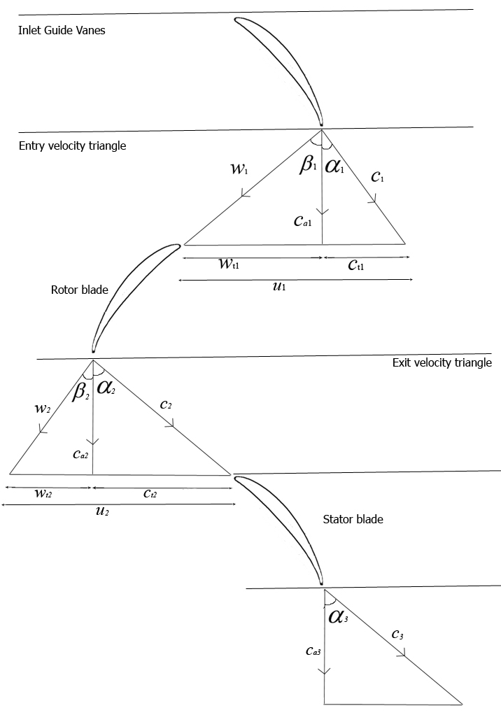
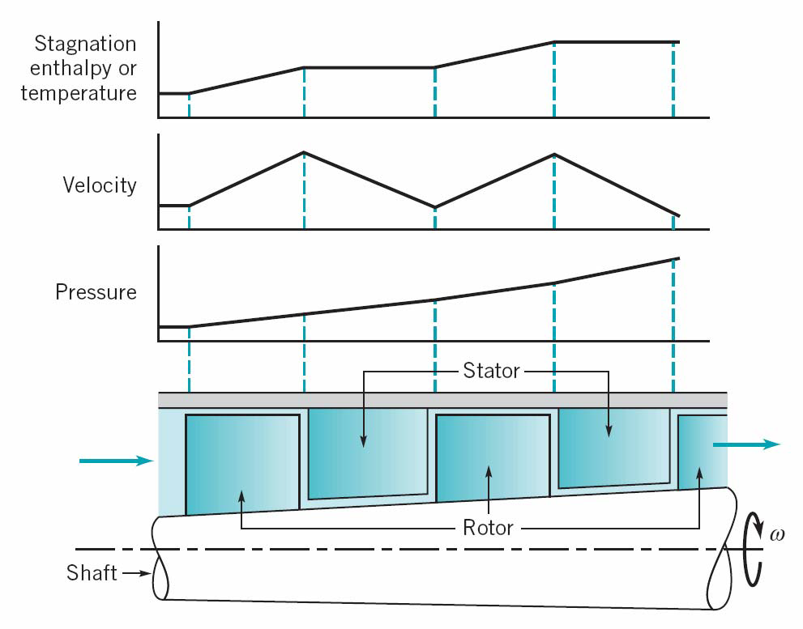
Compressible Flow Turbomachines
Performance Characteristics of Axial-Flow Compressor
The axial-flow compressor has a lower pressure rise per stage, a higher flowrate, and is more radially compact than a centrifugal compressor.
Stator blade rows act as diffusers, turning the fluid back toward the axial direction and increasing the static pressure

Slide 39
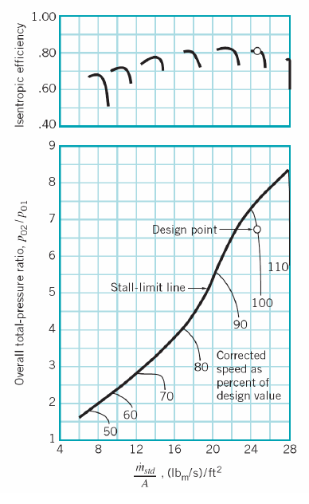


Compressible Flow Turbomachines
Performance Characteristics of Axial-Flow Compressor
As occurs with airplane wings, compressor blades can stall.
When the angle of incidence becomes too large, blade stall can occur and the result is compressor surge.
The common flow parameter used for compressor is the “reduced” or “corrected” mass flow:

Slide 40


Compressible Flow Turbomachines
Performance Characteristics of Axial-Flow Turbines
The axial-flow Turbines has usually a higher efficiency, a higher flowrate, and is more radially compact and relatively inexpensive than radial-flow Turbines.
They may be either impulse type or reaction type.
The flow may be either expanded in nozzles (“pressure steps”), or simply deviated by fixed blades (“velocity steps”).

Slide 41

Compressible Flow Turbomachines
Enthalpy, pressure, and velocity distribution in a two-stage impulse turbine
The gas accelerates through the supply nozzles, has some of its energy removed by the first-stage rotor blades, accelerates again through the second-stage nozzle row, and has additional energy removed by the second-stage rotor blades.
The static pressure remains constant across the rotor rows.
Across the second-stage nozzle row, the static pressure decreases, absolute velocity increases, and the stagnation enthalpy is constant.

Slide 42

Compressible Flow Turbomachines
Enthalpy, pressure, and velocity
distribution in a three-stage reaction turbine
Both the stationary and rotor blade act as flow-accelerating nozzles.
The static pressure and enthalpy decrease in the direction of flow for both the fixed and the rotating blade rows.

Slide 43
Summary of Design/off-Design evaluation of energy system components
Tubes and pipes
Mass conservation, energy equation, pressure losses evaluation through Moody diagram and tables for minor losses.
DESIGN: Pressure losses and tube diameters are obtained as functions of the required design flow rate and acceptable speed.
Off-DESIGN: The characteristic equation of the fluid circuit is obtained depending on geometrical parameters and all the possible current value of the flow rate.

Slide 44
Summary of Design/off-Design evaluation of energy system components
Turbomachinery
Mass & energy equation, Euler Theorem, specific speed N_{s}
DESIGN: The specific speed N_{s} is used to identify the kind of the machine, the main geometric ratios, the expected efficiency and the corresponding value of the flow coefficient (also of the dimensionless flow speed, or Mach number, when dealing with compressible fluids):
Then, rotor diameter is obtained as a function of the required design flow rate and acceptable rotational speed.
Off-DESIGN: The characteristic curves have to be known (dimensional or dimensionless). Then, the actual head coefficient, or β, and the expected efficiency are obtained as functions of the current values of the flow rate and of the rotational speed.

Slide 45

Summary of Design/off-Design evaluation of energy system components
Heat Exchangers (HEX)
Mass & energy equation (pressure losses evaluation through Moody diagram and loss tables, or analogous correlations) MLTD, or ε-NTU.
DESIGN: The kind of the HEX is chosen considering T and p of the fluids; then, the Global heat transfer coefficient U is obtained by means of Nu-Re-Pr correlation, or on the bases of literature, or experience.
The heat transfer Area and the unknown Temperatures (or flow rates) are obtained by using MLTD, or ε-NTU methods. The detailed design follows.
Off-DESIGN: The current value of U is obtained by re-calculating the Nu-Re-Pr correlation, taking into account the new fluid flow rates, speeds and temperatures.
When the internal/external thermal resistance is dominant, AND possible temperature variations do not affect the thermophysical property of the fluids AND the design value U_{D} is known:
$$\frac{U}{U_{D}}≈{\left(\frac{m}{m_{D}}\right)}^{0.8}$$

Slide 46
UNIVERSITÀ DEGLI STUDI DI TRIESTE
DIPARTIMENTO DI INGEGNERIA E ARCHITETTURA
Thank you for your attention!
Mauro Reini
Based on:
Prime movers, turbomachinery, Euler equation and the Bukingam Theorem
by
By E. Savory - Department of Mechanical and Material Engineering
University of Western Ontario
and
FUNDAMENTALS OF FLUID MECHANICS - Chapter 12 Pumps and Turbines
by
Jyh-Cherng Shieh - Department of Bio-Industrial Mechatronics Engineering
National Taiwan University
reini@units.it

