Slide 1


INTRODUCTION TO SOLAR ENERGY SYSTEMS
prof. Mauro REINI
docente di sistemi per l’energia e l’ambiente
Università di Trieste – Polo di Pordenone

Slide 2
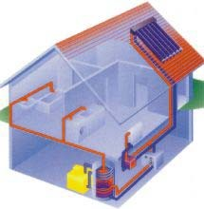
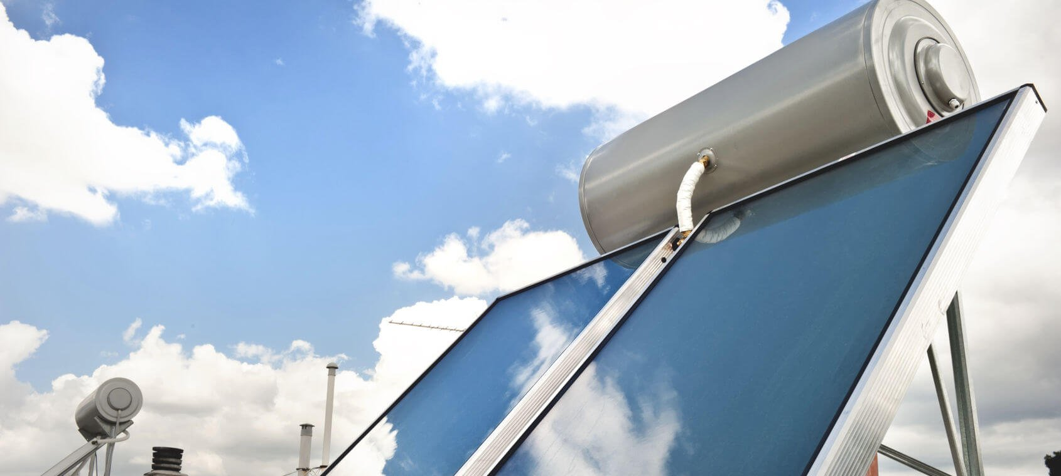
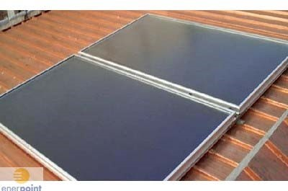
Solar radiation
Sun physics:
The energy that arrives on the Earth is never constant during the year even if the value of the solar constant is fixed:
Energy that arrives on a unitary surface perpendicular to the rays of the sun outside the atmosphere = 1367 W / m².
:

Slide 3
Solar radiation
The solar constant is a function of the Sun-Earth distance and varies
according to a cosine function:

Slide 4
Solar radiation-The positions of the sun
The position of the sun changes during the day and then consequently changes the atmospheric surface in which solar rays pass through; in order to calculate the energy that arrives in the solar panel it is important to know position of the sun during a day for every day of the year and place in which we are.
Using the celestial geometry to determine the position of the sun it is necessary to know some fundamental angles:

Slide 5
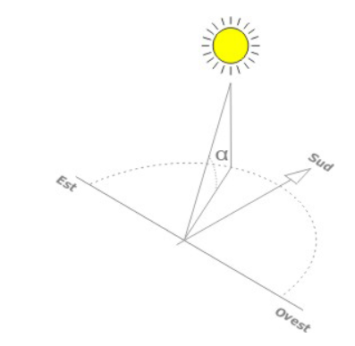
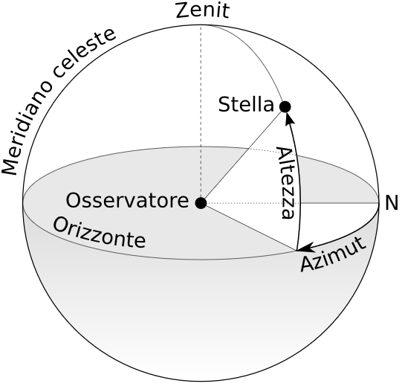
Solar radiation-The positions of the sun
α = solar height: angle formed between the direction of the solar rays and the horizontal plane
z = zenithal angle: angle formed between the solar rays and the direction of the zenith.
a = solar azimuth: angle formed between the projection on the horizontal plane of the solar rays and the south direction.
h = hour angle: angular distance between the sun and its projection at noon along its apparent trajectory on the celestial vault.
L = latitude: angle that the straight line passing through the considered location and the center of the earth forms with the plane of the equator.
δ = solar declination: angle that the direction of the solar rays forms at noon (on the considered meridian) with the equatorial plane

Slide 6
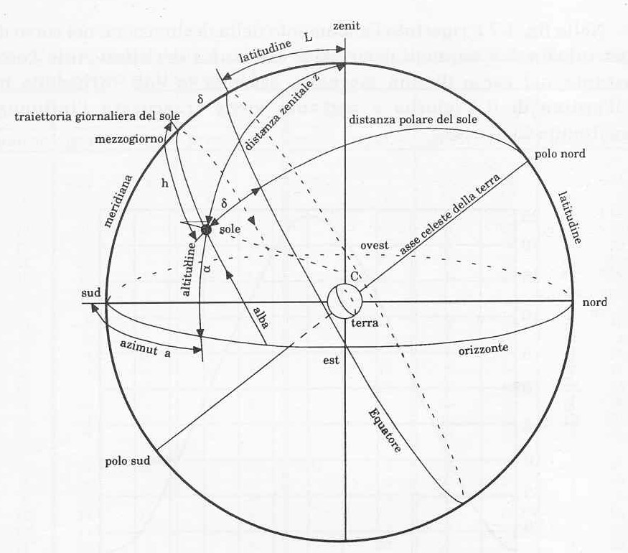
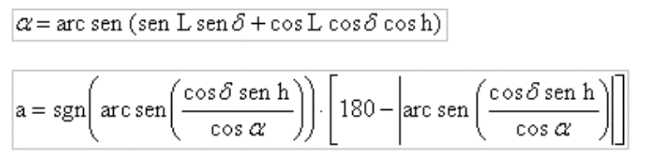
Solar radiation-The positions of the sun
The Instantaneous position of the sun is determined by
solar high and solar Azimut

Slide 7
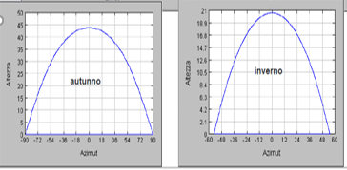
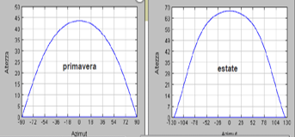
Solar radiation-The positions of the sun
we can see how changes the position of the sun in the four seasons.
When the solar energy arrives inside the atmosphere it reacts with atmospheric components that it meets on the way, so there are two energy events that can be observed:
Energy diffusion, due to air, steam and corpuscle
Energy absorption, due to O₃ (ozone), steam and CO₂
In fact, on the ground level solar radiations can be divided in two main components:
Direct radiation, that is the radiation that arrives to the Earth surface with direction equal to solar rays’ direction.
Diffused radiation, that is radiation that arrives to the Earth from every direction.
If the solar panel is not horizontal, we have to take into account also reflected radiation.

Slide 8
Solar radiation-
Solar energy at ground level
If the solar panel is not horizontal, we have to take into account also reflected radiation.
The normal direct irradiation on a surface orthogonal to the solar rays can be expressed by:
I_{bn} = I₀ τ_{b}
Where τ_{b} is the direct radiation coefficient given by:
$$τ_{b =0.5\{\exp\left[−0.65m\left(z,α\right)\right]+exp⁡[−0.095m\left(z,α\right)]\}}$$

Slide 9
Solar radiation-
Solar energy at ground level
And m(z, a) is a parameter called “relative air mass” in an altitude z over the sea level
it is defined as the ratio between the real length of solar rays’ path and their shortest path when sun is on zenit.

Slide 10
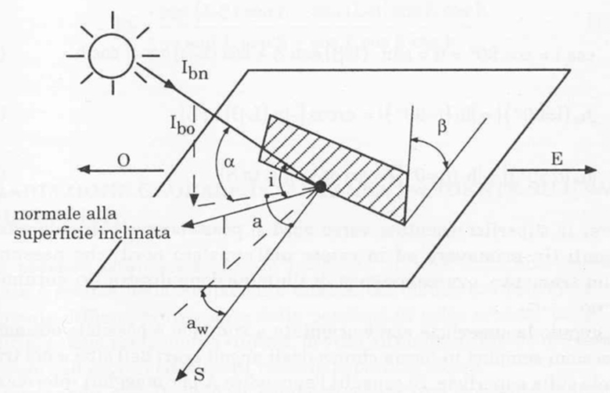
Solar radiation-
Immediate direct radiation on a surface
We can define a surface position with two angles:
Incline angle b (tilt) of surface with the respect of horizontal plane
Azimuth a_{w} of the surface, angle assembled by Sud direction and projection of perpendicular line of inclined surface on the horizontal plane.
The direct radiation on the surface is
G_{b} = I_{bn} cos(i)
Where i is the angle between solar rays and perpendicular line of inclined surface.
In order to design a solar system it is necessary to take into account that sun supply a limited quantity of energy and it is necessary to implement other energy systems; then it is necessary to put chargeable device for stock heat.

Slide 11
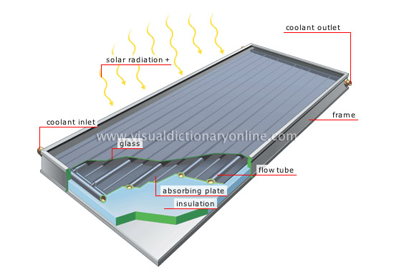
Solar radiation- Photovoltaic Plant - Panel:
Flat Panel
The main component of the flat panel are:
Metal plate collects solar energy and brings it to fluid (water).
Insulating material allows to limit losses from behind and sides.
Transparent materials allow to limit heat losses due to metal plate’s radiation; it has to be transparent for solar radiation but opaque for metal panel infrared radiation.

Slide 12
Solar radiation- Flat panel
Transmission through transparent materials :
There are three events for every layer crossed by the solar radiation:
Reflection
Refraction
Absorption
Where τ_{a} = absorption and r = reflection coefficient

Slide 13
Solar radiation- Flat panel
When the radiation across transparent material,
the metal plate absorbs the energy.
Where:
τ = transmitted energy coefficient,
ρ = reflected energy coefficient
α = absorbed energy coefficient
and
α = 1 – τ – ρ.
Immediate power absorbed by plate is given by:
G_{c,ass} = I_{b0}R_{b}(τα)_{b} + I_{d0}R_{d}(τα)_{d} + (I_{b0} +I_{d0})R_{r}(τα)_{g}

Slide 14
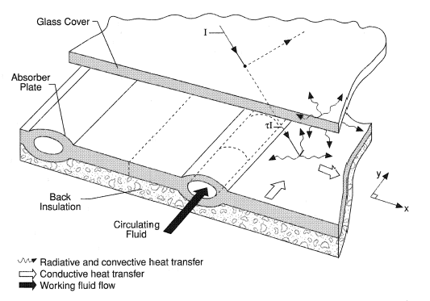
Solar radiation- Flat panel
Heat balance on the metal plate:
G_{c}A_{c}(τα) = q_{u} + q_{p} + d_{up}/dt
Where G_{c} = global irradiation on the metal plate,
A_{c} = metal plate area,
q_{u} = power given to fluid,
q_{p} = power lost due to irradiation
d_{up}/dt = power collected on the metal plate.
Flat panel efficiency
η = q_{u} / A_{c} G_{c}
If the fluid temperature increases the efficiency decreases
If the solar flow increases the efficiency increases

Slide 15
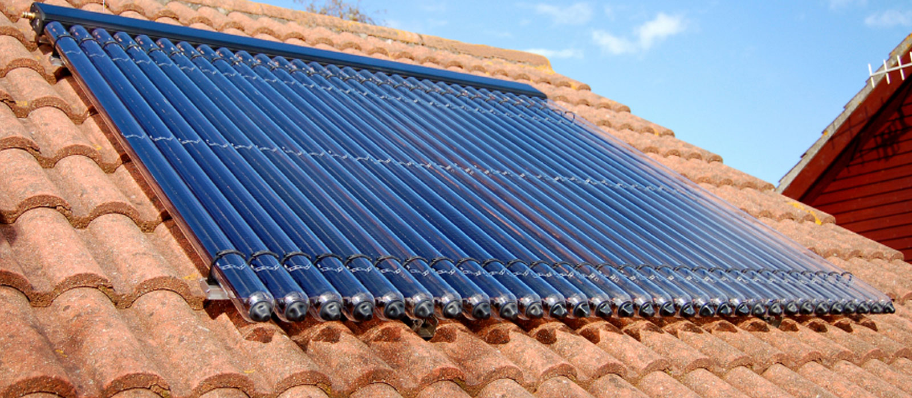
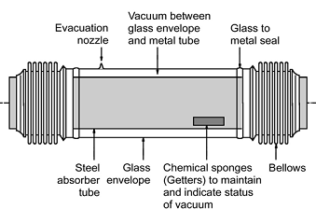
Solar radiation- Tubular panel
Tubular Panel
The efficiency increases with high temperature
Tube-shape allows vacuum (there isn’t heat exchange)

Slide 16
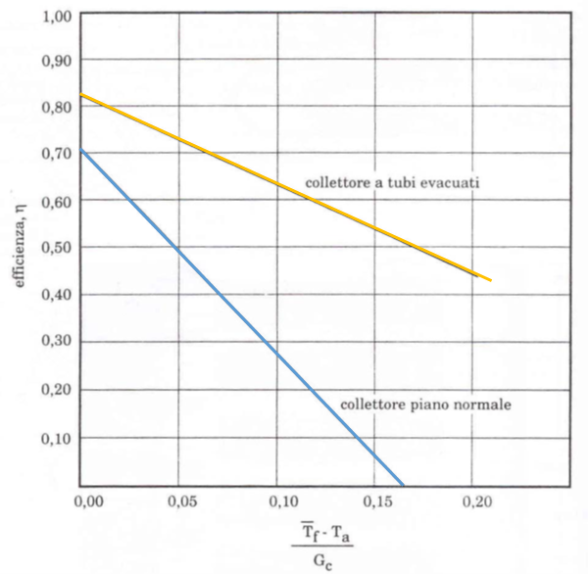
Solar radiation – Flat vs Tubular efficiency
Tubular panel
Flat panel

Slide 17
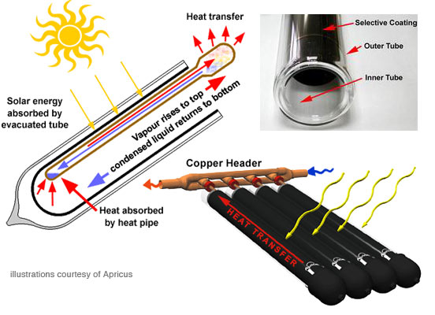
Solar radiations- Heat Pipe
Closed Pipe with inside a fluid
Fluid receives heat and it evaporates in the upper part
The steam meets the fluid in the condenser and then it becomes liquid
The steam goes in the upper part of the pipe and the fluid goes in the lower part

Slide 18
Solar radiations- Heat Pipe
“Stagnation”
non-working phase for flat panel, when the panel doesn’t produce energy because there isn’t heat exchange with the fluid.
“Dry out”
Phase when the steam can’t become liquid and it can’t exchange heat.
In the heat pipe or in tubular panel the temperature for heat exchange is higher than flat panel, for this reason they are better to heating locals in the winter.

Slide 19
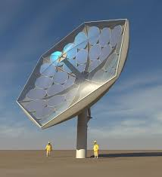
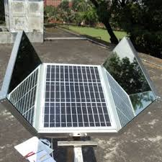
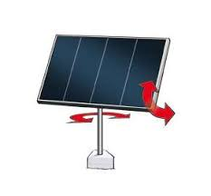
Solar radiations-Concentrations Panel
they collect energy quantity larger then static panel
They are used for big buildings
Maintenance costs higher then static panels
Used for electric energy production

Slide 20
Plant Design
consider monthly solar radiation on horizontal surface
Transform the value in sloped surface (panel)
Divide the value for average monthly day duration
Consider the difference between water average temperature in the panels and monthly outdoor average temperature.
Calculate daily average efficiency per month
Calculate daily average radiation per month that is equal to radiation on the panel multiplied for efficiency
Multiply the last value for number of days in the month
Divide heat needs for solar energy absorbed in that month and we obtain the panels surface (m²) needed to produce requested energy
Calculate panels surface for every month
Choose panels surface (maximum area means high cost of panels and more produced energy that used; minimum area means low costs but energy guaranteed in the hottest months) → economic analysis of the plant

Slide 21
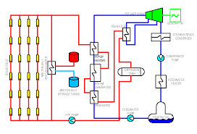
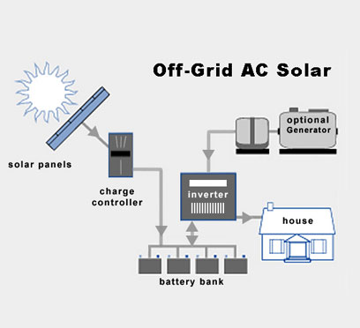
Plant Design

Slide 22
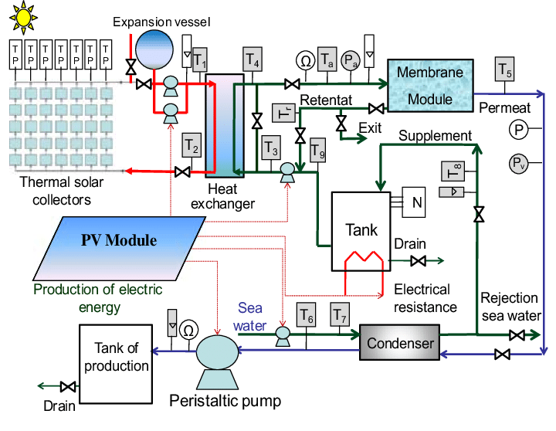
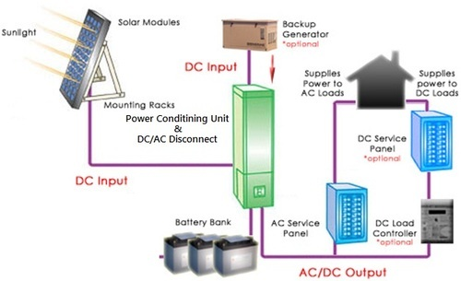
Plant Design

Slide 23
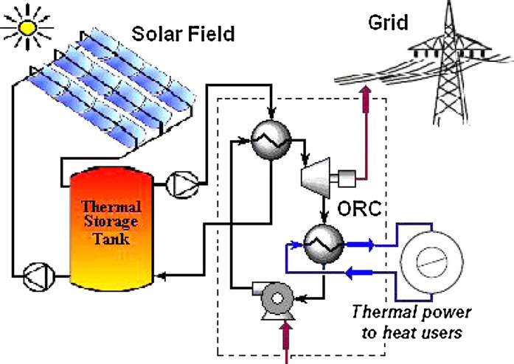
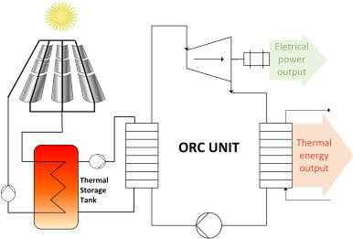
Solar Cogeneration

Slide 24
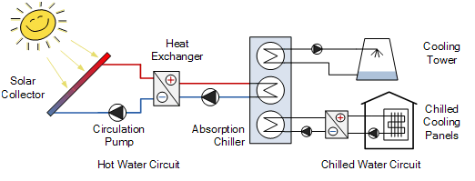
Solar cooling
From low temperature water (80°) produced by solar systems we can obtain refrigerate water (7°) for air-conditioning;
This process is called solar cooling
Heat solar system
Hot water refrigerator

Slide 25
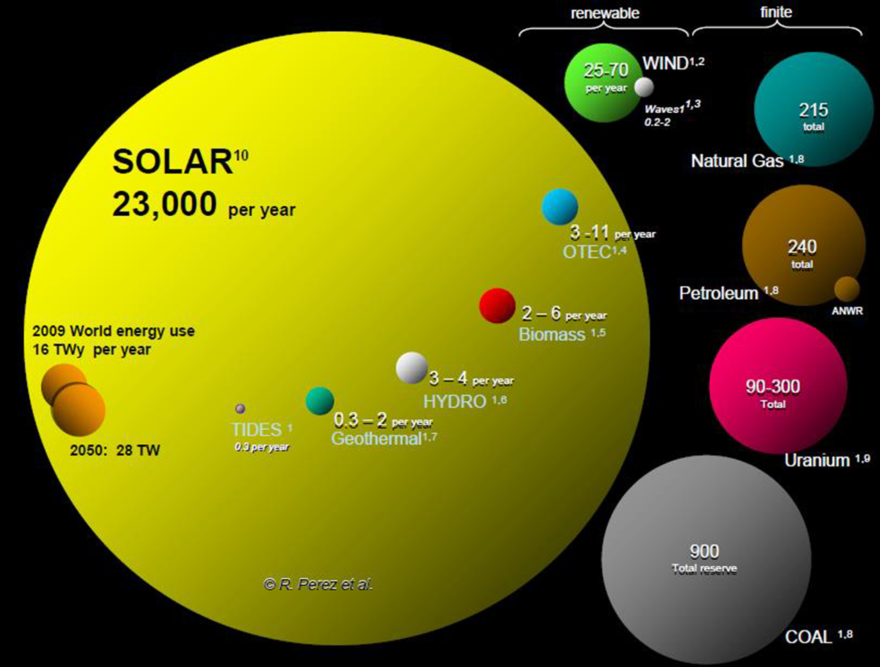
Solar Photovoltaic

Slide 26
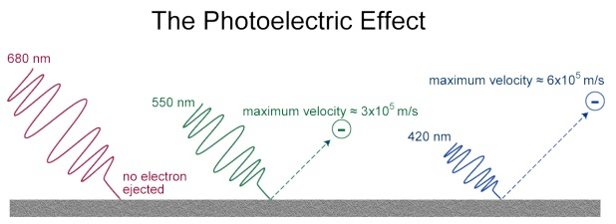
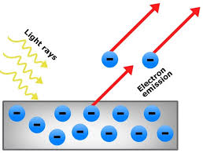
Photoelectric effect
The photoelectric effect is the emission of electrons or other free carriers when light falls on a metal material. Electrons emitted in this manner can be called photo electrons.

Slide 27
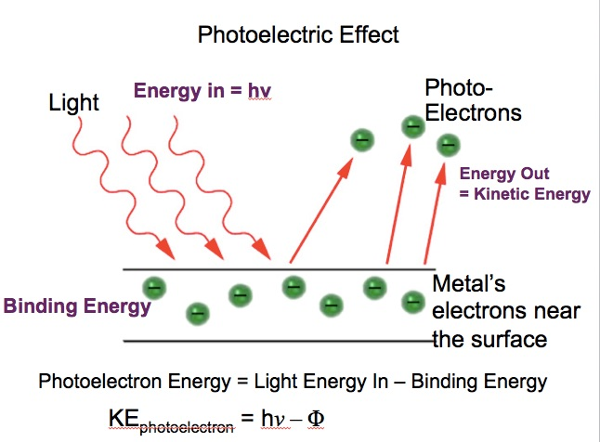
Photoelectric effect
According to classical electromagnetic theory, this effect can be attributed to the transfer of energy from the light to an electron.
From this perspective, an alteration in the intensity of light would induce changes in the kinetic energy of the electrons emitted from the metal

Slide 28
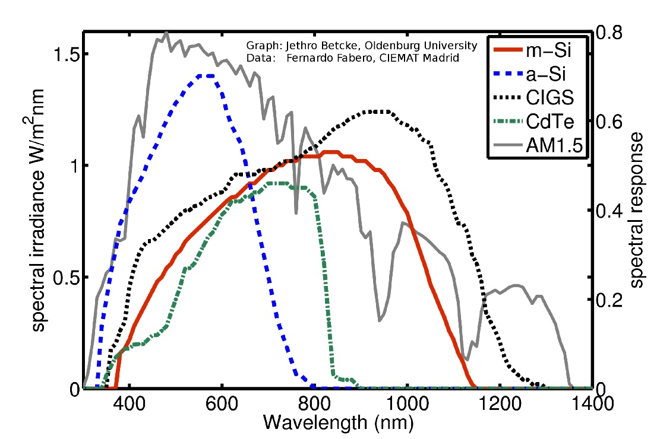
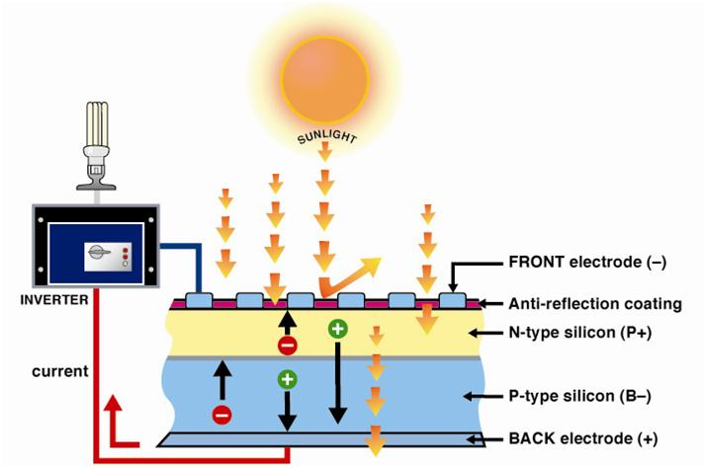
Solar Photovoltaic
Atmospher, clouds, shadows, ….
Response spectrum of PV materials
Panel surface orientation with respect of the apparent position of the sun in the sky

Slide 29
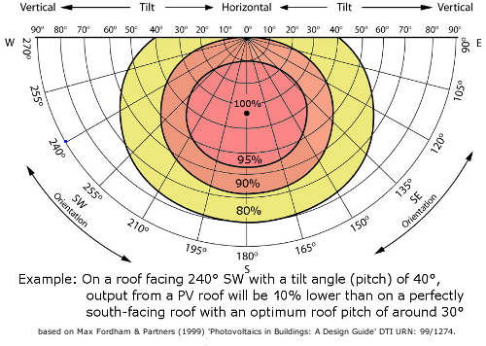
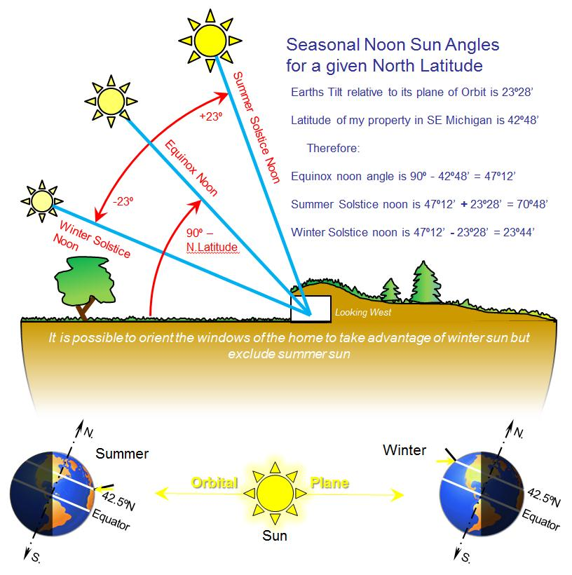
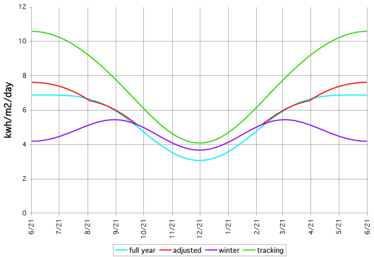
Solar Photovoltaic
Panel surface orientation with respect of the apparent position of the sun in the sky

Slide 30
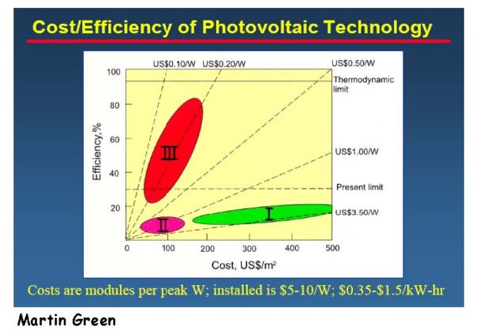
Solar Photovoltaic
First Generation
Solar cells currently on the market, made from crystalline silicon, they are a "mature" technology.
high cost costs needed to create silicon cells with sufficient purity.
Second Generation
are less mature as a PV technology, are generally created using vacuum deposition or chemical vapor deposition (CVD). These include CdTe or copper-indium-gallium-selenide (CIGS) technologies.
Their costs are lower, as are their efficiencies, but they are thinner and lighter than silicon cells.
Disposal at end-of-life is a consideration,
because of the toxicity of Cd, Te, Ga, and Se,
and because of concerns regarding their
earth abundance.
Third Generation
Is the object of current investigation.
High efficiency is not so important.
The goal is to move on lines with
low unit cost of energy production!

Slide 31
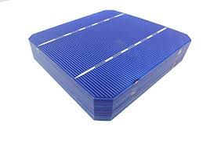
Solar Cells materials
A solar cell, or photovoltaic cell, is an electrical device that converts the energy of light directly into electricity by the photovoltaic effect, that is the creation of voltage and electric current in a material upon exposure to light.
The photovoltaic effect is closely related to the photoelectric effect. In either case, light is absorbed, causing excitation of an electron or other charge carrier to a higher-energy state. The main distinction is that the term photoelectric effect is now usually used when the electron is ejected out of the material (usually into a vacuum) and photovoltaic effect used when the excited charge carrier is still contained within the material. In either case, an electric potential (or voltage) is produced by the separation of charges, and the light has to have a sufficient energy to overcome the potential barrier for excitation.
The physical essence of the difference is usually that photoelectric emission separates the charges by ballistic conduction and photovoltaic emission separates them by diffusion, but some "hot carrier" photovoltaic device concepts blur this distinction.

Slide 32
Solar Cells materials
The operation of a photovoltaic (PV) cell requires three basic attributes:
The absorption of light, generating either electron-hole pairs or excitons.
The separation of charge carriers of opposite types.
The separate extraction of those carriers to an external circuit.
In contrast, a solar thermal collector supplies heat by absorbing sunlight, for the purpose of either direct heating or indirect electrical power generation from heat. A "photoelectrolytic cell" (photoelectrochemical cell), on the other hand, refers either to a type of photovoltaic cell (like that developed by Edmond Becquerel and modern dye-sensitized solar cells), or to a device that splits water directly into hydrogen and oxygen using only solar illumination.
Material
Solar cells are typically named after the semiconducting material they are made of. These materials must have certain characteristics in order to absorb sunlight. Some cells are designed to handle sunlight that reaches the Earth's surface, while others are optimized for use in space. Solar cells can be made of only one single layer of light-absorbing material (single-junction) or use multiple physical configurations (multi-junctions) to take advantage of various absorption and charge separation mechanisms

Slide 33
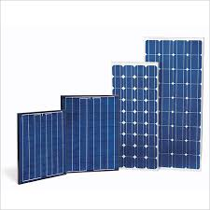
Solar Cells materials -Classification
Solar cells can be classified into first, second and third generation cells.
The first generation cells—also called conventional, traditional or wafer-based cells—are made of crystalline silicon, the commercially predominant PV technology, that includes materials such as polysilicon and monocrystalline silicon.
The Second generation cells are thin film solar cells, that include amorphous silicon, CdTe and CIGS cells and are commercially significant in utility-scale photovoltaic power stations, building integrated photovoltaics or in small stand-alone power system.
The third generation of solar cells includes a number of thin-film technologies often described as emerging photovoltaics—most of them have not yet been commercially applied and are still in the research or development phase.

Slide 34
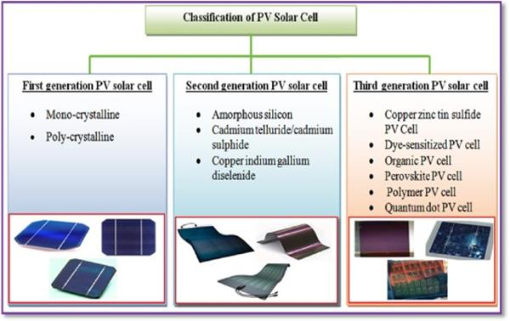
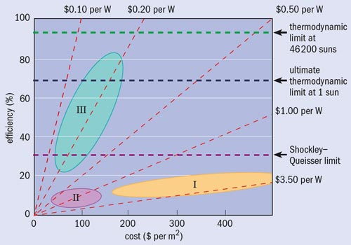
Solar Cells materials - Classification
Martin Green Diagram

Slide 35
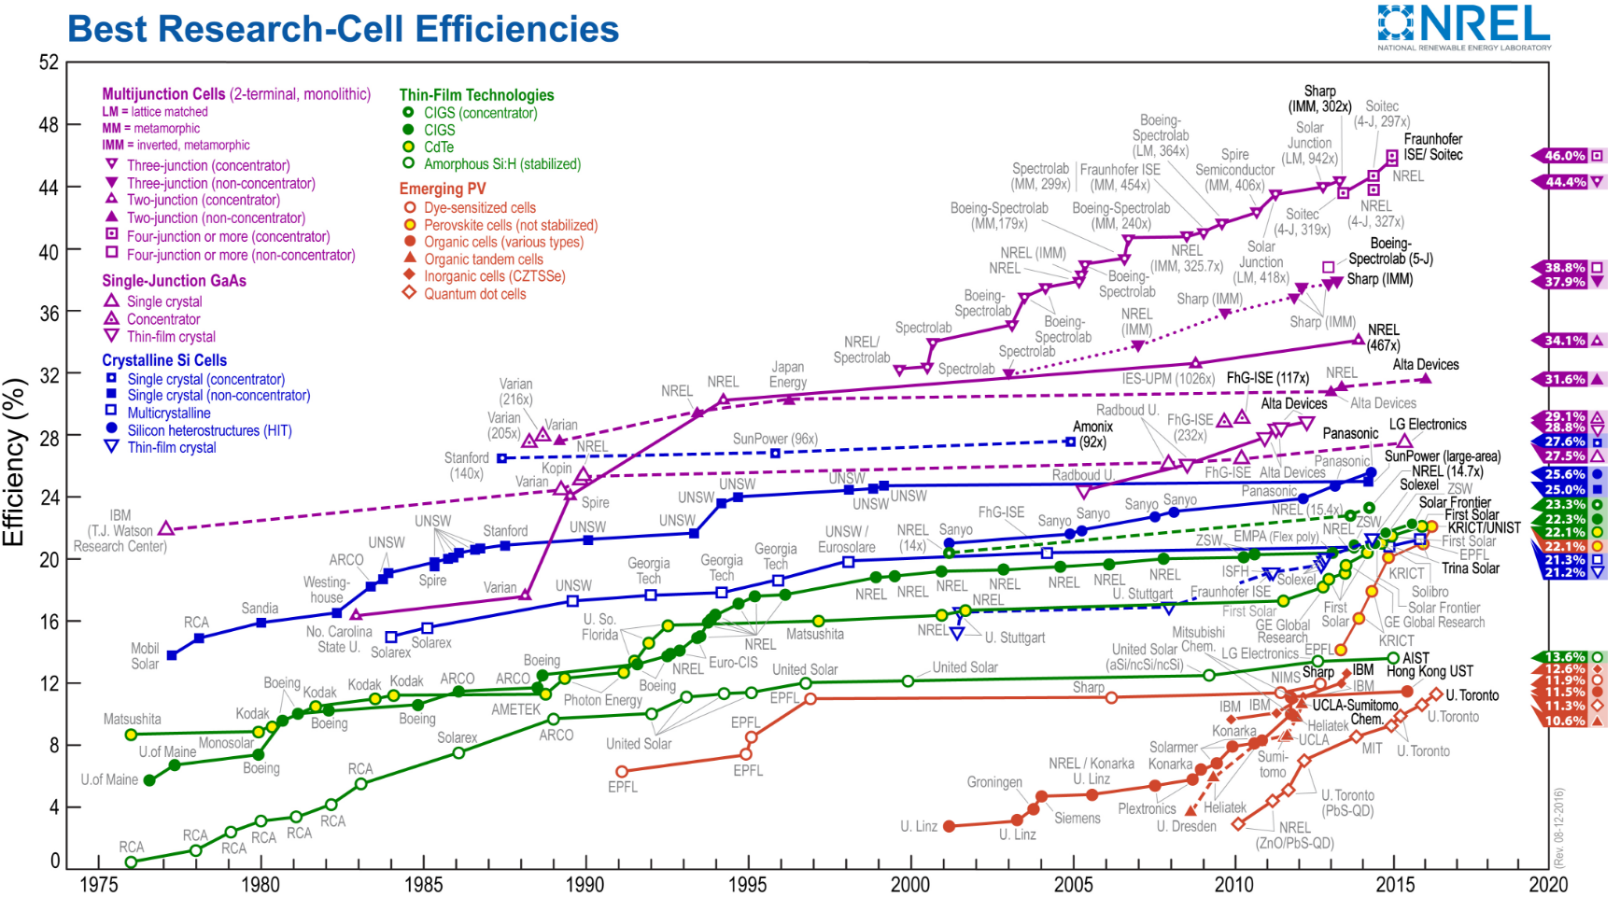
Solar Photovoltaic

Slide 36
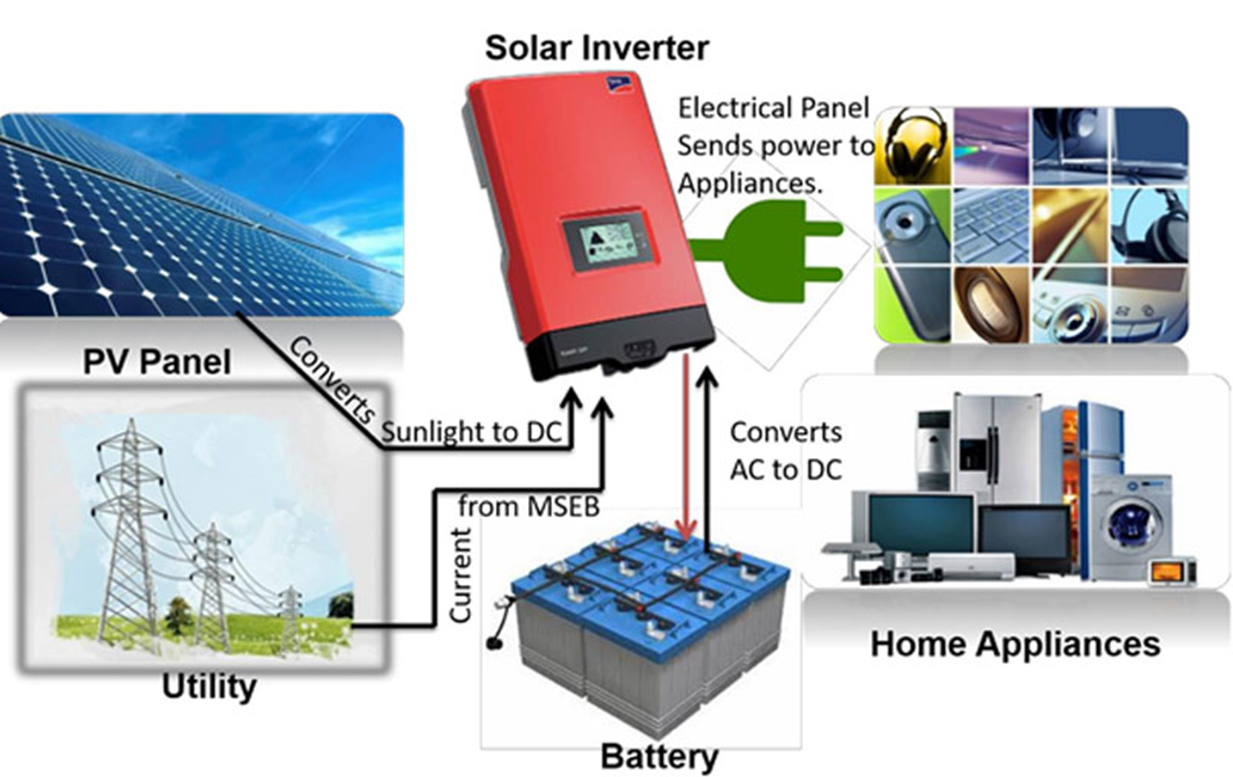
Solar Photovoltaic
Homic resistance of electric connection
Inverter (and battery) losses
BOS
Reduce system efficiency with respect to cell efficiency to about 10% (thin film) or less and to about 15% (cristal silicon)

Slide 37
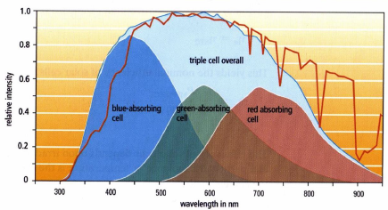
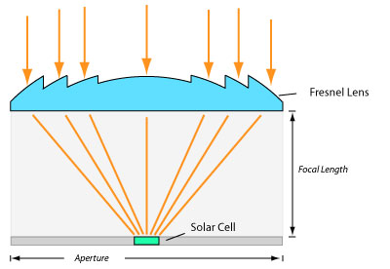
Solar Photovoltaic

Slide 38
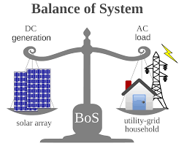
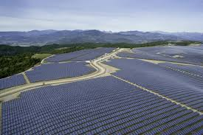
Modules and plant balance
Multiple solar cells in an integrated group, all oriented in one plane, constitute a solar photovoltaic panel or module. Photovoltaic modules often have a sheet of glass on the sun-facing side, allowing light to pass while protecting the semiconductor wafers.
Solar cells are usually connected in series and parallel circuits or series in modules, creating an additive voltage.
Connecting cells in parallel yields a higher current; however, problems such as shadow effects can shut down the weaker (less illuminated) parallel string (a number of series connected cells) causing substantial power loss and possible damage because of the reverse bias applied to the shadowed cells by their illuminated partners.

Slide 40
Modules and plant balance
Strings of series cells are usually handled independently and not connected in parallel, though as of 2014, individual power boxes are often supplied for each module, and are connected in parallel.
Although modules can be interconnected to create an array with the desired peak DC voltage and loading current capacity, using independent MPPTs (maximum power point trackers) is preferable.
Otherwise, shunt doesen’t can reduce shadowing power loss in arrays with series/parallel connected cells.

Slide 41
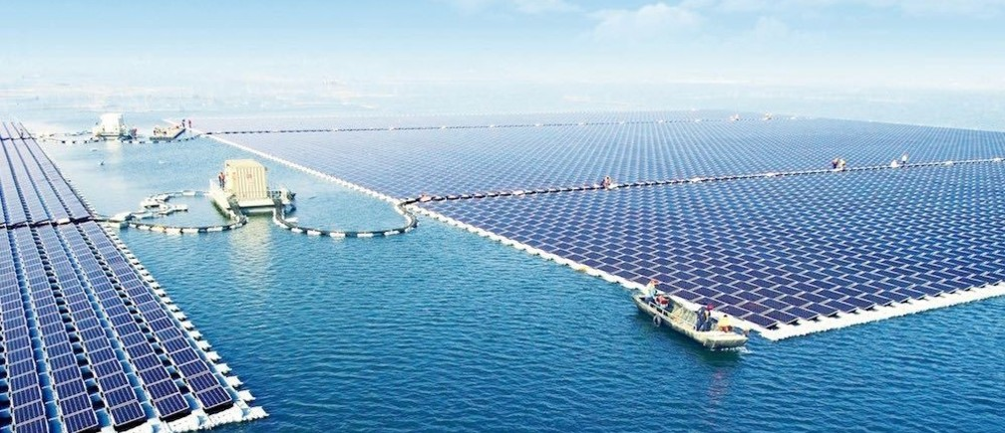
Solar Photovoltaic
China just switched on the world's largest floating solar power plant
The facility is located in the city of Huainan, in China’s eastern Anhui province. It has a capacity of 40 megawatts (MW), enough to power a small town. And in a stroke of pleasing symbolism, the plant floats over a flooded former coal-mining region.

Slide 42
INTRODUCTION TO SOLAR ENERGY SYSTEMS
Thanks for the attention
prof. Mauro REINI
docente di sistemi per l’energia e l’ambiente
Università di Trieste – Polo di Pordenone

